Slide 1

Government Composition and Economic Outcomes
Do different government political compositions show different patterns in economic outcomes?
Regina Khamatnurova · October 2026 · Comparative Political Data Set (CPDS)

Slide 2

Topic & Context
What is government composition?
Governments can differ in the political composition of their cabinets.
The CPDS summarizes this using the Schmidt Index, based on the share of cabinet posts held by parties of different political orientations.
1 — Right/centre hegemony
2 — Right/centre dominance
3 — Balance between left and right
4 — Left dominance
5 — Left hegemony
This project examines whether GDP growth, unemployment, and inflation show different patterns across these five government compositions.
Notes:
Before getting into the analysis, I want to quickly explain what I mean by government composition. My dataset uses the Schmidt Index, which classifies governments into five categories based on the political composition of their cabinet. It ranges from right and centre parties holding all cabinet positions, through a balance between left and right, to left parties holding all cabinet positions. I then compare three economic indicators across these categories: GDP growth, unemployment, and inflation

Slide 3
DATA PIPELINE PROJECT
The question
Main question
How does government political composition relate to economic outcomes across democratic countries?
GDP growth · Unemployment · Inflation
I wanted to understand whether different political orientations in government are associated with meaningful differences in economic outcomes — and use data to challenge or support my own assumptions as a voter.

Slide 4
DATA PIPELINE PROJECT
The dataset
SOURCE
SCOPE
[Comparative Political Data Set]
(https://cpds-data.org/data/)
[Period: 2000- 2019 / 36 countries / unit of analysis: country-year ]
SIZE
LIMITATION
[720 observations after filtering
20 years × 36 countries ]
[Observational data — associations cannot be interpreted as causal effects ]
Notes:
i wanted a relatively recent 20-year period while avoiding the exceptional economic disruption of the COVID-19 years. And also include most countries

Slide 5
DATA PIPELINE PROJECT
Cleaning and quality checks
Missing values
Checked selected analysis variables for missing data before processing.
Duplicates & validity
Checked duplicate country-year observations
Validated government categories and foreign keys
Checked political percentage ranges
Transformation
Filtered dataset to 2000–2019
Selected 9 relevant variables
Renamed columns for readability
Final dataset
720 country-year observations
36 countries · 20 years
Notes:
“I normalized the original dataset into three tables. country_year is my main table, while countries and government types are lookup tables. Each country and each government type can therefore be linked to many country-year observations.”

Slide 6
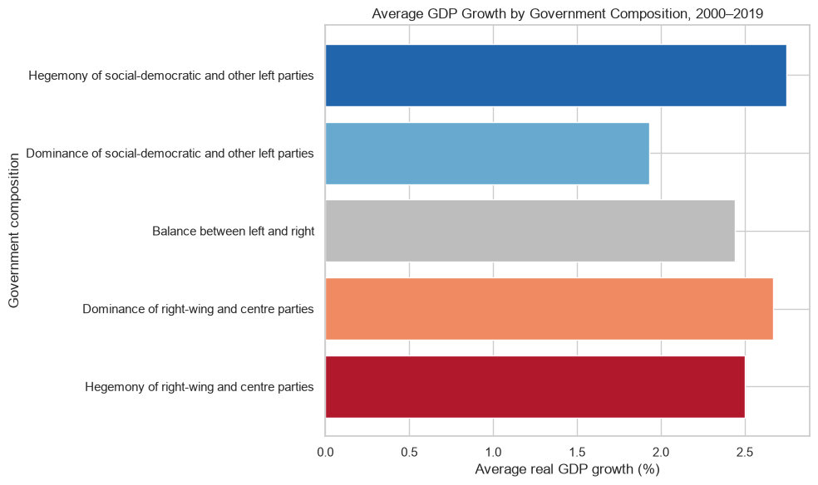
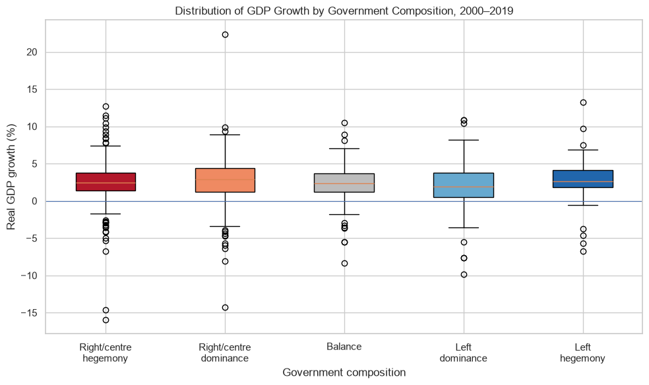
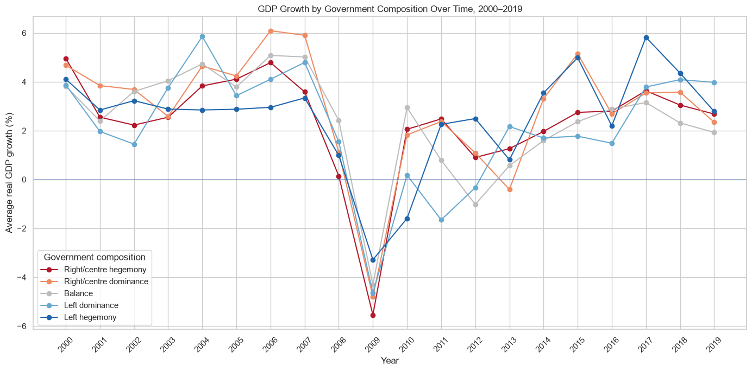
DATA PIPELINE PROJECT
Finding 1: GDP growth does not show a consistent pattern across government compositions
[GDP growth frequently moved in similar directions across all five government categories.The categories cross repeatedly, with no composition consistently associated with higher or lower GDP growth across 2000–2019 ]
Notes:
This was one of the results that surprised me. I expected the political composition to show a clearer relationship with economic performance. Instead, the categories often move together. You can see this particularly around the decline in 2009 and the subsequent recovery. That suggests that broader economic conditions and the year itself may be very important.

Slide 7
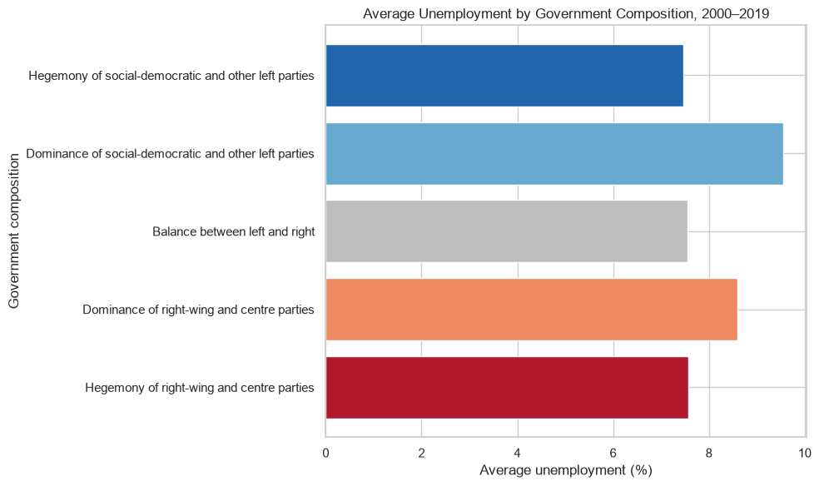
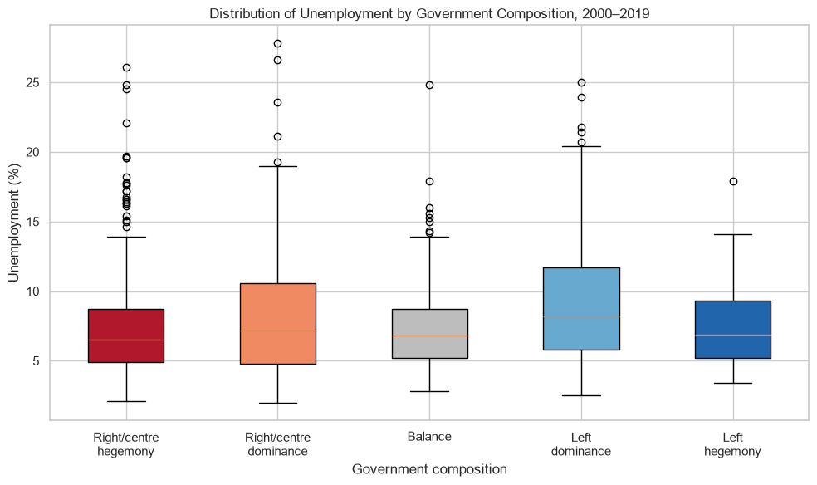
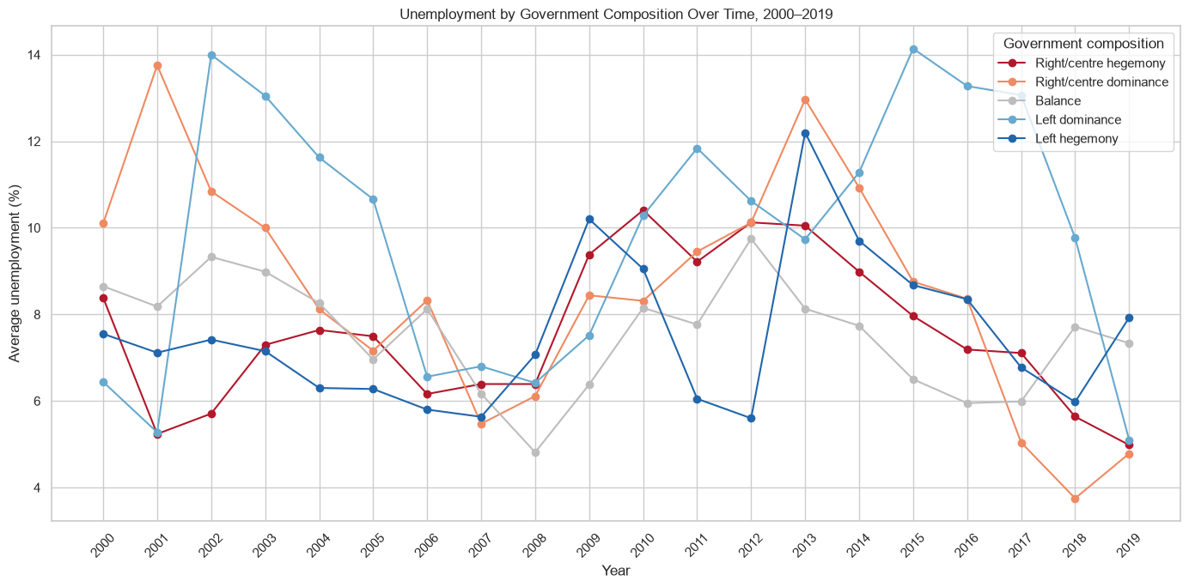
DATA PIPELINE PROJECT
Finding 2: Unemployment shows greater variation across government compositions
[Unemployment patterns differ more strongly between government categories than GDP growth.
However, the lines cross frequently, and no government composition remains consistently associated with higher or lower unemployment throughout 2000–2019 ]
Notes:
Unemployment looks somewhat different from GDP growth. The categories are less synchronized and there are larger differences between them in individual years. But again, there is no consistent ordering across the full period. The categories cross frequently, and the countries belonging to each category also change over time.

Slide 8
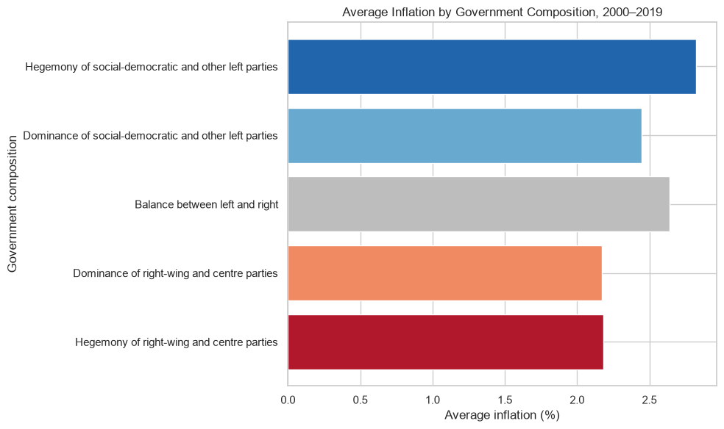
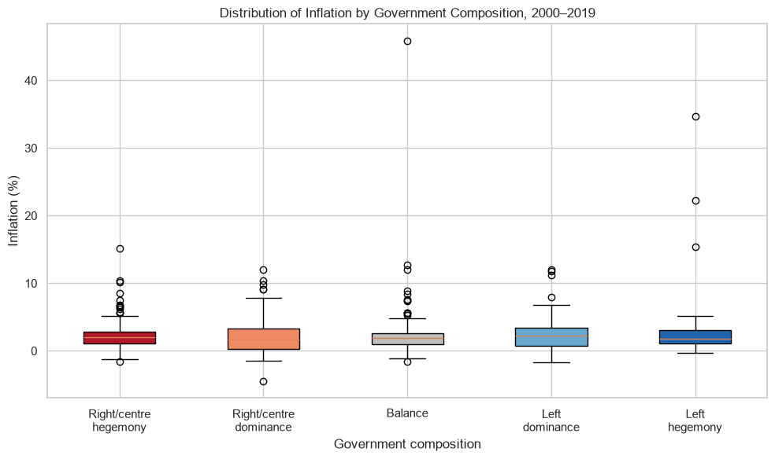
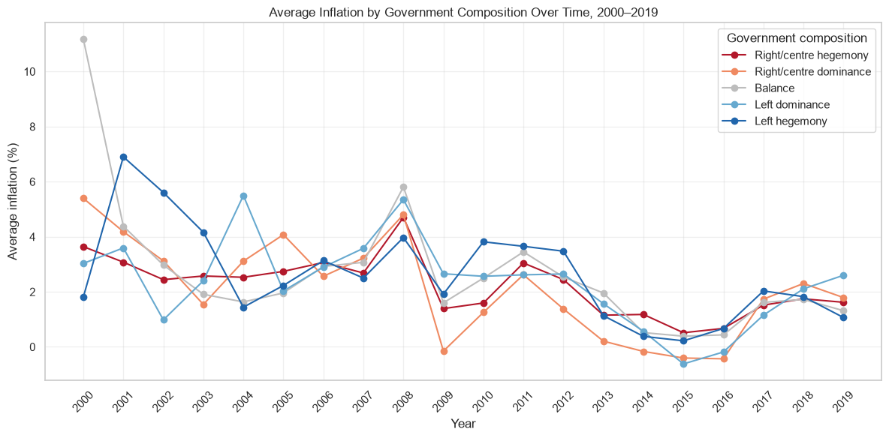
DATA PIPELINE PROJECT
Finding 3: Inflation differences narrow over time across government compositions
Inflation varied considerably across government compositions in the early 2000s.
From around 2009 onward, the categories became more closely clustered and frequently crossed, with no composition consistently associated with higher or lower inflation.
Notes:
Inflation adds another perspective. There are quite large differences between the categories in the early 2000s, including some extreme observations that I also saw in the boxplot. But over time, especially after 2009, the categories become much closer together. Again, there isn't one government composition that consistently has higher or lower inflation across the whole period

Slide 9
DATA PIPELINE PROJECT
Answer and takeaways
Answer to the main question
Economic outcomes differ across government compositions, but no consistent pattern appears across the political spectrum.
Government composition alone does not explain the differences observed in GDP growth, unemployment, or inflation
What the data cannot tell us
This analysis shows associations, not causality. Country-specific factors, global economic conditions, policy timing, and changing governments may all influence the results.
Notes:
I started this project partly because I wanted data to help me examine my own assumptions about politics and economic outcomes. I expected to find a clearer pattern, but the results were much more mixed. For me, the main takeaway is not that political composition doesn't matter, but that this dataset and this descriptive analysis don't support a simple relationship between political orientation and these economic indicators.

Slide 10
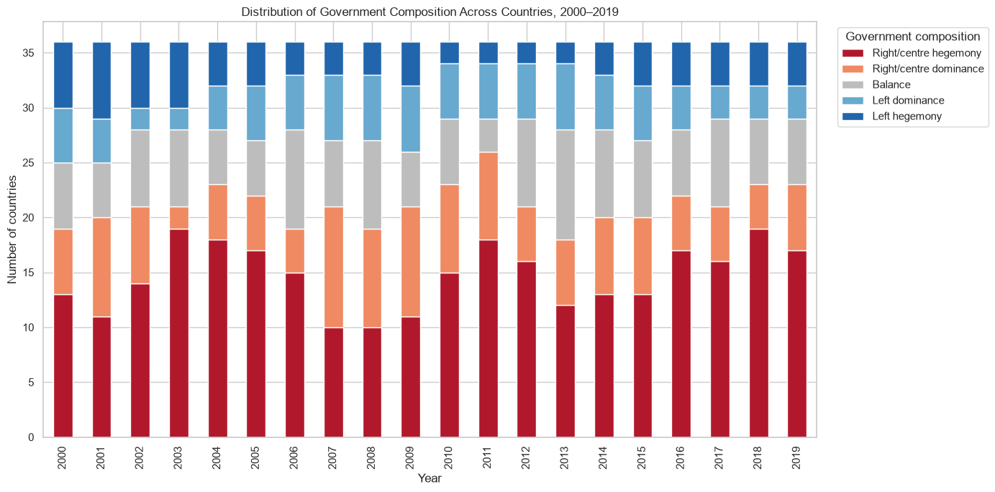
Notes:
An important imbalance in the data
Right/centre government compositions occur more frequently in the dataset than several other categories. Therefore, the groups being compared are not equally represented. The descriptive comparisons do not control for unequal group sizes, country differences, time effects, or other economic factors. More advanced statistical analysis would be needed to estimate whether government composition has an independent relationship with economic outcomes.

Slide 11
DATA PIPELINE PROJECT
Pipeline overview
1 Raw files
[CPDS Excel dataset
Political + economic indicators ]
2 Python cleaning
[Selected relevant variables
Filtered 2000–2019
Checked missing values, duplicates & validity ]
3 SQLite database
[3 relational tables
Primary & foreign keys
720 country-year observations ]
4 SQL + charts
[5+ analytical SQL queries
Pandas + Matplotlib visualizations
GDP, unemployment & inflation ]
Notes:
I first explored the original CPDS dataset, selected the variables relevant to my questions, transformed it into three relational tables, loaded those into SQLite, and then used SQL to answer my research questions and Python to visualize the results.

Slide 12
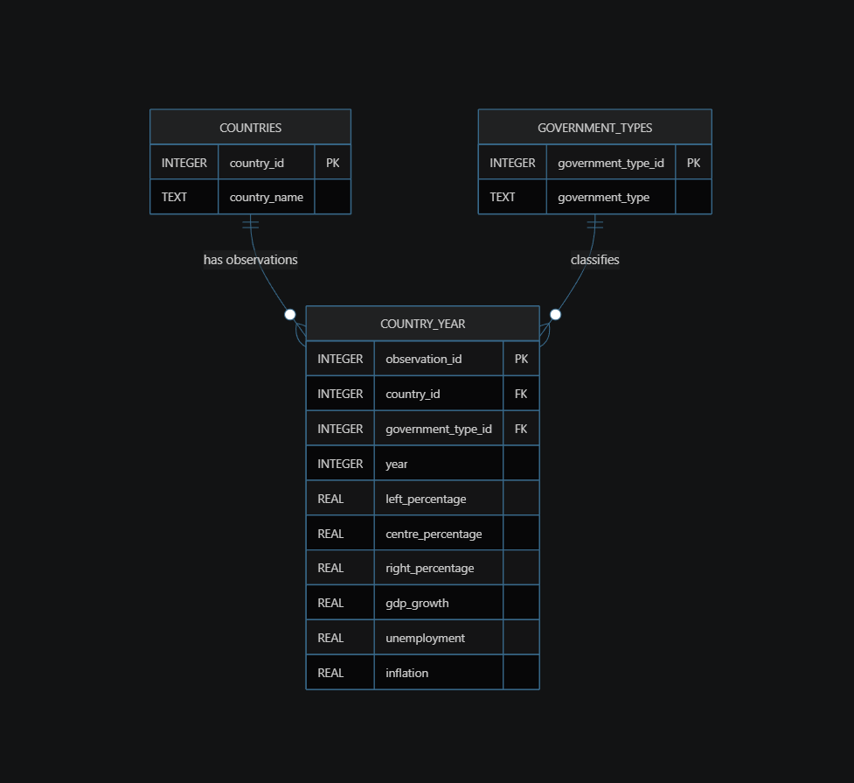
DATA PIPELINE PROJECT
Database design
Notes:
“I normalized the original dataset into three tables. country_year is my main table, while countries and government types are lookup tables. Each country and each government type can therefore be linked to many country-year observations.”

