Slide 1


Real Estate- House-Price in Taiwan
Submitted by:
Rekha Singh
M.Tech(NIT Trichy)

Slide 2

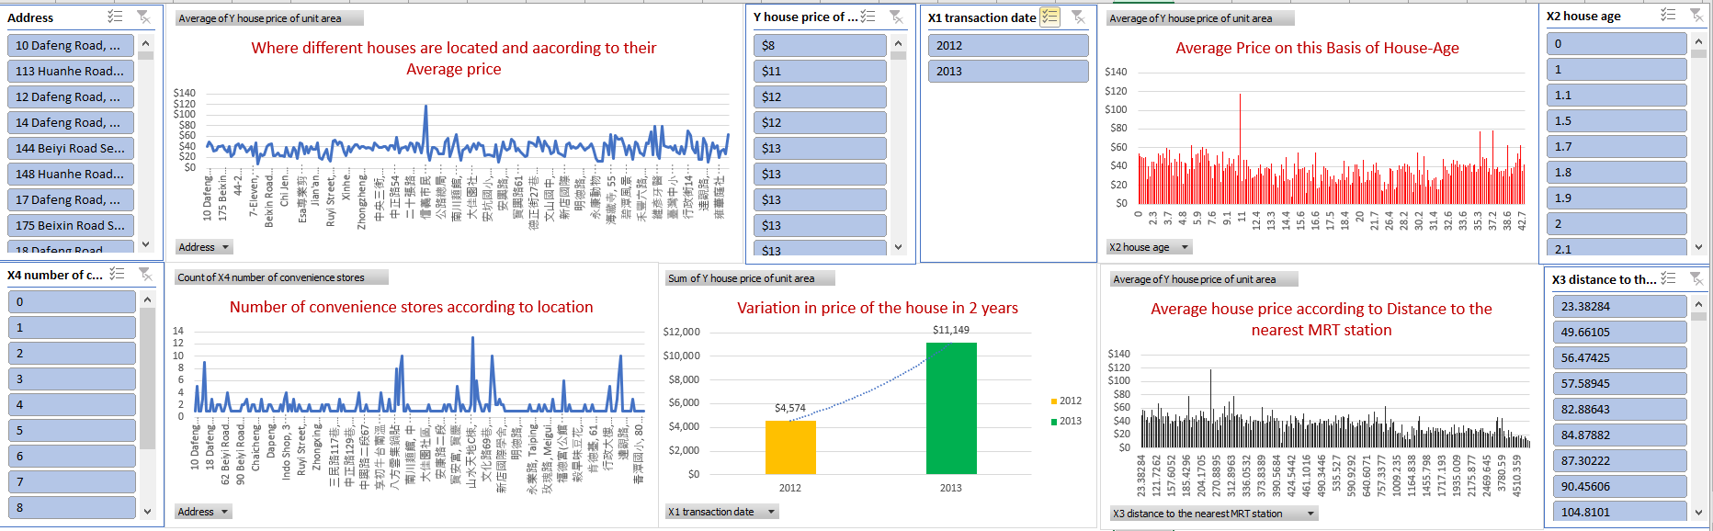
Dashboard

Slide 3

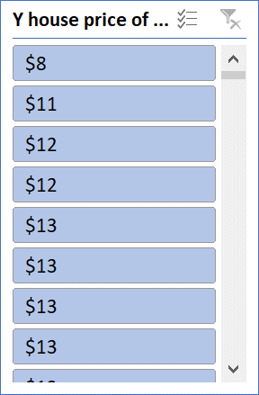
Transaction year​ represents at which the price of the house

Slide 4
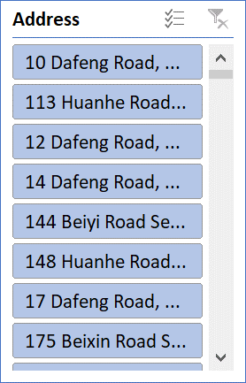
Address gives exact location of house and according to their price

Slide 5
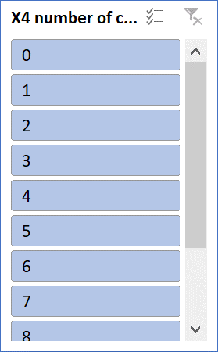
Convenient stores​ tell how many stores are available near the house

Slide 6
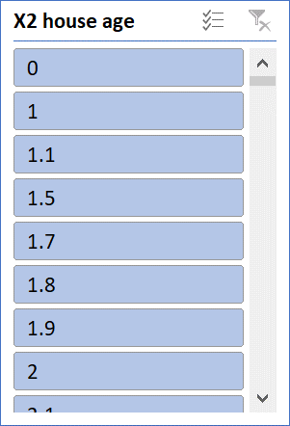
House age tells how old the house is and according to their price

Slide 7
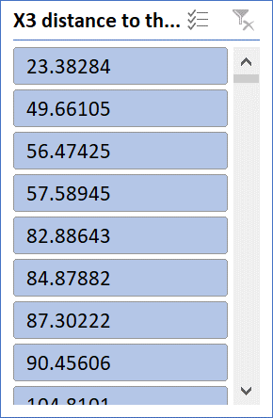
Distance to the nearest MRT station describes how far is the station from the house

Slide 8
Conclusion:-
House prices has maximum in 2013 and prices increased exponentially from last year 2012
Maximum house price in 健宏中醫診所, Zhongyang Road, Fumin Village, Dapinglin 23150, Taiwan location
Maximum Convenient stores is 10 in 7 different location but highest price in “ 瓦城, Jianguo Road, Fuxing Village, Dapinglin 23143, Taiwan”
10 years old house having maximum price $118
Maximum price $118of house which having distance to the nearest MRT station is 252.5822 Km

Slide 9
Reference Link:-
Google drive- Video link:- https://drive.google.com/file/d/1Ssj2qlFKqW4uq6WNMmNjW0Nk3ODp2P8i/view
You Tube :- https://www.youtube.com/watch?v=WcRPI9EleUs&feature=youtu.be

Slide 10
Thanks!

