Slide 1

COVID-19-INDIA
Submitted by:-
Rekha singh
M.TECH
(NIT Trichy)

Slide 2
Problem Statement:-
Analyze data of corona cases in different states in India
Gender wise corona cases
Age wise corona cases
District and city wise corona cases report
Corona cases on daily basis

Slide 3
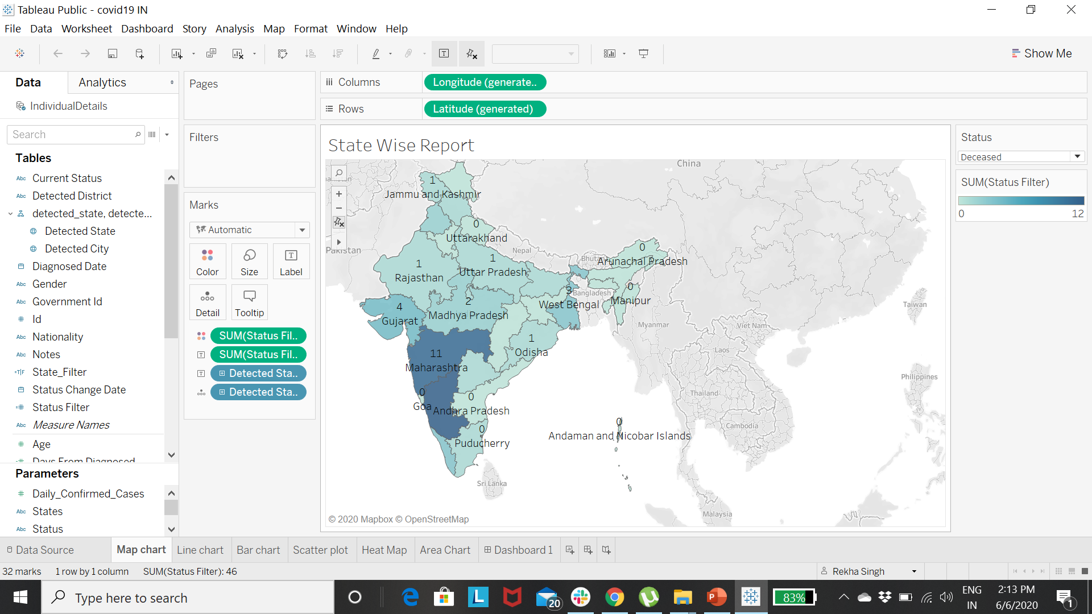
Map chart represented state of India:- how many people Hospitalized, Deceased, Migrated , Recovered during COVID-19

Slide 4
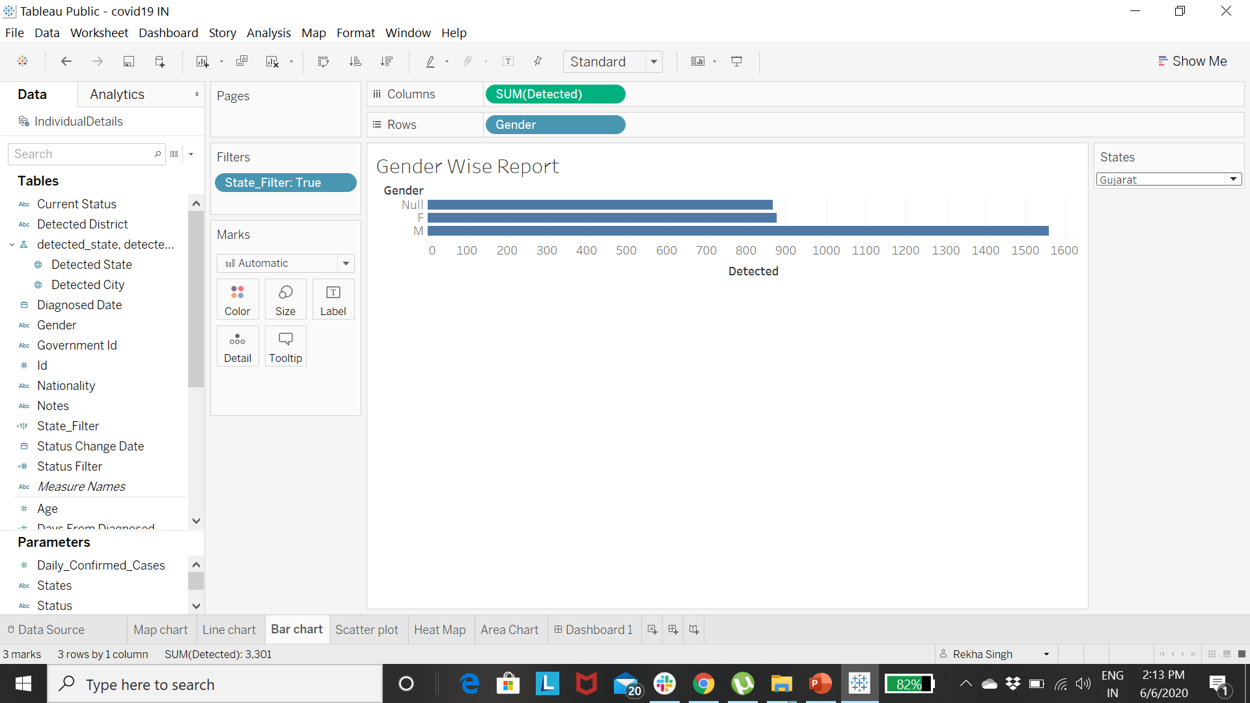
Bar chart represented gender-wise number of corona cases
* filter states accordingly

Slide 5
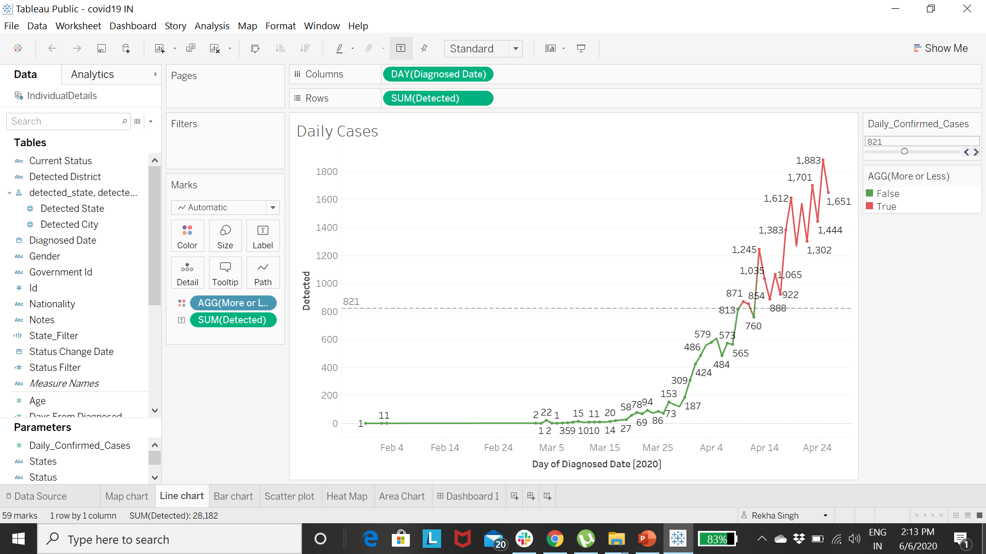
Line chart Represented number of confirmed cases on Daily Basis

Slide 6
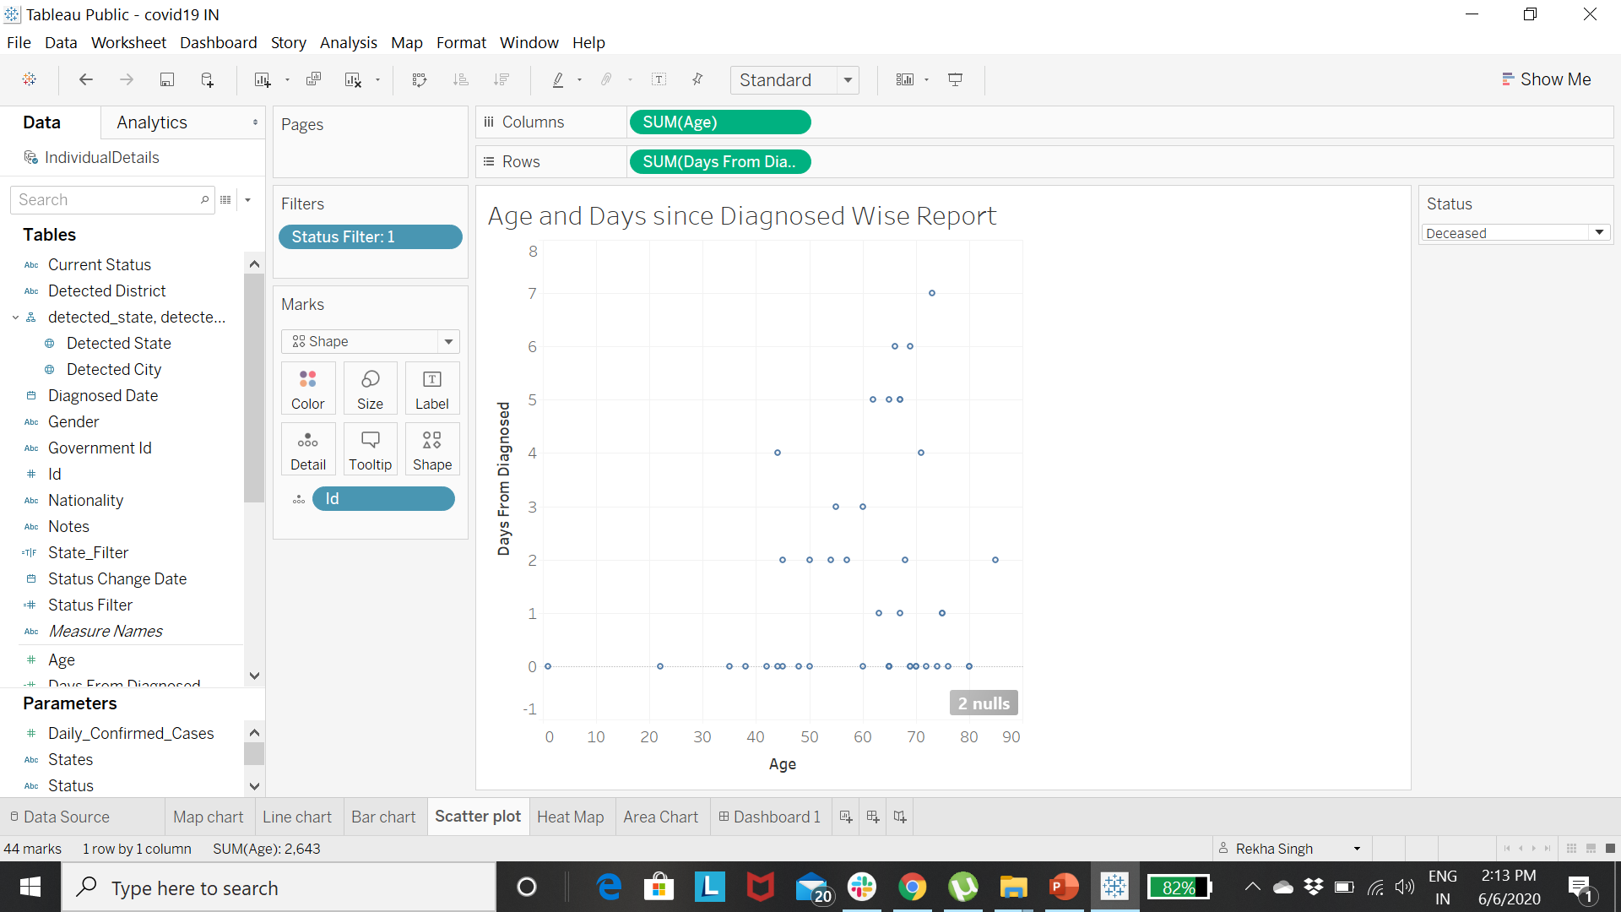
Scatter chart represented:- Deceased, Hospitalized,Migrated,Recovered cases according to patient-Age

Slide 7
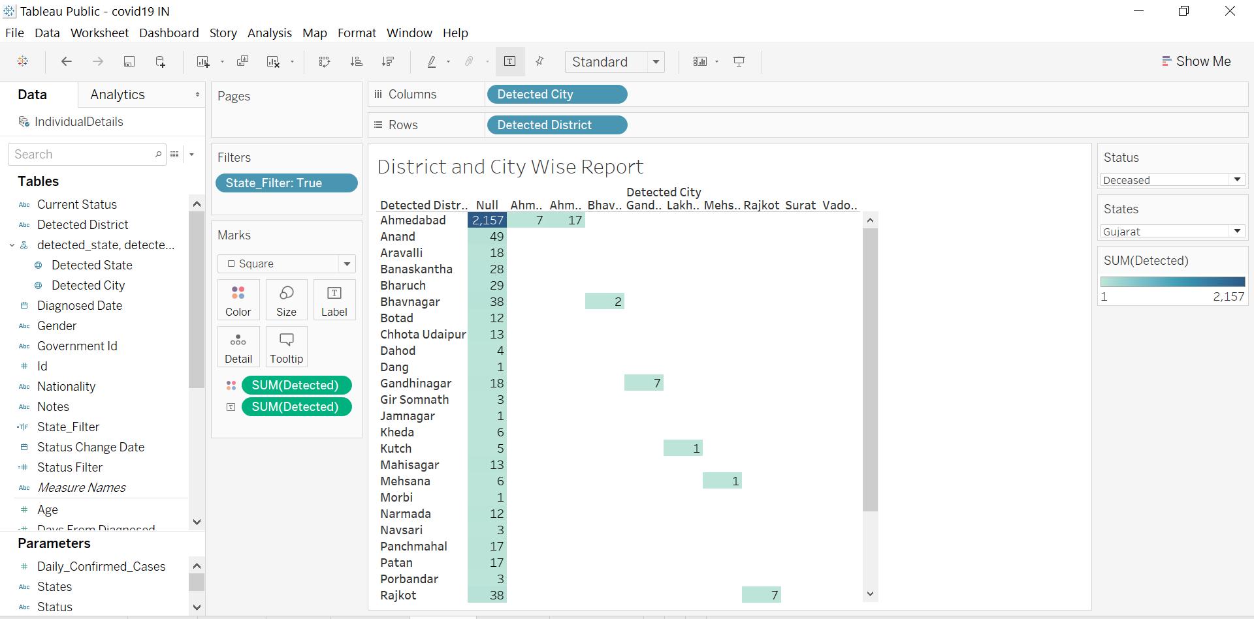
Heat Map represented District and city wise corona case

Slide 8
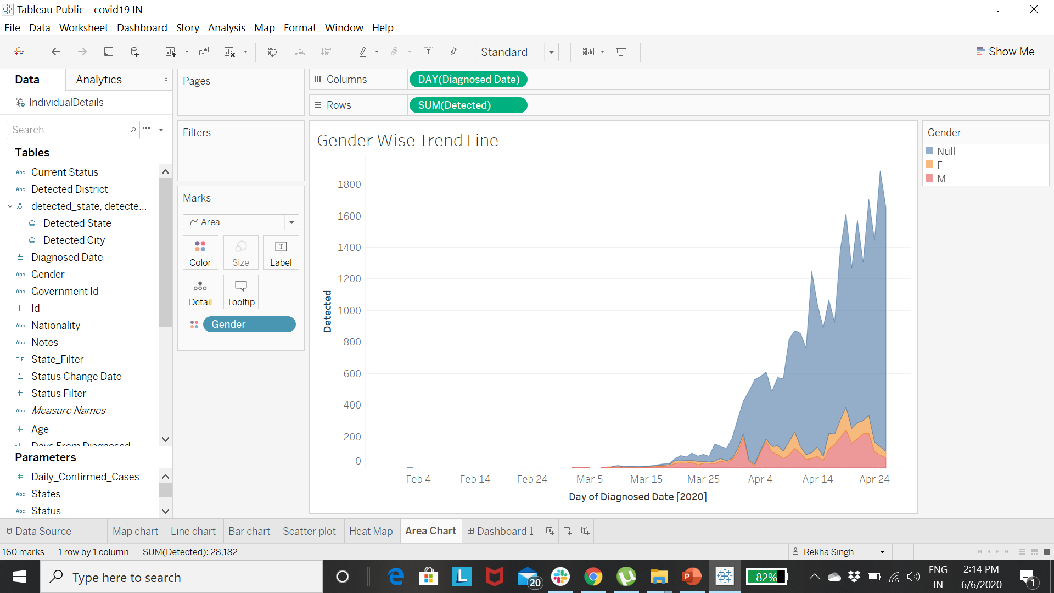
Area chart represented Detected corona cases versus Day of Diagnosed Data on the basis of gender

Slide 9
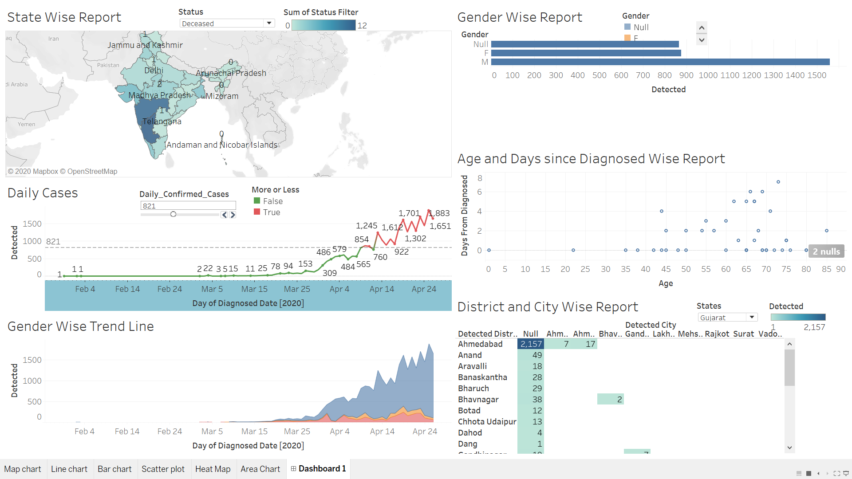
Tableau Dashboard

Slide 10
Conclusion:-
Mostly male effected by COVID-19
On the daily basis corona cases increased exponentially
More number of cases in Mumbai and Delhi.
Very few seniors have recovered

Slide 11
Reference Link:-
Source of dataset :-https://www.kaggle.com/search?q=covid-19+INDIA
Tableau Link:- https://public.tableau.com/profile/singh.rekha#!/vizhome/covid19IN_15913762572440/Dashboard1
Video link: https://drive.google.com/file/d/1cvcpRrVUMLo_v8XfTPPX2VVhV_7nqlCt/view

Slide 12
Thanks!

