Slide 1

Finding optimal location to open Italian restaurant in NewYork

Slide 2
Introduction
New York is a major central city for diversity since many people from different cultural atmospheres have brought their families and dreams to New York City
It is the most populous city in the United States with an estimated 2019 population of 8,336,817.
Problem :
The objective of this project is to find the optimal location to open a Italian
restaurant with low risk and high success rate/ROI
Some of the factors to be considered before opening a restaurant are:
Are there any Farmers Markets, Wholesale markets etc nearby so that the ingredients can be purchased fresh to maintain quality and cost?
Competitors in particular location
Are there any venues like Gyms, Entertainment zones, Parks etc nearby where floating population is high etc
NewYork Population
Demographics
Cuisine served / Menu of the competitors
Target Audience:
People who want to open restaurant of Italian cuisine and the people who want to know which neighborhoods has best Italian cuisine

Slide 3
Data
Data about NewYork boroughs and neighborhoods with their geographical coordinates are acquired from the link - https://cocl.us/new_york_dataset
Geojson file is acquired from “https://data.cityofnewyork.us/City-Government/Borough-Boundaries/tqmj-j8zm” to get the boundaries of Newyork which can be visualised using folium library
Data from the Foursquare API is acquired to know about the various restaurants in detail, in each neighborhood of New York city especially Italian cuisine

Slide 4
Methodology
Two functions are created to return dataframe of venue id, name and category and the other dataframe consists of venue ratings,likes and tips in addition to venue id and name
Exploratory data analysis is used to retrieve the top 5 neighborhoods that has average rating more than 9 and are visualised using folium

Slide 5
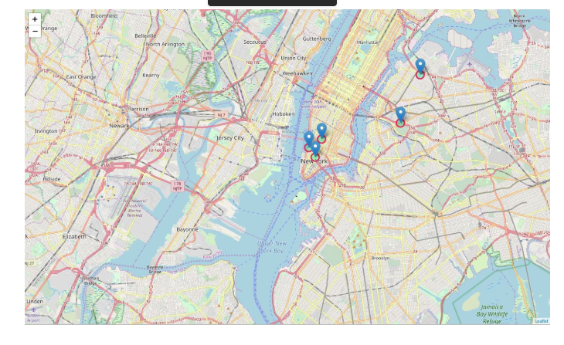
Visualization
Top 5 neighbourhoods which has top rated Italian restaurants in New York city.

Slide 6
Results
Out of 5 boroughs in NewYork, Queens and Brooklyn boroughs has highest number of neighborhoods and Manhattan has the least
Out of 295 Italian restaurants in neighborhoods of NewYork, Manhattan has highest number of restaurants despite having the minimum neighborhoods compared to other boroughs
Among neighborhoods, Belmont(borough-Bronx) has more number of restaurants of Italian cuisine
“Rubirosa Ristorante”which is in Manhattan is more liked and has more number of tips
Top 5 neighborhoods with restaurants of average rating more than 9 are Downtown,Boerum Hill,Central Harlem and Greenpoint
Manhattan has the highest average rating of 8.6 among boroughs
Area with less Italian restaurants is Queens and has average rating around 8
In Top 5 neighborhoods of average rating >9, 4 neighborhoods belong to borough “Brooklyn” which means brooklyn has highly rated restaurants of Italian cuisine in NewYork

Slide 7
Conclusion
Manhattan and Brooklyn has highly rated restaurants which means more number of customers are in that area who likes Italian cuisine. So the restaurant can be opened here but the investor has competitor risk.
The scope of this project can be expanded to understand the competitors(competitor analysis) by focusing on the features which help them to draw customers
If the investor want less competitor risk and high successful rate, Queens is the best area to open Italian restaurant as there are few restaurants when compared to other boroughs and has average rating of 8.

