Slide 1
DATA ANALYTICS REVIEW1:
DONE BY:
MAULISHREE AWASTHI-19BCE1864
REKHA V-19BCE1871

Slide 2
COVID-19 ANALYSIS AND GLOBAL FORCAST:

Slide 3
PROBLEM STATEMENT:
The COVID cases have been increasing at an exponential rate. So it is becoming necessary to analyze the pattern and trends by taking previous data.
Benefits: This analysis will help us take precautionary steps (mask, surplus beds, oxygen cylinders, remdesivir) to contain the spread of COVID-19.
This project aims at analyzing the dataset and drawing valuable insights.
Example: The people most affected, the country most affected, the severity of next wave.

Slide 4
OBJECTIVE AND SCOPE OF PROJECT:
In this project we will be diving deep into ‘What does data say about Covid-19 situation in World?’.
And with available data we come up with some observations and conclusions.
This analysis mainly focuses on:
Which countries got affected by COVID-19 the most?
Which countries observed the most hike in COVID-cases in recent months?
Which countries recovered from COVID-19 till date?
Which country suffered the most deaths due to COVID-19?

Slide 5
Data Source:
The following sources of data are used:
https://opendata.ecdc.europa.eu/covid19/casedistribution/csv
COVID19 Global Forecasting from Kaggle
COVID_19_INDIA from Kaggle
Tools and Technique:
Tools used: RStudio, Kaggle and Excel.
Techniques: Box Plot, Histogram, Bar Chart, Line Chart, Correlation.

Slide 6
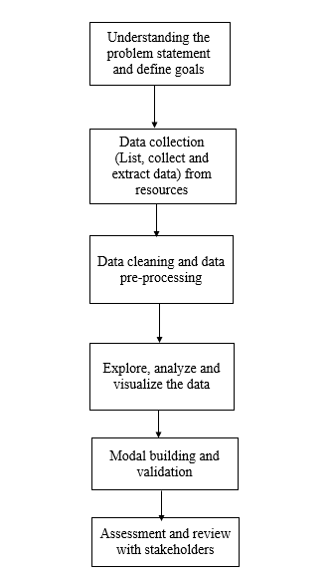
FLOW OF THE PROJECT:

Slide 7
DATA DESCRIPTION:
From the dataset: https://opendata.ecdc.europa.eu/covid19/casedistribution/csv
We have extracted data for a year across 12 variables. The variables are date-reported, day, month, year, cases, deaths, countries And Territories, geo-Id, country-territory-Code etc..
From the dataset: COVID19 Global Forecasting
We have extracted data for a year across 6 variables. The variables are Id, Province-State, country-region, date, confirmed cases and Fatalities.
From the dataset: COVID_19_INDIA
we have extracted data for a year across 9 variables. The variables are S.no, date, time, State/Union territory, confirmed cases, cured cases and deaths.

Slide 8
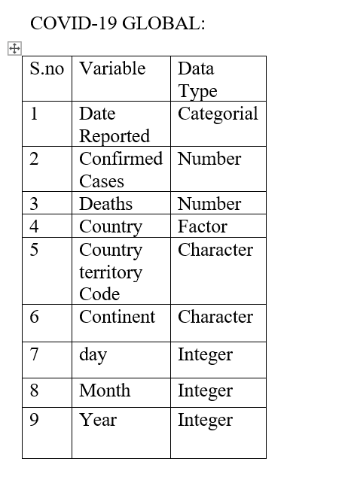
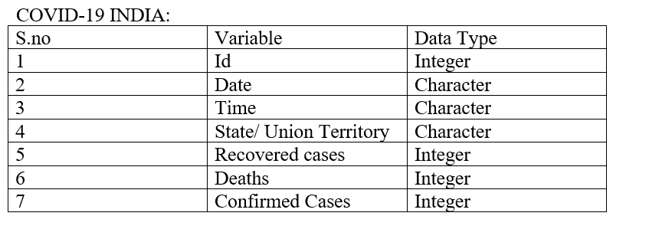
List of Variables and their type:

Slide 9
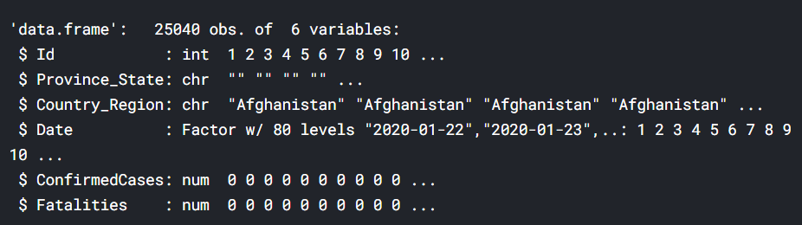
DATA PREPARATION: COVID-19 GLOBAL
Converting factor datatype to character:
covid_data_train[["Province_State"]] <- as.character(covid_data_train[["Province_State"]] )
covid_data_train[["Country_Region"]] <- as.character(covid_data_train[["Country_Region"]] )
str(covid_data_train)

Slide 10
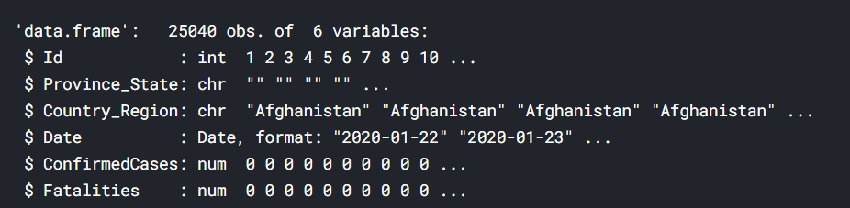
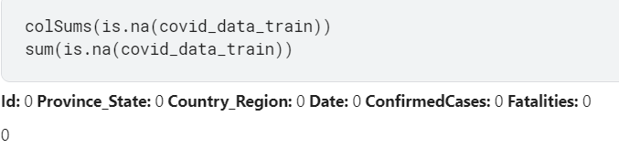
Convert the date from categorial to Date format:
covid_data_train[["Date"]] <- as.Date(covid_data_train[["Date"]], format = "%Y-%m-%d")
str(covid_data_train)
Show variables with missing values:
colSums(is.na(covid_data_train))
sum(is.na(covid_data_train))
There are 0 missing values

Slide 11
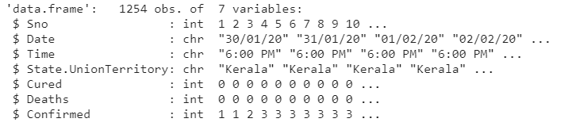
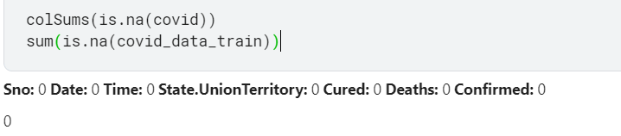
Data preparation: COVID-19-INDIA
Removing the columns which are not used:
covid <- subset(covid,select=c(ConfirmedIndianNational,ConfirmedForeignNational))
Searching for missing values:
colSums(is.na(covid))
sum(is.na(covid_data_train))
No missing values:

Slide 12
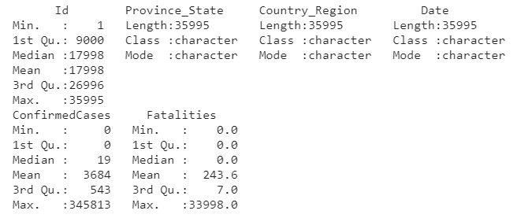
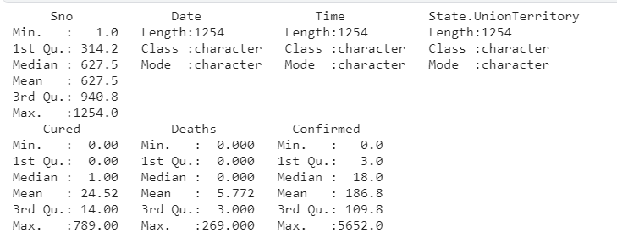
ANALYSIS OF COVID:
The statistical analysis of COVID-19 Global dataset
The statistical analysis of COVID-19 India dataset

Slide 13
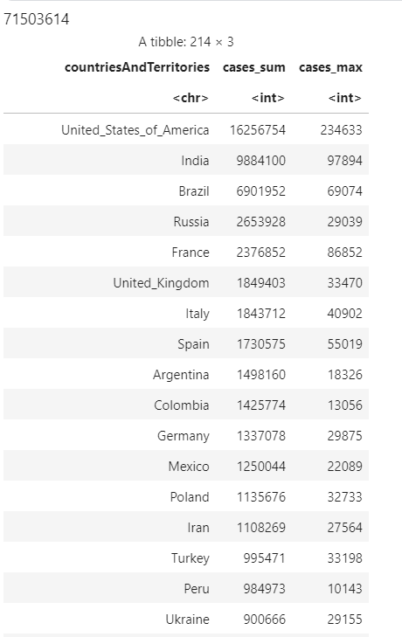
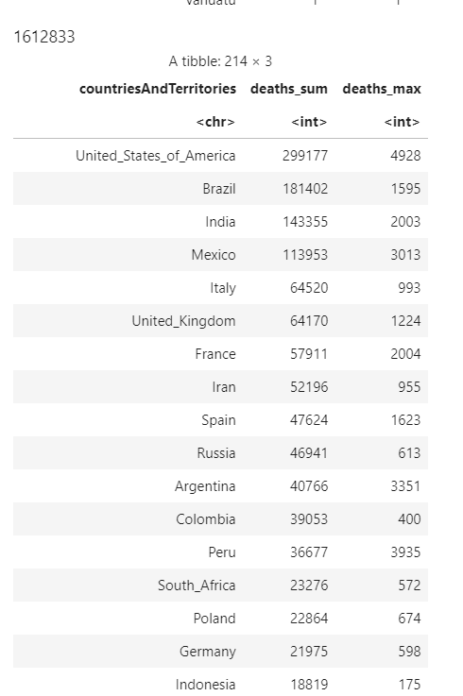
# total cases worldwide to date
sum(data$cases)
# total cases and max single day by country
data %>% group_by(countriesAndTerritories) %>%
summarise(cases_sum = sum(cases), cases_max = max(cases)) %>%
arrange(desc(cases_sum))
# total deaths worldwide to date
sum(data$deaths)
# total deaths and max single day by country
data %>% group_by(countriesAndTerritories) %>%
summarise(deaths_sum = sum(deaths), deaths_max = max(deaths)) %>%
arrange(desc(deaths_sum))

