Slide 1
DATA ANALYTICS REVIEW2:
DONE BY:
MAULISHREE AWASTHI-19BCE1864
REKHA V-19BCE1871

Slide 2
COVID-19 ANALYSIS AND GLOBAL FORCAST
VACCINE ANALYSIS IN INDIA

Slide 3
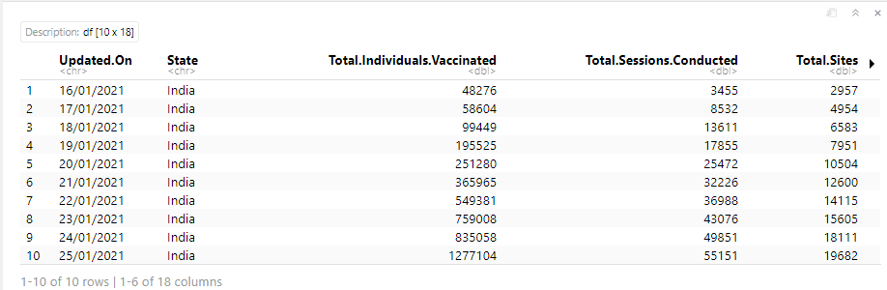
Exploratory data analysis
We are using a dataset named covid_vaccine_statewise from Kaggle.
The dataset contain 18 variables that are Updated.Date, State, Total.Individuals.Vaccinated, Total.Sessions.Conducted, First.Dose.Administered, Second.Dose.Administered etc...

Slide 4
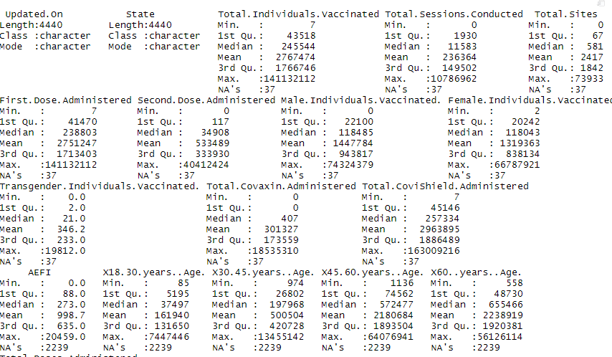
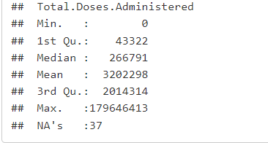
Statistics of Dataset:
summary(vaccine)

Slide 5
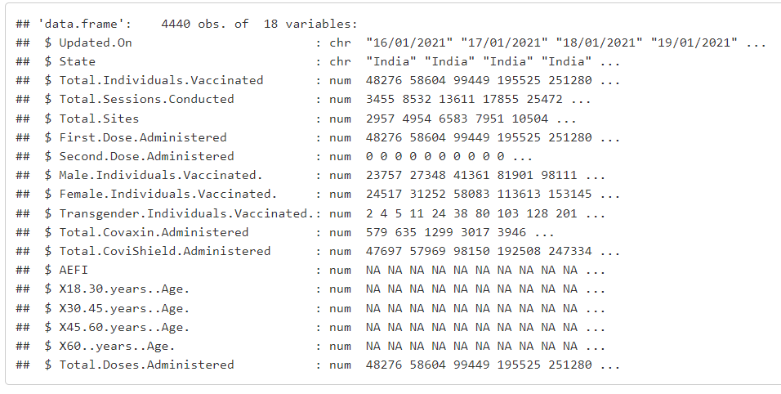
str(vaccine)

Slide 6
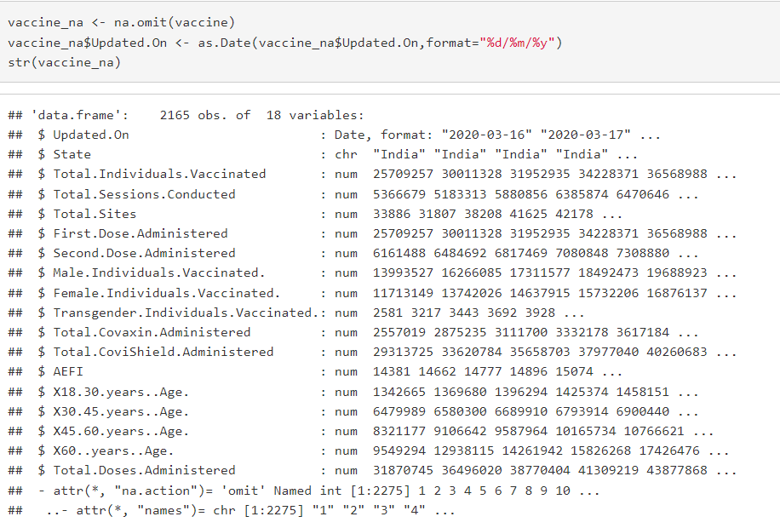
DATA PRE-PROCESSING:
Omitting the ‘NA’ values.
Changing the date formate.

Slide 7
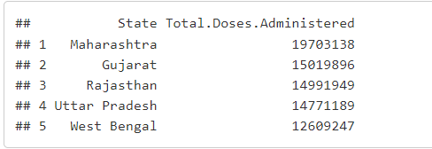
Top states which are vaccinated:
top_vaccine <- vaccine_na %>%
dplyr::filter(Updated.On ==max(Updated.On )) %>%
select(State,Total.Doses.Administered) %>%
arrange(desc(Total.Doses.Administered)) %>%
top_n(5)

