Slide 1

DEPLOYMENT

Slide 2
Deployment
Integration of Machine Learning Model into an existing production environment where the user can enter the input to generate output & later it can used in making business decisions.
In Python , we can achieve the same by using different frameworks
Django
Flask
Streamlit
Rshiny is another powerful extension based on R to build interactive dashboards

Slide 3
Deployment using Streamlit in Python

Slide 4
Reasons to use Streamlit
Build an app in few lines of code and with simple API
It doesn’t require any web development knowledge
Deploy the code instantly and see the changes simultaneously by saving the source code
It’s a open source framework

Slide 5
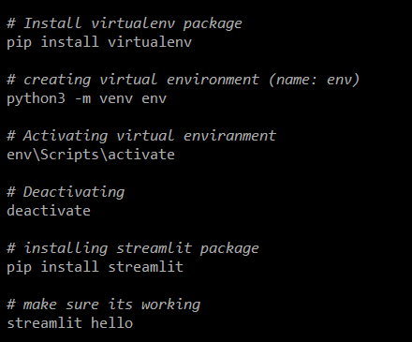
Installation
Setup a virtual environment
pip install streamlit
streamlit hello

Slide 6
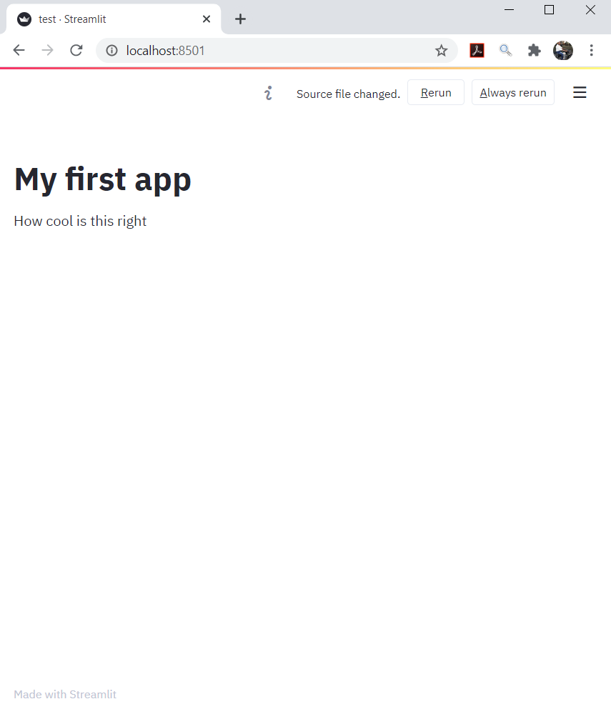
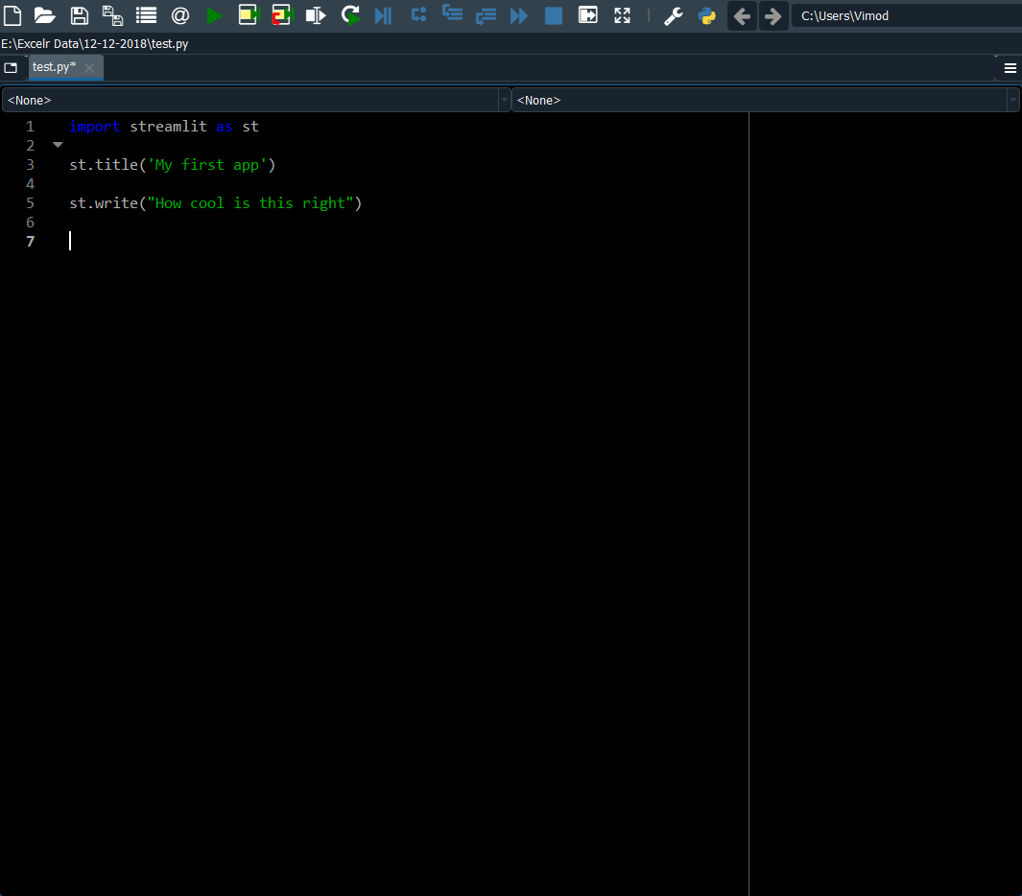
Write the code and execute it simultaneously

Slide 7
Different Magic functions
st.selectbox() is used to choose options from a series
st.sidebar() can be combined with other function so you can move your widgets to side bar
st.text() is used to add text
st.header() – Display text in header format
st.subheader() – Display text in subheader format
st.line_chart(),st.area_chart() – These are used to display line and area plots
st.pyplot() – used to display matplotlib.pyplot image
st.button() – Displays a button widget
st.checkbox() – Displays a check box.
For more information on Magic commands visit https://docs.streamlit.io/en/stable/api.html#magic-commands

Slide 8
Let’s try demo

Slide 9
Model Deployment using Streamlit Over Internet:
So Far we build the web app using Streamlit and it runs as a website on your local computer. Deploying over the internet increases the accessibility of your application. After deployment app can be accessed from mobile, computer from anywhere in the world.
Streamlit gives you a Streamlit Share feature to deploy your Streamlit web app for free on the internet. Once, your account is created, you simply need to push the deployment folder (local repo) to ‘Github’ (remote repo) and from here Streamlit takes care of the rest. as you can see down below the deployment page on streamlit.io.
Or You have other choices as well when it comes to hosting your model on the cloud. AWS, GCD, AZURE CLOUD are some popular services nowadays. Heroku is a free online model hosting service. you can host the model on the cloud for free. Deploying apps on Heroku is more flexible, Managing your app, package versions, storage is a lot easier with Heroku.
Let’s try to deploy using Streamlit Share !
https://share.streamlit.io/deploy

Slide 10
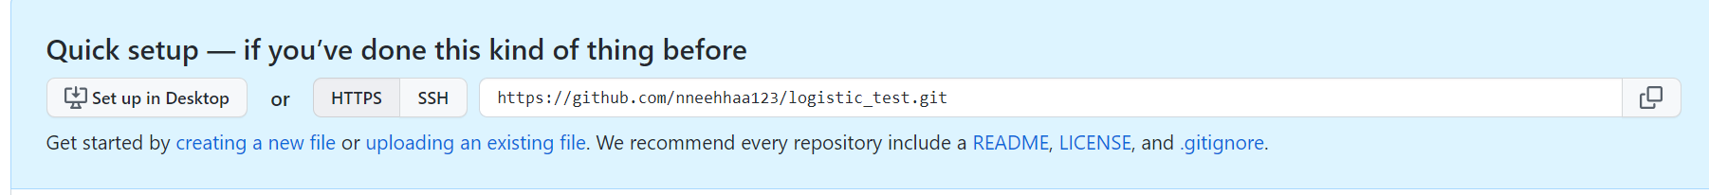
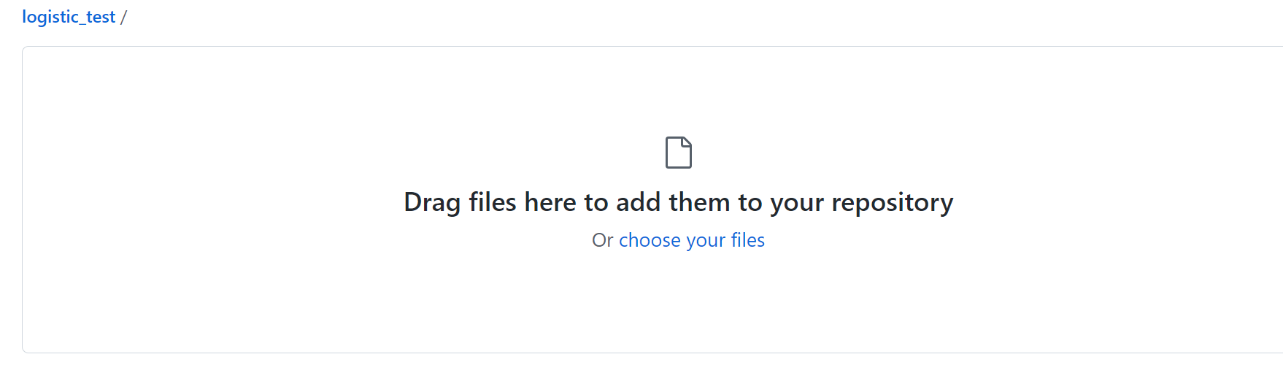
Create Git hub account
Create Github account if not done already.
Create a github repo and push your codes there:

Slide 11
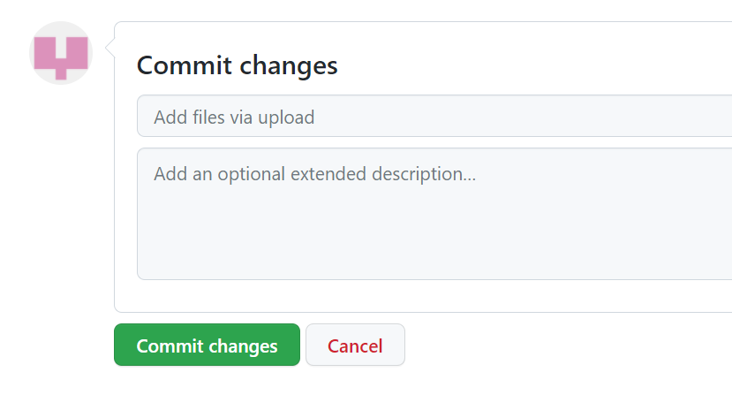
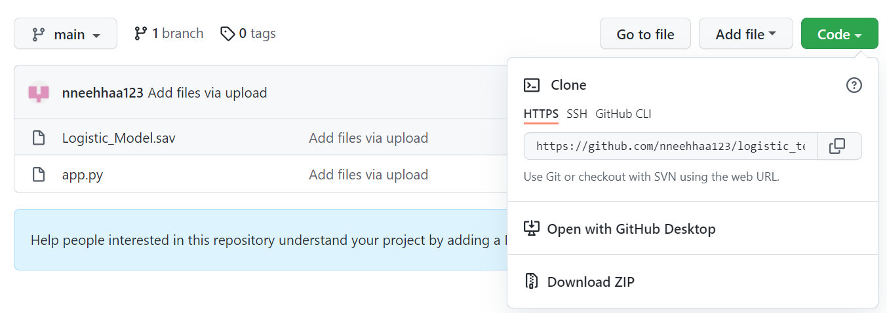
After upload click on commit changes. Give any relevant comments.
Then you can see your uploaded files here in repo. You can also copy link to your repo by clicking on code and then copy this HTTPS link.

Slide 12
Mandatory files to deploy app:
App.py: it has user input function defined as well as instruction to load model as well predictions. It can call other supporting files like another py files or models etc. Make sure to copy the same in git repo.
Requirements.txt: This has list of the library dependency. All the libraries imported in app.py file should be there in this file. As Stremlit reads this file and load these libraries while creating environment, Else it will give error while execution.

Slide 13
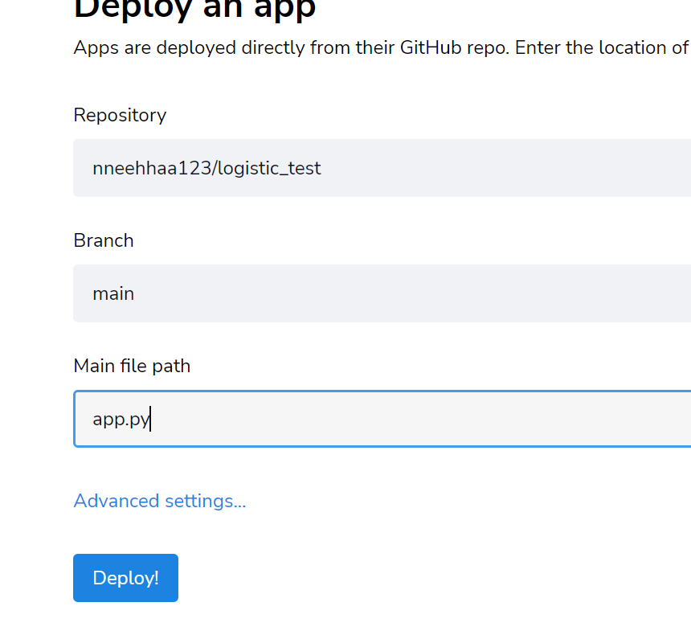
Stremlit share ask if you have Github account then directly link that account else you can create account by giving info and then deploy.
Note: Please wait for few minutes once you create git repo as it takes some time to reflect the same in Streamlit page.
Repository Name
Branch Name
File Name

Slide 14
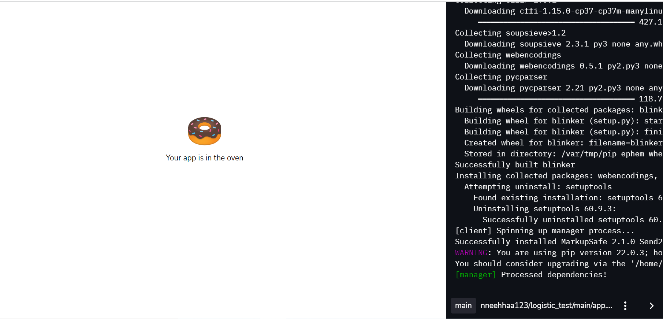
It takes few minutes to read all files and execute the same.

Slide 15
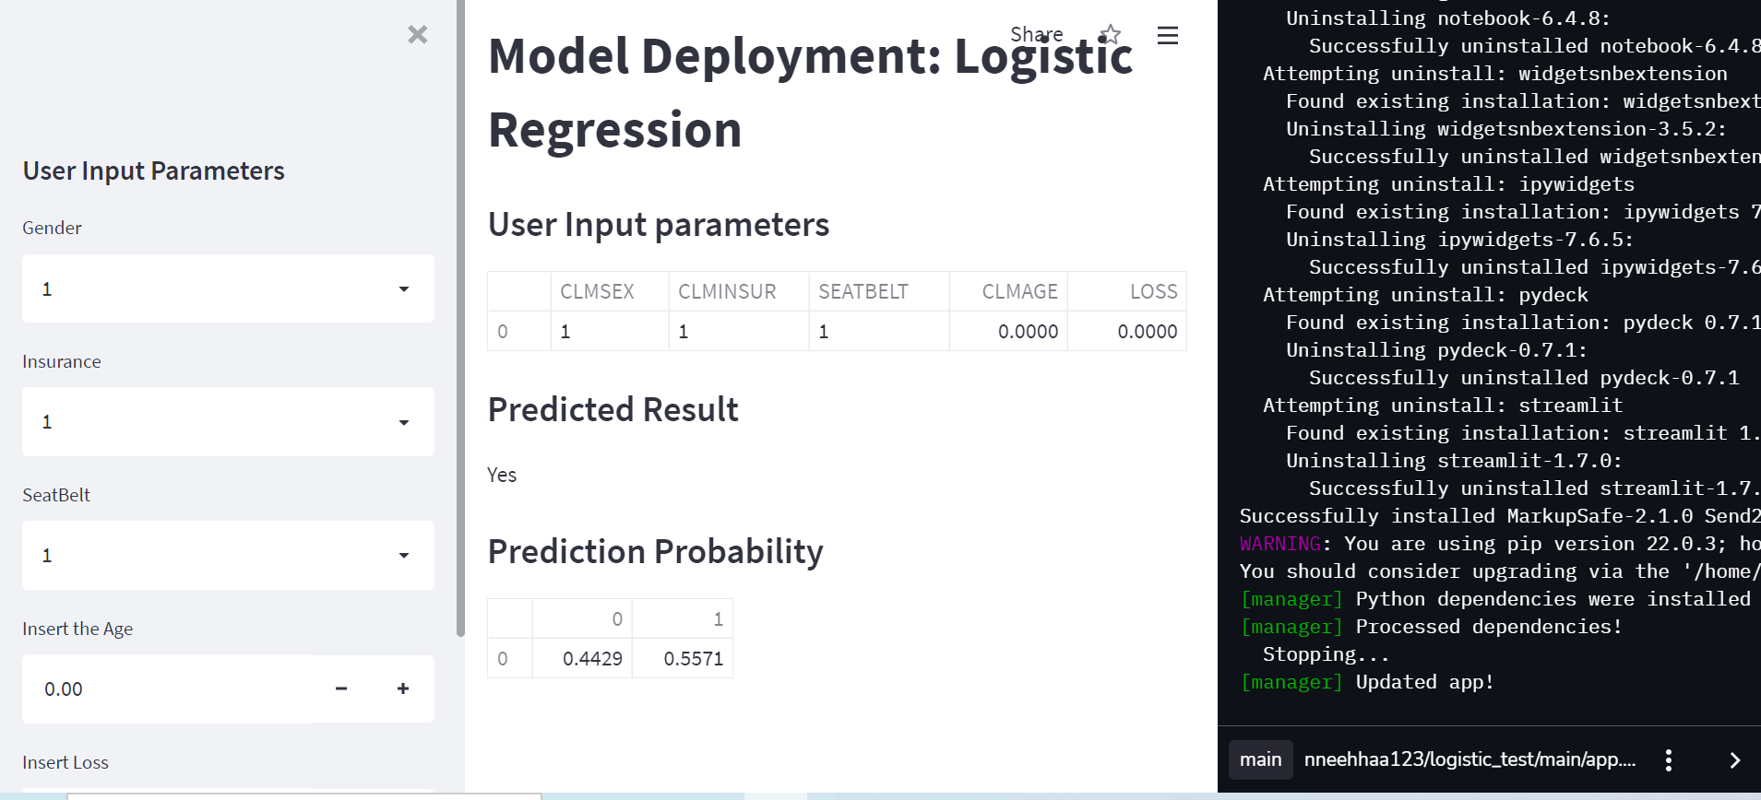
Output:
https://share.streamlit.io/nneehhaa123/logistic_test/main/app.py

Slide 16
Local deployment
Run below cmd in command prompt:
- change the directory in anaconda prompt cmd to location where all files exists with cmd ‘cd new_path’
- streamlit run app.py

Slide 17
Deployment using R Shiny

Slide 18
R Shiny Overview
Shiny is an open package from RStudio, which provides a web application framework to create interactive web applications (visualization) called “Shiny apps”. The ease of working with Shiny has what popularized it among R users. These web applications seamlessly display R objects (like plots, tables etc.) and can also be made live to allow access to anyone.
It provides extensive pre-built widgets which make it possible to build elegant and powerful applications with minimal effort

Slide 19
Explore Shiny app with these add-on packages
To add some more functionality to your Shiny App, there are some kick-ass packages available at your disposal. Here are few from RStudio.
http://rstudio.github.io/shinythemes/
http://rstudio.github.io/leaflet/
https://rstudio.github.io/shinydashboard/
http://shiny.rstudio.com/reference/shiny/latest/

Slide 20
Advantages
Efficient Response Time: The response time of shiny app is very small, making it possible to deliver real time output(s) for the given input.
Complete Automation of the app: A shiny app can be automated to perform a set of operations to produce the desire output based on input.
Knowledge of HTML, CSS or JavaScript not required: It requires absolutely no prior knowledge of HTML, CSS or JavaScript to create a fully functional shiny app.
Advance Analytics: Shiny app is very powerful and can be used to visualize even the most complex of data like 3D plots, maps, etc.
Cost effective: The paid versions of shinyapps.io and shiny servers provide a cost effective scalable solution for deployment of shiny apps online.
Open Source: Building and getting a shiny app online is free of cost, if you wish to deploy your app on the free version of shinyapps.io

Slide 21
Disadvantages
Requires timely updates: As the functions used in the app gets outdated sometimes with newer package versions, it becomes necessary to update your shiny app time to time.
No selective access and permissions: There’s no provision for blocking someone’s access to your app or proving selective access. Once the app is live on the web, it is freely accessible by everyone
Restriction on traffic in free version: In free version of shinyapps.io, you only get 25 active hours of your app per month per account.

Slide 22
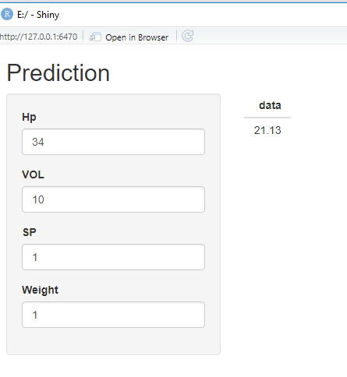
Shiny code
library(shiny)
ui <- fluidPage(
titlePanel("Prediction"),
sidebarLayout(
sidebarPanel(
numericInput("num","Hp",1),
numericInput("num1","VOL",1),
numericInput("num2","SP",1),
numericInput("num3","Weight",1)
),
mainPanel(
tableOutput("distplot"))))
server <- function(input, output) {
output$distplot <- renderTable({
Cars <- read.csv("c:/Cars.csv")
model.car <- lm(MPG~.,data=Cars)
nw=data.frame(HP=input$num,VOL=input$num1,SP=input$num2,WT=input$num3)
nw
w=predict(model.car,nw)
w
})
}

