Slide 1
Training a Playlist Curator Based on User Taste
ML Mini-Project | UE24CS352A | Problem 26
Rekha Dhorigol PES1UG24CS370
Sai Manogna B V PES1UG24CS399
Notes:
Introduce the project: we build a classifier that places a song into one of 13 playlists, or suggests a new playlist. Baseline is the Stanford paper; we extend it. Both team members introduce themselves.

Slide 2
From one song to the right playlist
1
2
3
Input
Model
Output
A song's audio features and metadata (e.g. danceability, energy, tempo, release year)
A classifier trained on 13 playlists (676 songs)
Top-3 playlists with probabilities, or "create a new playlist"
Baseline: Awadelkarim & Coelho, Stanford (2018). We re-implement it, then extend it.
Notes:
The paper's problem statement: given unfinished playlists and a set of unclassified songs, sort each song into the best playlist or suggest creating a new one. We implement both parts.

Slide 3
Paper baseline vs our changes
Stanford paper (2018)
Our project
Spotify API data: 10 audio features + 2,095 genre tags
13 curated playlists, 1,044 tracks
Perceptron, SVMs, 1-hidden-layer NN
Best: NN 82% test, RBF SVM 80%
Kaggle "30,000 Spotify Songs": audio + metadata, no genre tags
Same baselines, re-implemented in CV pipelines
Plus new features, models, tuning, feature selection
Plus a "new playlist" rule and a Streamlit app
Notes:
The paper's strength was 2,095 one-hot genre tags from the Spotify API. Our dataset has no per-track genre tags, so our baseline uses audio features only and scores much lower. That is a dataset difference, not a bug. We also keep scaling and feature selection inside CV pipelines.

Slide 4
Dataset: from 32,833 songs to 676
32,833
3,690
1,040
944
676
tracks in 449 playlists
tracks in our 13 playlists
balanced: 80 per playlist
unique tracks after removing duplicates
final: 52 per playlist
Labels: 13 distinct playlists, e.g. Permanent Wave, Neo-Soul, Hard Rock Workout, Electropop
playlist_genre and playlist_subgenre are not used as features: they come from the label (leakage)
Notes:
Kaggle dataset loaded with kagglehub. We chose 13 distinct playlists, balanced them, removed duplicate track IDs (a song can sit in several playlists) and kept 52 per playlist. The genre columns are derived from the playlist, so using them would leak the label.

Slide 5
Features and evaluation pipeline
A
Paper baseline
B
A + 3 ratios
C
B + 4 metadata
10 Spotify audio features
energy/dance, acoustic/energy, tempo x energy
instrumentalness, duration, popularity, release year
1
2
3
4
80/20 stratified split
Tune with 5-fold CV
Select by repeated CV
Report on test set
540 train, 136 test
training data only
5 folds x 3 repeats
used once
Notes:
Three feature sets let us show what each addition buys. Scaling and feature selection are inside sklearn Pipelines, so they are re-fit inside every CV fold: no leakage. The test set is touched only for final reporting; the final model is chosen by CV.

Slide 6
Replicating the paper's baselines
0.27 vs 0.10
RBF SVM scaled vs unscaled: scaling is essential, as in the paper
~0.30
our baseline vs the paper's 0.77 to 0.82: no genre tags, more overlapping playlists
Notes:
We reproduce the paper's Table 1 structure: scaled vs unscaled. The paper's key message that scaling matters holds. Our absolute accuracy is lower because the paper had 2,095 one-hot genre tags and mood-based playlists; we only have audio features.

Slide 7
Hyperparameter tuning pays off
SVM: GridSearchCV
C=30, gamma=0.003, quantile scaler
Random Forest: RandomizedSearchCV
200 trees, depth 12, min leaf 4
HistGB: RandomizedSearchCV
lr 0.03, 15 leaves, min leaf 40
Also: validation curve for SVM C; feature selection (mutual information, k=14) lifts the SVM to 0.494
Notes:
Hyperparameter tuning: GridSearchCV for the SVM (the scaler is also a tuned choice) and RandomizedSearchCV for the Random Forest, MLP and HistGB, all inside pipelines on the training split. Parameter tuning: the validation curve for C, and the abstain threshold later. All bars are 5-fold CV on the same split.

Slide 8
Tuned tree ensembles lead
0.527
CV accuracy, final Random Forest
0.551
test accuracy (macro-F1 0.548)
0.779
test top-3 accuracy (chance 0.077)
Notes:
Final model chosen by repeated CV, not by the test set: Random Forest (tuned), feature set C. The test set has only 136 songs, so it is about plus or minus 4 points; CV is the more reliable comparison. The soft-voting ensemble did not beat the single Random Forest.

Slide 9
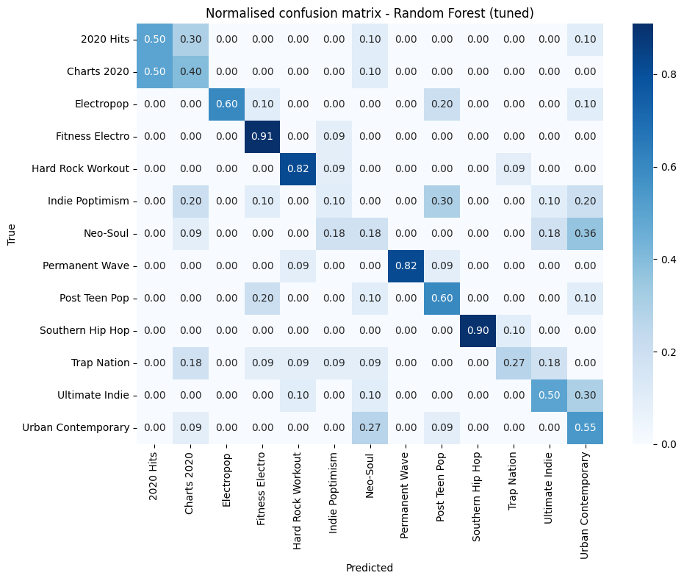
What drives it, what confuses it
release_year dominates: several playlists are era-themed. Near-duplicate playlists (Charts 2020 vs 2020 Hits, Neo-Soul vs Urban Contemporary) get mixed up.
Notes:
Be upfront: release year is by far the strongest feature (importance 0.27, next is 0.06). It is a legitimate metadata feature (the paper lists release date as missing data) but it works partly because these playlists are era-themed. Most errors are between near-duplicate playlists. The test set has about 10 songs per playlist, so single cells in the confusion matrix are noisy.

Slide 11
Suggest a new playlist when unsure
0.30
tuned confidence threshold
71%
of test songs answered, at 63.5% accuracy (55.1% overall)
0.46
accuracy on 2,422 unseen songs (top-3: 0.74)
Notes:
The paper's problem statement says assign the song or suggest a new playlist. If the top predicted probability is below the threshold, we recommend creating a new playlist. The threshold was tuned on out-of-fold predictions from the training split, then checked on the test set. The 2,422 unseen songs come from the same 13 playlists but were never in our 676-song dataset: this is our most reliable generalisation estimate.

Slide 12
Live demo: Streamlit app
1
Set a song's features
Lucky - Radiohead
sliders for audio features and metadata
Best match: Permanent Wave (81%)
true playlist: Permanent Wave
2
Click Suggest playlist
runs the saved Random Forest
Shape of You - Ed Sheeran
Low confidence (top: 19%)
3
Read the result
top-3 playlists, or a new-playlist suggestion
Suggest a NEW playlist
songs never used in training
Notes:
Run the app live: streamlit run app.py. Set sliders, click Suggest playlist. The two cards show real outputs from notebook section 16 on songs that were never in the training data: one confident and correct, one flagged as low confidence so the app suggests a new playlist. Backup: notebook section 16.

Slide 13
Team contributions
Rekha Dhorigol
Sai Manogna B V
PES1UG24CS370
PES1UG24CS399
Features and split (7)
Hyperparameter tuning (9)
Model comparison, final model, ablation (12)
Explainability (14)
Abstain rule, saved model, demo (15, 16)
Streamlit app, README
Dataset, EDA, cleaning, preprocessing, features (1 to 6)
Baseline replication (8)
Repeated CV (10), feature selection (11)
Segmentation study (12)
Error analysis and PCA (13)
Both: reading the paper, testing the code, write-up, slides, GitHub repository.
Notes:
Numbers in brackets are the notebook sections. Each of us should be ready to explain every section, but lead on our own parts during Q&A.

Slide 14
Conclusions
What we learned
Limits and next steps
Audio features alone give ~30% on 13 overlapping playlists
Metadata + tuning + tree ensembles: 0.53 CV, 0.55 test, 0.78 top-3
Fewer playlists is easier: 0.73 with 5, 0.86 with 2
A confidence threshold turns "unsure" into "new playlist"
Small data, small test split, overlapping playlists
Heavy reliance on release year (0.53 vs 0.43 CV without it)
Next: genre and artist embeddings (node2vec, GloVe) as in the paper
Notes:
Summarise: replicated the paper's baselines, extended them, tuned them honestly with CV, and added a new-playlist rule and an app. Be ready for: why release_year matters so much; why we score below the paper (no genre tags); why Random Forest was chosen (repeated CV); how we avoided leakage (pipelines, train-only tuning).

