Slide 1

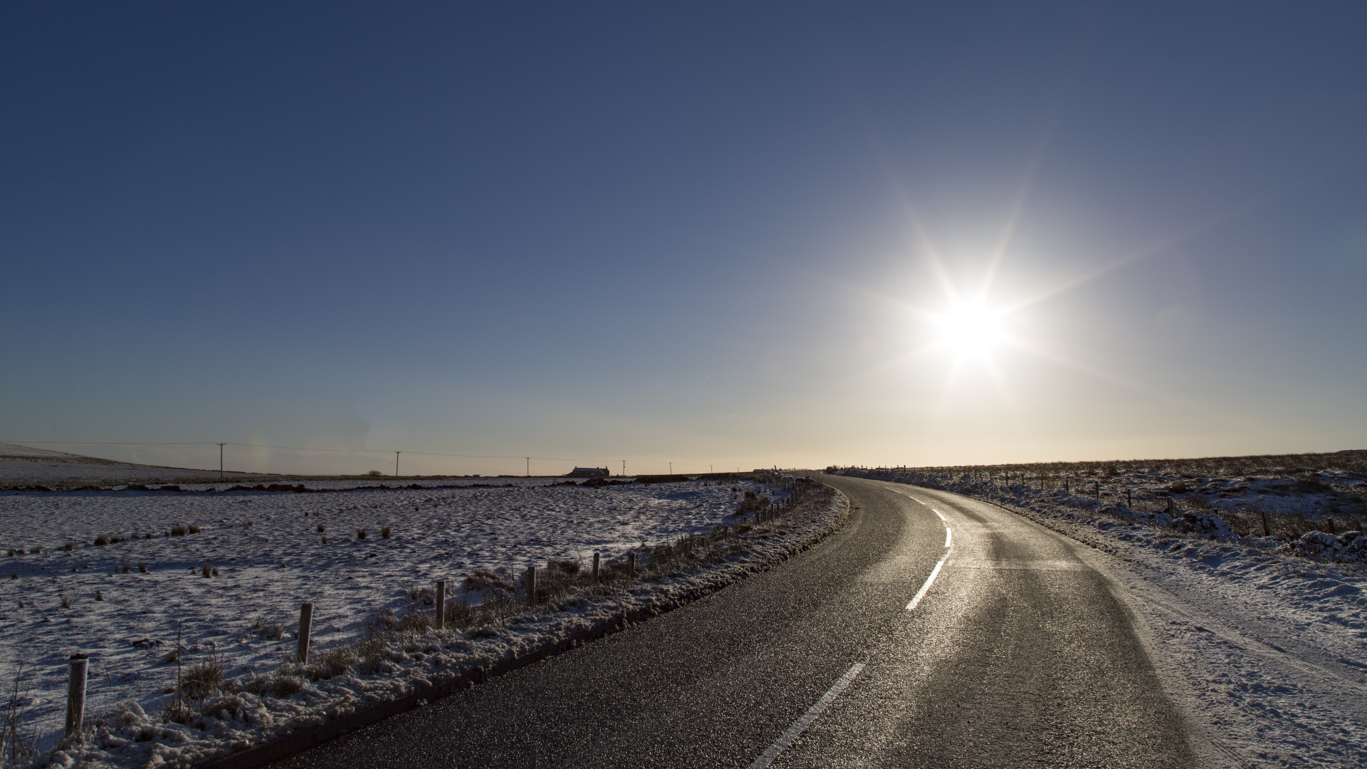
Data Visualization with
Tableau
Rekha .
01 Feb 2024

Slide 2

Overview
Introduction
01
Process
02
Purpose of Analysis
03
Results
04
Future Moves
05

Slide 3
Data Source- Kaggle This project investigates road accident causes like weather, road types, and vehicles to enhance safety measures. The goal is to reduce injuries and fatalities through improved infrastructure and increased public awareness.
Introduction

Slide 4
Process
Data Preparation
Importing Data
Dashboard
Goals
Results

Slide 5




Tools Stack
Excel
Python
Jupyter
Tableau

Slide 6
Purpose of analysis
Analysing data to understand the patterns and causes of road accidents.
Analysis of total accidents and casualties vary monthly and yearly, considering different locations.
Analyzing data to comprehend the severity of accidents (fatal, serious, slight) by examining vehicle type, road type, road surface, and weather conditions.
Aiming to improve preventive measures and reduce injuries and economic losses.

Slide 7

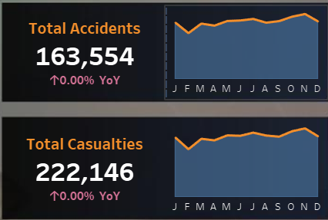
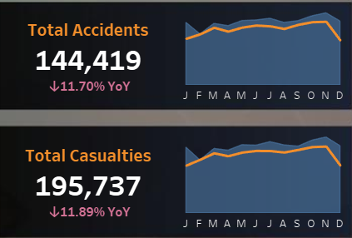
Results
The highest number of accidents and casualties was recorded in November for both years, showing a decrease in December for 2022 and decrease in February for 2021.
2021
Vs
2022

Slide 8
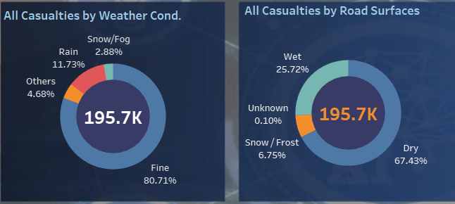
Results
The majority of accidents occur under clear weather conditions and dry road surfaces, rather than in snowy, wet, or foggy conditions.

Slide 9
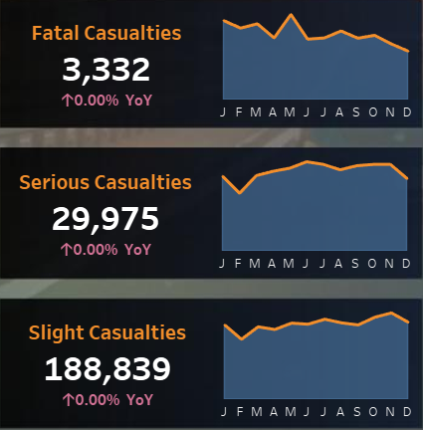
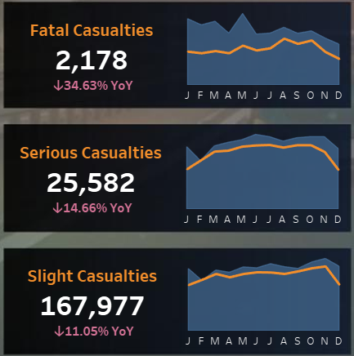
Results
Accident Severity-
All types of accident severities witnessed a overall decline in 2022, with December showing a notable decrease.
2021
2022

Slide 10
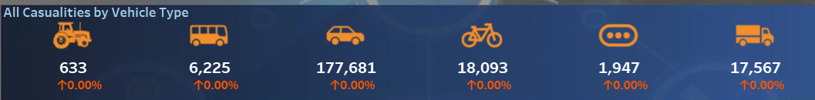
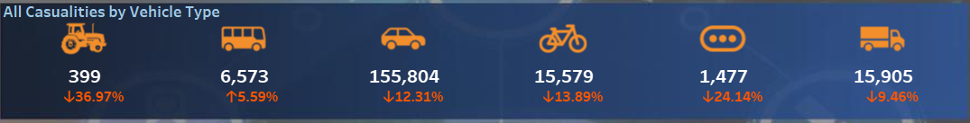
Results
Vehicle Type- In 2022, overall casualties by vehicle type decreased, but bus-related casualties saw a slight increase.
2021
2022

Slide 11
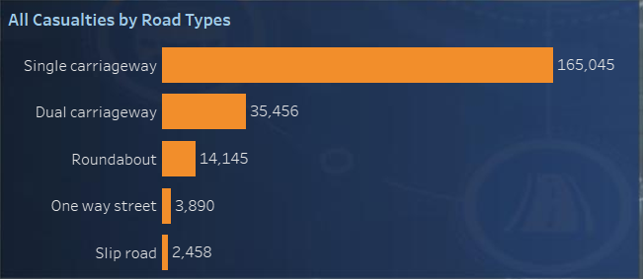
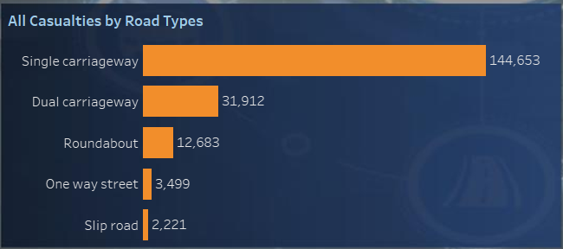
Results
Road Types-
All kind of Accident severity (Fatal, serious, slight) casualties occurred predominantly on single carriageways, with a minimum recorded on slip roads.
2021
2022

Slide 12
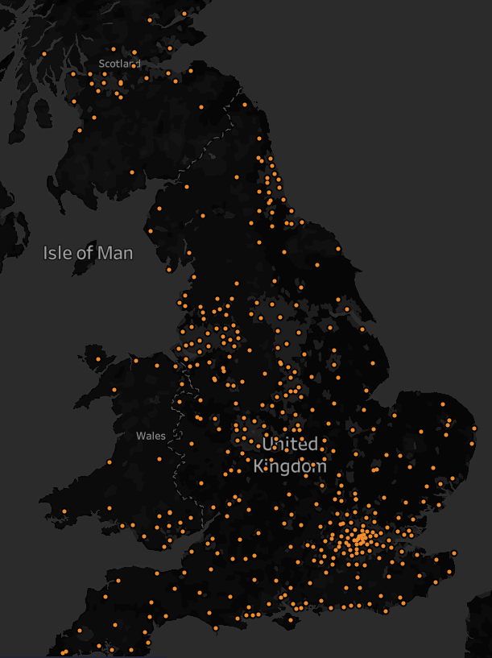
Results
Location- We also identified that many locations such as Barnet and Southwark where a significant number of accidents occurred, along with corresponding casualties and vehicle involved

Slide 13
Challenges
The data was quite large, causing delays in loading.
Encountered challenges in generating sparklines while developing KPIs.
Future moves
In the future if i get more data, I aim to look closely at important factors like the relation between time, age, gender, location the influence of lighting.
By examining these key factors, the goal is to enhance our understanding and contribute valuable insights to further improve road safety measures.

Slide 14
THANK YOU
https://github.com/rekhadivay
https://www.linkedin.com/in/rekharekha

