Slide 1
DSCI6004 Natural Language Processing Project
Team Members:
Navya Konakala
Sai Rekha Unnam
Venkata Sruthi Muppa

Slide 2

EXTRACTING LOGICAL ROUTES OVER THE WIKIPEDIA GRAPH TO FACILITATE QUESTION ANSWERING

Slide 3
Objective
Question answering is a task in NLP that accepts input in the form of questions from different categories and generates answers to those questions. Different question categories, such as open-domain or closed-domain questions, may be present.
In our project, we have thought of employing sequence-to-sequence encoders and decoders to respond to the Open domain question. Both our encoders and decoders employ Bidirectional LSTMS.

Slide 4
Dataset
SQUAD dataset has over 100000 questions for Reading comprehension task. This dataset was developed by the Standford. Here every answer to the question is a segment of text from the corresponding reading passage.
We can see that the passage is given in which the answers are present. When a question is asked based on the passage, a single answer like the one indicated in red or green is or a spam of answers like the one indicated in blue is returned.
https://github.com/chrischute/squad/blob/master/data/train-v2.0.json

Slide 5
Tools and Techniques
The tools and techniques used in question answering using sequence-to-sequence recurrent neural networks (RNNs) include natural language processing (NLP) techniques for preprocessing the input data, such as tokenization and word embeddings.
The model itself typically consists of two main parts: an encoder and a decoder. The encoder processes the input sequence and generates a context vector, while the decoder uses this vector to generate the output sequence, which in this case is the answer to the question.
To train the model, supervised learning is typically used, where the training data consists of pairs of questions and their corresponding answers. The performance of the model is then evaluated by comparing the generated answers to the ground truth answers in the test dataset.

Slide 6
Implementation
The retriever module in open domain question answering involves using a recurrent neural network (RNN) to learn the reasoning path through a Wikipedia paragraph graph.
The RNN is trained to retrieve relevant documents based on the history of previously retrieved documents. The output of the RNN is then used in a beam search to select the most relevant paragraphs from the output probability distribution.
The reader module involves encoding the questions and contexts using bi-directional LSTMs, and then using sequence-to-sequence attention to generate a weighted context vector. This vector is concatenated with the hidden state of the paragraphs, allowing the model to focus on the most relevant parts of the context for generating the answer.
The output of the reader module is then fed into a decoder, which uses another LSTM to generate the start and end indices of the answer in the context. This is done using softmax and cross-entropy loss to minimize the difference between the predicted and actual values.

Slide 7
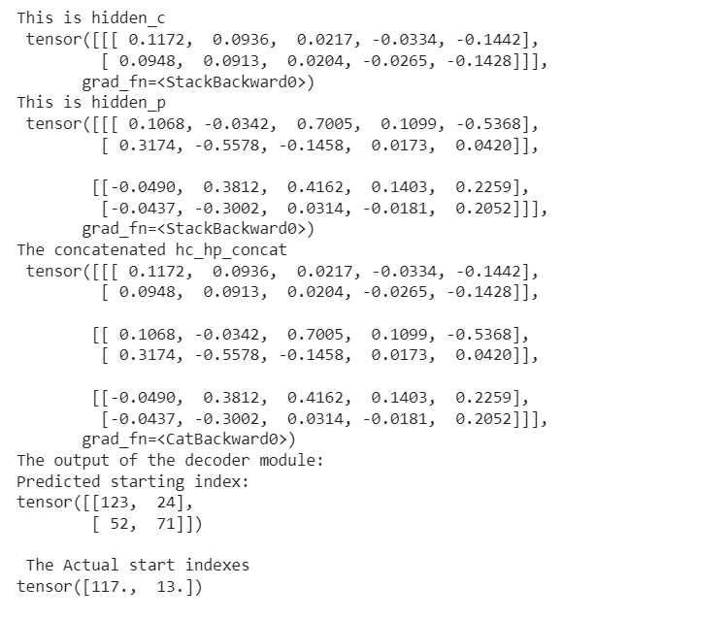
Results
The models produce the following results. The following results are obtained by training the encoder and decoder modules with hidden layer size 2 and the batch size 2.
The loss function to be implemented is a simple cross entropy loss between the actual and predicted values of start indexes which is the point in the passage where the answer begins.

Slide 8

Significance and Next Steps
Significance:
The model architecture, combining an encoder-decoder structure with bidirectional LSTMs, proves effective for capturing contextual information in sequential data.
The implementation demonstrates the potential for applications in natural language processing, where understanding context and predicting sequential information are crucial.
Next Steps:
Further refinement of hyperparameters and model architecture could enhance performance.
Evaluation metrics and additional training epochs should be considered for comprehensive model assessment.

Slide 9

Thank You

