Slide 1

CAKADIN (Cariin Kantor Dinas)
Oleh
Reksa Suhud Triatmojo 1515061001
Pariyem 1515061011
Bagus Arifudin 1515061032

Slide 2
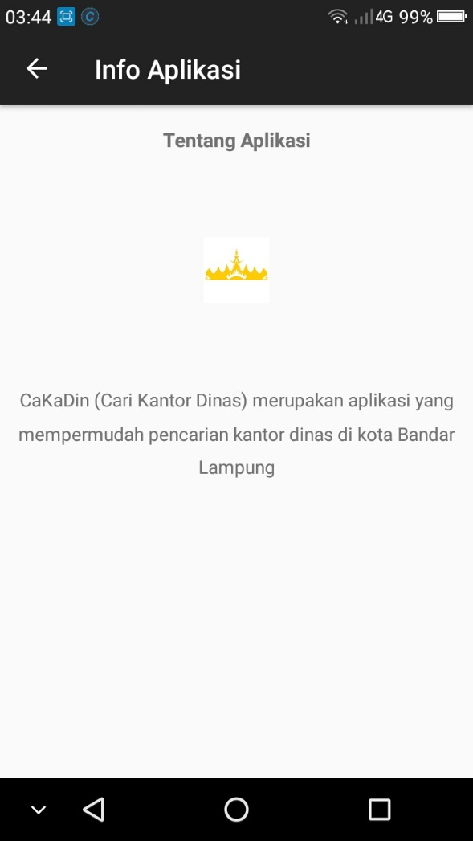

Apa itu CaKaDin
Cakadin is an application that is built to facilitate the public in searching for office services in the city of Bandar Lampung

Slide 3
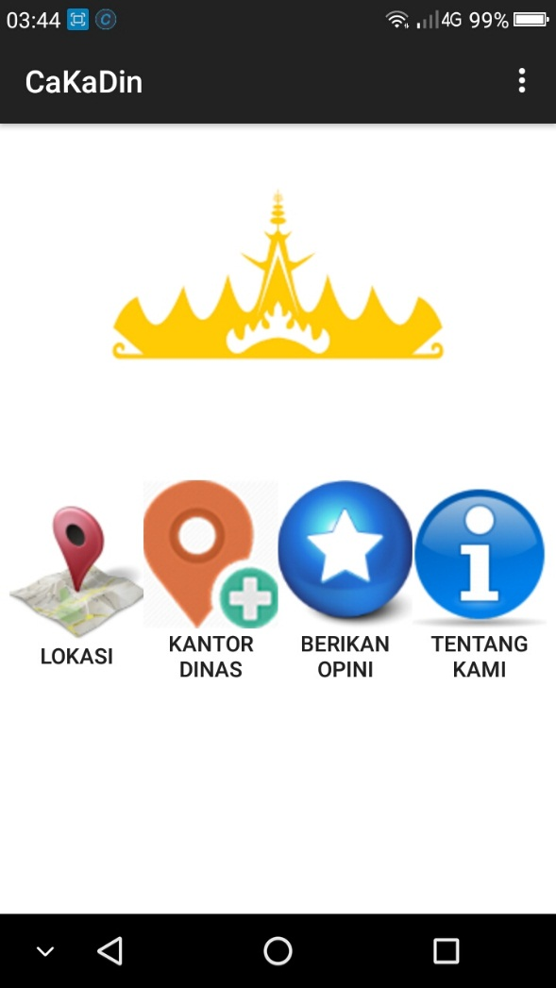

Cakadin’s App Menu
Lokasi : Office location is a menu that is used to find out the location of the official office in Bandar Lampung with a lot of information (name, phone number, rating, address, etc.)
Tambah Kantor Dinas : An “Add office” feature is a menu used to add new office location on the map
Berikan Opini : The opinion menu is used to evaluate the services of workers in the office
i
Tentang Kami : About is the menu that contains about application information

Slide 4
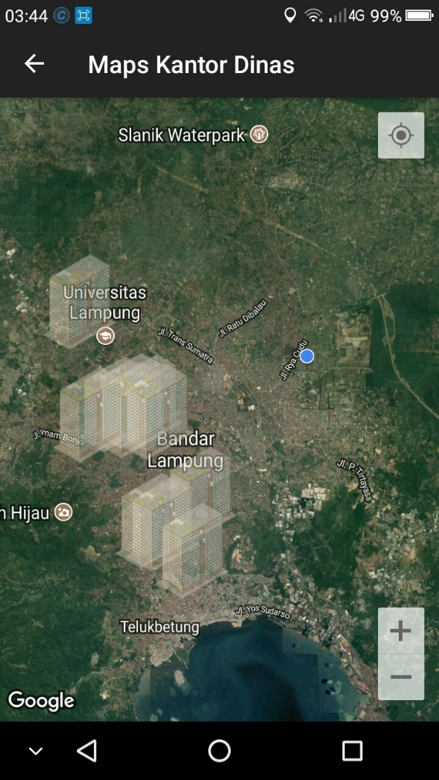
Office Location View
When the location menu is clicked, it will display the map of the Bandar Lampung area
When you tap a marker, the application will measuring distance between your current location to specific office (device location must be activated first)

Slide 5
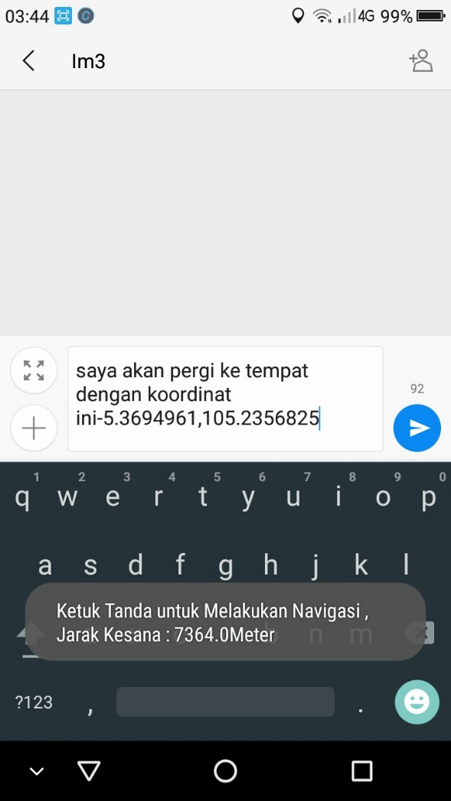
Specify Destination Location with coordinates
To determine the destination location can be by using the coordinate point as in the example like this image

Slide 6
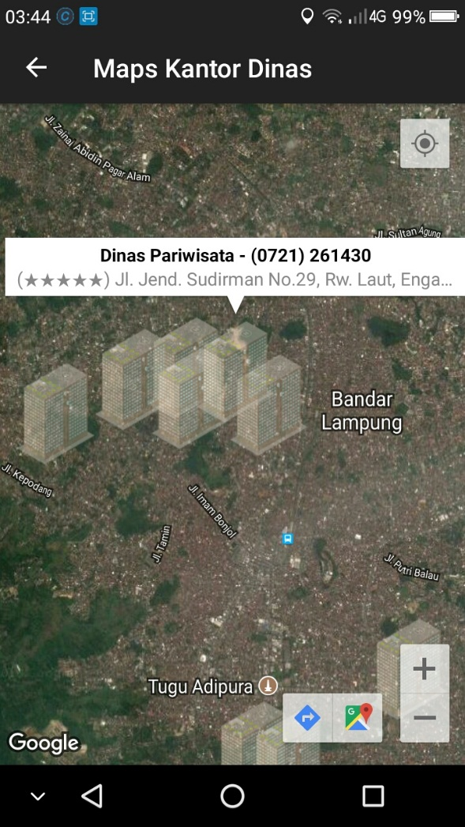
Example map: location of Tourism Department
When the list of office menu is clicked, it will display the office location in maps with building marker

Slide 7
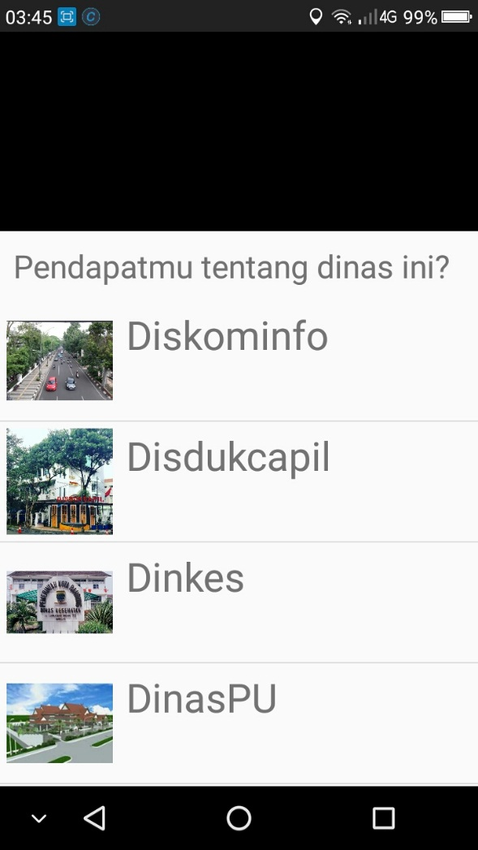

Give your opinion to an office!
Opinions submitted by the user will be used as in improving the service performance of each existing office

Slide 8
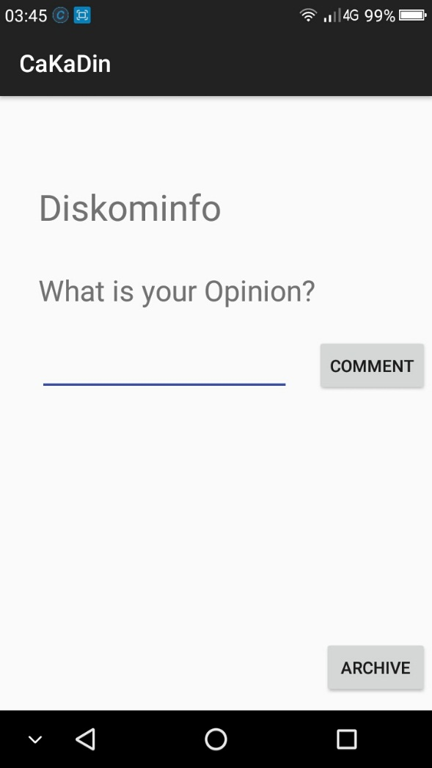
What is your opinion

Slide 9
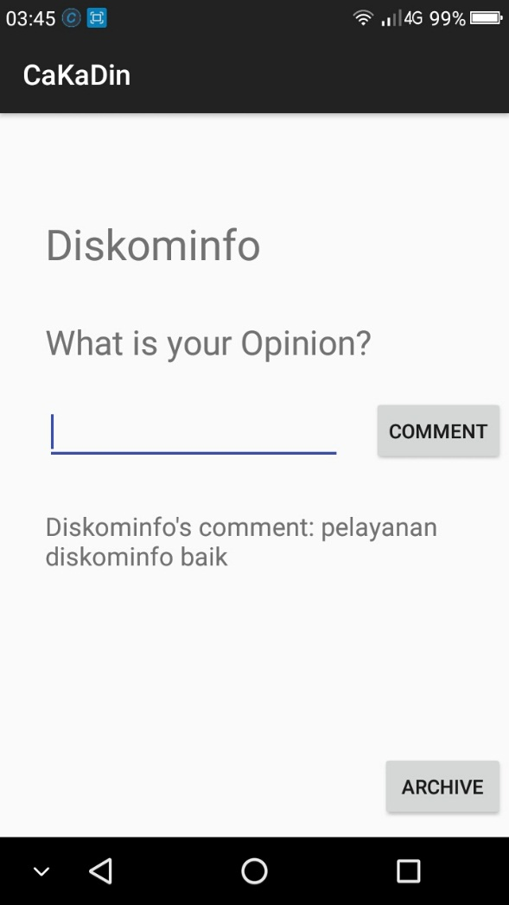
Example: user gives an opinion
Based on one user argues, that the communications service office departement has a good service

Slide 10


TOOLS USED
IDE ANDROID STUDIO V 3.0.1
SDK ANDROID API 22 ( ANDROID LOLLIPOP 5.0)

Slide 11

TEAM OF THIS PROJECT
LEAD OF PROGRAMMER
REKSA SUHUD TRI ATMOJO
CAKADIN
DATABASE DESIGNER
M. BAGUS ARIFUDIN
USER INTERFACE DESIGNER
PARIYEM

Slide 12

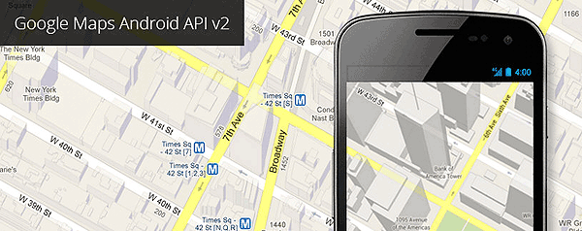
LIBRARY / API USED
GOOGLE MAPS API ANDROID V2
WITH MAP TYPE HYBRID = COMBINATING IMAGE SATELLITE MAP & TRAFFIC MAP

Slide 13

STAGES OF LABOR
UI DESIGN
SYSTEM DESIGN
LITERATURE STUDY
DATABASE DESIGN
COLLECTING THE INFO OF OFFICE DEPT.
MAKING MAPS ACTIVITY + INTEGRATING THE GMAPS API ANDROID
ADD ADDITIONAL FEATURE FROM THE REQUIREMENT
COMPILATION TO APK PACKAGE
FEATURE TESTING

Slide 14


