Slide 1


Slide 2

IFs are BAD!
OK, not always. But often:
Maintainability issues
Leads to hard-coding
Limits extensibility (often violating Open-Closed)
High Cyclomatic Complexity
Better alternatives available
Switch statements & conditional operator also count!
One or two IF/ELSEs not a problem, but..

Slide 3
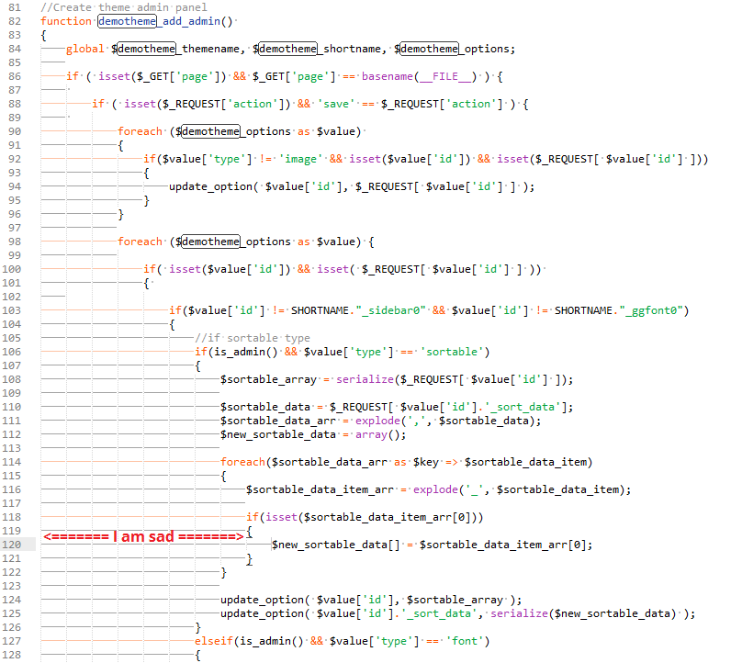

Slide 4
Rallying against the IF invasion
"Control structures have been around nearly as long as programming but it's hard for me to see them as more than an annoyance. Over and over again, I find that better code has fewer if-statements, fewer switches, and fewer loops.“
- Michael Feathers
"We don’t need to try and kill every if statement, but perhaps the more we do, the better our code becomes.“
Phil Haack
Anti If Campaign

Slide 5
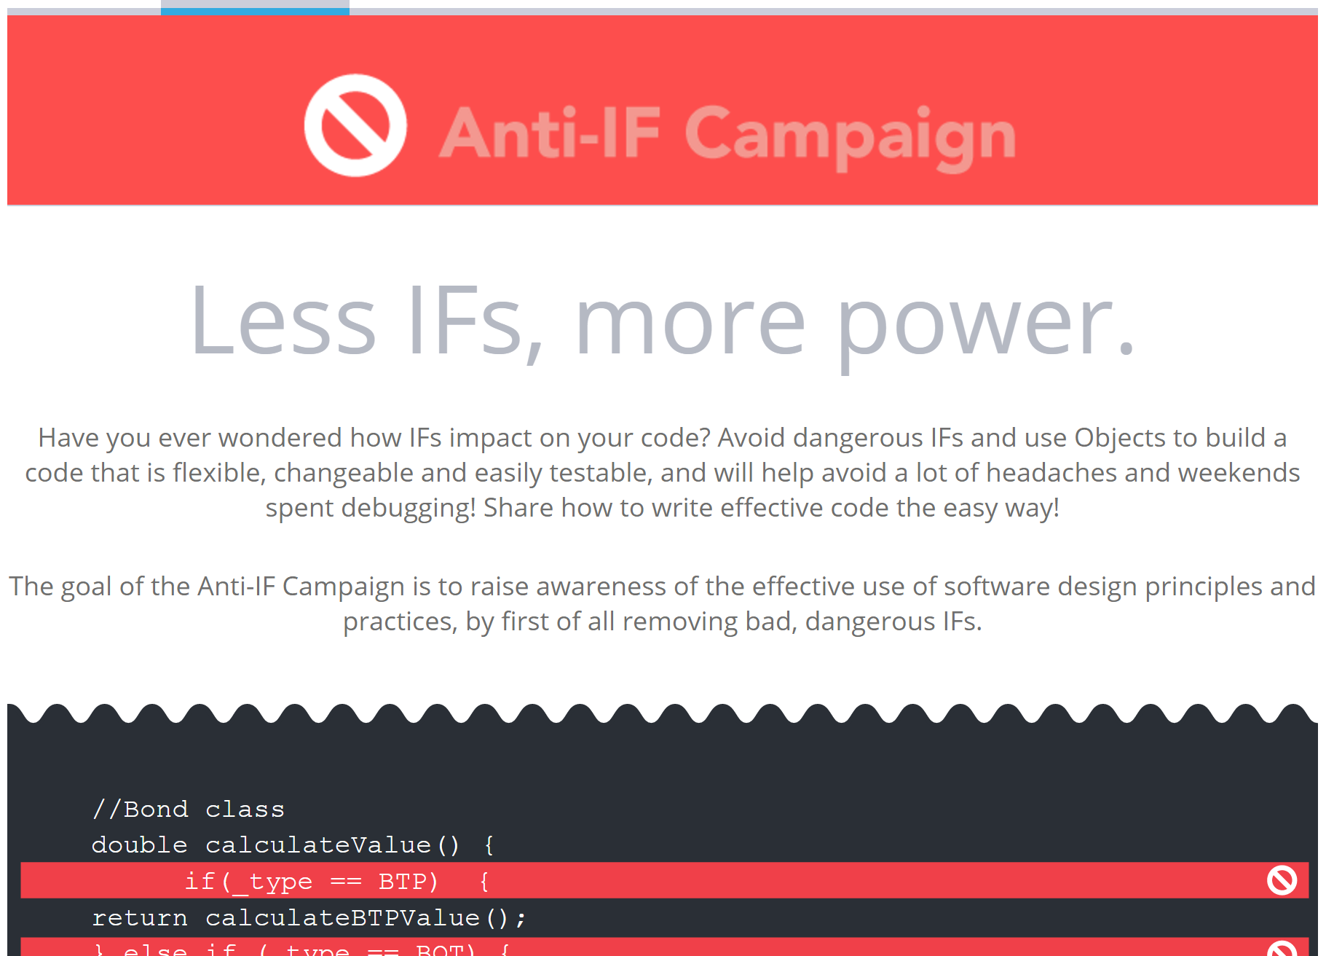

Slide 6
Problematic uses of IF
Too many conditionals
Nested Ifs
Multiple (any?) Else statements
Conditionals over types
Code same apart from conditional
Values hard-coded in conditionals

Slide 7
Alternatives
Declarative/functional style
Polymorphism
High-order functions
Strategy pattern
Dictionaries
?

Slide 8


Exorcise your IFs!

