Slide 1
Chapter 5 Finite State Machine
Dr. Ahmed Abou-Auf

Slide 2
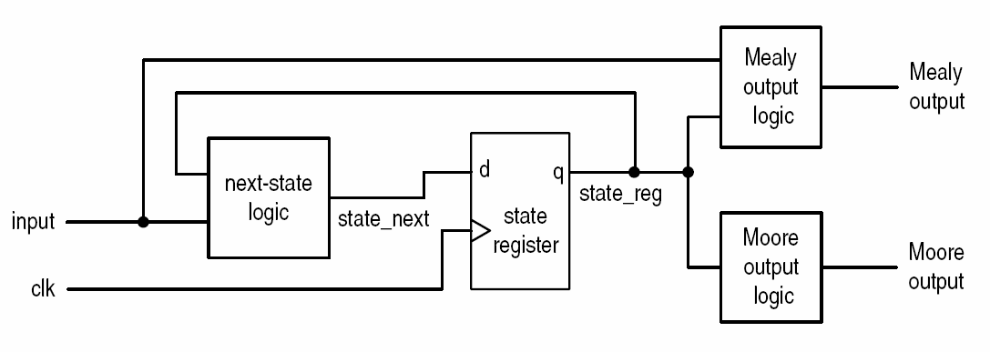
Finite State Machines
It is a synchronous sequential circuits
Contain irregular pattern for next-state logic
Used mainly as a controller in a large system
Mealy vs. Moore output
Moore machine: output is a function of state
Mealy machine: output function of state and input

Slide 3
State Diagram as a Design Tool
States
Each state is presented by a circle or a “bubble”
Transition between states
The machine transits from one state to another when input condition is met
The transition between states is presented by an arrow with logical expression of the inputs that represents the condition
Output
Moore output: inside the state
Mealy output: next to the input condition

Slide 4
Example—Simple Memory Controller
Inputs from FPGA/ASIC logic
reset: async reset
clk: controller and memory clock
mem: indicates memory operation when asserted (logic 1)
rw: 1 read operation, 0 write operation
burst: read 4 locations when asserted (logic 1)
1
Outputs
Output enable: oe (read)
Write enable: we (write)
Mealy output: me_we (write)
Note: address bus and data bus are not part of the memory controller.
Memory
FPGA
mem
Memory Controller
rw
oe
we
burst
clk
reset

Slide 5
Simple Memory Controller—State Diagram
Operations
write, read, read burst
6-state FSM
Idle, write, read1, read2, read3, read4
Inputs
reset, clk, mem, rw, burst
Outputs
Output enable: oe
Write enable: we
Mealy output: me_we

Slide 6
VHDL Implementation of FSM
Implementation Steps
Break the design into the same blocks of the basic FSM model
Infer the state register block
Code the next-state logic according to the state diagram
Code output logic according to the state diagram

Slide 7
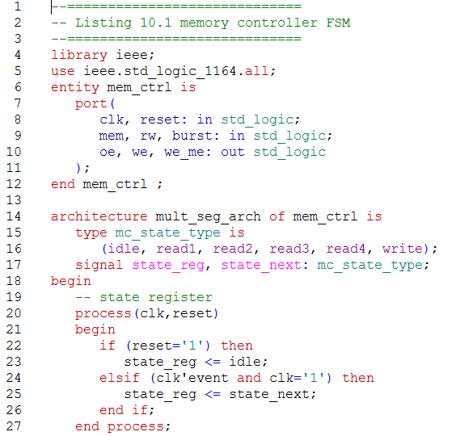
Example—VHDL (4-segment)

Slide 8
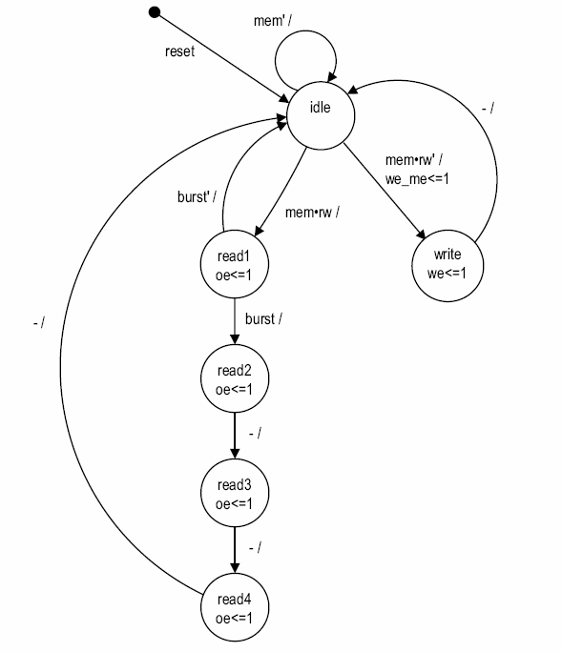
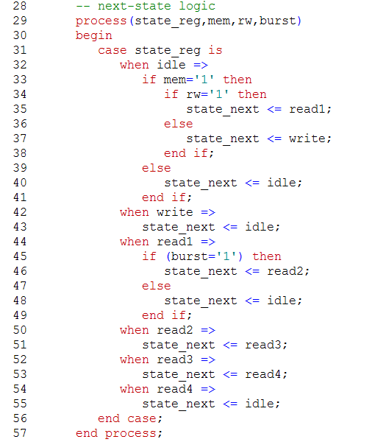
Example—VHDL (4-segment)

Slide 9
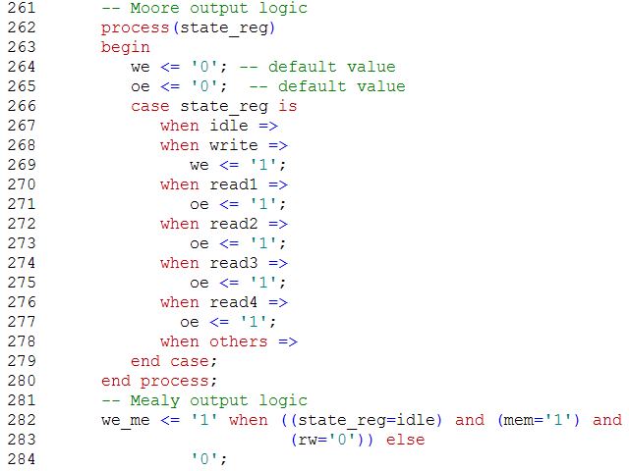
Example—VHDL (4-segment)

Slide 10
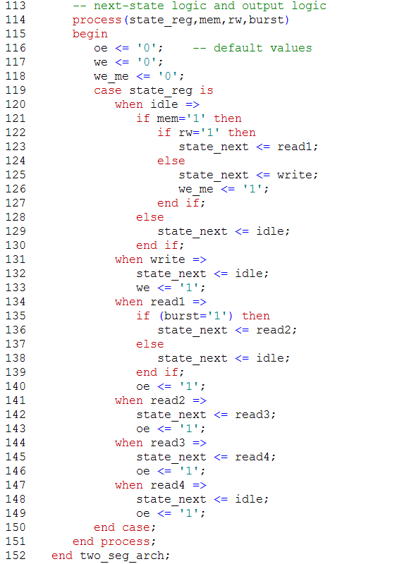
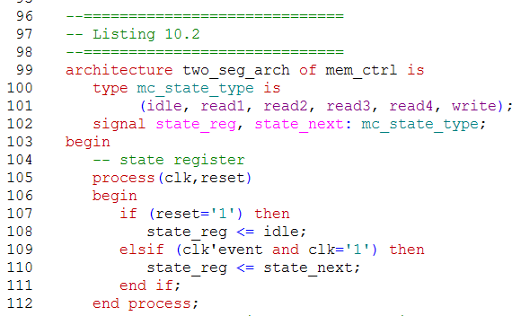
Example—VHDL (2-segment)

Slide 11
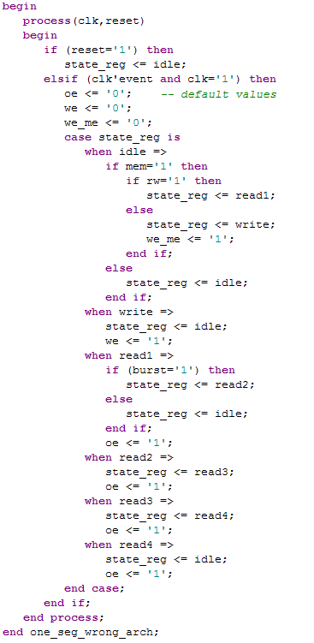
Example—VHDL (1-segment)

Slide 12
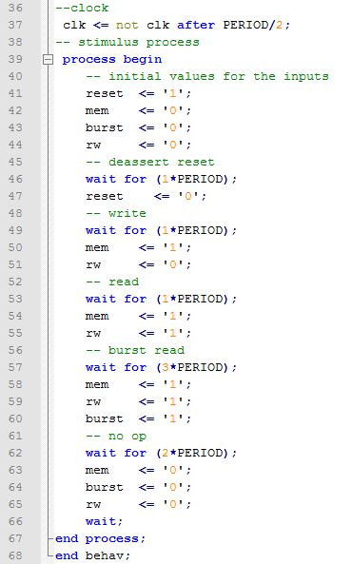
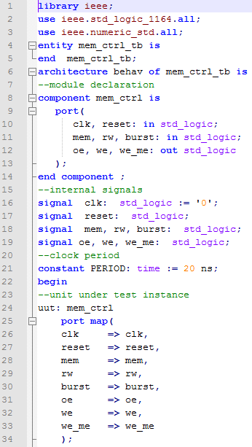
Testbench

Slide 13
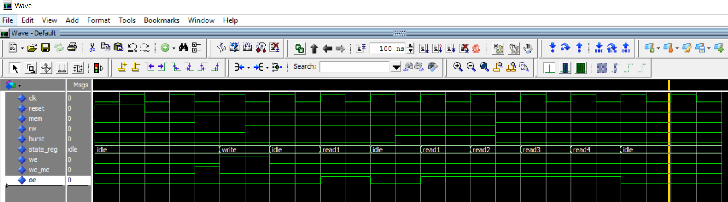
mem_ctrl Simulation

Slide 14
Moore vs Mealy output
Both machines have similar “computation capability”
But?
Mealy uses less states
Mealy more prone to input glitches
E.g., edge detection circuit
A circuit to detect the rising edge of a slow “strobe” input and generate a “short” (about 1-clock period) output pulse
clk
strobe
rise_edge
rising edge detection

Slide 15
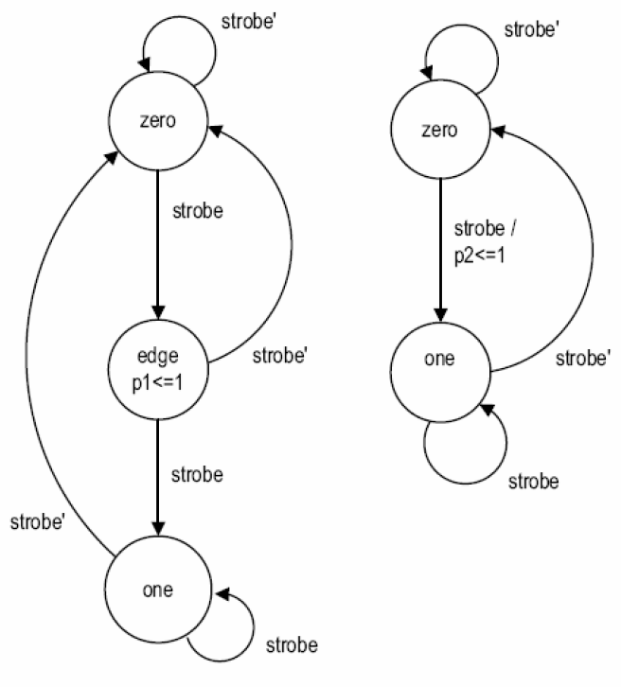
Moore vs Mealy
Mealy FSM
Moore FSM

Slide 16
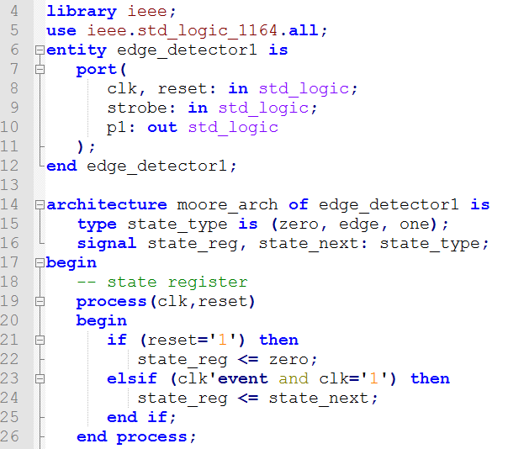
RTL Implementation of the Moore FSM

Slide 17
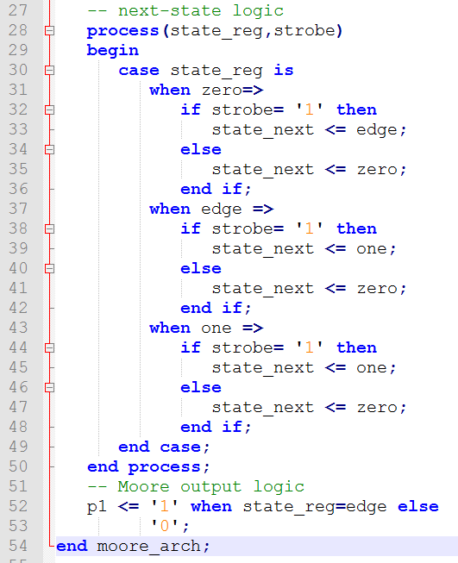
RTL Implementation of the Moore FSM

Slide 18
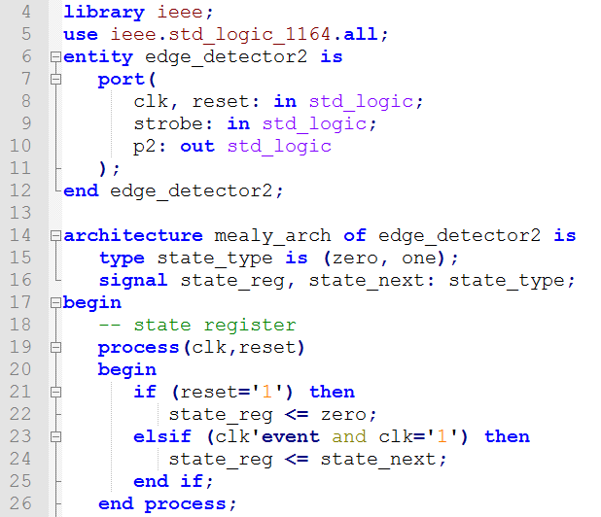
Mealy FSM Edge Detection

Slide 19
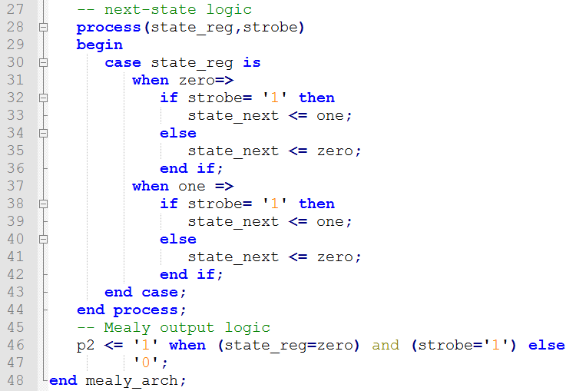
RTL Implementation of the Mealy FSM

Slide 20
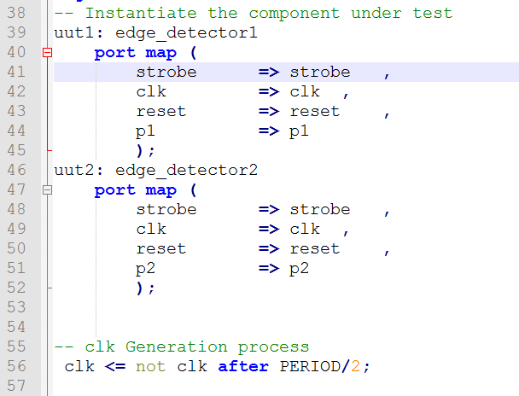
FSM Edge detection testbench

Slide 21
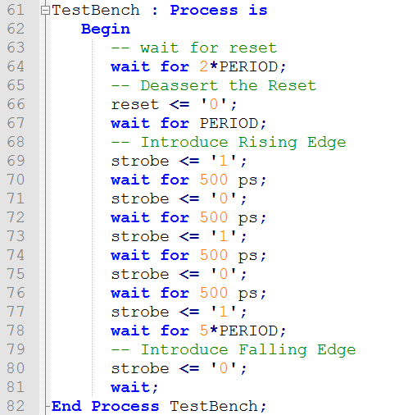
Edge detection testbench

Slide 22
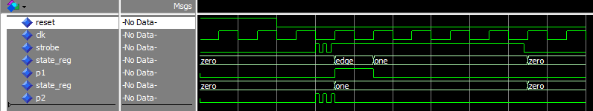
Edge Detector Simulation

Slide 23
Design Practical Edge Detector
clk
strobe
strobe_n
strobe_d
strobe_d_n
rise_edge |  |  |  |  |  |  |  |  |  | strobe | and | strobe_d_n
falling_edge |  |  |  |  |  |  |  |  |  | strobe_n | and | strobe_d
both_edge |  |  |  |  |  |  |  |  |  | strobe | xor | strobe_d

Slide 24
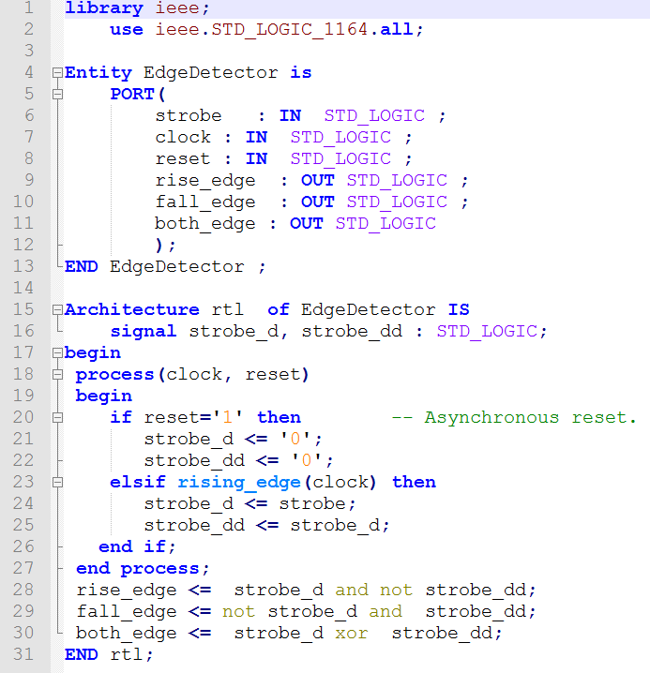
Practical Edge Detector—No FSM
strobe
strobe_d
strobe_dd
d
q
d
q
clock

Slide 25
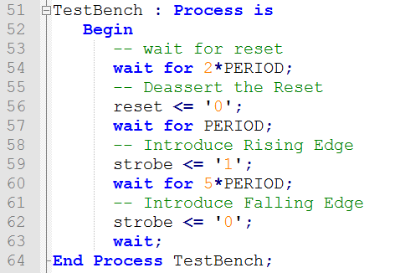
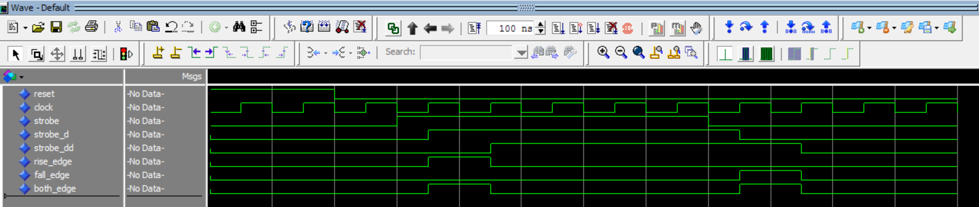
Simulation

Slide 26
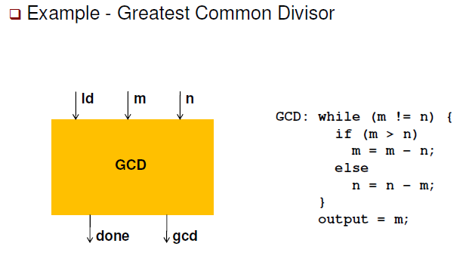
Mixing FSM and Datapath

Slide 27
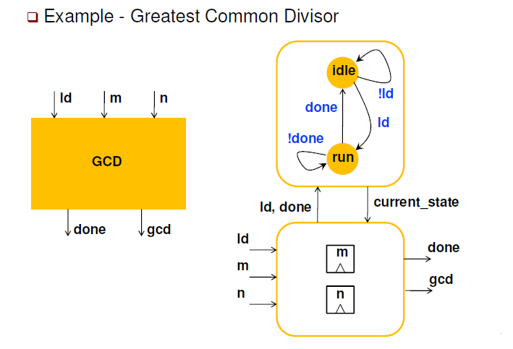
Mixing FSM and Datapath
FSM
Datapath

Slide 28
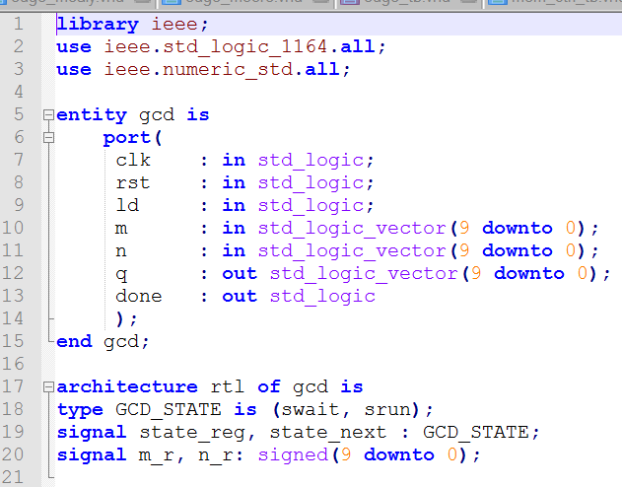
GCD—RTL

Slide 29
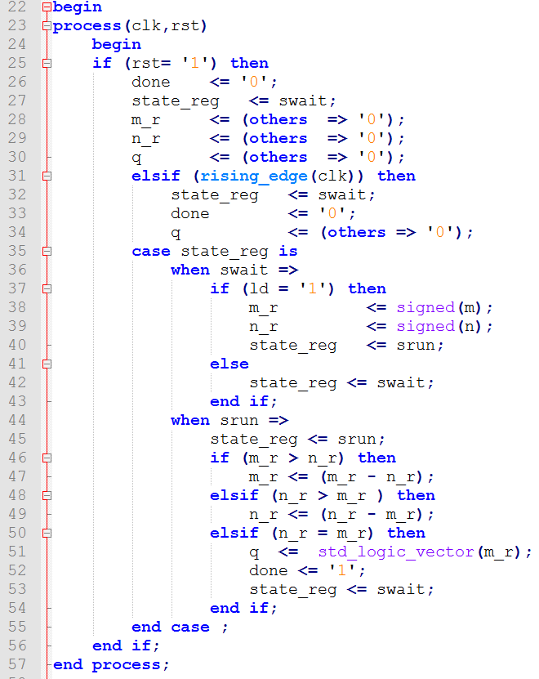
GCD—RTL

Slide 30
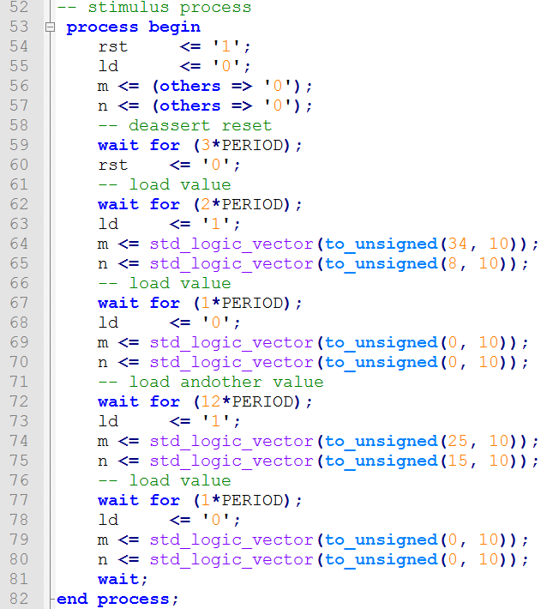
Testbench

Slide 31
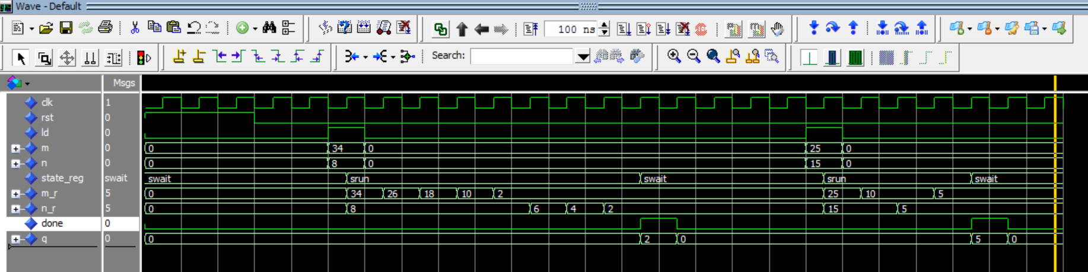
Simulation

Slide 32
State Encoding
State assignment:
assigns binary representations to symbolic states
Good assignment reduce the complexity of next-state/output logic
Typical assignment
Binary, Gray, one-hot, almost one-hot

Slide 33
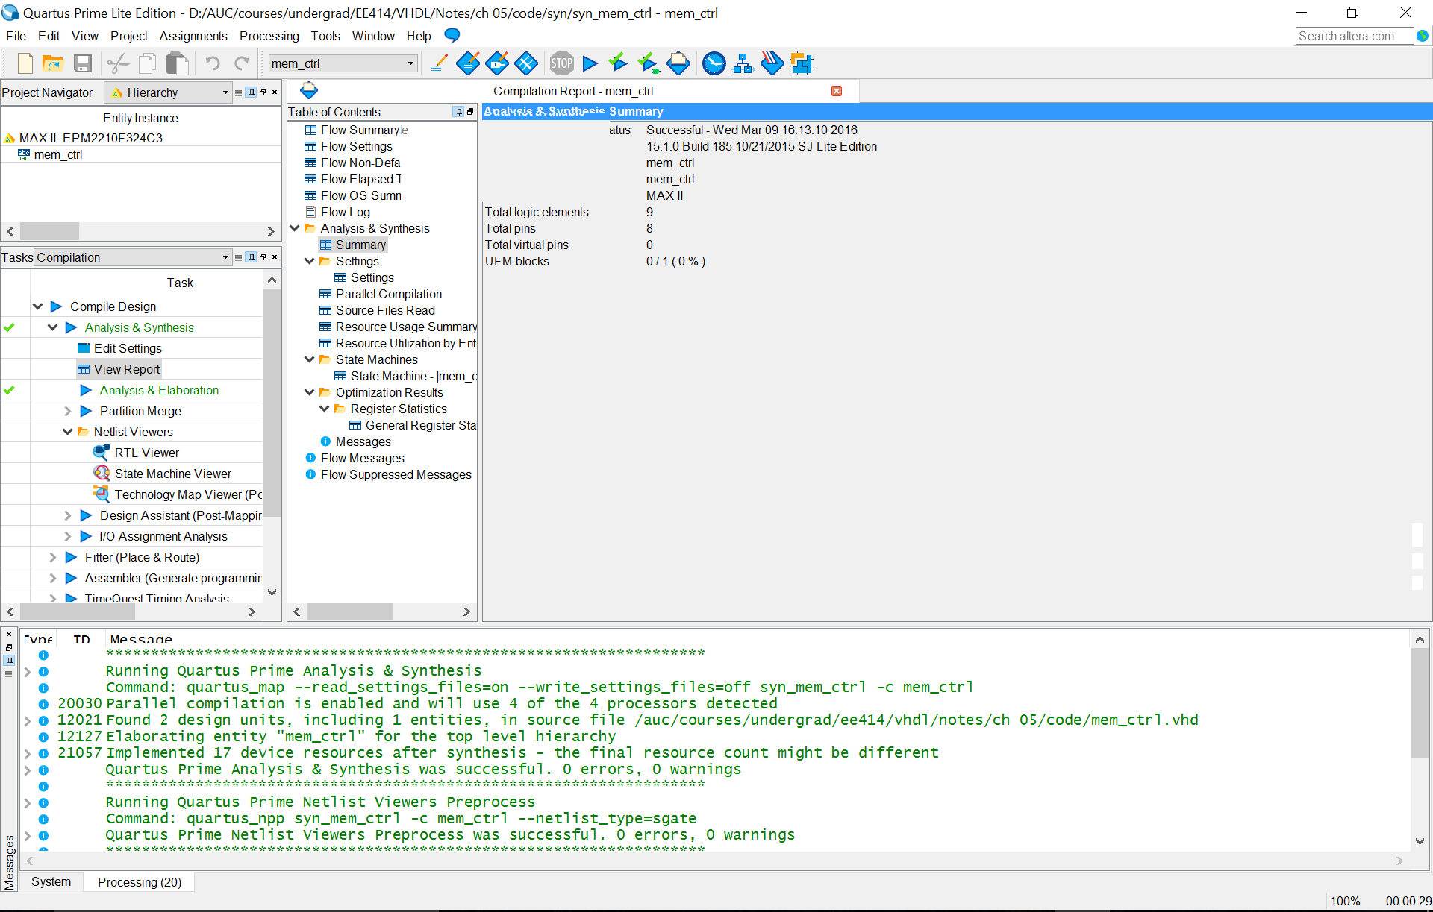
Synthesis mem_ctrl: Altera Quartus II

Slide 34
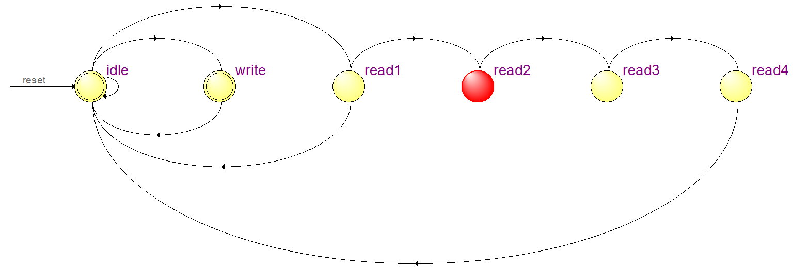
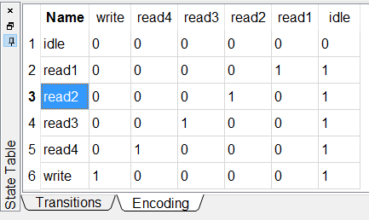
mem_ctrl—state encoding: FSM Viewer

Slide 35
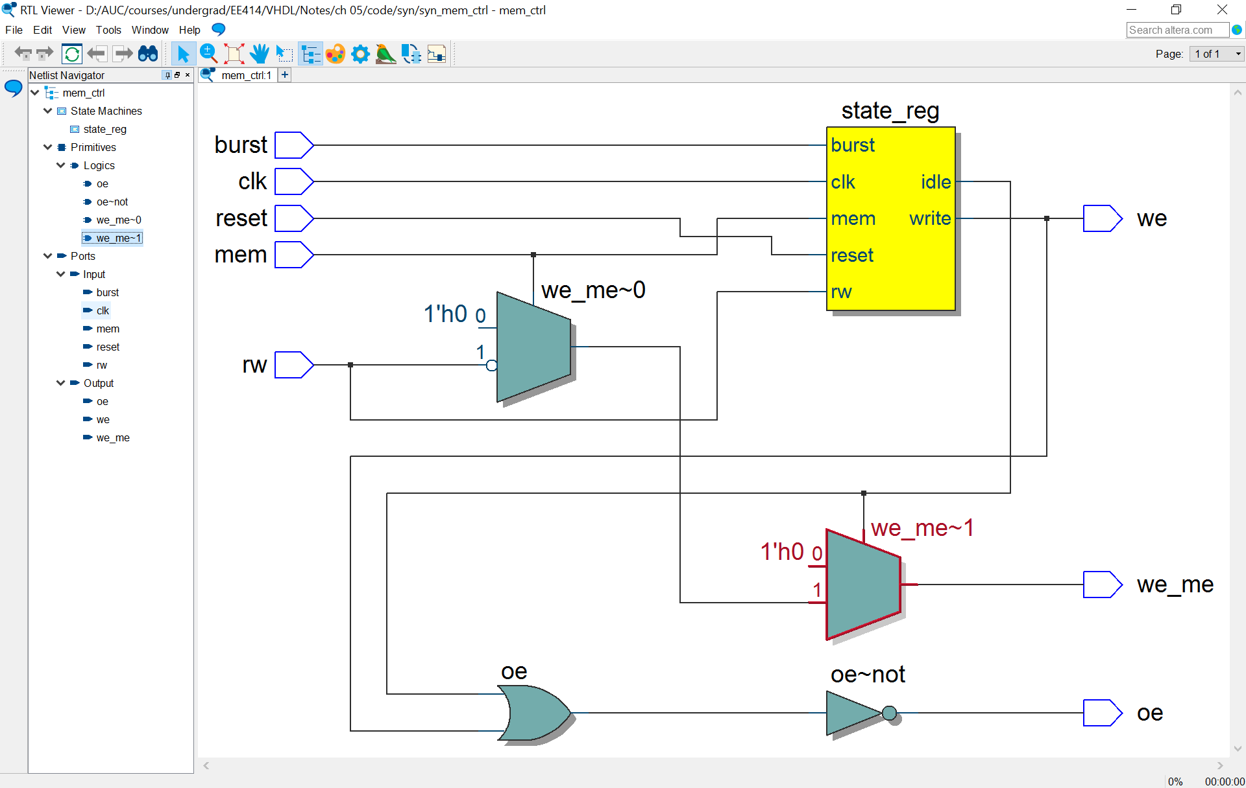
mem_ctrl—state encoding: RTL Viewer

Slide 36
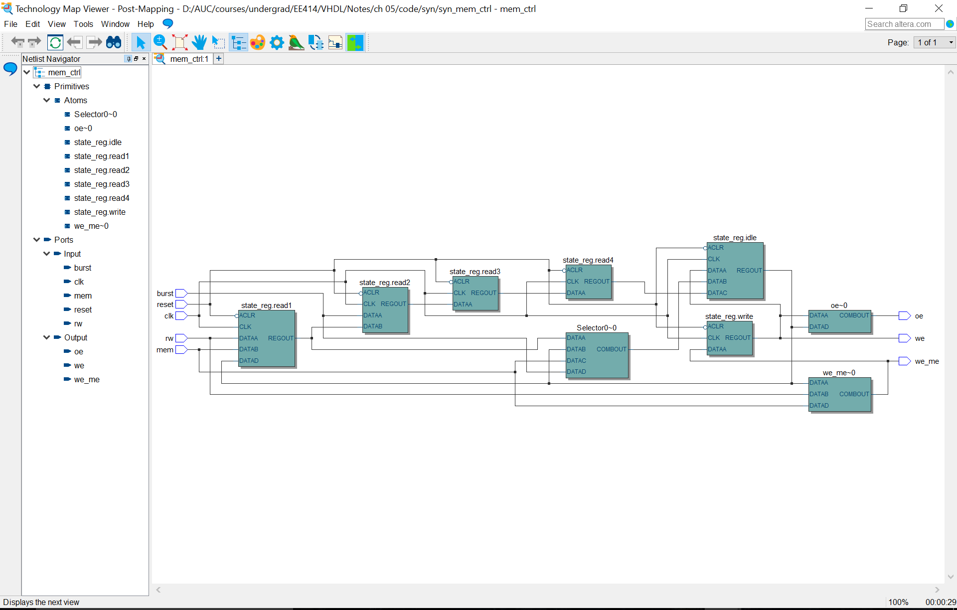
Technology Map Viewer

Slide 37
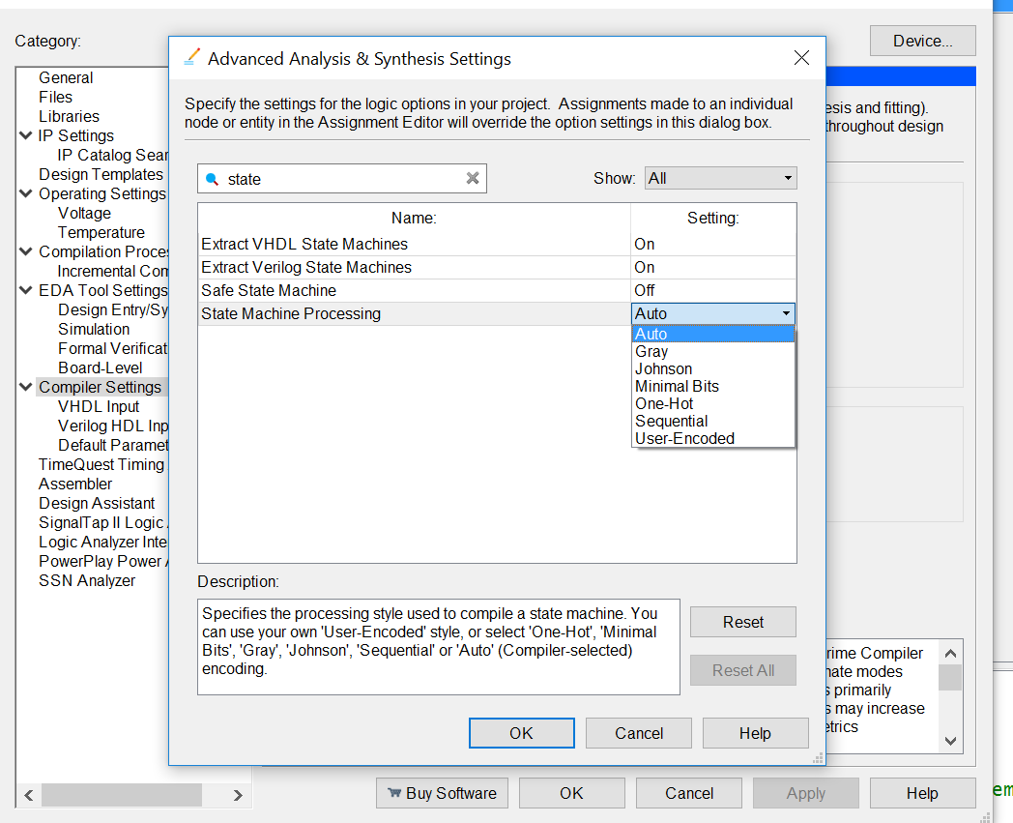
Optimization Options in Synthesis Settings

Slide 38
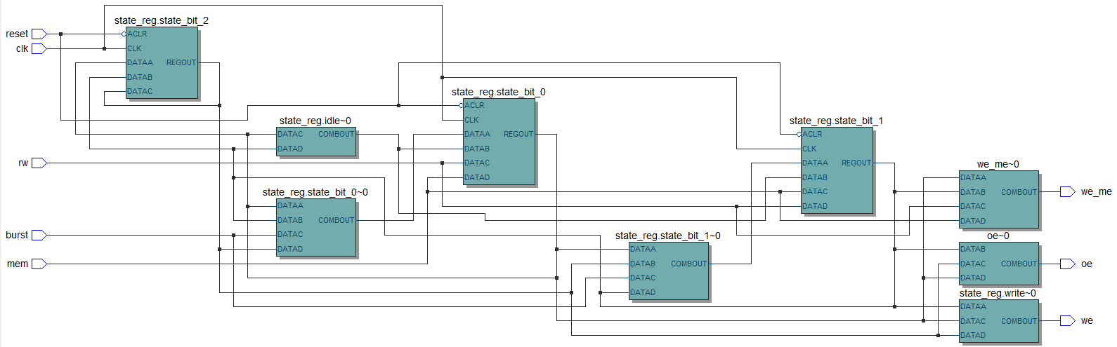
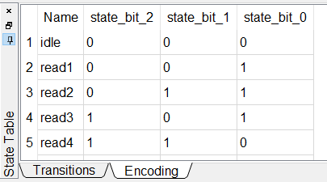
mem_ctrl: state encoding minimum bits

Slide 39
VHDL Synthesis Directives
Synthesis Directives:
VHDL attributes: enum_encoding
Explicit VHDL Assignment
Notes:
Attributes (user-defined)
Formal Definition
A value, function, type, range, signal, or constant that may be associated with one or more named entities in a description.
Simplified Syntax
attribute attribute_name: type; -- attribute declaration
attribute attribute_name of item : item_class is expression; -- attribute specification

Slide 40
Handling the unused state
Problem:
State presentation is not all inclusive—many unused states
If there is no proper handling of the unused state, the FSM can hang up forever.
Solution
Collect the unused states in an “others =>” clause and return to idle state.
Subtlety
The above solution is ok for the explicit state assignment as the unused states are know at the VHDL level
This is not the case for the enumerated states as the unused states are only known after synthesis and the “others=>” will be ignored by VHDL. However, synthesis tools take it into consideration.

Slide 41
Tri-state buffer
Output with “high-impedance”
VHDL description
y <= 'Z' when oe=‘0' else
a_in;
‘Z’ is not a value in Boolean algebra
Can’t be used as input to logical operations
f <= 'Z' and a;
y <= data_a when in_bus='Z' else
data_b;
Major application
Bi-directional I/O pins
Tri-state bus

Slide 42
Tristate Synthesis Issue
Synthesis Problem
with sel select
y <= 'Z' when "00",
'1' when "01"|"11",
'0' when others;
Solution—separate tristate buffer
with sel select
tmp <= '1' when "01"|"11",
'0' when others;
y <= 'Z' when sel="00" else
tmp;

Slide 43
Bi-directional i/o pins—single tristate buffer

Slide 44
Bi-directional i/o pins—double tristate buffer

