Slide 1
Chapter 8 Introduction to Timing Closure
Ahmed Abou-Auf
Fall 2019

Slide 2
Introduction
Problem
In designing ASIC/FPGA synchronous digital designs, from design entry to physical implementation, rarely you achieve the required timing performance of the design without iteration.
You often must go through numerous iterations of the design cycle in order to achieve timing closure :
HDL design entry,
synthesis,
physical implementation (Place and Route) and
Static Timing Analysis

Slide 3
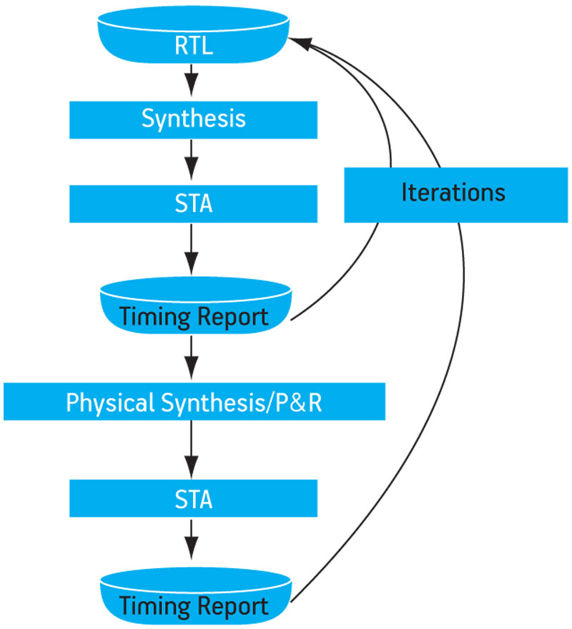
Static Timing Analysis (STA) Flow
Static Timing Analysis (STA) Iterations
The external environment, including the clock definitions, are specified typically using Synopsys Design Constraint (SDC) or an equivalent format. SDC is a timing constraint specification language.
The timing reports are in ASCII form, typically with multiple columns, with each column showing one attribute of the path delay

Slide 4
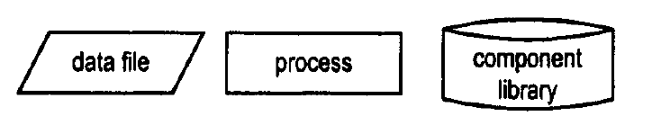
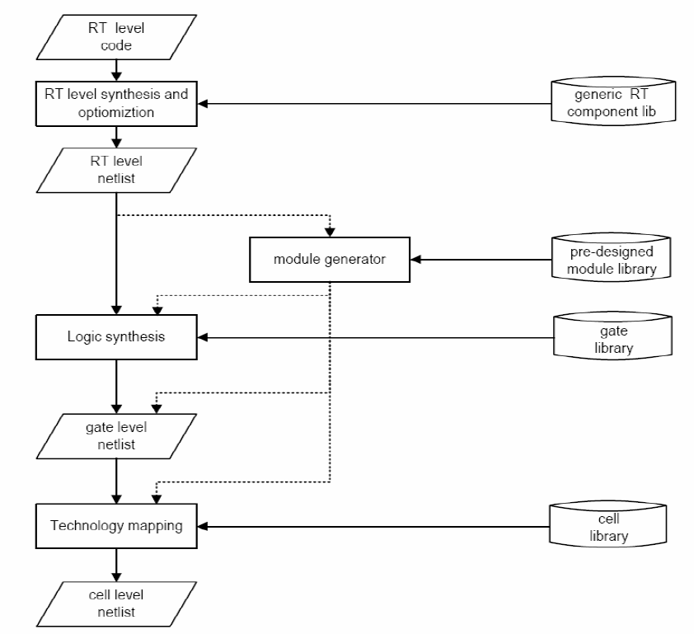
VHDL Synthesis Flow
Synthesis
Realize VHDL code using logic cells from the device’s library
a refinement process
Main steps:
RTL synthesis
Logic Synthesis
Technology Map

Slide 5
RTL Synthesis
RTL Synthesis
Transforms VHDL description into a circuit blocks constructed by components from generic RTL library
Generic components are technology independent
Functional units: Logic, relational, arithmetic operators
Routing units: multiplexers
Storage units: flip-flops and latches
Limited optimization to reduce circuit complexity
Operator sharing
Common code elimination

Slide 6
Operator Sharing
Example 1
Original code:
r <= a+b when boolean_exp else a+c;
Synthesis optimization:
src0 <= b when boolean_exp else c;
r <= a + src0;
Example 2
Original code:
process(a,b,c,d,...)
begin
if boolean_exp_1 then
r <= a+b;
elsif boolean_exp_2 then
r <= a+c;
else
r <= d+1;
end if
end process;
Synthesis optimization :
process(a,b,c,d,...)
begin
if boolean_exp_1 then
src0 <= a;
src1 <= b;
elsif boolean_exp_2 then
src0 <= a;
src1 <= c;
else
src0 <= d;
src1 <= "00000001";
end if;
end process;
r <= src0 + src1;
Summary
Sharing is done by additional routing circuit
Merit of sharing depends on the complexity of the operator and the routing circuit

Slide 7
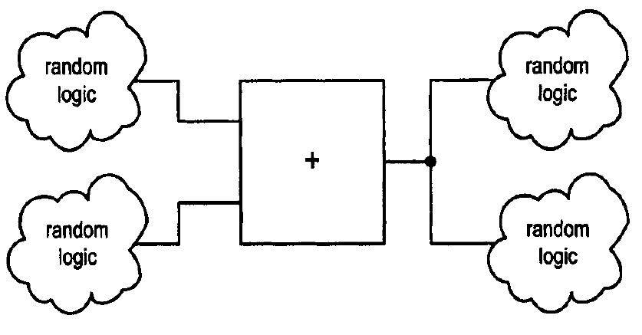
RTL Synthesis (cont.)
Module generator
Random logic can be taken to directly to gate-level synthesis
“Regular” logic such as adders, subtractors, incrementors/ decrementors, shifter, multipliers can be replaced by predesigned module
Regular logic circuits are pre-designed module is more efficient
Module can be generated in different levels of details
Reduce the processing time

Slide 8
Logic Synthesis
Realize the circuit with the optimal number of “generic” gate level components (inv, and, nand, or, nor, etc.)
Technology independent gates
no information about the size and propagation delay
Two categories:
Two-level synthesis: sum-of-product format (high-fan out and fan in)
Multi-level synthesis: several degree of freedom, more efficient. Implementation can exploited for size and/or speed

Slide 9
Technology Mapping
Map “generic” gates to “device-dependent” logic cells
Logic cells are defined by function and physical parameters: size, delay, input/output
Standard cell libraries for ASIC
Category | ADK 3.1 Cells
Basic Logic Gates | and02, and03, and03, or02, or03, or04, nand02, nand02_2x, nand03, nand03_2x, nand03_2x, nand04, nand04_2x, nor02, nor02_2x, nor02ii, nor03, nor03_2x, nor04, nor04_2x, xnor2, xnor2_2x, xor2, xor2_2x, mux21, mux21_ni, hadd1, fadd1, buf02, buf04, buf08, buf12, buf16, inv01, inv02, inv04, inv08, inv12, inv16, tri01, trib04, trib08
AND-OR | ao21, ao22, ao221, ao32, ao32, aoi22, aoi221, aoi222, aoi32, aoi321, aoi322, aoi33, aoi332, aoi333, aoi422, aoi43, aoi44,
OR-AND-INV | oai21, oai22, oai221, oai222, oai32, oai321, oai322, oai33, oai332, oai333, oai422, oai43, oai44,
Flip-Flops/Latches | dff, dffr, dffs, dffs_ni, dffsr, dffsr_ni, latch, latchr, latchs, latchs_ni, latchsr, latchsr_ni, sff, sffr, sffr_ni, sffs, sffsr, sffsr_ni,
Pads | PadInC, PadOut, PadBidirHE

Slide 10
Static Timing Analysis
Static Timing Analysis
Static timing analysis is a method of validating the timing performance of a design by checking all possible paths for timing violations without having to simulate. No vector generation is required, no functionality check is done.
The way STA is performed on a given design:
Design is broken down into sets of timing paths,
Calculates the signal propagation delay along each path
And checks for violations of timing constraints inside the design and at the input/output interface.
key concepts in STA method:
timing path,
actual time,
required time (specified by timing constraints),
slack (difference between required and actual) and
critical path (a timing path that is most likey to cause timing failure.)

Slide 11
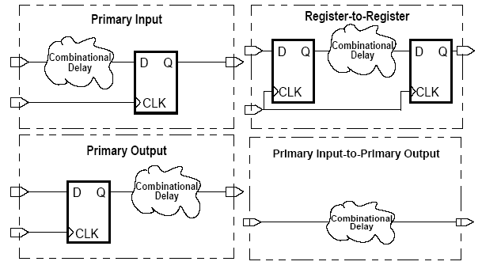
Data Paths
From a primary input pin to data input of a flip flop
From output of a flip-flop to a data input of a flip-flop
From a data output of a flip-flop to a primary output pin
From a primary input pin to a primary output pin

Slide 12
Clock Period
The clock period has to accommodate the delay in the critical path

Slide 13
Setup Slack
The critical path of the setup slack corresponds to maximum propagation delay and minimum slack. Negative slack means timing violation and failure.

Slide 14
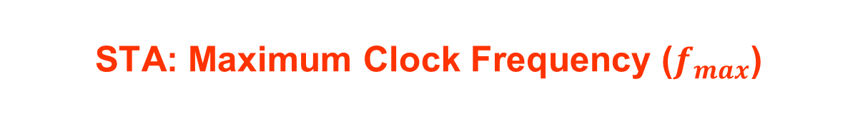
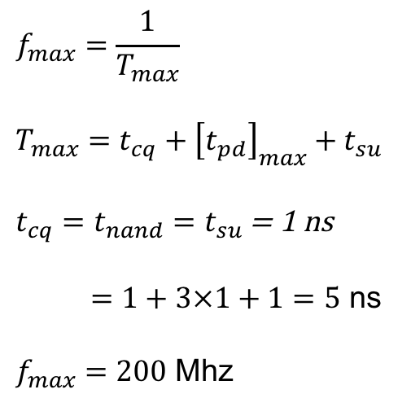
STA: Maximum Clock Frequency ($f_{max}$)
Computing fmax is a basic function of a timing analyzer. Fmax is the highest frequency for which the circuit will produce a correct output.
$$f_{max}=\frac{1}{T_{max}}$$
$$T_{max}=t_{cq}+{\left[t_{pd}\right]}_{max}+t_{su}$$
$t_{cq}=t_{nand}=t_{su}$ = 1 ns
$=1+3×1+1=5$ ns
$f_{max}=200$ Mhz

Slide 15
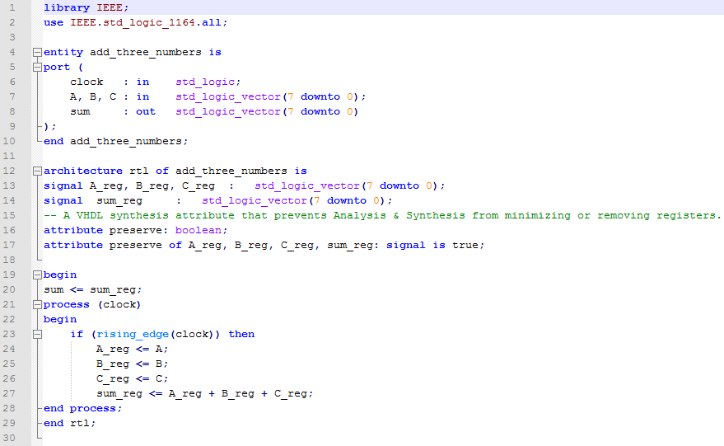

Maximum Clock Frequency ($f_{max}$)

Slide 16
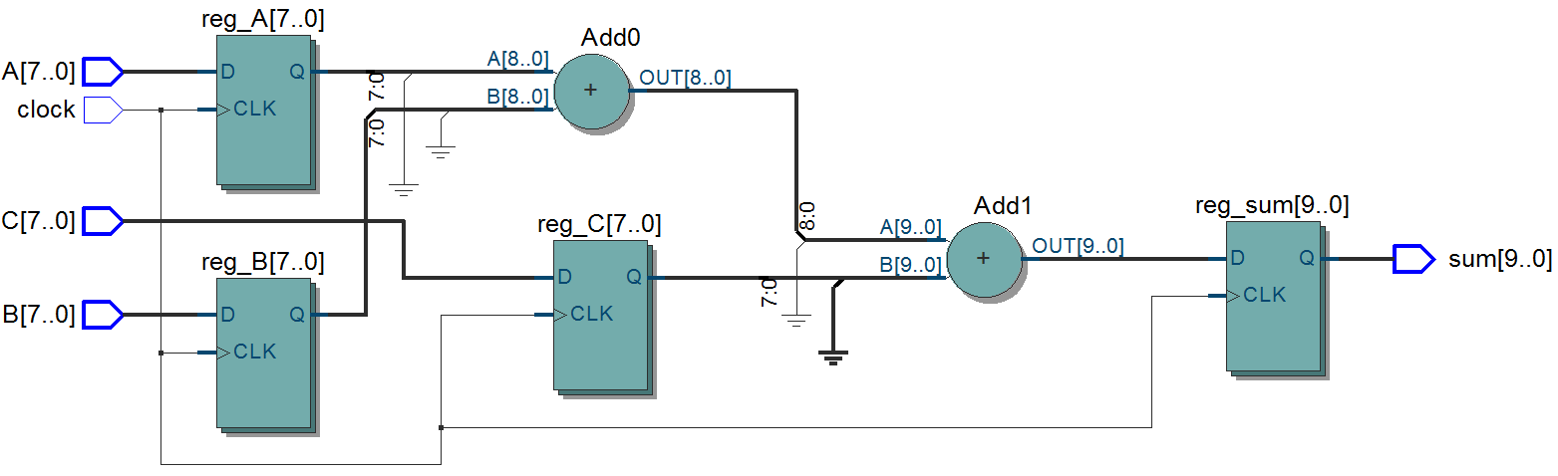



Maximum Clock Frequency ($F_{max}$)
Unconstrained design.
Post-synthesis RTL View netlist for add_three_numbers example
$F_{max}$ timing report
Notes:
The maximum clock frequency that can be achieved without violating internal setup (t_{SU}) and hold (t_{H}) time requirements. Unrestricted f_{MAX} is the maximum frequency at which a design can run. Restricted f_{MAX} is the maximum frequency a design can run considering device limits, such as maximum toggle rates.

Slide 17
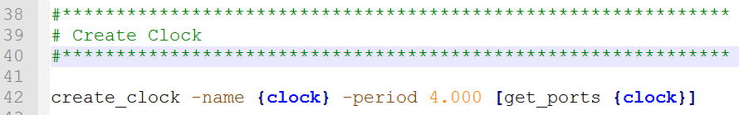
Constraining the design
250 MHz

Slide 18
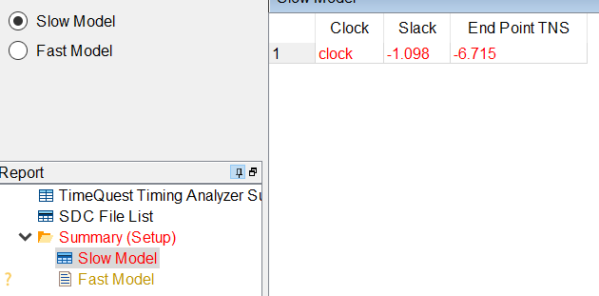
Timing report
Timing violation

Slide 19
Solving Timing Closure—Pipelining
f_{MAX} =
n MHz
D
Q
two logic levels
D
Q
f_{MAX} ≈
2n MHz
one level
one level
D
Q
D
Q
D
Q
Notes:
Inserting flip-flops into a datapath is called pipelining.
Pipelining increases performance by reducing the number of logic levels (LUTs) between flip-flops.
All Xilinx FPGA device families support pipelining. The basic slice structure is a logic level (six-input LUT) followed by a flip-flop.
Adding a pipeline stage, as shown in this example, will not exactly double f_{MAX}. The flip-flop that is added to the circuit has an input setup time and a clock-to-Q time that make the pipelined circuit run at less than double the original frequency.
You will see a more detailed example of increasing performance by pipelining later in this section.

Slide 20
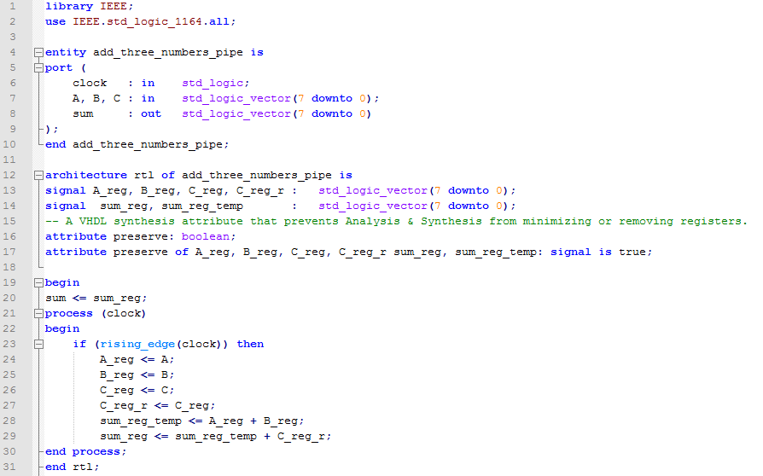
Modify RTL--Pipelined

Slide 21
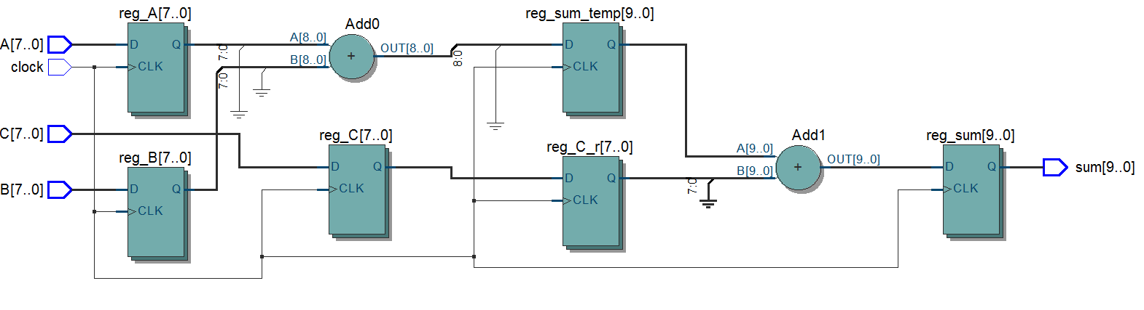
Modified RTL—Post Synthesis
Post-synthesis RTL View netlist for add_three_numbers_pipe example

Slide 22
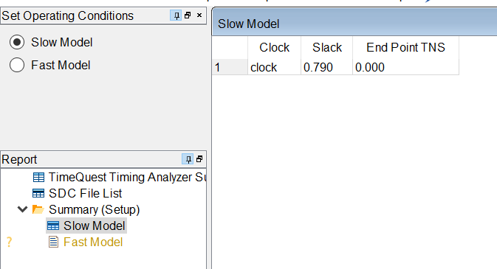
Timing report
+ve slack
Timing met

Slide 23

Hold Slack
The critical path of the hold slack corresponds to minimum propagation delay. Negative slack means timing violation and failure.
$${slack}_{h}=actual −required$$

Slide 24
Three-Step Process for Timing Closure
Constrain your design
Always use timing constraints, even when your timing objective is modest
Over-constraining gets you nothing, but costs extra PAR time. Unrealistic timing constraints will cause the tools to stop.
Timing Reports
Your synthesis tool’s timing report and the Post-Map Static Timing Report contain performance estimates
Both will tell you if your constraints are realistic
Timing Closure
After implementing, review the Post-Place & Route Static Timing Report to determine if your objectives were met
If your constraints failed, use the Timing Report to determine the cause
Notes:
Timing constraints should be used to define your performance objectives. Tight timing constraints will increase your compile time. Unrealistic constraints will cause the implementation tools to stop.
Use the Synthesis Report or the Post-Map Static Timing Report to determine whether your constraints are realistic.
After implementing, review the Post-Place & Route Static Timing Report to determine whether your performance objectives were met. If constraints were not met, use the Timing Report to determine the cause.
You can learn more about interpreting Timing Reports in the “Timing Closure” module in the Designing for Performance course.

Slide 25
History of Timing Constraints
Timing constraints were introduced in the early 1990s.
These were mainly used for specifying design characteristics that could not be captured in the HDL and were used to drive synthesis tools, Synopsys Design Compiler.
When Synopsys PrimeTime incorporated the concept of Tcl, these constraints were modified to be an extension of the Tcl format.
This set was called SDC or Synopsys Design Constraints.
SDC
SDC commands are based on “Tool Command Language” (Tcl).
SDC an extension to Tcl, tool-specific commands can be intermixed with native Tcl constructs like variable, expressions, statements, and subroutines, making it a very powerful language for implementation tools.
Today most implementation and STA tools use SDC as the standard format for capturing design intent for area, power, and performance.

Slide 26
create a clock constraint

Slide 27
Constraining Input Paths
Figure shows an input path of the design under analysis (DUA). Flip- flop UFF0 is external to the design and provides data to the flip-flop UFF1 which is internal to the design. The data is connected through the input port INP1.
The clock definition for CLKA specifies the clock period, which is the total amount of time available between the two flip-flops UFF0 and UFF1.
The time taken by the external logic is Tclk2q, the CK to Q delay of the launch flip-flop UFF0, plus Tc1, the delay through the external combinational logic.
Thus, the delay specification on an input pin INP1 defines an external delay of Tclk2q plus Tc1. This delay is specified with respect to a clock, CLKA in this example.
set Tclk2q 0.9 set Tc1 0.6 set_input_delay -clock CLKA -max [expr Tclk2q + Tc1] \
[get_ports INP1]

Slide 28
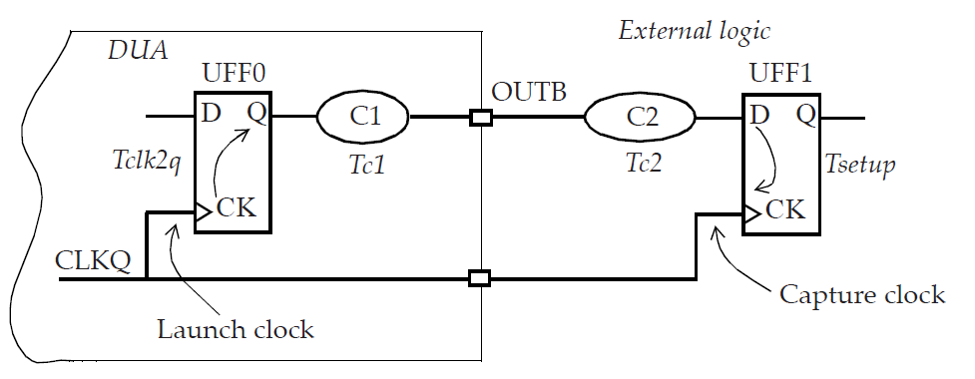
Constraining Output Paths
Tc1 and Tc2 are the delays through the combinational logic.
The period for the clock CLKQ defines the total available time between the flip-flops UFF0 and UFF1.
The external logic has a total delay of Tc2 plus Tsetup. This total delay, Tc2 + Tsetup, has to be specified as part of the output delay specification.
Thus,
set Tsetup 1.1 set Tc2 3.9 set_output_delay -clock CLKQ –max [expr Tc2 + Tsetup] \
[[get_ports OUTB]

Slide 29
Timing Exceptions
So far we saw how you can constrain your clocks and ports to specify the timing
requirements for the design. However, even after setting these global requirements,
designers would want to make certain exclusions for certain paths. This may be
done to specify certain unique requirements on the paths or provide additional scope
for leniency. Such constraints are referred to as timing exceptions . There are three
kinds of timing exceptions:
False paths – These are paths that don’t need to meet any timing requirements. Implementation tools ignore timing on such paths when constrained.
Multi cycle paths – These are paths that need more than one cycle to propagate data. Implementation tools relax timing on such paths.
Min and max delay – These are paths with specific maximum and minimum delay requirements and specified when designers want to override inferred setup and hold requirements.

Slide 30
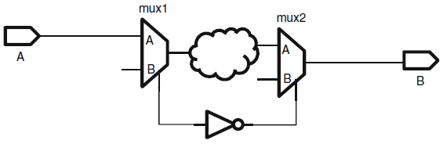
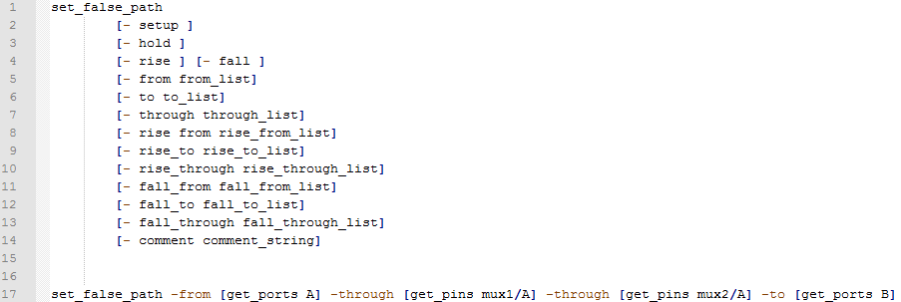
Exceptions: set_false_path
By timing all the paths in the circuit the timing analyzer can determine all the critical paths in the circuit.
However, the circuit may have false paths, which are the paths in the circuit which are never exercised during normal circuit operation for any set of inputs.
STA (Static Timing Analysis) tools are able to identify simple false paths; however they are not able to identify all the false paths and sometimes report false paths as critical paths. Removal of false paths makes circuit testable and its timing performance predictable (sometimes faster)

Slide 31
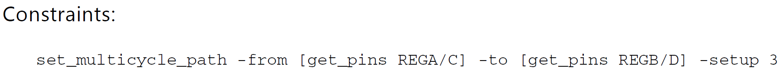
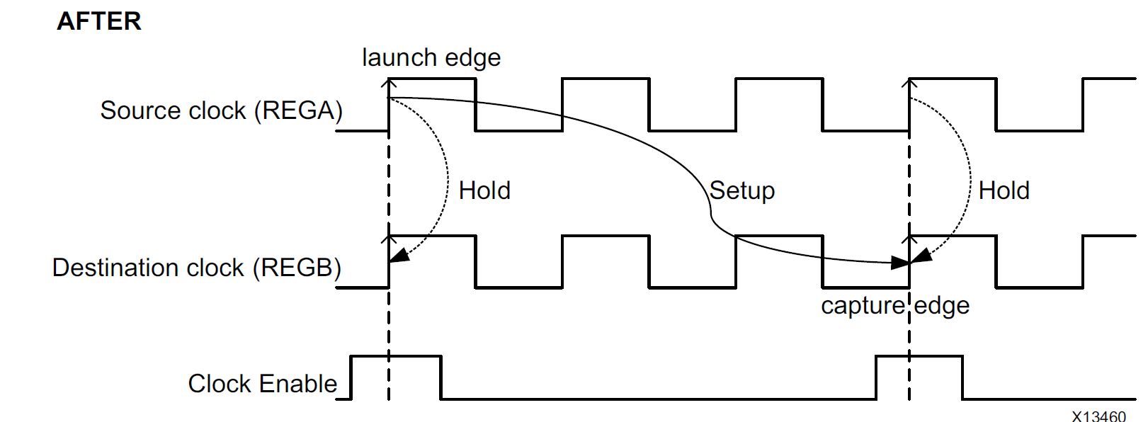
Exceptions: set_multicycle_path

Slide 32
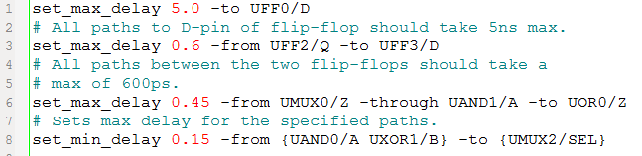
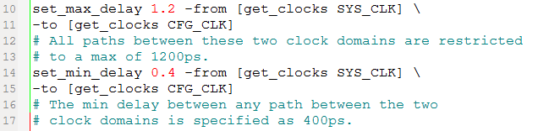
Min and max delay
Point-to-point paths can be constrained by using the
set_min_delay and
set_max_delay
This constraint overrides any default single cycle timing paths and any multicycle path constraints for such paths.
One can also specify similar point-to-point constraints from one clock to another clock.

Slide 33
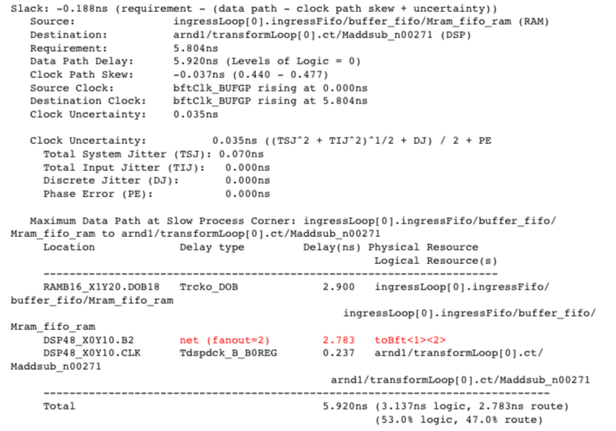
Timing Closure: Case 1 (Issue)

Slide 34
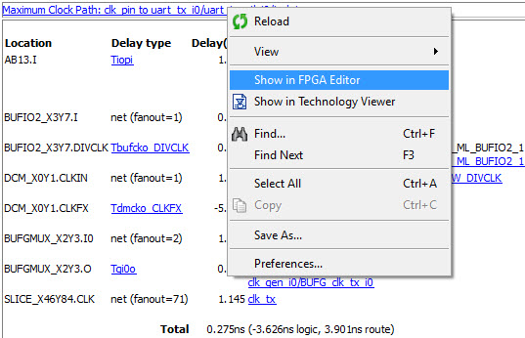
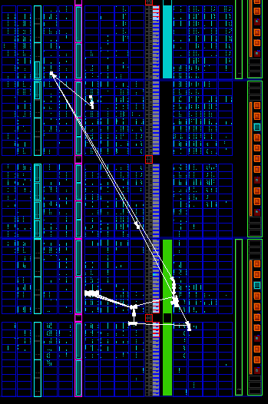
Cross-Probing
Shows the placement of logic in a delay path
Right-click on the delay path to see this option
The FPGA Editor view is used for seeing the actual placement and routing used
The Technology view shows logical path through components
Notes:
This enables you to quickly view the placement of logic in critical paths.
With the OFFSET IN/OUT constraint you can probe both the data and clock paths.

Slide 35
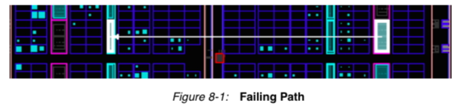
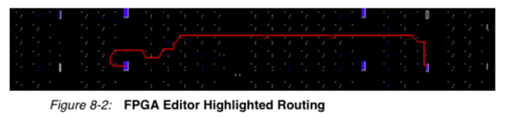
Case 1: Cause
Probable Cause
The Timing Report shows that the only variable in the path is the route between the RAM and DSP. This confirms that placement is most likely the issue with this failing path.
Viewing Path

Slide 36
Timing Closure: Case 1 (Solutions)
To achieve timing closure, place the DSP and RAM on the same side of the device:
Layout Constraint: Create physical location constraints (LOC) for the DSP and RAM so the instances have a LOC constraint applied in order to achieve timing closure.
Layout Constraint: Create AREA GROUP constraints to lock logic to a specific area of a clock region.
Synthesis: Apply a set_max_delay constrain on the path between the RAM and DSP, giving it a higher precedence than the create_clock constraint.
RTL Change: Pipeline the logic between the RAM and DSP blocks to give the placer tool maximum flexibility in timing closure for the full design.

Slide 37
Timing Closure: Case 2 (Issue)
Data Path: source to dest
Delay type Delay(ns) Logical Resource(s)
---------------------------- -------------------
Tcko 0.290 source
net (fanout=7) 0.125 net_1
Tilo 0.060 lut_1
net (fanout=187) 2.500 net_2
Tilo 0.060 lut_2
net (fanout=1) 0.174 net_3
Tilo 0.060 lut_3
net (fanout=1) 0.204 net_4
Tdick 0.300 dest
---------------------------- ------------------------------
Total 3.773ns (0.770ns logic, 3.003ns route)
(20.0% logic, 80.0% route)
This path is constrained to 3 ns
What is the primary cause of the timing failure?

Slide 38
Timing Closure: Case 2 (Solution)
Resolving a Path with High Fanout
Synthesis: Duplicate the driver, instruct the synthesis tool not to remove the duplicate logic (synthesis global constraint MAX_FANOUT).
RTL: add a global buffer to the high fanout signal.
Notes:
For more information about duplicating flip-flops, see the “FPGA Design Techniques” module.

Slide 39
Timing Closure: Case 3 (Issue)
Data Path: source to dest
Delay type Delay(ns) Logical Resource(s)
---------------------------- -------------------
Tcko 0.290 source
net (fanout=7) 0.521 net_1
Tilo 0.060 lut_1
net (fanout=1) 0.280 net_2
Tilo 0.060 lut_2
net (fanout=1) 0.223 net_3
Tilo 0.060 lut_3
net (fanout=1) 0.223 net_4
Tilo 0.060 lut_4
net (fanout=1) 0.310 net_5
Tilo 0.060 lut_5
net (fanout=1) 0.233 net_6
Tilo 0.060 lut_6
net (fanout=1) 0.308 net_7
Tdick 0.300 dest
---------------------------- --------------------------------------
Total 3.048ns (0.950ns logic, 2.098ns route)
(31.2% logic, 68.8% route)
This path is also constrained to 3 ns
There are no really long delays, but there are a lot of logic levels

Slide 40
Timing Closure: Case 3 (Solution)
Use Proper RTL Coding
Implement synchronous design techniques
Use case statements for large decoding
Avoid nested if-then-else statements
Do not create internally generated clocks except though DCM or PLL
Make sure that internally created resets are synchronous
Use only one edge of the clock.
Cross-clock domains via synchronization circuits.
Register top-level inputs and outputs for fastest performance and increased pin-locking capability
Use hierarchy to separate functionality and clock domains.
Employ pipelining for critical paths.
Comment your code to highlight Multi-Cycle paths and critical paths

