Slide 1
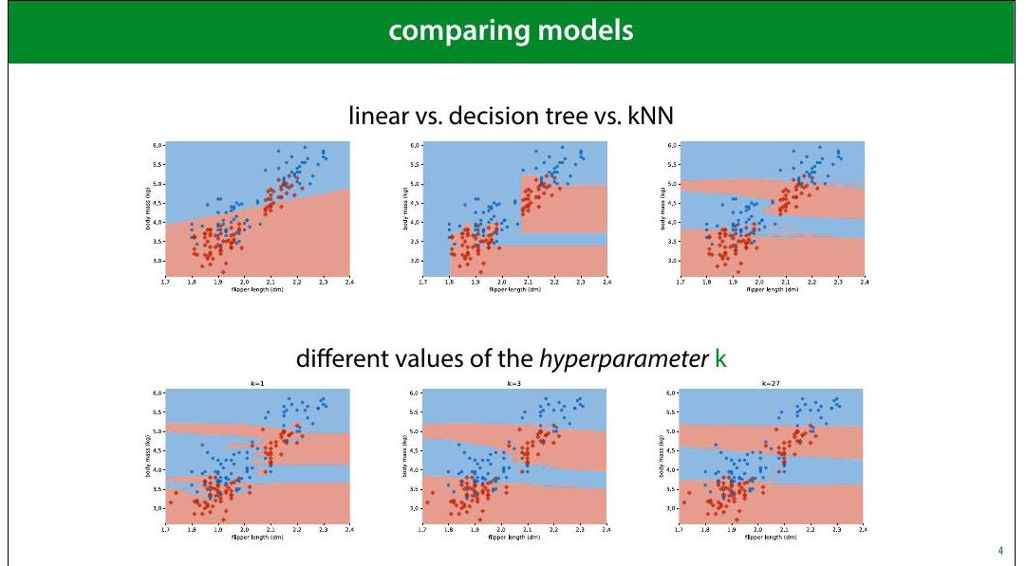
Notes:
You compare models to 8igure out which is the best.
Ultimately, to choose which model you want to use in
production.
This could be literally the production version of a piece of
software, or just the model whose predictions you decide to
use in the future.
Sometimes you are comparing different model types (a
decision tree vs a linear model), but you might also be
comparing different ways of con8iguring the same model
type. For instance in the kNN classi8ier, how many
neighbours (k) should we look at to determine our
classi8ication?
With the 2D dataset, we can look at the decision boundary,
and make a visual judgment. Usually, that’s not the case: our
feature space will have hundreds of dimensions, and we’ll
need to measure the performance of a model.

Slide 2
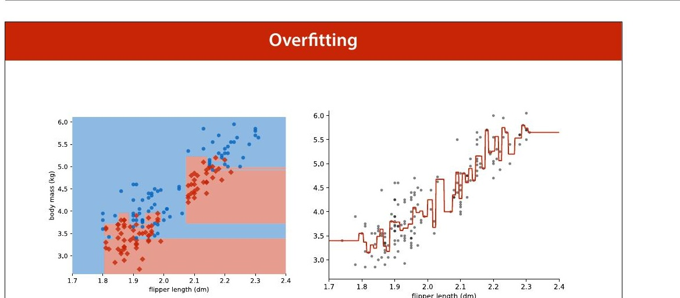
Notes:
We’ve already seen what happens when you evaluate on the
training data. A model that 8its the training data perfectly
may not be much use when it comes to data you haven't
seen before.

Slide 3
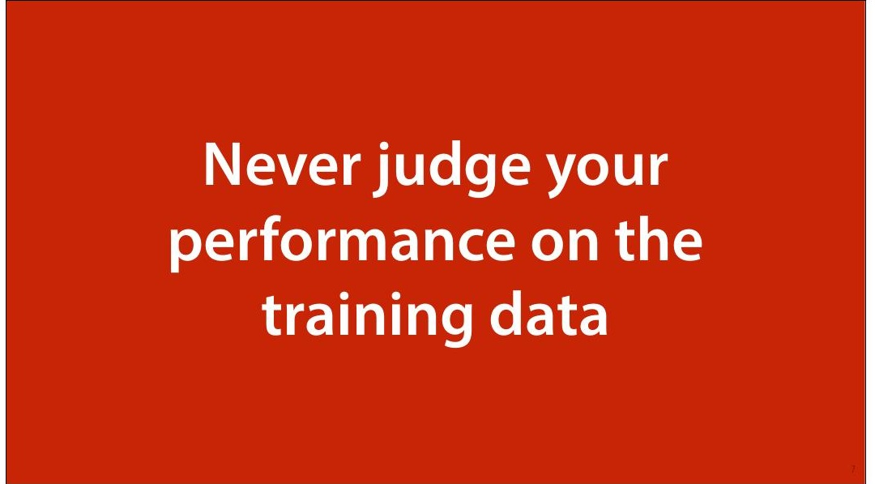

Slide 4
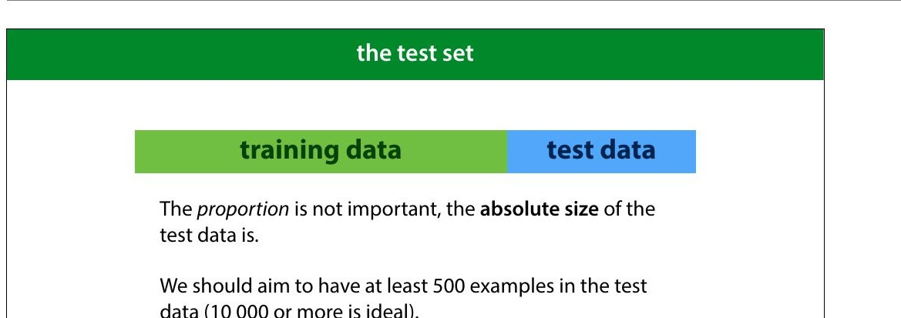
Notes:
So the 8irst thing we do in machine learning is withhold
some data. We train our classi8iers on the training data and
test on the test data. That way, if we get good performance,
we know that we’re likely to get a good performance on
future data as well, and we haven’t just memorised random
8luctuations in the training data.
How should we split our data? The most important factor is
the size in instances of the test data. The bigger this
number, the more precise our estimate of our model’s error.
Ideally, we separate 10 000 test instances, and use
whatever we have left over as training data. Unfortunately,
this is not always realistic. We’ll look at this a little more
later.

Slide 5
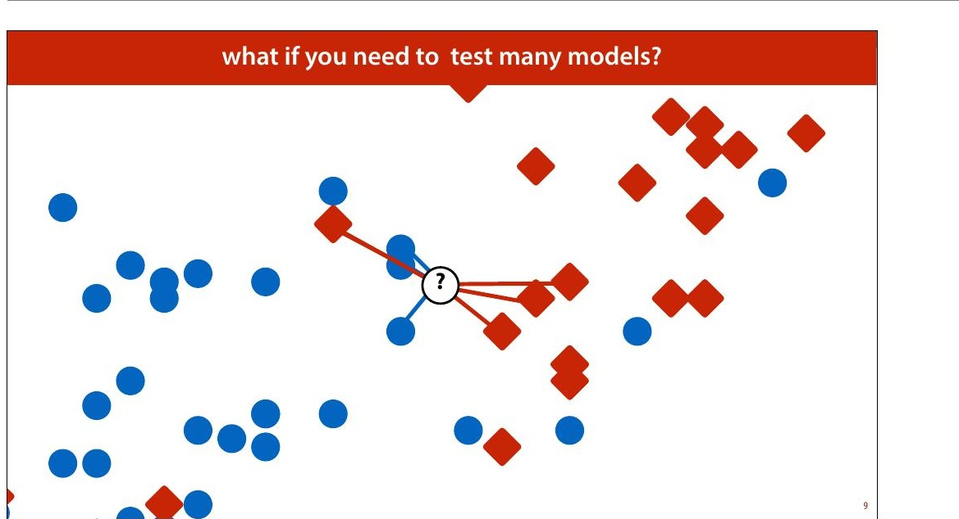
Notes:
But even if we withhold some test data, we can still go
wrong. We’ll use k nearest neighbours (kNN) as a running
example. Remember, kNN assigns the class of the k nearest
points.
k is what is called a hyperparameter. We need to choose
its value in some way before we run the algorithm. The
algorithm doesn't specify how it should be chosen. One way
of choosing k is to try a few values, and to see for which k
we get the best performance.

Slide 6
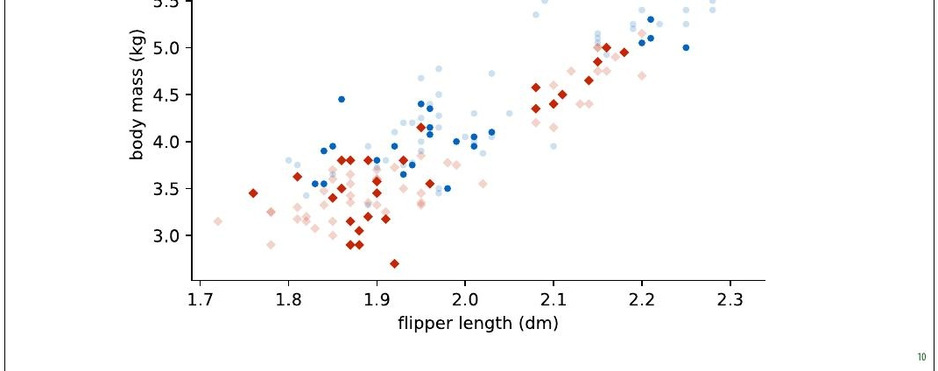
Notes:
We will use the data from the 8irst lecture as an example.
We will take a small subsample of the dataset, so that the
effects that we want to illustrate become exaggerated.

Slide 7
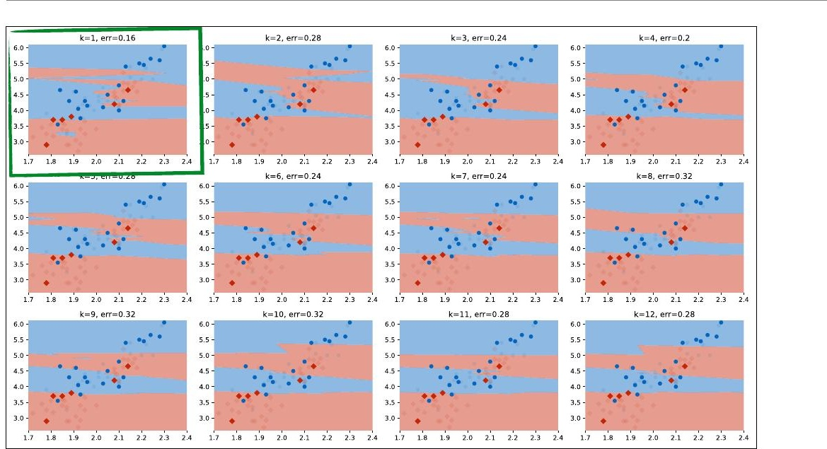
Notes:
Here we’ve tested 12 different values of k on the same test
data (using quite a small test set to illustrate the idea). We
can see that for k=1, we get the best performance. We
plotted the test data (with the training data in low opacity).

Slide 8
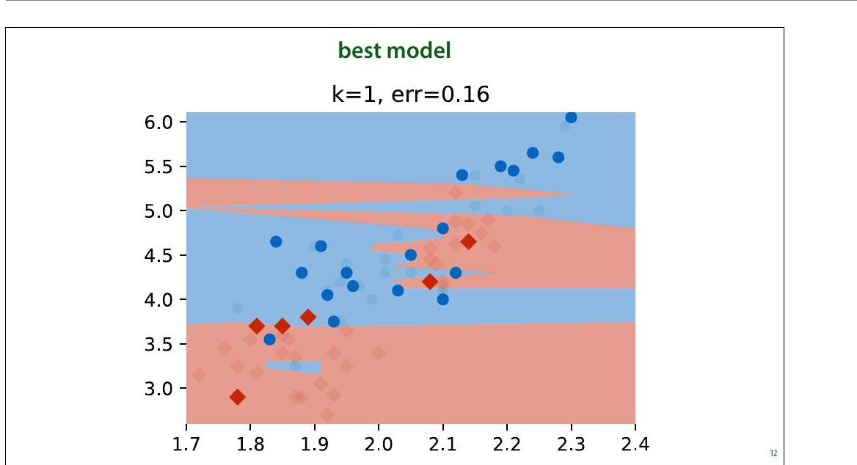
Notes:
Here is the best run. Should we conclude that k=1 is
de8initely a better setting than k=2 or k=3? Should we
conclude that we can expect an error of 0.16 on any future
data from the same source?

Slide 9
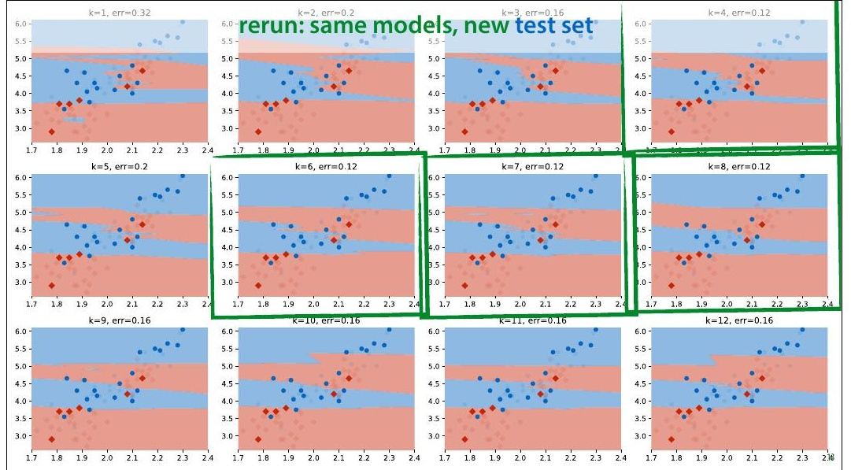
Notes:
In this case, we have some more data from the same source,
so we can evaluate the classi8iers again on a fresh test set.
This is a luxury we don't normally have (we normally use all
the data we are given).
What we see is that k=1 no longer gives us the best
performance. In fact, we get a radically different best value
of k, and k=1 now gives us the highest error in the run.

Slide 10
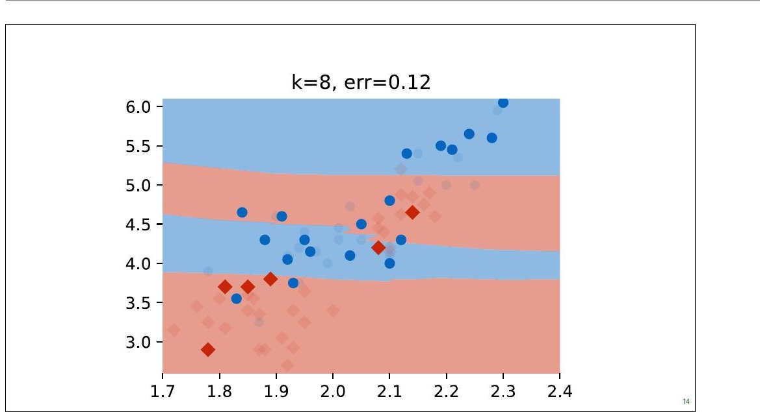
Notes:
Here is one of the the new best runs.

Slide 11
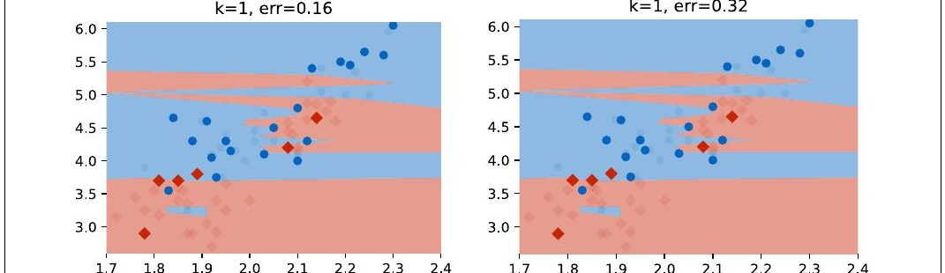
Notes:
The same models, different test sets and the conclusions are
entirely different. We were diligent in splitting our dataset
and evaluating only on withheld data, and yet if we had
done only one run on one dataset, as we normally would,
we would have concluded that k=1 is the best setting and
that an error of 0.16 can be expected with that value.
If we look at the k=1 model from the second run (the one
we chose), we will see that the performance on the new test
set is terrible. If we select a model in this way and take it
into production, we will 8ind that it performs terribly.
So what's happening here?

Slide 12
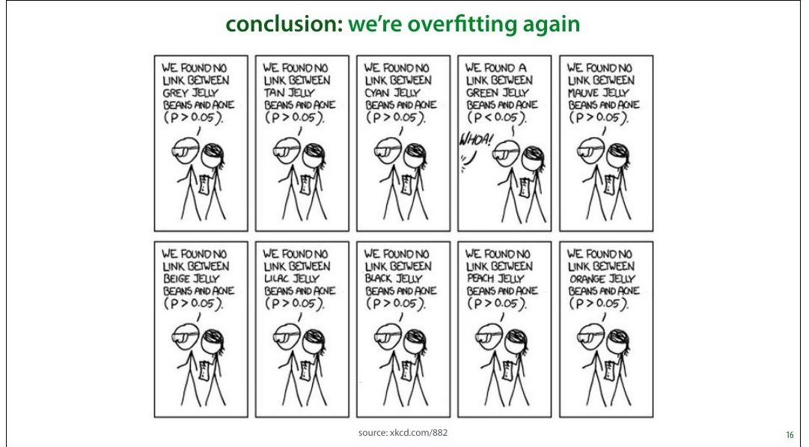
Notes:
This is essentially the over8itting problem again. Our
method of choosing the hyperparameter k is just another
learning algorithm. By testing so many values of k on such a
small amount of test data, we are over8itting our choice of k
on the test data. The model we choose 8its well because of
random 8luctuations in the data. When we resample the
data, these 8luctuations disappear and the performance
drops.
This is an instance of the multiple testing problem in
statistics. We’re testing so many things, that the likelihood
of a noticeable effect popping up by chance increases. We
are in danger of ascribing meaning to random 8luctuations.
Speci8ically, in our case, the k=1 classi8ier got lucky on a
few examples, that just happened to fall on the right side of
the decision boundary. If we draw some new data, the same
classi8ier won't be lucky again. The more different values of
k we try, the more we are in danger of this kind of random
luck determining which hyperparameters come out as

Slide 13
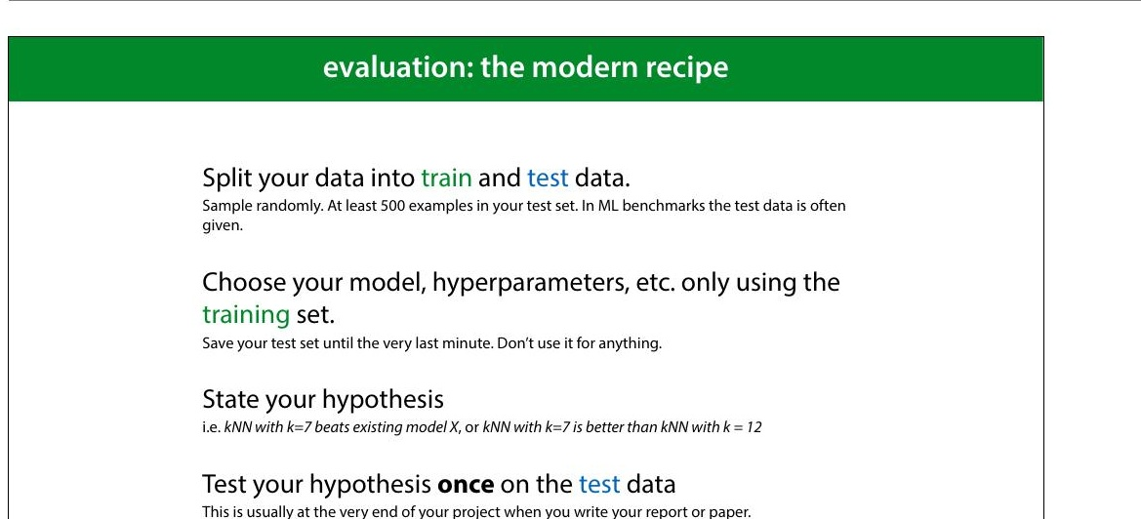
Notes:
There are many different approaches to machine learning
experimentation, and not every paper you see will follow
this approach, but this is the most common one.
It’s important to mention in your paper that you followed
this approach, since the reader can’t usually see it from the
presented results.

Slide 14
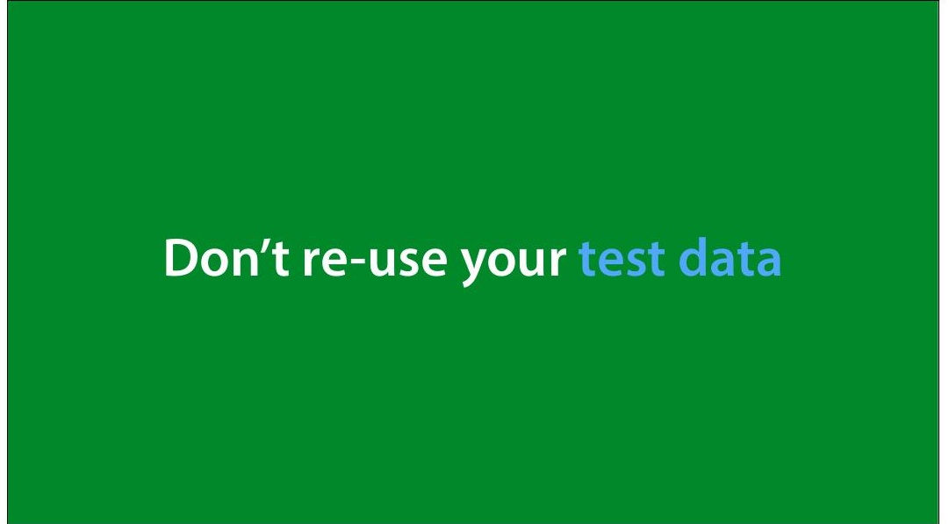
Notes:
Just to emphasize the important point: the more you use
the test data, the less reliable your conclusions become.
Figure out what the end of your project is, and do not touch
the test data until the end.
In really important and long-term projects, it’s not a bad
idea to withhold multiple test sets. This allows you to still
test your conclusions in case you’ve ended up using the
original test data too often.

Slide 15
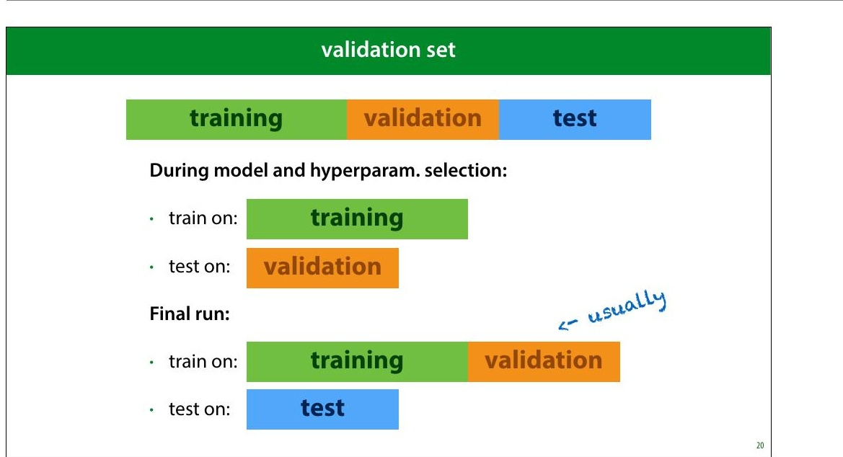
Notes:
This means that you need to test which model to use, which
hyperparameters to give it, and how to extract your
features only on the training data. In order not to evaluate
on the training data for these evaluations, you usually split
the training data again: into a (new) training set and a
validation set.
Ideally, your validation data is the same size as your test set,
but you can make it a little smaller to get some more
training data.
This means that you need to carefully plan your research
process. If you start out with just a single split and keep
testing on the same test data, there’s no going back (you
can’t unsee your test data). And usually, you don’t have the
means to gather some new dataset.
It’s usually 8ine in the 8inal run to append the validation
data to your training data. This is not always the case
however, so if you use a standard benchmark you should
check if this is allowed, and if you use your own dataset, you
should describe carefully whether you do this.

Slide 16
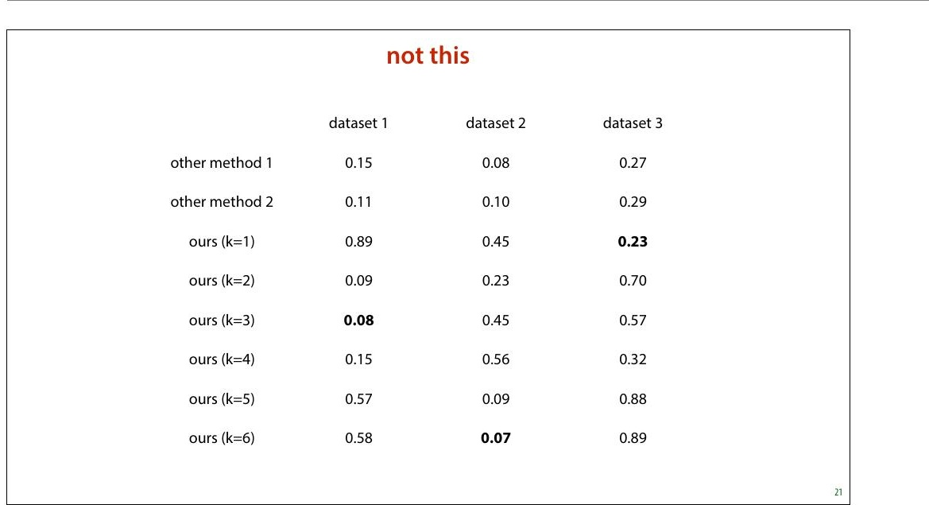
Notes:
This may seem like a simple principle to follow, but it goes
wrong a lot. Not just in student papers, also in published
research.
Here’s what you might come across in a bad machine
learning paper. In this (8ictional) example, the authors are
introducing a new method (labeled ours) which has a
hyperparameter k. They are claiming that their model beats
every baseline, because their numbers are higher (for
speci8ic hyperparameters).
These numbers create three impressions that are not
actually validated by this experiment:
That the authors have a better model than the two other •
methods shown.
That if you want to run the model on dataset 1, you •
should use k=3
That if you have data like dataset 1, you can then expect •
an error of 0.08.

Slide 17
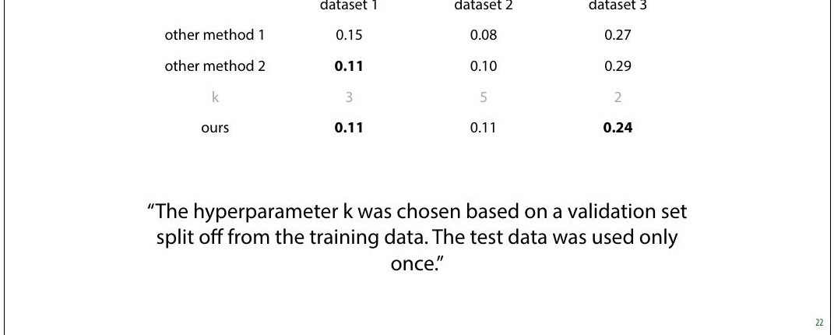
Notes:
Here is what we should do instead. We should use the
training data (with validation withheld) to select our
hyperparameters, make a single choice for k for each
different dataset, and then estimate the accuracy of only
that model.
Note that the numbers have changed, because in the
previous example the authors gave themselves an
advantage by multiple testing. With a proper validation
split, that advantage disappears. These numbers are worse,
but more accurate. (I made these numbers up, but this is
the sort of thing you might see)
Now, we can actually draw the conclusions that the table
implies:
On dataset 3, the new method is the best. •
If we want to use the method on dataset 3 (or similar •
data) we should use k=2
If our data is similar to that of dataset 3, we could expect •

Slide 18
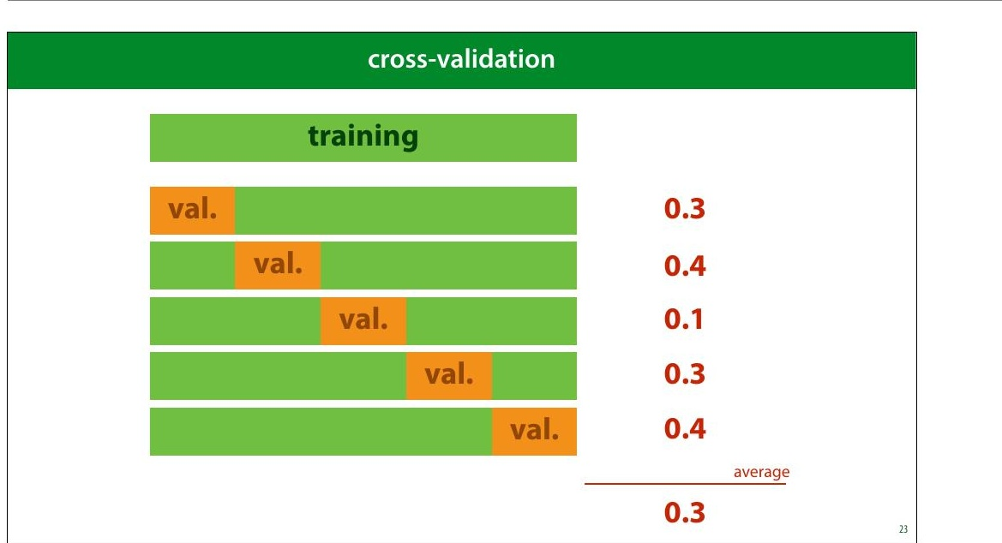
Notes:
After you’ve split off a test and validation set, you may be
left with very little training data. If this is the case, you can
make better use of your training data by performing cross-
validation. You split your data into 5 chunks (“folds”) and
for each speci8ic choice of hyperparameters that you want
to test, you do 8ive runs: each with one of the folds as
validation data. You then average the scores of these runs.
This can be costly (because you need to train 8ive times as
many classi8iers), but you ensure that every instance has
been used as a training example once.
After selecting your hyperparameters with crossvalidation,
you still test once on the test data.
You may occasionally see papers that estimate error of their
8inally chosen model by cross validation as well (splitting
off multiple test sets), but this is a complicated business,
and has fallen out of fashion. We won’t go into in this
course.

Slide 19
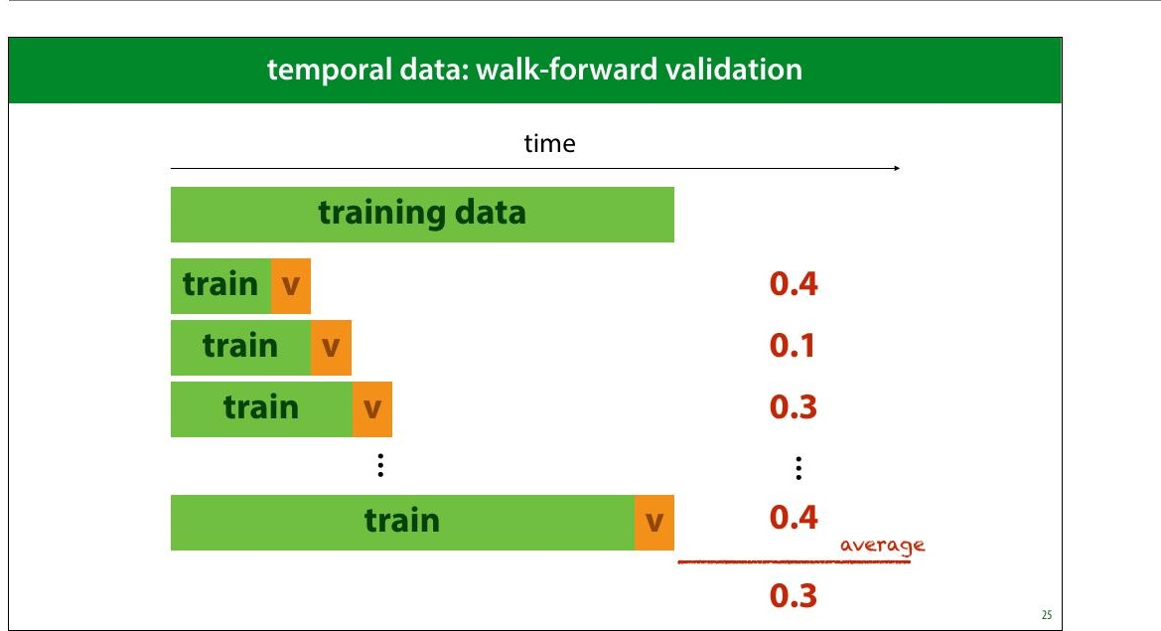
Notes:
If you want to do cross-validation in such time sensitive
data, you’ll have to slice the dataset like this.

Slide 20
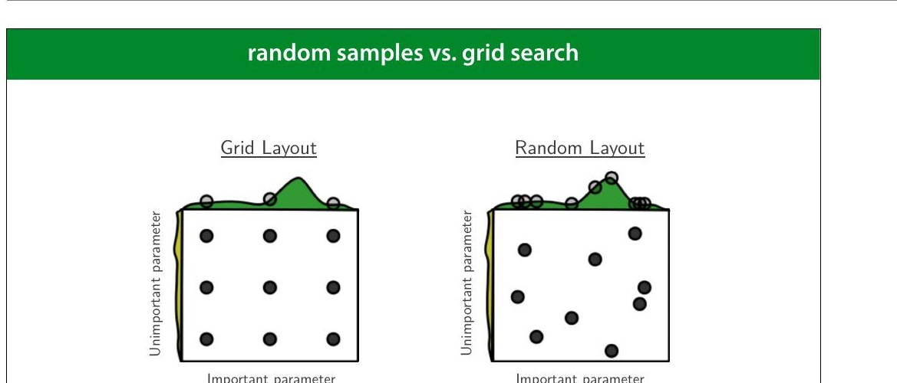
Notes:
If you are going to use some kind of automated search,
trying a bunch of different combinations of hyperparameter
values, and then trying random samples in the hyper
parameter space is often better than exhaustively checking
a grid. This picture neatly illustrates why. If one parameter
turns out not to be important, and another does, a grid
search restricts us to only three samples over the important
parameter, at the cost training nine different models.
If we randomize the samples, we get nine different values of
each parameter at the same cost.
source: http://www.jmlr.org/papers/volume13/
bergstra12a/bergstra12a.pdf (recommended reading)

Slide 21
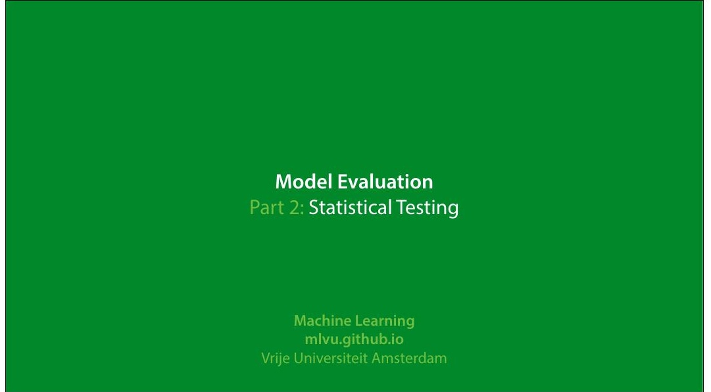
Notes:
|section|Statistical Testing|
|video|https://surfdrive.surf.nl/8iles/index.php/s/
AoCsdmxAmof17Y9/download|

Slide 22
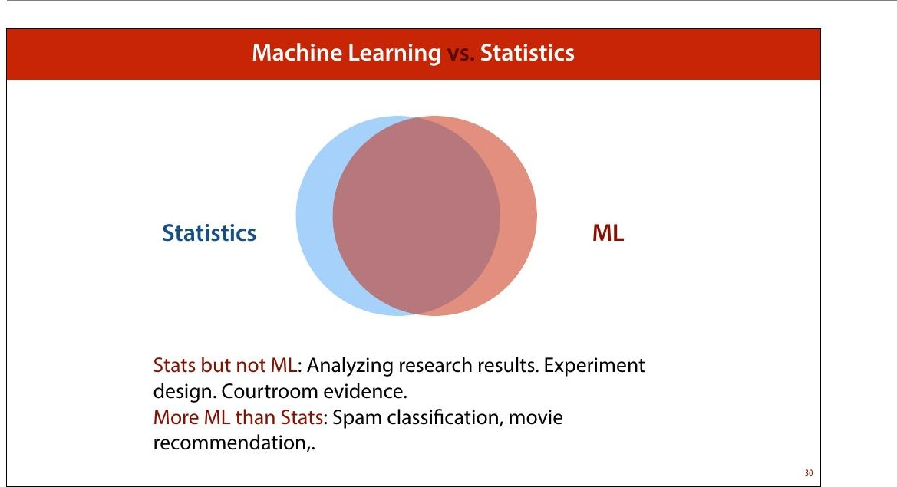
Notes:
As noted in the 8irst lecture, statistics and ML are very
closely related. It’s surprising then, that when we perform
ML experiments, we use relatively little of the statistics
toolkit. We don’t often do signi+icance tests, for instance.

Slide 23
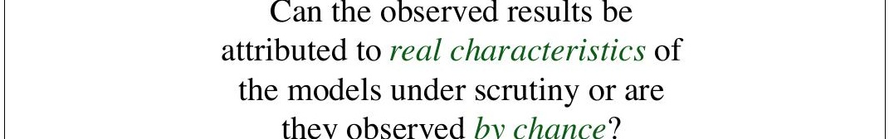
Notes:
This brings us to the main question that statistical analysis
is meant to answer. If we do things properly, and we have a
large dataset, our estimate will be close to the true value.
Often, we can even prove how close it is likely to be. But
there will be some difference, which will be entirely
random.
So, when we estimate the test accuracy of models A and B
and we see that classi8ier A is better than classi8ier B
because their estimated accuracies on the test set are .997
and .998 respectively, can we really trust that statement?
Maybe this random noise we get when we compute the
estimate of the accuracy caused this difference. In other
words, how sure can we be, from these values, that the
true accuracy of A is also higher than the true accuracy
of B?
quote source: http://www.icmla-conference.org/icmla11/
PE_Tutorial.pdf

Slide 24
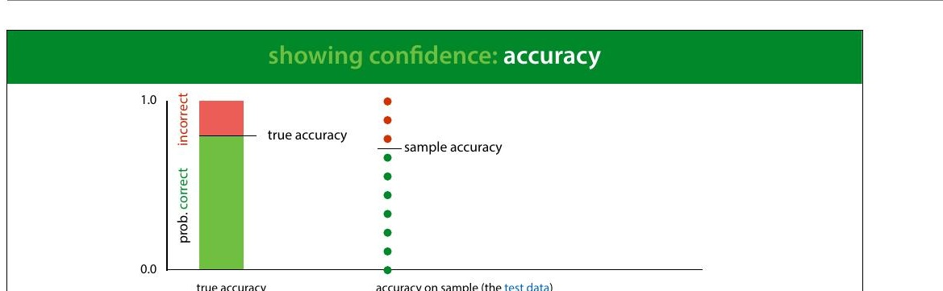
Notes:
One way of doing this is to compute a con+idence interval.
Here we see the process of computing a sample accuracy in
a simple animation: we start with the true accuracy (for
some given classi8ier, on the data distribution) which is
somewhere between 0 and 1. We sample a bunch of points
from the data distribution (our test set), and take the
relative frequency of correctly classi8ied instances as the
sample accuracy.
Here, in the top half of the slide we model the process of
taking one instance of our test set and seeing whether the
classi8ier classi8ies it correctly as a single random draw
resulting in the outcome correct or incorrect. We'll see in
the next lecture that this type of distribution is called a
Bernoulli distribution.
The whole process of sampling the entire test set and
computing the sample accuracy is also a random process. If
we were to repeat it, sampling a new test set, we'd get a
different value for the sample accuracy. To simplify this, we
can look at the total number of instances in our sample that

Slide 25
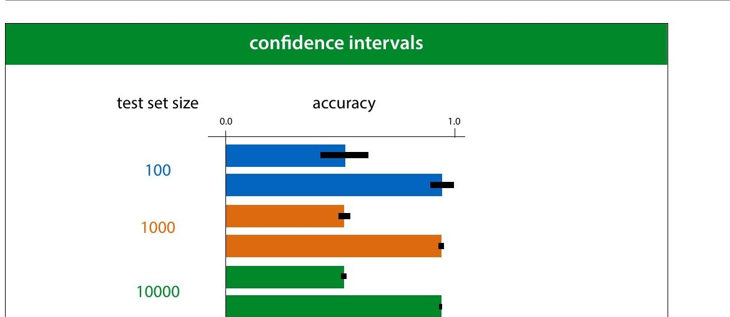
Notes:
The size of this con8idence interval depends on two factors:
the true accuracy and the size of the test set. Here are some
examples for different accuracies and test set sizes.
This tells us that if the true success probability (accuracy)
of a classi8ier is 0.5, and the test set contains 100 examples,
our con8idence interval has size 0.2. This means that even if
we report 0.5 as the accuracy, we may well be wrong by as
much as 0.1 either side.
Even if these con8idence intervals are usually not reported,
you can easily work them out (or look them up) yourself.
So, if you see someone say that classi8ier A is better than
classi8ier B because A scored 60% accuracy and and B score
59%, on a test set of 100 instances, you have reason to be
sceptical.
In short, this is why large test sets are important. Without
at least 1000 instances in your test data, you cannot reliably
tell the difference between two classi8iers.

Slide 26
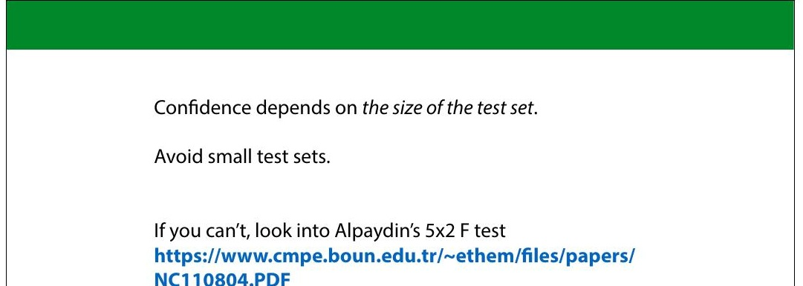
Notes:
If you don’t have the luxury of a large test set, you may need
to do some statistical testing to see whether the effect
you’ve observed (classi8ier A is better than classi8ier B) is
genuine or down to random chance. It’s generally accepted
that Alpaydin’s 5x2 cross validation is the best test for this
purpose. It’s out of scope for this course, but follow the link
if you run into this problem.

Slide 27
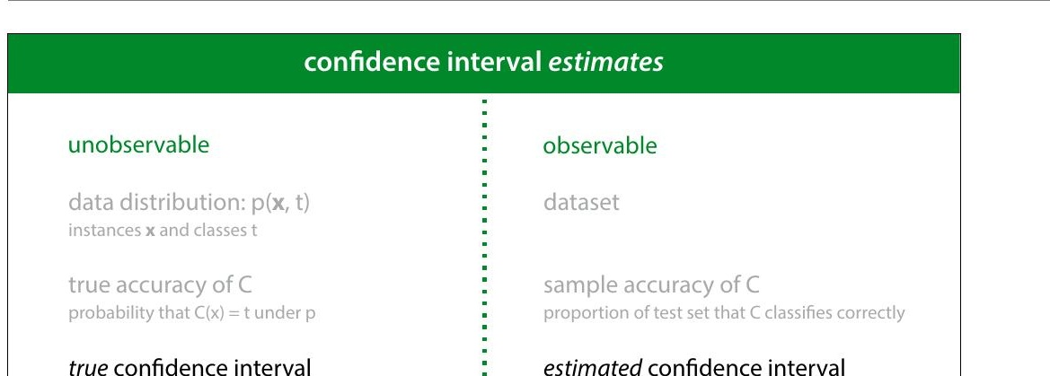
Notes:
These are good concepts to help us think about what we are
measuring when we compute metrics on our test data. But
it's important to realize that these are unobservable values.
We can only work out the true con8idence interval for the
sample accuracy if we know the true accuracy. This puts the
con8idence intervals we've talked about so far in the
unobservable column.
So what about all those con8idence intervals you see
reported in the literature? These are estimated con8idence
intervals. They are usually computed in the same way as the
true con8idence interval, but wherever we need the true
value of some metric, we replace it by its estimate. This
gives us a con8idence interval that isn't as correct as the
true con8idence interval, and one that would change slightly
if we were to resample the test set, but we can at least
compute it, and it generally behaves in roughly the same
way as the true con8idence interval.

Slide 28
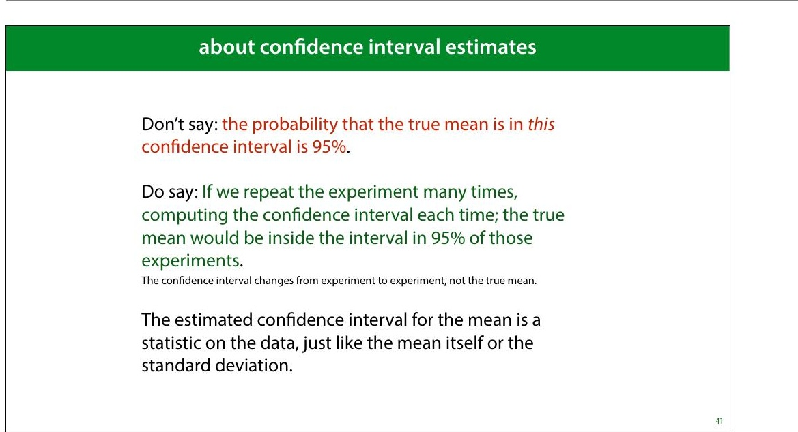
Notes:
When we use the phrase con>idence interval to refer to this
kind of estimate, it's important to speak about it correctly.
There is no probability associated with the true mean at all.
It is simply an objective, determined value (which we don’t
know). The probability comes from sampling, and from
computing the interval from a sample.
So instead of having a 8ixed interval, with the true mean
jumping around probabilistically, we have a 8ixed true mean
around which we get an interval that jumps around if we
resample the data. The probability of it jumping so much
that it no longer contains the true mean is 5%.
This is typical frequentist agonizing over what the phrase
“probability” means. Con>idence intervals are a uniquely
frequentist tool. If the distinction on the slide doesn’t make
sense to you, look back to the probability video in the
preliminaries.

Slide 29
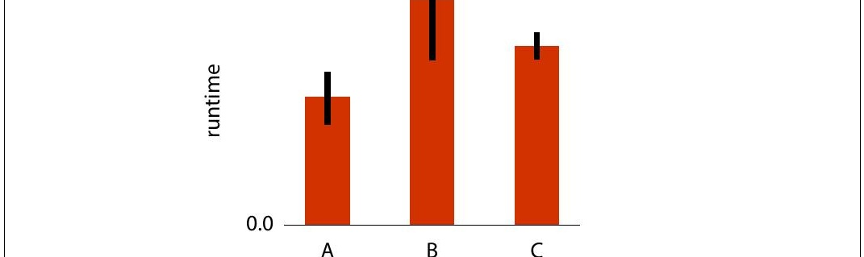
Notes:
A very relevant question is how do you interpret error
bars?
If you see a picture like this, showing the mean runtime of
an experiment, measured for three models, and averaged
over a number of runs, what would you imagine the error
bars denote? We've seen standard deviations, standard
errors and con8idence intervals. What do error bars
represent?

Slide 30
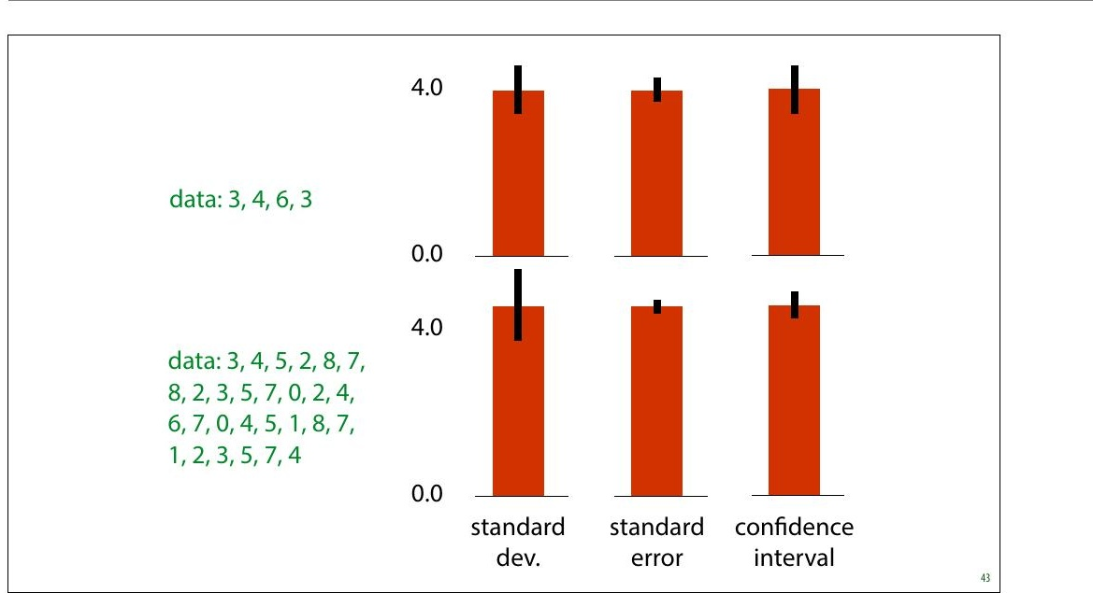
Notes:
The truth is that there is no standard de8inition for what
error bars denote, and if the authors didn’t specify what
their error bars indicate, the authors messed up.
These are the three most common options. If you didn't
quite get all the details of the previous slides, this slide
illustrates the most important distinction: If we sample
more data, the estimate of our standard deviation
becomes more accurate. It’s an estimate of a property of our
data distribution. The error bars representing standard
deviation don't get smaller, they just get closer to their
correct size (which may be very wide around the head of
the bar).
The standard error and the con8idence interval are
indicators of how con8ident we are about our estimate of
the mean of our data. For these, the more data we have, the
smaller they get. As we saw earlier, under the right
assumptions, the 95% con8idence interval is roughly twice
the standard error.

Slide 31
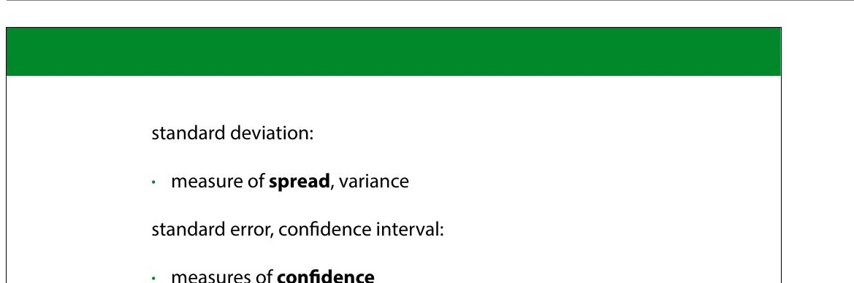

Slide 32
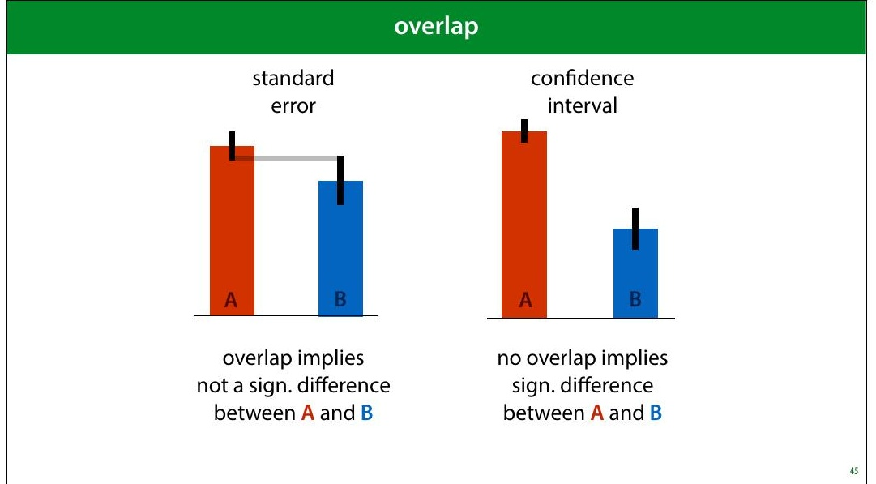
Notes:
Under certain assumptions, the standard error of two
estimates can tell you whether a Student's t test allows you
to reject the null hypothesis that the two distributions are
the same. This would allow you to say, for instance, that
there is a statistically signi8icant difference between the
accuracy estimates on two classi8iers. As we said before,
such testing is not very popular in machine learning, so we
won't go into it in detail, but this can offer an additional
perspective on error bars.
We won’t discuss the Student’s t test in detail, but it’s a
common test for comparing two normally distributed values.
Say you plot the mean squared error for regression models
A and B, together with some error bars. Does the the fact
that the error bars overlap or not tell you whether the
measured difference between the two models is statistically
signi8icant? That is, does it indicate whether we can
conclude that A is a better model than B?
Yes, but we have to be careful. For standard error bars, the

Slide 33
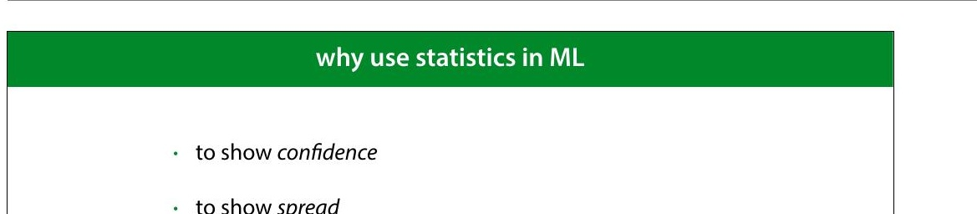
Notes:
All of this was about showing con+idence: showing how
reliable our numbers are as estimates of the true values that
we can’t observe.
Showing spread is more about providing insight to the
reader. Say I train a classi8ier by gradient descent. If I have a
big test set, I can very con>idently measure and report the
accuracy of this particular classi8ier. However, gradient
descent uses random initialization. If I repeat the training
process, I may end up in a different local minimum, and get
a different classi8ication performance. It’s likely that I also
want to communicate how much the measured
performance is dependent on this randomness. In short,
how lucky did we get in our choice of classi8ier?

Slide 34


Why Stats in ML?
Show Confidence
Quantify certainty in predictions with confidence intervals, p-values, and statistical tests
Show Spread
Visualize variability in data through standard deviation, variance, and distribution plots

Slide 35
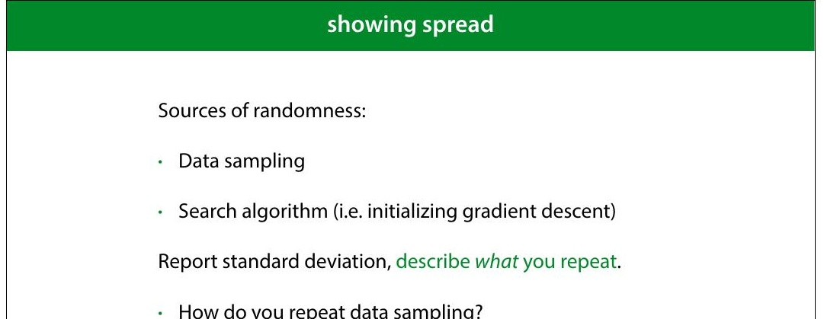
Notes:
If we have a large enough test set, we know that the
con8idence interval for our measurement of the
performance is small enough. But we also want to know
how much the randomness in our process affects the result.
What is the probability that repeating the process (on the
same data, or on new data) produces wildly different
results?
For factors like the initialisation of gradient descent, this is
easy to test: you just rerun a few times on the same data.
But how do you test how robust the results are against
sampling a new dataset?

Slide 36
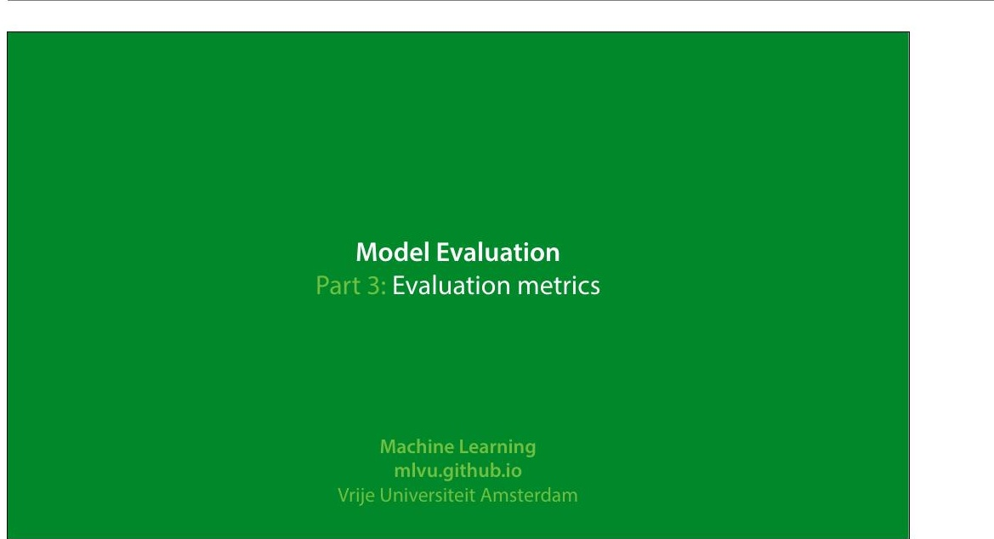
Notes:
In this video we'll look at how to evaluate regression and
classi8ication experiments. There will be a few pointers on
regression, but the main topic will be classi8ication
experiments.
|section|Metrics|
|video|https://surfdrive.surf.nl/8iles/index.php/s/
TrR5TrtLDZLBs08/download|

Slide 37
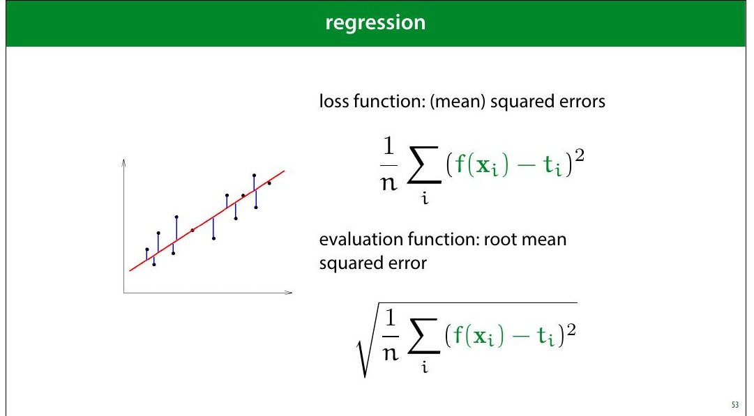
Notes:
One thing to pay attention to is that if you use MSE loss, you
may want to report the square root (the RMSE). The RMSE
is minimised at the same places as the MSE, but it’s easier
to interpret, because it has the same units as the original
output value.
For instance, if your outputs are in meters, then your MSE is
measured in square meters, but your RMSE is also
measured in meters.

Slide 38
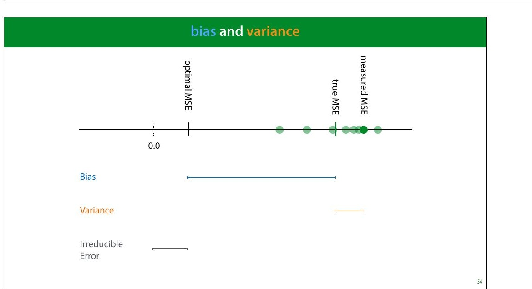
Notes:
Bias and variance are good concepts to keep in mind when
thinking about regression performance. The bias is the
difference between your optimal MSE and the true MSE.
This is the part of your error that is down to fundamental
problems with your model: for instance, you are 8itting a
line trough data with a parabolic pattern. This part stays the
same if you resample your data.
The variance is the difference between the true MSE and
the measured MSE. This is the part of your error that is
down to aspects of the random sampling of the data. This
part changes when you resample your data.
Normally, we train a regression model once, and get one
MSE value. This gives us one dot on the axis above. Without
repeating the process on freshly sampled data, we can't tell
how our error falls apart in bias and variance. However, we
can usually get some contextual clues, or investigate using
resampling.

Slide 39
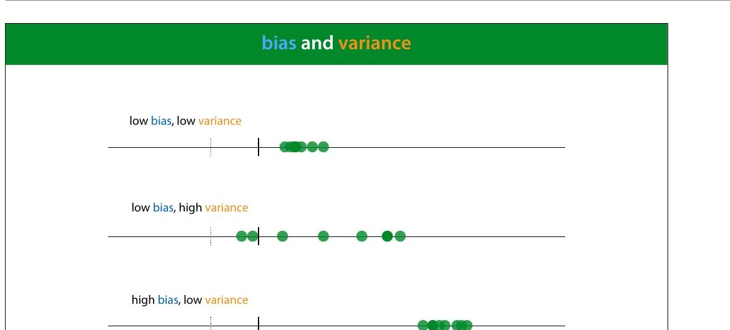

Slide 40
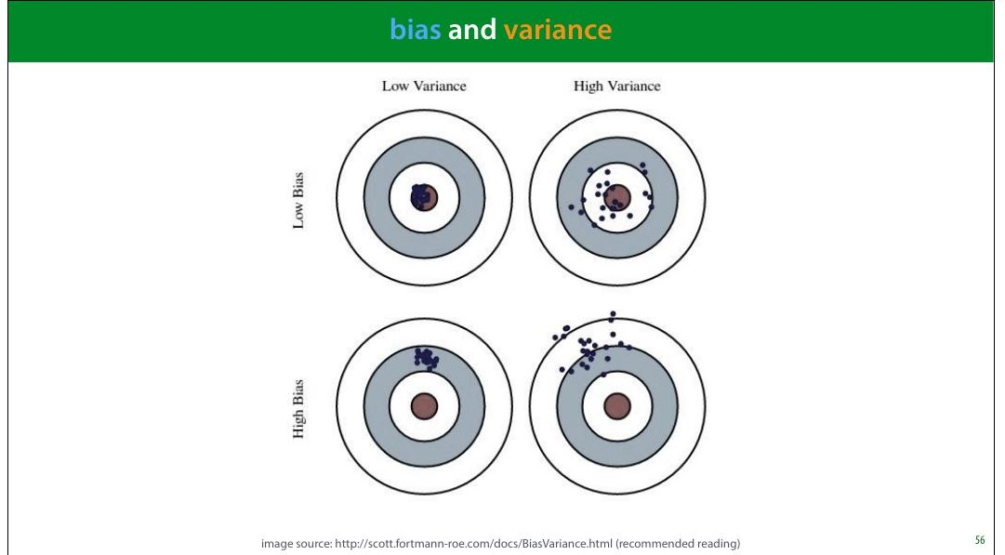
Notes:
Here is a metaphor that is often used to describe bias and
variance: a dartboard.
Remember, this is a metaphor for our RMSE error estimate.
That means that normally, we have only one dart and we
can’t tell whether our error is due to high bias or high
variance.
image source: http://scott.fortmann-roe.com/docs/
BiasVariance.html (recommended reading)

Slide 41
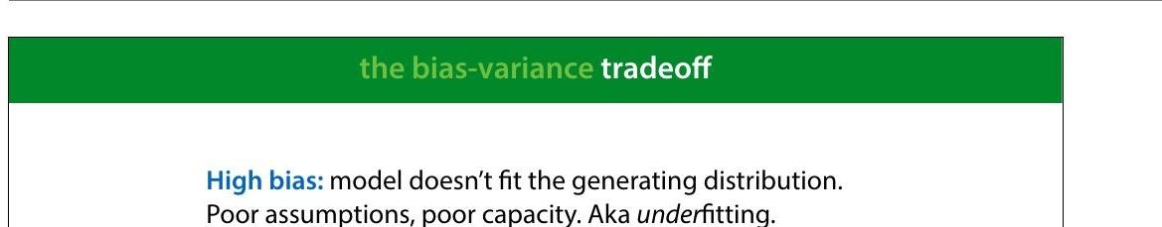
Notes:
High bias tends to happen when the model is too simple to
follow the true "shape" of the data. Linear models in low-
dimensional spaces often have this problem. Here, we see
that the data has a slight curve, which is clearly part of its
natural pattern, and something the model should learn.
Since it's restricted to a line, however, it cannot make this
shape.

Slide 42
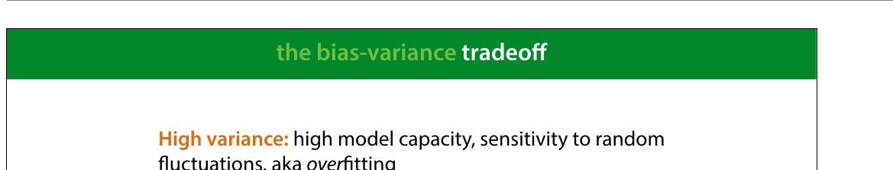
Notes:
High variance happens when the model has the capacity to
follow the shape of the data perfectly, but it does it so
perfectly that it tends to get thrown off by small
8luctuations.
Here, the model doesn't just follow the natural curve of the
data, it goes in and out of every random 8luctuation to
model every single point perfectly.
Even though this model (a regression tree) 8its the data
perfectly, if we resample the data, we are stuck with all
sorts of weird peaks that won’t 8it the new data. This is
where the variance comes from. The true error varies
wildly, because the model captures every single random
8luctuation in the training data. These 8luctuation will cause
a large error in the test data, which we put down to
variance rather than bias.

Slide 43
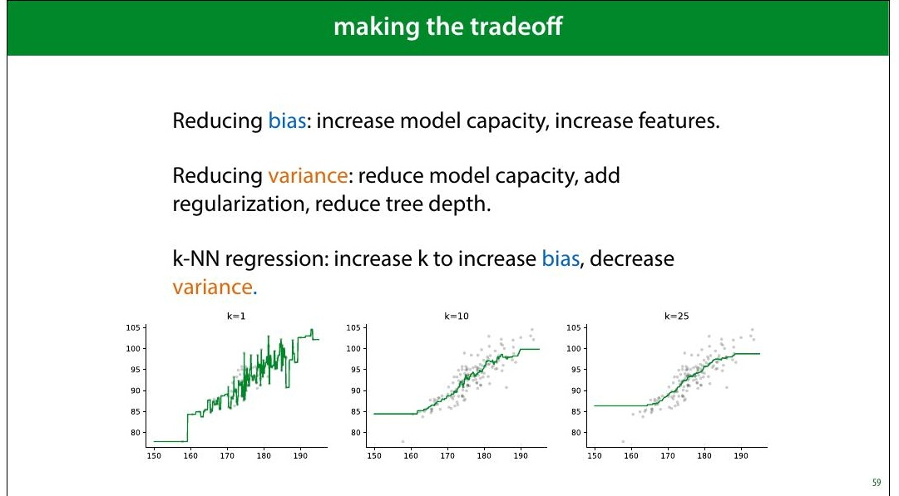
Notes:
We will see techniques for all of these in the coming weeks.
Note that often, it really is a tradeoff: reducing the bias,
increases the variance and vice versa.
For some algorithms, there is a single parameter that allows
us to make the bias/variance tradeoff. kNN is one example:
low k values give us high variance, high k values give us
high bias.
In the strictest de>inition of bias and variance, these concepts
only apply to the mean squared error, where they explictly
appear as terms if you rewrite the error in a certain way.
However, in general machine learning parlance, the terms
are applied to any regression error, and they are roughly
synonymous with under- and over>itting.

Slide 44
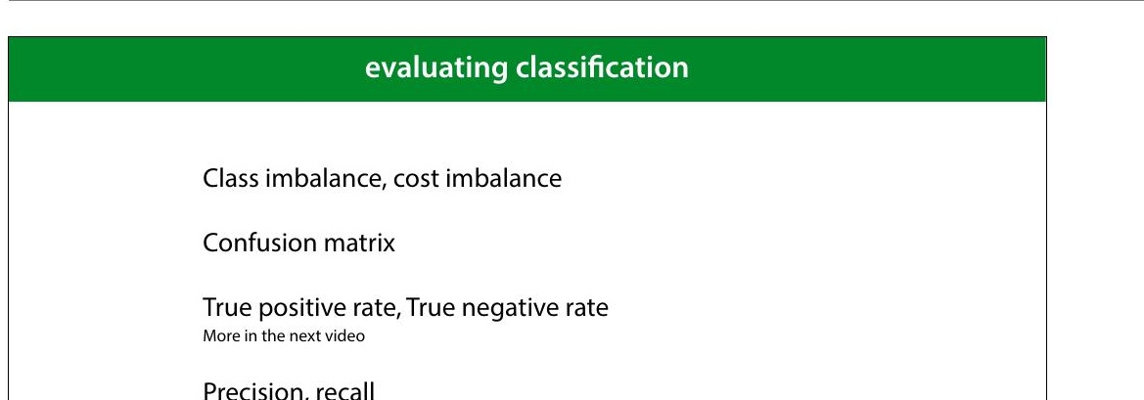
Notes:
Let's now move to classi8ication. We'll start by explaining
these four topics.

Slide 45
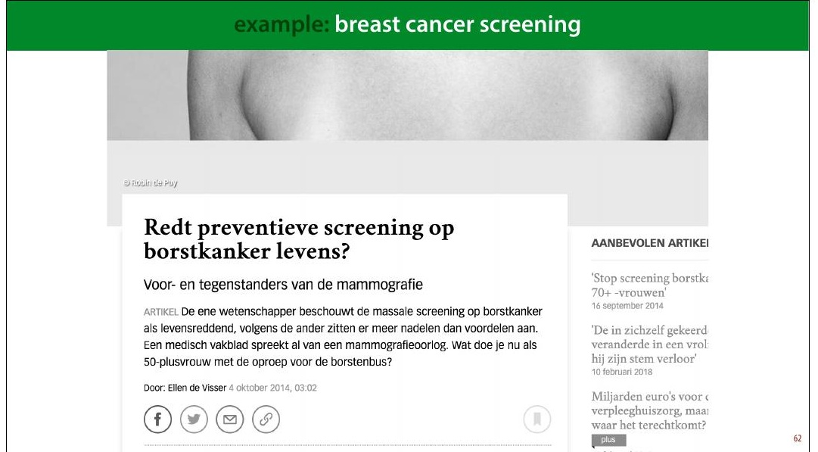
Notes:
Here's one example domain: breast cancer screening
A recurring discussion in the Dutch media is the question
whether all women over 50 be screened for breast cancer.
This is an analogy for classi8ication: the instances are
people and the target label is “has cancer” or “has no
cancer.” You may think that this is a no-brainer: the more
tests we do, the more lives saved. But we need to take into
account how good the classi8ier is, and how bad the
consequences are of it making a mistake.
The 8irst problem this example illustrates is class
imbalance. Unlike the classi8iers we've seen so far, this
example has, thankfully, far more negatives than positives.
In a given year the people in this age group for whom breast
cancer will manifest is about half a percent. This includes
men, for whom breast cancer is rare (but not impossible),
so when we talk about screening for women over 50, we
should probably assume about 1% positives.
This means that we need to be very careful when

Slide 46
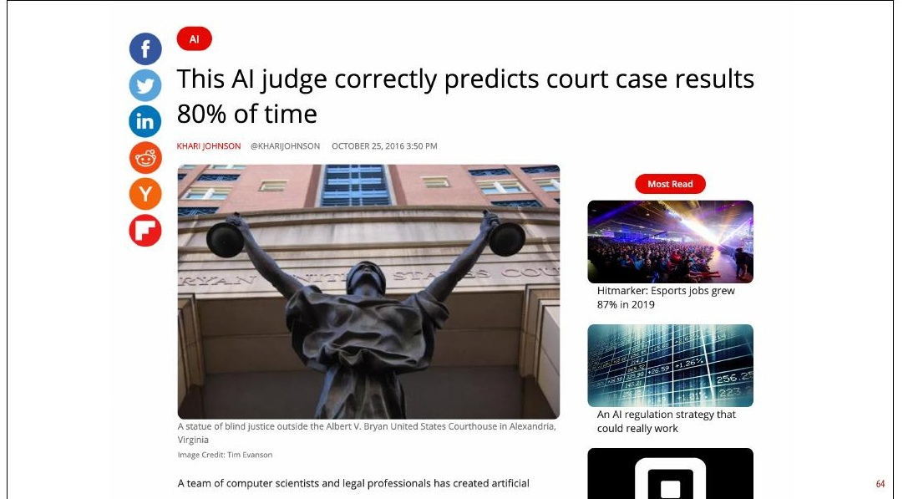
Notes:
So the next time you see a headline like this, your 8irst
question should be: what was the class distribution in the
training data? If 90% of the cases in the training data are
acquittals, this is not a very impressive result.
As it happens, in this case the classes were balanced 50/50,
so 80 percent is at least notable. However, now we have a
classi8ier trained on arti8icially balanced data. In a
production environment (whatever that means here), the
classes are likely not balanced 50/50, so this speci8ic
classi8ier will be of no further use.
Here is the original paper: https://peerj.com/articles/
cs-93/#fn-6 There are some issues with this research
beyond the class balance.

Slide 47
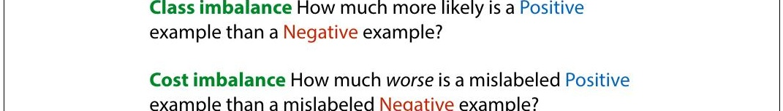
Notes:
Another reason to mistrust accuracy is cost imbalance. In
breast cancer screening are two types of misclassi8ication:
diagnosing a healthy person with cancer and diagnosing a
person with cancer as healthy. Both come with a cost but
not the same cost.
We can either miss a cancer diagnosis (a false negative),
which means the cancer will be caught much later and be
much harder to treat. However, diagnosing a healthy person
with cancer (a false positive) means they will be sent for
unnecessary invasive testing and suffer great psychological
stress. The cost of this is much less than the cost of missing
a positive, but it isn't zero.
This is what the discussion in the media centers on. If the
screening causes many more false negatives than false
positives, it may mean that the cost to human lives balances
out, and the net effect of the screening isn't to save more
lives.
There is of course, also the 8inancial cost of screening a

Slide 48
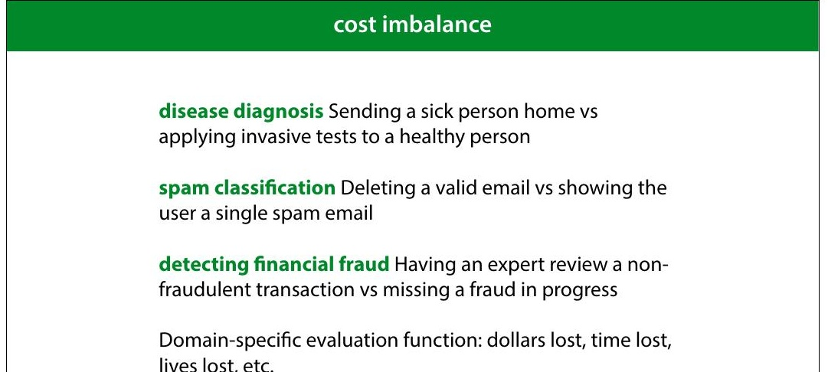
Notes:
Here are some examples of problems with cost imbalance
In all these cases, one misclassi8ication one way costs much
more than a misclassi8ication the other way. But both cost
something. The time of an expert reviewer is not free, even
though 8ive minutes of his time may be much cheaper than
the cost of letting a single fraud go unchecked. In such a
case, you may decide that missing one fraud is as costly as
having an expert review 500 harmless transactions. This is
then the general balance you are hoping for: one false
negative for every 500 false positives.
If you’re lucky, both types of misclassi8ication have the same
unit, and you can turn your error (an estimate of the
number of misclassi8ications) into a domain speci8ic
evaluation function (like estimated dollars lost, or time
saved). You simply assign a cost to each type if
misclassi+ication, and multiply it by how often that
misclassi+ication occurs in the test set. The total is the
evaluation function you want to minimize.

Slide 49
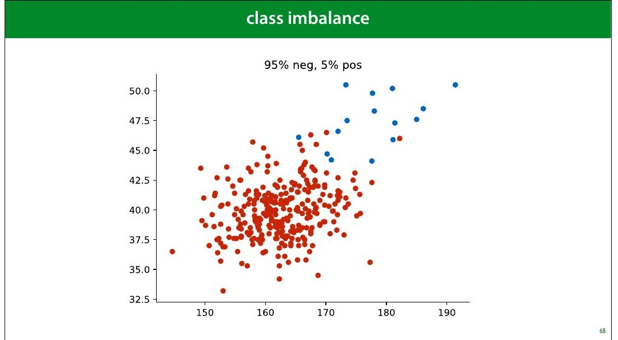
Notes:
Here is a pretty imbalanced dataset (though still not as
imbalanced as the cancer/not cancer problem). It looks
pretty dif8icult. What would be a good performance on this
task?

Slide 50
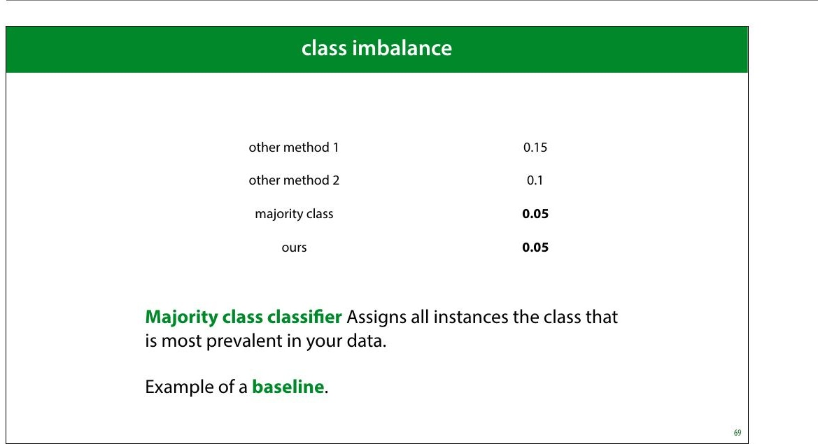
Notes:
As we've seen, even though an error of 0.05 might sound
pretty good, but on an imbalanced dataset like this, there is
a very simple classi8ier that gets that performance easily.
The classi8ier that assigns anything the class with the most
instances. We call this the majority class classi+ier.
The majority class classi8ier is an example of a baseline, a
simple method that is not meant to be used as a real model,
but that can help you calibrate the performance scores. In
this case, it tells you that you’re really only interested in in
the error range from 0 to 0.05. Any higher error than that is
pretty useless.

Slide 51
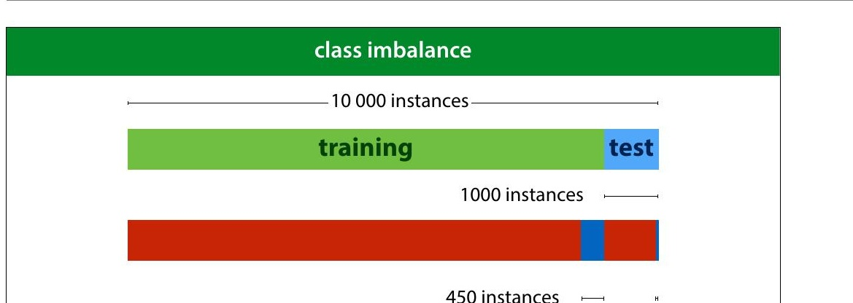
Notes:
Here is another way that class imbalance can screw things
up for you. You might think you have a pretty decent
amount of data with 10 000 instances. However if you split
off a test set of 1 000 instances, you'd be left with just 50
instances of the positive class in your data. Practically, your
8inal evaluation will just be a question of how many of these
50 positives you detect. This means that you can really only
have 50 “levels of performance” that you can distinguish
b e tw e e n .
Yo u c a n m ake a bigger test set of course (and you probably
should) but that leads to problems in your training data.
Since you’re essentially building a detector for positives, it
doesn’t help if you can only give it 100 examples of what a
positive looks like.
In the next lecture, we’ll look at some tricks we can use to
boost performance on such imbalanced data.

Slide 52

Notes:
The best thing to do under class and cost imbalance, is to
look at your performance in more detail. We’ll look at six
different ways to measure classi8ier performance.
Most of these are only relevant if you have class or cost
imbalance. If you have a nice, balanced dataset, it’s likely
that error or accuracy is all you need.

Slide 53

Notes:
This is a confusion matrix (also known as a contingency
table). It's simply a table with the actual classes on the
rows, and the predicted classes on the columns, and a tally
in each cell of how often each actual class is given a
particular prediction. On the diagonal we tally all the
correct classi8ications and off the diagonal we tally all the
possible mistakes.
A confusion matrix doesn’t give you a single number, so it’s
more dif8icult to compare two classi8iers by their confusion
matrices, but it’s a good way to get insight into what your
classi8ier is actually doing.
Note that for a binary classi8ication problem, we are getting
the two types of mistakes (false positives and false
negatives) along the second diagonal. If we have cost
imbalance, the balance between these two values gives us a
quick insight into how well the classi8ier is aligned with our
estimate for the misclassi8ication costs.
You can plot the confusion matrix for either the training,

Slide 54

Notes:
We call accurately classi8ied instances true positives and
true negatives. Misclassi8ications are called false positives
and false negatives.

Slide 55

Notes:
Here we see the confusion matrix for the majority class
baseline (the classi8ier that calls everything positive) in a
problem with high class imbalance.

Slide 56

Notes:
Precision and recall are two metrics that express a tradeoff
between the two types of mistakes.
Precision: what proportion of the returned positives are
actually positive?
Recall: what proportion of the existing positives did we
8ind?
The idea is that we usually want to 8ind as many positives as
possible, so we should be eager to label things positive,
increasing the recall, but if we are too eager, we will label
lots of negatives as positive as well, which will hurt our
precision. Our main challenge in designing a classi8ier in the
face of cost and class imbalance, is to 8ind the right tradeoff
between precision and recall.

Slide 57

Notes:
It always takes me a minute to 8igure out what precision
and recall mean in any given situation, and I usually consult
this diagram from Wikipedia to help me out.
The idea is that the goal of the classi8ier is to select the
positives in the dataset. The more it selects, the higher its
recall, but the lower its precision, as more negatives end up
in the selection.
source: By Walber - own work, CC BY-SA 4.0, https://
commons.wikimedia.org/w/index.php?
curid=36926283

Slide 58

Notes:
There are many more metrics which you can derive from
the confusion matrix. Wikipedia provides a helpful table, in
case you ever come across them. For most purposes,
precision, recall, accuracy and balanced accuracy are
suf8icient.
Note that some terms, like recall, go by many different
names.

Slide 59

Notes:
All of these metrics can be applied to different datasets.
When we compute (say) accuracy on the test set, we talk
about test accuracy. This is computed—only once—at the
very end of our project, to show that our conclusions are
true.
When we compute it on the validation set we call it
validation accuracy. We compute this to help us choose
good hyperparameters.
And, predictably, when we compute it on the training data,
we call it training accuracy. Remember that in the 8irst
lecture I said, emphatically, that you should never judge
your model on how it performs on the training set. Why
then, would you ever want to compute the training accuracy
(or any other metrics on the training data)?

Slide 60

Notes:
The answer is that the difference between your validation
accuracy and your training accuracy, will tell you whether
or not your model is over8itting (matching the data too
well) or under8itting (not matching the data well enough).
The difference between the training and validation sets is
called the generalization gap. As in, it's the amount of
performance that won't generalize to data that isn't your
training data.

Slide 61

Notes:
source: Jim Unger, Herman.

Slide 62

Notes:
|section|PR, ROC and AUC|
|video|https://surfdrive.surf.nl/8iles/index.php/s/
p6Atngg3Q5AzMiz/download|

Slide 63

Notes:
Let's return to the metrics of precision and recall. We often
have to make a tradeoff between high precision and high
recall. We can boost our recall by calling more things
positive. The drawback is that our precision will go down if
this means including more negatives among the things we
call positive. We can boost our precision by calling fewer
things positive, which will hurt our recall.
How exactly we make the tradeoff depends on our cost
imbalance, and our class imbalance. To help us investigate,
we can plot the precision and recall we get from different
classi8iers.
source: By Walber - own work, CC BY-SA 4.0, https://
commons.wikimedia.org/w/index.php?
curid=36926283

Slide 64

Notes:
Another pair of metrics that provides this kind of tradeoff
are the true positive and false negative rate.
true positive rate: what proportion of the actual positives
did we get right. The higher the better. I.e. How many of the
people with cancer did we detect.
false positive rate: what proportion of the actual negatives
did we get wrong (by labelling them as positives). The
lower the better. I.e. How many healthy people did we
diagnose with cancer.
The

Slide 65

Notes:
We want to get the TPR as high as possible, and the FPR as
low as possible. That means the TPR/FPR space has the
best classi8ier in the top left corner. This space is called ROC
space.
Again, the orange points are the extremes, and easy to
achieve.
ROC stands for receiver-operating characteristic. Like so
many names in machine learning , this is a historical artifact,
a leftover from its invention in WWII to improve the detection
of Japanese aircraft from radar signals.

Slide 66

Notes:
So far we’ve thought of FPR/TPR and precision/recall as a
way to analyze a given set of models.
However, what if we had a single classi8ier, but we could
control how eager it was to call things positive? If we made
it entirely timid, it would classify nothing as positive and
start in the bottom left corner. As it grew more brave, it
would start classifying some things as positive, but only if it
was really sure, and its true positive rate would go up. If we
made it even more daring, it would start getting some
things wrong and both the TPR and the FPR would increase.
Finally, it would end up classifying everything as positive,
and end up on the top right corner.
The curve this classi8ier would trace out, would give us an
indication of its performance, independent of how brave or
how timid we make it. How can we build such a classi8ier?

Slide 67

Notes:
We can achieve this by turning a regular classi8ier into a
ranking classi+ier (also known as a scoring classi+ier). A
ranking classi8ier doesn’t just provide classes, it also gives a
score of how negative or how positive a point is. We can use
this to rank the points from most negative to most positive.
How to do this depends on the type of model we use. Here’s
how to do it for a linear classi8ier. We simply measure the
distance to the decision boundary. We can now scale our
classi8ier from timid to bold by moving the decision
boundary from left to right.
After we have a ranking, we can scale the eagerness of the
classi8ier to make things positive. by moving the threshold
(the dotted line) from left to right, the classi8ier becomes
more eager to call things negative. This allows us to trade
off the true positive rate and the false positive rate.

Slide 68

Notes:
We can make a big matrix of all the pairs for which we know
how they should be ranked: negative points on the
horizontal axis, positive on the vertical. The more sure we
are that a point is positive, the closer we put it to the
bottom left corner. This is called a coverage matrix. We
color a cell green if the corresponding points are ranked the
right way round, and red if they are ranked the wrong way
round.
Note that the proportion of this table that is red, is the
probability of making a ranking error.

Slide 69

Notes:
The coverage matrix shows us exactly what happens to the
true positive rate and the false positive rate if we move the
threshold from the right to the left. We get exactly the kind
of behaviour we talked about earlier. We move from the all-
positive classi8ier step by step to the all-negative classi8ier.

Slide 70

Notes:
This is one of the question types on the exam. People very
often make mistakes in this question, so make sure you
understand what a ranking error is. It's not a misclassi+ied
example. It's a property of a pair of examples.
There are more details in the third homework.

Slide 71

Notes:
This means we can create any classi8ier in this green area,
called the convex hull of the set of green dots. This is called
the area under the (ROC) curve.
The AUC is a good indication of the quality of the classi8ier.
Every point in the green shaded area is a classi>ier we now
how to make, so the bigger this area, the more classi>iers we
can make (although the ones on the boundary are the only
ones we’d ever want to use).
If we have no idea of how we want to make the tradeoff
between the TPR and the FPR, the AUC may be a good way
to compare classi8iers in general.

Slide 72

Notes:
As we saw before: normalizing the coverage matrix gives us
the ROC space (barring some small differences that
disappear for large datasets). The area under the ROC curve
is an estimate of the green proportion of the coverage
matrix. This gives us a good way to interpret the AUC.
The AUC (in ROC space) is an estimate of the probability
that a ranking classi+ier puts a randomly drawn pair of
positive and negative examples in the correct order.

Slide 73

Notes:
Let's look at how this works for another type of classi8ier. To
reiterate, how we get a ranking from a classi+ier
depends entirely on the model class.
The decision tree is an example of a partitioning classi8ier. Is
splits the feature space into partitions, and assigns each
partition, also known as a segment, a class. All instances in
the segment get the same class.

Slide 74

Notes:
In this example we have an instance space that has been
split into four segments by a decision tree. We rank the
segments by the proportion of positive points. We then put
all points in one region on the same level in the ranking.
In this example, b is more negative than a, because b’s
segment contains only negative examples, whereas a’s
segment contains a mix of positive and negative examples.

Slide 75

Notes:
This means that for some pairs (like f,z), the classi8ier ranks
them as “the same”. We’ll color these cells orange in the
coverage matrix.
For large datasets, these regions will not contribute much
to the total area under the curve.

Slide 76

Notes:
An alternative to the ROC is the precision/recall curve. It
works in exactly the same way, but has precision and recall
on the axes.
As you can see in this tweet, in many settings the PR curve
can be much more informative, especially when you’re a
plotting the curves. Practically, it’s little effort to just plot
both, and judge which one is more informative.
ROC has the bene8it of an intuitive interpretation for the
AUC (the probability of ordering a random pair the right
way round). I haven’t yet found a similar interpretation for
the PR-AUC.

Slide 77

Notes:
To interpret the AUC, you should know not just what
classi8ier was used, but how it was made into a collection of
classi8iers. You should also know whether it’s the area
under an ROC curve, or a precision/recall curve.

Slide 78

Notes:
To put a classi8ier into production, a ranking may not be
enough. Sometimes, you just need to produce a single
answer. In that case, you can still use the ROC and PR curves
to tune your hyperparameters and choose your model, but
ultimately, you’ll need to choose a threshold as well: the
point at which you decide to call something a positive.
This is more of a software development issue than a
scienti8ic choice. Often, you have to look carefully at the
curves, perhaps together with the end users, to make a
decision.
The second approach works best with probabilistic
classi8iers, which we’ll discuss next lecture.

Slide 79


Slide 80

Notes:
|section|Social Impact 2|
|video|https://surfdrive.surf.nl/8iles/index.php/s/
6o4T6Xzi8EAc1x5/download|
Model evaluation is not just about showing how well your
model works. It’s also about working out what it means to
get a certain performance. And more importantly, what it
doesn’t mean.

Slide 81

Notes:
In this video, we will use the following research as a
running example. In 2017 researchers from Stanford built a
classi8ier that predicted sexual orientation (restricted to the
classes “heterosexual” and “gay”) from pro8ile image taken
from a dating site. They reported 91% ROC-AUC on men
and 83% ROC-AUC on women.
The results were immediately cited as evidence of a
biological link between biology and sexual orientation. The
following important caveats were largely overlooked in
media reports:
Some of the performance came from facial landmarks •
(roundness, length of nose, distance between eyes, etc),
but some came from super8icial details like hairstyle,
lighting and grooming.
The results were true when averaged over a large •
population. It’s true that women live longer than men on
average, but that doesn’t mean that there are no old men.
Likewise, the fact that you can guess orientation based

Slide 82

Notes:
Like in the previous video, we’ll look at some important
questions to ask yourself when you come up against a topic
like this. Let’s ask the same questions again (with some new
ones thrown in for good measure).

Slide 83

Notes:
In these cases, it’s important to know your history.
Physiognomy is the study which attempts to infer character
from facial features.
In this case there’s is a long history of scientists claiming to
be able to divine personal attributes (most often
“criminality”) from the structure of a subject’s face. This is
called physiogmony and almost any claim made has been
conclusively disproven, and based on poor scienti8ic
practice and spurious correlations.
That doesn’t mean, of course, that the entire idea of
physiognomy is conclusively disproven. Just because people
got it wrong in the past doesn’t mean there couldn’t still be
a link. But it does mean that when we are stumbling into
the same area with new tools, we should be aware of the
mistakes made in the past, so that we can be careful not to
repeat them.

Slide 84

Notes:
The next thing to be aware of is what you’re looking at. This
is especially important with modern systems that can look
at raw image data without extracting speci8ic, interpretable
features.
Here a visualization of a classi8ier looking at a chest x-ray
and making a prediction of whether the patient has
Cardiomegaly (an enlarged heart). The positive values in
the heat map indicate that those regions are important for
the current classi8ication. The largest values are near the
heart, which is what we expect.
The colors are a bit misleading, since the black background
washes them out. Pay more attention to the actual numbers.
However, the classi8ier is also getting a positive
contribution from the “PORTABLE” label in the top right
corner and the marker on the right. These indicate that the
x-ray was taken with a portable scanner. Such scanners are
only used when a patient’s condition has progressed so far
that they can’t leave their house. In such cases it’s a safe bet

Slide 85

Notes:
These problems are often called “Clever Hans” effects.
Clever Hans, or der Kluge Hans, was an early-20th century
German horse, who appeared to be able to do arithmetic.
As it turned out, Hans was not doing arithmetic, but just
reading the body language of its handler, to see whether it
was moving towards the right answer. This is impressive in
itself, of course, but it does mean that Hans didn’t show the
kind of intelligence that was being attributed to him.
Crucially, this was not a hoax. The handler truly believed that
Hans was able to do arithmetic, and had no idea that he was
guiding him subconsciously. This, incidentally is also why
double-blind experiments are so important in other >ields.
For us, Hans serves as a powerful reminder that just
because we’re seeing the performance we were hoping for,
doesn’t mean we’re seeing it for the reasons we were hoping
for.

Slide 86

Notes:
A related question you should ask when you 8ind that you
can successfully predict X from Y is which causes which?
eimanyapgosesi bolene ftfehctes olfevfatri,e dfrom [1], shows a feature that
ftothuenspdec trwumhoefn attempting to predict criminality
hoanve tahe dsaamteainsteents itoyfd ifs-aces of criminals and non-criminals.
foefv etryhienpiurt i m8iangedtointhegasv eir-s that the angle made by the corners
of the mouth and the tip of the nose is a highly predictive
PTEhGeso aftudetchodoinrgste cshu-ggest that such facial features are
noyfd ecvriciem-deipnenadelnitt,y
wonhCernim wineal iltoyok at the dataset we see that it’s not
ufcetiaont,uonreewsa yooff tashseess ifnagcthee, so much as the expression that
iIldna ntdhteest “clnasosifine-rscwriithminal” photographs, the subjects hold
flithgehclta sssimficaitlioen, eaxpse riimse cntos.mmon, whereas in the criminal set the
expressions have a more explicitly relaxed jaw. What we’re
thheehyrpeo thaersiest hnatosttil lffaacceial features, so much as facial
roughaspossible.
This is important, because it changes the interpretation of
t th r e e cl a s s i fi c a t io n m e th o d s w o rk o n i m a g e
mt ha e erv ea su au tel tth se rc oe rmf rpm al ne cte se ol ny . The physiognomical interpretation is n t h e n d l i p o a
f e at ur e s , i n c lu d in g 1 . F a c ia l la n d m a rk p o i n t s

Slide 87

Notes:
Let’s go back to the sexuality classi8ier. What might a Clever
Hans effect look like here? In the most extreme case, you
might expect a classi8ier just to look at the background of
the image. The authors were more careful here than you
249
might expect:
The background of the image was blurred and the the •
facial features (eyes, nose, mouth) were detected and
aligned.
The focus of the classi8ier was investigated with saliency •
maps (indicators of where the model is looking). This is a
fallible method, but it does show a general focus on the
face. (Still, remember how small the effect was in the ep e n d e n t v a ri a b l e ) u s in g 5 0 0 s i n g u la r v al u e s e x tr a c te d
-F a c e s c o r e s ( i n d e p e n d en t v a r i a b le s) . L e a s t a b s o lu t e
saliency map for the chest X-ray.)
A second classi8ier was fed only facial landmarks: the • s e t t o 1 ; t h e r e g u la r i z a t i o n p a r a m e t e r w a s a u t o m a t i - %
t e d u s i n g 1 0 - f o l d c r o s s - v a l i d a t i o n .
position of the eyes, roundness of the jaw, etc. That is, the h e m o d e l b u i l t o n t h e t r a i n i n g s e t , c o m b i n i n g t h e S V D
l i t y r e d u c t i o n a n d l o g i s t i c r e g r e s s i o n , w a s u s e d t o p r e -
u a l o r i e n t a t i o n o f t h e p a r t i c i p a n t s i n t h e t e s t s e t . T h i s photo was translated to a series of explicit features. The
suggestion being that this prevents Clever Hans effects.

Slide 88

Notes:
Another question we suggested in the last video is whether
the target label you’ve chosen is saying what you think it’s
saying.
Here, the authors inferred sexuality from the stated
preference in the dating pro8ile. This is clearly correlated
with sexuality, but not the same thing. Firstly, sexuality is
one of those attributes (like movie genre) that can only be
crudely approximated by a set of 8inite categories.
Moreover, for many people it’s not a 8ixed attribute, and it is
subject to some evolution throughout their life.
The stated preference on a dating pro8ile also means that
you are capturing only those gay people who are willing to
live (relatively) openly as gay. This may be highly dependent
on social background. It’s certainly conceivable that in
poorer subcultures, people are less likely to come out as
gay, either to their community or to themselves.
This means that what we’re detecting when we’re
classifying a face in this dataset as “gay” is more likely a
combination of factors that are correlation to that label.

Slide 89

Notes:
So, what kind of hypotheses can we think of for what is
causing the performance of the classi8ier?
The authors observe that in their dataset the heterosexual
men are more likely have facial hair. That’s most likely to be
a grooming choice, based on the differences in gay and
heterosexual subcultures.
For other correlations, such as that between sexuality and
nose length, the authors suggest the prenatal hormone
theory, a theory that relates prenatal hormone levels in the
m o t h e r w i th t h e s e x ua l it y o f t h e s u b je ct . I n s h o r t , a
bio l o g i c a l m e c h a n is m t h a t is r e s p o n s ib le f o r b o t h th e
(slight) variation in facial features and the variation in
sexual preference.
But that’s not the only possibility. In the previous slide, we
saw that it’s dif8icult to separate facial features from facial
expressions. However, even if we somehow eliminate the
expression, that doesn’t mean that every facial feature we
see is determined at birth. For instance, the roundness of

Slide 90

Notes:
The authors plotted the four average faces for the classes
male/female and gay/heterosexual in their dataset. Here
are the four options. It’s a peculiar property of datasets of
(aligned) faces that the mean is often quite a realistic face
itself.
Consider this plot with the hypotheses on the previous
slide. What differences do you see? Pay particular attention
to the differences in skin tone, grooming, body weight, and
the presence of glasses.
I’ll leave you to decide which you think is the more likely
explanation for these difference: choice of presentation,
social class, or sexuality.

Slide 91

Notes:
The authors repeated their experiments by classifying
based purely on facial landmarks. The idea is that we can 253
detect landmarks very accurately, and classifying on these
alone removes a lot of sources for potential Clever Hans
effects.
We see that all subsets of the face landmarks allow for some
predictive performance, but there is a clear difference
between them. Note that just because we are isolating
landmarks, doesn’t mean that we are focusing only on
biological causes. As we saw earlier, the shape of the mouth
is determined more by expression than by facial features,
and the roundness of the jaw is partly determined by body
weight, which is correlated with social class.
We will discuss the AUC metric in the third lecture. For now,
you can think of a classi8ier with 81% AUC as one that,
given a random pair of gay and heterosexual instances from
the data, will successfully select the gay instance 81% of the
time.

Slide 92

Notes:
To interpret numbers like these, it’s good to get some points
of reference. If we try to guess somebody’s gender or sex
(the distinction doesn’t matter much for such a crude
guess), while knowing nothing about them except their
age, the best we can expect to do is slightly better than
chance level (51% of our guesses will be correct). The
reason we can get better than chance level is that women
tend to live longer than men. This means that if we guess
“female” for older people, we are a little bit more likely to
be correct.
If we restrict ourselves to older people, the effect becomes
more pronounced and we can get to the level the sexuality
classi8ier achieved (based purely on noses in the female
part of the data). This can help us to interpret the AUC the
authors managed to achieve. Note that this accuracy is
achieved by calling everybody female, and the AUC is
achieved by guessing that the older person in a pair is
always female. Think about that. If you walk into a care
home blindfolded and simply call everybody female,

Slide 93

Notes:
To provide some points of references for ROC curves, here
are all the curves you can achieve for sex/gender
classi8ication based on a single physical measurement. For
some of these we get very impressive looking curves. But is
the word "detection" really appropriate when you are
making one physical measurement and predicting sex or
gender based on that?
The lowest AUC comes from using buttock circumference as
a feature, and the highest from using neck circumference.
Since these are soldiers, it's likely that differences due to
muscle volume are more pronounced here than they would
be generally. This plot is for the complete, unbalanced data
so there is a 4:1 class imbalance (male:female).

Slide 94

Notes:
Here are the histograms per sex/gender for the ANSUR
data. There is a big discrepancy, but notice also how big the
area of overlap is.
This is always what we should imagine when people say
that property A is predictive for attribute B. Just because
there’s some difference between the populations doesn’t
mean that there are no short men or tall women. And most
importantly it doesn’t mean that being short makes you in
some way more feminine or being tall makes you in some
way more masculine.

Slide 95

Notes:
After all that, it’s natural to ask whether this research
project was a mistake. In short, were the authors wrong to
do this, and if so in what way? This is a question of values
rather than science, so it’s up to you to decide. I’ll just note
some important points to consider.
Firstly, the authors weren’t looking to prove this point one
way or another, and they initially stumbled on to their
8indings. Given that a result has been established, it’s most
often unethical not to report it. So long as that reporting is
done carefully and responsibly, of course.
The stated aim of the paper is not to make any claims about
causal mechanisms. The authors are less interested in
whether the classi8ier picks up on grooming choices of
biological features, than in whether the guess can be made
with some success at all.
If we decide that the result did need to be reported, we may
consider whether the authors were guilty of poor framing.
The use of the word detecting is subject to

Slide 96

Notes:
If you 8ind yourself in the unfortunate situation of having to
publish something controversial like this, or having to
interpret somebody else's work on a controversial topic,
keep these tips in mind.
Finally, and this is a personal opinion, so make of it what
you will: if you read about research like this in a newspaper,
or on social media, remember that you are an academic (or
at least you will be when you graduate). That comes with a
certain responsibility to dig into the primary research
before you make a judgment. Don't just trust the journalists,
or worse, the commenters on Twitter. If you really want to
give your opinion on a situation like this, dig out the
original paper and read it. If you don't, the most honest
thing to do is to withhold judgment.
What you you will 8ind when you dig down, is almost always
that the truth is much more subtle than the news and social
media make it look. In this speci8ic case, the majority of
criticism leveled at the authors was simply inaccurate.
There are valid and serious criticisms of the paper, but you

Slide 97

Notes:
I’m indebted to people on twitter for helping me to see the
different angles on this topic.

Slide 98

Notes:
|section|No Free Lunch|
|video|https://surfdrive.surf.nl/8iles/index.php/s/
Ox1323uBQfMfwmX/download|

Slide 99

Notes:
We end with a very short, but important discussion.
A question that often arises is: which classi>ier, model, search
method, etc. is the best, independent of the data? Before we
see the data, can we make a best guess for which
approaches to try? Are there some methods that always
work really well?

Slide 100

Notes:
In the 90s two researchers, named Wolpert and MacReady
published a proof of an important theorem. The details are
technical, but it basically stated that if we look at
optimization algorithms (of which machine learning
algorithms are a speci8ic instance), by averaging their
performance over all possible tasks, they all perform
exactly the same. That is, if we want to know which
algorithm is the best independent of the task, we cannot tell
them apart by their performance.

Slide 101

Notes:
Here is another example, that should show you what a
strange result the no free lunch theorem is. The common
practice of dataset splitting and choosing a model by its test
set performance is also an algorithm. We do it manually, but
we could also program it into a computer. Let's say we want
to choose between two methods A and B. We can follow the
normal approach: split the data, apply both and choose
whichever performs best. Call this method C.
We can also do a ridiculous, counter-intuitive thing and
choose the method that performs worst. Call this method D.
The no free lunch theorem says that method D should
outperform method C just as often as the other way around.
The kind of datasets where this happens are the ones where
the test set happens to behave very differently from the
training set. Since we usually make the split randomly, these
would be very unusual or unlikely datasets, and we feel
justi8ied in using method C. Still, this only works because
we are able to make certain assumptions about our data.

Slide 102

Notes:
In a way, we’re back to the problem of induction. For any
given situation where a learning method works, there’s a
situation where it doesn’t. Induction (aka. learning from
experience) works in practice, but there are exceptions, and
we can't tell just by looking at the data when it will and
won't work.
Note that if there were some algorithm that could tell us
which situation we were in, we could just use this algorithm
to select our learning method, and beat the NFL theorem.
In short, we need to make some assumptions about the
nature of whatever it was that created our data. Without
such assumptions, learning doesn't work.

Slide 103

Notes:
This is an increasingly important phrase in machine
learning. The inductive bias of a method or model are those
assumptions about the domain that are, explicitly or
implicitly, hardcoded into the model.
For instance, in a linear regression model, the assumption is
that all instances lie on a line (or the higher-dimensional
equivalent). If this assumption isn't violated too much, the
model is a good 8it for the data. If the assumption is violated
very badly, we need to look for ways to change the
inductive bias, for instance by picking a different model, or
by enriching the linear model with extra features, like we
will do in the next lecture.
We can summarize the business of machine learning and
data science as follows. The business of the machine
learning researcher is to create a variety of models with
helpful inductive biases. The business of the data scientist is
to 8igure out which of the available inductive biases is
helpful for any given problem.

Slide 104

Notes:
One “out” to the NFL Theorem, is that there is a “universal
distribution” governing all processes that create data.
The NFL Theorem implicitly assumes that all datasets are
equally likely. Since this is not the case, there is some other,
non-uniform distribution that tells us which datasets are
more likely than others, averaged over all possible settings.
Using such a universal data distribution, we could (in
theory) work out a universally best learning algorithm.

Slide 105

Notes:
We don't have too many practical ideas about the properties
of such a universal distribution, but one thing that crops up
a lot is that simple data is necessarily more likely than
complex data.
This suggests that in learning we should have a simplicity
bias. If there are two models that both 8it the data, one very
simple, like a linear model, and one very complex, like a
very big decision tree, then it's more likely that the simple
model generated the data.
Such simplicity biases can be implemented in many
different ways, and we'll see some concrete examples as the
course progresses.

Slide 106


