Slide 1
Eval in
Software 2.0
Testing, metrics, and confidence when your code is a model
reliableai.github.io
Fabio Casati · University of Trento

Slide 2
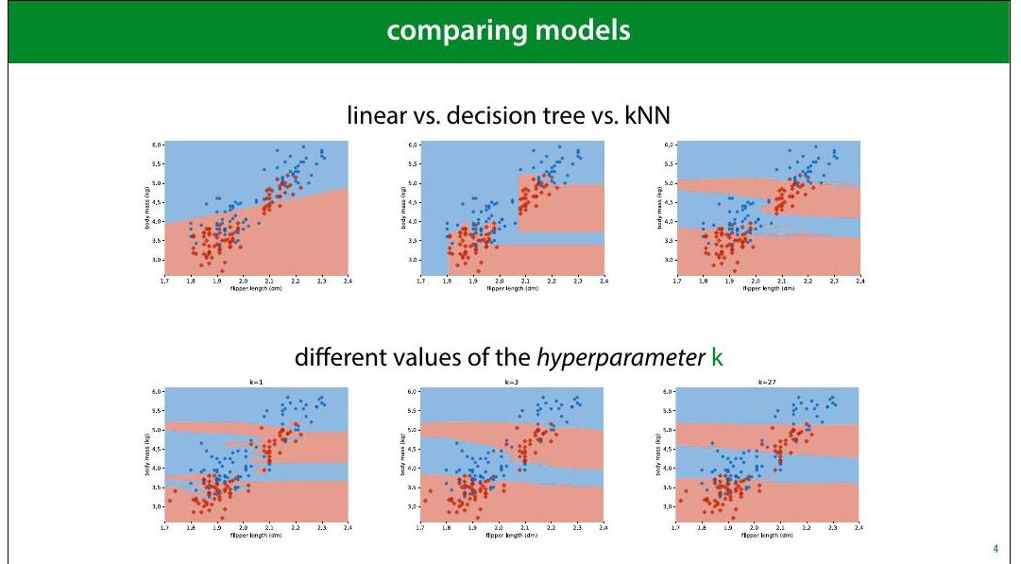
1
Notes:
You compare models to figure out which is the best. Ultimately, to choose which model you want to use in production. This could be literally the production version of a piece of software, or just the model whose predictions you decide to use in the future. Sometimes you are comparing different model types (a decision tree vs a linear model), but you might also be comparing different ways of configuring the same model type. For instance in the kNN classifier, how many neighbours (k) should we look at to determine our classification? With the 2D dataset, we can look at the decision boundary, and make a visual judgment. Usually, that's not the case: our feature space will have hundreds of dimensions, and we'll need to measure the performance of a model.

Slide 3
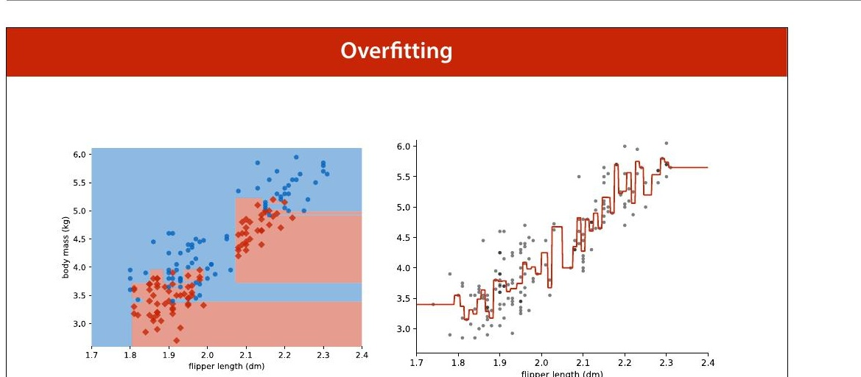
2
Notes:
We've already seen what happens when you evaluate on the training data. A model that fits the training data perfectly may not be much use when it comes to data you haven't seen before.

Slide 4
Never judge your
performance on the
training data
3

Slide 5
the test set
training data
test data
The proportion is not important, the absolute size of the test data is.
We should aim to have at least 500 examples in the test data (10,000 or more is ideal).
4
Notes:
So the first thing we do in machine learning is withhold some data. We train our classifiers on the training data and test on the test data. That way, if we get good performance, we know that we're likely to get a good performance on future data as well, and we haven't just memorised random fluctuations in the training data. How should we split our data? The most important factor is the size in instances of the test data. The bigger this number, the more precise our estimate of our model's error. Ideally, we separate 10,000 test instances, and use whatever we have left over as training data.

Slide 6
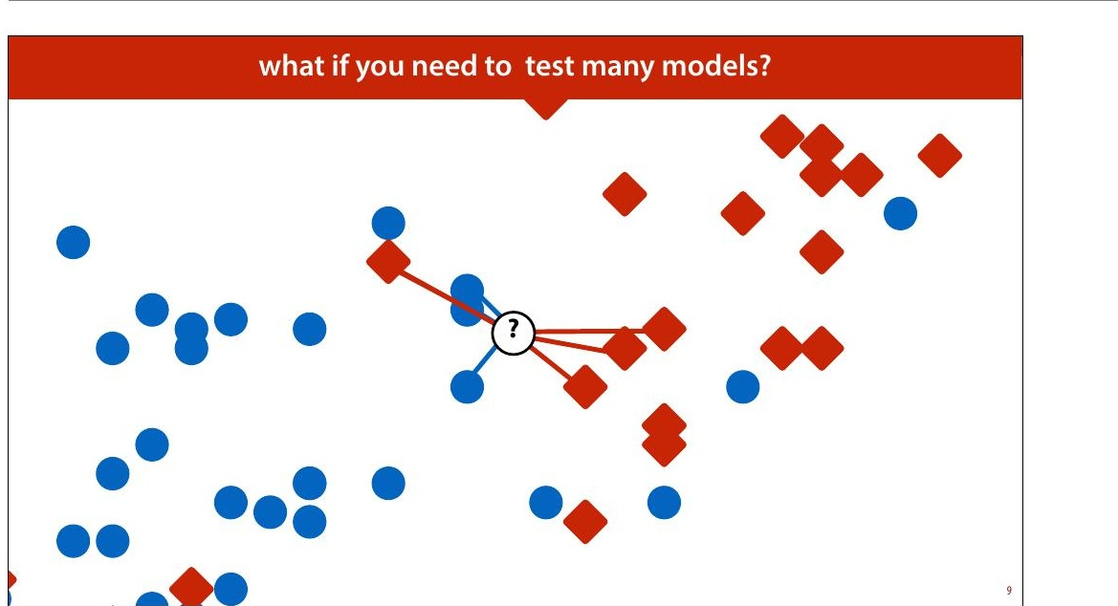
5
Notes:
But even if we withhold some test data, we can still go wrong. We'll use k nearest neighbours (kNN) as a running example. Remember, kNN assigns the class of the k nearest points. k is what is called a hyperparameter. We need to choose its value in some way before we run the algorithm. The algorithm doesn't specify how it should be chosen. One way of choosing k is to try a few values, and to see for which k we get the best performance.

Slide 7
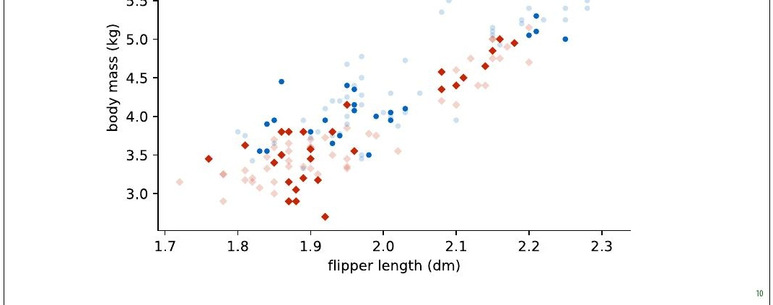
subsampled data
6
Notes:
We will use the data from the first lecture as an example. We will take a small subsample of the dataset, so that the effects that we want to illustrate become exaggerated.

Slide 8
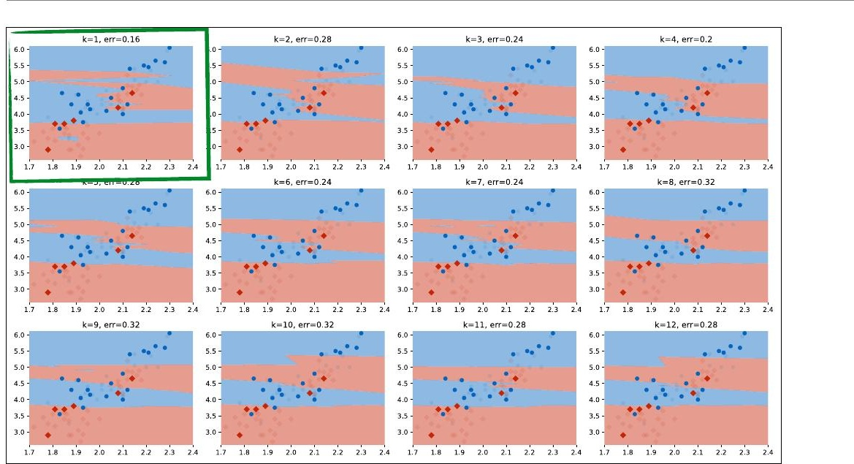
first run: 12 values of k
7
Notes:
Here we've tested 12 different values of k on the same test data (using quite a small test set to illustrate the idea). We can see that for k=1, we get the best performance. We plotted the test data (with the training data in low opacity).

Slide 9
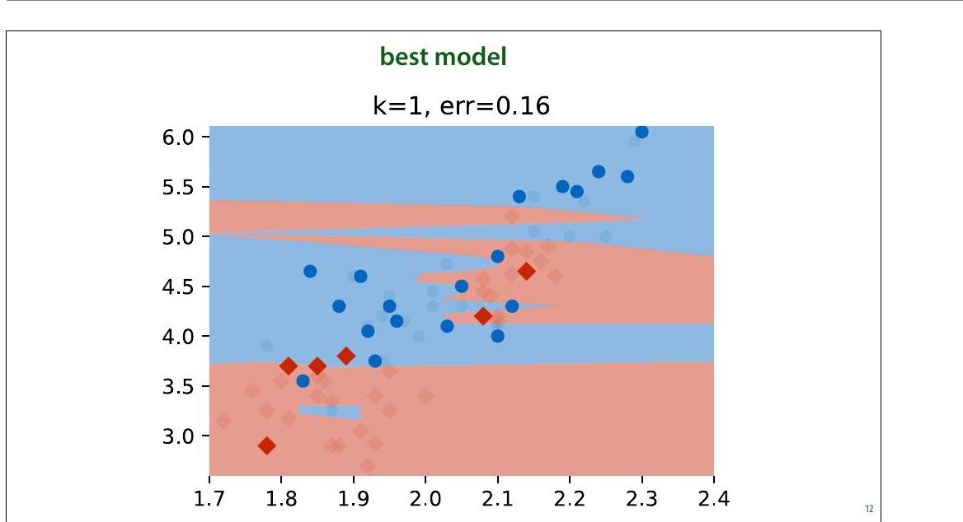
8
Notes:
Here is the best run. Should we conclude that k=1 is definitely a better setting than k=2 or k=3? Should we conclude that we can expect an error of 0.16 on any future data from the same source?

Slide 10
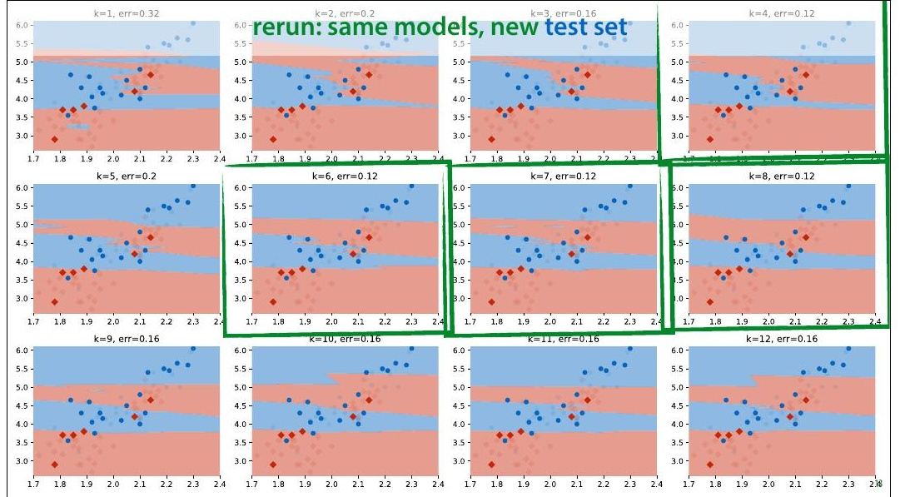
9
Notes:
In this case, we have some more data from the same source, so we can evaluate the classifiers again on a fresh test set. This is a luxury we don't normally have (we normally use all the data we are given). What we see is that k=1 no longer gives us the best performance. In fact, we get a radically different best value of k, and k=1 now gives us the highest error in the run.

Slide 11
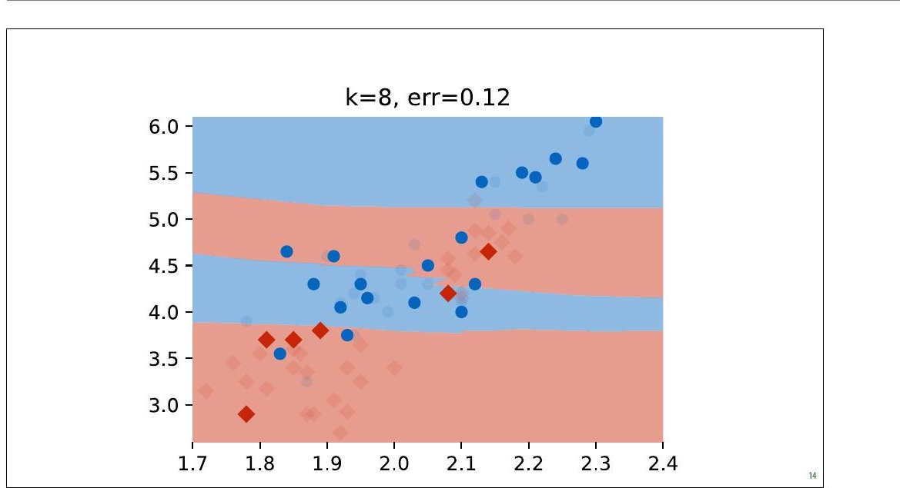
new best model
10
Notes:
Here is one of the new best runs.

Slide 12
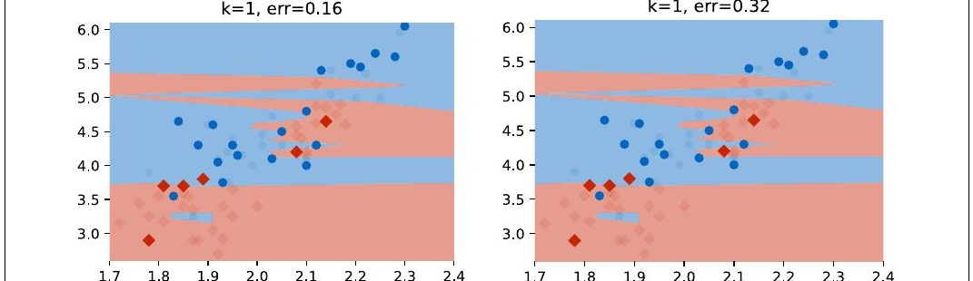
same model, different test sets
11
Notes:
The same models, different test sets and the conclusions are entirely different. We were diligent in splitting our dataset and evaluating only on withheld data, and yet if we had done only one run on one dataset, as we normally would, we would have concluded that k=1 is the best setting and that an error of 0.16 can be expected with that value. If we look at the k=1 model from the second run (the one we chose), we will see that the performance on the new test set is terrible. If we select a model in this way and take it into production, we will find that it performs terribly. So what's happening here?

Slide 13
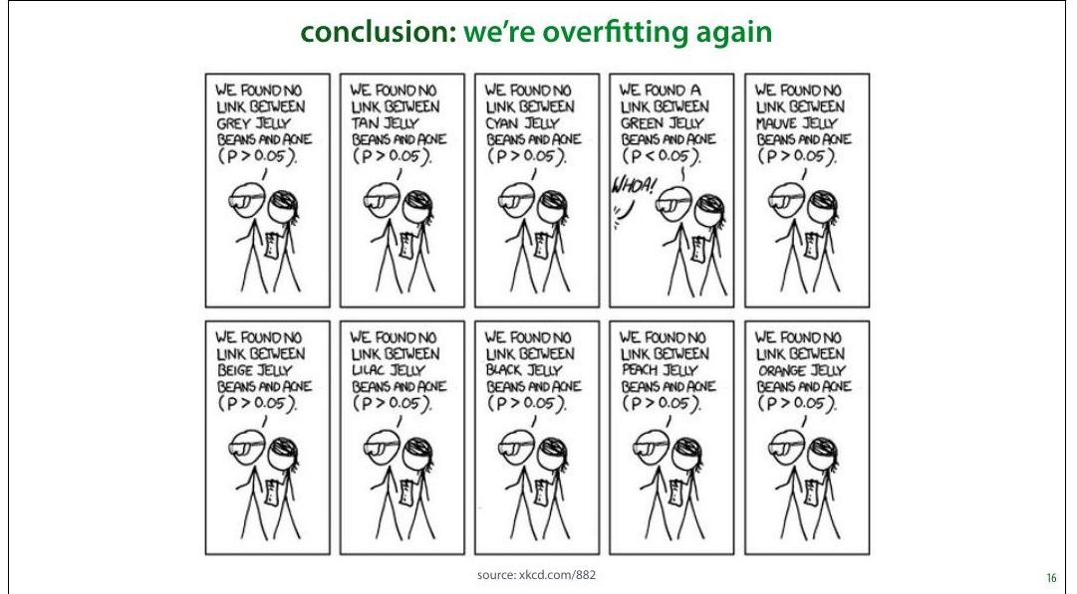
12
Notes:
This is essentially the overfitting problem again. Our method of choosing the hyperparameter k is just another learning algorithm. By testing so many values of k on such a small amount of test data, we are overfitting our choice of k on the test data. The model we choose fits well because of random fluctuations in the data. When we resample the data, these fluctuations disappear and the performance drops. This is an instance of the multiple testing problem in statistics. We're testing so many things, that the likelihood of a noticeable effect popping up by chance increases.

Slide 14
evaluation: the modern recipe
1
Split your data into train and test data.
Sample randomly. At least 500 examples in your test set. In ML benchmarks the test data is often given.
2
Choose your model, hyperparameters, etc. only using the training set.
Save your test set until the very last minute. Don't use it for anything.
3
State your hypothesis
i.e. kNN with k=7 beats existing model X, or kNN with k=7 is better than kNN with k=12
4
Test your hypothesis once on the test data
This is usually at the very end of your project when you write your report or paper.
13
Notes:
There are many different approaches to machine learning experimentation, and not every paper you see will follow this approach, but this is the most common one. It's important to mention in your paper that you followed this approach, since the reader can't usually see it from the presented results.

Slide 15
Don't re-use your
test data
14
Notes:
Just to emphasize the important point: the more you use the test data, the less reliable your conclusions become. Figure out what the end of your project is, and do not touch the test data until the end. In really important and long-term projects, it's not a bad idea to withhold multiple test sets.

Slide 16
validation set
training
validation
test
During model and hyperparam. selection:
train on:
training
test on:
validation
Final run:
(usually)
train on:
training
validation
test on:
test
15
Notes:
This means that you need to test which model to use, which hyperparameters to give it, and how to extract your features only on the training data. In order not to evaluate on the training data for these evaluations, you usually split the training data again: into a (new) training set and a validation set. Ideally, your validation data is the same size as your test set, but you can make it a little smaller to get some more training data.

Slide 17
not this
 | dataset 1 | dataset 2 | dataset 3
other method 1 | 0.15 | 0.08 | 0.27
other method 2 | 0.11 | 0.10 | 0.29
ours (k=1) | 0.89 | 0.45 | 0.23
ours (k=2) | 0.09 | 0.23 | 0.70
ours (k=3) | 0.08 | 0.45 | 0.57
ours (k=4) | 0.15 | 0.56 | 0.32
ours (k=5) | 0.57 | 0.09 | 0.88
ours (k=6) | 0.58 | 0.07 | 0.89
16
Notes:
Here's what you might come across in a bad machine learning paper. In this (fictional) example, the authors are introducing a new method (labeled ours) which has a hyperparameter k. They are claiming that their model beats every baseline, because their numbers are higher (for specific hyperparameters). These numbers create three impressions that are not actually validated by this experiment.

Slide 18
but this
 | dataset 1 | dataset 2 | dataset 3
other method 1 | 0.15 | 0.08 | 0.27
other method 2 | 0.11 | 0.10 | 0.29
k | 3 | 5 | 2
ours | 0.11 | 0.11 | 0.24
“The hyperparameter k was chosen based on a validation set split off from the training data. The test data was used only once.”
17
Notes:
Here is what we should do instead. We should use the training data (with validation withheld) to select our hyperparameters, make a single choice for k for each different dataset, and then estimate the accuracy of only that model. Note that the numbers have changed, because in the previous example the authors gave themselves an advantage by multiple testing. With a proper validation split, that advantage disappears. These numbers are worse, but more accurate.

Slide 19
cross-validation
training
val.
0.3
val.
0.4
val.
0.1
val.
0.3
val.
0.4
average
0.3
18
Notes:
After you've split off a test and validation set, you may be left with very little training data. If this is the case, you can make better use of your training data by performing cross-validation. You split your data into 5 chunks ('folds') and for each specific choice of hyperparameters that you want to test, you do five runs: each with one of the folds as validation data. You then average the scores of these runs.

Slide 20
temporal data: walk-forward validation
time
→
training data
train
v
0.4
train
v
0.1
train
v
0.3
train
v
0.4
⋮
⋮
average
0.3
19
Notes:
If you want to do cross-validation in time-sensitive data, you'll have to slice the dataset like this. The validation fold always comes after the training data in time.

Slide 21
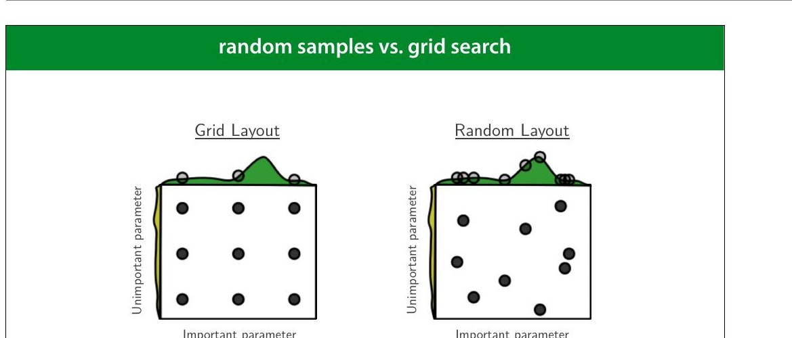
source: Bergstra & Bengio (2012), JMLR
20
Notes:
If you are going to use some kind of automated search, trying a bunch of different combinations of hyperparameter values, random sampling in the hyperparameter space is often better than exhaustively checking a grid. If one parameter turns out not to be important, a grid search restricts us to only three samples over the important parameter, at the cost of training nine different models. If we randomize the samples, we get nine different values of each parameter at the same cost.

Slide 22
Model Evaluation
Part 2: Statistical Testing
Machine Learning
mlvu.github.io
Vrije Universiteit Amsterdam

Slide 23
Machine Learning vs. Statistics
Statistics
ML
Stats but not ML: Analyzing research results. Experiment design. Courtroom evidence.
More ML than Stats: Spam classification, movie recommendation.
30

Slide 24
Can the observed results be attributed to real characteristics of the models under scrutiny or are they observed by chance?

Slide 25
showing confidence: accuracy
accuracy on sample (the test data)
1.0
incorrect
true accuracy
sample accuracy
prob. correct
0.3
0.15
0.0
true accuracy
0.0
0
1
2
3
4
5
6
7
8
9
10
Distribution on sample accuracy
same classifier, resampled test data
confidence interval
34
Notes:
One way of doing this is to compute a confidence interval.
Here we see the process of computing a sample accuracy in
a simple animation: we start with the true accuracy (for
some given classifier, on the data distribution) which is
somewhere between 0 and 1. We sample a bunch of points
from the data distribution (our test set), and take the
relative frequency of correctly classified instances as the
sample accuracy.
Here, in the top half of the slide we model the process of
taking one instance of our test set and seeing whether the
classifier classifies it correctly as a single random draw
resulting in the outcome correct or incorrect. We'll see in
the next lecture that this type of distribution is called a
Bernoulli distribution.
The whole process of sampling the entire test set and
computing the sample accuracy is also a random process. If
we were to repeat it, sampling a new test set, we'd get a
different value for the sample accuracy. To simplify this, we
can look at the total number of instances in our sample that
the classifier classified correctly (so we don't divide by N).
In that case, it turns out we can work out the distribution of
this process as well: the number of
"correct"s we get in N
samples from a Bernoulli distribution forms what is known
as a Binomial distribution.
The technical details aren't important. The main message is
that we can define precisely what distribution we can
expect on the value of the sample accuracy of we keep the
classifier and the true accuracy fixed, but resample the test
data. In this case, we see that for a true accuracy of 0.8, and
a test set of N=10 instances, we are most likely to see that
the classifier correctly classifies 7 instances in our sample
(as we did in the top half of the slide). However, it's also
perfectly possible to see 5, 6, or 8 instances classified
correctly.
This is a complicated picture with multiple random processes
going on. Take a little time to wrap your head around this
before moving on.
Imagine that if we have two classifiers, and we compute
sample accuracies for both on a test set of 10 instances. We
get 5/10 correct for one classifier and 8/10 correct for theconfidence intervals
test set size
accuracy
0.0 1.0
100
1000
10000
accuracy
35
36
other. Can we conclude that the first is definitely worse than
the second? What we see here is that if they both have a
true accuracy of 0.8, it would be perfectly likely to see these
numbers. In short, with such little test data, we have much
uncertainty around our estimate of the true accuracy.
One way to quantify this uncertainty is to draw a
confidence interval. This is simply any interval on the
values of our sample accuracy that captures a given
proportion of the probability mass, usually 95%. You can
draw the confidence interval anywhere you like so long as
you decide how to draw it before seeing the data. The most
common approach is symmetrically around the mean, but
you can also start at the mean and extend it to the right as
far as possible or to the left as far as possible.
The confidence interval captures our uncertainty. We don't
know the true value of the accuracy, and we can't estimate it
very accurately, but we know it's most likely one of these
values.

Slide 26
confidence intervals
accuracy
test set size
0.0
1.0
100
1000
10000
Notes:
The size of this confidence interval depends on two factors:
the true accuracy and the size of the test set. Here are some
examples for different accuracies and test set sizes.
This tells us that if the true success probability (accuracy)
of a classifier is 0.5, and the test set contains 100 examples,
our confidence interval has size 0.2. This means that even if
we report 0.5 as the accuracy, we may well be wrong by as
much as 0.1 either side.
Even if these confidence intervals are usually not reported,
you can easily work them out (or look them up) yourself.
So, if you see someone say that classifier A is better than
classifier B because A scored 60% accuracy and and B score
59%, on a test set of 100 instances, you have reason to be
sceptical.
In short, this is why large test sets are important. Without
at least 1000 instances in your test data, you cannot reliably
tell the difference between two classifiers.

Slide 27
test set size
Confidence depends on the size of the test set.
Not on the proportion train vs test

Slide 28
confidence interval estimates
unobservable
observable
data distribution: p(x, t)
instances x and classes t
dataset
true accuracy of C
probability that C(x) = t under p
sample accuracy of C
proportion of test set that C classifies correctly
true confidence interval
estimated confidence interval
true accuracy
sample accuracy (estimated from data)
Notes:
These are good concepts to help us think about what we are
measuring when we compute metrics on our test data. But
it's important to realize that these are unobservable values.
We can only work out the true confidence interval for the
sample accuracy if we know the true accuracy. This puts the
confidence intervals we've talked about so far in the
unobservable column.
So what about all those confidence intervals you see
reported in the literature? These are estimated confidence
intervals. They are usually computed in the same way as the
true confidence interval, but wherever we need the true
value of some metric, we replace it by its estimate. This
gives us a confidence interval that isn't as correct as the
true confidence interval, and one that would change slightly
if we were to resample the test set, but we can at least
compute it, and it generally behaves in roughly the same
way as the true confidence interval.

Slide 29
about confidence interval estimates
Don’t say: the probability that the true mean is in this confidence interval is 95%.
Do say: If we repeat the experiment many times, computing the confidence interval each time; the true mean would be inside the interval in 95% of those experiments.
The confidence interval changes from experiment to experiment, not the true mean.
The estimated confidence interval for the mean is a statistic on the data, just like the mean itself or the standard deviation.
41

Slide 30
interpreting error bars
Notes:
A very relevant question is how do you interpret error
bars?
If you see a picture like this, showing the mean runtime of
an experiment, measured for three models, and averaged
over a number of runs, what would you imagine the error
bars denote? We've seen standard deviations, standard
errors and confidence intervals. What do error bars
represent?

Slide 31
data: 3, 4, 6, 3
data: 3, 4, 5, 2, 8, 7,
8, 2, 3, 5, 7, 0, 2, 4,
6, 7, 0, 4, 5, 1, 8, 7,
1, 2, 3, 5, 7, 4
43
Notes:
The truth is that there is no standard definition for what
error bars denote, and if the authors didn’t specify what
their error bars indicate, the authors messed up.
These are the three most common options. If you didn't
quite get all the details of the previous slides, this slide
illustrates the most important distinction: If we sample
more data, the estimate of our standard deviation
becomes more accurate. It’s an estimate of a property of our
data distribution. The error bars representing standard
deviation don't get smaller, they just get closer to their
correct size (which may be very wide around the head of
the bar).
The standard error and the confidence interval are
indicators of how confident we are about our estimate of
the mean of our data. For these, the more data we have, the
smaller they get. As we saw earlier, under the right
assumptions, the 95% confidence interval is roughly twice
the standard error.

Slide 32
spread vs. confidence
standard deviation:
measure of spread, variance
standard error, confidence interval:
measures of confidence
with more data:
std dev stays the same, std error and CI shrink

Slide 33
overlap
standard
error
confidence
interval
A
B
A
B
overlap implies
not a sign. difference
between A and B
no overlap implies
sign. difference
between A and B
45
Notes:
Under certain assumptions, the standard error of two
estimates can tell you whether a Student's t test allows you
to reject the null hypothesis that the two distributions are
the same. This would allow you to say, for instance, that
there is a statistically significant difference between the
accuracy estimates on two classifiers. As we said before,
such testing is not very popular in machine learning, so we
won't go into it in detail, but this can offer an additional
perspective on error bars.
We won’t discuss the Student’s t test in detail, but it’s a
common test for comparing two normally distributed values.
Say you plot the mean squared error for regression models
A and B, together with some error bars. Does the the fact
that the error bars overlap or not tell you whether the
measured difference between the two models is statistically
significant? That is, does it indicate whether we can
conclude that A is a better model than B?
Yes, but we have to be careful. For standard error bars, the
existence of overlap implies that there is no significant
difference between the two effects. That is, the possibility
that the difference is due to random chance is high, and a
repeat of the experiment on new data may show a different
result. If you plot confidence interval error bars, and there
is no overlap, you may conclude that the difference between
the models is significant. If you repeat the experiment on
fresh data, it is very likely that model A would beat model B
again.
In both cases, the converse does not hold. If the SEM error
bars do not overlap, there may or may not be a significant
difference. If the confidence interval error bars do overlap,
there may still be a significant difference, depending on
how much they overlap.
All of this requires the assumption that the original values for
which the bar indicates the mean are normally distributed.

Slide 34
Why Stats in ML?
✓
≡
Show Confidence
Show Spread
Quantify certainty in predictions with confidence intervals, p-values, and statistical tests
Visualize variability in data through standard deviation, variance, and distribution plots

Slide 35




If you show spread:
Describe the dimensions of variability
Different customers
Different domains
Different model parameters
…

Slide 36
Model Evaluation
Part 3: Evaluation Metrics
Machine Learning
mlvu.github.io
Vrije Universiteit Amsterdam

Slide 37
Regression
Loss function: Mean Squared Error
MSE = (1/n) ∑ᵢ ( f(xᵢ) − tᵢ )²
Evaluation function: Root Mean Squared Error
RMSE = √[ (1/n) ∑ᵢ ( f(xᵢ) − tᵢ )² ]
RMSE has the same units as the output → easier to interpret.

Slide 38
Bias and Variance
optimal
MSE
true
MSE
measured
MSE
0.0
Bias
Variance
Irreducible Error

Slide 39
Bias and Variance
low bias, low variance
low bias, high variance
high bias, low variance
high bias, high variance

Slide 40
Bias and Variance: Dartboard Metaphor
Low Variance
High Variance
Low
Bias
High
Bias
Metaphor source: scott.fortmann-roe.com/docs/BiasVariance.html

Slide 41
High Bias: Underfitting
What happens
The model is too simple to capture the true shape of the data. A linear model forced through data with a parabolic pattern cannot follow the curve.
Characteristics
Poor assumptions or poor model capacity
Error stays the same when you resample
Also called underfitting

Slide 42
High Variance: Overfitting
What happens
The model has enough capacity to follow every random fluctuation in the training data. It fits perfectly but will fail on new data.
Characteristics
High model capacity, captures noise
Error varies wildly when you resample
Also called overfitting

Slide 43
Making the Tradeoff
Reducing Bias
Increase model capacity.
Increase number of features.
Reducing Variance
Reduce model capacity.
Add regularization.
Reduce tree depth.
k-NN Regression
Increase k → increase bias, decrease variance.
k=1: high variance | k=25: high bias
Often a real tradeoff: reducing bias increases variance and vice versa.

Slide 44
Evaluating Classification
Class imbalance, cost imbalance
Confusion matrix
True positive rate, true negative rate
Precision, recall
ROC plot, coverage matrix, AUC

Slide 45
Example: Breast Cancer Screening
Should all women over 50 be screened for breast cancer?
This is a classification problem: the instances are people, the target label is "has cancer" or "has no cancer." More screening seems obviously good — but we need to account for classifier quality and the costs of mistakes.
Class Imbalance
Cost Imbalance
~1% of screened women will have breast cancer. Far more negatives than positives.
Missing a cancer (FN) is far worse than a false alarm (FP), but false positives have real costs too.
Accuracy alone is misleading when classes and costs are imbalanced.

Slide 46
Misleading Accuracy Headlines
"AI judge correctly predicts court case results 80% of time"
— VentureBeat, October 2016
First question to ask:
In this case:
What was the class distribution in the training data? If 90% are acquittals, 80% accuracy is trivial — a majority class classifier achieves 90%.
Classes were balanced 50/50, so 80% is notable. But a model trained on balanced data will fail in production where classes are not 50/50.

Slide 47
Class Imbalance vs Cost Imbalance
Class Imbalance
How much more likely is a Positive example than a Negative example?
When one class vastly outnumbers the other, accuracy can be misleading.
Cost Imbalance
How much worse is a mislabeled Positive example than a mislabeled Negative example?
Different types of misclassification carry different real-world costs.

Slide 48
Cost Imbalance: Examples
Disease diagnosis
FN: Sending a sick person home vs FP: Invasive tests on a healthy person
Spam classification
FN: Deleting a valid email vs FP: Showing user a single spam email
Financial fraud
FN: Missing a fraud in progress vs FP: Expert reviews a harmless transaction
Domain-specific evaluation: assign a cost to each misclassification type, multiply by frequency. Minimize total cost (dollars lost, time lost, lives lost).

Slide 49
Class Imbalance
A classifier on this data might look good with 95% accuracy — but so does always predicting Negative.

Slide 50
Class Imbalance: Majority Class Baseline
Method | Error
Other method 1 | 0.15
Other method 2 | 0.10
Majority class | 0.05
Our model | 0.05
Majority Class Classifier
Assigns every instance the most prevalent class. This is a baseline — not a real model, but it calibrates your expectations.
With 95/5 imbalance, the useful error range is only 0 to 0.05. Anything worse than that is useless.

Slide 51
Class Imbalance: Train/Test Split Problem
10,000 instances total
training
test
1,000 test instances with 5% positives:
950 negative
The problem
Only 50 positive instances in the test set. Your evaluation is essentially: how many of these 50 did you find? That gives you only ~50 distinguishable performance levels. Making the test set bigger steals from already-scarce positive training examples.

Slide 52
Other Performance Metrics
Confusion matrix
Full breakdown of predictions vs actual classes
Precision, recall
Focus on the positive class predictions
True positive rate, false positive rate
Rates relative to actual positives and negatives
ROC plot, AUC
Threshold-independent performance curves
Coverage matrix
Evaluate across operating points
Most of these only matter with class or cost imbalance. For balanced datasets, accuracy may suffice.

Slide 53
Confusion Matrix
predicted
 | pos | neg
pos | 6 | 1 | 7
neg | 2 | 5 | 7
 | 8 | 6 | 14
actual
Diagonal = correct predictions. Off-diagonal = errors.
Reveals the balance of false positives vs false negatives.

Slide 54
True Positives, False Positives, FN, TN
predicted
 | pos | neg
pos | True Positives | False Negatives
neg | False Positives | True Negatives
True Positive: Actually positive, predicted positive
False Positive: Actually negative, predicted positive
False Negative: Actually positive, predicted negative
True Negative: Actually negative, predicted negative
Correct
FP
FN

Slide 55
With Class Imbalance: Majority Class Baseline
Majority class classifier on imbalanced data (96% positive):
predicted
 | pos | neg
pos | 385 | 0 | 385
neg | 15 | 0 | 15
 | 400 | 0 | 400
actual
Predicting everything as positive gives 96.25% accuracy (385/400) but is completely useless — it misses 0% of negatives. The confusion matrix reveals what accuracy hides.

