Slide 1
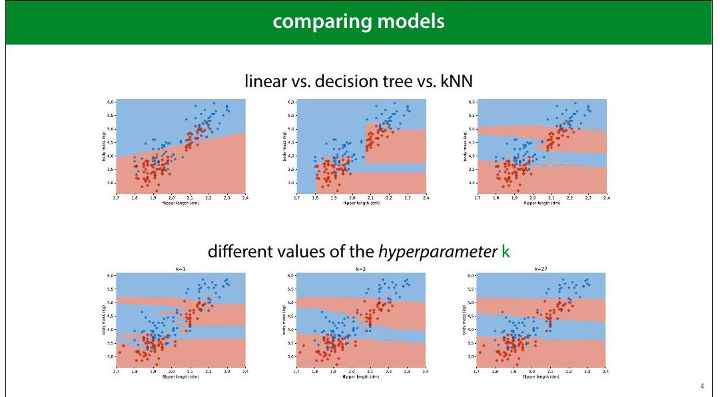
Notes:
You compare models to 8igure out which is the best.
Ultimately, to choose which model you want to use in
production.
This could be literally the production version of a piece of
software, or just the model whose predictions you decide to
use in the future.
Sometimes you are comparing different model types (a
decision tree vs a linear model), but you might also be
comparing different ways of con8iguring the same model
type. For instance in the kNN classi8ier, how many
neighbours (k) should we look at to determine our
classi8ication?
With the 2D dataset, we can look at the decision boundary,
and make a visual judgment. Usually, that’s not the case: our
feature space will have hundreds of dimensions, and we’ll
need to measure the performance of a model.

Slide 2
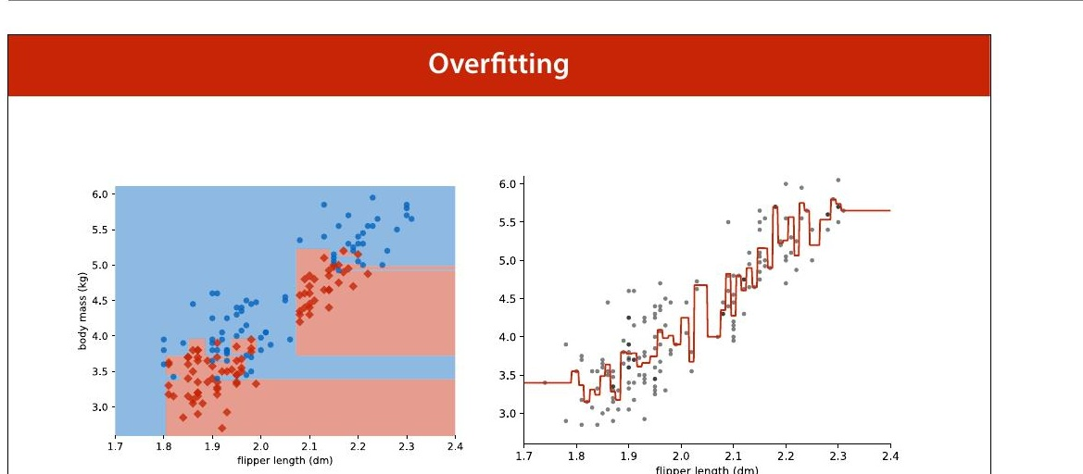
Notes:
We’ve already seen what happens when you evaluate on the
training data. A model that 8its the training data perfectly
may not be much use when it comes to data you haven't
seen before.

Slide 3
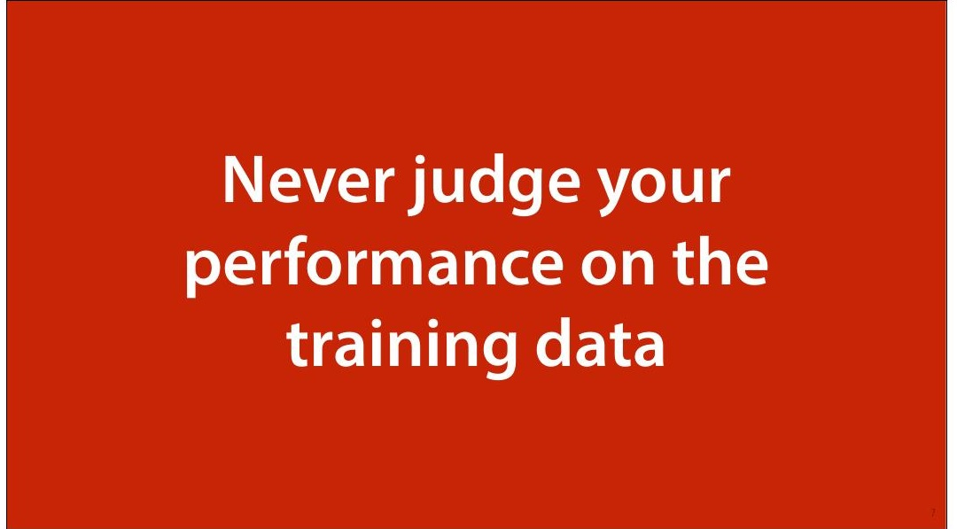

Slide 4
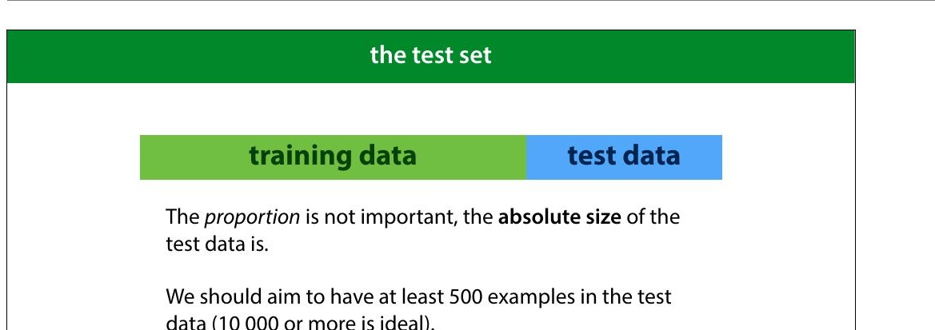
Notes:
So the 8irst thing we do in machine learning is withhold
some data. We train our classi8iers on the training data and
test on the test data. That way, if we get good performance,
we know that we’re likely to get a good performance on
future data as well, and we haven’t just memorised random
8luctuations in the training data.
How should we split our data? The most important factor is
the size in instances of the test data. The bigger this
number, the more precise our estimate of our model’s error.
Ideally, we separate 10 000 test instances, and use
whatever we have left over as training data. Unfortunately,
this is not always realistic. We’ll look at this a little more
later.

Slide 5
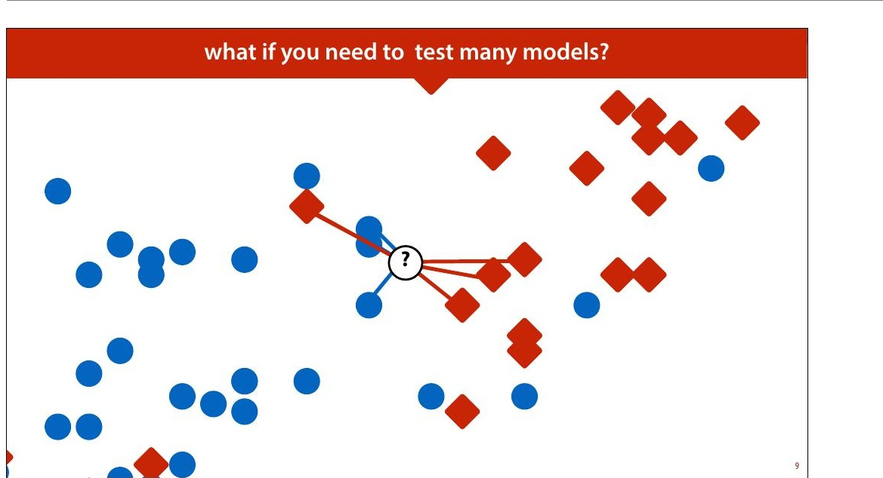
Notes:
But even if we withhold some test data, we can still go
wrong. We’ll use k nearest neighbours (kNN) as a running
example. Remember, kNN assigns the class of the k nearest
points.
k is what is called a hyperparameter. We need to choose
its value in some way before we run the algorithm. The
algorithm doesn't specify how it should be chosen. One way
of choosing k is to try a few values, and to see for which k
we get the best performance.

Slide 6
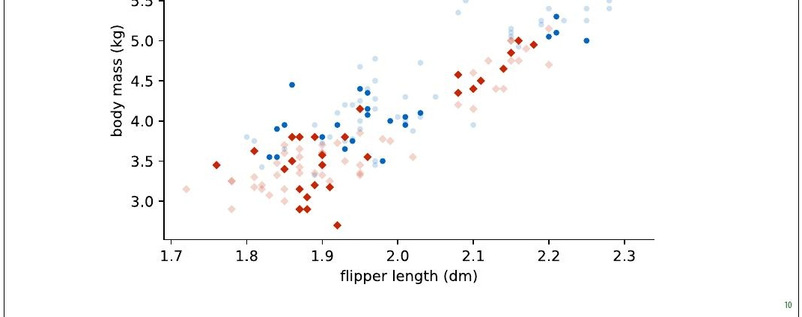
Notes:
We will use the data from the 8irst lecture as an example.
We will take a small subsample of the dataset, so that the
effects that we want to illustrate become exaggerated.

Slide 7
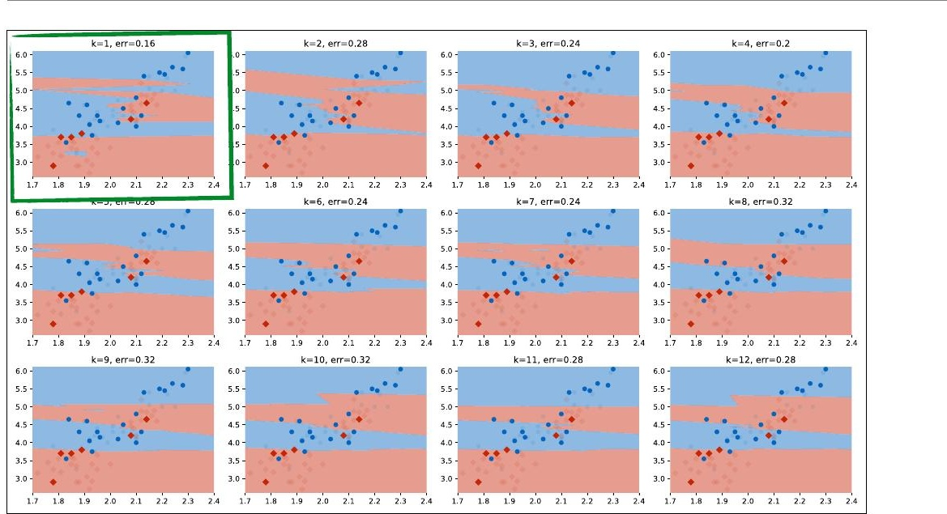
Notes:
Here we’ve tested 12 different values of k on the same test
data (using quite a small test set to illustrate the idea). We
can see that for k=1, we get the best performance. We
plotted the test data (with the training data in low opacity).

Slide 8
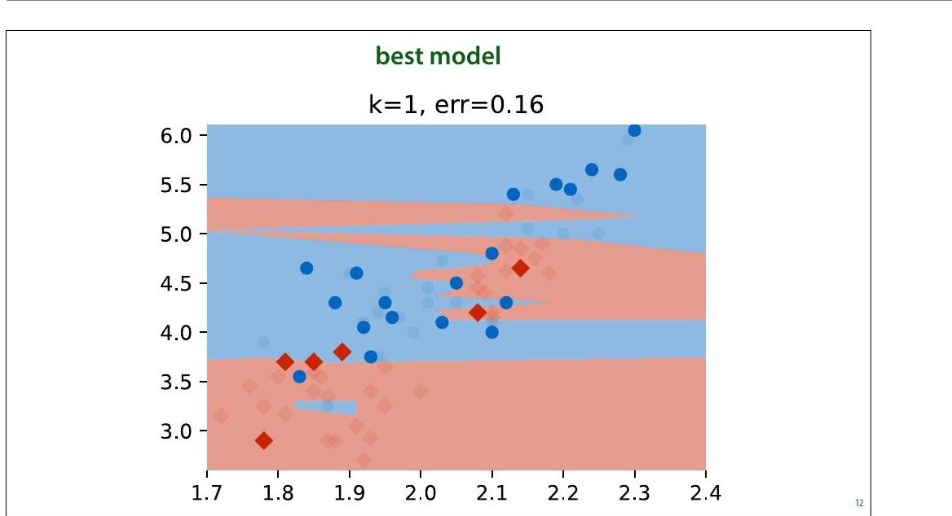
Notes:
Here is the best run. Should we conclude that k=1 is
de8initely a better setting than k=2 or k=3? Should we
conclude that we can expect an error of 0.16 on any future
data from the same source?

Slide 9
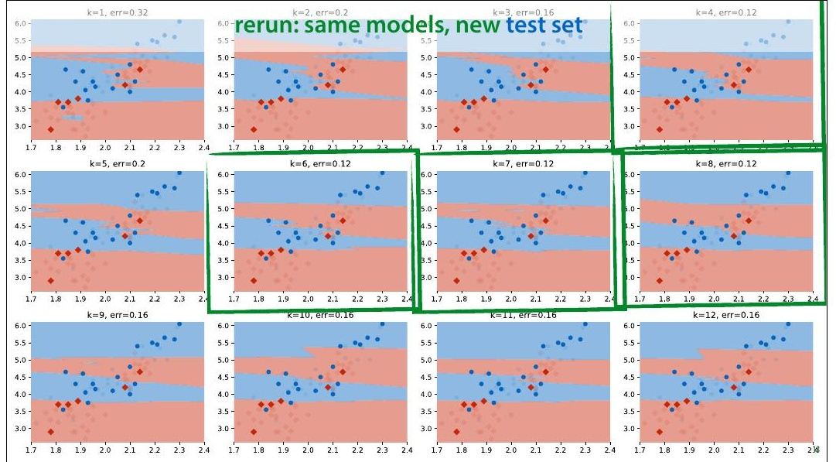
Notes:
In this case, we have some more data from the same source,
so we can evaluate the classi8iers again on a fresh test set.
This is a luxury we don't normally have (we normally use all
the data we are given).
What we see is that k=1 no longer gives us the best
performance. In fact, we get a radically different best value
of k, and k=1 now gives us the highest error in the run.

Slide 10
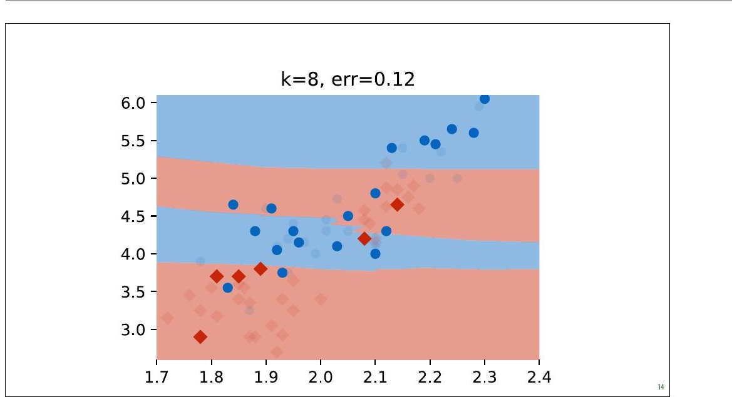
Notes:
Here is one of the the new best runs.

Slide 11
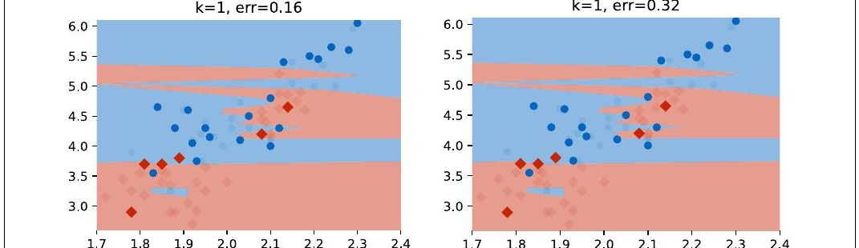
Notes:
The same models, different test sets and the conclusions are
entirely different. We were diligent in splitting our dataset
and evaluating only on withheld data, and yet if we had
done only one run on one dataset, as we normally would,
we would have concluded that k=1 is the best setting and
that an error of 0.16 can be expected with that value.
If we look at the k=1 model from the second run (the one
we chose), we will see that the performance on the new test
set is terrible. If we select a model in this way and take it
into production, we will 8ind that it performs terribly.
So what's happening here?

Slide 12
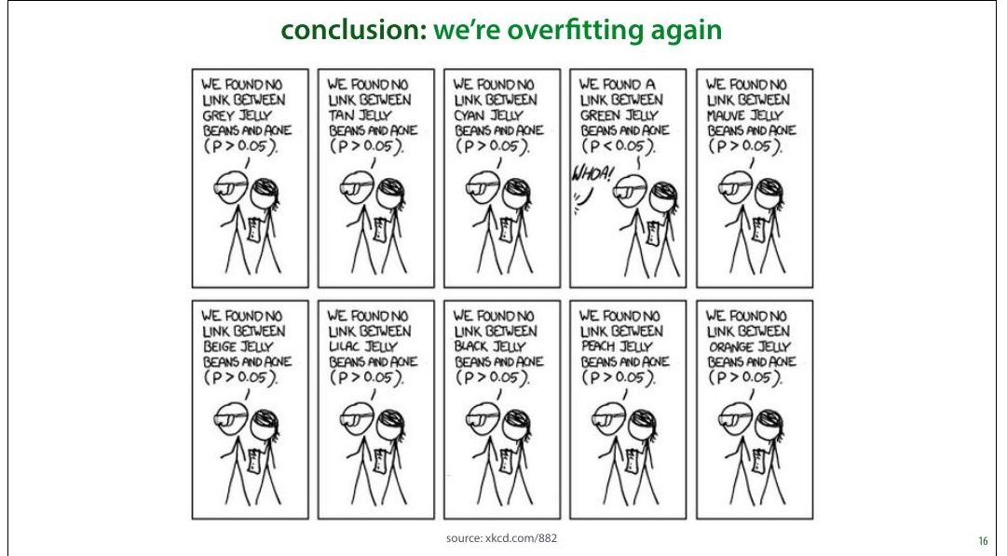
Notes:
This is essentially the over8itting problem again. Our
method of choosing the hyperparameter k is just another
learning algorithm. By testing so many values of k on such a
small amount of test data, we are over8itting our choice of k
on the test data. The model we choose 8its well because of
random 8luctuations in the data. When we resample the
data, these 8luctuations disappear and the performance
drops.
This is an instance of the multiple testing problem in
statistics. We’re testing so many things, that the likelihood
of a noticeable effect popping up by chance increases. We
are in danger of ascribing meaning to random 8luctuations.
Speci8ically, in our case, the k=1 classi8ier got lucky on a
few examples, that just happened to fall on the right side of
the decision boundary. If we draw some new data, the same
classi8ier won't be lucky again. The more different values of
k we try, the more we are in danger of this kind of random
luck determining which hyperparameters come out as

Slide 13
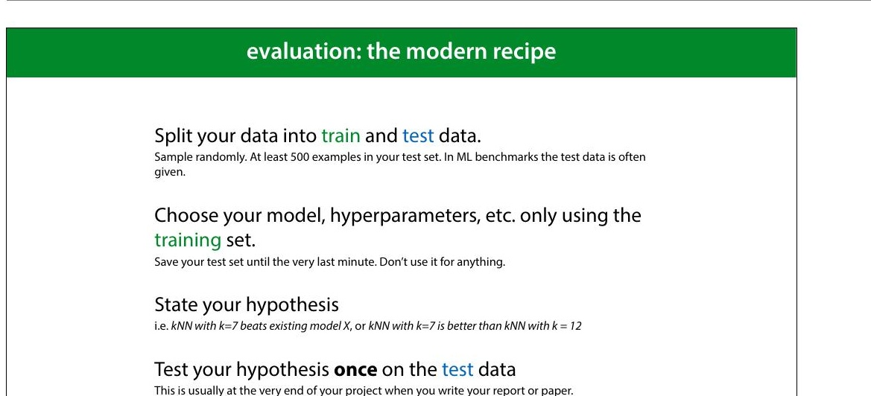
Notes:
There are many different approaches to machine learning
experimentation, and not every paper you see will follow
this approach, but this is the most common one.
It’s important to mention in your paper that you followed
this approach, since the reader can’t usually see it from the
presented results.

Slide 14
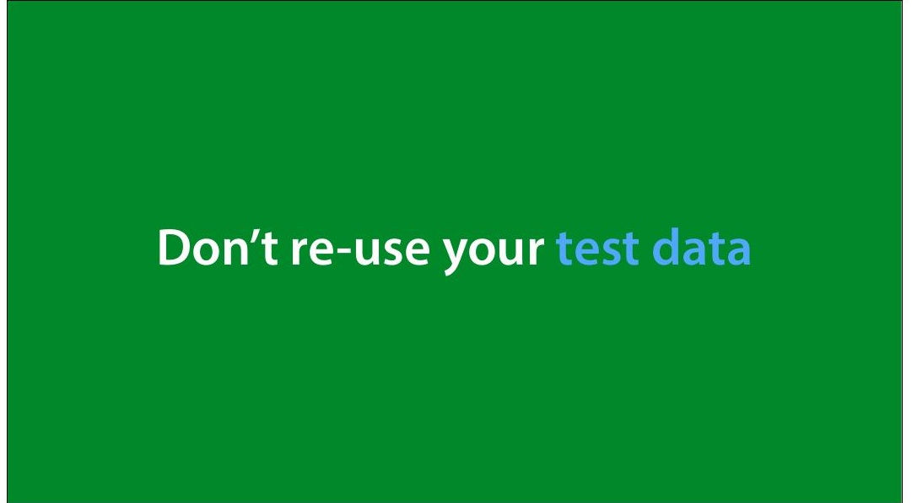
Notes:
Just to emphasize the important point: the more you use
the test data, the less reliable your conclusions become.
Figure out what the end of your project is, and do not touch
the test data until the end.
In really important and long-term projects, it’s not a bad
idea to withhold multiple test sets. This allows you to still
test your conclusions in case you’ve ended up using the
original test data too often.

Slide 15
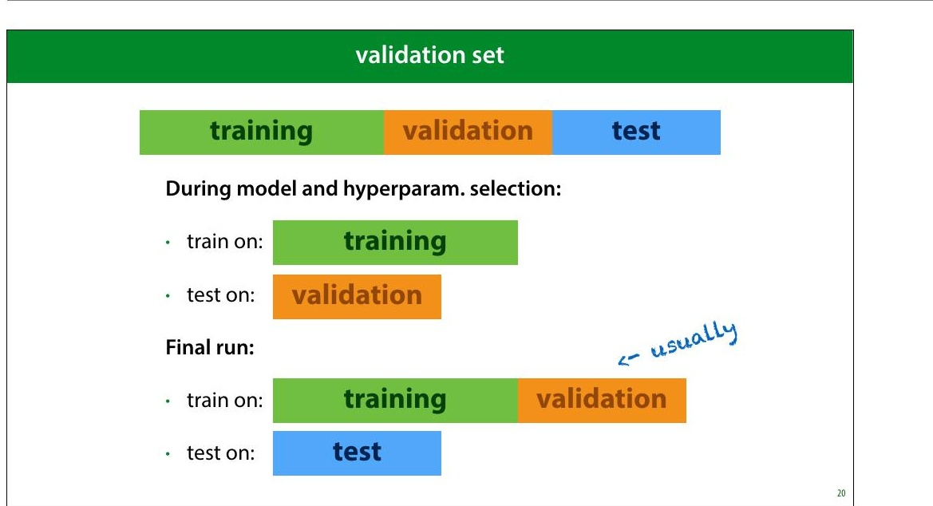
Notes:
This means that you need to test which model to use, which
hyperparameters to give it, and how to extract your
features only on the training data. In order not to evaluate
on the training data for these evaluations, you usually split
the training data again: into a (new) training set and a
validation set.
Ideally, your validation data is the same size as your test set,
but you can make it a little smaller to get some more
training data.
This means that you need to carefully plan your research
process. If you start out with just a single split and keep
testing on the same test data, there’s no going back (you
can’t unsee your test data). And usually, you don’t have the
means to gather some new dataset.
It’s usually 8ine in the 8inal run to append the validation
data to your training data. This is not always the case
however, so if you use a standard benchmark you should
check if this is allowed, and if you use your own dataset, you
should describe carefully whether you do this.

Slide 16
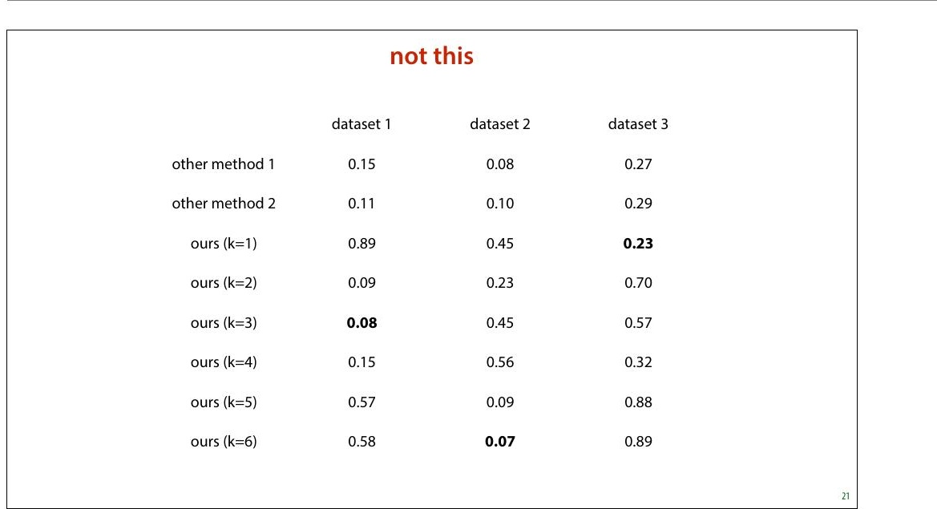
Notes:
This may seem like a simple principle to follow, but it goes
wrong a lot. Not just in student papers, also in published
research.
Here’s what you might come across in a bad machine
learning paper. In this (8ictional) example, the authors are
introducing a new method (labeled ours) which has a
hyperparameter k. They are claiming that their model beats
every baseline, because their numbers are higher (for
speci8ic hyperparameters).
These numbers create three impressions that are not
actually validated by this experiment:
That the authors have a better model than the two other •
methods shown.
That if you want to run the model on dataset 1, you •
should use k=3
That if you have data like dataset 1, you can then expect •
an error of 0.08.

Slide 17
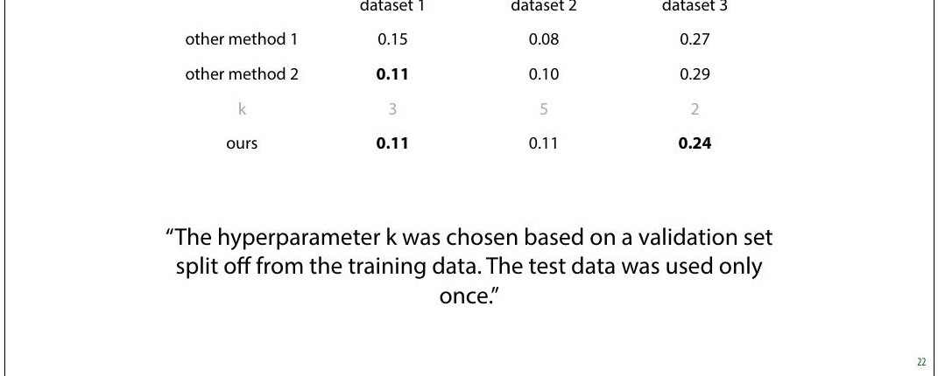
Notes:
Here is what we should do instead. We should use the
training data (with validation withheld) to select our
hyperparameters, make a single choice for k for each
different dataset, and then estimate the accuracy of only
that model.
Note that the numbers have changed, because in the
previous example the authors gave themselves an
advantage by multiple testing. With a proper validation
split, that advantage disappears. These numbers are worse,
but more accurate. (I made these numbers up, but this is
the sort of thing you might see)
Now, we can actually draw the conclusions that the table
implies:
On dataset 3, the new method is the best. •
If we want to use the method on dataset 3 (or similar •
data) we should use k=2
If our data is similar to that of dataset 3, we could expect •

Slide 18
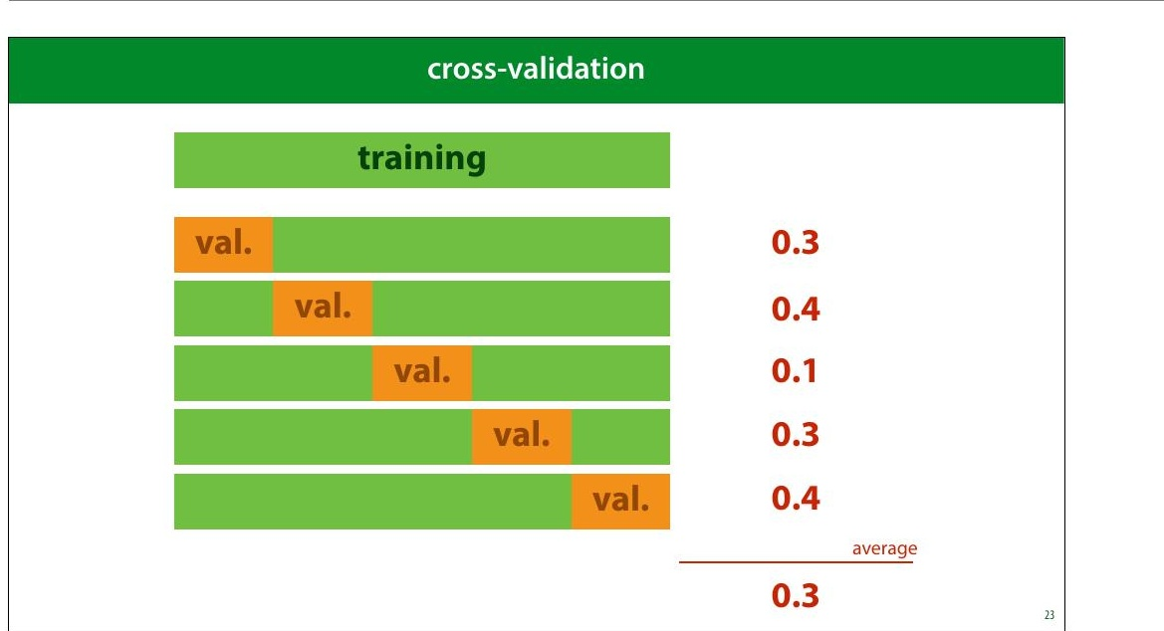
Notes:
After you’ve split off a test and validation set, you may be
left with very little training data. If this is the case, you can
make better use of your training data by performing cross-
validation. You split your data into 5 chunks (“folds”) and
for each speci8ic choice of hyperparameters that you want
to test, you do 8ive runs: each with one of the folds as
validation data. You then average the scores of these runs.
This can be costly (because you need to train 8ive times as
many classi8iers), but you ensure that every instance has
been used as a training example once.
After selecting your hyperparameters with crossvalidation,
you still test once on the test data.
You may occasionally see papers that estimate error of their
8inally chosen model by cross validation as well (splitting
off multiple test sets), but this is a complicated business,
and has fallen out of fashion. We won’t go into in this
course.

Slide 19
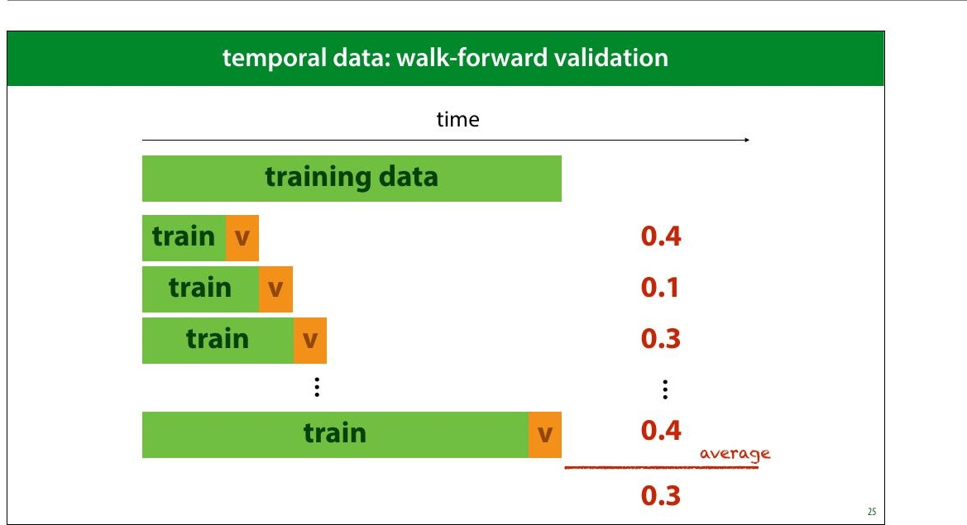
Notes:
If you want to do cross-validation in such time sensitive
data, you’ll have to slice the dataset like this.

Slide 20
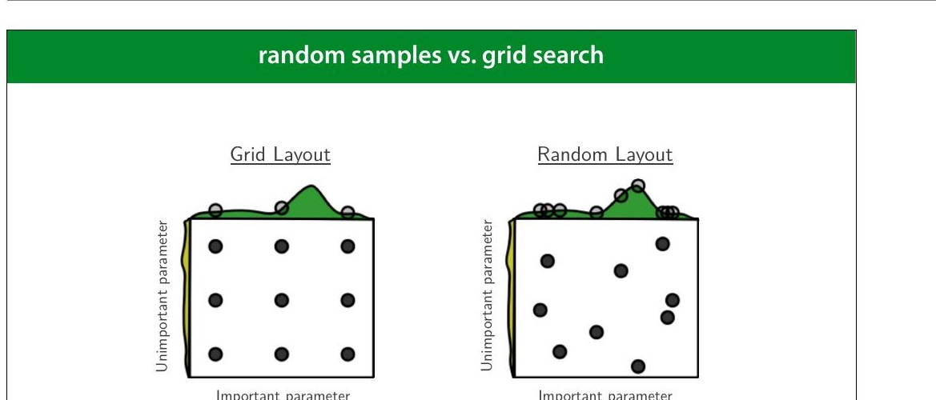
Notes:
If you are going to use some kind of automated search,
trying a bunch of different combinations of hyperparameter
values, and then trying random samples in the hyper
parameter space is often better than exhaustively checking
a grid. This picture neatly illustrates why. If one parameter
turns out not to be important, and another does, a grid
search restricts us to only three samples over the important
parameter, at the cost training nine different models.
If we randomize the samples, we get nine different values of
each parameter at the same cost.
source: http://www.jmlr.org/papers/volume13/
bergstra12a/bergstra12a.pdf (recommended reading)

