Slide 1
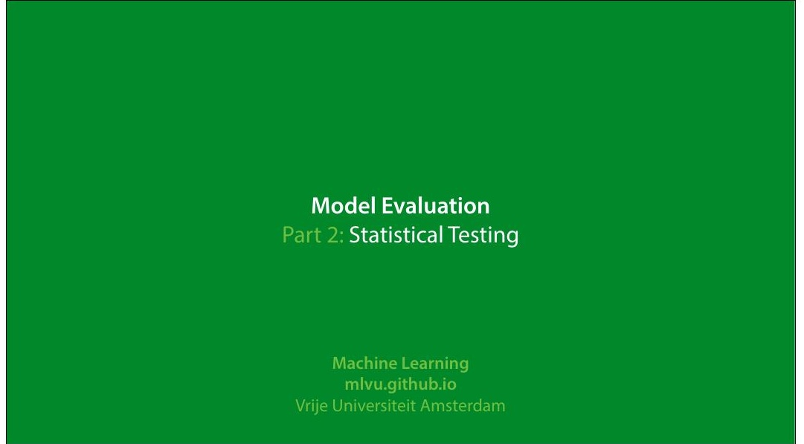
Notes:
|section|Statistical Testing|
|video|https://surfdrive.surf.nl/8iles/index.php/s/
AoCsdmxAmof17Y9/download|

Slide 2
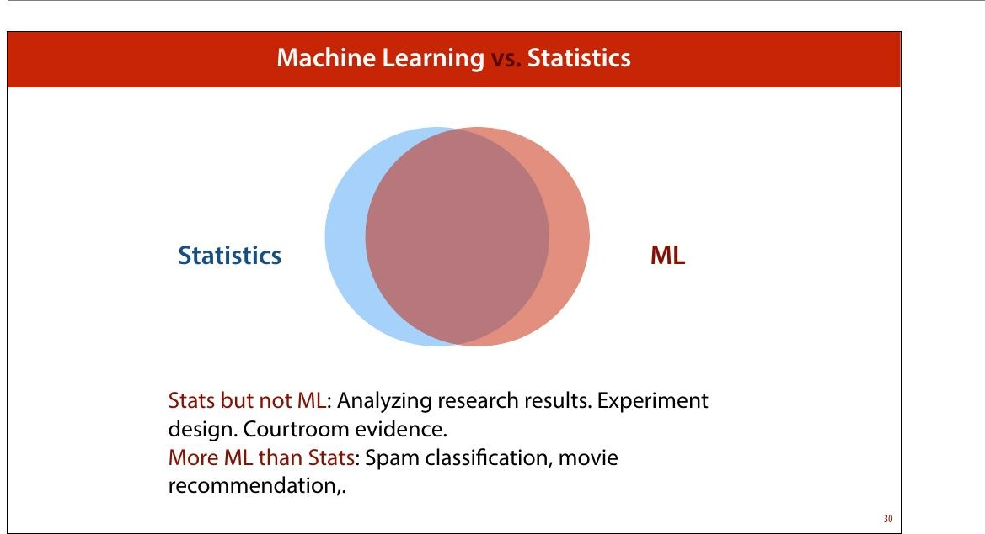
Notes:
As noted in the 8irst lecture, statistics and ML are very
closely related. It’s surprising then, that when we perform
ML experiments, we use relatively little of the statistics
toolkit. We don’t often do signi+icance tests, for instance.

Slide 3
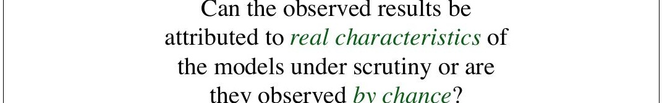
Notes:
This brings us to the main question that statistical analysis
is meant to answer. If we do things properly, and we have a
large dataset, our estimate will be close to the true value.
Often, we can even prove how close it is likely to be. But
there will be some difference, which will be entirely
random.
So, when we estimate the test accuracy of models A and B
and we see that classi8ier A is better than classi8ier B
because their estimated accuracies on the test set are .997
and .998 respectively, can we really trust that statement?
Maybe this random noise we get when we compute the
estimate of the accuracy caused this difference. In other
words, how sure can we be, from these values, that the
true accuracy of A is also higher than the true accuracy
of B?
quote source: http://www.icmla-conference.org/icmla11/
PE_Tutorial.pdf

Slide 4
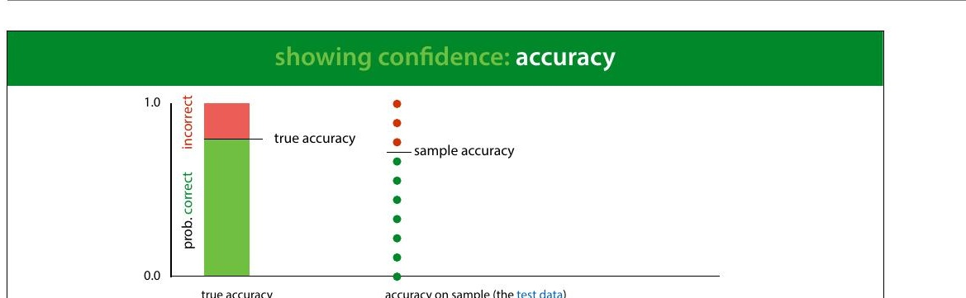
Notes:
One way of doing this is to compute a con+idence interval.
Here we see the process of computing a sample accuracy in
a simple animation: we start with the true accuracy (for
some given classi8ier, on the data distribution) which is
somewhere between 0 and 1. We sample a bunch of points
from the data distribution (our test set), and take the
relative frequency of correctly classi8ied instances as the
sample accuracy.
Here, in the top half of the slide we model the process of
taking one instance of our test set and seeing whether the
classi8ier classi8ies it correctly as a single random draw
resulting in the outcome correct or incorrect. We'll see in
the next lecture that this type of distribution is called a
Bernoulli distribution.
The whole process of sampling the entire test set and
computing the sample accuracy is also a random process. If
we were to repeat it, sampling a new test set, we'd get a
different value for the sample accuracy. To simplify this, we
can look at the total number of instances in our sample that

Slide 5
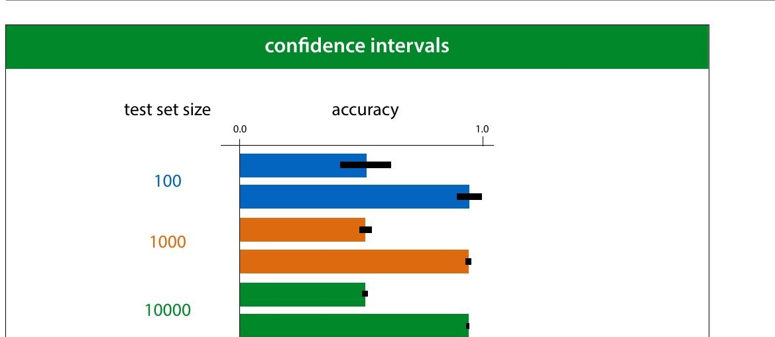
Notes:
The size of this con8idence interval depends on two factors:
the true accuracy and the size of the test set. Here are some
examples for different accuracies and test set sizes.
This tells us that if the true success probability (accuracy)
of a classi8ier is 0.5, and the test set contains 100 examples,
our con8idence interval has size 0.2. This means that even if
we report 0.5 as the accuracy, we may well be wrong by as
much as 0.1 either side.
Even if these con8idence intervals are usually not reported,
you can easily work them out (or look them up) yourself.
So, if you see someone say that classi8ier A is better than
classi8ier B because A scored 60% accuracy and and B score
59%, on a test set of 100 instances, you have reason to be
sceptical.
In short, this is why large test sets are important. Without
at least 1000 instances in your test data, you cannot reliably
tell the difference between two classi8iers.

Slide 6
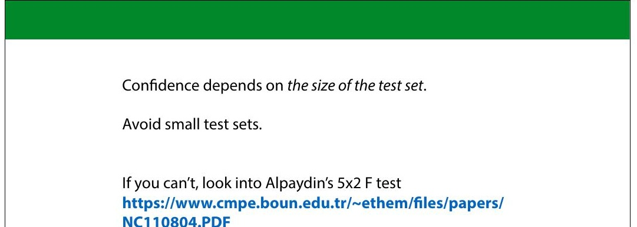
Notes:
If you don’t have the luxury of a large test set, you may need
to do some statistical testing to see whether the effect
you’ve observed (classi8ier A is better than classi8ier B) is
genuine or down to random chance. It’s generally accepted
that Alpaydin’s 5x2 cross validation is the best test for this
purpose. It’s out of scope for this course, but follow the link
if you run into this problem.

Slide 7
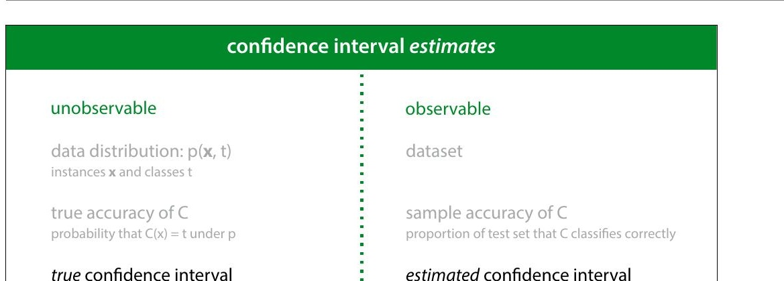
Notes:
These are good concepts to help us think about what we are
measuring when we compute metrics on our test data. But
it's important to realize that these are unobservable values.
We can only work out the true con8idence interval for the
sample accuracy if we know the true accuracy. This puts the
con8idence intervals we've talked about so far in the
unobservable column.
So what about all those con8idence intervals you see
reported in the literature? These are estimated con8idence
intervals. They are usually computed in the same way as the
true con8idence interval, but wherever we need the true
value of some metric, we replace it by its estimate. This
gives us a con8idence interval that isn't as correct as the
true con8idence interval, and one that would change slightly
if we were to resample the test set, but we can at least
compute it, and it generally behaves in roughly the same
way as the true con8idence interval.

Slide 8
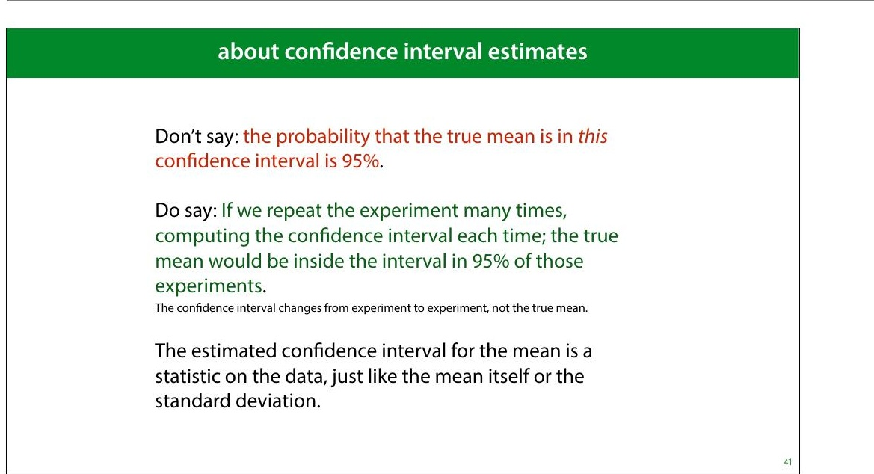
Notes:
When we use the phrase con>idence interval to refer to this
kind of estimate, it's important to speak about it correctly.
There is no probability associated with the true mean at all.
It is simply an objective, determined value (which we don’t
know). The probability comes from sampling, and from
computing the interval from a sample.
So instead of having a 8ixed interval, with the true mean
jumping around probabilistically, we have a 8ixed true mean
around which we get an interval that jumps around if we
resample the data. The probability of it jumping so much
that it no longer contains the true mean is 5%.
This is typical frequentist agonizing over what the phrase
“probability” means. Con>idence intervals are a uniquely
frequentist tool. If the distinction on the slide doesn’t make
sense to you, look back to the probability video in the
preliminaries.

Slide 9
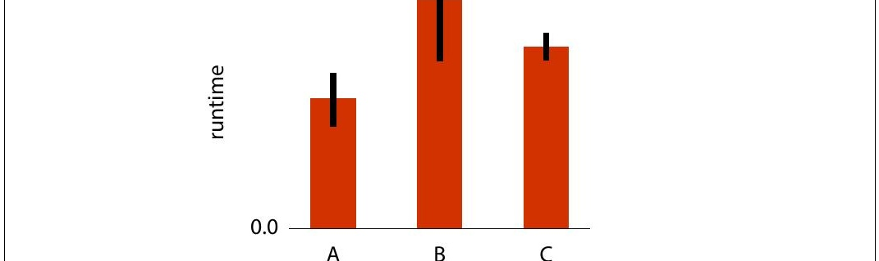
Notes:
A very relevant question is how do you interpret error
bars?
If you see a picture like this, showing the mean runtime of
an experiment, measured for three models, and averaged
over a number of runs, what would you imagine the error
bars denote? We've seen standard deviations, standard
errors and con8idence intervals. What do error bars
represent?

Slide 10
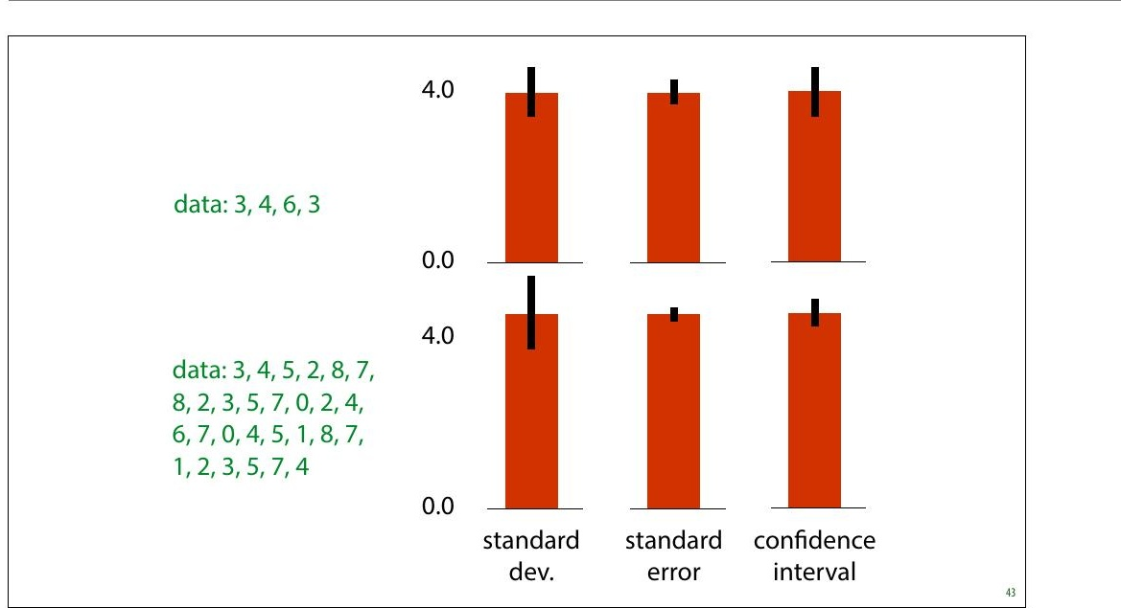
Notes:
The truth is that there is no standard de8inition for what
error bars denote, and if the authors didn’t specify what
their error bars indicate, the authors messed up.
These are the three most common options. If you didn't
quite get all the details of the previous slides, this slide
illustrates the most important distinction: If we sample
more data, the estimate of our standard deviation
becomes more accurate. It’s an estimate of a property of our
data distribution. The error bars representing standard
deviation don't get smaller, they just get closer to their
correct size (which may be very wide around the head of
the bar).
The standard error and the con8idence interval are
indicators of how con8ident we are about our estimate of
the mean of our data. For these, the more data we have, the
smaller they get. As we saw earlier, under the right
assumptions, the 95% con8idence interval is roughly twice
the standard error.

Slide 11
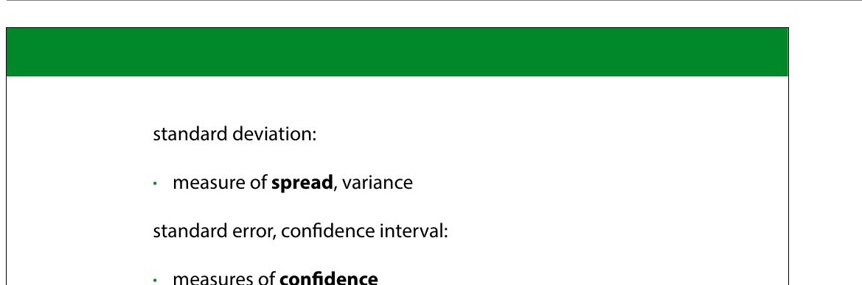

Slide 12
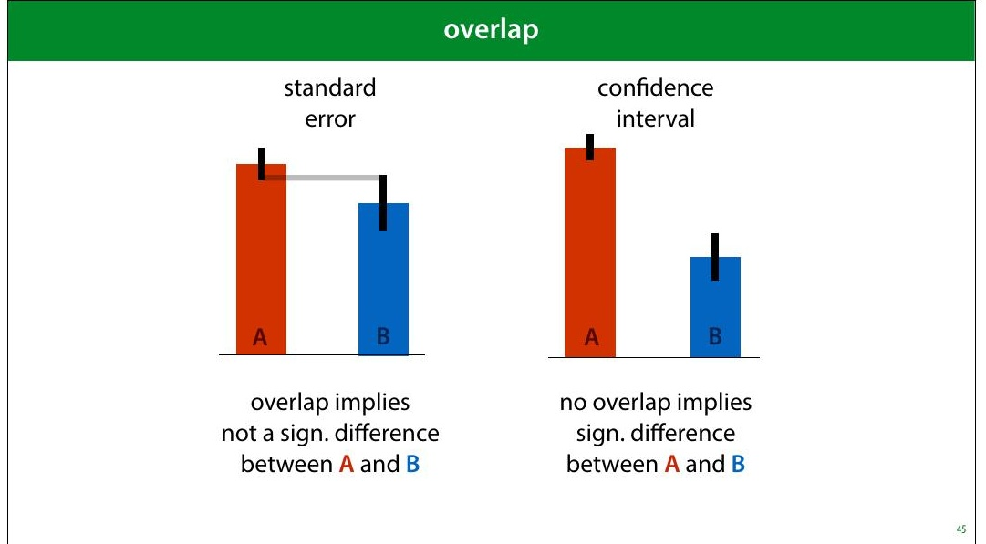
Notes:
Under certain assumptions, the standard error of two
estimates can tell you whether a Student's t test allows you
to reject the null hypothesis that the two distributions are
the same. This would allow you to say, for instance, that
there is a statistically signi8icant difference between the
accuracy estimates on two classi8iers. As we said before,
such testing is not very popular in machine learning, so we
won't go into it in detail, but this can offer an additional
perspective on error bars.
We won’t discuss the Student’s t test in detail, but it’s a
common test for comparing two normally distributed values.
Say you plot the mean squared error for regression models
A and B, together with some error bars. Does the the fact
that the error bars overlap or not tell you whether the
measured difference between the two models is statistically
signi8icant? That is, does it indicate whether we can
conclude that A is a better model than B?
Yes, but we have to be careful. For standard error bars, the

Slide 13
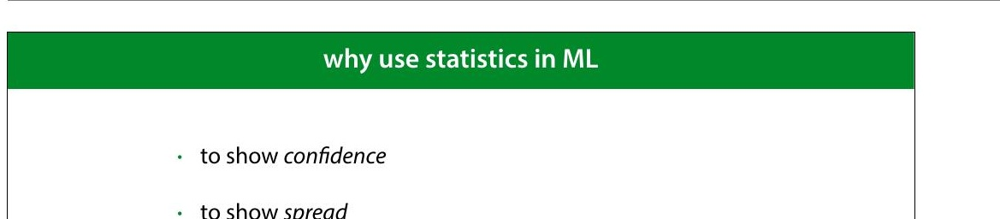
Notes:
All of this was about showing con+idence: showing how
reliable our numbers are as estimates of the true values that
we can’t observe.
Showing spread is more about providing insight to the
reader. Say I train a classi8ier by gradient descent. If I have a
big test set, I can very con>idently measure and report the
accuracy of this particular classi8ier. However, gradient
descent uses random initialization. If I repeat the training
process, I may end up in a different local minimum, and get
a different classi8ication performance. It’s likely that I also
want to communicate how much the measured
performance is dependent on this randomness. In short,
how lucky did we get in our choice of classi8ier?

Slide 14


Why Stats in ML?
Show Confidence
Quantify certainty in predictions with confidence intervals, p-values, and statistical tests
Show Spread
Visualize variability in data through standard deviation, variance, and distribution plots

Slide 15
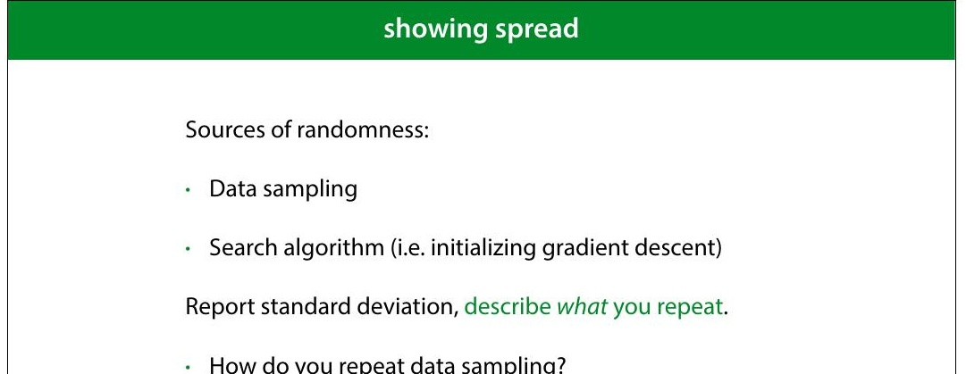
Notes:
If we have a large enough test set, we know that the
con8idence interval for our measurement of the
performance is small enough. But we also want to know
how much the randomness in our process affects the result.
What is the probability that repeating the process (on the
same data, or on new data) produces wildly different
results?
For factors like the initialisation of gradient descent, this is
easy to test: you just rerun a few times on the same data.
But how do you test how robust the results are against
sampling a new dataset?

