Slide 1

Notes:
In this video we'll look at how to evaluate regression and
classi8ication experiments. There will be a few pointers on
regression, but the main topic will be classi8ication
experiments.
|section|Metrics|
|video|https://surfdrive.surf.nl/8iles/index.php/s/
TrR5TrtLDZLBs08/download|

Slide 2
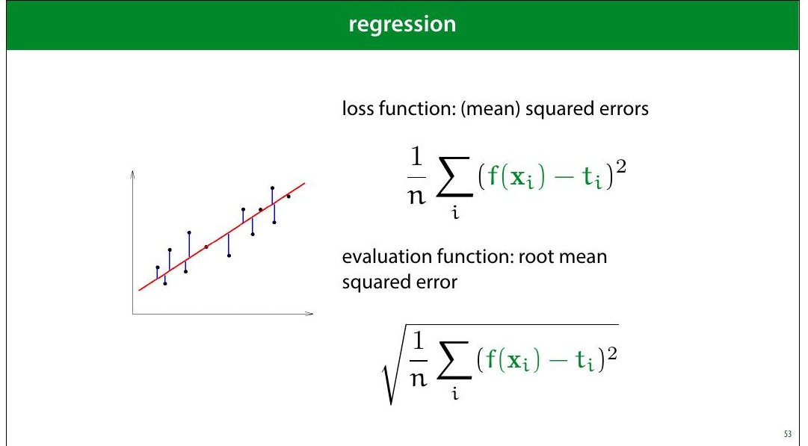
Notes:
One thing to pay attention to is that if you use MSE loss, you
may want to report the square root (the RMSE). The RMSE
is minimised at the same places as the MSE, but it’s easier
to interpret, because it has the same units as the original
output value.
For instance, if your outputs are in meters, then your MSE is
measured in square meters, but your RMSE is also
measured in meters.

Slide 3
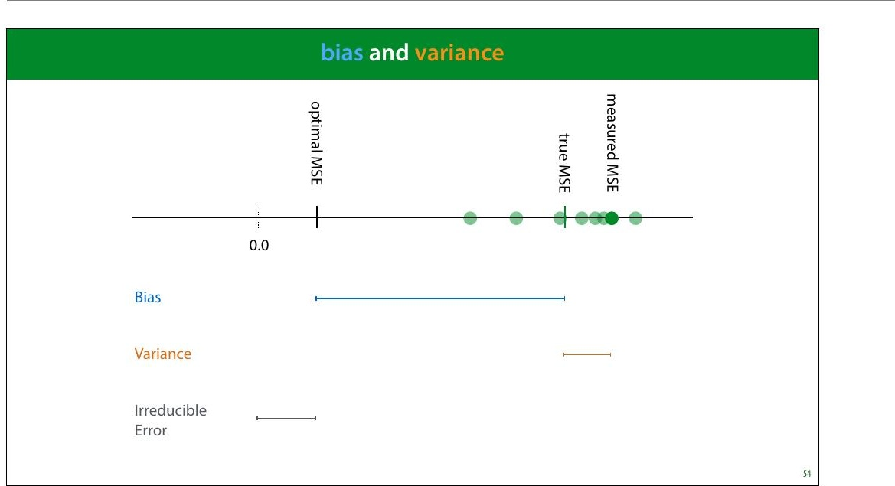
Notes:
Bias and variance are good concepts to keep in mind when
thinking about regression performance. The bias is the
difference between your optimal MSE and the true MSE.
This is the part of your error that is down to fundamental
problems with your model: for instance, you are 8itting a
line trough data with a parabolic pattern. This part stays the
same if you resample your data.
The variance is the difference between the true MSE and
the measured MSE. This is the part of your error that is
down to aspects of the random sampling of the data. This
part changes when you resample your data.
Normally, we train a regression model once, and get one
MSE value. This gives us one dot on the axis above. Without
repeating the process on freshly sampled data, we can't tell
how our error falls apart in bias and variance. However, we
can usually get some contextual clues, or investigate using
resampling.

Slide 4
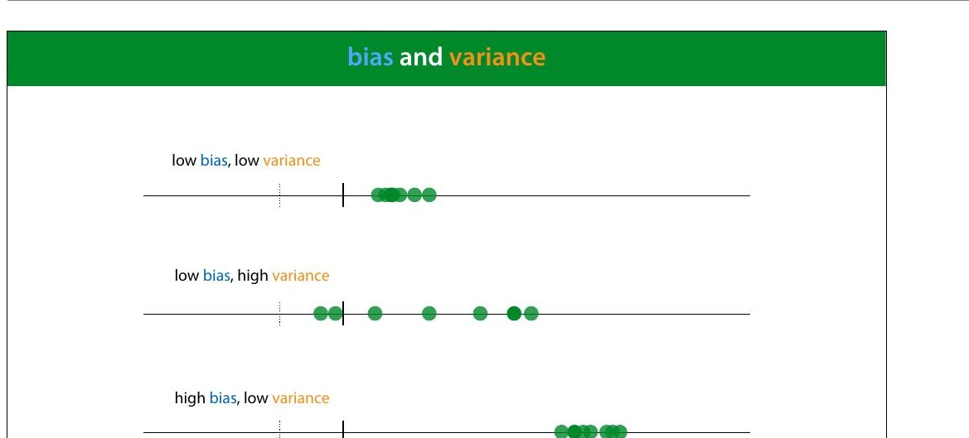

Slide 5
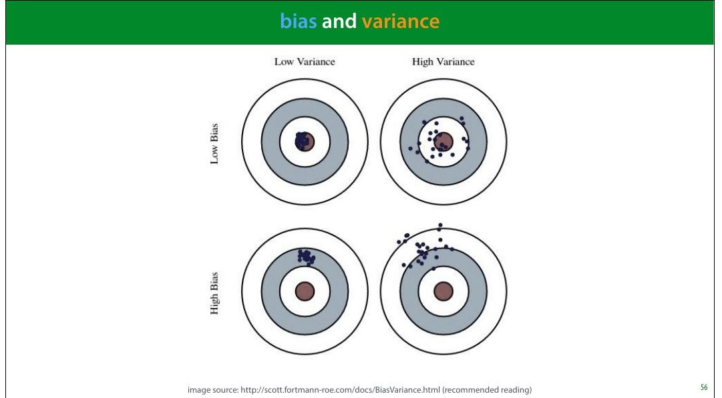
Notes:
Here is a metaphor that is often used to describe bias and
variance: a dartboard.
Remember, this is a metaphor for our RMSE error estimate.
That means that normally, we have only one dart and we
can’t tell whether our error is due to high bias or high
variance.
image source: http://scott.fortmann-roe.com/docs/
BiasVariance.html (recommended reading)

Slide 6
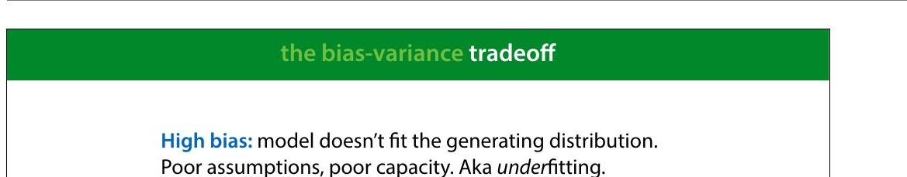
Notes:
High bias tends to happen when the model is too simple to
follow the true "shape" of the data. Linear models in low-
dimensional spaces often have this problem. Here, we see
that the data has a slight curve, which is clearly part of its
natural pattern, and something the model should learn.
Since it's restricted to a line, however, it cannot make this
shape.

Slide 7
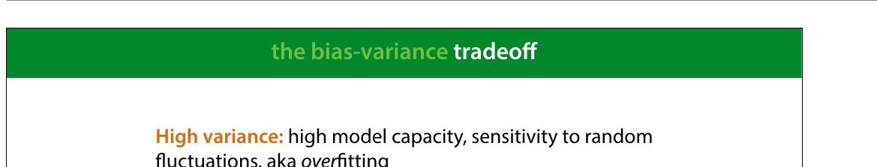
Notes:
High variance happens when the model has the capacity to
follow the shape of the data perfectly, but it does it so
perfectly that it tends to get thrown off by small
8luctuations.
Here, the model doesn't just follow the natural curve of the
data, it goes in and out of every random 8luctuation to
model every single point perfectly.
Even though this model (a regression tree) 8its the data
perfectly, if we resample the data, we are stuck with all
sorts of weird peaks that won’t 8it the new data. This is
where the variance comes from. The true error varies
wildly, because the model captures every single random
8luctuation in the training data. These 8luctuation will cause
a large error in the test data, which we put down to
variance rather than bias.

Slide 8
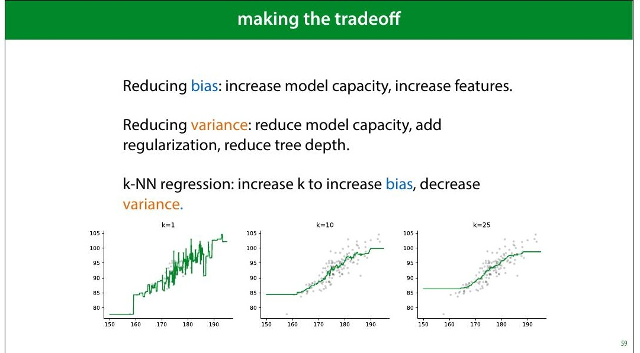
Notes:
We will see techniques for all of these in the coming weeks.
Note that often, it really is a tradeoff: reducing the bias,
increases the variance and vice versa.
For some algorithms, there is a single parameter that allows
us to make the bias/variance tradeoff. kNN is one example:
low k values give us high variance, high k values give us
high bias.
In the strictest de>inition of bias and variance, these concepts
only apply to the mean squared error, where they explictly
appear as terms if you rewrite the error in a certain way.
However, in general machine learning parlance, the terms
are applied to any regression error, and they are roughly
synonymous with under- and over>itting.

Slide 9
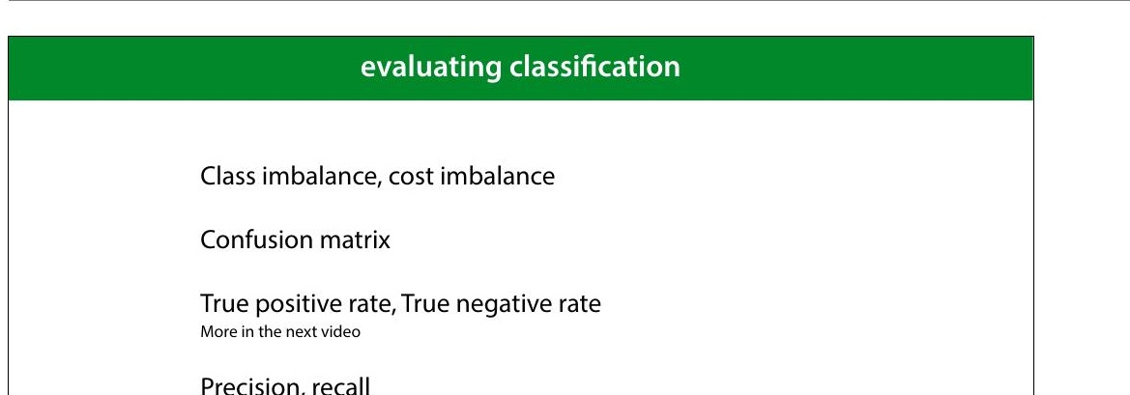
Notes:
Let's now move to classi8ication. We'll start by explaining
these four topics.

Slide 10
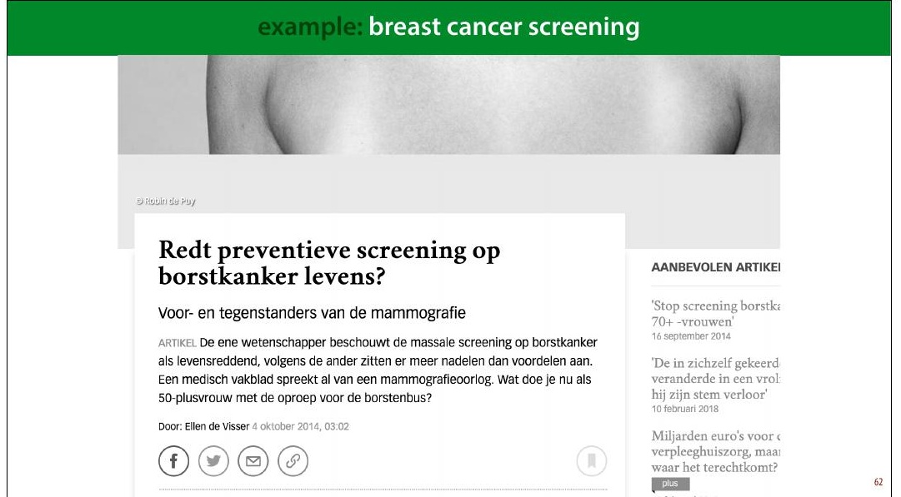
Notes:
Here's one example domain: breast cancer screening
A recurring discussion in the Dutch media is the question
whether all women over 50 be screened for breast cancer.
This is an analogy for classi8ication: the instances are
people and the target label is “has cancer” or “has no
cancer.” You may think that this is a no-brainer: the more
tests we do, the more lives saved. But we need to take into
account how good the classi8ier is, and how bad the
consequences are of it making a mistake.
The 8irst problem this example illustrates is class
imbalance. Unlike the classi8iers we've seen so far, this
example has, thankfully, far more negatives than positives.
In a given year the people in this age group for whom breast
cancer will manifest is about half a percent. This includes
men, for whom breast cancer is rare (but not impossible),
so when we talk about screening for women over 50, we
should probably assume about 1% positives.
This means that we need to be very careful when

Slide 11
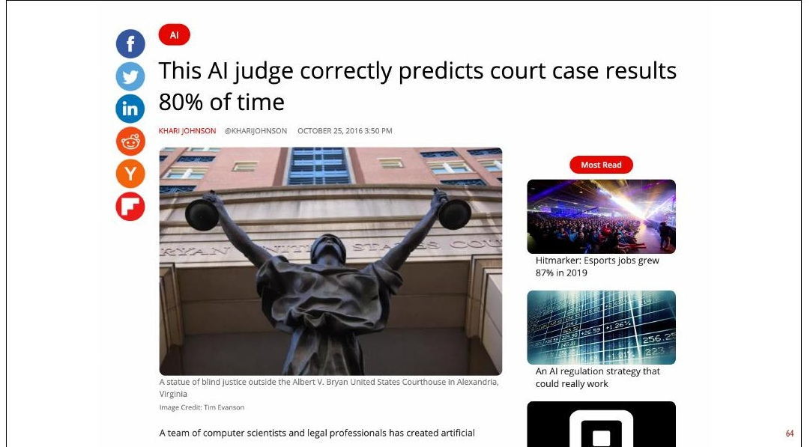
Notes:
So the next time you see a headline like this, your 8irst
question should be: what was the class distribution in the
training data? If 90% of the cases in the training data are
acquittals, this is not a very impressive result.
As it happens, in this case the classes were balanced 50/50,
so 80 percent is at least notable. However, now we have a
classi8ier trained on arti8icially balanced data. In a
production environment (whatever that means here), the
classes are likely not balanced 50/50, so this speci8ic
classi8ier will be of no further use.
Here is the original paper: https://peerj.com/articles/
cs-93/#fn-6 There are some issues with this research
beyond the class balance.

Slide 12
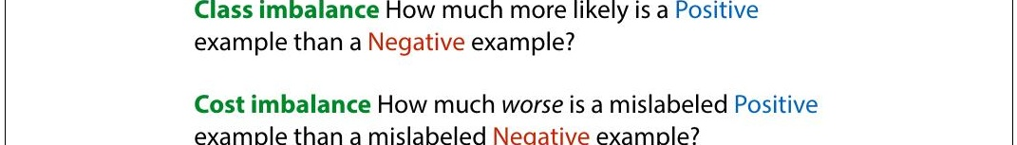
Notes:
Another reason to mistrust accuracy is cost imbalance. In
breast cancer screening are two types of misclassi8ication:
diagnosing a healthy person with cancer and diagnosing a
person with cancer as healthy. Both come with a cost but
not the same cost.
We can either miss a cancer diagnosis (a false negative),
which means the cancer will be caught much later and be
much harder to treat. However, diagnosing a healthy person
with cancer (a false positive) means they will be sent for
unnecessary invasive testing and suffer great psychological
stress. The cost of this is much less than the cost of missing
a positive, but it isn't zero.
This is what the discussion in the media centers on. If the
screening causes many more false negatives than false
positives, it may mean that the cost to human lives balances
out, and the net effect of the screening isn't to save more
lives.
There is of course, also the 8inancial cost of screening a

Slide 13
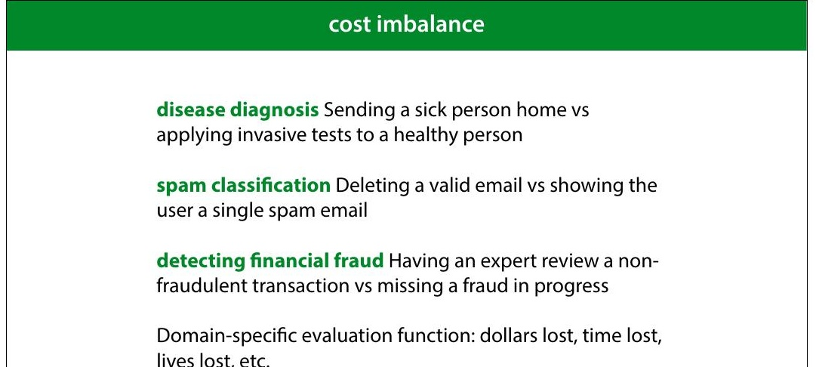
Notes:
Here are some examples of problems with cost imbalance
In all these cases, one misclassi8ication one way costs much
more than a misclassi8ication the other way. But both cost
something. The time of an expert reviewer is not free, even
though 8ive minutes of his time may be much cheaper than
the cost of letting a single fraud go unchecked. In such a
case, you may decide that missing one fraud is as costly as
having an expert review 500 harmless transactions. This is
then the general balance you are hoping for: one false
negative for every 500 false positives.
If you’re lucky, both types of misclassi8ication have the same
unit, and you can turn your error (an estimate of the
number of misclassi8ications) into a domain speci8ic
evaluation function (like estimated dollars lost, or time
saved). You simply assign a cost to each type if
misclassi+ication, and multiply it by how often that
misclassi+ication occurs in the test set. The total is the
evaluation function you want to minimize.

Slide 14
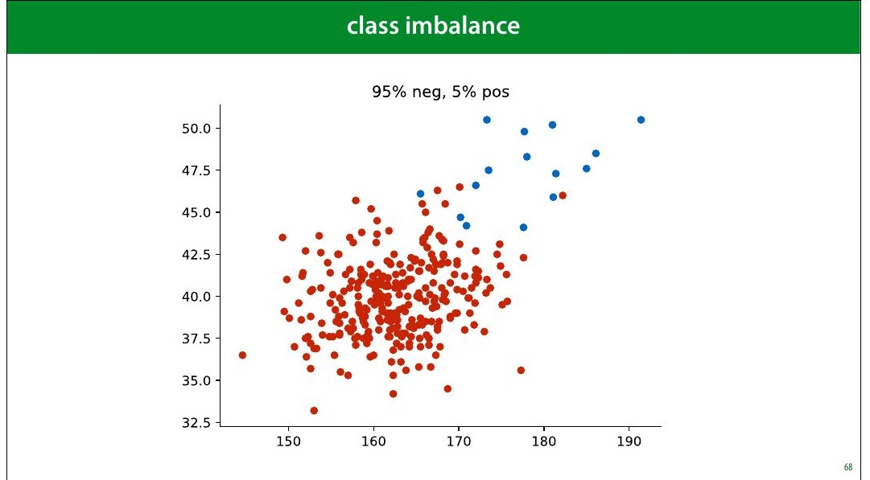
Notes:
Here is a pretty imbalanced dataset (though still not as
imbalanced as the cancer/not cancer problem). It looks
pretty dif8icult. What would be a good performance on this
task?

Slide 15
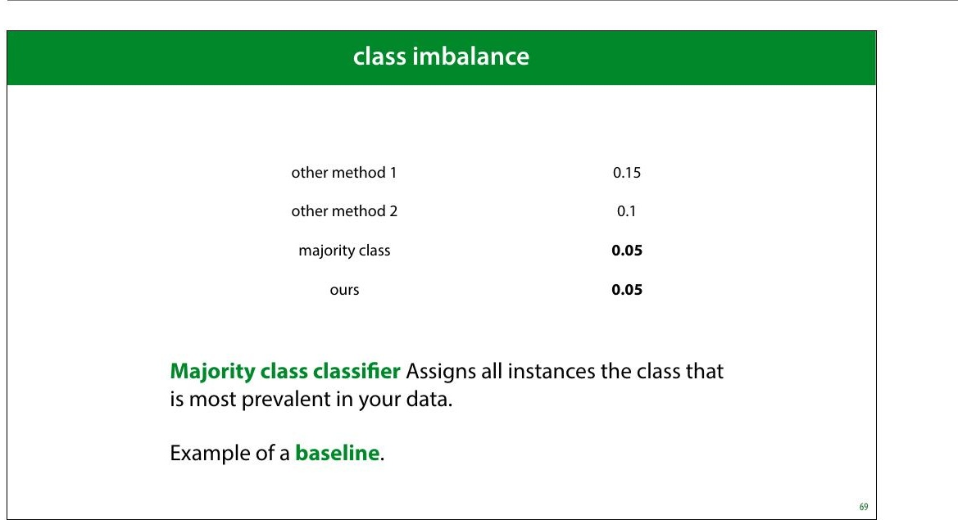
Notes:
As we've seen, even though an error of 0.05 might sound
pretty good, but on an imbalanced dataset like this, there is
a very simple classi8ier that gets that performance easily.
The classi8ier that assigns anything the class with the most
instances. We call this the majority class classi+ier.
The majority class classi8ier is an example of a baseline, a
simple method that is not meant to be used as a real model,
but that can help you calibrate the performance scores. In
this case, it tells you that you’re really only interested in in
the error range from 0 to 0.05. Any higher error than that is
pretty useless.

Slide 16
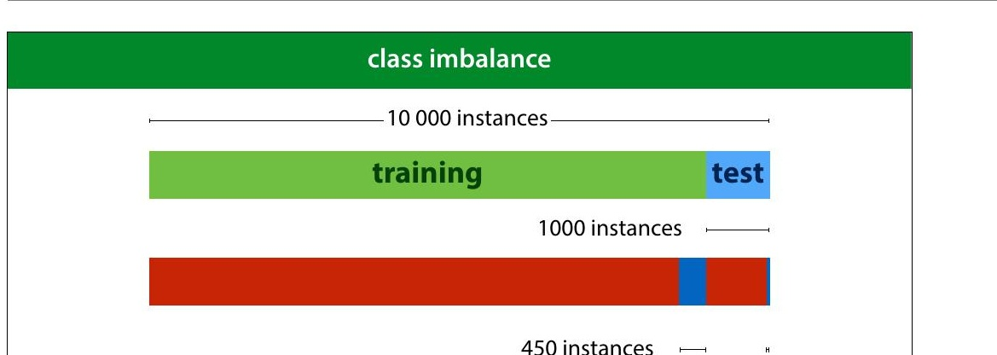
Notes:
Here is another way that class imbalance can screw things
up for you. You might think you have a pretty decent
amount of data with 10 000 instances. However if you split
off a test set of 1 000 instances, you'd be left with just 50
instances of the positive class in your data. Practically, your
8inal evaluation will just be a question of how many of these
50 positives you detect. This means that you can really only
have 50 “levels of performance” that you can distinguish
b e tw e e n .
Yo u c a n m ake a bigger test set of course (and you probably
should) but that leads to problems in your training data.
Since you’re essentially building a detector for positives, it
doesn’t help if you can only give it 100 examples of what a
positive looks like.
In the next lecture, we’ll look at some tricks we can use to
boost performance on such imbalanced data.

Slide 17
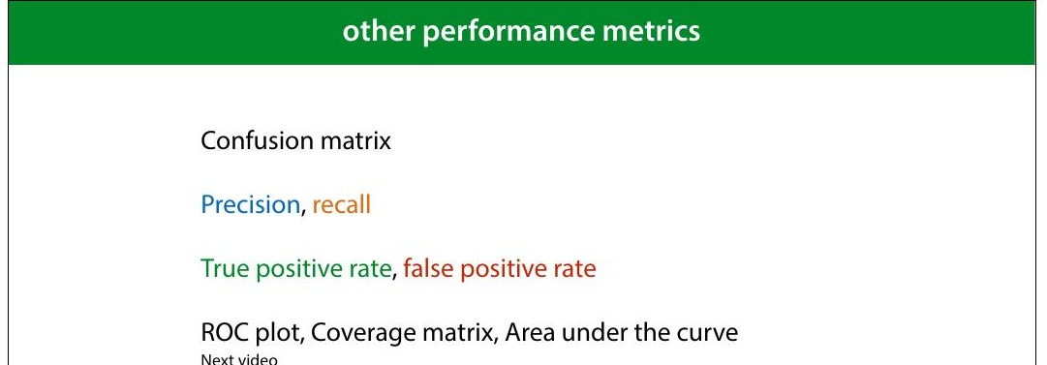
Notes:
The best thing to do under class and cost imbalance, is to
look at your performance in more detail. We’ll look at six
different ways to measure classi8ier performance.
Most of these are only relevant if you have class or cost
imbalance. If you have a nice, balanced dataset, it’s likely
that error or accuracy is all you need.

Slide 18
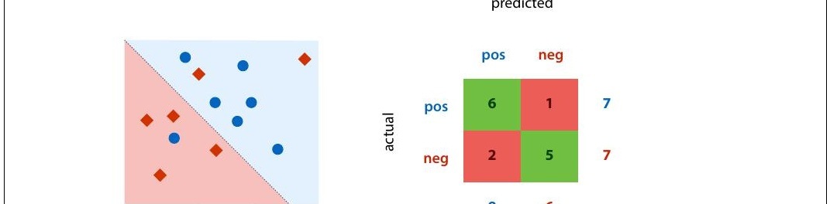
Notes:
This is a confusion matrix (also known as a contingency
table). It's simply a table with the actual classes on the
rows, and the predicted classes on the columns, and a tally
in each cell of how often each actual class is given a
particular prediction. On the diagonal we tally all the
correct classi8ications and off the diagonal we tally all the
possible mistakes.
A confusion matrix doesn’t give you a single number, so it’s
more dif8icult to compare two classi8iers by their confusion
matrices, but it’s a good way to get insight into what your
classi8ier is actually doing.
Note that for a binary classi8ication problem, we are getting
the two types of mistakes (false positives and false
negatives) along the second diagonal. If we have cost
imbalance, the balance between these two values gives us a
quick insight into how well the classi8ier is aligned with our
estimate for the misclassi8ication costs.
You can plot the confusion matrix for either the training,

Slide 19
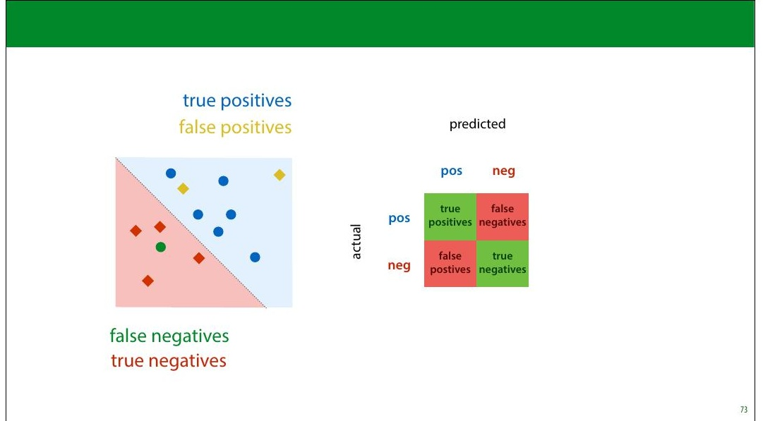
Notes:
We call accurately classi8ied instances true positives and
true negatives. Misclassi8ications are called false positives
and false negatives.

Slide 20
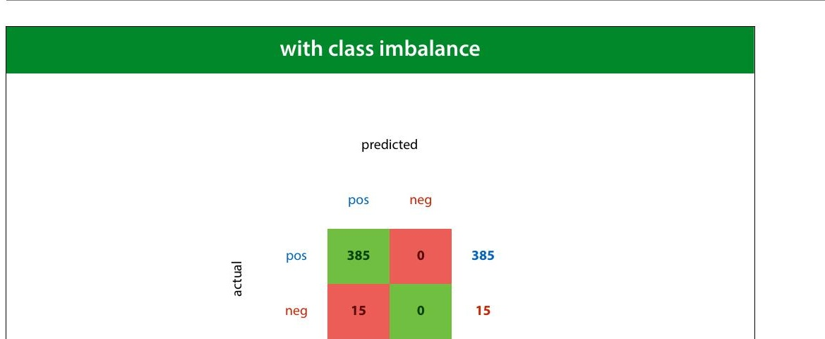
Notes:
Here we see the confusion matrix for the majority class
baseline (the classi8ier that calls everything positive) in a
problem with high class imbalance.

