Slide 1
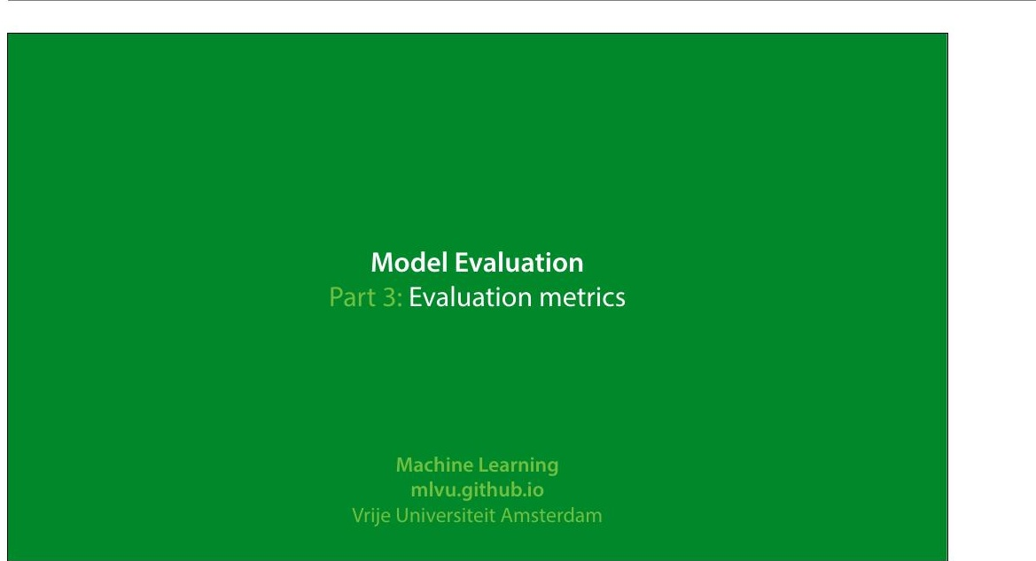
Notes:
In this video we'll look at how to evaluate regression and
classi8ication experiments. There will be a few pointers on
regression, but the main topic will be classi8ication
experiments.
|section|Metrics|
|video|https://surfdrive.surf.nl/8iles/index.php/s/
TrR5TrtLDZLBs08/download|

Slide 2
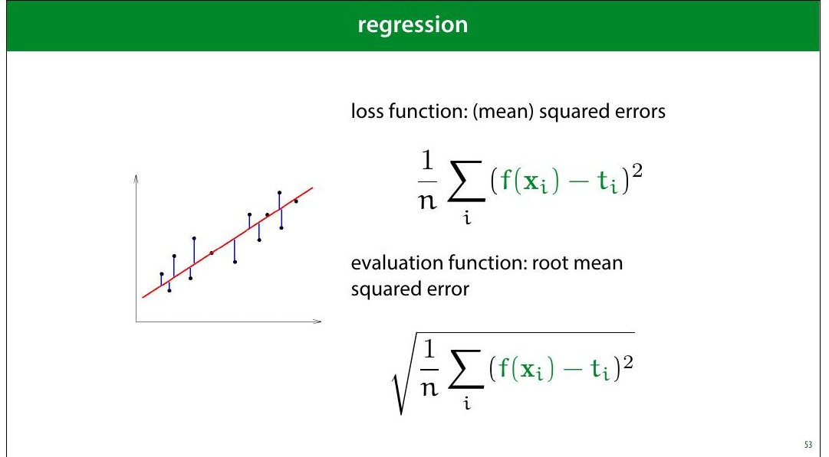
Notes:
One thing to pay attention to is that if you use MSE loss, you
may want to report the square root (the RMSE). The RMSE
is minimised at the same places as the MSE, but it’s easier
to interpret, because it has the same units as the original
output value.
For instance, if your outputs are in meters, then your MSE is
measured in square meters, but your RMSE is also
measured in meters.

Slide 3
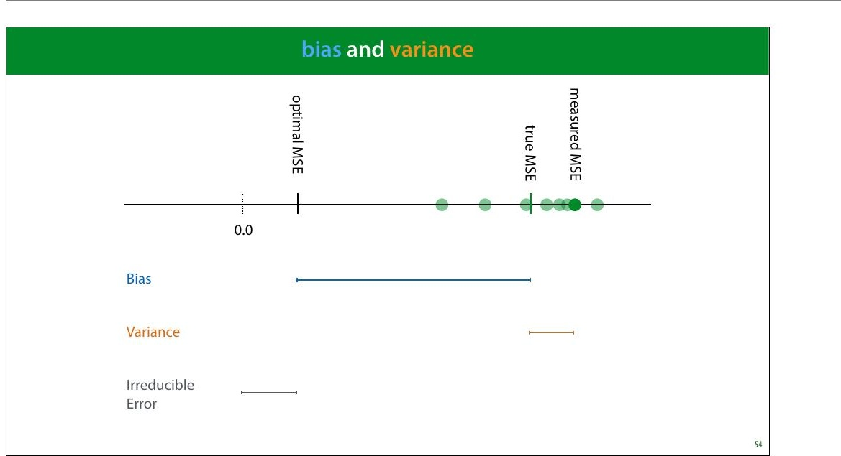
Notes:
Bias and variance are good concepts to keep in mind when
thinking about regression performance. The bias is the
difference between your optimal MSE and the true MSE.
This is the part of your error that is down to fundamental
problems with your model: for instance, you are 8itting a
line trough data with a parabolic pattern. This part stays the
same if you resample your data.
The variance is the difference between the true MSE and
the measured MSE. This is the part of your error that is
down to aspects of the random sampling of the data. This
part changes when you resample your data.
Normally, we train a regression model once, and get one
MSE value. This gives us one dot on the axis above. Without
repeating the process on freshly sampled data, we can't tell
how our error falls apart in bias and variance. However, we
can usually get some contextual clues, or investigate using
resampling.

Slide 4
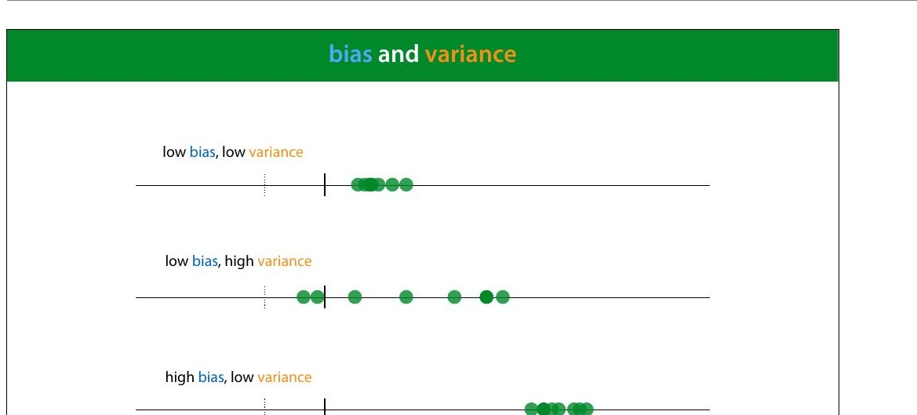

Slide 5
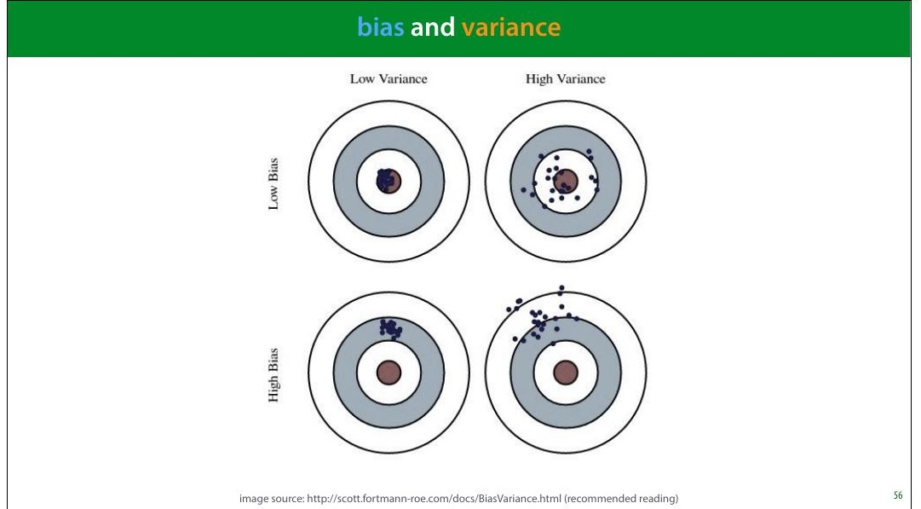
Notes:
Here is a metaphor that is often used to describe bias and
variance: a dartboard.
Remember, this is a metaphor for our RMSE error estimate.
That means that normally, we have only one dart and we
can’t tell whether our error is due to high bias or high
variance.
image source: http://scott.fortmann-roe.com/docs/
BiasVariance.html (recommended reading)

Slide 6
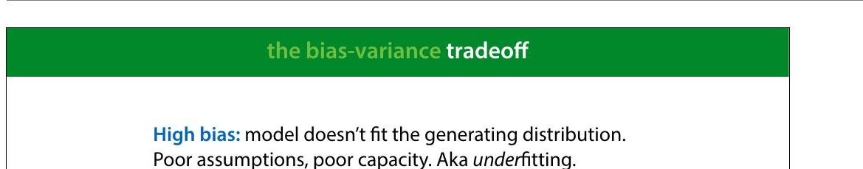
Notes:
High bias tends to happen when the model is too simple to
follow the true "shape" of the data. Linear models in low-
dimensional spaces often have this problem. Here, we see
that the data has a slight curve, which is clearly part of its
natural pattern, and something the model should learn.
Since it's restricted to a line, however, it cannot make this
shape.

Slide 7
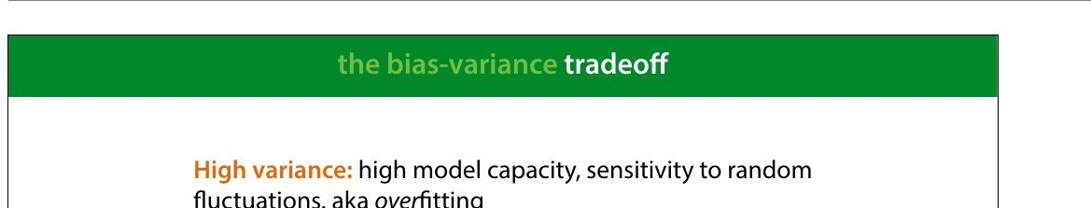
Notes:
High variance happens when the model has the capacity to
follow the shape of the data perfectly, but it does it so
perfectly that it tends to get thrown off by small
8luctuations.
Here, the model doesn't just follow the natural curve of the
data, it goes in and out of every random 8luctuation to
model every single point perfectly.
Even though this model (a regression tree) 8its the data
perfectly, if we resample the data, we are stuck with all
sorts of weird peaks that won’t 8it the new data. This is
where the variance comes from. The true error varies
wildly, because the model captures every single random
8luctuation in the training data. These 8luctuation will cause
a large error in the test data, which we put down to
variance rather than bias.

Slide 8
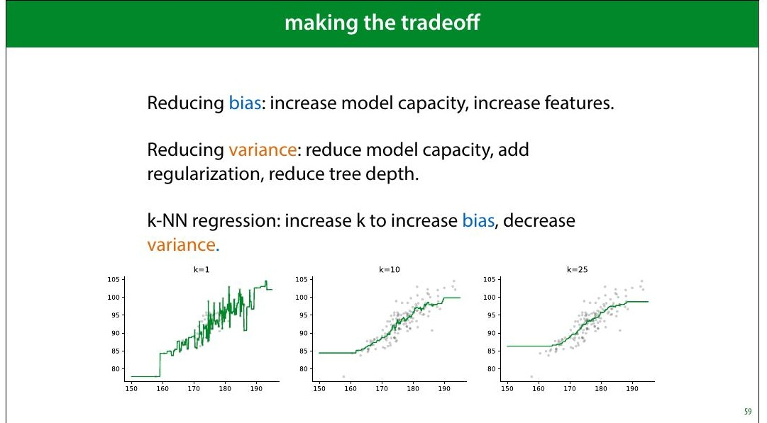
Notes:
We will see techniques for all of these in the coming weeks.
Note that often, it really is a tradeoff: reducing the bias,
increases the variance and vice versa.
For some algorithms, there is a single parameter that allows
us to make the bias/variance tradeoff. kNN is one example:
low k values give us high variance, high k values give us
high bias.
In the strictest de>inition of bias and variance, these concepts
only apply to the mean squared error, where they explictly
appear as terms if you rewrite the error in a certain way.
However, in general machine learning parlance, the terms
are applied to any regression error, and they are roughly
synonymous with under- and over>itting.

Slide 9
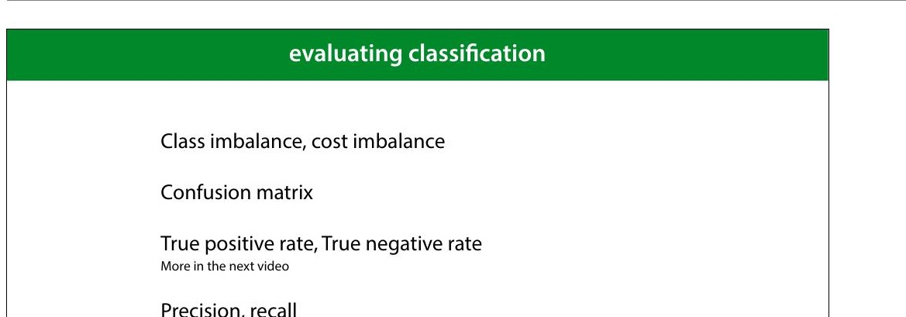
Notes:
Let's now move to classi8ication. We'll start by explaining
these four topics.

Slide 10
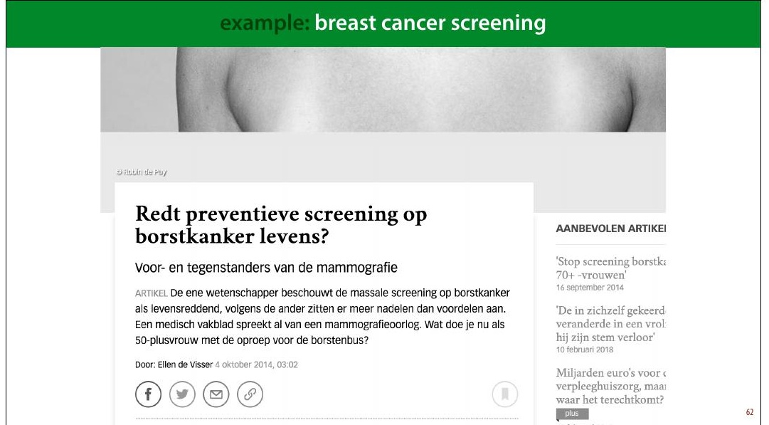
Notes:
Here's one example domain: breast cancer screening
A recurring discussion in the Dutch media is the question
whether all women over 50 be screened for breast cancer.
This is an analogy for classi8ication: the instances are
people and the target label is “has cancer” or “has no
cancer.” You may think that this is a no-brainer: the more
tests we do, the more lives saved. But we need to take into
account how good the classi8ier is, and how bad the
consequences are of it making a mistake.
The 8irst problem this example illustrates is class
imbalance. Unlike the classi8iers we've seen so far, this
example has, thankfully, far more negatives than positives.
In a given year the people in this age group for whom breast
cancer will manifest is about half a percent. This includes
men, for whom breast cancer is rare (but not impossible),
so when we talk about screening for women over 50, we
should probably assume about 1% positives.
This means that we need to be very careful when

Slide 11
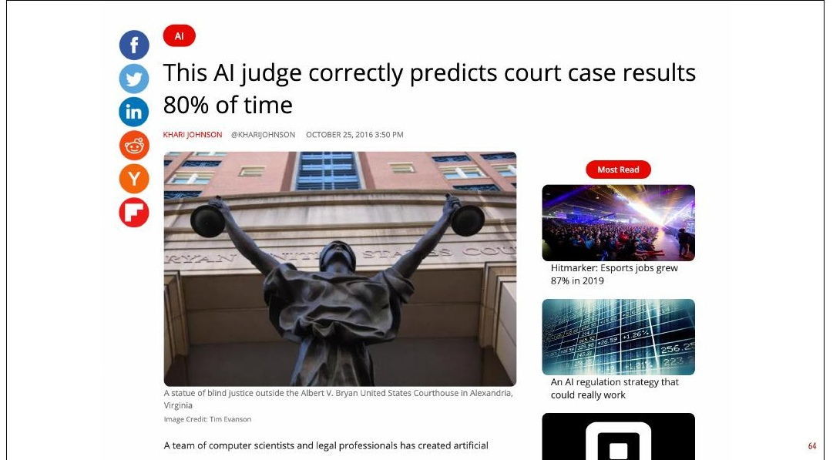
Notes:
So the next time you see a headline like this, your 8irst
question should be: what was the class distribution in the
training data? If 90% of the cases in the training data are
acquittals, this is not a very impressive result.
As it happens, in this case the classes were balanced 50/50,
so 80 percent is at least notable. However, now we have a
classi8ier trained on arti8icially balanced data. In a
production environment (whatever that means here), the
classes are likely not balanced 50/50, so this speci8ic
classi8ier will be of no further use.
Here is the original paper: https://peerj.com/articles/
cs-93/#fn-6 There are some issues with this research
beyond the class balance.

Slide 12
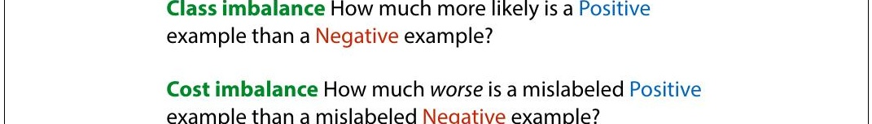
Notes:
Another reason to mistrust accuracy is cost imbalance. In
breast cancer screening are two types of misclassi8ication:
diagnosing a healthy person with cancer and diagnosing a
person with cancer as healthy. Both come with a cost but
not the same cost.
We can either miss a cancer diagnosis (a false negative),
which means the cancer will be caught much later and be
much harder to treat. However, diagnosing a healthy person
with cancer (a false positive) means they will be sent for
unnecessary invasive testing and suffer great psychological
stress. The cost of this is much less than the cost of missing
a positive, but it isn't zero.
This is what the discussion in the media centers on. If the
screening causes many more false negatives than false
positives, it may mean that the cost to human lives balances
out, and the net effect of the screening isn't to save more
lives.
There is of course, also the 8inancial cost of screening a

Slide 13
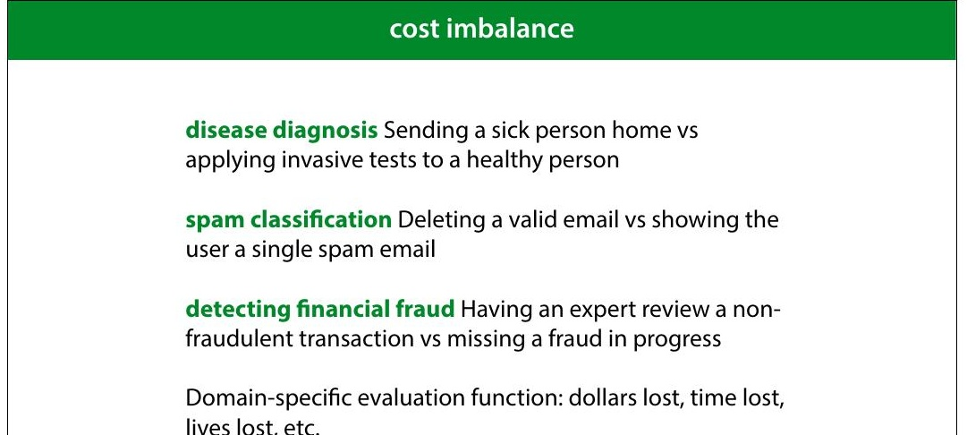
Notes:
Here are some examples of problems with cost imbalance
In all these cases, one misclassi8ication one way costs much
more than a misclassi8ication the other way. But both cost
something. The time of an expert reviewer is not free, even
though 8ive minutes of his time may be much cheaper than
the cost of letting a single fraud go unchecked. In such a
case, you may decide that missing one fraud is as costly as
having an expert review 500 harmless transactions. This is
then the general balance you are hoping for: one false
negative for every 500 false positives.
If you’re lucky, both types of misclassi8ication have the same
unit, and you can turn your error (an estimate of the
number of misclassi8ications) into a domain speci8ic
evaluation function (like estimated dollars lost, or time
saved). You simply assign a cost to each type if
misclassi+ication, and multiply it by how often that
misclassi+ication occurs in the test set. The total is the
evaluation function you want to minimize.

Slide 14
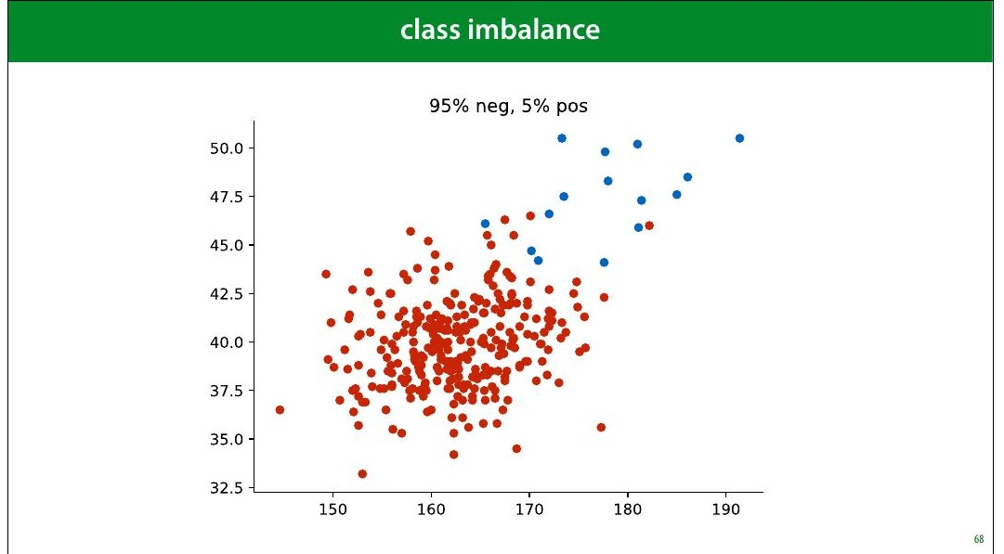
Notes:
Here is a pretty imbalanced dataset (though still not as
imbalanced as the cancer/not cancer problem). It looks
pretty dif8icult. What would be a good performance on this
task?

Slide 15
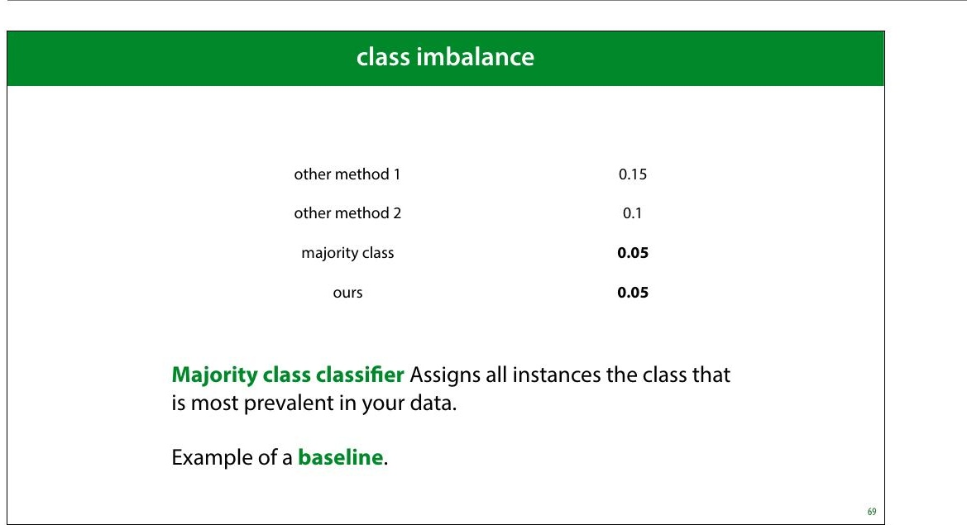
Notes:
As we've seen, even though an error of 0.05 might sound
pretty good, but on an imbalanced dataset like this, there is
a very simple classi8ier that gets that performance easily.
The classi8ier that assigns anything the class with the most
instances. We call this the majority class classi+ier.
The majority class classi8ier is an example of a baseline, a
simple method that is not meant to be used as a real model,
but that can help you calibrate the performance scores. In
this case, it tells you that you’re really only interested in in
the error range from 0 to 0.05. Any higher error than that is
pretty useless.

Slide 16
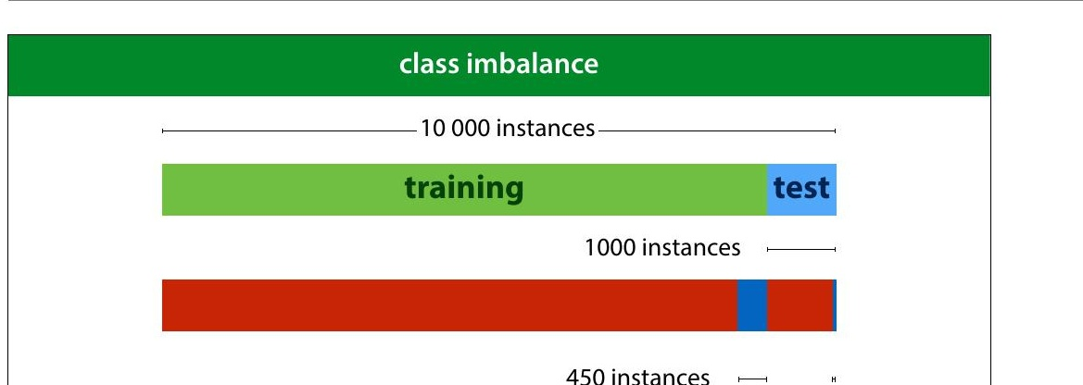
Notes:
Here is another way that class imbalance can screw things
up for you. You might think you have a pretty decent
amount of data with 10 000 instances. However if you split
off a test set of 1 000 instances, you'd be left with just 50
instances of the positive class in your data. Practically, your
8inal evaluation will just be a question of how many of these
50 positives you detect. This means that you can really only
have 50 “levels of performance” that you can distinguish
b e tw e e n .
Yo u c a n m ake a bigger test set of course (and you probably
should) but that leads to problems in your training data.
Since you’re essentially building a detector for positives, it
doesn’t help if you can only give it 100 examples of what a
positive looks like.
In the next lecture, we’ll look at some tricks we can use to
boost performance on such imbalanced data.

Slide 17
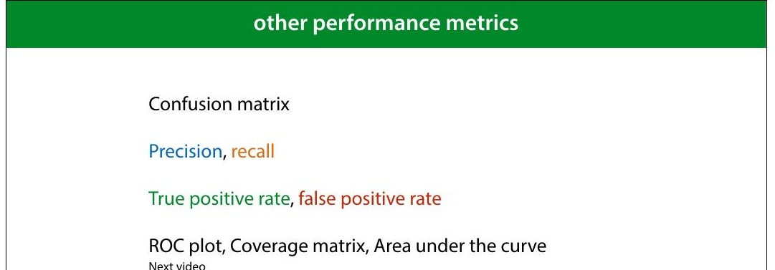
Notes:
The best thing to do under class and cost imbalance, is to
look at your performance in more detail. We’ll look at six
different ways to measure classi8ier performance.
Most of these are only relevant if you have class or cost
imbalance. If you have a nice, balanced dataset, it’s likely
that error or accuracy is all you need.

Slide 18
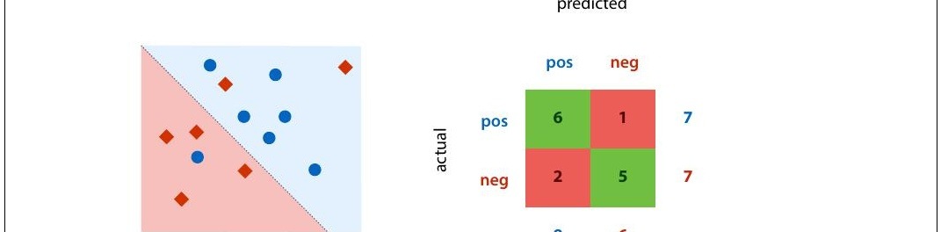
Notes:
This is a confusion matrix (also known as a contingency
table). It's simply a table with the actual classes on the
rows, and the predicted classes on the columns, and a tally
in each cell of how often each actual class is given a
particular prediction. On the diagonal we tally all the
correct classi8ications and off the diagonal we tally all the
possible mistakes.
A confusion matrix doesn’t give you a single number, so it’s
more dif8icult to compare two classi8iers by their confusion
matrices, but it’s a good way to get insight into what your
classi8ier is actually doing.
Note that for a binary classi8ication problem, we are getting
the two types of mistakes (false positives and false
negatives) along the second diagonal. If we have cost
imbalance, the balance between these two values gives us a
quick insight into how well the classi8ier is aligned with our
estimate for the misclassi8ication costs.
You can plot the confusion matrix for either the training,

Slide 19
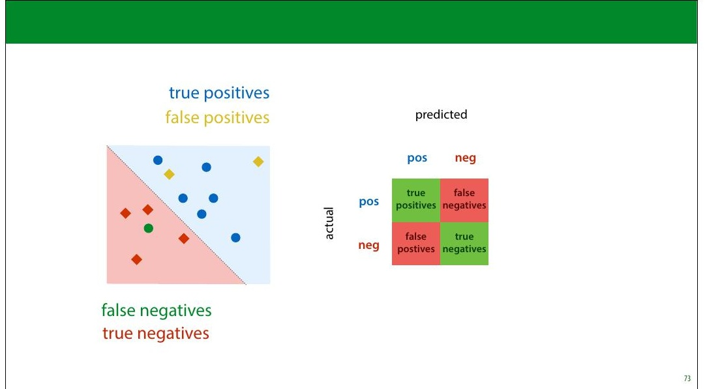
Notes:
We call accurately classi8ied instances true positives and
true negatives. Misclassi8ications are called false positives
and false negatives.

Slide 20
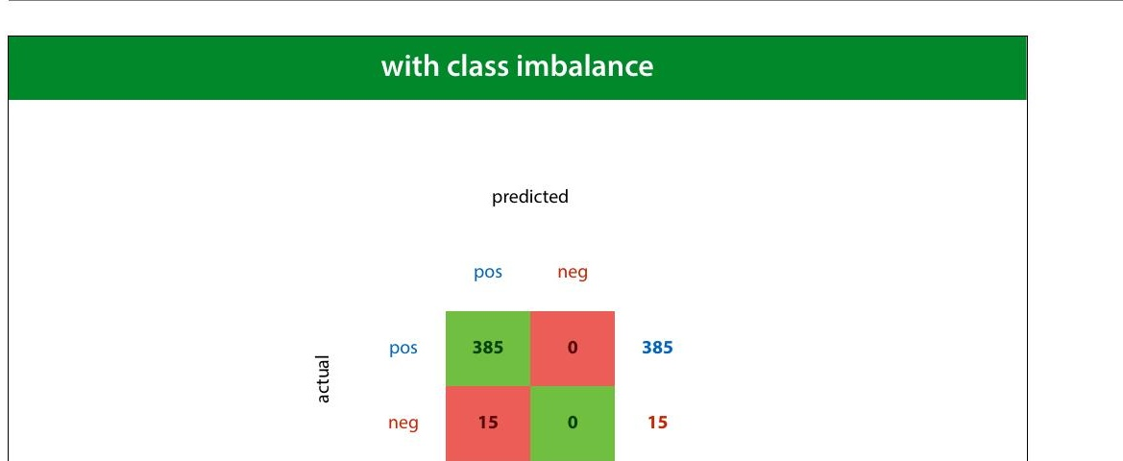
Notes:
Here we see the confusion matrix for the majority class
baseline (the classi8ier that calls everything positive) in a
problem with high class imbalance.

Slide 21
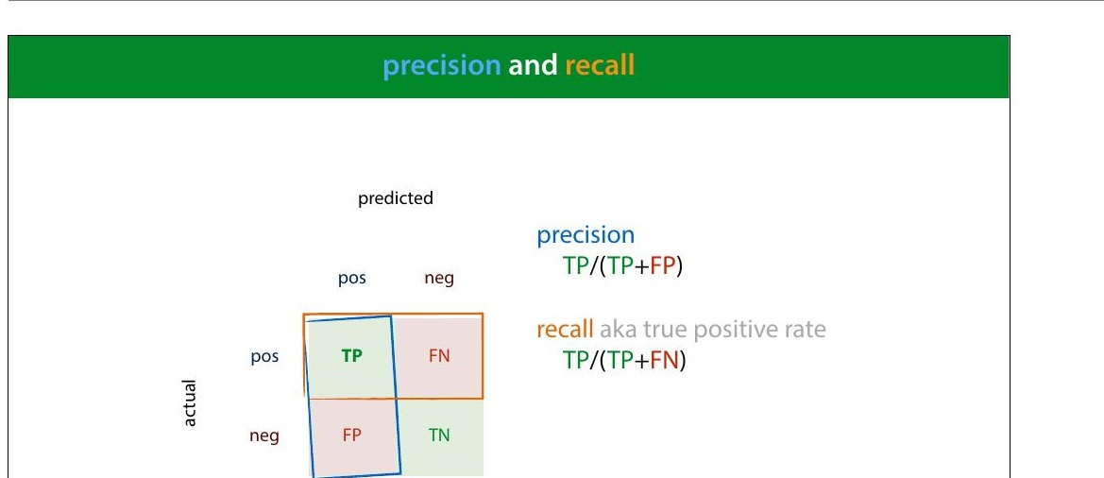
Notes:
Precision and recall are two metrics that express a tradeoff
between the two types of mistakes.
Precision: what proportion of the returned positives are
actually positive?
Recall: what proportion of the existing positives did we
8ind?
The idea is that we usually want to 8ind as many positives as
possible, so we should be eager to label things positive,
increasing the recall, but if we are too eager, we will label
lots of negatives as positive as well, which will hurt our
precision. Our main challenge in designing a classi8ier in the
face of cost and class imbalance, is to 8ind the right tradeoff
between precision and recall.

Slide 22
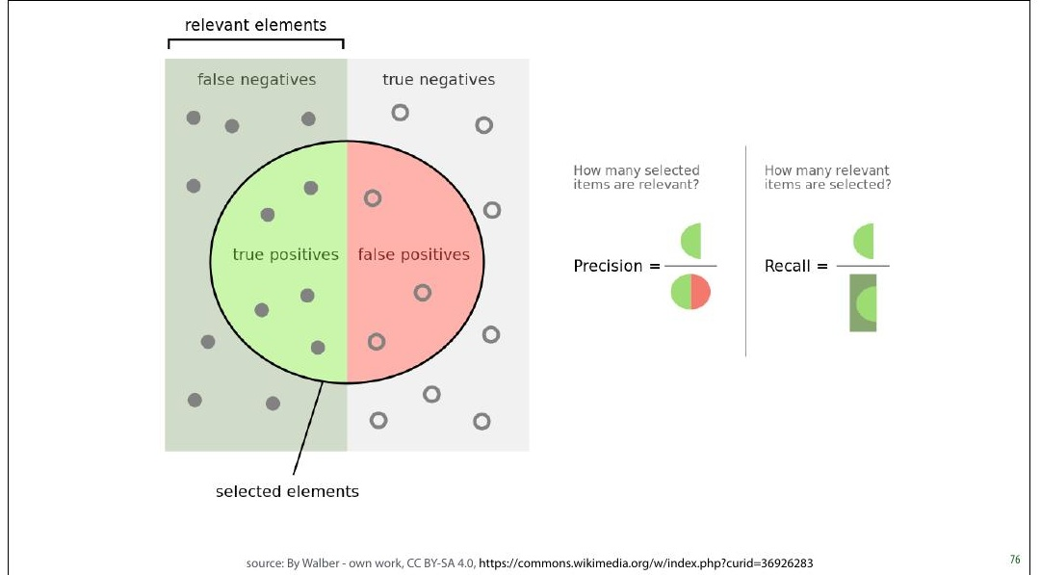
Notes:
It always takes me a minute to 8igure out what precision
and recall mean in any given situation, and I usually consult
this diagram from Wikipedia to help me out.
The idea is that the goal of the classi8ier is to select the
positives in the dataset. The more it selects, the higher its
recall, but the lower its precision, as more negatives end up
in the selection.
source: By Walber - own work, CC BY-SA 4.0, https://
commons.wikimedia.org/w/index.php?
curid=36926283

Slide 23
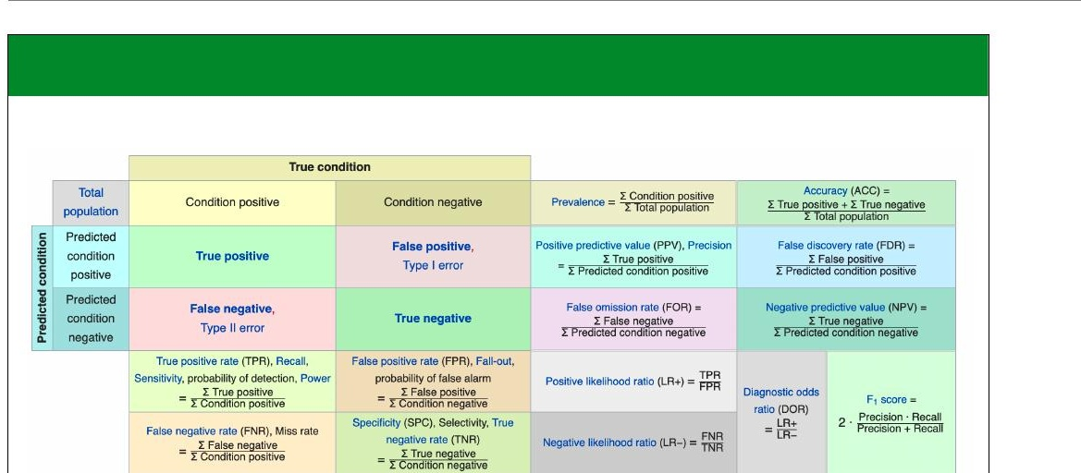
Notes:
There are many more metrics which you can derive from
the confusion matrix. Wikipedia provides a helpful table, in
case you ever come across them. For most purposes,
precision, recall, accuracy and balanced accuracy are
suf8icient.
Note that some terms, like recall, go by many different
names.

Slide 24
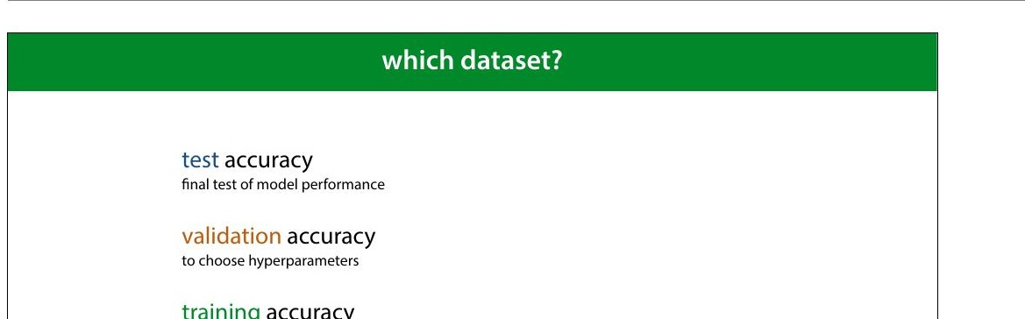
Notes:
All of these metrics can be applied to different datasets.
When we compute (say) accuracy on the test set, we talk
about test accuracy. This is computed—only once—at the
very end of our project, to show that our conclusions are
true.
When we compute it on the validation set we call it
validation accuracy. We compute this to help us choose
good hyperparameters.
And, predictably, when we compute it on the training data,
we call it training accuracy. Remember that in the 8irst
lecture I said, emphatically, that you should never judge
your model on how it performs on the training set. Why
then, would you ever want to compute the training accuracy
(or any other metrics on the training data)?

Slide 25
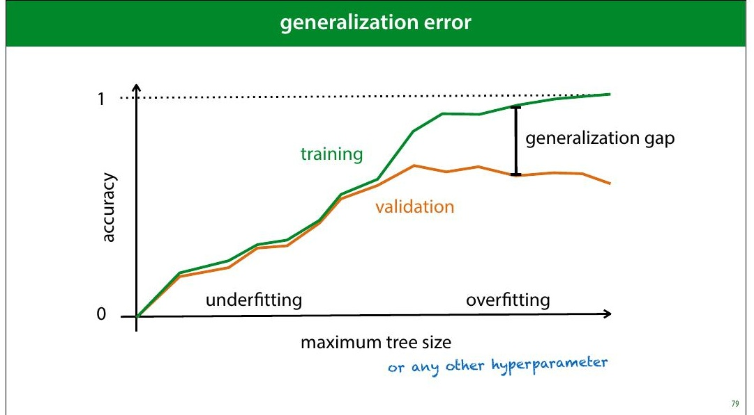
Notes:
The answer is that the difference between your validation
accuracy and your training accuracy, will tell you whether
or not your model is over8itting (matching the data too
well) or under8itting (not matching the data well enough).
The difference between the training and validation sets is
called the generalization gap. As in, it's the amount of
performance that won't generalize to data that isn't your
training data.

Slide 26
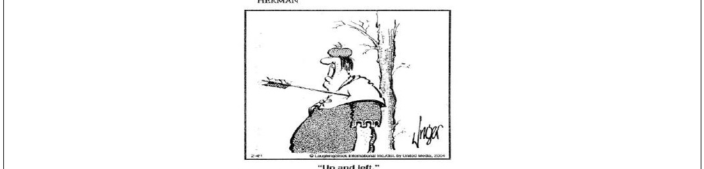
Notes:
source: Jim Unger, Herman.

Slide 27

Notes:
|section|PR, ROC and AUC|
|video|https://surfdrive.surf.nl/8iles/index.php/s/
p6Atngg3Q5AzMiz/download|

Slide 28

Notes:
Let's return to the metrics of precision and recall. We often
have to make a tradeoff between high precision and high
recall. We can boost our recall by calling more things
positive. The drawback is that our precision will go down if
this means including more negatives among the things we
call positive. We can boost our precision by calling fewer
things positive, which will hurt our recall.
How exactly we make the tradeoff depends on our cost
imbalance, and our class imbalance. To help us investigate,
we can plot the precision and recall we get from different
classi8iers.
source: By Walber - own work, CC BY-SA 4.0, https://
commons.wikimedia.org/w/index.php?
curid=36926283

Slide 29
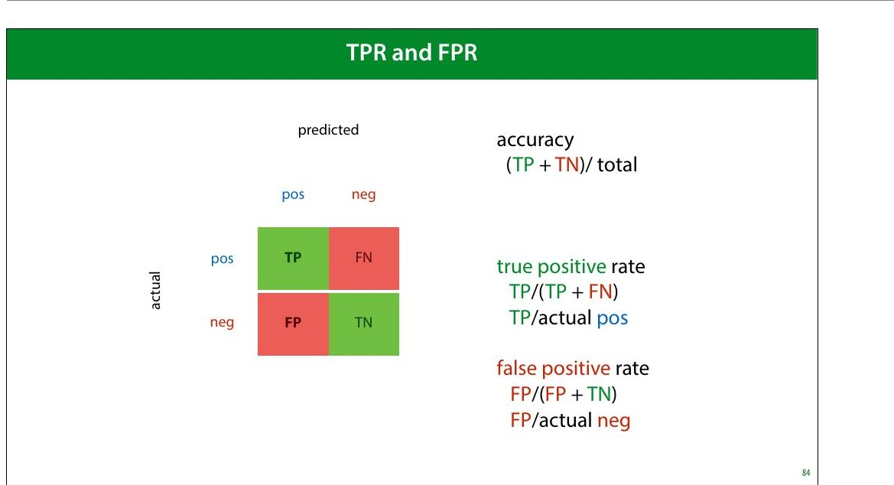
Notes:
Another pair of metrics that provides this kind of tradeoff
are the true positive and false negative rate.
true positive rate: what proportion of the actual positives
did we get right. The higher the better. I.e. How many of the
people with cancer did we detect.
false positive rate: what proportion of the actual negatives
did we get wrong (by labelling them as positives). The
lower the better. I.e. How many healthy people did we
diagnose with cancer.
The

Slide 30
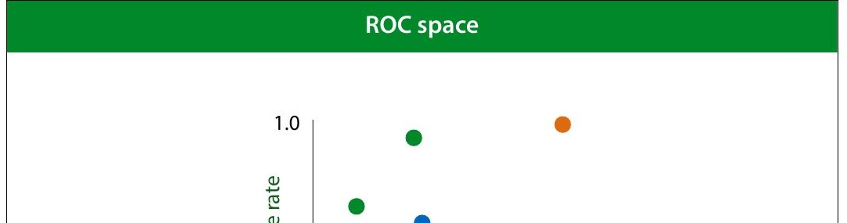
Notes:
We want to get the TPR as high as possible, and the FPR as
low as possible. That means the TPR/FPR space has the
best classi8ier in the top left corner. This space is called ROC
space.
Again, the orange points are the extremes, and easy to
achieve.
ROC stands for receiver-operating characteristic. Like so
many names in machine learning , this is a historical artifact,
a leftover from its invention in WWII to improve the detection
of Japanese aircraft from radar signals.

Slide 31
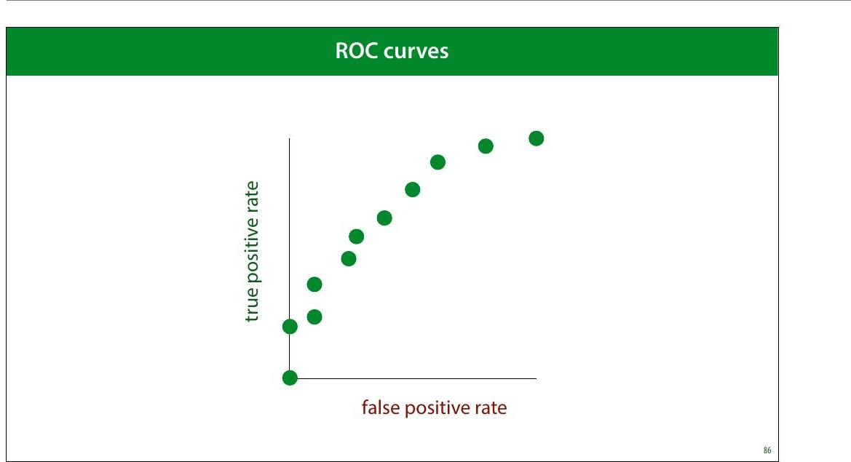
Notes:
So far we’ve thought of FPR/TPR and precision/recall as a
way to analyze a given set of models.
However, what if we had a single classi8ier, but we could
control how eager it was to call things positive? If we made
it entirely timid, it would classify nothing as positive and
start in the bottom left corner. As it grew more brave, it
would start classifying some things as positive, but only if it
was really sure, and its true positive rate would go up. If we
made it even more daring, it would start getting some
things wrong and both the TPR and the FPR would increase.
Finally, it would end up classifying everything as positive,
and end up on the top right corner.
The curve this classi8ier would trace out, would give us an
indication of its performance, independent of how brave or
how timid we make it. How can we build such a classi8ier?

Slide 32
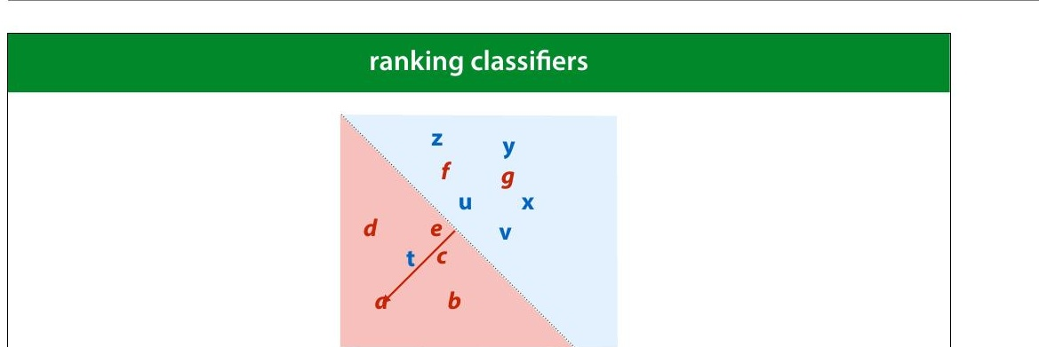
Notes:
We can achieve this by turning a regular classi8ier into a
ranking classi+ier (also known as a scoring classi+ier). A
ranking classi8ier doesn’t just provide classes, it also gives a
score of how negative or how positive a point is. We can use
this to rank the points from most negative to most positive.
How to do this depends on the type of model we use. Here’s
how to do it for a linear classi8ier. We simply measure the
distance to the decision boundary. We can now scale our
classi8ier from timid to bold by moving the decision
boundary from left to right.
After we have a ranking, we can scale the eagerness of the
classi8ier to make things positive. by moving the threshold
(the dotted line) from left to right, the classi8ier becomes
more eager to call things negative. This allows us to trade
off the true positive rate and the false positive rate.

Slide 33
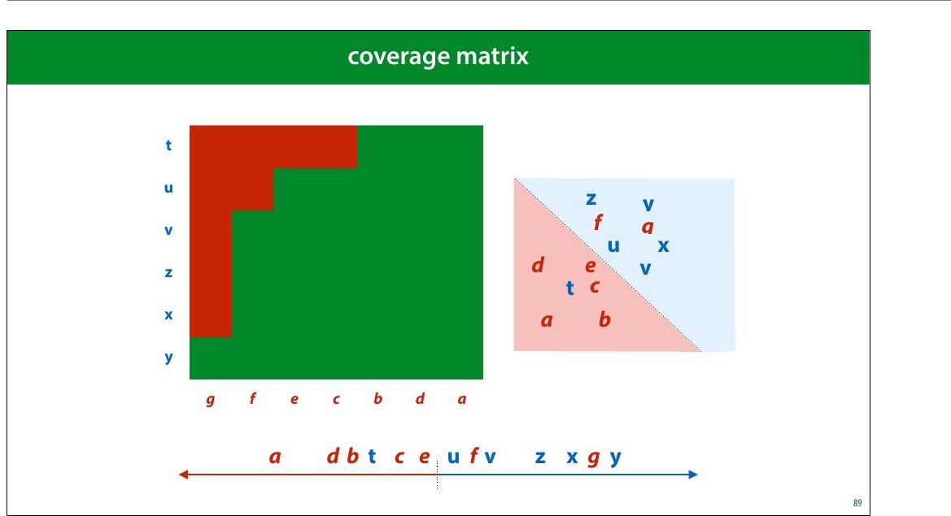
Notes:
We can make a big matrix of all the pairs for which we know
how they should be ranked: negative points on the
horizontal axis, positive on the vertical. The more sure we
are that a point is positive, the closer we put it to the
bottom left corner. This is called a coverage matrix. We
color a cell green if the corresponding points are ranked the
right way round, and red if they are ranked the wrong way
round.
Note that the proportion of this table that is red, is the
probability of making a ranking error.

Slide 34
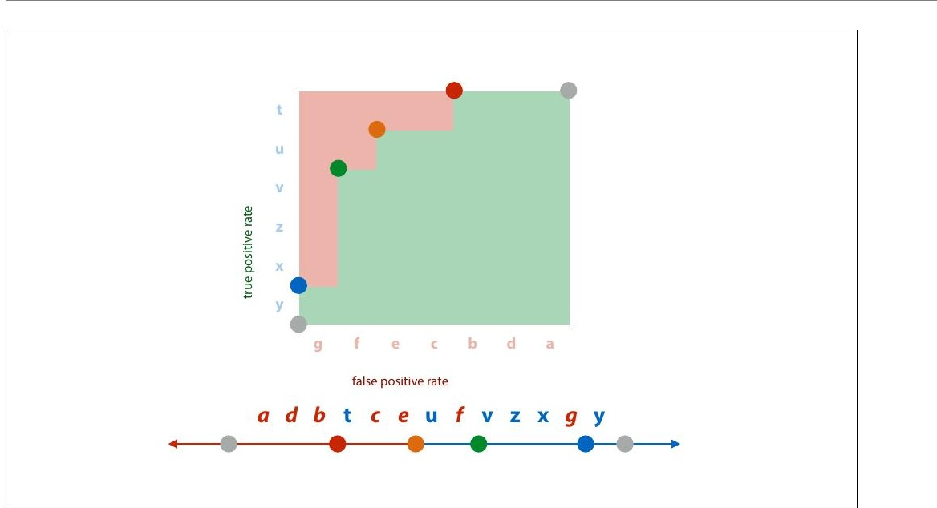
Notes:
The coverage matrix shows us exactly what happens to the
true positive rate and the false positive rate if we move the
threshold from the right to the left. We get exactly the kind
of behaviour we talked about earlier. We move from the all-
positive classi8ier step by step to the all-negative classi8ier.

Slide 35
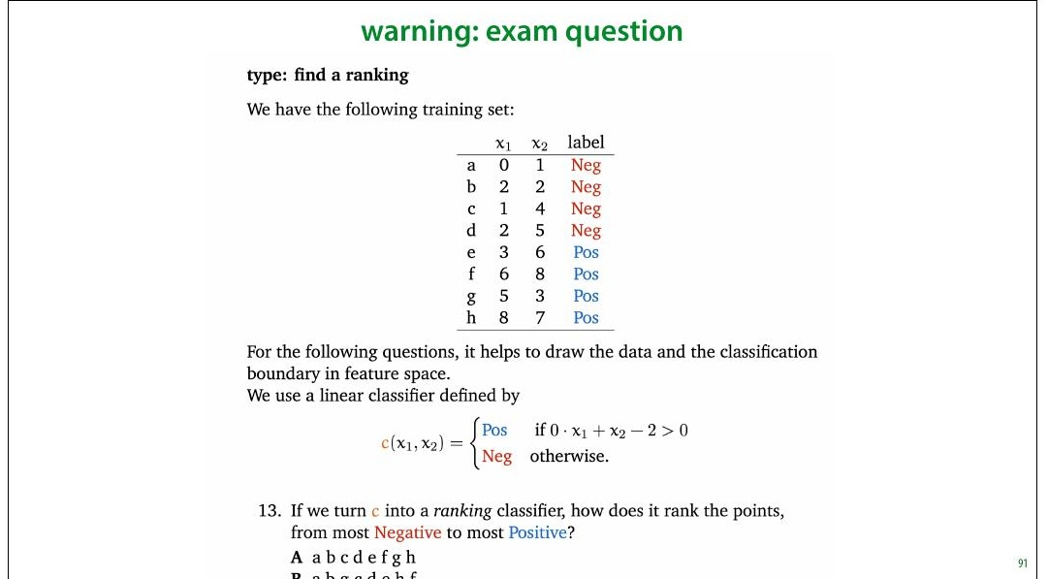
Notes:
This is one of the question types on the exam. People very
often make mistakes in this question, so make sure you
understand what a ranking error is. It's not a misclassi+ied
example. It's a property of a pair of examples.
There are more details in the third homework.

Slide 36
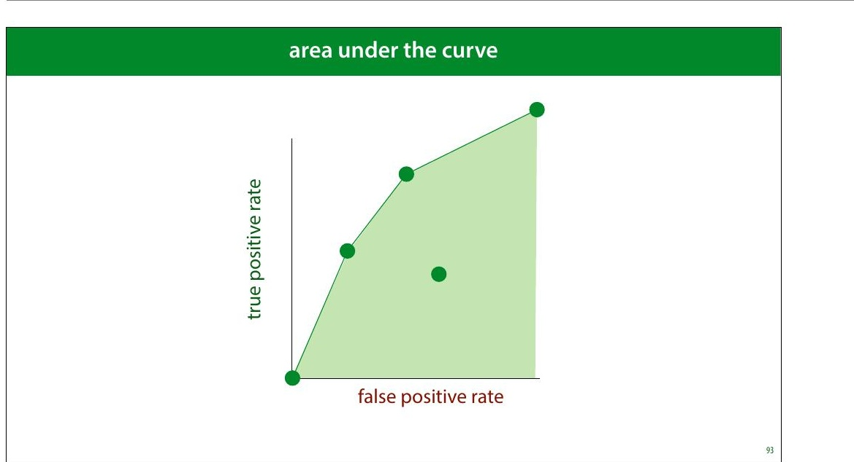
Notes:
This means we can create any classi8ier in this green area,
called the convex hull of the set of green dots. This is called
the area under the (ROC) curve.
The AUC is a good indication of the quality of the classi8ier.
Every point in the green shaded area is a classi>ier we now
how to make, so the bigger this area, the more classi>iers we
can make (although the ones on the boundary are the only
ones we’d ever want to use).
If we have no idea of how we want to make the tradeoff
between the TPR and the FPR, the AUC may be a good way
to compare classi8iers in general.

Slide 37
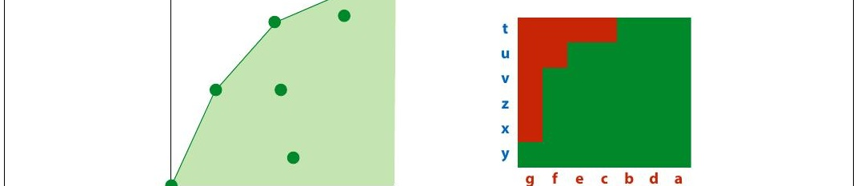
Notes:
As we saw before: normalizing the coverage matrix gives us
the ROC space (barring some small differences that
disappear for large datasets). The area under the ROC curve
is an estimate of the green proportion of the coverage
matrix. This gives us a good way to interpret the AUC.
The AUC (in ROC space) is an estimate of the probability
that a ranking classi+ier puts a randomly drawn pair of
positive and negative examples in the correct order.

Slide 38
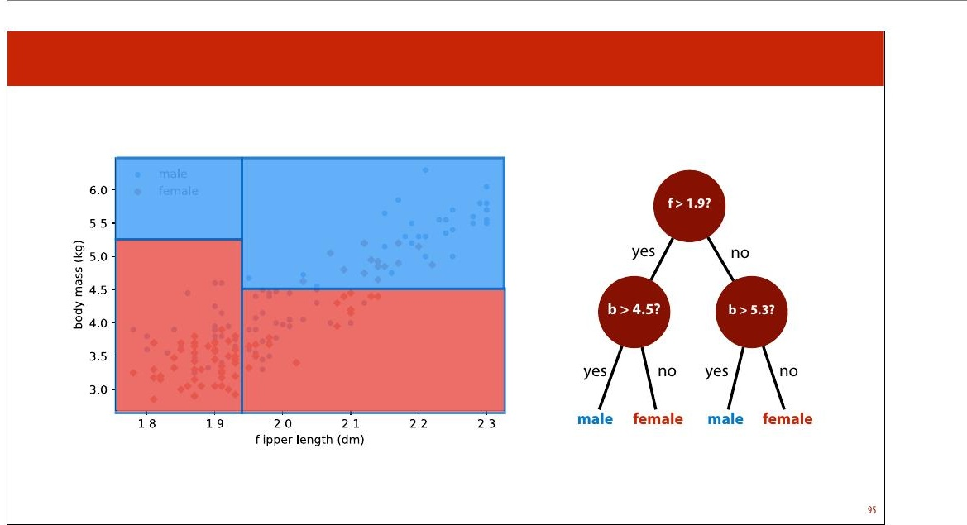
Notes:
Let's look at how this works for another type of classi8ier. To
reiterate, how we get a ranking from a classi+ier
depends entirely on the model class.
The decision tree is an example of a partitioning classi8ier. Is
splits the feature space into partitions, and assigns each
partition, also known as a segment, a class. All instances in
the segment get the same class.

Slide 39
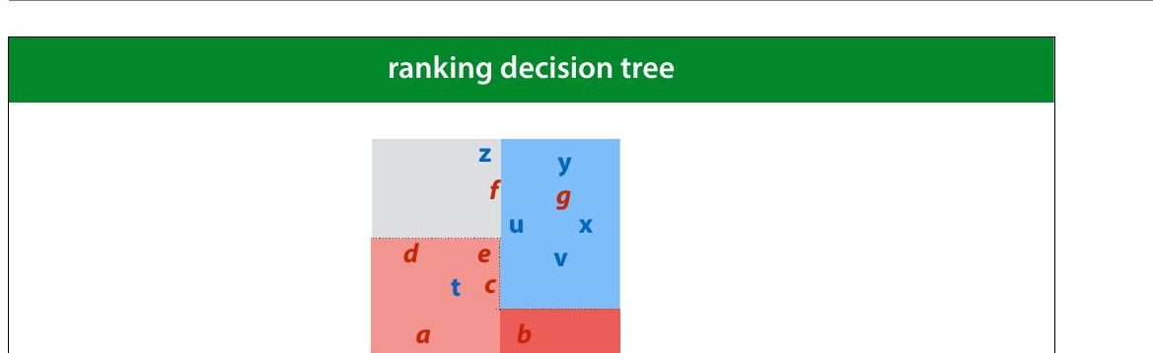
Notes:
In this example we have an instance space that has been
split into four segments by a decision tree. We rank the
segments by the proportion of positive points. We then put
all points in one region on the same level in the ranking.
In this example, b is more negative than a, because b’s
segment contains only negative examples, whereas a’s
segment contains a mix of positive and negative examples.

Slide 40
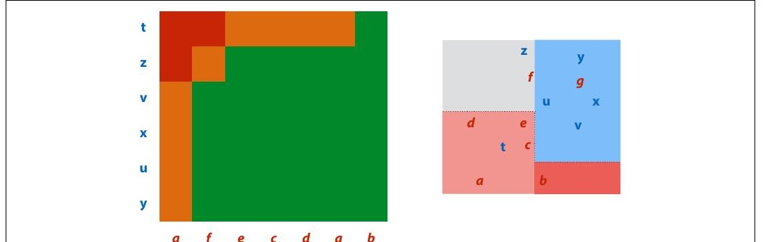
Notes:
This means that for some pairs (like f,z), the classi8ier ranks
them as “the same”. We’ll color these cells orange in the
coverage matrix.
For large datasets, these regions will not contribute much
to the total area under the curve.

Slide 41
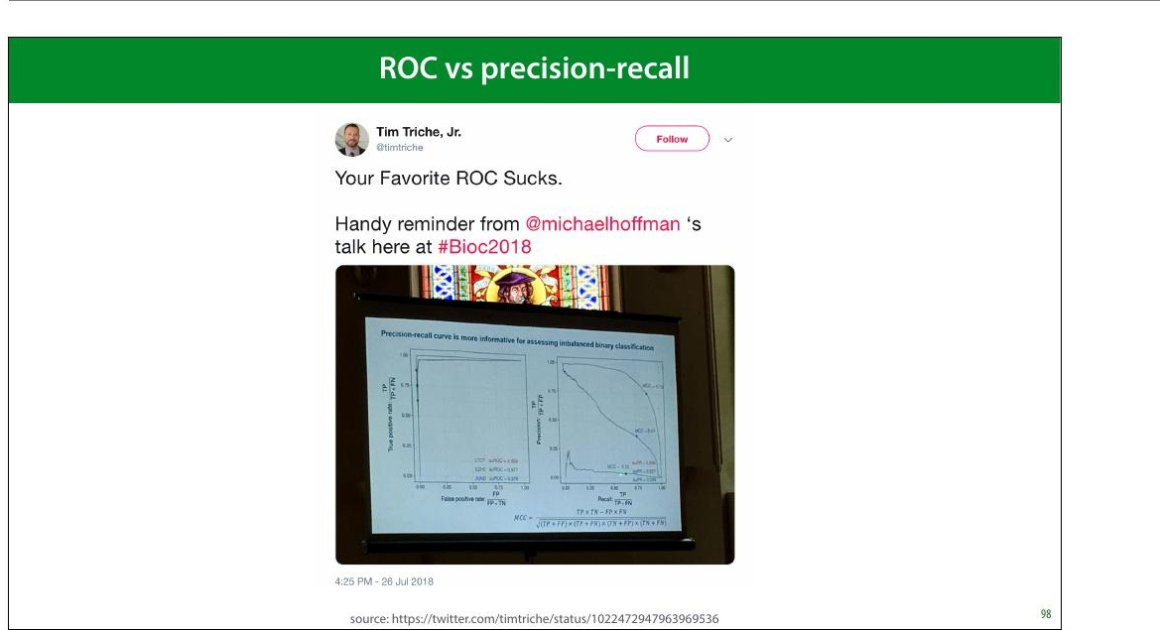
Notes:
An alternative to the ROC is the precision/recall curve. It
works in exactly the same way, but has precision and recall
on the axes.
As you can see in this tweet, in many settings the PR curve
can be much more informative, especially when you’re a
plotting the curves. Practically, it’s little effort to just plot
both, and judge which one is more informative.
ROC has the bene8it of an intuitive interpretation for the
AUC (the probability of ordering a random pair the right
way round). I haven’t yet found a similar interpretation for
the PR-AUC.

Slide 42
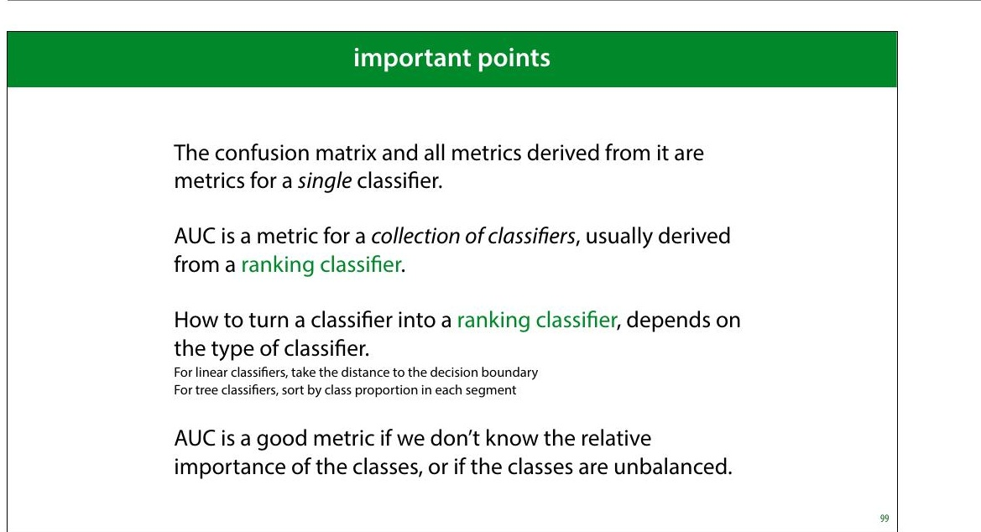
Notes:
To interpret the AUC, you should know not just what
classi8ier was used, but how it was made into a collection of
classi8iers. You should also know whether it’s the area
under an ROC curve, or a precision/recall curve.

Slide 43
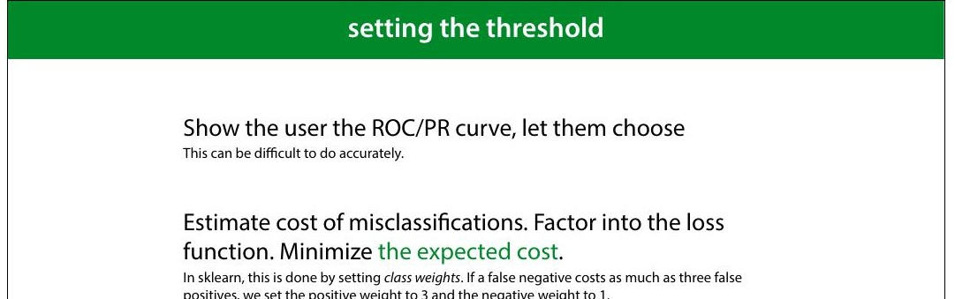
Notes:
To put a classi8ier into production, a ranking may not be
enough. Sometimes, you just need to produce a single
answer. In that case, you can still use the ROC and PR curves
to tune your hyperparameters and choose your model, but
ultimately, you’ll need to choose a threshold as well: the
point at which you decide to call something a positive.
This is more of a software development issue than a
scienti8ic choice. Often, you have to look carefully at the
curves, perhaps together with the end users, to make a
decision.
The second approach works best with probabilistic
classi8iers, which we’ll discuss next lecture.

Slide 44
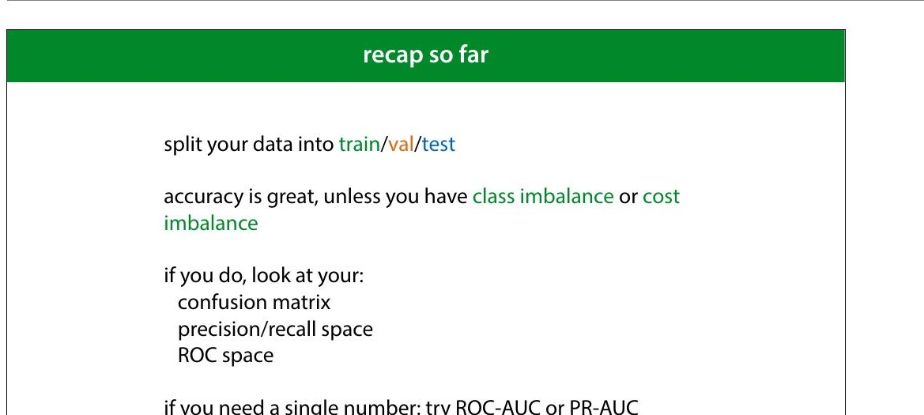

Slide 45
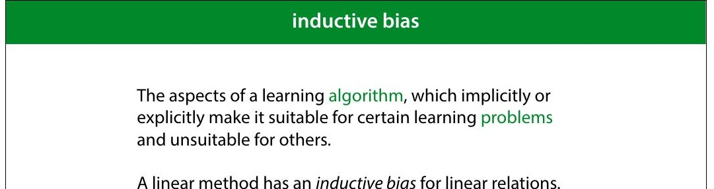
Notes:
This is an increasingly important phrase in machine
learning. The inductive bias of a method or model are those
assumptions about the domain that are, explicitly or
implicitly, hardcoded into the model.
For instance, in a linear regression model, the assumption is
that all instances lie on a line (or the higher-dimensional
equivalent). If this assumption isn't violated too much, the
model is a good 8it for the data. If the assumption is violated
very badly, we need to look for ways to change the
inductive bias, for instance by picking a different model, or
by enriching the linear model with extra features, like we
will do in the next lecture.
We can summarize the business of machine learning and
data science as follows. The business of the machine
learning researcher is to create a variety of models with
helpful inductive biases. The business of the data scientist is
to 8igure out which of the available inductive biases is
helpful for any given problem.

Slide 46
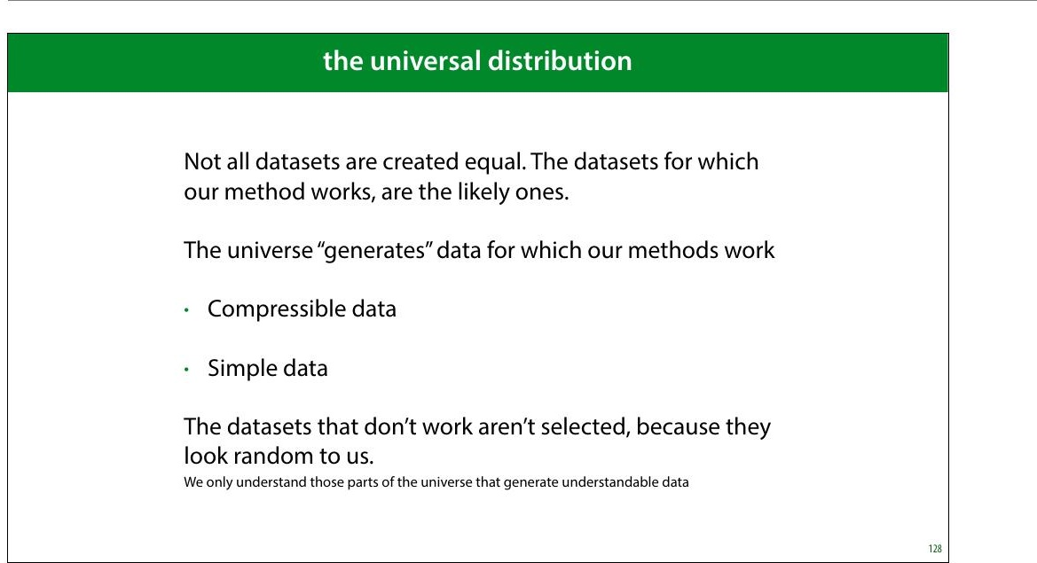
Notes:
One “out” to the NFL Theorem, is that there is a “universal
distribution” governing all processes that create data.
The NFL Theorem implicitly assumes that all datasets are
equally likely. Since this is not the case, there is some other,
non-uniform distribution that tells us which datasets are
more likely than others, averaged over all possible settings.
Using such a universal data distribution, we could (in
theory) work out a universally best learning algorithm.

Slide 47
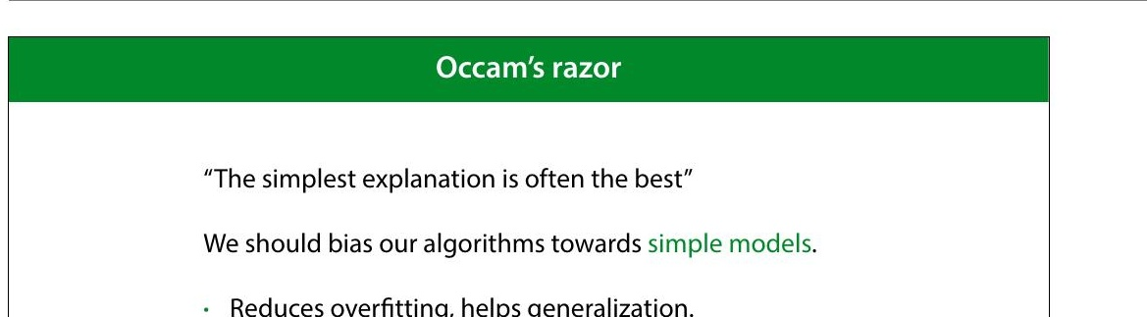
Notes:
We don't have too many practical ideas about the properties
of such a universal distribution, but one thing that crops up
a lot is that simple data is necessarily more likely than
complex data.
This suggests that in learning we should have a simplicity
bias. If there are two models that both 8it the data, one very
simple, like a linear model, and one very complex, like a
very big decision tree, then it's more likely that the simple
model generated the data.
Such simplicity biases can be implemented in many
different ways, and we'll see some concrete examples as the
course progresses.

