Slide 1
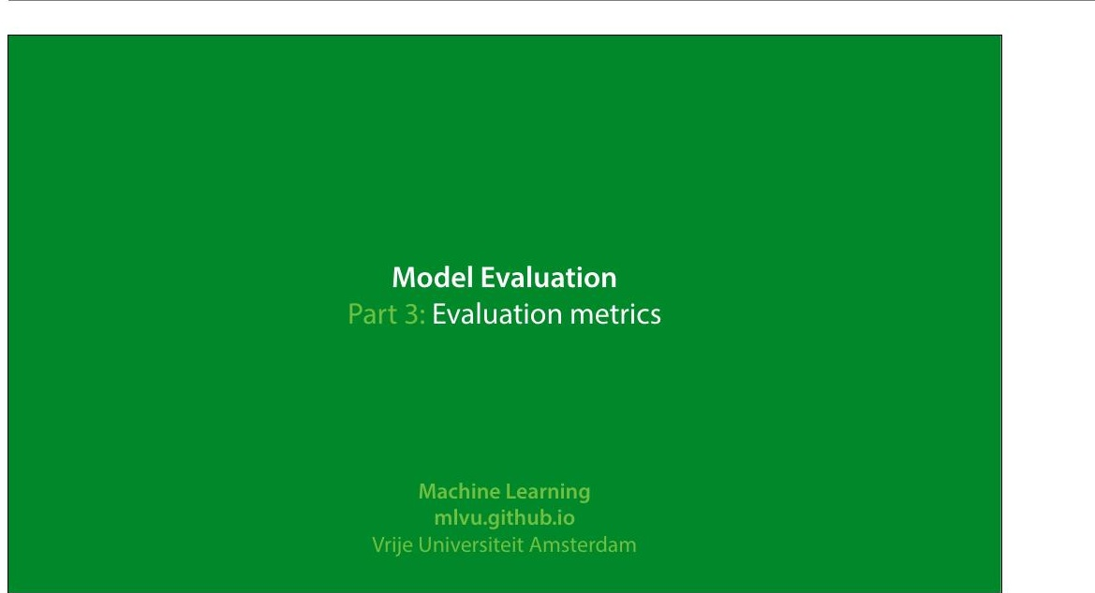
Notes:
In this video we'll look at how to evaluate regression and
classi8ication experiments. There will be a few pointers on
regression, but the main topic will be classi8ication
experiments.
|section|Metrics|
|video|https://surfdrive.surf.nl/8iles/index.php/s/
TrR5TrtLDZLBs08/download|

Slide 2
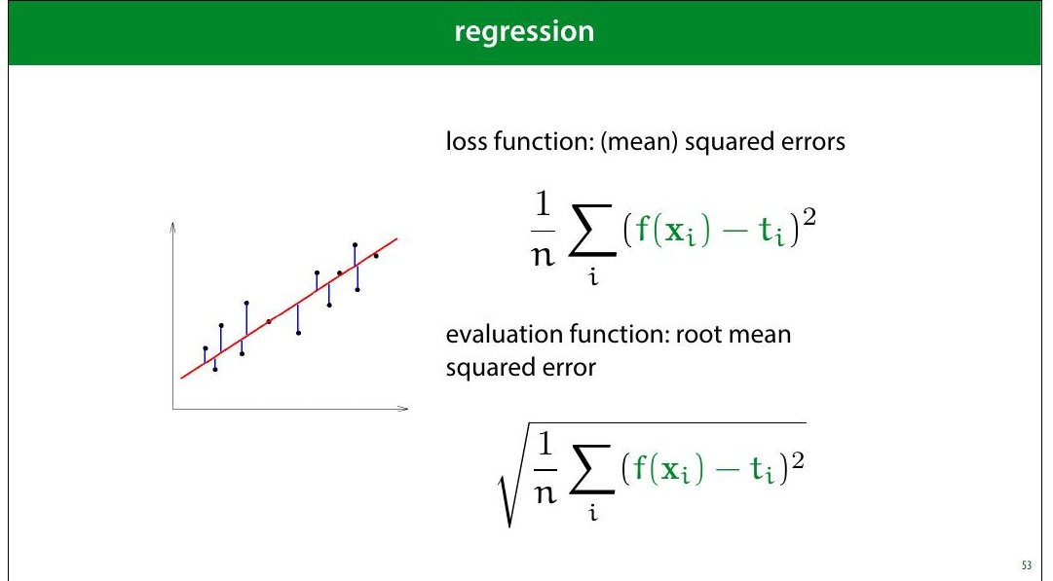
Notes:
One thing to pay attention to is that if you use MSE loss, you
may want to report the square root (the RMSE). The RMSE
is minimised at the same places as the MSE, but it’s easier
to interpret, because it has the same units as the original
output value.
For instance, if your outputs are in meters, then your MSE is
measured in square meters, but your RMSE is also
measured in meters.

Slide 3
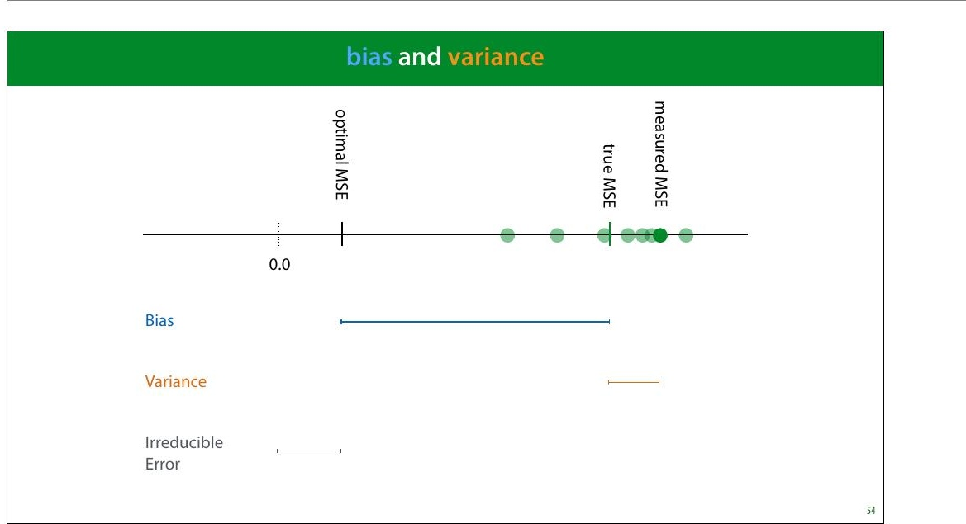
Notes:
Bias and variance are good concepts to keep in mind when
thinking about regression performance. The bias is the
difference between your optimal MSE and the true MSE.
This is the part of your error that is down to fundamental
problems with your model: for instance, you are 8itting a
line trough data with a parabolic pattern. This part stays the
same if you resample your data.
The variance is the difference between the true MSE and
the measured MSE. This is the part of your error that is
down to aspects of the random sampling of the data. This
part changes when you resample your data.
Normally, we train a regression model once, and get one
MSE value. This gives us one dot on the axis above. Without
repeating the process on freshly sampled data, we can't tell
how our error falls apart in bias and variance. However, we
can usually get some contextual clues, or investigate using
resampling.

Slide 4
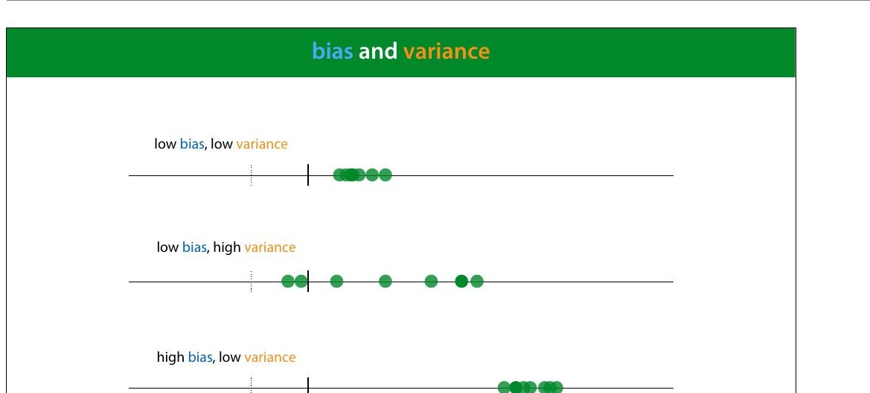

Slide 5
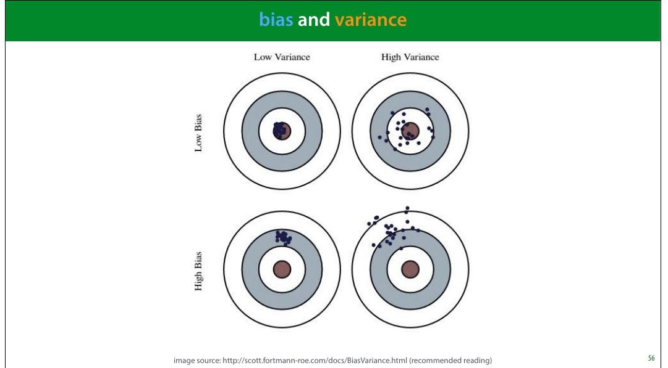
Notes:
Here is a metaphor that is often used to describe bias and
variance: a dartboard.
Remember, this is a metaphor for our RMSE error estimate.
That means that normally, we have only one dart and we
can’t tell whether our error is due to high bias or high
variance.
image source: http://scott.fortmann-roe.com/docs/
BiasVariance.html (recommended reading)

Slide 6
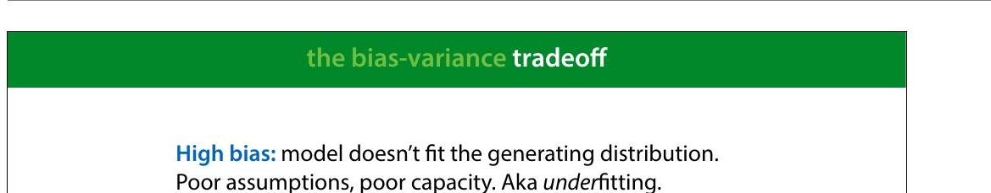
Notes:
High bias tends to happen when the model is too simple to
follow the true "shape" of the data. Linear models in low-
dimensional spaces often have this problem. Here, we see
that the data has a slight curve, which is clearly part of its
natural pattern, and something the model should learn.
Since it's restricted to a line, however, it cannot make this
shape.

Slide 7
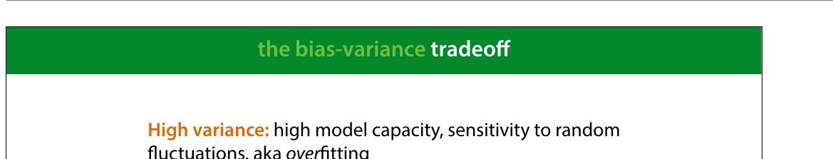
Notes:
High variance happens when the model has the capacity to
follow the shape of the data perfectly, but it does it so
perfectly that it tends to get thrown off by small
8luctuations.
Here, the model doesn't just follow the natural curve of the
data, it goes in and out of every random 8luctuation to
model every single point perfectly.
Even though this model (a regression tree) 8its the data
perfectly, if we resample the data, we are stuck with all
sorts of weird peaks that won’t 8it the new data. This is
where the variance comes from. The true error varies
wildly, because the model captures every single random
8luctuation in the training data. These 8luctuation will cause
a large error in the test data, which we put down to
variance rather than bias.

Slide 8
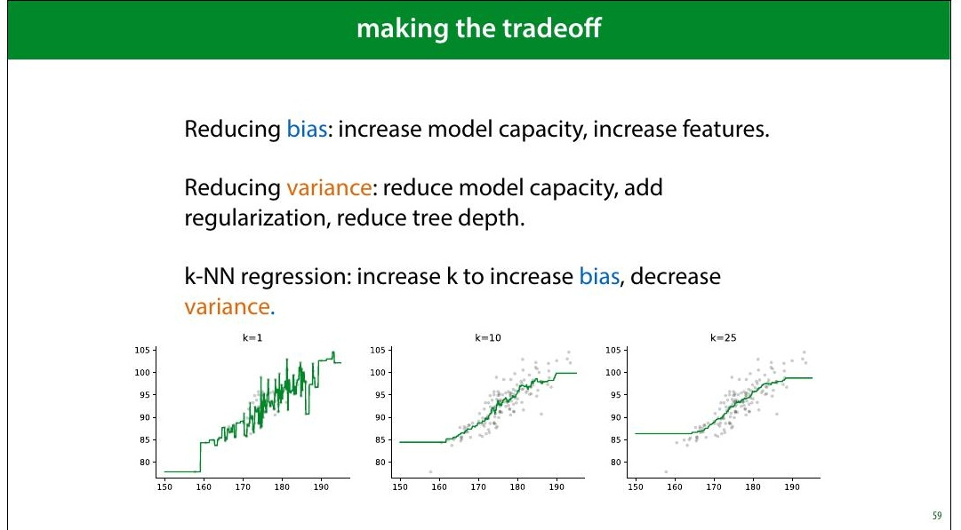
Notes:
We will see techniques for all of these in the coming weeks.
Note that often, it really is a tradeoff: reducing the bias,
increases the variance and vice versa.
For some algorithms, there is a single parameter that allows
us to make the bias/variance tradeoff. kNN is one example:
low k values give us high variance, high k values give us
high bias.
In the strictest de>inition of bias and variance, these concepts
only apply to the mean squared error, where they explictly
appear as terms if you rewrite the error in a certain way.
However, in general machine learning parlance, the terms
are applied to any regression error, and they are roughly
synonymous with under- and over>itting.

Slide 9
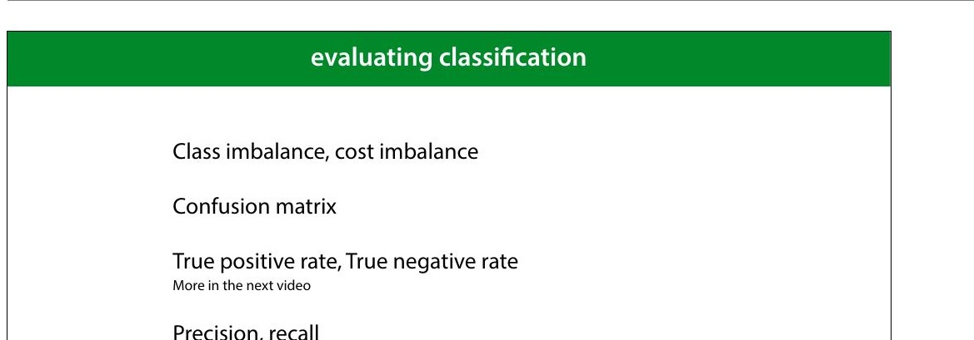
Notes:
Let's now move to classi8ication. We'll start by explaining
these four topics.

Slide 10
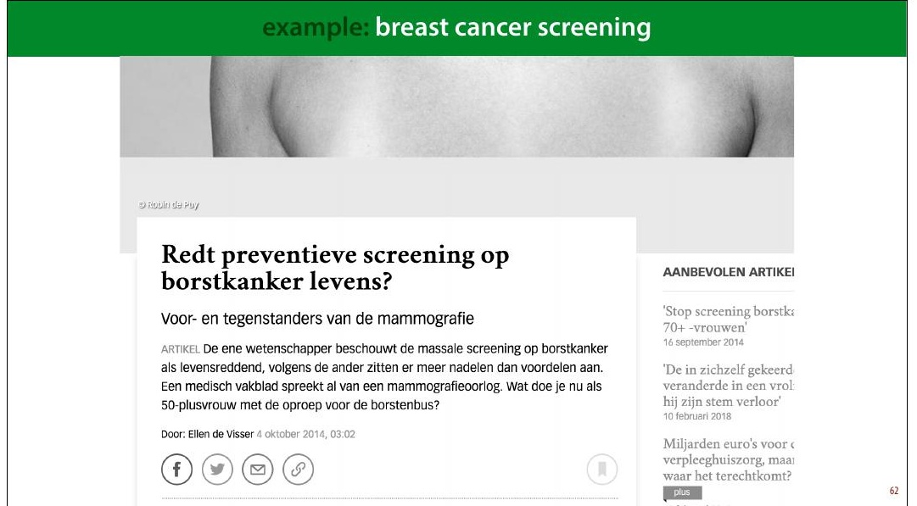
Notes:
Here's one example domain: breast cancer screening
A recurring discussion in the Dutch media is the question
whether all women over 50 be screened for breast cancer.
This is an analogy for classi8ication: the instances are
people and the target label is “has cancer” or “has no
cancer.” You may think that this is a no-brainer: the more
tests we do, the more lives saved. But we need to take into
account how good the classi8ier is, and how bad the
consequences are of it making a mistake.
The 8irst problem this example illustrates is class
imbalance. Unlike the classi8iers we've seen so far, this
example has, thankfully, far more negatives than positives.
In a given year the people in this age group for whom breast
cancer will manifest is about half a percent. This includes
men, for whom breast cancer is rare (but not impossible),
so when we talk about screening for women over 50, we
should probably assume about 1% positives.
This means that we need to be very careful when

Slide 11
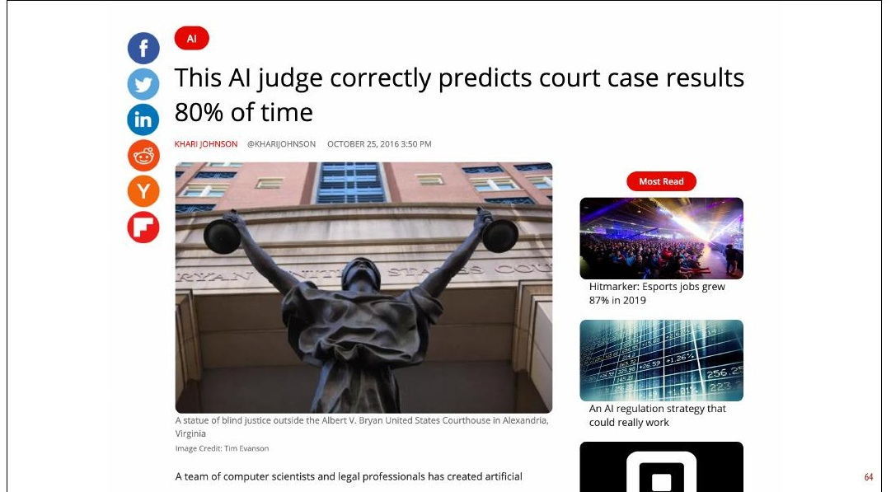
Notes:
So the next time you see a headline like this, your 8irst
question should be: what was the class distribution in the
training data? If 90% of the cases in the training data are
acquittals, this is not a very impressive result.
As it happens, in this case the classes were balanced 50/50,
so 80 percent is at least notable. However, now we have a
classi8ier trained on arti8icially balanced data. In a
production environment (whatever that means here), the
classes are likely not balanced 50/50, so this speci8ic
classi8ier will be of no further use.
Here is the original paper: https://peerj.com/articles/
cs-93/#fn-6 There are some issues with this research
beyond the class balance.

Slide 12
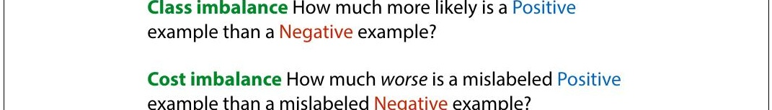
Notes:
Another reason to mistrust accuracy is cost imbalance. In
breast cancer screening are two types of misclassi8ication:
diagnosing a healthy person with cancer and diagnosing a
person with cancer as healthy. Both come with a cost but
not the same cost.
We can either miss a cancer diagnosis (a false negative),
which means the cancer will be caught much later and be
much harder to treat. However, diagnosing a healthy person
with cancer (a false positive) means they will be sent for
unnecessary invasive testing and suffer great psychological
stress. The cost of this is much less than the cost of missing
a positive, but it isn't zero.
This is what the discussion in the media centers on. If the
screening causes many more false negatives than false
positives, it may mean that the cost to human lives balances
out, and the net effect of the screening isn't to save more
lives.
There is of course, also the 8inancial cost of screening a

Slide 13
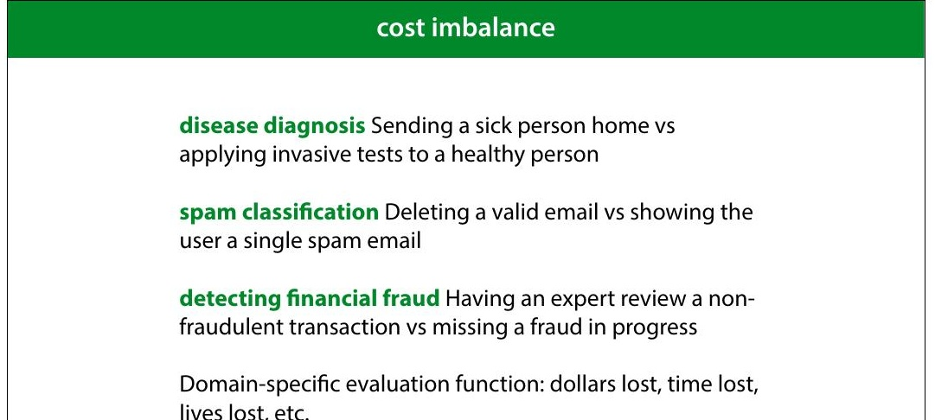
Notes:
Here are some examples of problems with cost imbalance
In all these cases, one misclassi8ication one way costs much
more than a misclassi8ication the other way. But both cost
something. The time of an expert reviewer is not free, even
though 8ive minutes of his time may be much cheaper than
the cost of letting a single fraud go unchecked. In such a
case, you may decide that missing one fraud is as costly as
having an expert review 500 harmless transactions. This is
then the general balance you are hoping for: one false
negative for every 500 false positives.
If you’re lucky, both types of misclassi8ication have the same
unit, and you can turn your error (an estimate of the
number of misclassi8ications) into a domain speci8ic
evaluation function (like estimated dollars lost, or time
saved). You simply assign a cost to each type if
misclassi+ication, and multiply it by how often that
misclassi+ication occurs in the test set. The total is the
evaluation function you want to minimize.

Slide 14
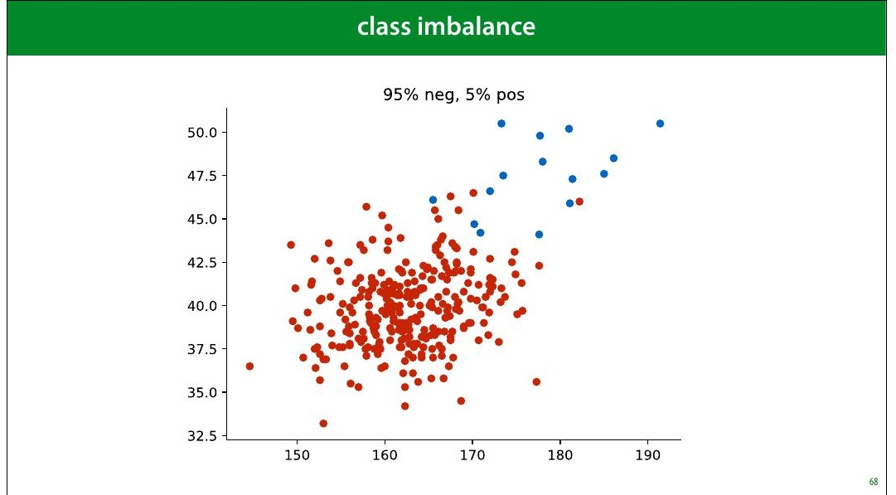
Notes:
Here is a pretty imbalanced dataset (though still not as
imbalanced as the cancer/not cancer problem). It looks
pretty dif8icult. What would be a good performance on this
task?

Slide 15
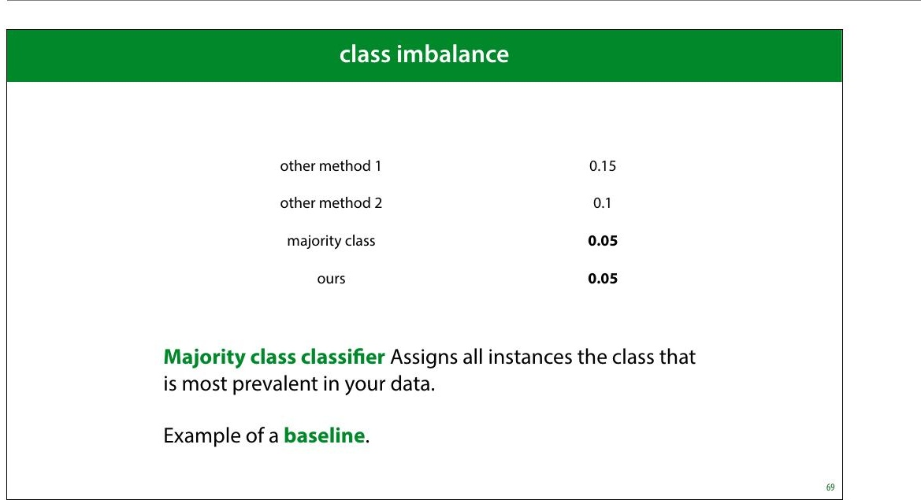
Notes:
As we've seen, even though an error of 0.05 might sound
pretty good, but on an imbalanced dataset like this, there is
a very simple classi8ier that gets that performance easily.
The classi8ier that assigns anything the class with the most
instances. We call this the majority class classi+ier.
The majority class classi8ier is an example of a baseline, a
simple method that is not meant to be used as a real model,
but that can help you calibrate the performance scores. In
this case, it tells you that you’re really only interested in in
the error range from 0 to 0.05. Any higher error than that is
pretty useless.

Slide 16
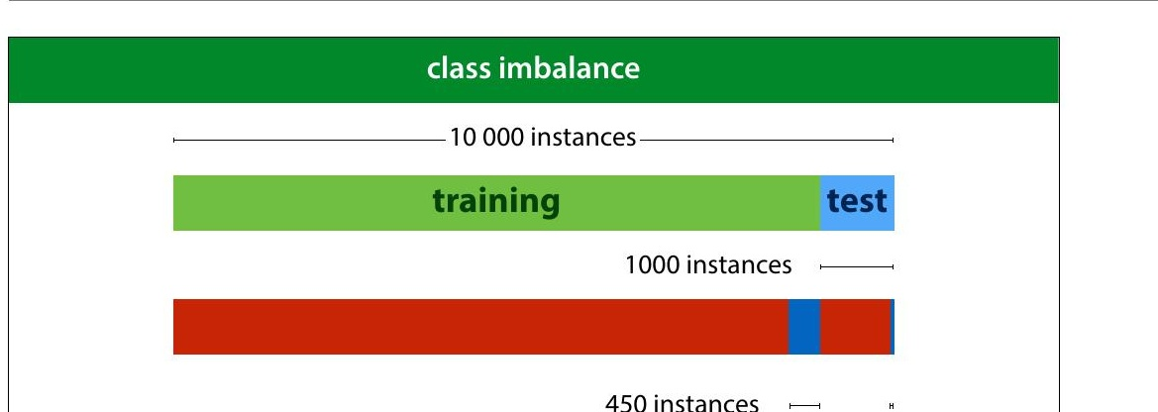
Notes:
Here is another way that class imbalance can screw things
up for you. You might think you have a pretty decent
amount of data with 10 000 instances. However if you split
off a test set of 1 000 instances, you'd be left with just 50
instances of the positive class in your data. Practically, your
8inal evaluation will just be a question of how many of these
50 positives you detect. This means that you can really only
have 50 “levels of performance” that you can distinguish
b e tw e e n .
Yo u c a n m ake a bigger test set of course (and you probably
should) but that leads to problems in your training data.
Since you’re essentially building a detector for positives, it
doesn’t help if you can only give it 100 examples of what a
positive looks like.
In the next lecture, we’ll look at some tricks we can use to
boost performance on such imbalanced data.

Slide 17
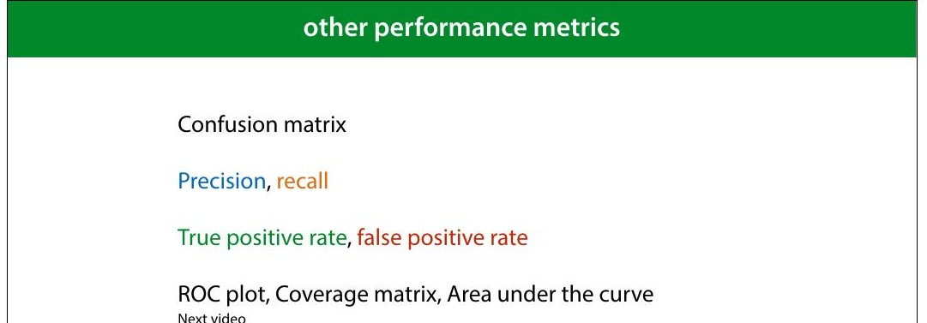
Notes:
The best thing to do under class and cost imbalance, is to
look at your performance in more detail. We’ll look at six
different ways to measure classi8ier performance.
Most of these are only relevant if you have class or cost
imbalance. If you have a nice, balanced dataset, it’s likely
that error or accuracy is all you need.

Slide 18
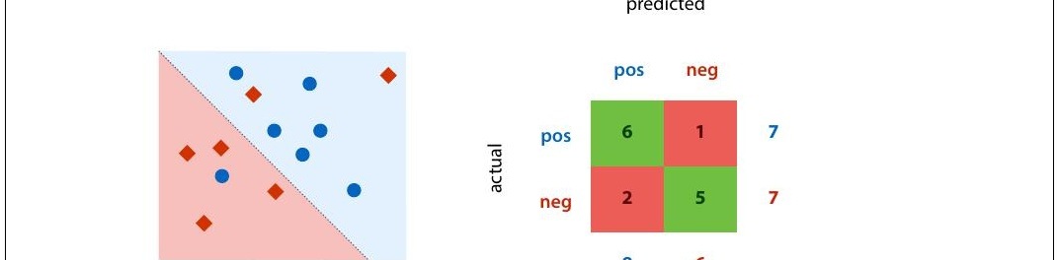
Notes:
This is a confusion matrix (also known as a contingency
table). It's simply a table with the actual classes on the
rows, and the predicted classes on the columns, and a tally
in each cell of how often each actual class is given a
particular prediction. On the diagonal we tally all the
correct classi8ications and off the diagonal we tally all the
possible mistakes.
A confusion matrix doesn’t give you a single number, so it’s
more dif8icult to compare two classi8iers by their confusion
matrices, but it’s a good way to get insight into what your
classi8ier is actually doing.
Note that for a binary classi8ication problem, we are getting
the two types of mistakes (false positives and false
negatives) along the second diagonal. If we have cost
imbalance, the balance between these two values gives us a
quick insight into how well the classi8ier is aligned with our
estimate for the misclassi8ication costs.
You can plot the confusion matrix for either the training,

Slide 19
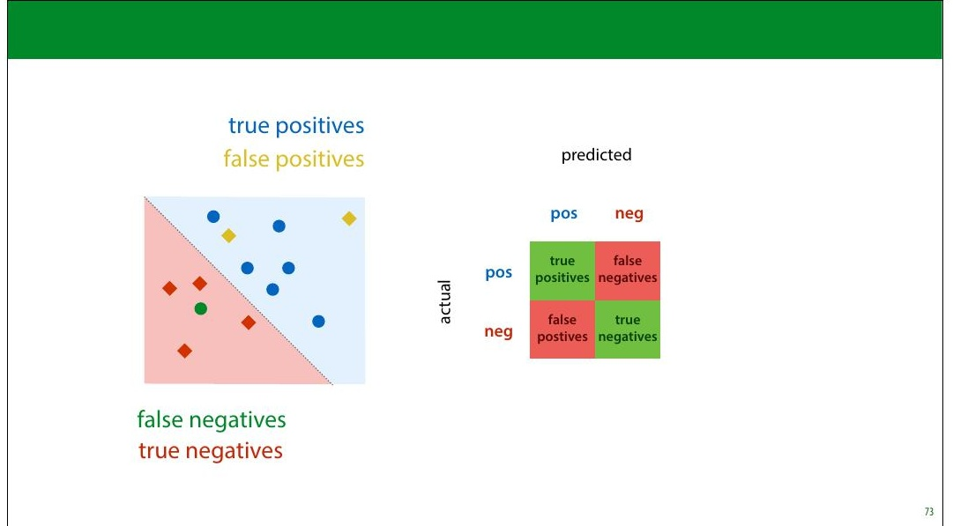
Notes:
We call accurately classi8ied instances true positives and
true negatives. Misclassi8ications are called false positives
and false negatives.

Slide 20
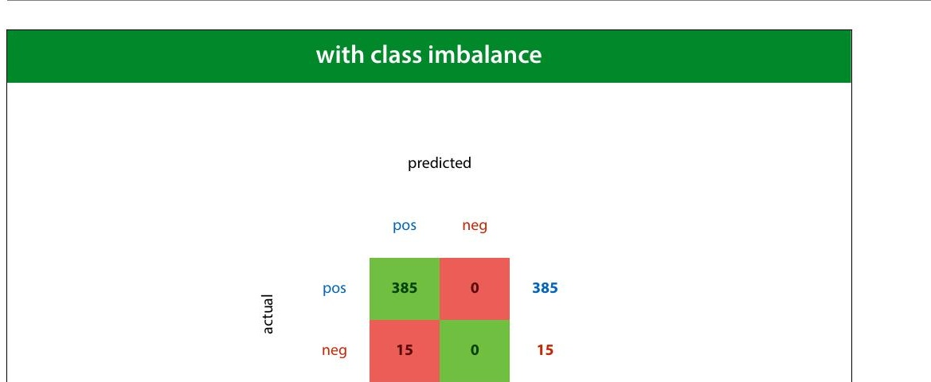
Notes:
Here we see the confusion matrix for the majority class
baseline (the classi8ier that calls everything positive) in a
problem with high class imbalance.

Slide 21
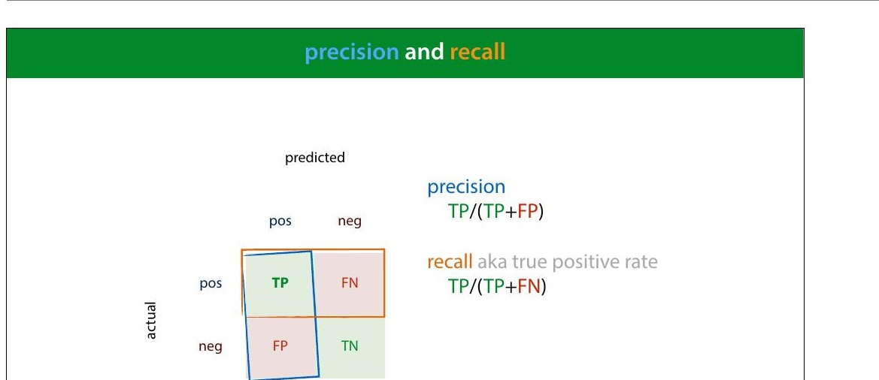
Notes:
Precision and recall are two metrics that express a tradeoff
between the two types of mistakes.
Precision: what proportion of the returned positives are
actually positive?
Recall: what proportion of the existing positives did we
8ind?
The idea is that we usually want to 8ind as many positives as
possible, so we should be eager to label things positive,
increasing the recall, but if we are too eager, we will label
lots of negatives as positive as well, which will hurt our
precision. Our main challenge in designing a classi8ier in the
face of cost and class imbalance, is to 8ind the right tradeoff
between precision and recall.

Slide 22
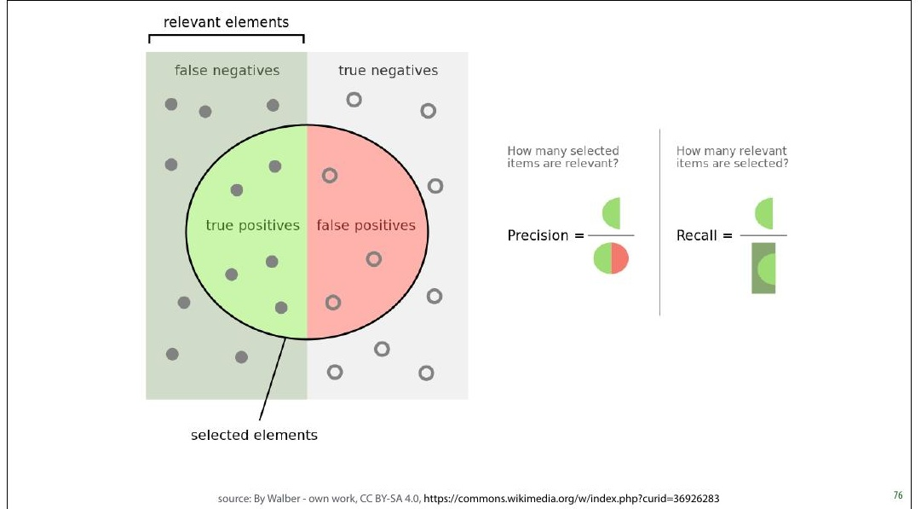
Notes:
It always takes me a minute to 8igure out what precision
and recall mean in any given situation, and I usually consult
this diagram from Wikipedia to help me out.
The idea is that the goal of the classi8ier is to select the
positives in the dataset. The more it selects, the higher its
recall, but the lower its precision, as more negatives end up
in the selection.
source: By Walber - own work, CC BY-SA 4.0, https://
commons.wikimedia.org/w/index.php?
curid=36926283

Slide 23
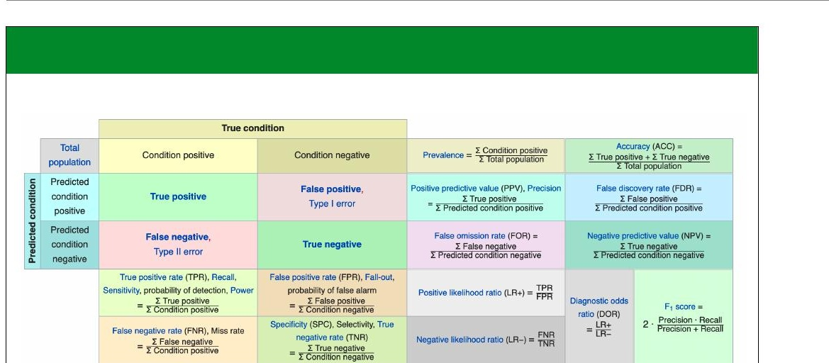
Notes:
There are many more metrics which you can derive from
the confusion matrix. Wikipedia provides a helpful table, in
case you ever come across them. For most purposes,
precision, recall, accuracy and balanced accuracy are
suf8icient.
Note that some terms, like recall, go by many different
names.

Slide 24
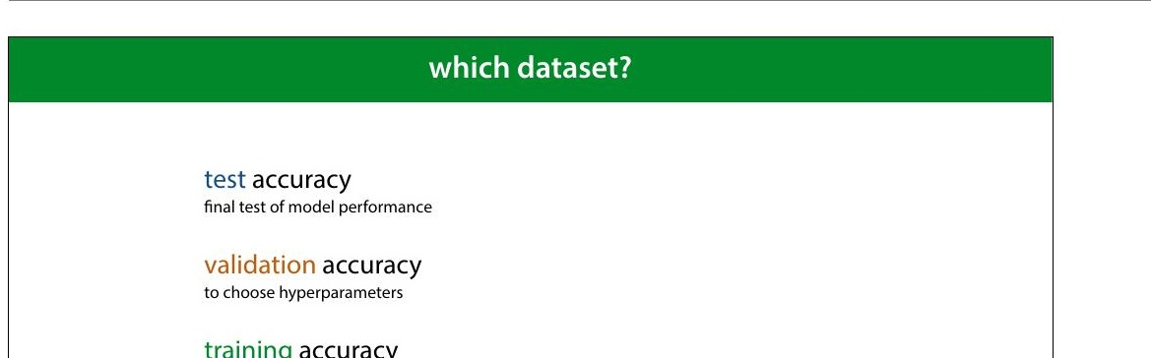
Notes:
All of these metrics can be applied to different datasets.
When we compute (say) accuracy on the test set, we talk
about test accuracy. This is computed—only once—at the
very end of our project, to show that our conclusions are
true.
When we compute it on the validation set we call it
validation accuracy. We compute this to help us choose
good hyperparameters.
And, predictably, when we compute it on the training data,
we call it training accuracy. Remember that in the 8irst
lecture I said, emphatically, that you should never judge
your model on how it performs on the training set. Why
then, would you ever want to compute the training accuracy
(or any other metrics on the training data)?

Slide 25
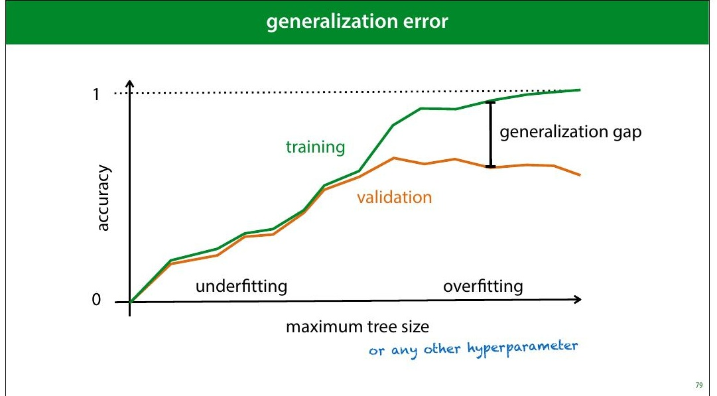
Notes:
The answer is that the difference between your validation
accuracy and your training accuracy, will tell you whether
or not your model is over8itting (matching the data too
well) or under8itting (not matching the data well enough).
The difference between the training and validation sets is
called the generalization gap. As in, it's the amount of
performance that won't generalize to data that isn't your
training data.

Slide 26
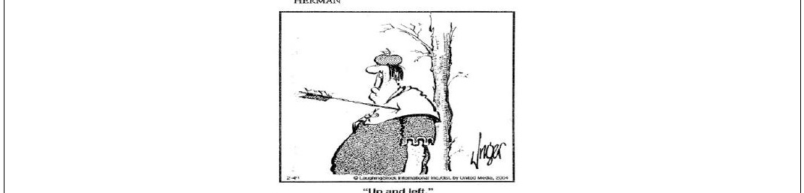
Notes:
source: Jim Unger, Herman.

Slide 27

Notes:
|section|PR, ROC and AUC|
|video|https://surfdrive.surf.nl/8iles/index.php/s/
p6Atngg3Q5AzMiz/download|

Slide 28

Notes:
Let's return to the metrics of precision and recall. We often
have to make a tradeoff between high precision and high
recall. We can boost our recall by calling more things
positive. The drawback is that our precision will go down if
this means including more negatives among the things we
call positive. We can boost our precision by calling fewer
things positive, which will hurt our recall.
How exactly we make the tradeoff depends on our cost
imbalance, and our class imbalance. To help us investigate,
we can plot the precision and recall we get from different
classi8iers.
source: By Walber - own work, CC BY-SA 4.0, https://
commons.wikimedia.org/w/index.php?
curid=36926283

Slide 29
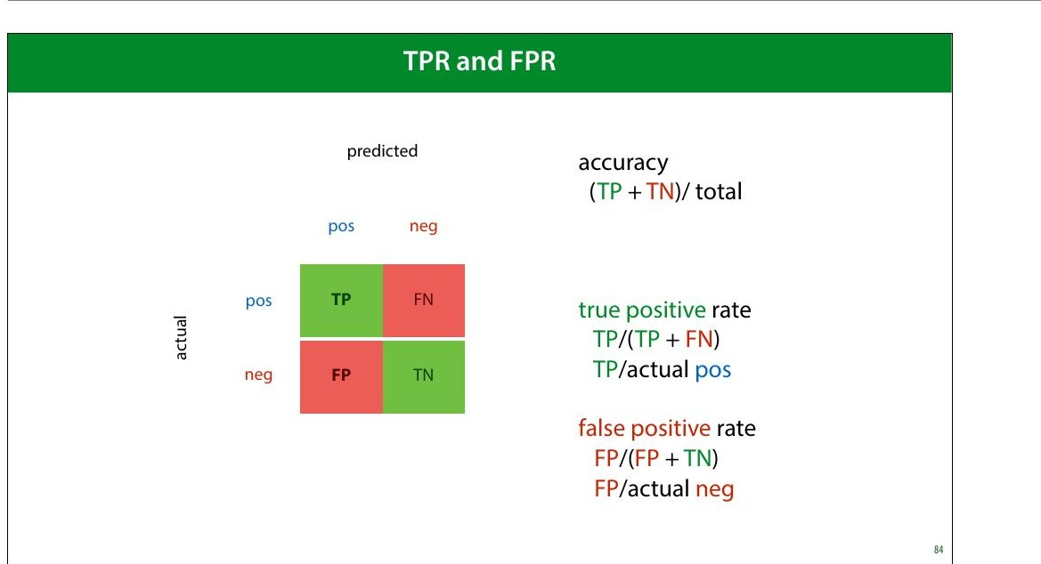
Notes:
Another pair of metrics that provides this kind of tradeoff
are the true positive and false negative rate.
true positive rate: what proportion of the actual positives
did we get right. The higher the better. I.e. How many of the
people with cancer did we detect.
false positive rate: what proportion of the actual negatives
did we get wrong (by labelling them as positives). The
lower the better. I.e. How many healthy people did we
diagnose with cancer.
The

Slide 30
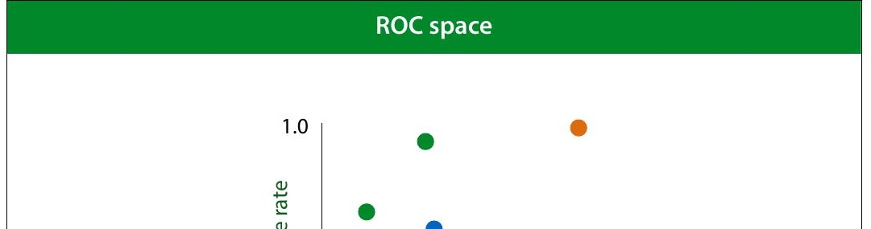
Notes:
We want to get the TPR as high as possible, and the FPR as
low as possible. That means the TPR/FPR space has the
best classi8ier in the top left corner. This space is called ROC
space.
Again, the orange points are the extremes, and easy to
achieve.
ROC stands for receiver-operating characteristic. Like so
many names in machine learning , this is a historical artifact,
a leftover from its invention in WWII to improve the detection
of Japanese aircraft from radar signals.

Slide 31
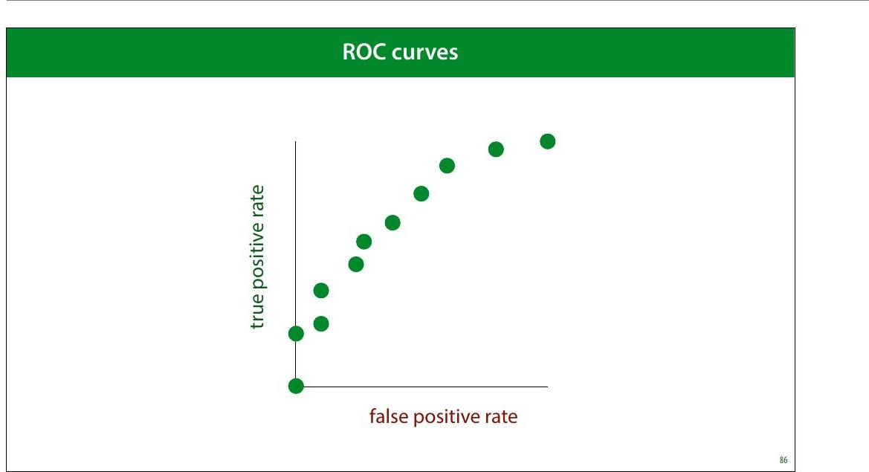
Notes:
So far we’ve thought of FPR/TPR and precision/recall as a
way to analyze a given set of models.
However, what if we had a single classi8ier, but we could
control how eager it was to call things positive? If we made
it entirely timid, it would classify nothing as positive and
start in the bottom left corner. As it grew more brave, it
would start classifying some things as positive, but only if it
was really sure, and its true positive rate would go up. If we
made it even more daring, it would start getting some
things wrong and both the TPR and the FPR would increase.
Finally, it would end up classifying everything as positive,
and end up on the top right corner.
The curve this classi8ier would trace out, would give us an
indication of its performance, independent of how brave or
how timid we make it. How can we build such a classi8ier?

Slide 32
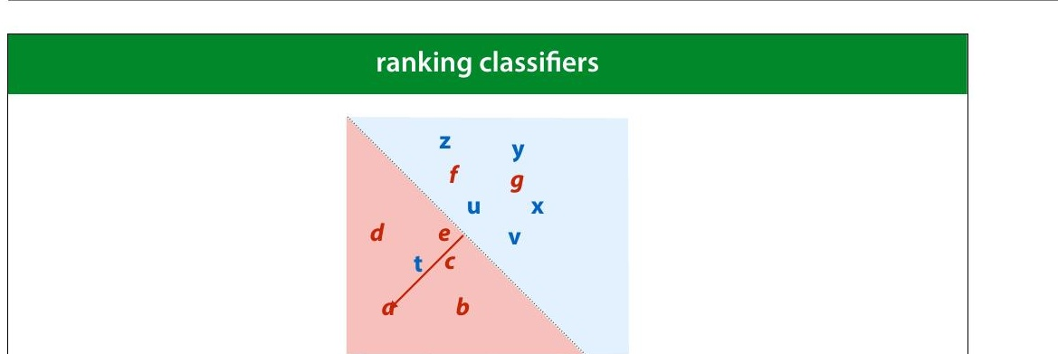
Notes:
We can achieve this by turning a regular classi8ier into a
ranking classi+ier (also known as a scoring classi+ier). A
ranking classi8ier doesn’t just provide classes, it also gives a
score of how negative or how positive a point is. We can use
this to rank the points from most negative to most positive.
How to do this depends on the type of model we use. Here’s
how to do it for a linear classi8ier. We simply measure the
distance to the decision boundary. We can now scale our
classi8ier from timid to bold by moving the decision
boundary from left to right.
After we have a ranking, we can scale the eagerness of the
classi8ier to make things positive. by moving the threshold
(the dotted line) from left to right, the classi8ier becomes
more eager to call things negative. This allows us to trade
off the true positive rate and the false positive rate.

Slide 33
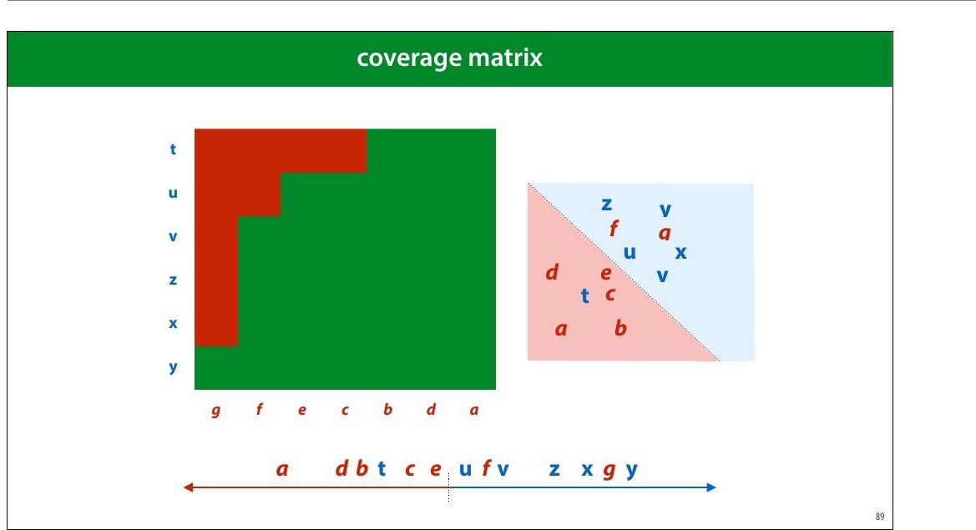
Notes:
We can make a big matrix of all the pairs for which we know
how they should be ranked: negative points on the
horizontal axis, positive on the vertical. The more sure we
are that a point is positive, the closer we put it to the
bottom left corner. This is called a coverage matrix. We
color a cell green if the corresponding points are ranked the
right way round, and red if they are ranked the wrong way
round.
Note that the proportion of this table that is red, is the
probability of making a ranking error.

Slide 34
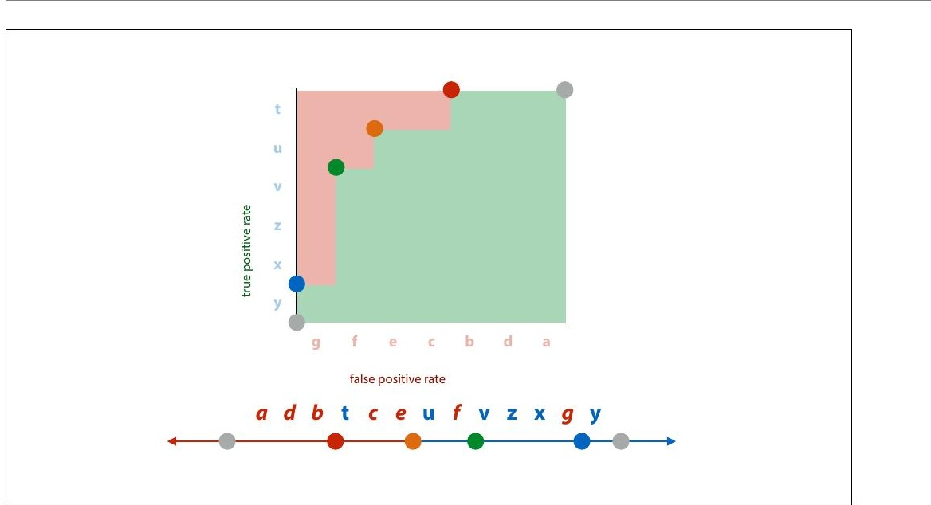
Notes:
The coverage matrix shows us exactly what happens to the
true positive rate and the false positive rate if we move the
threshold from the right to the left. We get exactly the kind
of behaviour we talked about earlier. We move from the all-
positive classi8ier step by step to the all-negative classi8ier.

Slide 35
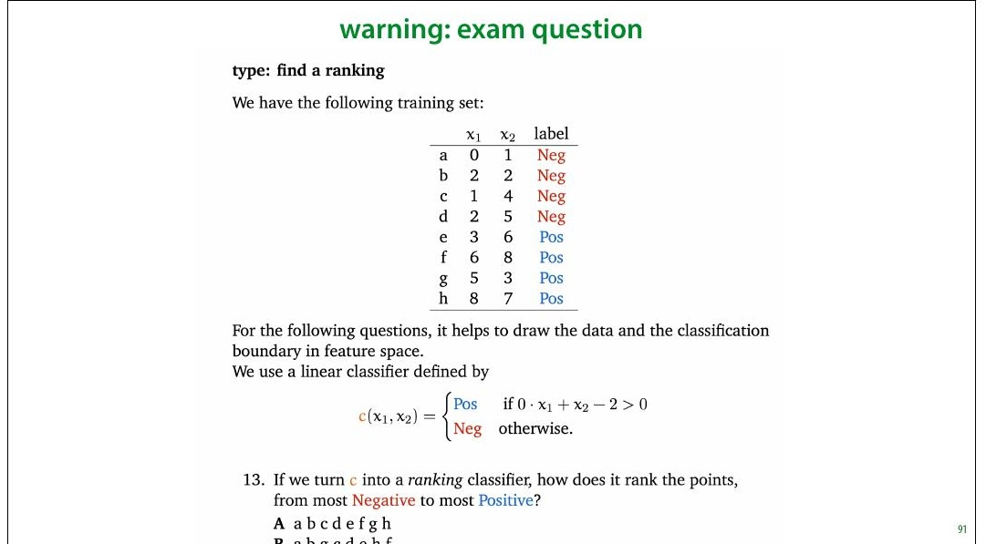
Notes:
This is one of the question types on the exam. People very
often make mistakes in this question, so make sure you
understand what a ranking error is. It's not a misclassi+ied
example. It's a property of a pair of examples.
There are more details in the third homework.

Slide 36
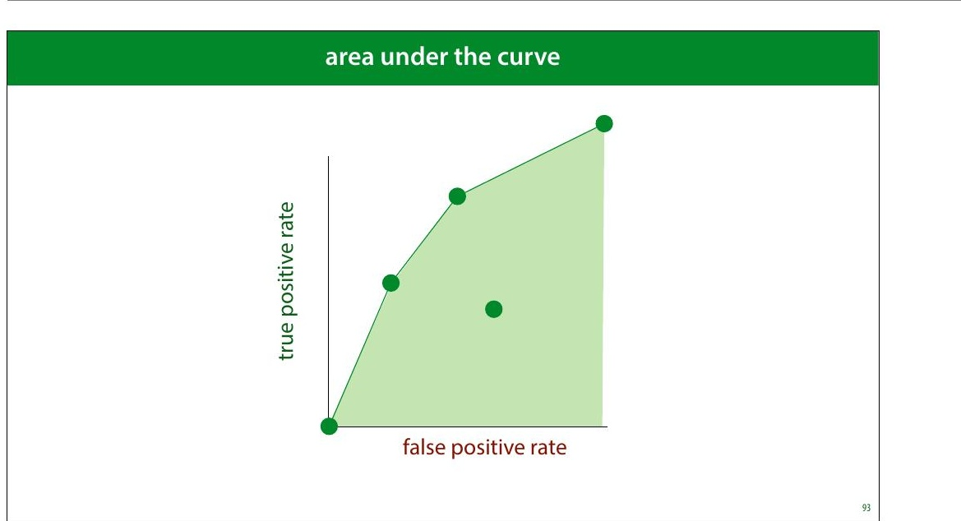
Notes:
This means we can create any classi8ier in this green area,
called the convex hull of the set of green dots. This is called
the area under the (ROC) curve.
The AUC is a good indication of the quality of the classi8ier.
Every point in the green shaded area is a classi>ier we now
how to make, so the bigger this area, the more classi>iers we
can make (although the ones on the boundary are the only
ones we’d ever want to use).
If we have no idea of how we want to make the tradeoff
between the TPR and the FPR, the AUC may be a good way
to compare classi8iers in general.

Slide 37
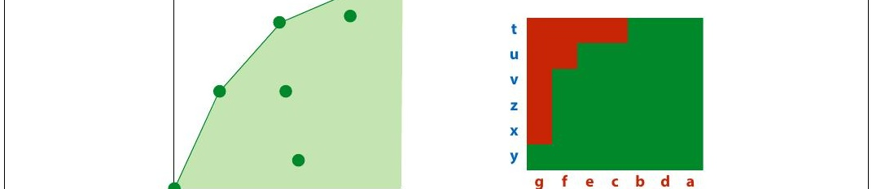
Notes:
As we saw before: normalizing the coverage matrix gives us
the ROC space (barring some small differences that
disappear for large datasets). The area under the ROC curve
is an estimate of the green proportion of the coverage
matrix. This gives us a good way to interpret the AUC.
The AUC (in ROC space) is an estimate of the probability
that a ranking classi+ier puts a randomly drawn pair of
positive and negative examples in the correct order.

Slide 38
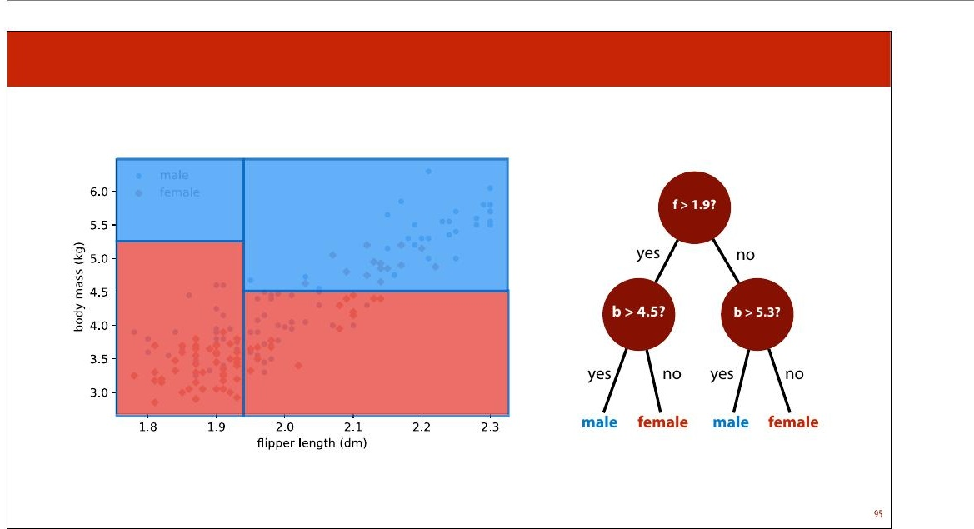
Notes:
Let's look at how this works for another type of classi8ier. To
reiterate, how we get a ranking from a classi+ier
depends entirely on the model class.
The decision tree is an example of a partitioning classi8ier. Is
splits the feature space into partitions, and assigns each
partition, also known as a segment, a class. All instances in
the segment get the same class.

Slide 39
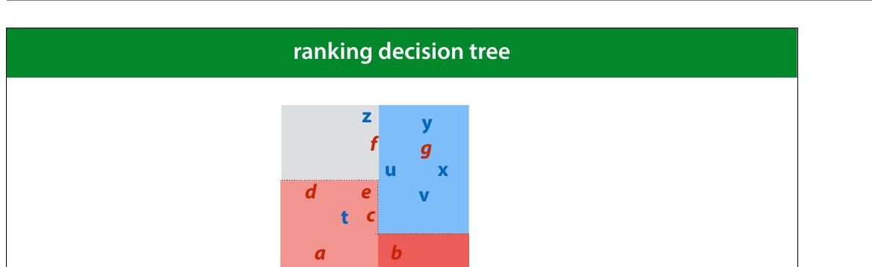
Notes:
In this example we have an instance space that has been
split into four segments by a decision tree. We rank the
segments by the proportion of positive points. We then put
all points in one region on the same level in the ranking.
In this example, b is more negative than a, because b’s
segment contains only negative examples, whereas a’s
segment contains a mix of positive and negative examples.

Slide 40
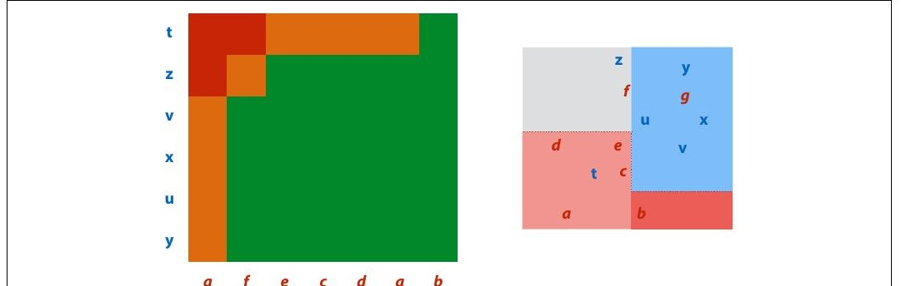
Notes:
This means that for some pairs (like f,z), the classi8ier ranks
them as “the same”. We’ll color these cells orange in the
coverage matrix.
For large datasets, these regions will not contribute much
to the total area under the curve.

Slide 41
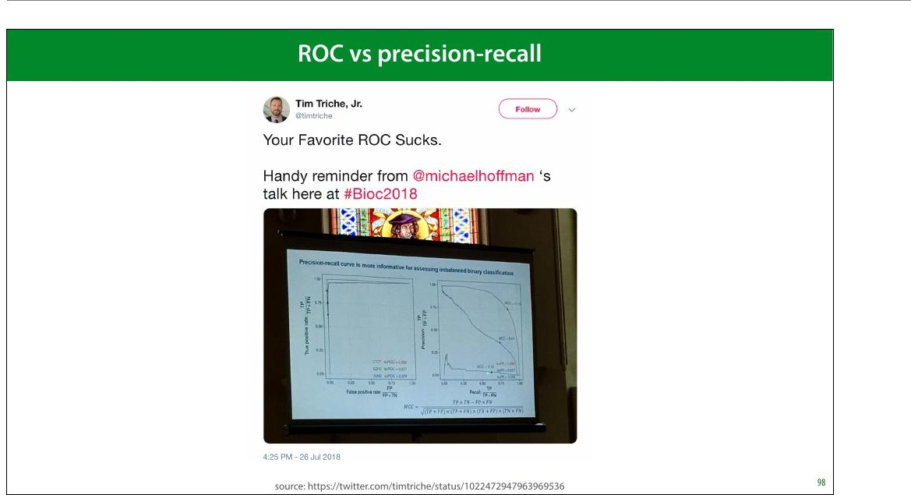
Notes:
An alternative to the ROC is the precision/recall curve. It
works in exactly the same way, but has precision and recall
on the axes.
As you can see in this tweet, in many settings the PR curve
can be much more informative, especially when you’re a
plotting the curves. Practically, it’s little effort to just plot
both, and judge which one is more informative.
ROC has the bene8it of an intuitive interpretation for the
AUC (the probability of ordering a random pair the right
way round). I haven’t yet found a similar interpretation for
the PR-AUC.

Slide 42
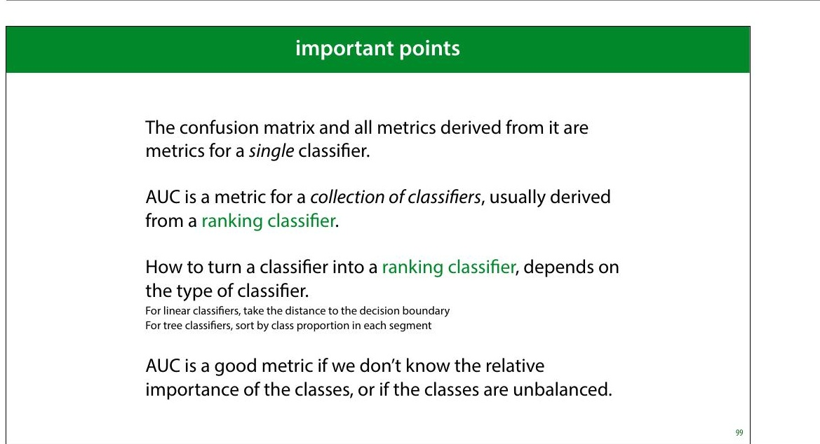
Notes:
To interpret the AUC, you should know not just what
classi8ier was used, but how it was made into a collection of
classi8iers. You should also know whether it’s the area
under an ROC curve, or a precision/recall curve.

Slide 43
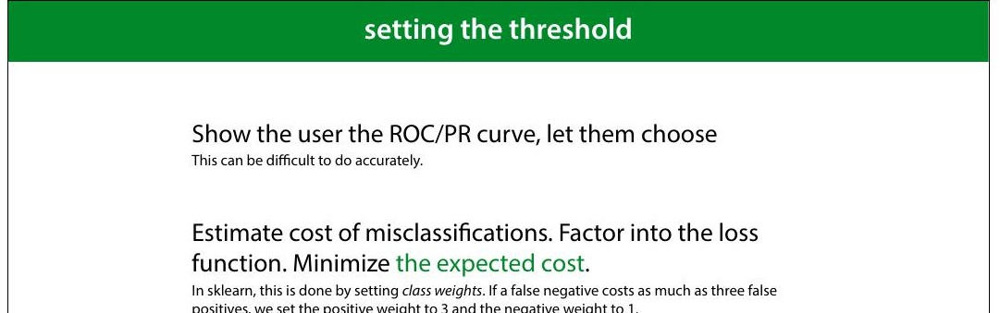
Notes:
To put a classi8ier into production, a ranking may not be
enough. Sometimes, you just need to produce a single
answer. In that case, you can still use the ROC and PR curves
to tune your hyperparameters and choose your model, but
ultimately, you’ll need to choose a threshold as well: the
point at which you decide to call something a positive.
This is more of a software development issue than a
scienti8ic choice. Often, you have to look carefully at the
curves, perhaps together with the end users, to make a
decision.
The second approach works best with probabilistic
classi8iers, which we’ll discuss next lecture.

Slide 44
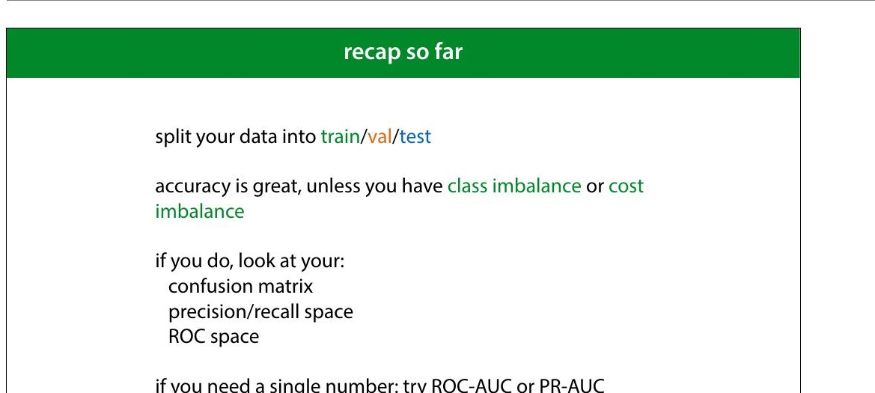

Slide 45

Notes:
|section|Social Impact 2|
|video|https://surfdrive.surf.nl/8iles/index.php/s/
6o4T6Xzi8EAc1x5/download|
Model evaluation is not just about showing how well your
model works. It’s also about working out what it means to
get a certain performance. And more importantly, what it
doesn’t mean.

Slide 46
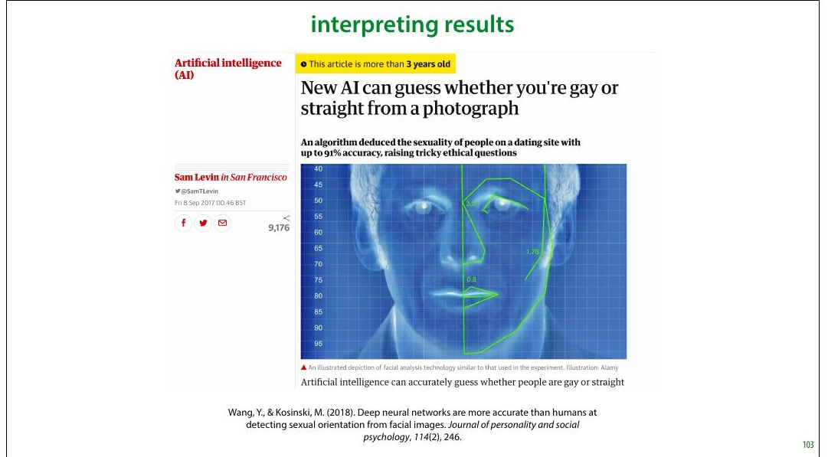
Notes:
In this video, we will use the following research as a
running example. In 2017 researchers from Stanford built a
classi8ier that predicted sexual orientation (restricted to the
classes “heterosexual” and “gay”) from pro8ile image taken
from a dating site. They reported 91% ROC-AUC on men
and 83% ROC-AUC on women.
The results were immediately cited as evidence of a
biological link between biology and sexual orientation. The
following important caveats were largely overlooked in
media reports:
Some of the performance came from facial landmarks •
(roundness, length of nose, distance between eyes, etc),
but some came from super8icial details like hairstyle,
lighting and grooming.
The results were true when averaged over a large •
population. It’s true that women live longer than men on
average, but that doesn’t mean that there are no old men.
Likewise, the fact that you can guess orientation based

Slide 47
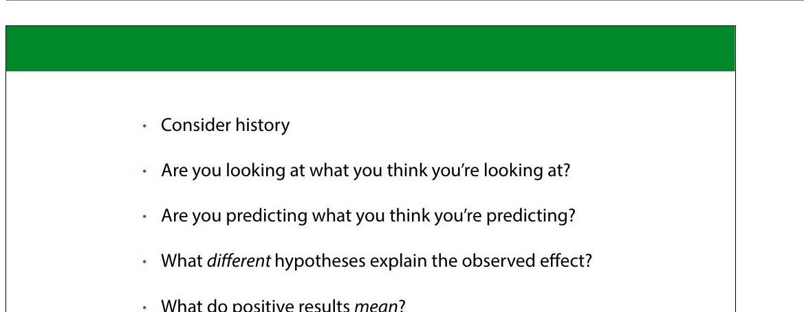
Notes:
Like in the previous video, we’ll look at some important
questions to ask yourself when you come up against a topic
like this. Let’s ask the same questions again (with some new
ones thrown in for good measure).

Slide 48
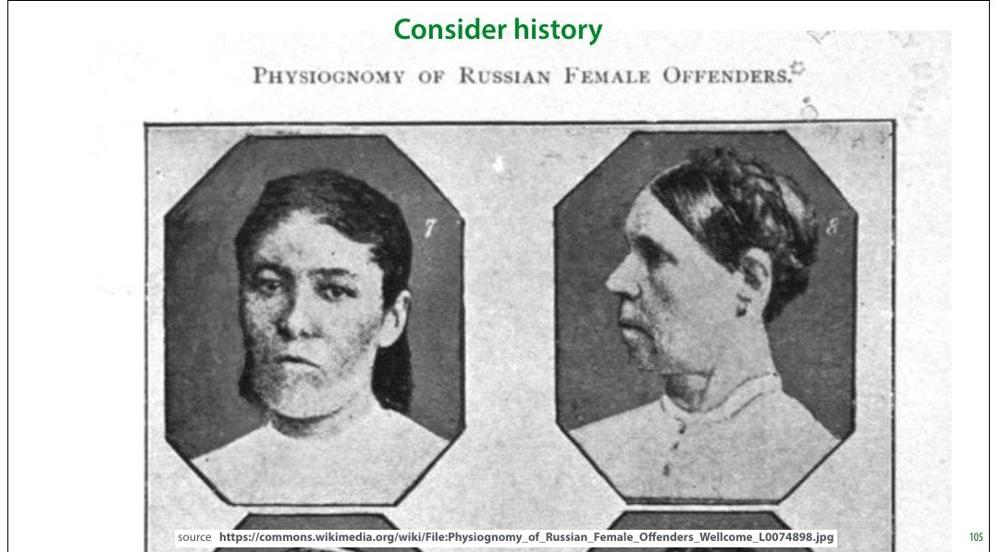
Notes:
In these cases, it’s important to know your history.
Physiognomy is the study which attempts to infer character
from facial features.
In this case there’s is a long history of scientists claiming to
be able to divine personal attributes (most often
“criminality”) from the structure of a subject’s face. This is
called physiogmony and almost any claim made has been
conclusively disproven, and based on poor scienti8ic
practice and spurious correlations.
That doesn’t mean, of course, that the entire idea of
physiognomy is conclusively disproven. Just because people
got it wrong in the past doesn’t mean there couldn’t still be
a link. But it does mean that when we are stumbling into
the same area with new tools, we should be aware of the
mistakes made in the past, so that we can be careful not to
repeat them.

Slide 49
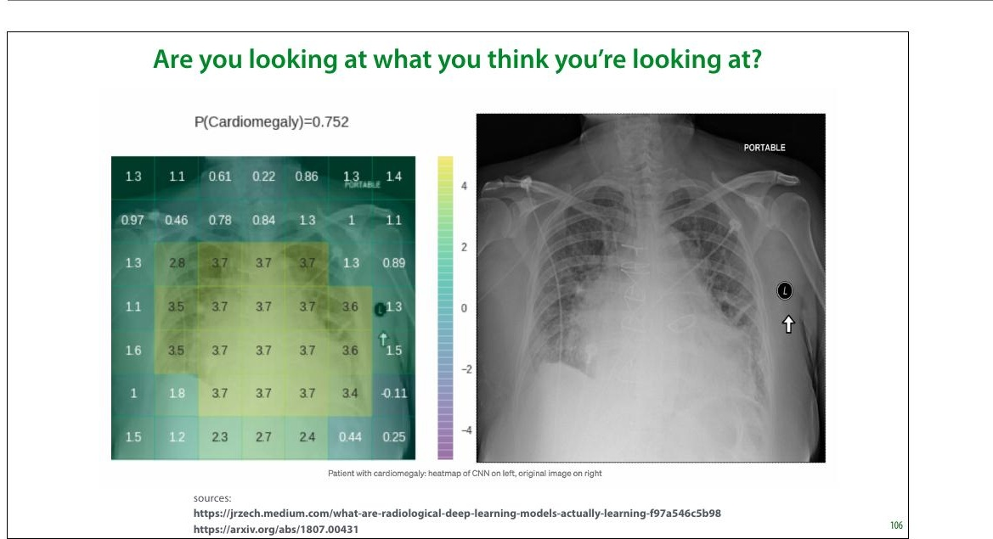
Notes:
The next thing to be aware of is what you’re looking at. This
is especially important with modern systems that can look
at raw image data without extracting speci8ic, interpretable
features.
Here a visualization of a classi8ier looking at a chest x-ray
and making a prediction of whether the patient has
Cardiomegaly (an enlarged heart). The positive values in
the heat map indicate that those regions are important for
the current classi8ication. The largest values are near the
heart, which is what we expect.
The colors are a bit misleading, since the black background
washes them out. Pay more attention to the actual numbers.
However, the classi8ier is also getting a positive
contribution from the “PORTABLE” label in the top right
corner and the marker on the right. These indicate that the
x-ray was taken with a portable scanner. Such scanners are
only used when a patient’s condition has progressed so far
that they can’t leave their house. In such cases it’s a safe bet

Slide 50
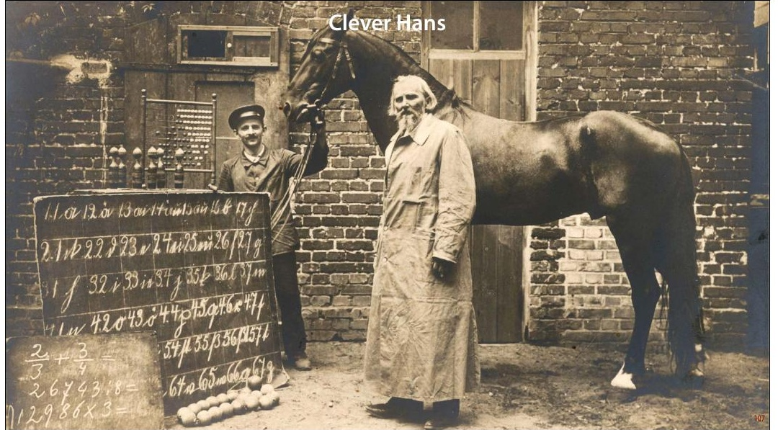
Notes:
These problems are often called “Clever Hans” effects.
Clever Hans, or der Kluge Hans, was an early-20th century
German horse, who appeared to be able to do arithmetic.
As it turned out, Hans was not doing arithmetic, but just
reading the body language of its handler, to see whether it
was moving towards the right answer. This is impressive in
itself, of course, but it does mean that Hans didn’t show the
kind of intelligence that was being attributed to him.
Crucially, this was not a hoax. The handler truly believed that
Hans was able to do arithmetic, and had no idea that he was
guiding him subconsciously. This, incidentally is also why
double-blind experiments are so important in other >ields.
For us, Hans serves as a powerful reminder that just
because we’re seeing the performance we were hoping for,
doesn’t mean we’re seeing it for the reasons we were hoping
for.

Slide 51
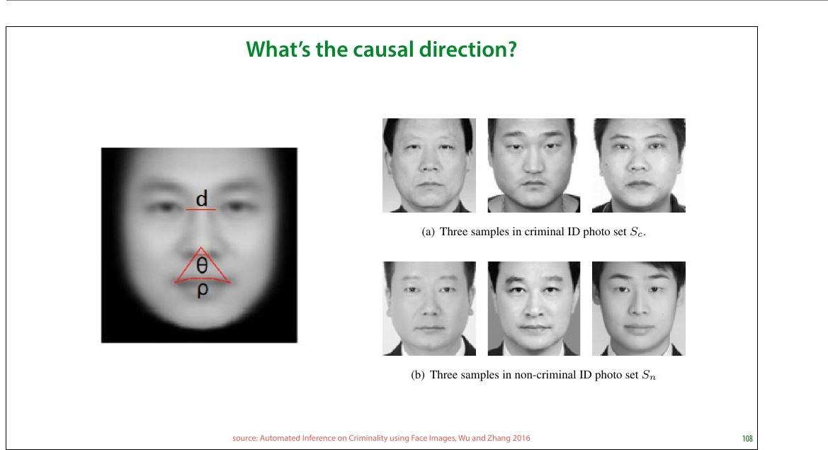
Notes:
A related question you should ask when you 8ind that you
can successfully predict X from Y is which causes which?
eimanyapgosesi bolene ftfehctes olfevfatri,e dfrom [1], shows a feature that
ftothuenspdec trwumhoefn attempting to predict criminality
hoanve tahe dsaamteainsteents itoyfd ifs-aces of criminals and non-criminals.
foefv etryhienpiurt i m8iangedtointhegasv eir-s that the angle made by the corners
of the mouth and the tip of the nose is a highly predictive
PTEhGeso aftudetchodoinrgste cshu-ggest that such facial features are
noyfd ecvriciem-deipnenadelnitt,y
wonhCernim wineal iltoyok at the dataset we see that it’s not
ufcetiaont,uonreewsa yooff tashseess ifnagcthee, so much as the expression that
iIldna ntdhteest “clnasosifine-rscwriithminal” photographs, the subjects hold
flithgehclta sssimficaitlioen, eaxpse riimse cntos.mmon, whereas in the criminal set the
expressions have a more explicitly relaxed jaw. What we’re
thheehyrpeo thaersiest hnatosttil lffaacceial features, so much as facial
roughaspossible.
This is important, because it changes the interpretation of
t th r e e cl a s s i fi c a t io n m e th o d s w o rk o n i m a g e
mt ha e erv ea su au tel tth se rc oe rmf rpm al ne cte se ol ny . The physiognomical interpretation is n t h e n d l i p o a
f e at ur e s , i n c lu d in g 1 . F a c ia l la n d m a rk p o i n t s

Slide 52
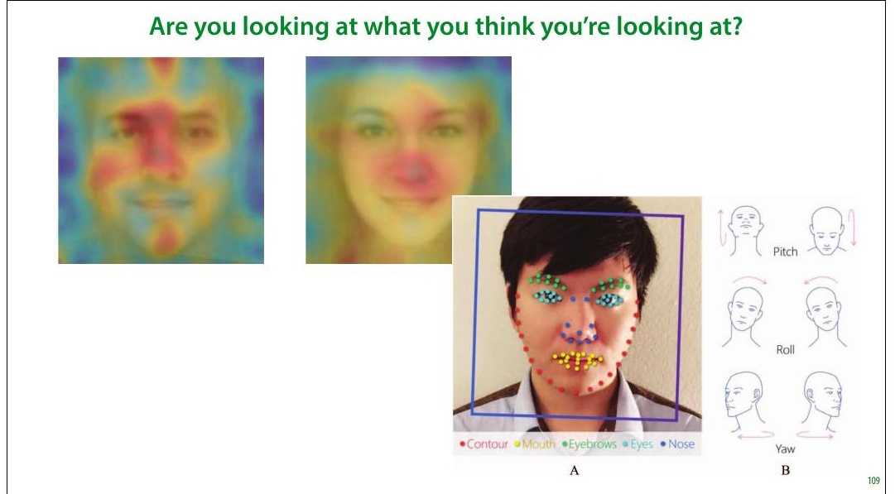
Notes:
Let’s go back to the sexuality classi8ier. What might a Clever
Hans effect look like here? In the most extreme case, you
might expect a classi8ier just to look at the background of
the image. The authors were more careful here than you
249
might expect:
The background of the image was blurred and the the •
facial features (eyes, nose, mouth) were detected and
aligned.
The focus of the classi8ier was investigated with saliency •
maps (indicators of where the model is looking). This is a
fallible method, but it does show a general focus on the
face. (Still, remember how small the effect was in the ep e n d e n t v a ri a b l e ) u s in g 5 0 0 s i n g u la r v al u e s e x tr a c te d
-F a c e s c o r e s ( i n d e p e n d en t v a r i a b le s) . L e a s t a b s o lu t e
saliency map for the chest X-ray.)
A second classi8ier was fed only facial landmarks: the • s e t t o 1 ; t h e r e g u la r i z a t i o n p a r a m e t e r w a s a u t o m a t i - %
t e d u s i n g 1 0 - f o l d c r o s s - v a l i d a t i o n .
position of the eyes, roundness of the jaw, etc. That is, the h e m o d e l b u i l t o n t h e t r a i n i n g s e t , c o m b i n i n g t h e S V D
l i t y r e d u c t i o n a n d l o g i s t i c r e g r e s s i o n , w a s u s e d t o p r e -
u a l o r i e n t a t i o n o f t h e p a r t i c i p a n t s i n t h e t e s t s e t . T h i s photo was translated to a series of explicit features. The
suggestion being that this prevents Clever Hans effects.

Slide 53
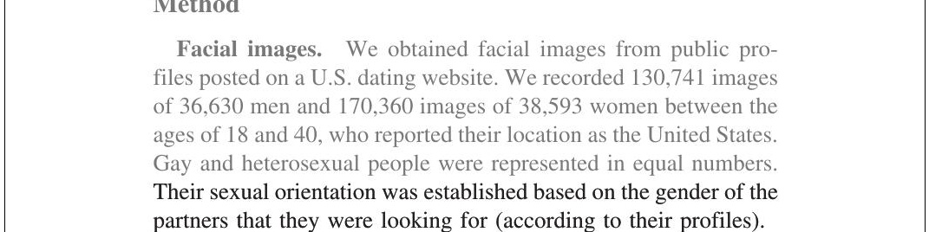
Notes:
Another question we suggested in the last video is whether
the target label you’ve chosen is saying what you think it’s
saying.
Here, the authors inferred sexuality from the stated
preference in the dating pro8ile. This is clearly correlated
with sexuality, but not the same thing. Firstly, sexuality is
one of those attributes (like movie genre) that can only be
crudely approximated by a set of 8inite categories.
Moreover, for many people it’s not a 8ixed attribute, and it is
subject to some evolution throughout their life.
The stated preference on a dating pro8ile also means that
you are capturing only those gay people who are willing to
live (relatively) openly as gay. This may be highly dependent
on social background. It’s certainly conceivable that in
poorer subcultures, people are less likely to come out as
gay, either to their community or to themselves.
This means that what we’re detecting when we’re
classifying a face in this dataset as “gay” is more likely a
combination of factors that are correlation to that label.

Slide 54

Notes:
So, what kind of hypotheses can we think of for what is
causing the performance of the classi8ier?
The authors observe that in their dataset the heterosexual
men are more likely have facial hair. That’s most likely to be
a grooming choice, based on the differences in gay and
heterosexual subcultures.
For other correlations, such as that between sexuality and
nose length, the authors suggest the prenatal hormone
theory, a theory that relates prenatal hormone levels in the
m o t h e r w i th t h e s e x ua l it y o f t h e s u b je ct . I n s h o r t , a
bio l o g i c a l m e c h a n is m t h a t is r e s p o n s ib le f o r b o t h th e
(slight) variation in facial features and the variation in
sexual preference.
But that’s not the only possibility. In the previous slide, we
saw that it’s dif8icult to separate facial features from facial
expressions. However, even if we somehow eliminate the
expression, that doesn’t mean that every facial feature we
see is determined at birth. For instance, the roundness of

Slide 55

Notes:
The authors plotted the four average faces for the classes
male/female and gay/heterosexual in their dataset. Here
are the four options. It’s a peculiar property of datasets of
(aligned) faces that the mean is often quite a realistic face
itself.
Consider this plot with the hypotheses on the previous
slide. What differences do you see? Pay particular attention
to the differences in skin tone, grooming, body weight, and
the presence of glasses.
I’ll leave you to decide which you think is the more likely
explanation for these difference: choice of presentation,
social class, or sexuality.

Slide 56

Notes:
The authors repeated their experiments by classifying
based purely on facial landmarks. The idea is that we can 253
detect landmarks very accurately, and classifying on these
alone removes a lot of sources for potential Clever Hans
effects.
We see that all subsets of the face landmarks allow for some
predictive performance, but there is a clear difference
between them. Note that just because we are isolating
landmarks, doesn’t mean that we are focusing only on
biological causes. As we saw earlier, the shape of the mouth
is determined more by expression than by facial features,
and the roundness of the jaw is partly determined by body
weight, which is correlated with social class.
We will discuss the AUC metric in the third lecture. For now,
you can think of a classi8ier with 81% AUC as one that,
given a random pair of gay and heterosexual instances from
the data, will successfully select the gay instance 81% of the
time.

Slide 57

Notes:
To interpret numbers like these, it’s good to get some points
of reference. If we try to guess somebody’s gender or sex
(the distinction doesn’t matter much for such a crude
guess), while knowing nothing about them except their
age, the best we can expect to do is slightly better than
chance level (51% of our guesses will be correct). The
reason we can get better than chance level is that women
tend to live longer than men. This means that if we guess
“female” for older people, we are a little bit more likely to
be correct.
If we restrict ourselves to older people, the effect becomes
more pronounced and we can get to the level the sexuality
classi8ier achieved (based purely on noses in the female
part of the data). This can help us to interpret the AUC the
authors managed to achieve. Note that this accuracy is
achieved by calling everybody female, and the AUC is
achieved by guessing that the older person in a pair is
always female. Think about that. If you walk into a care
home blindfolded and simply call everybody female,

Slide 58

Notes:
To provide some points of references for ROC curves, here
are all the curves you can achieve for sex/gender
classi8ication based on a single physical measurement. For
some of these we get very impressive looking curves. But is
the word "detection" really appropriate when you are
making one physical measurement and predicting sex or
gender based on that?
The lowest AUC comes from using buttock circumference as
a feature, and the highest from using neck circumference.
Since these are soldiers, it's likely that differences due to
muscle volume are more pronounced here than they would
be generally. This plot is for the complete, unbalanced data
so there is a 4:1 class imbalance (male:female).

Slide 59

Notes:
Here are the histograms per sex/gender for the ANSUR
data. There is a big discrepancy, but notice also how big the
area of overlap is.
This is always what we should imagine when people say
that property A is predictive for attribute B. Just because
there’s some difference between the populations doesn’t
mean that there are no short men or tall women. And most
importantly it doesn’t mean that being short makes you in
some way more feminine or being tall makes you in some
way more masculine.

Slide 60

Notes:
After all that, it’s natural to ask whether this research
project was a mistake. In short, were the authors wrong to
do this, and if so in what way? This is a question of values
rather than science, so it’s up to you to decide. I’ll just note
some important points to consider.
Firstly, the authors weren’t looking to prove this point one
way or another, and they initially stumbled on to their
8indings. Given that a result has been established, it’s most
often unethical not to report it. So long as that reporting is
done carefully and responsibly, of course.
The stated aim of the paper is not to make any claims about
causal mechanisms. The authors are less interested in
whether the classi8ier picks up on grooming choices of
biological features, than in whether the guess can be made
with some success at all.
If we decide that the result did need to be reported, we may
consider whether the authors were guilty of poor framing.
The use of the word detecting is subject to

Slide 61

Notes:
If you 8ind yourself in the unfortunate situation of having to
publish something controversial like this, or having to
interpret somebody else's work on a controversial topic,
keep these tips in mind.
Finally, and this is a personal opinion, so make of it what
you will: if you read about research like this in a newspaper,
or on social media, remember that you are an academic (or
at least you will be when you graduate). That comes with a
certain responsibility to dig into the primary research
before you make a judgment. Don't just trust the journalists,
or worse, the commenters on Twitter. If you really want to
give your opinion on a situation like this, dig out the
original paper and read it. If you don't, the most honest
thing to do is to withhold judgment.
What you you will 8ind when you dig down, is almost always
that the truth is much more subtle than the news and social
media make it look. In this speci8ic case, the majority of
criticism leveled at the authors was simply inaccurate.
There are valid and serious criticisms of the paper, but you

Slide 62

Notes:
I’m indebted to people on twitter for helping me to see the
different angles on this topic.

Slide 63

Notes:
|section|No Free Lunch|
|video|https://surfdrive.surf.nl/8iles/index.php/s/
Ox1323uBQfMfwmX/download|

Slide 64

Notes:
We end with a very short, but important discussion.
A question that often arises is: which classi>ier, model, search
method, etc. is the best, independent of the data? Before we
see the data, can we make a best guess for which
approaches to try? Are there some methods that always
work really well?

Slide 65

Notes:
In the 90s two researchers, named Wolpert and MacReady
published a proof of an important theorem. The details are
technical, but it basically stated that if we look at
optimization algorithms (of which machine learning
algorithms are a speci8ic instance), by averaging their
performance over all possible tasks, they all perform
exactly the same. That is, if we want to know which
algorithm is the best independent of the task, we cannot tell
them apart by their performance.

Slide 66

Notes:
Here is another example, that should show you what a
strange result the no free lunch theorem is. The common
practice of dataset splitting and choosing a model by its test
set performance is also an algorithm. We do it manually, but
we could also program it into a computer. Let's say we want
to choose between two methods A and B. We can follow the
normal approach: split the data, apply both and choose
whichever performs best. Call this method C.
We can also do a ridiculous, counter-intuitive thing and
choose the method that performs worst. Call this method D.
The no free lunch theorem says that method D should
outperform method C just as often as the other way around.
The kind of datasets where this happens are the ones where
the test set happens to behave very differently from the
training set. Since we usually make the split randomly, these
would be very unusual or unlikely datasets, and we feel
justi8ied in using method C. Still, this only works because
we are able to make certain assumptions about our data.

Slide 67

Notes:
In a way, we’re back to the problem of induction. For any
given situation where a learning method works, there’s a
situation where it doesn’t. Induction (aka. learning from
experience) works in practice, but there are exceptions, and
we can't tell just by looking at the data when it will and
won't work.
Note that if there were some algorithm that could tell us
which situation we were in, we could just use this algorithm
to select our learning method, and beat the NFL theorem.
In short, we need to make some assumptions about the
nature of whatever it was that created our data. Without
such assumptions, learning doesn't work.

Slide 68

Notes:
This is an increasingly important phrase in machine
learning. The inductive bias of a method or model are those
assumptions about the domain that are, explicitly or
implicitly, hardcoded into the model.
For instance, in a linear regression model, the assumption is
that all instances lie on a line (or the higher-dimensional
equivalent). If this assumption isn't violated too much, the
model is a good 8it for the data. If the assumption is violated
very badly, we need to look for ways to change the
inductive bias, for instance by picking a different model, or
by enriching the linear model with extra features, like we
will do in the next lecture.
We can summarize the business of machine learning and
data science as follows. The business of the machine
learning researcher is to create a variety of models with
helpful inductive biases. The business of the data scientist is
to 8igure out which of the available inductive biases is
helpful for any given problem.

Slide 69

Notes:
One “out” to the NFL Theorem, is that there is a “universal
distribution” governing all processes that create data.
The NFL Theorem implicitly assumes that all datasets are
equally likely. Since this is not the case, there is some other,
non-uniform distribution that tells us which datasets are
more likely than others, averaged over all possible settings.
Using such a universal data distribution, we could (in
theory) work out a universally best learning algorithm.

Slide 70

Notes:
We don't have too many practical ideas about the properties
of such a universal distribution, but one thing that crops up
a lot is that simple data is necessarily more likely than
complex data.
This suggests that in learning we should have a simplicity
bias. If there are two models that both 8it the data, one very
simple, like a linear model, and one very complex, like a
very big decision tree, then it's more likely that the simple
model generated the data.
Such simplicity biases can be implemented in many
different ways, and we'll see some concrete examples as the
course progresses.

Slide 71


