Slide 1
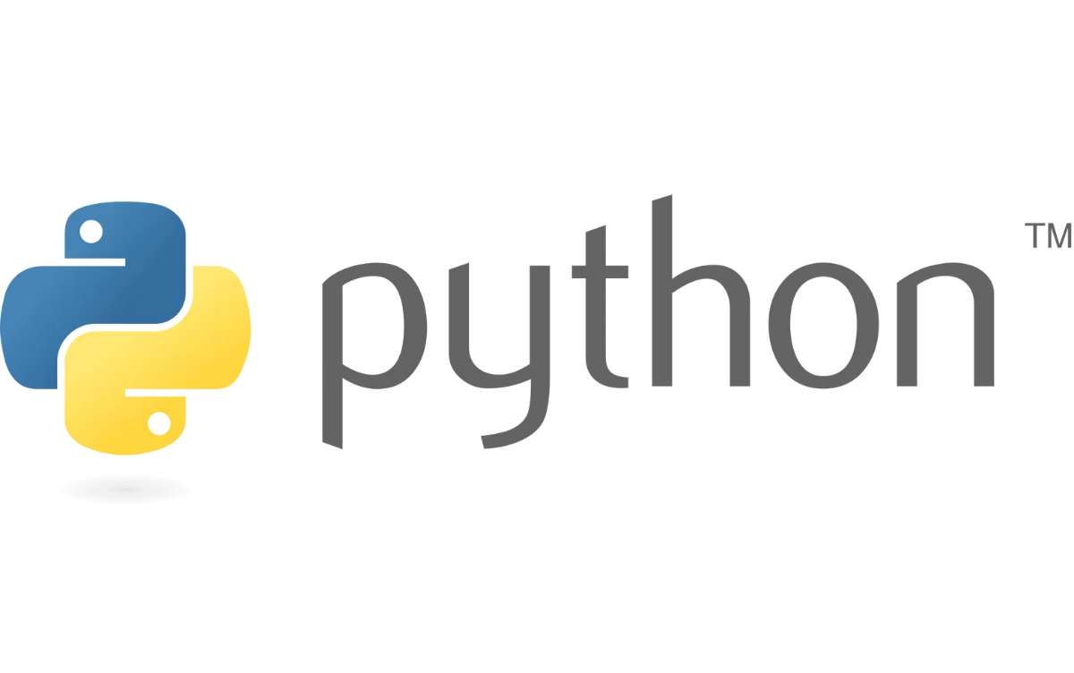

From Basics to Intermediate
Demo

Slide 2

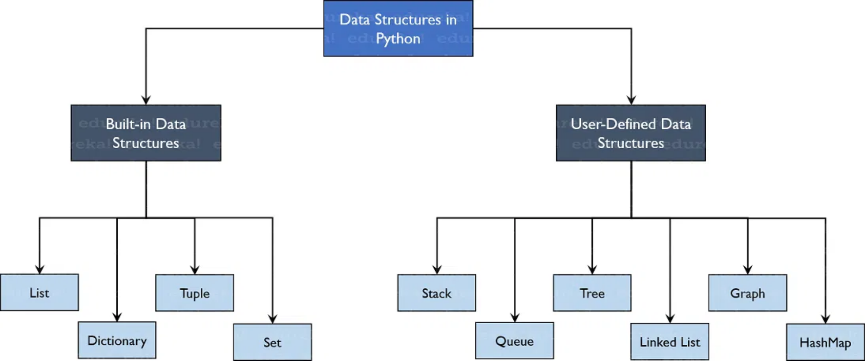
Core Data Types & Mutability
Basic Data Types
Mutability Concept
Mutable:
Can be changed after creation (lists, dictionaries, sets)
a = 42 # Integer
b = 3.14 # Float
c = "Hello World" # String
g = True # Boolean
Immutable:
Cannot be changed after creation (integers, floats, strings, tuples)
# Demonstrating mutability
my_list = [1, 2, 3]
my_list[0] = 4 # Works! Lists are mutable
print(my_list) # Output: [4, 2, 3]
my_tuple = (1, 2, 3)
# my_tuple[0] = 4 # Error! Tuples are immutable
Collection Types
d = [1, 2, 3, 4] # List (mutable)
e = (1, 2, 3) # Tuple (immutable)
f = {"name": "Alice", "age": 25} # Dictionary

Slide 3

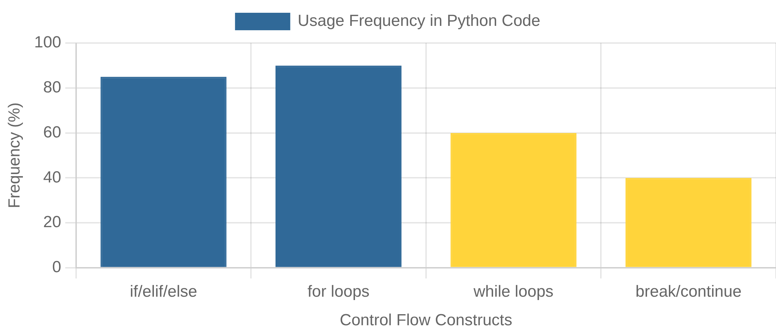
Control Flow & Loops
Conditional Statements
While Loops
# if, elif, else structure
temperature = 25
if temperature > 30:
print("It's hot outside!")
elif temperature > 20:
print("It's a nice day!")
else:
print("It's a bit cold.")
count = 0
while count < 5:
print(count)
count += 1
# Break and continue
numbers = [1, 2, 3, 4, 5]
i = 0
while i < len(numbers):
if numbers[i] == 3:
i += 1
continue
if numbers[i] == 5:
break
print(numbers[i])
i += 1
For Loops
# Iterating through a list
fruits = ["apple", "banana", "cherry"]
for fruit in fruits:
print(f"I like {fruit}")
# Using range
for i in range(5):
print(i) # Prints 0, 1, 2, 3, 4
Control Flow Visualization

Slide 4


Functions & Error Handling
Defining Functions
Error Handling
# Basic function definition
def greet(name):
"""This function greets the person"""
return f"Hello, {name}!"
# Function with default parameter
def greet_with_time(name, time="morning"):
return f"Good {time}, {name}!"
print(greet("Alice")) # Hello, Alice!
print(greet_with_time("Bob")) # Good morning, Bob!
print(greet_with_time("Charlie", "evening"))
# Good evening, Charlie!
# Basic try-except block
try:
result = 10 / 0
except ZeroDivisionError:
print("Cannot divide by zero!")
# Multiple exceptions
try:
value = int(input("Enter a number: "))
result = 100 / value
except ValueError:
print("Please enter a valid number!")
except ZeroDivisionError:
print("Cannot divide by zero!")
finally:
print("This always executes")
Function Arguments
Common Python Exceptions
# *args and **kwargs
def flexible_function(*args, **kwargs):
print(f"Positional args: {args}")
print(f"Keyword args: {kwargs}")
flexible_function(1, 2, 3, name="Alice", age=25)
# Positional args: (1, 2, 3)
# Keyword args: {'name': 'Alice', 'age': 25}
BaseException
├── Exception
│ ├── ArithmeticError
│ ├── LookupError (IndexError, KeyError)
│ ├── ValueError
│ ├── TypeError
│ ├── ImportError
│ ├── FileNotFoundError
└── SystemExit, KeyboardInterrupt (for system events)

Slide 5


Object-Oriented Programming Basics
Classes and Objects
Attributes and Methods
# Basic class definition
class Book:
def __init__(self, isbn, title, author, year):
self.isbn = isbn
self.title = title
self.author = author
self.year = year
def __repr__(self):
return f"Book: {self.title} by {self.author}"
# Creating an object
my_book = Book("978-1234567890", "Python Basics",
"John Doe", 2023)
class Rectangle:
# Class attribute
shape_type = "quadrilateral"
def __init__(self, width, height):
# Instance attributes
self.width = width
self.height = height
# Instance method
def area(self):
return self.width * self.height
rect = Rectangle(5, 10)
print(f"Area: {rect.area()}") # Area: 50
OOP Concepts
Encapsulation:
Bundling data and methods
Inheritance:
Creating new classes from existing ones
Polymorphism:
Same interface, different forms
Abstraction:
Hiding implementation details

Slide 6

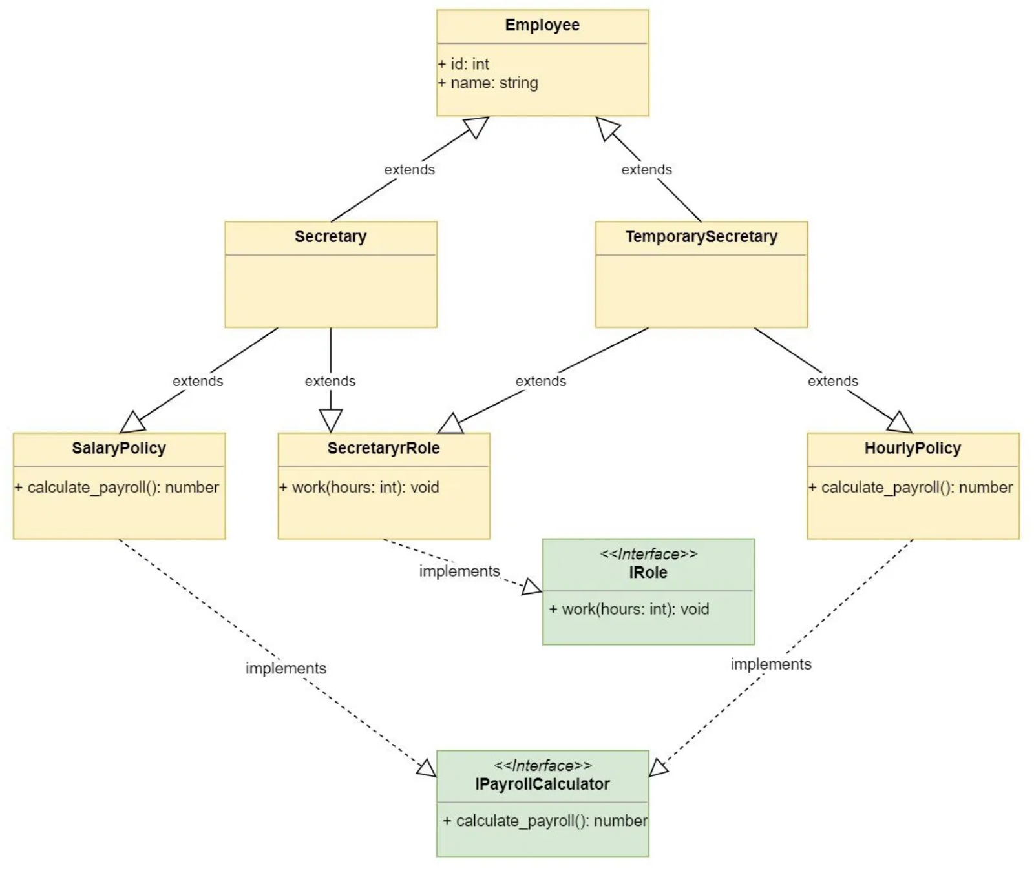
Advanced OOP: Inheritance & Special Methods
Inheritance
Special Methods
# __repr__ method for string representation
def __repr__(self):
return (f"Book: isbn='{self.isbn}', "
f"title='{self.title}', "
f"author='{self.author}', "
f"publication_year='{self.publication_year}'")
# Usage
my_book = Book("978-1234567890", "Python Basics",
"John Doe", 2023)
print(my_book) # Calls __repr__ automatically
class Book:
def __init__(self, isbn, title, author, publication_year):
self.isbn = isbn
self.title = title
self.author = author
self.publication_year = publication_year
# Child class inheriting from Book
class LibraryBook(Book):
def __init__(self, isbn, title, author, publication_year,
shelf_location, isAvailable):
# Call parent constructor
super().__init__(isbn, title, author, publication_year)
# Add new attributes
self.shelf_location = shelf_location
self._isAvailable = isAvailable
Common Special Methods
__init__(self, ...)
: Constructor
__repr__(self)
: String representation for debugging
__str__(self)
: String representation for end users
__len__(self)
: Length of object (for len() function)
__eq__(self, other)
: Equality comparison (==)

Slide 7

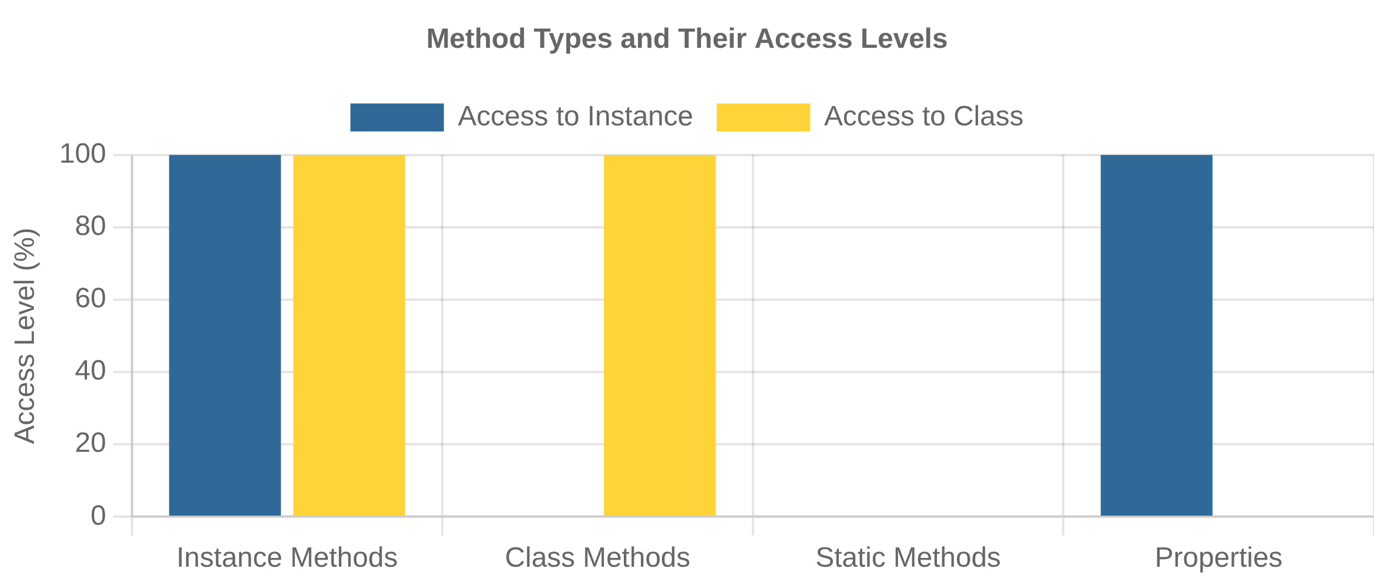
Advanced OOP: Class & Static Methods, Properties
Class Methods
Properties
# From book_management.py
@classmethod
def create_new_arrival(cls, isbn, title, author, publication_year):
shelf_location = "New Arrival - Front Desk"
is_available = True
return cls(isbn, title, author, publication_year,
shelf_location, is_available)
# Usage
new_book = LibraryBook.create_new_arrival(
"978-1234567890", "Python Advanced",
"Jane Smith", 2023)
@property
def isAvailable(self):
return self._isAvailable
@isAvailable.setter
def set_isAvailable(self, isavailable):
if(isinstance(isavailable, bool)):
self._isAvailable = isavailable
else:
raise ValueError("the value is not a bool")
# Usage
book = LibraryBook("978-1234567890", "Python Basics",
"John Doe", 2023, "A1", True)
print(book.isAvailable) # Access like an attribute
book.set_isAvailable = False # Set using the setter
Static Methods
# From book_management.py
@staticmethod
def isAntique(publicationYear):
if publicationYear > 0:
currentYear = datetime.now().year
yearDifference = currentYear - publicationYear
if yearDifference > 100:
return True
return False
else:
raise TypeError("enter value greater than zero")
# Usage
is_antique = LibraryBook.isAntique(1900)
Method Types Comparison

Slide 8

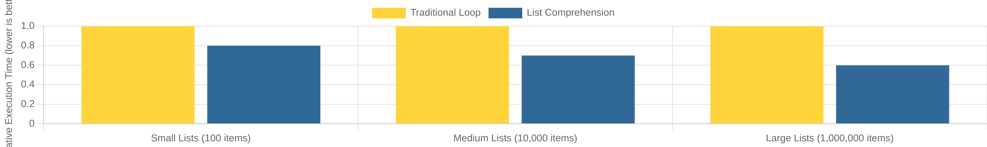
Advanced Data Structures & Comprehensions
List Comprehensions
Dictionary Comprehensions
# Traditional way
squares = []
for x in range(10):
squares.append(x**2)
# List comprehension
squares = [x**2 for x in range(10)]
# With conditional
even_squares = [x**2 for x in range(10) if x % 2 == 0]
# Create a dictionary of squares
square_dict = {x: x**2 for x in range(5)}
print(square_dict) # {0: 0, 1: 1, 2: 4, 3: 9, 4: 16}
# From week_2.py
countDict = {word: words.count(word) for word in set(words)
if word in words_to_find}
Comprehension Benefits
More concise and readable code
Set Comprehensions
Often faster than traditional loops
Follows functional programming principles
# Create a set of squares
square_set = {x**2 for x in range(10)}
# With conditional
vowels = 'aeiou'
consonants = {c for c in 'python' if c not in vowels}
Performance Comparison

Slide 9


Functional Programming Concepts
Lambda Functions
Map Function
# Convert temperatures from Celsius to Fahrenheit
celsius = [0, 10, 20, 30, 40]
fahrenheit = list(map(lambda c: (c * 9/5) + 32, celsius))
print(fahrenheit) # [32.0, 50.0, 68.0, 86.0, 104.0]
# From week_2.py
lower_word_list = list(map(lambda word: word.lower(), words))
# Regular function
def add(x, y):
return x + y
# Equivalent lambda function
add_lambda = lambda x, y: x + y
print(add(5, 3)) # 8
print(add_lambda(5, 3)) # 8
# From week_2.py
filtered_word = lambda word: word.startswith(letter)
list_of_filtered_words = list(filter(filtered_word, words))
Filter Function
# Get only even numbers
numbers = [1, 2, 3, 4, 5, 6, 7, 8, 9, 10]
even_numbers = list(filter(lambda x: x % 2 == 0, numbers))
print(even_numbers) # [2, 4, 6, 8, 10]
# From week_2.py
filtered_word = lambda word: word.startswith(letter)
list_of_filtered_words = list(filter(filtered_word, words))
Common Lambda Use Cases
Sorting with custom keys
Short callback functions
Function arguments to map/filter/reduce
Functional vs Imperative Approaches

Slide 10

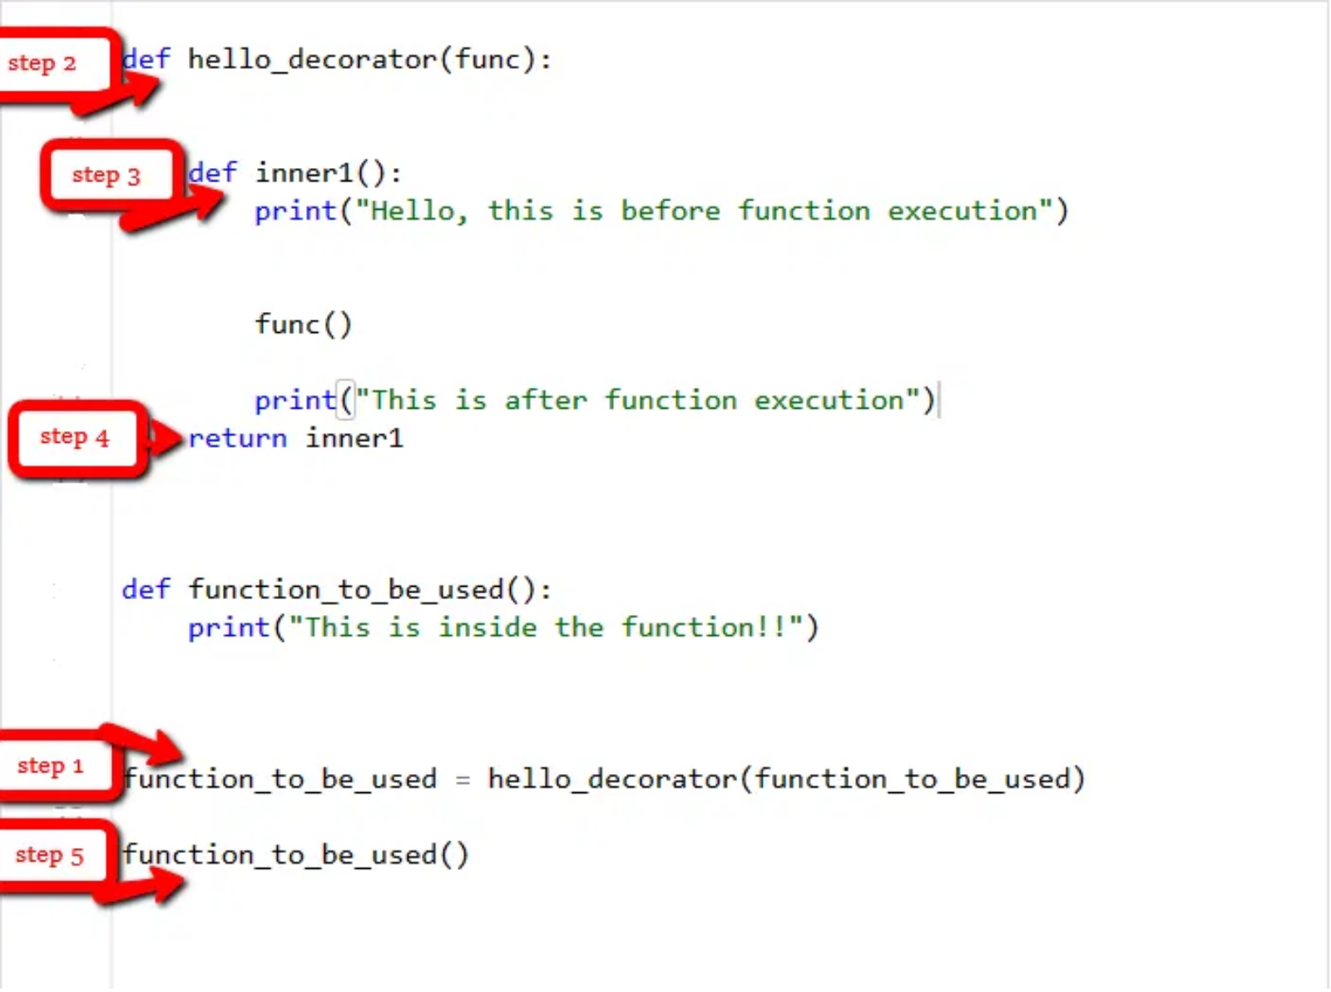
Decorators
Understanding Decorators
Practical Examples
# Basic decorator structure
def my_decorator(func):
def wrapper():
print("Before function call")
func()
print("After function call")
return wrapper
@my_decorator
def say_hello():
print("Hello!")
Timing decorator
def measure_time(func):
def wrapper(*args, **kwargs):
start_time = time.time()
result = func(*args, **kwargs)
total_time = time.time() - start_time
print(f"Function {func.__name__} took {total_time}s")
return result
return wrapper
@measure_time
def simulate_process(custom_time):
time.sleep(custom_time)
Text transformation
def force_uppercase(func):
def wrapper(*args):
result = func(*args)
return result.upper()
return wrapper
@force_uppercase
def get_name(name):
return name

Slide 11

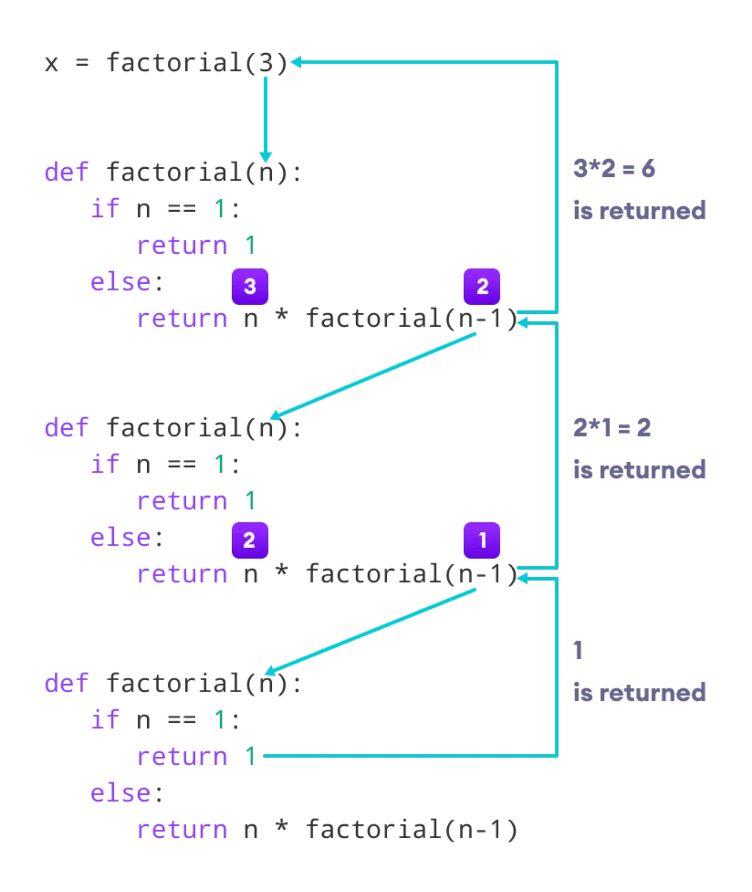
Recursion
Understanding Recursion
Examples from week_2.py
A function that calls itself
Requires a base case to prevent infinite recursion
Breaks complex problems into simpler subproblems
def total_words(word_count):
# Base case
if len(word_count) == 0:
return 0
return 1 + total_words(word_count[1:])
def factorial(n):
# Base case
if n == 0 or n == 1:
return 1
# Recursive case
else:
return n * factorial(n-1)
def longest_word_finder(words, longest_word):
# Base case
if not words:
return longest_word
if len(longest_word) < len(words[0]):
longest_word = words[0]
return longest_word_finder(words[1:], longest_word)

Slide 12

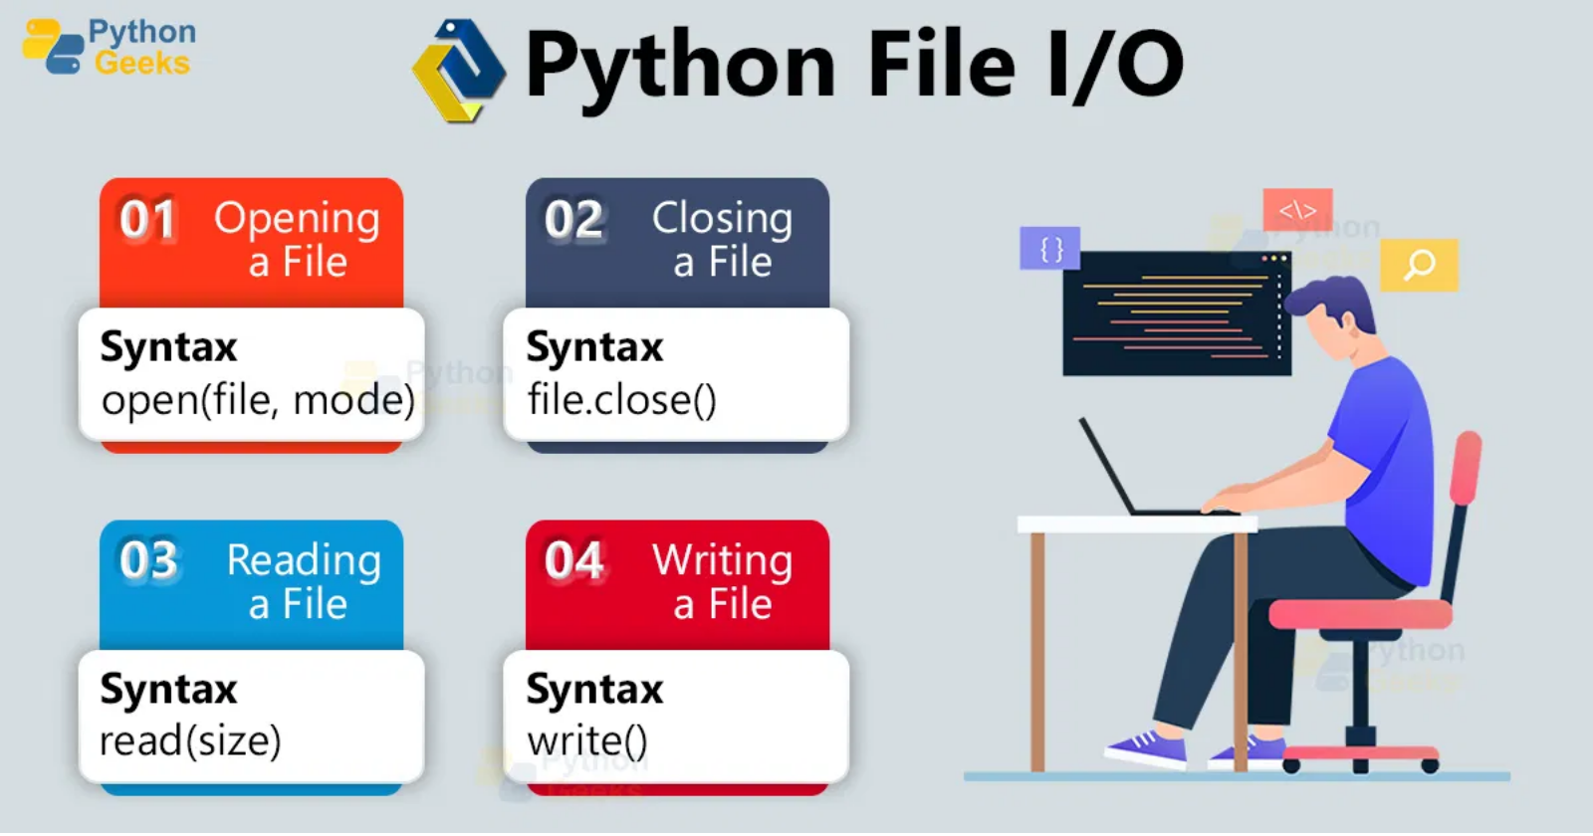
File I/O
Text Files
CSV Files
with open("file.txt", "w") as file:
file.write("Hello, Python!")
with open("file.txt", "r") as file:
content = file.read()
Writing CSV
with open(csvFilePath, "w", newline='') as CsvFile:
phoneBook = [
{"Name": "rehan", "address": "Rawalpindi"}
]
writer = csv.writer(CsvFile)
writer.writerow(phoneBook[0].keys())
for dic in phoneBook:
writer.writerow(dic.values())
JSON Files
- Writing JSON
with open(JsonFilePath, "w") as JsonFile:
json.dump(countDict, JsonFile, indent=4)
- Reading JSON
with open(JsonFilePath, "r") as JsonFile:
showcaseDict = json.load(JsonFile)

Slide 13

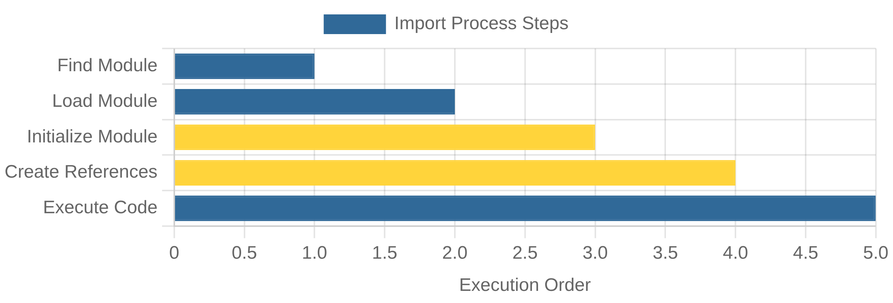
Modules and Packaging
Modules
Packages
import math
print(math.sqrt(16)) # 4.0
from math import sqrt, pi
print(sqrt(16)) # 4.0
import numpy as np
library-system/
├── Library_software_logic/
│ ├── __init__.py
│ ├── book_management.py
│ └── library_operations.py
└── main.py
from Library_software_logic.book_management import LibraryBook
Creating Modules
# File: my_module.py
def greet(name):
return f"Hello, {name}!"
PI = 3.14159
# In another file
import my_module
print(my_module.greet("Alice"))

Slide 14
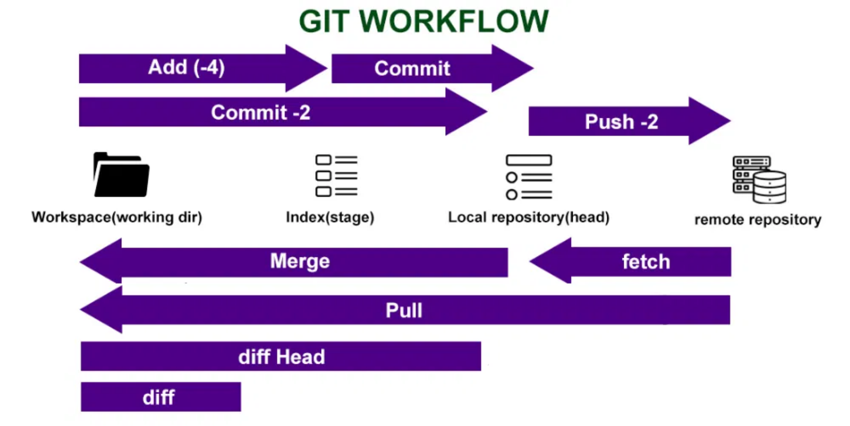
Version Control with Git
Git Basics
Working with GitHub
git remote add origin https://github.com/username/repo.git
git push -u origin main
git pull origin main
git clone https://github.com/username/repo.git
git init
git add file.py
git add .
git commit -m "Initial commit"
git status
git log
Branching & Merging
git branch feature-branch
git checkout feature-branch
git checkout -b feature-branch
git checkout main
git merge feature-branch

Slide 15
Conclusion & Next Steps
Key Concepts Covered
Core Python
Advanced Features
OOP & Organization
Data types & mutability
Comprehensions
Classes & inheritance
Control flow & loops
Lambda, map & filter
Special methods
Functions & error handling
Decorators & recursion
Modules & packages
File I/O operations
Version control with Git

