Slide 1

PROJECT PRESENTATION
Ticket Booking
System
✓
(ConcurrencySafe)
QR
A reliable booking h real-time seat availability,
thread-safe reservations and instant booking confirmation.
DIGITAL TICKET
REVIEW - 1
TEAM MEMBERS
R. Sai Charan Reddi — 2520090184
G. Manideep Patel — 2520090100
P. Akhil Yadav — 2520090155
DBMS
2026

Slide 2
02
Project Abstract
Reliable ticket reservations under concurrent access
PROJECT ABSTRACT
The Ticket Booking System (ConcurrencySafe) is a web-based application designed to simplify and digitize the event participation process. Traditional event management often involves manual registration, paper tickets, long queues, and difficulty accessing event-related information. This application addresses these challenges by providing attendees with a single platform to independently manage their event activities.
The proposed system uses concurrency-safe booking mechanisms to maintain real-time seat availability. Synchronization, locking, and other concurrency-control techniques protect shared resources so that only one transaction can successfully reserve a particular ticket. Users can view available tickets, select seats, make bookings, and receive confirmations.
The system updates seat status after a successful booking and prevents other users from reserving an already-booked seat. It demonstrates multithreading and concurrency management while improving reliability, data consistency, and the booking experience when many users access the system simultaneously.
TICKET SELECTING SYSTEM • CONCURRENCYSAFE

Slide 3
03
Introduction
Reliable ticket booking for multiple users at once
THE IDEA
SELECTING JOURNEY
A consistent booking process protected from race conditions.
1
VIEW
✓
View available tickets and seats
2
SELECT
✓
Select a ticket and request a booking
3
RESERVE
✓
Receive booking confirmation
✓
See updated seat availability
4
CONFIRM
✓
Prevent duplicate reservations
TICKET SELECTING SYSTEM • CONCURRENCYSAFE

Slide 4
04
Problem Statement & Objectives
Preventing duplicate bookings and preserving data consistency
PROBLEM STATEMENT
OBJECTIVES
!
Multiple users request the same seat
✓
Ensure thread-safe ticket reservations
✓
Maintain real-time seat availability
!
Risk of double booking
✓
Prevent duplicate bookings
!
Incorrect seat availability
✓
Keep booking records consistent
!
Inconsistent transaction records
✓
Manage shared resources safely
✓
Provide reliable booking confirmations
TICKET SELECTING SYSTEM • CONCURRENCYSAFE

Slide 5
05
Key Features
Core functionality for users and safe concurrent booking
USER FEATURES
SYSTEM / ADMIN FEATURES
✓
View available tickets
✓
Select seats
✓
Manage ticket inventory
✓
Track booking requests
✓
Submit booking requests
✓
Receive booking confirmation
✓
Maintain booking records
✓
Concurrency-safe reservation
✓
View current seat status
✓
See booking status
✓
Update seat status
✓
Synchronize shared resources
✓
Access booking records
✓
Avoid duplicate reservations
✓
Protect transaction consistency
✓
Support multiple simultaneous users
TICKET SELECTING SYSTEM • CONCURRENCYSAFE

Slide 6
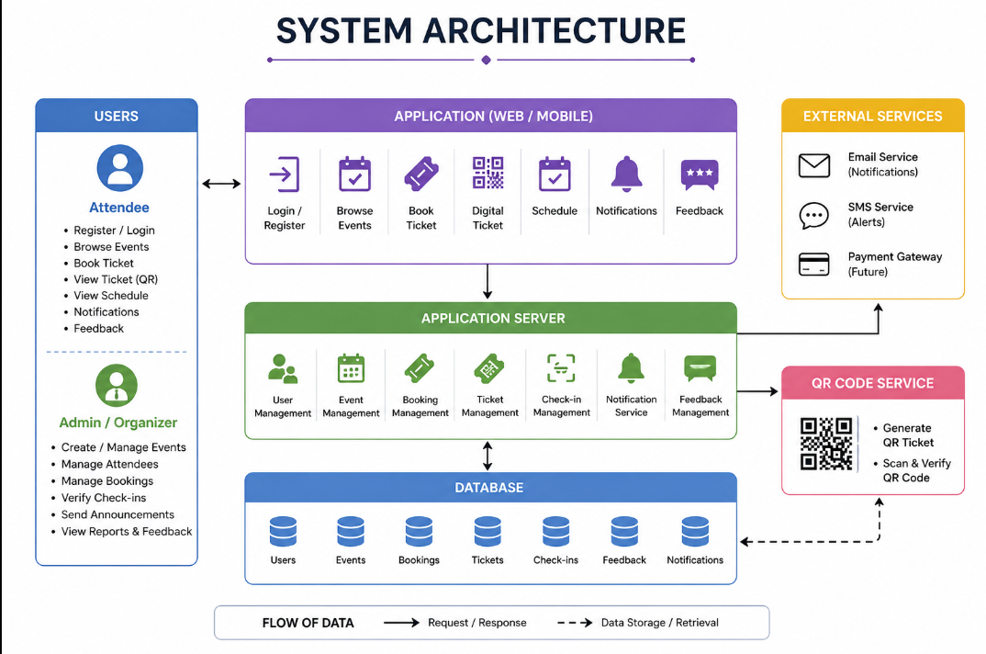
TICKET BOOKING SYSTEM • SYSTEM ARCHITECTURE

Slide 7
07
Application Workflow
End-to-end ticket reservation process
1
View Tickets
2
Select Seat
3
Request Booking
4
Check Availability
Self-service step
Self-service step
Self-service step
Self-service step
5
Apply Lock
6
Confirm Booking
7
Update Seat Status
8
Return Confirmation
Self-service step
Self-service step
Self-service step
Self-service step
VIEW → SELECT → VERIFY → ATTEND → CONFIRM
TICKET SELECTING SYSTEM • CONCURRENCYSAFE

Slide 8
08
Future Scope
Potential enhancements for a more dependable booking platform
1
Secure payment gateway
Support safe online ticket payments.
2
Booking notifications
Send booking confirmations and seat updates.
3
Scalable concurrency
Handle more simultaneous booking requests.
4
Distributed deployment
Support multiple application instances safely.
5
Live seat availability
Display updated availability in real time.
6
Booking analytics
Track demand, bookings and failed conflicts.
Future vision: scale into a reliable, real-time ticket reservation platform.
TICKET SELECTING SYSTEM • CONCURRENCYSAFE

Slide 9
09
Conclusion
A reliable system for consistent ticket reservations
IN SUMMARY
KEY TAKEAWAY
The Ticket Booking System transforms the attendee journey by combining registration, booking, digital ticketing, QR check-in, schedules, notifications and feedback in one platform.
THREAD SAFETY
+
DATA CONSISTENCY
+
FASTER RESERVE
It prevents duplicate reservations, maintains accurate records, and provides booking confirmations even when many users access the system simultaneously.
THANK YOU
Questions & Discussion
TICKET SELECTING SYSTEM • CONCURRENCYSAFE

