Slide 1

PROJECT • REVIEW 2
Ticket Booking System
Concurrency Safe
TICKETS
Reliable Concurrent Ticket Reservation
Book • Synchronize • Confirm
A reliable booking platform that prevents double booking when multiple users reserve tickets simultaneously.
✓
TEAM MEMBERS
R SAI CHARAN REDDI — 2520090184
G MANIDEEP PATEL — 2520090100
P AKHIL YADAV — 2520090155
Concurrency Safe

Slide 2
02
Abstract
A concurrency-safe approach to ticket reservation
PROJECT OVERVIEW
CONCURRENCY
The Ticket Booking System (ConcurrencySafe) is designed to provide a reliable and efficient way for multiple users to book tickets simultaneously. It addresses double booking, incorrect seat availability, and inconsistent transaction records.
SAFE
BOOKING
FOR ALL
The system maintains real-time seat availability and uses synchronization, locking, or other concurrency-control techniques so that only one request can successfully reserve a contested ticket.
Request • Lock • Confirm
TICKET BOOKING • CONCURRENCY SAFE

Slide 3
03
Problem Statement
Challenges in concurrent ticket booking
TRADITIONAL BOOKING
PROPOSED APPROACH
Multiple users request the same ticket
Concurrency-safe booking mechanisms ensure that only one transaction reserves a contested ticket and that seat status remains accurate.
Double booking can occur
Seat availability can become inconsistent
Transaction records may become inconsistent
Shared booking resources need protection
Concurrent requests increase system complexity
TICKET BOOKING • CONCURRENCY SAFE

Slide 4
04
Software Requirements
Tools and technologies for the booking system
BACKEND
DATA ACCESS
DATABASE
Java
Spring Boot
REST APIs
Spring Data JPA
Persistent data
Booking operations
MySQL
Users, tickets, seats
Bookings
DEVELOPMENT TOOLS
TESTING
CONCURRENCY
Maven
IntelliJ IDEA / Eclipse
Git & GitHub
Postman
REST API testing
Booking requests
synchronized
Lock
ExecutorService
TICKET BOOKING • CONCURRENCY SAFE

Slide 5
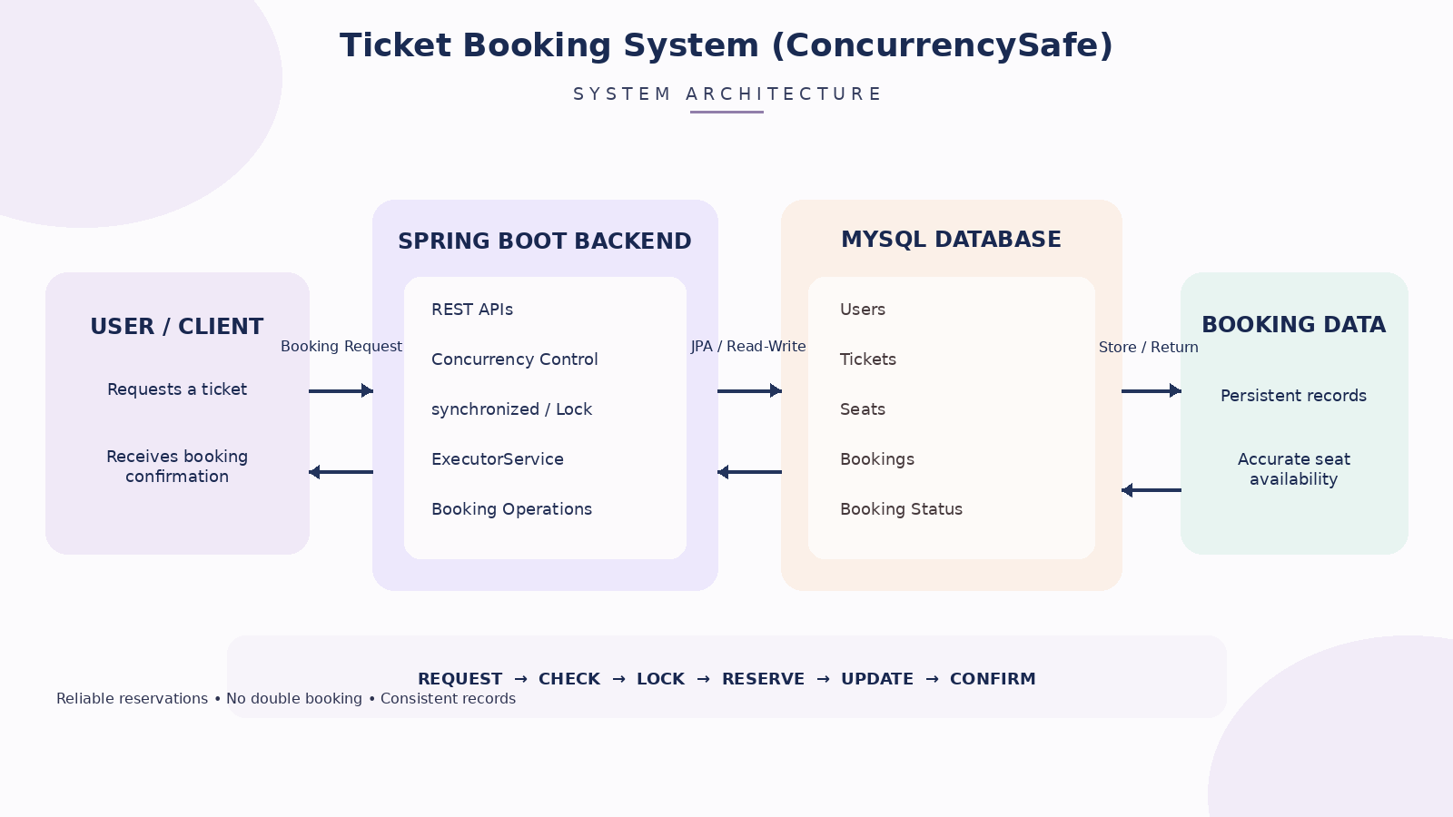
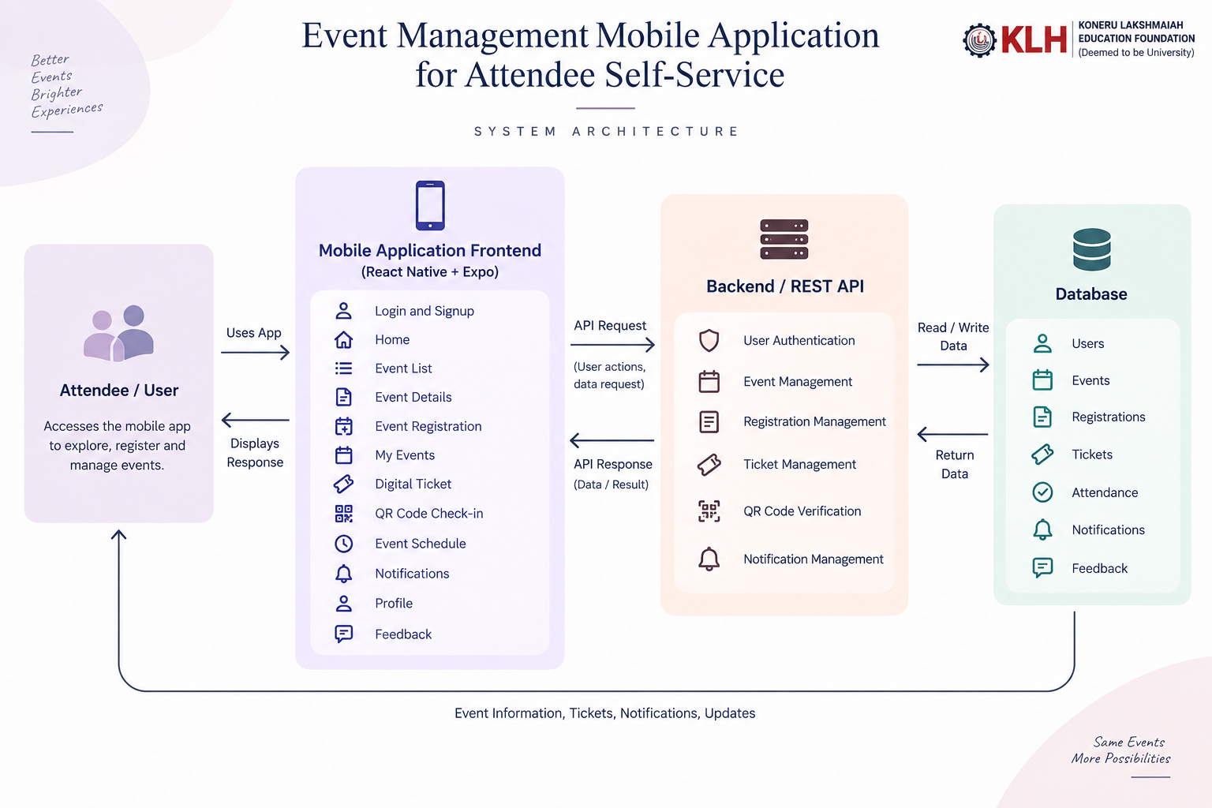

Slide 6
05
System Architecture
Ticket Booking System • Concurrency Safe
USER / CLIENT
Booking request • Seat selection
View availability
SPRING BOOT
REST APIs • Booking logic
Request handling
SPRING DATA JPA
Data access • Persistence
Booking operations
MYSQL
Users • Tickets
Seats • Bookings
CONCURRENCY CONTROL
synchronized • Lock • ExecutorService
Protect shared ticket resources and prevent double booking
SAFE BOOKING FLOW
1 REQUEST
User requests ticket
2 CHECK
Check availability
3 LOCK
Apply lock / synchronize
4 RESERVE
Reserve ticket
5 UPDATE
Update status
6 CONFIRM
Save & confirm
Java • Spring Boot • Spring Data JPA • MySQL • Postman

Slide 7
06
Core Features
Key features for reliable ticket booking
Ticket Availability
Seat Selection
View available tickets
Select a ticket / seat
Concurrent Requests
Synchronization
Handle multiple users safely
Protect shared booking resources
Double-Booking Prevention
Real-Time Seat Status
Only one request can reserve a ticket
Update status after booking
Booking Confirmation
Accurate Records
Confirm successful reservation
Maintain consistent transactions
TICKET BOOKING • CONCURRENCY SAFE

Slide 8
07
Database Design
Main data entities used by the booking system
USERS
TICKETS
SEATS
User ID
Name
Email
Password
Ticket ID
Event
Type
Price
Seat ID
Ticket
Number
Status
BOOKINGS
BOOKING STATUS
CONCURRENCY CONTROL
Booking ID
User
Ticket
Status
Reserved / Available
Transaction result
Timestamp
Shared ticket resource
Lock / synchronization
TICKET BOOKING • CONCURRENCY SAFE

Slide 9
08
Concurrent Booking Flow
How a booking request moves safely through the system
01
User Requests Ticket
02
Check Availability
03
Apply Lock / Synchronize
04
Reserve Ticket
→
→
→
05
Update Ticket Status
06
Save Booking Record
07
Send Confirmation
→
→
REQUEST → CHECK → LOCK → RESERVE → UPDATE → CONFIRM
TICKET BOOKING • CONCURRENCY SAFE

Slide 10
09
Thank You
Questions & Discussion
TICKET BOOKING SYSTEM
(CONCURRENCY SAFE)
TEAM MEMBERS
R SAI CHARAN REDDI — 2520090184
G MANIDEEP PATEL — 2520090100
P AKHIL YADAV — 2520090155
Reliable bookings. Consistent records.

