Slide 1

Community-Detection
Platform
Combining content signals with graph structure to discover meaningful communities
Data Structures and Algorithms - 3 (25CS2103E)
A.Y. 2026–2027 | Team No. 20 | Section 13
C. Srikar Reddy • G. Manideep Patel • R. Sai Charan Reddi
Guide: Dr. Dyuti Banerjee, Assistant Professor, AIDS

Slide 2
Abstract
1
Project Overview
The Community-Detection Platform is a web-based system for identifying and analyzing communities in social, collaboration, and communication networks. It combines content information with graph connections to create a weighted interaction graph. Text and interaction data are processed to assign weights using connection strength and content similarity. Community detection techniques group closely related nodes, while an interactive dashboard reports modularity, density, conductance, community sizes, and partition results. The platform is intended for efficient analysis of large graphs and can support social-media moderation, marketing analysis, research collaboration, and communication analysis.
Content signals
Graph connections
Weighted graph
Community quality
Community-Detection Platform | Data Structures and Algorithms - 3

Slide 3
Introduction
2
Background
Proposed Approach
Social and collaboration networks contain both structural relationships and rich textual content. Understanding their community structure helps reveal how users, entities, or groups interact.
1. Collect node content and interaction/link data.
2. Process text and measure content similarity.
3. Combine interaction strength and content relevance into edge weights.
4. Detect communities and evaluate the resulting partition.
5. Present the network and metrics through an interactive dashboard.
Why Community Detection?
Communities are groups of nodes with stronger internal relationships. Detecting them supports moderation, marketing, research collaboration, and communication analysis.
Community-Detection Platform | Data Structures and Algorithms - 3

Slide 4
Literature Survey
3
Graph-Based Community Detection
Content-Aware Analysis
Proposed Integration
Traditional methods identify groups primarily from network structure. Modularity-based approaches are widely used because they compare the strength of within-community connections against between-community connections.
Text associated with nodes can provide additional evidence about similarity. TF-IDF or embedding-based representations can be used to estimate content similarity between connected entities.
This project combines content signals and graph links in a weighted interaction graph. The goal is to produce communities that reflect both structural relationships and shared content.
Literature focus for this project: structural communities + content similarity + scalable graph analysis.
Community-Detection Platform | Data Structures and Algorithms - 3

Slide 5
Problem Statement and Objectives
4
Problem Statement
Objectives
Graph-only community detection may miss information contained in what connected nodes say. A useful platform must therefore integrate content signals with graph structure and provide interpretable quality measures while remaining practical for large graphs.
• Construct a weighted interaction graph from links, interactions, and content.
• Measure content similarity and combine it with connection strength.
• Detect communities using suitable graph algorithms.
• Report partition quality using modularity, density, and conductance.
• Visualize communities, sizes, and network structure.
• Support analysis of large and complex graphs.
Community-Detection Platform | Data Structures and Algorithms - 3

Slide 6
Hardware and Software Requirements
5
Hardware Requirements
Software Requirements
• Processor: Intel Core i3 / equivalent or above
• RAM: 8 GB minimum
• Storage: 10 GB available space
• Display: 1366 × 768 or higher
• Internet connection for development and package installation
• Operating System: Windows / Linux
• Programming Language: Python
• Backend: Flask
• Data Processing: Pandas, NumPy, Scikit-learn
• Graph Analysis: NetworkX
• Community Detection: Louvain / Leiden
• Visualization: HTML, CSS, JavaScript, Cytoscape.js / D3.js
Community-Detection Platform | Data Structures and Algorithms - 3

Slide 7
Results
6
Input Data
Weighted Graph
Communities
Quality Metrics
Expected Analysis Output
Quality Reporting
Platform Result
• Network structure visualization
• Community assignments
• Community sizes
• Partition summary
• Strong and weak interaction patterns
• Modularity
• Density
• Conductance
• Internal vs. external connectivity
• Comparative partition quality
An interactive dashboard that allows users to inspect the graph, understand detected groups, and evaluate how well the partition represents the network.
Note: The abstract specifies the result types and metrics; numerical performance values are to be obtained after implementation and testing.
Community-Detection Platform | Data Structures and Algorithms - 3

Slide 8
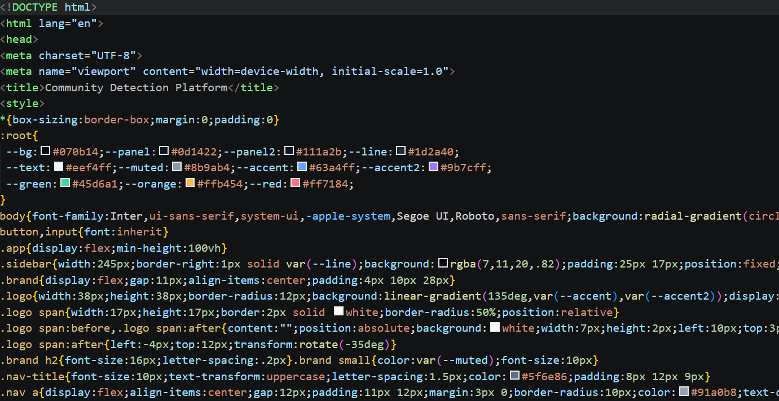
CODE

Slide 9
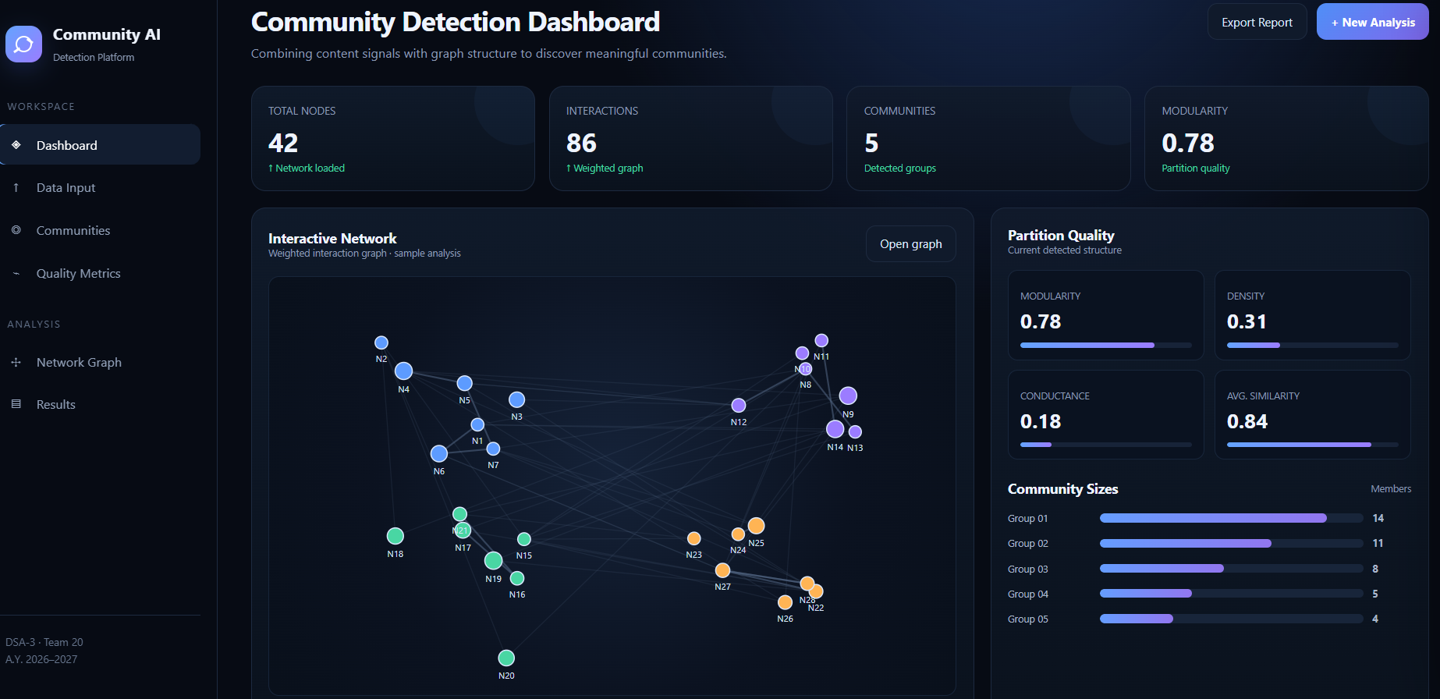
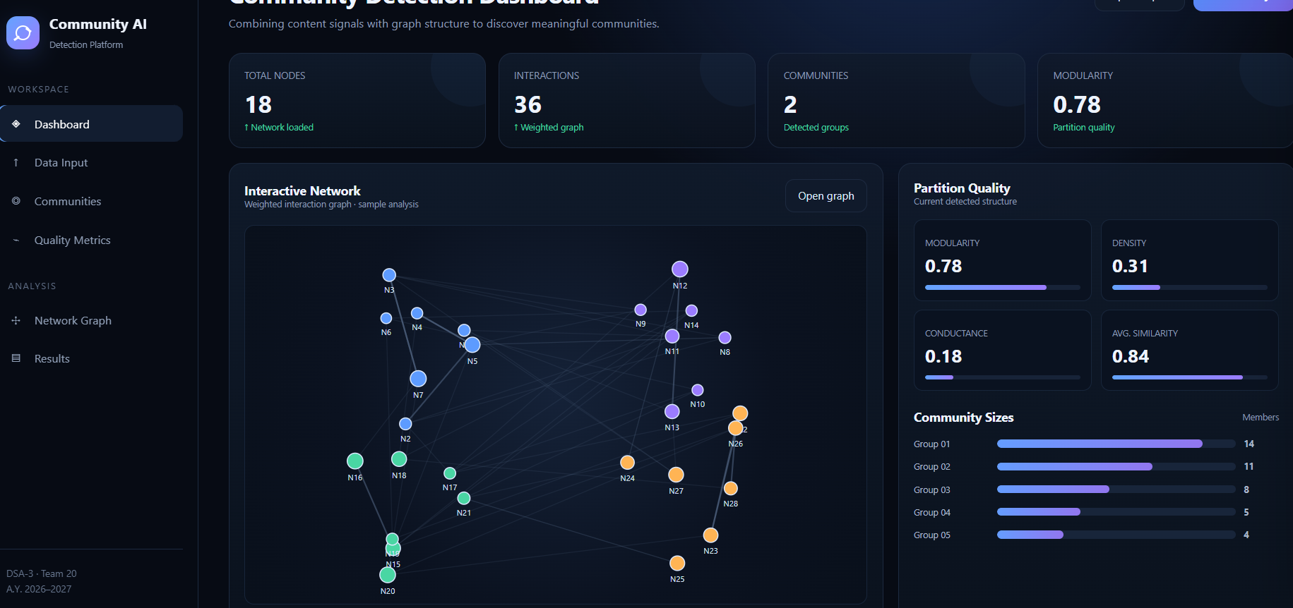
SCREENSHOTS OF OUR PROJECT
DASHBOARD
CSV FILE

Slide 10
Conclusion
7
Conclusion
The Community-Detection Platform provides a unified approach for analyzing complex networks by combining content information with graph structure. A weighted interaction graph represents both connection strength and content similarity, allowing communities to be identified using graph-based detection techniques. The platform also provides quality metrics such as modularity, density, and conductance to make partition results easier to evaluate. Through an interactive dashboard, users can inspect network structure, community sizes, and detected groups. The approach is suitable for social, collaboration, and communication networks and can support practical analysis in moderation, marketing, research, and communication applications.
Community-Detection Platform | Data Structures and Algorithms - 3

Slide 11
Future Scope
8
• Support very large graphs using sparse data structures and distributed graph processing.
• Use advanced language models or embeddings for richer content similarity.
• Add real-time community detection for continuously changing networks.
• Compare more community detection algorithms and automatically select the best partition.
• Add role-based dashboards and exportable analytical reports.
• Extend the platform to dynamic, temporal, and multilayer networks.
Goal: scalable, interpretable, content-aware community analysis
Community-Detection Platform | Data Structures and Algorithms - 3

