Slide 1
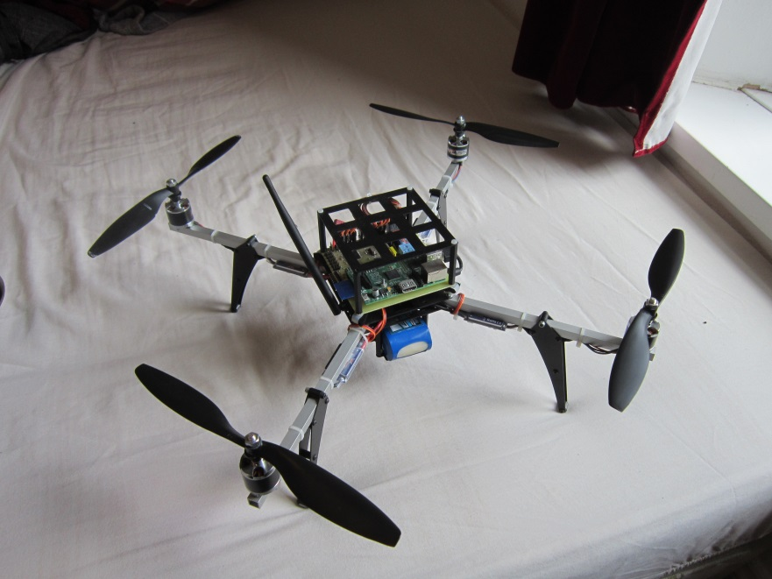
Porting Previous C++ Quadcopter Project from Linux to Bare-metal System
---Tai Li
Matthew Waston, The Design and Implementation of a Robust AHRS for Implementation on a Quadrotor Platform

Slide 2
Introduction
Explanation of previous quadcopter project
Objectives
Design & verification plan
Progress along this project
Goals achieved
Feedback
Questions
© The University of Sheffield

Slide 3
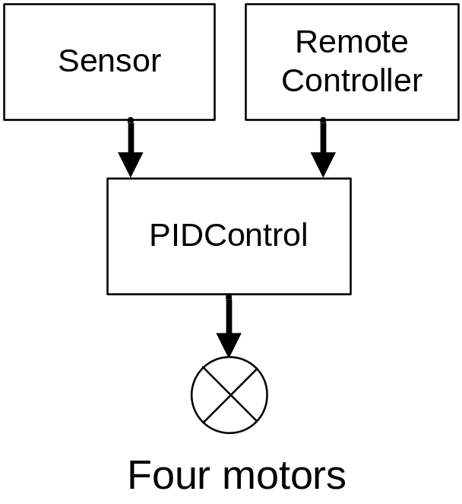
How a quadcopter works
Measure the current actual status of the copter from the sensor (gyroscope, accelerator, magnetometer)
Receive the expected status of the copter from the remote control
Feed them into a PID control
Update motors status
© The University of Sheffield

Slide 4
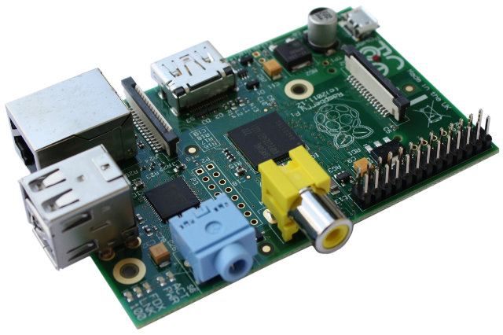
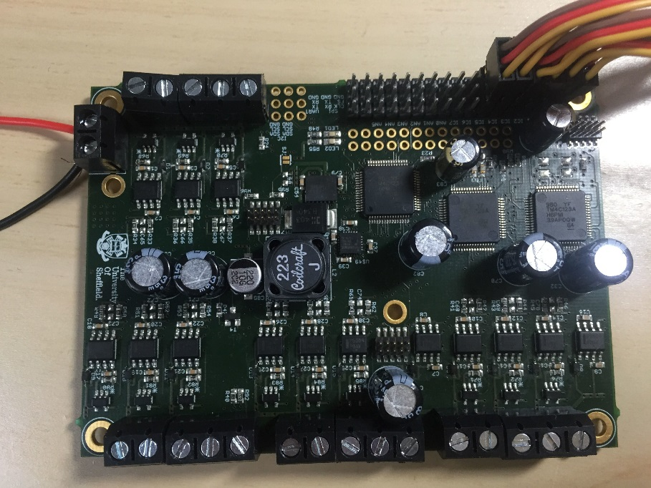
Dev-board used
http://upload.wikimedia.org/wikipedia/commons/4/45/Raspberry_Pi_-_Model_B.jpg
Raspberry Pi
a credit card-sized single-board computers, running on Linux
operating system
Customized TI board
Three TI microcontrollers, sensor, with motor control electronics, running on bare-metal system
© The University of Sheffield

Slide 5
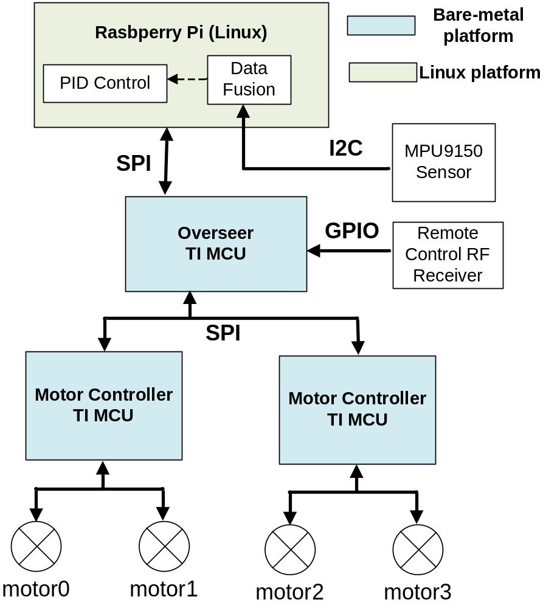
Previous project
A Raspberry Pi
-- GCC toolchain
Three TI processors
on a customized board
-- TI toolchain
© The University of Sheffield

Slide 6
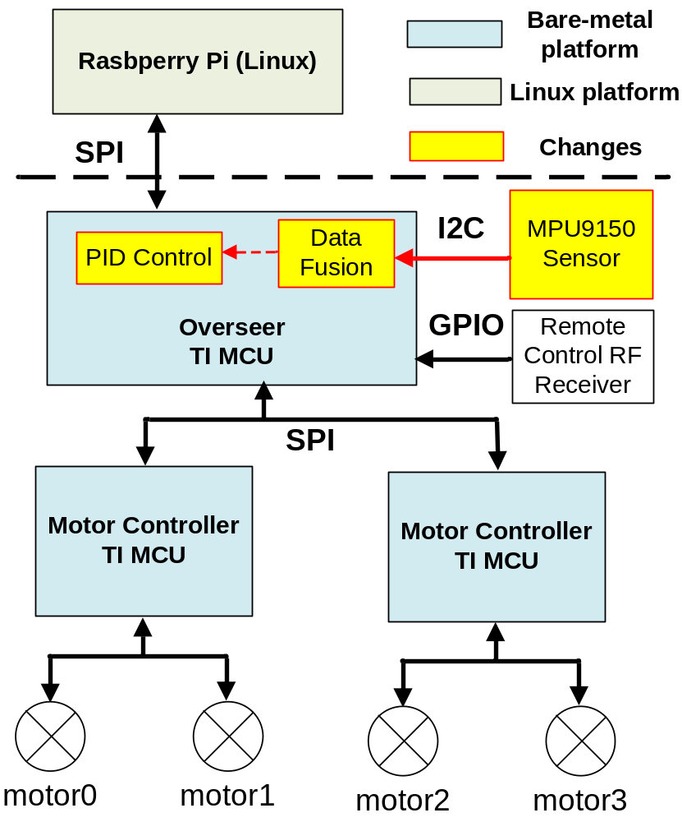
Current project
Three TI processors
on a customized board
-- all in TI toolchain
Raspberry Pi is
optional for advanced
control
© The University of Sheffield

Slide 7
Objectives
Free up Raspbeery Pi on the top to run advanced control, e.g. unmanned control, wifi/bluetooth-support
A test case of the customized board as a Raspberry Pi shield (as well as building more peripheral drivers for this board)
© The University of Sheffield

Slide 8
Design/Test Plan
V model (bottom-up verification)
Peripheral driver level design/verification
  I2C driver --- sensor data fetching
  General purpose timer --- regularly updating system
Computational level verification
  Sensor data fusion --- filtering noise in sensor data
System level design/verification
  - Standalone Copter & Pi-Controlled Copter run mode
© The University of Sheffield

Slide 9
I2C driver for sensor
Understood how I2C works
Understood how previous I2C code worked on Raspberry Pi (SMBus driver in fact) as well as clarifying what I2C support available from TI peripheral drivers
Wrote a SMBus driver present on I2C protocol while keeping the same driver header file
Verified it using oscilloscope and self-checking tests
© The University of Sheffield

Slide 10
General purpose timer
Tried to find an example (of Tiva-C) but lots of different examples for other series of TI processors
Debugged code by reading through TI timer module section in the processor specification
Time generated by timer module was not right --- found a bug in TI system API, returning wrong clock frequency (confirmed from TI)
© The University of Sheffield

Slide 11
Sensor fusion
Started with removing Linux dependencies
No printf support --- added in
Generated a reference from Raspberry Pi and compare the test result generated from customized TI board and Raspbeery Pi (lots of checking points had been set for observations)
Found a defeat in TI compiler (the bug should be shown as at least a compile-time warning but TI compiler did not warn)
© The University of Sheffield

Slide 12
Printf support
SPI solution
- No enough bandwidth for a general printf
UART solution
- Costly in terms of project time
JTAG solution
- Not enough support on it
- Found a wiki-page about printf support on
a TI DSP
© The University of Sheffield

Slide 13
System run modes
Built up two run modes :
- Standalone Copter (by remote control)
- Pi-Controlled Copter
(customized TI board as a peripheral driver)
Added SPI commands for switching run modes
Found a run-time error because TI linker allocates insufficient memory in heap size and stack size
© The University of Sheffield

Slide 14
Goal achieved
Software finished but quadcopter hardware prototype has not been tested
Provided more peripheral drivers as support for this customized TI dev-board
Built a test environment for self-checking (mainly for peripheral drivers)
Created lots of specs and wiki-like docs/reference for further projects
© The University of Sheffield

Slide 15

Feedback
http://www.wallpapervortex.com/wallpaper-24698_the_good_the_bad_and_the_ugly.html#.VTCDS_nF9w4
© The University of Sheffield

Slide 16
The good
I LIKED IT
- C++ (low level & object-oriented)
- Register-level operations on hardware
- Poor/beginner-unfriendly support
GitHub --- revision control tools
Created lots of documentations and wiki-like docs for whom this project might be passed to
© The University of Sheffield

Slide 17
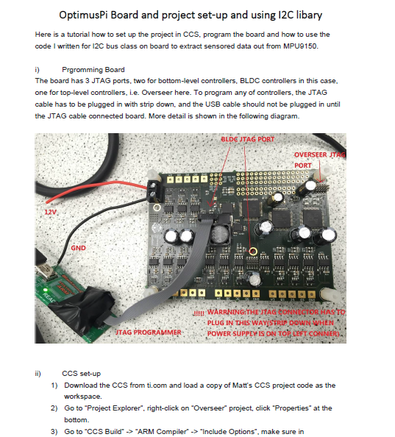
© The University of Sheffield

Slide 18
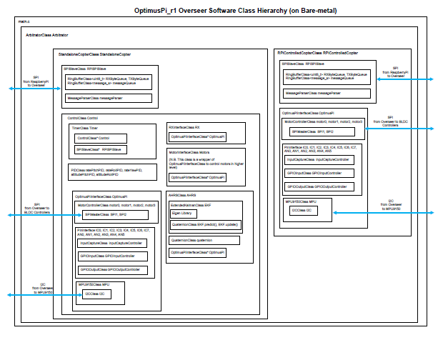
© The University of Sheffield

Slide 19
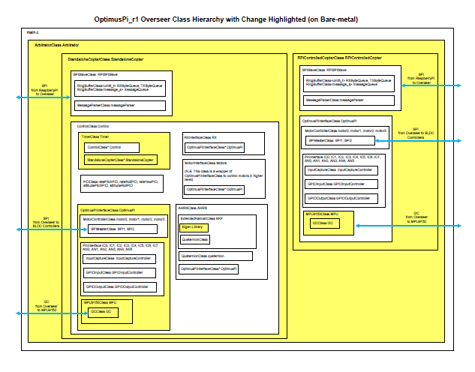
© The University of Sheffield

Slide 20
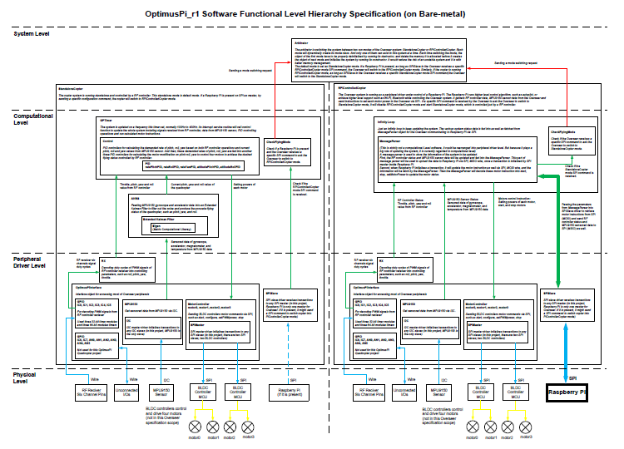
© The University of Sheffield

Slide 21
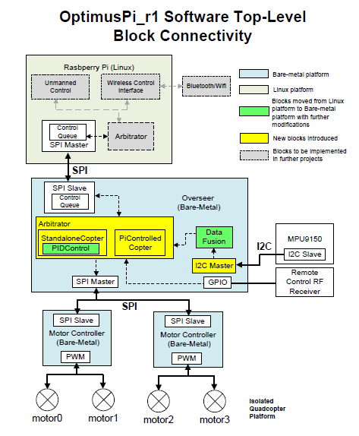
© The University of Sheffield

Slide 22
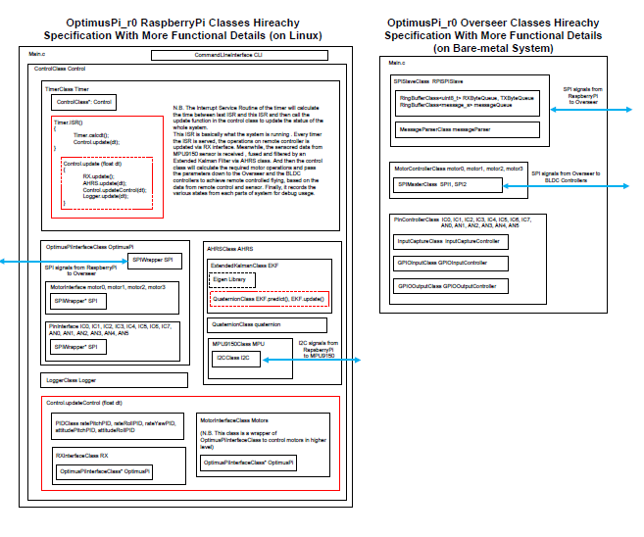
© The University of Sheffield

Slide 23
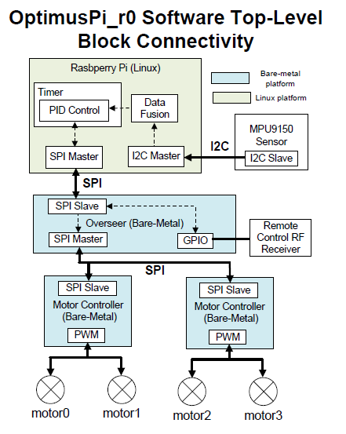
© The University of Sheffield

Slide 24
The bad
Sharing a JTAG programmer with another student in the first semester.
No documentation on software
No documentation on setting up TI eclipse project/Raspberry Pi eclipse project
Lack of quadcopter hardware specification
© The University of Sheffield

Slide 25
The ugly
No reference and little comments in previous code, and Matthew was not around.
- The code he passed down was more like a
released version rather than a draft version.
No user online support on this TI processor (Tiva-C) and poor TI official support
Run-time error/bug when code was moved to another platform due to using TI toolchain
© The University of Sheffield

Slide 26
Questions?
You can find this project including source code and documents at my GitHub https://github.com/relliky/OptimusPi_r1
© The University of Sheffield

