Slide 1

Windows

Slide 2

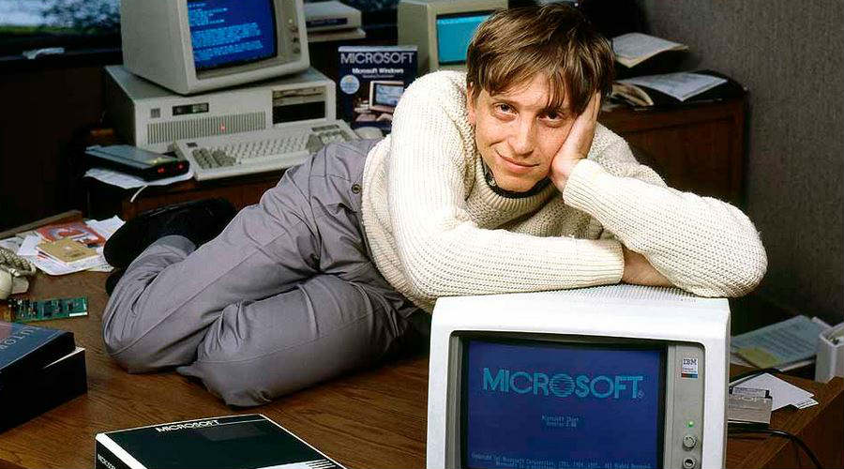
First, There was DOS
History

Slide 3
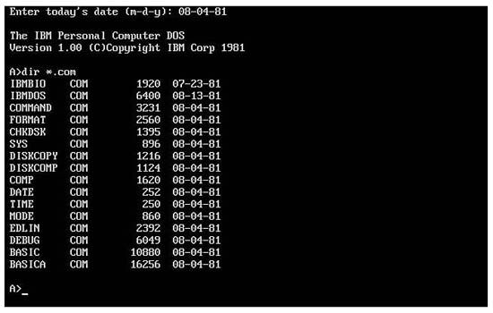
DOS
Disk Operating System
Adapted from an OS Bill Gates and Paul Allen Purchased
First released in 1981 with the IBM PC
Non-Multitasking
System Calls via Interrupt Vectors
History

Slide 4
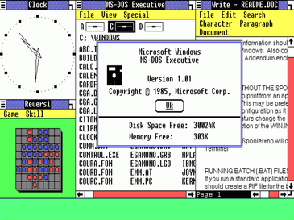
Windows 1.0 (1985)
Provided Graphical Environment for DOS
Ran as a DOS program.
Supported Multi-Tasking of Windows Applications
Users would boot DOS, and then start windows.
History

Slide 5
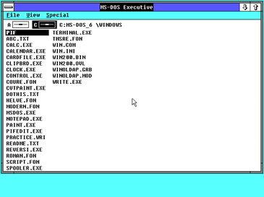
Windows 2.0 (1987)
A refinement of Windows 1.0
Support for VGA Graphics
Used 286 and 386 extensions
Still ran on top of DOS
History

Slide 6
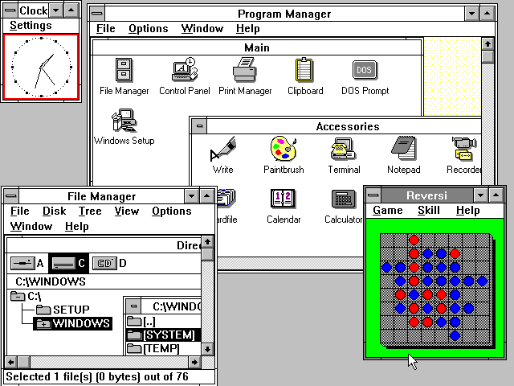
Windows 3.0 (1990)
A Further Refinement of Windows
Still runs on top of DOS
Improved Multi-Tasking
Full access to 386 extensions
Added networking and workgroup support in 3.11
History

Slide 7
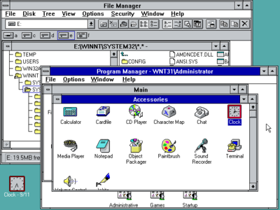
Windows NT 3.1 (1993)
Ran on its own kernel, not DOS based
Both Server and Workstation editions
Uses code developed as part of the OS/2 Project
Graphical Shell looks like Windows 3.1.
Fully 32-bit, Multi-Tasking Operating System
History

Slide 8
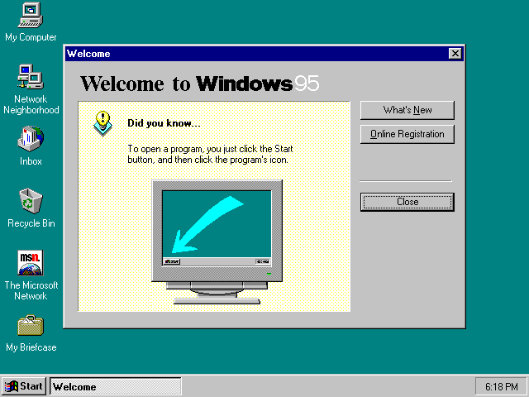
Windows 95 (1995)
Fully 32-bit Windows
First to boot windows by default
Still DOS based!
Introduced Start Menu
Wildly Successful in the PC Market
History

Slide 9
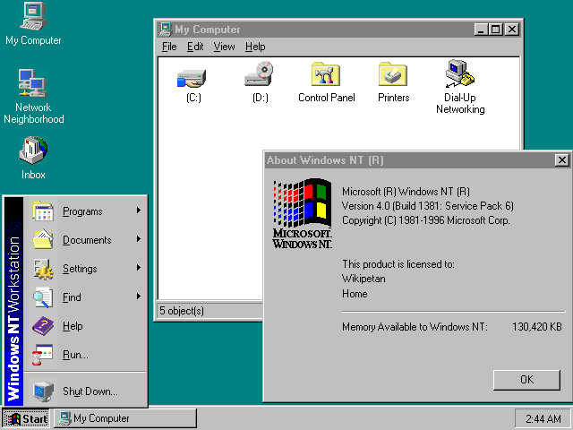
Windows NT 4.0 (1996)
Refinement of NT 3.1
Graphical Shell Updated to look like windows 95.
Robust Server and Workstation
Built-In TCP/IP Networking and IIS Webserver
History

Slide 10
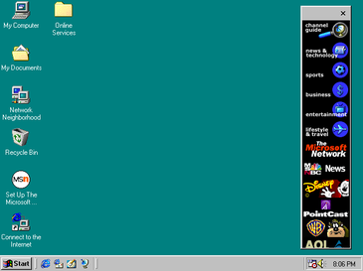
Windows 98 (1998)
Refinement of Windows 95
Improved Web Support
First Windows to ship with Internet Explorer
Led to an anti-trust lawsuit due to IE integration.
First “web-enabled” PC Operating System
History

Slide 11
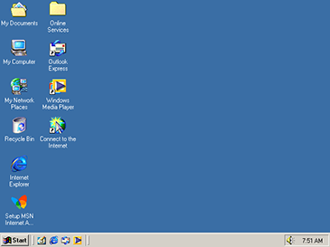
Windows ME (2000)
The final DOS-Based Windows.
An unholy abomination where elements of the NT kernel were integrated into DOS
Generally considered to be inferior to windows 98.
At the same time, there was a mobile version of windows (Windows CE).
History

Slide 12
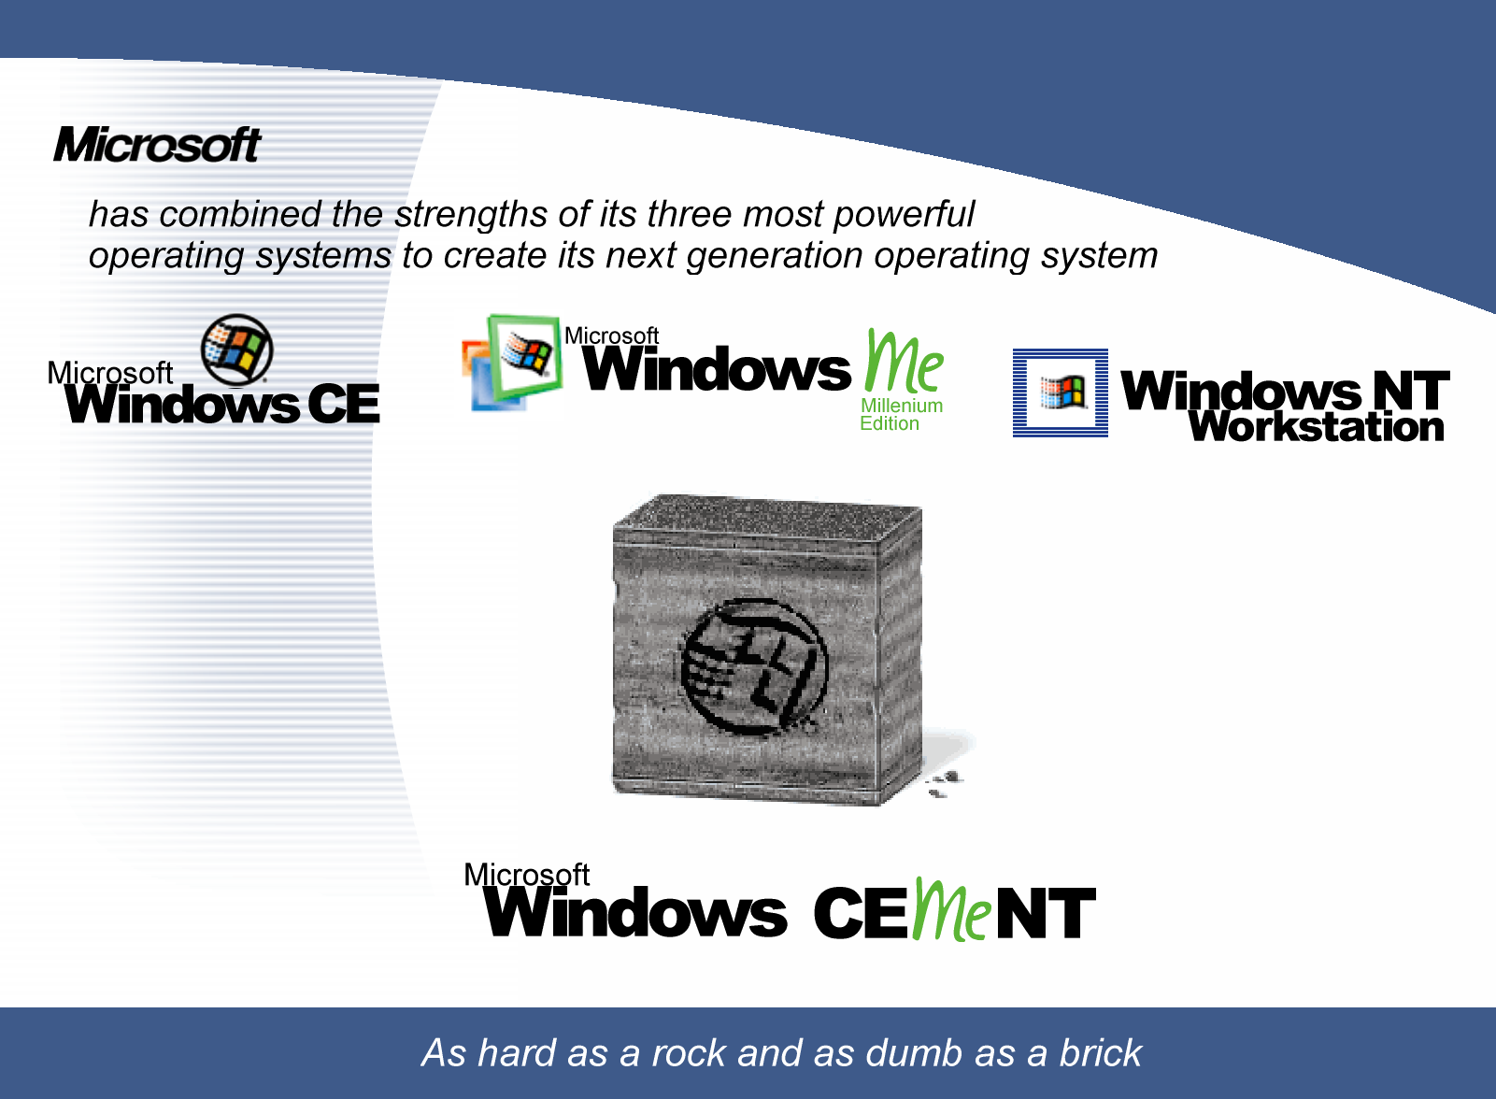
A Meme is Born!
History

Slide 13
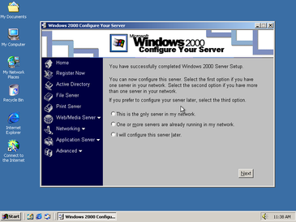
Windows 2000 (2000)
Windows 2000 has a graphical shell which looks like Windows ME
Runs on NT Kernel
Designed for Server and Workstation use
First Windows NT system to no bear the “NT” brand.
Successful in the server market.
History

Slide 14
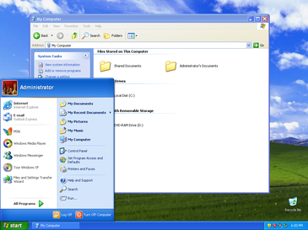
Windows XP (2001)
First general PC OS which was not based on DOS
End-User Features Integrated into NT kernel
Improved compatibility with win16 and Win32 APIs.
The beginning of the modern windows Operating System Offerings (Windows, and Windows Server)
History

Slide 15
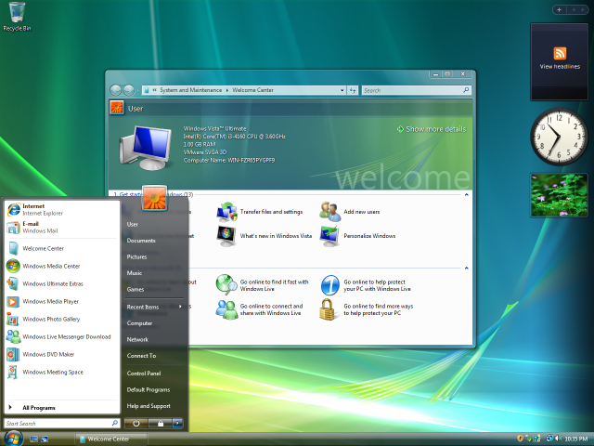
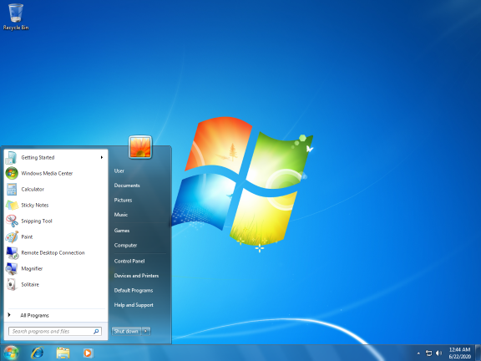
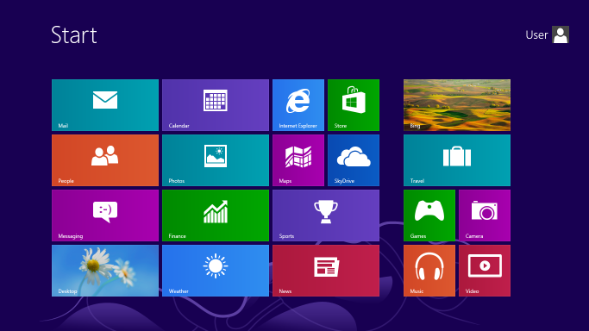
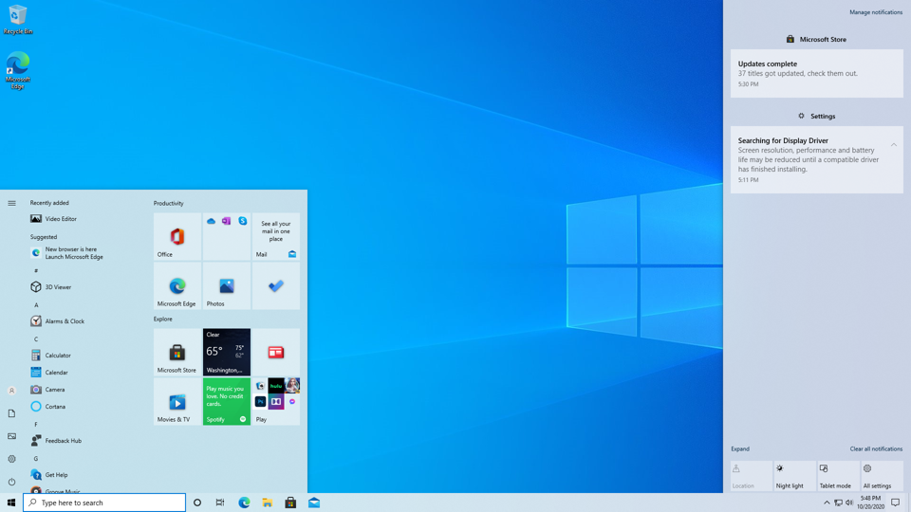
Modern Windows Versions
Windows Vista (2006)
Windows 7 (2009)
Windows 8 (2012)
Windows 10 (2015)
History

Slide 16
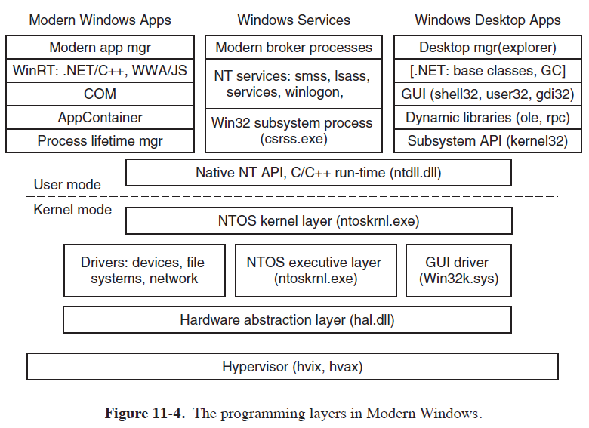
Programming Layers
Windows Programming

Slide 17
Calling Conventions
RPC (Remote Procedure Call)
Calls Between Services
Similar to Message Passing
A program publishes an API in the kernel, the kernel supervises calls.
LPC (Local Procedure Call)
Used for System Calls in Substructures
Published in dll (Dynamic Linked Library)
These Make Calls to Subsystems and Kernels
Windows Programming

Slide 18
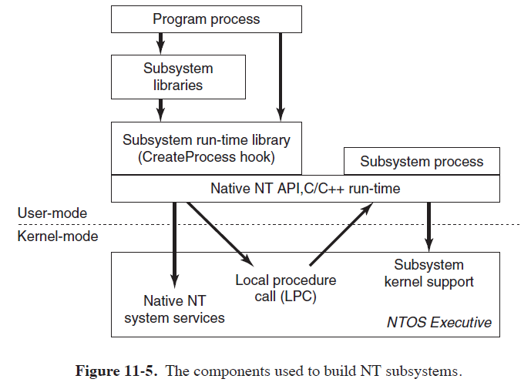
NT Subsystems
Windows Programming

Slide 19
Getting a Handle On It
In windows, a handle is used to refer to objects across boundaries.
Kernel Objects
Windows Service Objects
Handles are Integers
Handles may refer to a wide variety of objects!
NT
Kernel
Handle
Client Process
Handle
Windows Service
Windows Programming

Slide 20
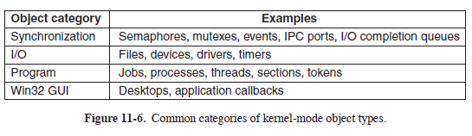
Kernel Objects
P. 868
The Windows Kernel supports a wide variety of objects.
Some of these, like GUI elements, are quite complex.
All are manipulated through function calls using handles.
Windows Programming

Slide 21
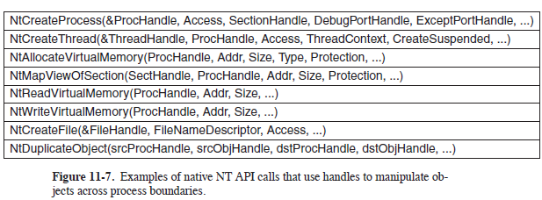
NT API Calls
P. 869
NT API Calls Create and Manipulate Handle Objects
A large portion of the native API calls are “undocument” which really means “subject to change without warning.”
Using Native API calls is uncommon.
Windows Programming

Slide 22
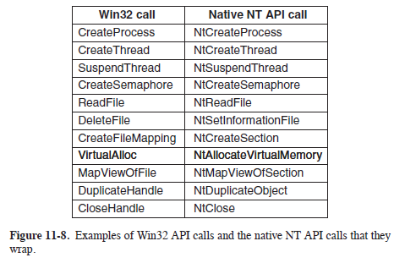
Win32 API
Win32 API is a library which wraps NT API Calls.
Some Win32 calls actually run completely in user space.
Most common Windows system programming API
Fully Documented and much more stable, changes very little.
P. 872
Windows Programming

