Slide 1


SIMPLE ATTENDANCE
FINAL PROJECT IN
INFORMATION MANAGEMENT 1
RECORD
Overview
Objectives
Features
User’s Guide
Repository
Documentations
SYSTEM
Leader:
Lea Peña
Member: Jamaica Reloz
Francis Ryan Rebaldo

Slide 2

OVERVIEW:
The Simple Attendance Record System will help you learn how to use PHP CRUD functions. This system is capable of recording the attendance of every student. This application is user-friendly kind of system. This system has two sides which are the administrator and the Student side. A simple attendance record system tracks the attendance of individuals such as students, or organization members. Key components include a user interface with secure login, a dashboard, and attendance entry forms, supported by a database storing user information, and attendance records. It offers functionalities like manual and automated attendance entry.
INFORMATION MANAGEMENT 1
SIMPLE ATTENDANCE
RECORD SYSTEM

Slide 3
OBJECTIVES:
The objectives of the Simple Attendance Record System (SARS) are to:
Here are some key objectives for a simple attendance record system:
1. Accurate Attendance Tracking : Ensure precise recording of attendance data for all individuals, minimizing errors and discrepancies.
2. User-Friendly Interface : Provide a simple and intuitive user interface for easy attendance entry and management by all users, including administrators and attendees.
3. Real-Time Monitoring : Enable real-time monitoring of attendance to facilitate timely interventions and decision-making by administrators.
4. Security and Privacy : Ensure secure login and authentication mechanisms to protect user data and maintain privacy.
5. Scalability and Customization : Design the system to be scalable and customizable to meet the specific needs of different organizations.
6. Data Integration : Enable seamless integration with other systems, such as payroll or academic management systems, to ensure cohesive data management.
INFORMATION MANAGEMENT 1
SIMPLE ATTENDANCE
RECORD SYSTEM

Slide 4
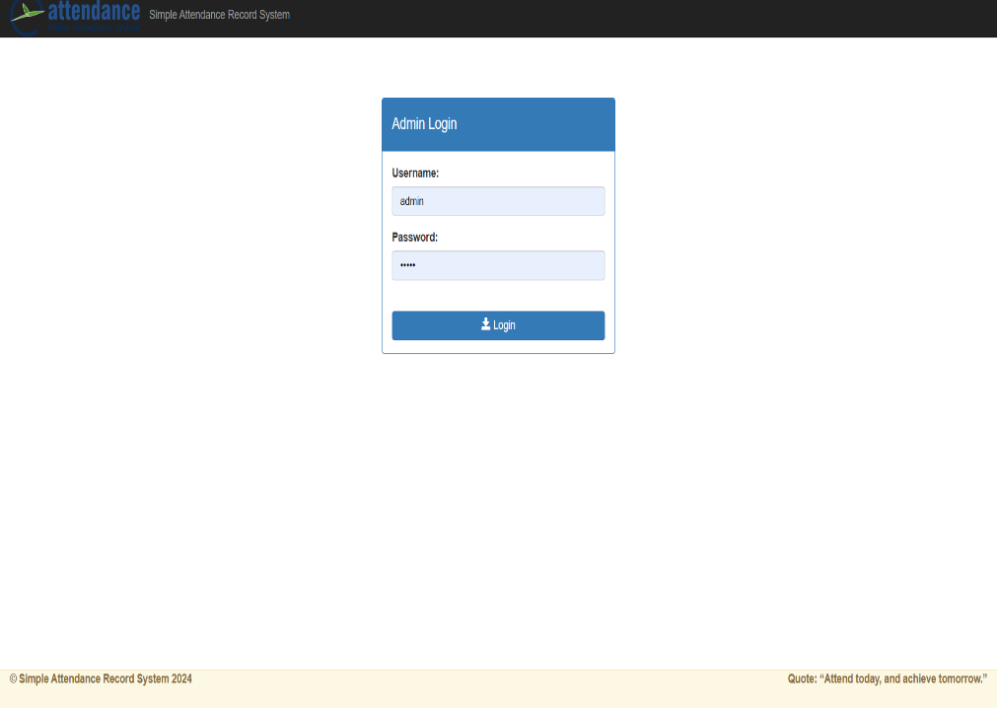
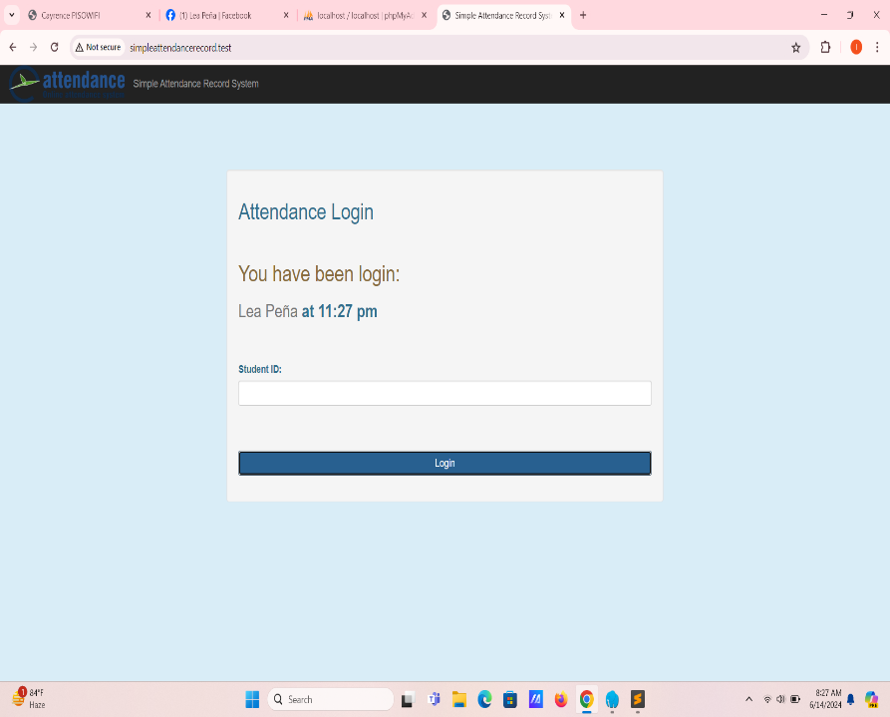
INFORMATION MANAGEMENT 1
SIMPLE ATTENDANCE
RECORD SYSTEM
User’s Guide
Step 1: Logging In
Open your favorite browser type localhost/simpleattendancerecord/admin
Enter your username and password in the designated fields.
Example – username =“lea” password =“admin”
Student may log in, in simpleattendacerecord.test , type it in your favorite browser.
Click on the "Login" button to access the system.

Slide 5
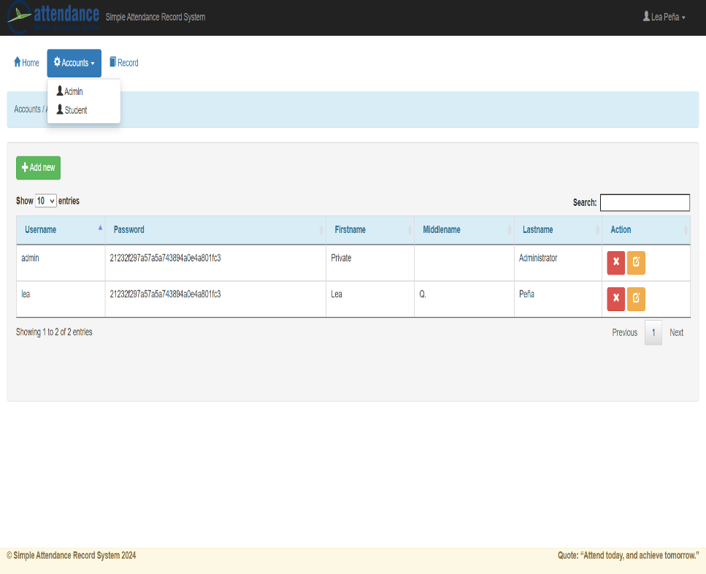
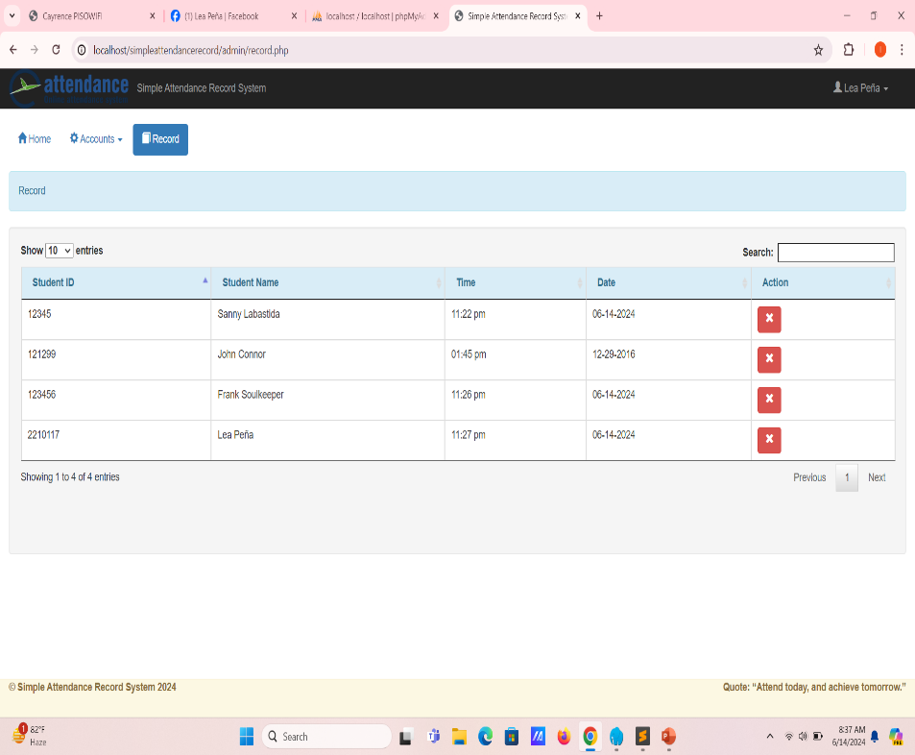
INFORMATION MANAGEMENT 1
SIMPLE ATTENDANCE
RECORD SYSTEM
Step 2: Accessing the Attendance
User’s Guide
From the admin dashboard, select the “Accounts" option. Then, you can see two options the admin and students.
Step 3: Checking the Students
Choose the Student option to see the students who attended.

Slide 6
Repository
GitHub link here!
INFORMATION MANAGEMENT 1
SIMPLE ATTENDANCE
RECORD SYSTEM

Slide 7
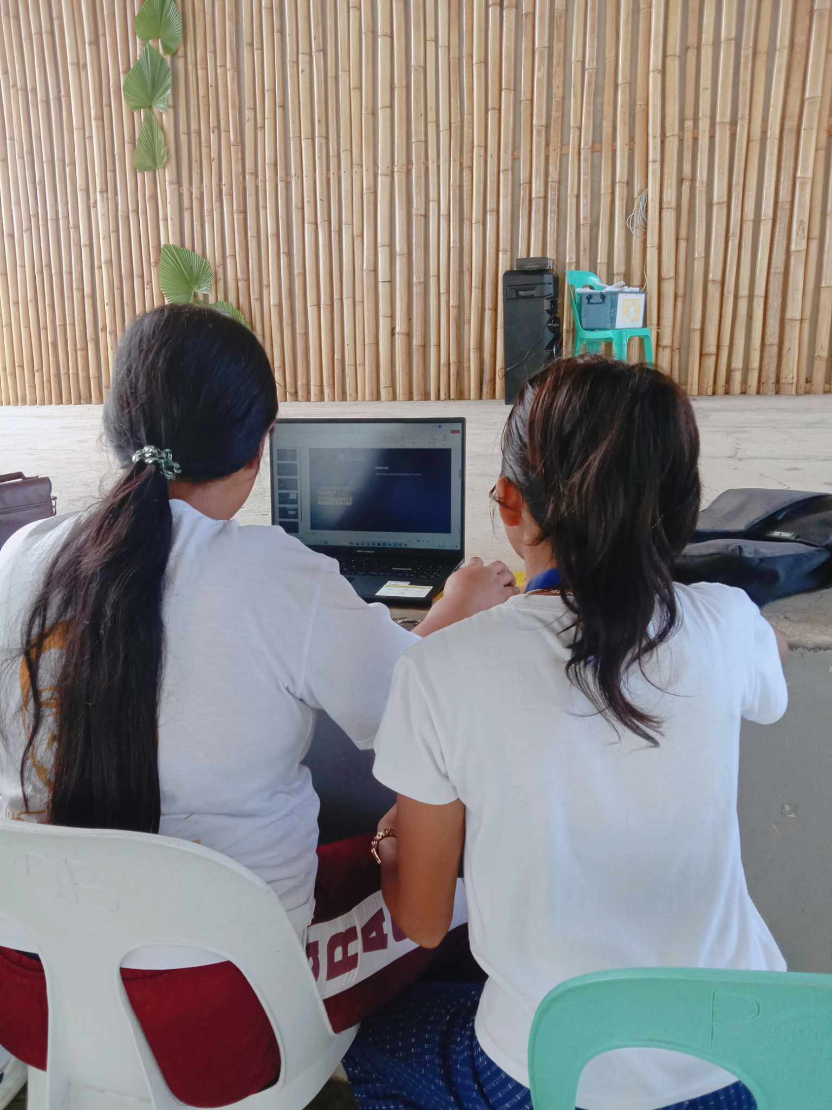
DOCUMENTATIONS
INFORMATION MANAGEMENT 1
SIMPLE
ATTENDANCE
RECORD SYSTEM

