Slide 1
Securing your Kubernetes supply chain with container image signing
Rene Schach – 11.02.2026
ContainerDays London 2026

Slide 2



Container image signing
default: container images are „anonymous“
add digital cryptographic signature to a container image
ensures its authenticity and integrity
signature is created based on the image digest
Layer 1
Layer 2
Layer 3
…
Layer n
Notes:
just as you'd expect a signature to verify the authenticity of a document, image signing does the same for container images
If a tag is used instead of digest, it uses the digest that‘s currently associated with the tag

Slide 3

benefits
Container registry
Kubernetes Cluster
image creation
Image A
Image B
Image C
deployment
Pod A
Pod B
Pod C
Pushing malicious images
Modify image
Create malicious workloads
signature is created based on the image digest
digest is computed from each image layer
image modification -> layer changes -> new digest
signature associated with one dedicated digest
Benefits
protection against image tampering/modifications
Benefits
verify that image is from a trusted publisher
useful for auditing purposes, helping organizations to track the origins
Notes:
Sign as close to build time as possible
As images move across the supply chain, there are different attack points one can exploit
Pushing malicious images into the registry
Altering images in transit

Slide 4
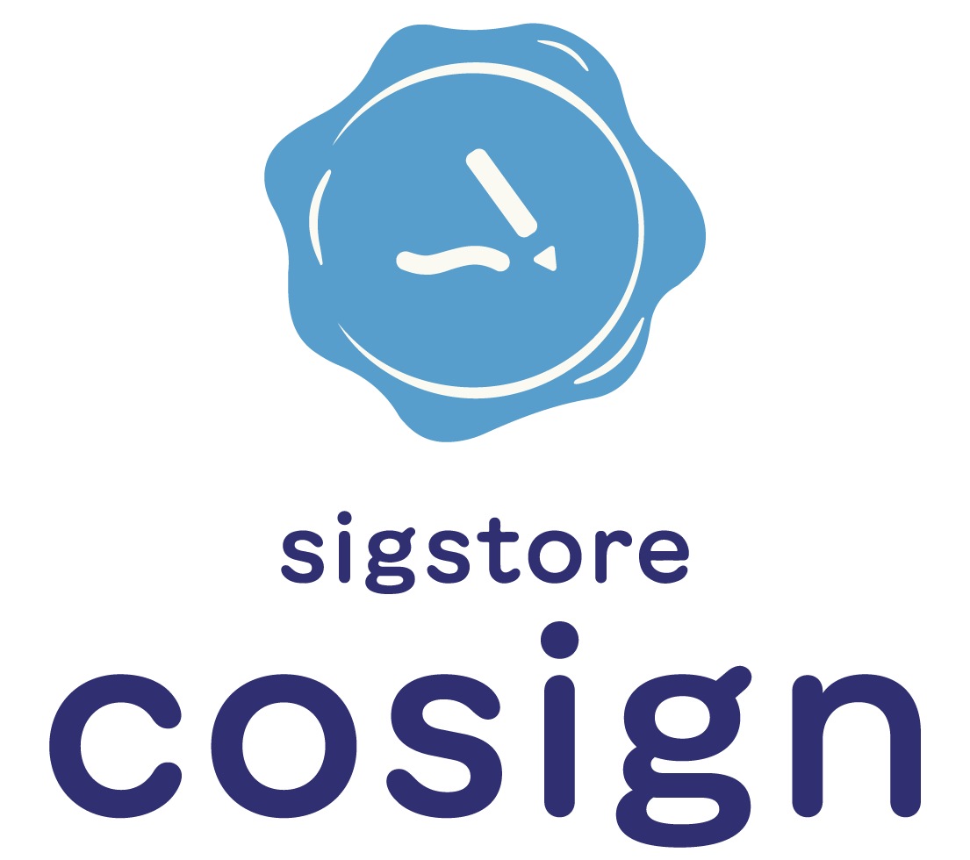
Cosign
popular tool for signing container images
can also be used to sign other artifacts like generic blobs, scripts or configuration files
Two approaches:
signing with generated public/private keypair
keyless (OIDC-based) signing using Fulcio and Rekor

Slide 5




Cosign With key
Container registry
build and push container image
name based on digest
reg.my/xyz/image:tag
sha256:foobarbaz
reg.my/xyz/image:sha256-foobarbaz.sig
sha256:bazbat
Keypair
create signature with private key
Private key
Can also be maintained in external KMS providers (e.g. HashiCorp Vault, Google Cloud KMS)
use cosign
to generate keypair
verify signature with public key
Public key

Slide 6

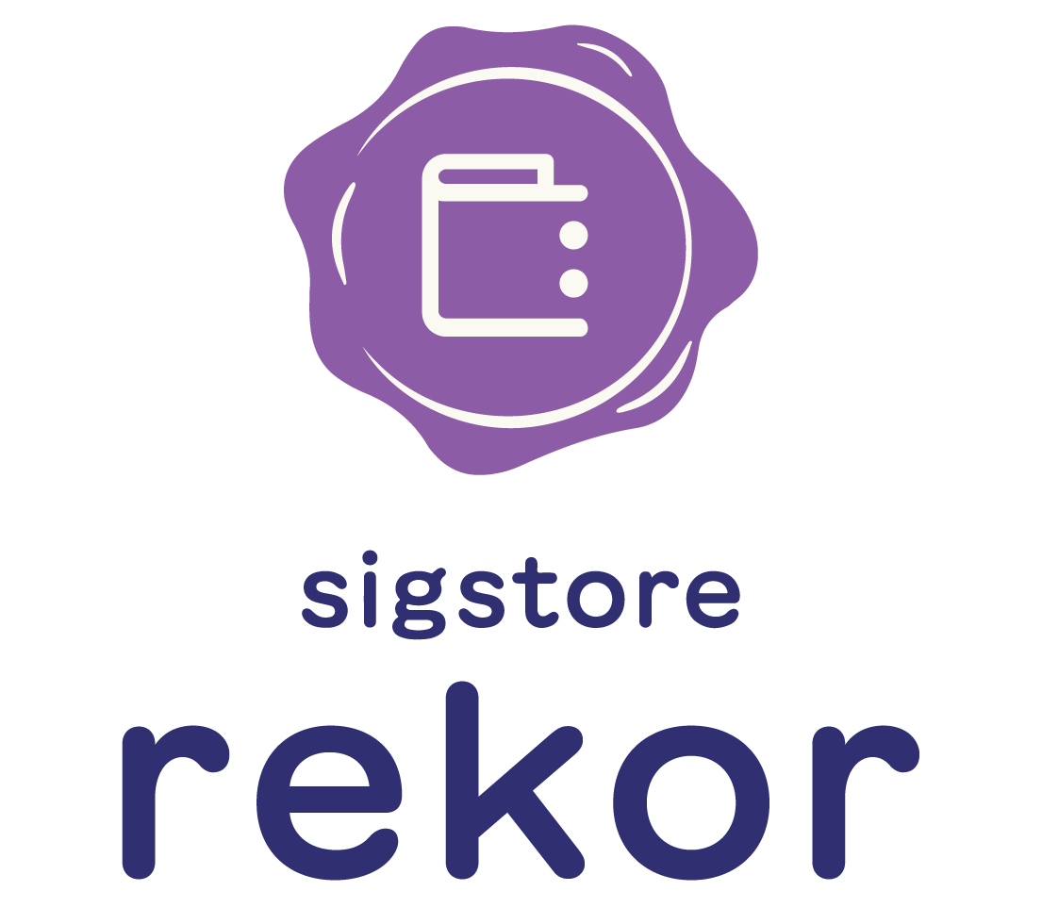



Keyless Cosign
Container registry
build and push container image
name based on digest
reg.my/xyz/image:tag
sha256:foobarbaz
reg.my/xyz/image:sha256-foobarbaz
sha256:bazbat
retrieve OIDC token
Verify signature using transparency log entry
log in
request short-lived signing certificate with OIDC token
stores signature, certificate and public key
OIDC provider
In-memory
public/private
keypair
binds identity to public key
Notes:
Keyless signing associates identities, rather than keys, with an artifact signature
creates a transparency log entry containing information that will allow signature verification without the (destroyed) private key. The log entry contains u.a. the public key, the certificate and the signature.
The log entry is timestamped. Rekor “witnesses” the signing event by entering a timestamped entry into the records that attests that the secure signing process has occurred.
Verification: compares the attributes of the remote signature (GHCR) against the timestamped Rekor entry. If they match, it confirms that the signature is valid

Slide 7
DEMO TIME

Slide 8





Thank You! Q&A
Demo | Repository
Find me on LinkedIn @ReneSchach
cosign | GitHub

Slide 9
Demo usecases
Explain demo setup
Kind cluster
Golang demo app which displays pod name
Sigstore policy-controller installed
Build demo container and push to github container registry
-------
Cosign generate local key pair and sign image with it
Verify image with local public key
Fail case for verifying image (e.g. use image without signatures -> nginx:alpine)
-------
Keyless signing in Github Actions pipeline
Show pipeline and what it does
Manual verification of keyless signing
Show failcase (e.g. try to verify image which was signed with key in first showcase)
--------
Kyverno policies
Showcase policy with key and keyless
create K8s secret before
Comment out one entry and show failcase
---------
If some time left: show key storage in Github actions and GCP

Slide 13
DEMO TIME

Slide 22
Your Table For Comparing Stuff
Service | Service 1 | Service 2 | Service 3 | Service 4 | Service 5
VMs | ✅ | ✅ | ✅ | ✅ | ✅
Managed Kubernetes | ✅ | ✅ | ✅ | ✅ | ✅
Object Storage | ✅ | ✅ | ✅ | ✅ | ✅
Managed Database | ✅ | ✅ | ✅ | ✅ | ✅
…

Slide 23
This could be your table
Whatever 1 | Whatever 2
say the thing | say the other thing
do it again | and so on

Slide 24
Add Your Title
Project Detail:
Your Note goes here
Your Note goes here
Your Note goes here

Slide 26
Add your Title
Project Detail:
Your Note goes here
Your Note goes here
Your Note goes here
Your Note goes here
Your Note goes here
Your Note goes here
Project Detail:
Your Note goes here
Your Note goes here
Your Note goes here
Your Note goes here
Your Note goes here
Your Note goes here

Slide 28
Add your Title
Project Detail:
Your Note goes here
Your Note goes here
Your Note goes here
Project Detail:
Your Note goes here
Your Note goes here
Your Note goes here
Project Detail:
Your Note goes here
Your Note goes here
Your Note goes here
Project Detail:
Your Note goes here
Your Note goes here
Your Note goes here

Slide 38







wanNa show off some Icons?
Operational Excellence
Security Excellence
Technical Excellence
API Excellence
Cost Excellence
Dev & DevOps Excellence
People Excellence

Slide 39
ISmartArt Example Slide
PEOPLE
Number of people
Number of teams
TECHNOLOGY
Maturity
Automation level
Skills
Org structure
Tech stack
Business
CULTURE
Mindset
Passion
Values
Leadership
EVERY COMPANY
IS DIFFERENT

Slide 40
Another Example for SmartArt Slide
Create a culture of autonomy
Fix vulns early
Deploy faster
Operate within teams
Deliver
software
products.
Secure,
faster & more
reliable.

Slide 41

Another Example for Smartart Slide
Raw Data
Correlate Data to Teams
Define KPI’s
Correlate KPI’s to Excellences
Calculate Excellence Maturity Indexes

Slide 42
ANOTHER SMARTART
Evaluate
areas with room for improvement
Gather & prepare
mitigating activities
Test
run PoCs
Run
large-scale initiatives
Identify
patterns for highest impact

Slide 44

Another Quote Layout
Builds a dedicated product with business-relevant outcome that is typically retrievable via an API.

Slide 45

TRY THIS SLIDE LAYOUT FOR YOUR QUOTES

Slide 47

Pretty List using Corporate Icon
Collaborative Culture
CI/CD pipelines
Security Scanning Solutions – primarily on code
IAC (Infrastructure as Code) – Cattle vs Pets
Config Management, (GitOps)
Monitoring & Logging, (Chaos Engineering)
DevOps teams doing operations & on-call

Slide 59
Comparison Slide you can use
First Party Hosting
Vertrauter Provider
Nutzung chinesischer Cloud-Anbieter mit primärem Standort in China
Volle Einhaltung chinesischer Gesetze
Unbekannte lokale Services & APIs, meist mit chinesischer Dokumentation
Starke Integration in chinesisches Ökosystem (z.B. WeChat)
Häufig monatliches Billing für Services
Ungewohnte Interfaces für westliche Nutzer (z.B. Angebot Einblendungen)
Internationale Clouds mit angepasster Infrastruktur in China
Vertraute Benutzeroberfläche und Tools
Dokumentation und Support mit Fokus auf Englisch
Datenhaltung in China und Einhaltung lokaler Vorschriften
Teilweise eingeschränkte Features
Keine direkte Integration mit internationaler Infrastruktur

Slide 73
Project Name
Project Manager
Project Code
Date of Status Entry
Overall Project Status |  | Your overall project status notes go here
Component | Status | Owner/Team | Notes
Quality |  | Firstname Lastname
Schedule |  | Firstname Lastname
Budget |  | Firstname Lastname
Scope |  | Firstname Lastname
Risks |  | Firstname Lastname

Slide 75

Maybe you have to say
even more
Say it here
Maybe you have to say
even more
And say some more
Maybe you have to say
even more
Maybe you have to say
even more

