Slide 1
Kubernetes on the edge: running low-latency workloads with WebAssembly
Rene Schach – 04.09.2026
ContainerDays Hamburg 2026
Notes:
DO NOT FORGET DISCLAIMER:
- not part of my daily job
- take everything with a grain of salt

Slide 2


A workload at the edge
small applications
resource constraints
local event/data processing
Does every workload need to run as a container ?
Notes:
Imagine a Kubernetes cluster running in a factory or retail store. The node may have limited CPU, memory, and storage. Applications are most likely small. An application may remain idle for minutes and then need to react immediately when an event arrives.
Examples could include:
Preprocessing sensor data before sending it to the cloud.
Evaluating a policy close to the device.
Kubernetes makes sense because:
Declarative deployments
Controlled rollouts
Health monitoring
Versioned application updates
Then introduce the central question:
“Kubernetes gives us the scheduling and operational model we want. But do all these small workloads really need to start as conventional Linux containers?”

Slide 3
pRecising LAtency
Network
Startup
Execution
Notes:
Explain that there are at least three different kinds of latency:
Network latency: How far the request travels.
Startup latency: How long a new workload instance takes to become available.
Execution latency: How long the application takes to process a request once it is running.
Moving compute to the edge primarily reduces network latency. WebAssembly may help with startup time, deployment size, and workload density. It does not automatically make arbitrary application code faster.
A good sentence here would be:
“Running at the edge removes distance. WebAssembly can remove some of the startup and packaging overhead. Those are related benefits, but they are not the same thing.”

Slide 4

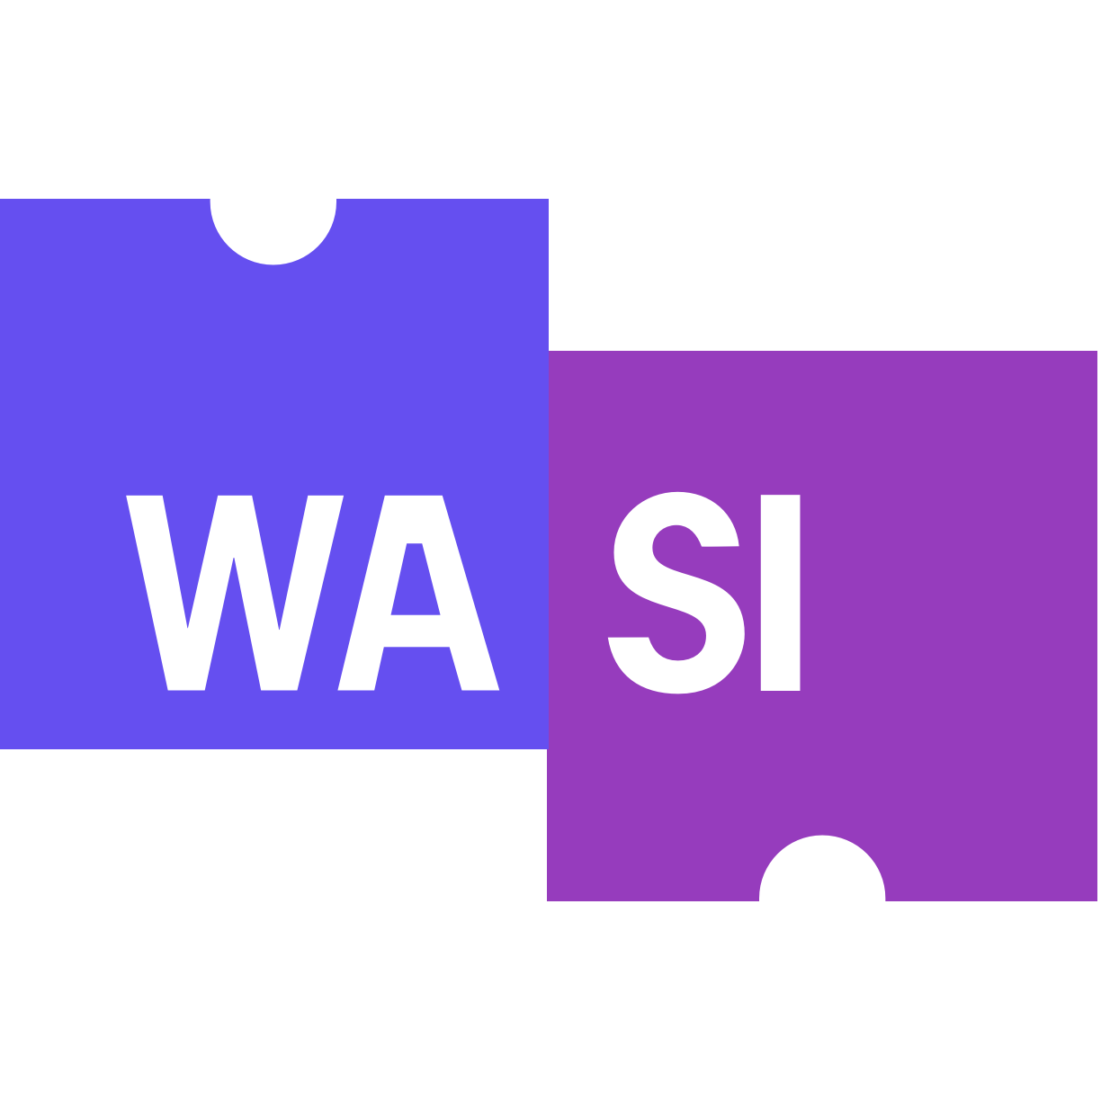
WASM & WASI
WASM originates from the browser world
not tied to browsers: use WASM-compatible runtime to run on servers
compact, low-level bytecode designed to be efficiently compiled
provides standardized host interfaces for WebAssembly outside the browser
files, networking, I/O
current version WASI preview 0.3.1
Notes:
- introduce a different compilation target other than Javascript
- compile module -> serve it from browser -> execute locally in browser
- especially useful for computationally intensive applications such as games, graphics or image processing.
- WebAssembly itself deliberately does not define how a program interacts with an operating system
- interface between WASM and host system

Slide 5
Containers vs WASM components
 | Container | WebAssembly
Execution model | Native Linux process | Guest code inside Wasm runtime
Artifact (size) | App + userspace + dependencies | WASM component only
Startup | Container/process initialization | Potentially very fast instantiation
Notes:
Isolation: With containers, isolation primarily happens around a native process. With Wasm, the application starts inside a sandboxed execution environment and only receives the capabilities the host exposes (containers: namespaces/cgroups)
Host access: Containers generally run applications that assume conventional OS functionality (filesystem, environment variables). With Wasm, the workload only gets interfaces provided by the runtime
POTENTIAL QUESTIONS MIGHT ARISE LIKE “WDYM BY THIS AND THAT?“

Slide 6





WASM ON Kubernetes
CRI (plugin)
running container
runc
containerd-shim-runc-v2
WASM component
WASM runtime (wasmtime, wasmer, wasmedge …)
WASM-specific shim
Requires installation of runtime and custom RuntimeClass

Slide 7
DEMO TIME

Slide 8
WASM replacing Containers ?
No — and it doesn't need to
Containers
General-purpose default
Mature ecosystem
Broad compatibility
WASM
Specialized workloads
Lightweight & sandboxed
Edge / Function-as-a-Service
Today
WASI pre-1.0
Tooling still evolving
One cluster. Different runtime choices for different workloads
Notes:
- For an application that's already running perfectly well as a container, there usually isn't a reason to rewrite it for Wasm
- WebAssembly gets interesting is when the workload is small, isolated, frequently instantiated, or running on constrained infrastructure
- WebAssembly doesn't need to replace containers in order to succeed
- A lot of early experiments came and went, and WASI still only at 0.3.0
- So perhaps the future isn't containers or WebAssembly. It's Kubernetes choosing the right runtime for the workload

Slide 9

Thank You! Q&A
Demo | Repository
Find me on LinkedIn @ReneSchach
WebAssembly | GitHub

