Slide 1
Pre-registered report: Space Sequence Synesthesia Diagnostic using form mapping
Rémy Lachelin
Chhavi Sachdeva
Nicolas Rothen

Slide 2
Introduction
Sequence-Space Synesthesia (SSS) or visuo-spatial forms is the phenomenon where people visualize ordered sequences in particular spatial positions. For example, numbers, weekdays or months (synesthetic inducers) are represented as arranged into specific spatial positions is space (synesthetic concurrent).
Heterogeneity and homogeneity of SSS
SSS spatial (visuo-spatial) forms are idiosyncratic, which results in considerable heterogeneity in how this phenomenon is manifested across individuals. One source of heterogeneity is given by dimensionality: some SSS experiences involve three-dimensional (3D) and two-dimensional (2D) spatial arrangement (Eagleman 2009; Price and Pearson 2013). Another source is the reference frame, for example some SSS, the spatial forms appear to occupy an external space around the body (i.e. projector) while for others the forms are experience in an internal space (i.e. associator) (Dixon, Smilek, and Merikle 2004; Smilek et al. 2007). Further variability can be explained by temporal-spatial properties, some SSS reporting they can manipulate their spatial forms such as “zooming” in and out, rotating or shifting perspectives (Gould et al. 2014). Lastly, the shape, complexity and layout of the spatial forms are also heterogeneous for example ovals, lines, loops. Although some forms are more recurrent, such as ovals for months (Eagleman 2009).
Despite the after mentioned heterogeneities, SSS has some phenomenological charachteristics. Automaticity: the inducer automatically triggers the concurrent. Unidirectionality: while the inducer triggers the concurrent, the concurrent does not trigger the inducer. Developmentally early: the experience was already present during childhood. Consciousness: The concurrent is consciously perceived. Consistency: the inducer-concurrent pair remains stable in time. These criteria can be tested both with self reported questionnaire (i.e. for development and consciousness), the other can be assessed more experimentally.
Consistency tests
Beside subjective self-report questionnaire, more objective tests have been developed to test for consistency (Baron-Cohen et al. 1993). In practice, those test are mostly used to validate self-reports for experimental needs (i.e. identifying SSS and controls).
Brang et al.(2010), evaluated consistent responses when the distance between same stimuli (i.e. January and January) was within 1.96 z-scores compared to the adjacent stimuli (i.e. February). This criteria might however be to conservatory since it detected synesthesia in 4 of 81 self-reported synesthetes.
(Seron et al. 1992)
Consistency tests rely on tasks allowing a precise report of the concurrent. For example using colour-pickers to differentiate self-reported color-grapheme, in this task an inducer is presented (i.e. the letter “A”) accompanied by a colour wheel, which the participant can manually adjust the characteristics. Using a particular distance (i.e. euclidean) in color space (i.e. CIELUV which was designed for perceptual uniformity) between the repeated responses has led to satisfactory accuracy (Rothen et al. 2013). The rationale being that synesthetes should give be consistent in responding (i.e. less variable) across time delayed repetitions. A measure of consistency between repetitions has been the total area drawn by the coordinates for certain stimuli across repetitions (Rothen et al. 2016), sometimes combined with standard deviation of responses (Ward, n.d.) or permuting the responses to compare single responses to a chance level calculated from permutationsas in Root (2021). Consistency for SSS has followed a similar design: participants have to position the potential inducer on a computer screen . A measure of consistency between the x and y coordinates is then compared. The total area between the responses of same inducer has been suggested to be used (Rothen et al. 2016). (Ward et al. 2018)
One general caveat for consistency tasks, is that synesthetic forms are idiosyncratic. In other words, the inducer-concurrent pairs might lead to form. Other problems with this type of consistency tests is that (1) it might favor one form of SSS, such as those with linear spatial forms (Ward, n.d.). (2) some participant not knowing the responses might click on the same position, leading to high consistencies (see Rothen et al. 2016). (3)
Moreover, this kind of criteria might bias the diagnosis to include synesthetes with straight lines which leads to less variability than more complex forms(Ward?).
Present study
The goal of this registered report is to compare different consistency features on their ability to classify SSS from controls using Receiver Operator Characteristics (ROC). In the present Phase I we merge already available datasets to replicate systematic consistency test methods from the literature to additional new features. These new features are designed to take advantage of two properties of synesthetic responses First, the importance of ordinality between the inducers (i.e. Monday -> Tuesday -> Wednesday, ect). Some studies have systematically investigated ordinality, but using adjacent inducers (i.e. the distances between Monday, Tuesday and Wednesday as in (Brang et al. 2010). Other have used the angle formed by adjacent inducers (Eagleman 2009).
Second, thee particular synthetic forms of the sequential spatial location. These forms might have geometrical properties. For example months of the year might be represented circularly (as already described by (Galton 1880) for numbers).
To take advantage of sequential and geometrical synesthetic forms, we harnessed a geo-spatial package(Pebesma 2018) to extract geometrical features from participant x and y coordinate responses. This packages allows for example to build string or polygons for each repetition and compare different geometrical features. Those individual geometrical features are then compared using Receiver Operator Characteristics (ROC) between individuals grouped as synesthets and control. In the present phase I,we compare ROC on three merged derivation datasets using the same task on SSS Ward (n.d.). In future phase II, we compare whether the features selected to diagnose SSS in phase I, on a validation dataset that is not yet acquired (registered report on the open science foundation: https://osf.io/9efjb/).
The rationale here is that synesthetic responses should have geometrical feature that differ from controls. For example, several SSS representations for months are circular.

Slide 3
General Methods
Phase I: present analyses. We merged three available datasets and compared available diagnostic criteria across datasets using Receiver Operator Characteristics (ROC) for different approaches. First, we attempt at reproducing the diagnostic criteria on stimulus level consistency such as area and perimeter. Second, we explore a new approach consisting of comparing geometrical features across repetitions. Third, we apply second order approaches such as permutation tests. On one hand we reproduce Root et al. (2021) permutation test that was developed for colour-grapheme synesthesia applied to SSS, as in ward (n.d.)). On the other hand we apply permutations across repetitions to obtain a permuted measure of consistency. In other words, we shuffle the presentation order and compute the geometrical feature in non chronological order. Finally we use General Linear Model’s (GLM) to attempt to fit the best diagnostic curve combining different criteria.
Phase II: future analyses. On a future dataset to be collected using the same task, we will compare the predictive power of the selected features using ROC.
Materials
A the exception of (Rothen et al. 2016) (see https://osf.io/6hq94/files/osfstorage), the data from (Ward, n.d.; Van Petersen et al. 2020a) were collected online. The 29 inducers were: the 12 months of a year, 7 days of the week and 10 numbers (i.e. hindo-arabic numerals from 0 to 9). (Van Petersen et al. 2020a) Also presented 50 and 100 numerals, which we excluded here. (Ward, n.d.) data is collected using the Syntoolkit.
Procedure
The details for the task’s administration of each dataset are described in each respective article: (Ward, n.d.) conducted the task online and (Rothen et al. 2016; Van Petersen et al. 2020a) in laboratory. Each stimuli is presented randomly and sequentially centrally on the screen. Participant are instructed to click on the screen position where they visualize them.
Stimulus included here are 7 weekdays (Monday to Sunday), 12 months (January to December) and 9 numbers (0 to 9). For Ward’s data the stimulus were presented in randomized order with the constraint that no stimulus was repeated until all unique stimuli (N = 29) had been presented once.
Importantly, while the three datasets included in phase I include three repetitions per stimuli, the phase II will use four repetition per stimuli.

Slide 4
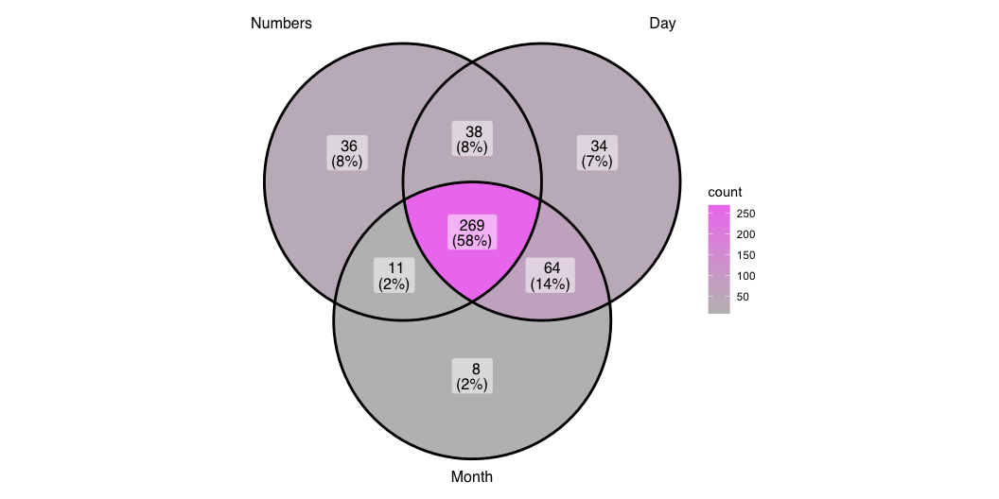
Phase I. Methods
Phase I. Merge and prepare data
We merged four datasets: Rothen et al. (2016),(Ward, n.d.) (from: https://osf.io/p5xsd/files/osfstorage) ,(Van Petersen et al. 2020b). Additional data was gently provided by private communications with Pr. Ward, see Table 2. To match the other datasets, stimuli form (Van Petersen et al. 2020b) are translated from Dutch to English and for the stimuli, only numbers from 0 to 9 are kept (excluding 50 and 100).
We kept 685 from the initial 689 participants. First, we excluded 1307 empty responses including responses with the same coordinates across conditions and repetitions, causing the depletion of 2 participants. 2 participants were excluded for having less than 4 coordinate points since this would impeach computing polygons, see Section 3.3.2. Note also that this means 0 participants did not have coordinates in all conditions, for example no coordinates for numbers. Then, x and y coordinates were then separately normalized (z-score) per participant.
Phase I. Population
From the final sample of N = 685, 396 were synesthetes and 289 controls. Table 2 breaks down the number of synesthetes and control contributed by each dataset.
Since not all the data is directly associated to demographics, we resume in Table 1 gthe original sample’s reported descriptives.
Regarding the synesthes, we can only describe their profile from the data by Pr. Ward (i.e. from 573 cases. These profiles are described only for the stimulus class that are used in the consistency test (i.e. number, weekdays and month), see Figure 1.
Figure 1: Venn diagram of the types of self-reported SSS

Slide 5
Phase I. Analysis
First, we reproduce consistency methods found in the literature using the same task ((Rothen et al. 2016; Ward, n.d.; Van Petersen et al. 2020a; Root et al. 2021)) and compare the results. These methods are on the stimulus level, hence they asses the consistency for each stimulus within the repetitions.
Second, we extract features on the form level. We harness a geography package to compute geometry based features. Informed on the ordinality of the stimulus (i.e. monday, tuesday, ect), we construct segments and polygon by conditions and repetitions. These methods are on the form or category level. The rationale here is to see whether when considering the stimuli as ordered coordinates, i.e. as segments or polygon, they are consistent between repetitions.
Since these methods are also relying on repetition order (i.e. the segment for numbers are constructed with repetition 1 - vs. 2 vs. 3, that is their chronological order of experimental presentation), we also compute the best AUC features by permuting repetitions. We predict that permuted averaged features should lead to better classifications. Because synesthete’s within stimulus consistency should lead to similar forms interdependently from the chronological order of stimulus presentation.
Finally, we also intent a corelational approach.
Stimulus level: area and perimeter between repetitions
Conceptually more consistent responses to the same stimuli should be closer. This distance can be computed as the area or the perimeter formed by the x,y coordinate between the repetitions (i.e. (x1, y1), (x2, y2), (x3, y3)). With three repetitions, the area is calculated as in using the formula Equation 1 and the perimeter Equation 2.
$$Area=\left(x1y2+x2y3+x3y1–x1y3–x2y1–x3y2\right)/2 \left(1\right)$$
$$Perimeter=\sqrt{{\left(x2−x1\right)}^{2}+{\left(y2–y1\right)}^{2}}+\sqrt{{\left(x3−x2\right)}^{2}+{\left(y3–y2\right)}^{2}}+\sqrt{{\left(x1−x3\right)}^{2}+{\left(y1–y3\right)}^{2}} \left(2\right)$$
Since the screen sizes differ, we computed the area on individually z-score transformed x,y coordinates. The area of each stimuli is then averaged for each participants.
Next we replicate (Root et al. 2021) permuted consistency method. For each individual, the x and y coordinates are randomly permuted and the areas are calculated. After 1000 permutations per individual, a z-score is calculated with the observed means compared to the permuted distribution, see Equation 3.
$$Zscore=\left[\left(Observed\right)–\left(MeanPermuted\right)\right]/\left(SDPermuted\right) \left(3\right)$$
The permuted distribution would be the theoretical individual chance level distribution and hence the z-score reflects where the observed area lies from the chance level.
Category level: additional features
Taking the stimuli as an ordered sequence we can consider them as a geometrical segments (i.e. open geometrical form) and polygons (i.e. closed geometrical form), similarly as originally described in Galton (1880). From there we can extract several geometrical properties. First, we extract the number of self-intersections of each segments. Conceptually, SSS should have less chance to produce that self-intersect than control. The number of self-intersections are added separately for each repetitions and conditions and averaged per participants.
The next geometrical features are extracted using the simple feature sf package (Pebesma 2018) to generate ordered segments and polygons based on the individually z-score transformed x and y coordinates. sf has originally been developed for geography.
We calculate the polygon’s area and perimeter of the polygons and average per participants.
Then we use the second order functions provided by the sf package to check for topological features from the polygons. These tests return a boolean. First we test each polygon for simplicity, a simple polygon being described as not having self-intersections or self-tangencies.
Then we test for topological validity, this function tests if a polygon is is well-formed and valid in 2D according to the Open Geopsatial Consotrtium rules (see https://postgis.net/docs/ST_IsValid.html and https://postgis.net/docs/using_postgis_dbmanagement.html#OGC_Validity).
Finally, we also attempted a correlational approach. Here we correlate the coordinates.
Category level: additional improvements
Until now the form based features are computed by chronologically ordered repetitions. For example, Monday is repeated three times per ID. The coordinates for Monday presented the first time will always be used to form the segment/polygon with the Tuesday presented the first time. However, for consistency, this should be independent from chronological order. To circumvent this, we can permute the repetitions per conditions. I predict the permuted averages of the same features should give rise to better AUC.
Finally, we used General Linear Model (GLM) on the two features with the best AUC and add the prediction as an additional feature. A GLM could provide a formula where multiple features could be combined in order to optimize AUC.

Slide 6
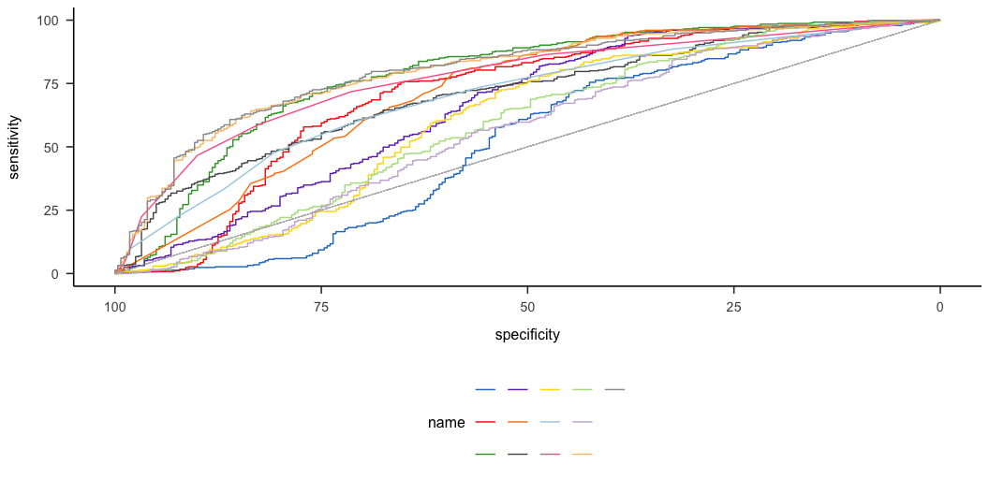
Phase I Results
Each feature in classifying SSS from controls was compared with Receiver Operator Characteristics (ROC) analyses. Area Under the Curve (AUC) is used to determine which feature is best at classifying SSS from Controls. In Addition, we also use discrimination power (Equation 4).
$$DP=\frac{sqrt\left(3\right)}{π}\left(log\left(X\right)+log\left(Y\right)\right) \left(4\right)$$
where: $X=sensitivity/\left(1−sensitivity\right)$ and $Y=specificity/\left(1−specificity\right)$
Optimal cutoff’s are calculated using Youden’s criterias.
The results from the ROC analysis for each features are summarized in Table 3,sorted by the highest AUC and Figure 2. The results suggest that best AUC with the permuted validity score (AUC = 80.09, cut-off = 0.17) and then the average normalized perimiter between the repetitions of each stimuli (AUC = 78.50, cut-off = 1.92 z-scores). Interestingly, while the permuted validity cut-off leads to higher specificity (77.50 vs. 74.29), the opposite is true for the sensitivity criteria (73.60 vs. 70.40).
Figure 2: All the ROC curves for each features

Slide 7
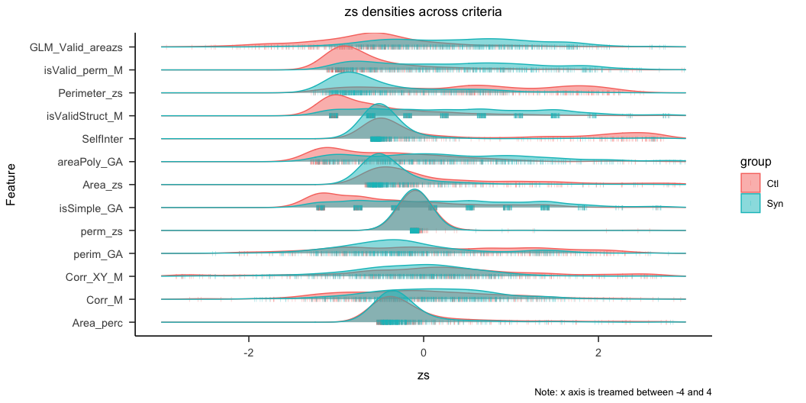
Figure 3: Density plots of all the features comparing SSS and controls

Slide 8
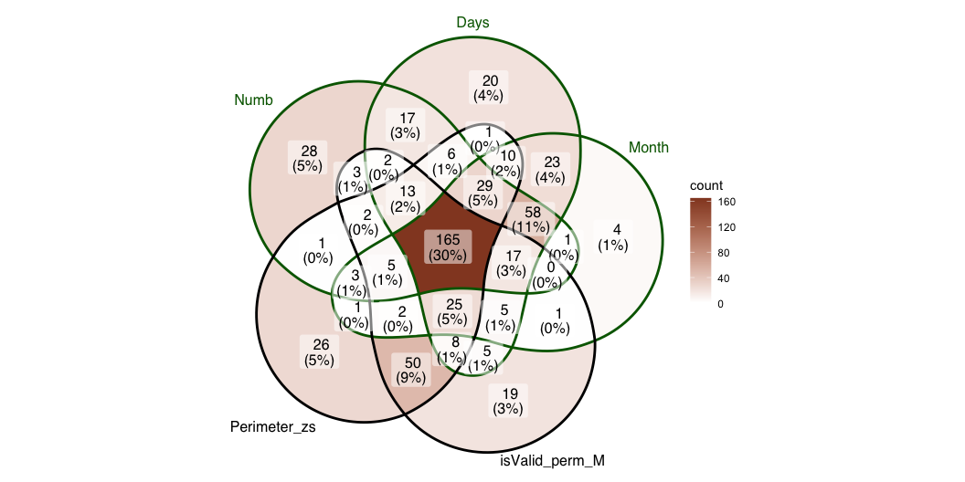
For the concern that some criteria might bias towards types of synesthesia, we compared the groups by sub-type of SSS (i.e. weekdays, months and numbers) with the classifications using the cut-offs for permuted validity and perimeter. Figure 4 shows the venn diagram including only data from Ward (since we don’t have the details from the other datasets). This suggests that 11% of the subsample in
Figure 4: Avocado Venn Diagramm of self-report and tests

Slide 9
Further analyses aimed at estimating the reliability of features when sub sampling the dataset with different slices. First Section 10.1 we recalculated the ROC by sub sampling the data from the most extreme groups. The extreme groups were defined by the percentiles on the questionnaire sores, hence only the data from Ward is included there. We computed AUC, sensitivity and sensibility for the 10-90 %, 20-80 %, 30-70 %, 40-60 % subsampled participants depending on the dsistribution of the syneshtesia questionnaire (see Ward et al. 2018). The results for AUC Figure 5, sensitivity Figure 6 and specificity Figure 7.
However we also found differences across the datasets, see Figure 9 for AUC, Figure 10 for sensitivity and Figure 11 for specificity.
To confirm that the results are not circular, we correlated questionnaire scores with the features results, see Section 10.2, Figure 8
Finally, descriptively we also wanted to see whether one of the main criteria would be more beneficial for one form of SSS or the other, see

Slide 10
Phase II Methods
Additional data using the same task will be collected in the future. The procedure will be the same as for the previously decribed task only that this time there will be four repetitions. We aim at extracting the same criteria on this new dataset and compare whether we can accurately predict the groups based on the thresholds described here.

Slide 11
Phase II Materials:
Materials are more details on the procedure are described here https://osf.io/pjb6e/?view_only=d467ebf4c1f94076ae4ac61298255065.

Slide 12
Phase II Planned population
https://osf.io/6h8dx

Slide 13
Discussion
Shifting from investigating consistency across stimulus position to across repetitions have led to some improvement in ROC. The best criteria was a GLM
From the different features we extracted, topological validity across the repetitions appeared to be the one leading to the largest Area Under the Curve.
Limitations
Although an optimal tool to discriminate SSS might be particularly relevant for experimental purposes, it is important to consider some limitations. These consistency tools are designed with a limited set of sequential stimuli (i.e. months, weeks and the first ten natural numbers). Other sequences might also be represented in particular spatial positions such as temperature, ect. Another point is that rather than categorical, synesthesia might be present on a continuum in the general population. In that case diagnostic cutoffs might not be relevant, rather a score would be necessary (Price and Pearson 2013). Finally, there might also be an issue of circularity - as with many diagnostics : how synesthesia is defined determines how synestetes are detected which are the groups on which synesthesia is defined (Simner 2012). This is particularly relevant when the two diagnostic criteria on which validity are compared are self-reports (i.e. being conscious) and consistency.
The heterogeneity of methods used to detect SSS, combined with the heterogeneity of SSS complicates the task to estimate general population prevalence of SSS (Jonas and Price 2014; Brang et al. 2010; Sagiv et al. 2006). For the present stake, the circularity issue makes it difficult since consistency diagnostic tools are designed to best classify control from synesthetes and hence depend on how those groups are initially defined. For example Section 10.3 suggests that the best AUC is given by different features depending on the different datasets.
Numerals. While weekdays and months are finite sets, numerals are infinite. It is possible that some criteria could improve wen taking a larger set of numerals into account, in particular since there many descriptively interesting form occur at different decimals (in hindo-arabic decimal number system), see examples in (Galton 1880) .
SSS with 3D representations might also be under-diagnosed since the test is in 2D. However it seems that most SSS are relatively good at transposing 3D to 2D, which might be also explain by a more general advantage in visuo-spatial memory for SSS (Brang et al. 2010).
Overlapping responses. A methodological issue concerns participants that give the same responses across conditions. These responses are a complication since we can’t infer whether those conditions did not give rise to a synesthetic response in a synthesete or whether it is from a control that was confused about the instructions. On a methodological level, those responses can critically bias the diagnostic criteria. On one side excluding those responses would imbalance the number of responses by participant, on the other side including these responses might bias the diagnostic.
Future studies could use machine learning and/or neural network in an attempt to fin the best criteria for classifying synesthetes from control. This approach however need to have a clear explanability, since the main use of a criteria is experimental. Ideally, we would need an algorithm which could give individual probability to have SSS on which a threshold would help to
See also (Root et al. 2025).
Conclusions
The feature that led to the best AUC was topological validity. If confirmed, this might lead to interesting conclusions about how SSS map ordinal stimuli in space. The parallel between maps and neuroscience has a long history (i.e. retinotopy, sonotopy or somatotopy), hence it seems that the automatic spatial associations in SSS follow to some extend some topological rules (Eagleman 2009).
The optimal criterion needs to be informed about the order between inducers (i.e. to construct the polygons) and interestingly suggests that synthetic inducer are structurally mapped following topological rules analogous to geographical space structures. Hence suggesting a spatial nature for the synthetic forms of space sequence synesthetes.
Interestingly, ordinality is very important an important semantic property of numbers (REF). Moreover that numbers are acquired sequentially (i.e. 1 is learned before 2) (REF). Hence the importance of ordinality in SSS is coherent with developmental accounts of Synesthesia (Price and Pearson 2013).

Slide 14
References
Baron-Cohen, Simon, John Harrison, Laura H Goldstein, and Maria Wyke. 1993. “Coloured Speech Perception: Is Synaesthesia What Happens When Modularity Breaks Down?” Perception 22 (4): 419–26. https://doi.org/10.1068/p220419.
Brang, David, Ursina Teuscher, V. S. Ramachandran, and Seana Coulson. 2010. “Temporal Sequences, Synesthetic Mappings, and Cultural Biases: The Geography of Time.” Consciousness and Cognition 19 (1): 311–20. https://doi.org/10.1016/j.concog.2010.01.003.
Dixon, Mike J., Daniel Smilek, and Philip M. Merikle. 2004. “Not All Synaesthetes Are Created Equal: Projector Versus Associator Synaesthetes.” Cognitive, Affective, & Behavioral Neuroscience 4 (3): 335–43. https://doi.org/10.3758/CABN.4.3.335.
Eagleman, David M. 2009. “The Objectification of Overlearned Sequences: A New View of Spatial Sequence Synesthesia.” Cortex 45 (10): 1266–77. https://doi.org/10.1016/j.cortex.2009.06.012.
Galton, Francis. 1880. “Visualised Numerals.” Nature 21 (533): 252–56. https://doi.org/10.1038/021252a0.
Gould, Cassandra, Tom Froese, Adam B. Barrett, Jamie Ward, and Anil K. Seth. 2014. “An Extended Case Study on the Phenomenology of Sequence-Space Synesthesia.” Frontiers in Human Neuroscience 8 (July). https://doi.org/10.3389/fnhum.2014.00433.
Jonas, Clare N., and Mark C. Price. 2014. “Not All Synesthetes Are Alike: Spatial Vs. Visual Dimensions of Sequence-Space Synesthesia.” Frontiers in Psychology 5 (October). https://doi.org/10.3389/fpsyg.2014.01171.
Pebesma, Edzer. 2018. “Simple Features for R: Standardized Support for Spatial Vector Data.” The R Journal 10 (1): 439–46. https://doi.org/10.32614/RJ-2018-009.
Price, Mark, and David Pearson. 2013. “Toward a Visuospatial Developmental Account of Sequence-Space Synesthesia.” Frontiers in Human Neuroscience 7 (October). https://doi.org/10.3389/fnhum.2013.00689.
Root, Nicholas, Michiko Asano, Helena Melero, Chai-Youn Kim, Anton V. Sidoroff-Dorso, Argiro Vatakis, Kazuhiko Yokosawa, Vilayanur Ramachandran, and Romke Rouw. 2021. “Do the Colors of Your Letters Depend on Your Language? Language-Dependent and Universal Influences on Grapheme-Color Synesthesia in Seven Languages.” Consciousness and Cognition 95 (October): 103192. https://doi.org/10.1016/j.concog.2021.103192.
Root, Nicholas, Ana Chkhaidze, Helena Melero, Anton Sidoroff-Dorso, Gregor Volberg, Yijia Zhang, and Romke Rouw. 2025. “How “Diagnostic” Criteria Interact to Shape Synesthetic Behavior: The Role of Self-Report and Testretest Consistency in Synesthesia Research.” Consciousness and Cognition 129 (March): 103819. https://doi.org/10.1016/j.concog.2025.103819.
Rothen, Nicolas, Kristin Jünemann, Andy D. Mealor, Vera Burckhardt, and Jamie Ward. 2016. “The Sensitivity and Specificity of a Diagnostic Test of Sequence-Space Synesthesia.” Behavior Research Methods 48 (4): 1476–81. https://doi.org/10.3758/s13428-015-0656-2.
Rothen, Nicolas, Anil K. Seth, Christoph Witzel, and Jamie Ward. 2013. “Diagnosing Synaesthesia with Online Colour Pickers: Maximising Sensitivity and Specificity.” Journal of Neuroscience Methods 215 (1): 156–60. https://doi.org/10.1016/j.jneumeth.2013.02.009.
Sagiv, N, J Simner, J Collins, B Butterworth, and J Ward. 2006. “What Is the Relationship Between Synaesthesia and Visuo-Spatial Number Forms?” Cognition 101 (1): 114–28. https://doi.org/10.1016/j.cognition.2005.09.004.
Seron, Xavier, Mauro Pesenti, Marie-Pascale Noël, Gérard Deloche, and Jacques-André Cornet. 1992. “Images of Numbers, or “When 98 Is Upper Left and 6 Sky Blue”.” Cognition, Numerical cognition, 44 (1): 159–96. https://doi.org/10.1016/0010-0277(92)90053-K.
Simner, Julia. 2012. “Defining Synaesthesia.” British Journal of Psychology 103 (1): 1–15. https://doi.org/10.1348/000712610X528305.
Smilek, Daniel, Alicia Callejas, Mike J. Dixon, and Philip M. Merikle. 2007. “Ovals of Time: Time-Space Associations in Synaesthesia.” Consciousness and Cognition 16 (2): 507–19. https://doi.org/10.1016/j.concog.2006.06.013.
Van Petersen, Eline, Mareike Altgassen, Rob Van Lier, and Tessa M. Van Leeuwen. 2020b. “Enhanced Spatial Navigation Skills in Sequence-Space Synesthetes.” Cortex 130 (September): 49–63. https://doi.org/10.1016/j.cortex.2020.04.034.
———. 2020a. “Enhanced Spatial Navigation Skills in Sequence-Space Synesthetes.” Cortex 130 (September): 49–63. https://doi.org/10.1016/j.cortex.2020.04.034.
Ward, Jamie. n.d. “Optimizing a Measure of Consistency for Sequence-Space Synaesthesia.” https://doi.org/10.31234/osf.io/5cnr7.
Ward, Jamie, Alberta Ipser, Eva Phanvanova, Paris Brown, Iris Bunte, and Julia Simner. 2018. “The Prevalence and Cognitive Profile of Sequence-Space Synaesthesia.” Consciousness and Cognition 61 (May): 79–93. https://doi.org/10.1016/j.concog.2018.03.012.

Slide 15
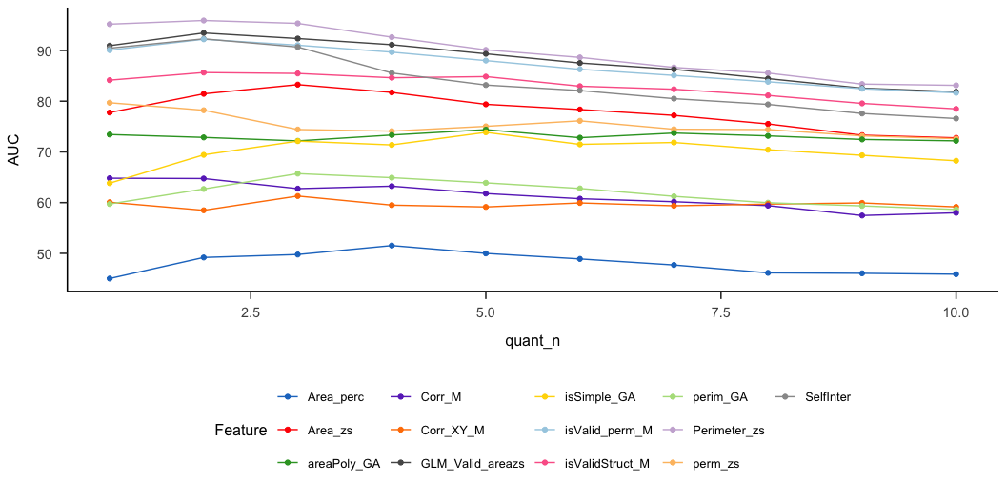
Appendix phase I
To additionally test the validity of the criteria, we computed the ROC again by subsampling the groups based on the questionnaire scores so to have more extreme groups. This was done only on the data from Ward, since the other did not include a questionnaire in the data.
Appendix 1 Subsambled data by questionnaire quantiles (10% steps)
In the following, we compare the data sampled by the questionnaire score. Based on the distribution of the questionnaire score, we sampled the 10 % with the lowest and 10 % with the highest scores. Those are then compared with the 20 and 20 % and so on until 40 and 40 %. The rationale of this procedure is that AUC, sensitivity and specificity should remain stable across percentiles for a feature to be valid, see Figure 5. In other words the ROC should remain unchanged if we take extreme groups compared to less extreme ones.
Figure 5: Lineplots of AUC by percentile

Slide 16
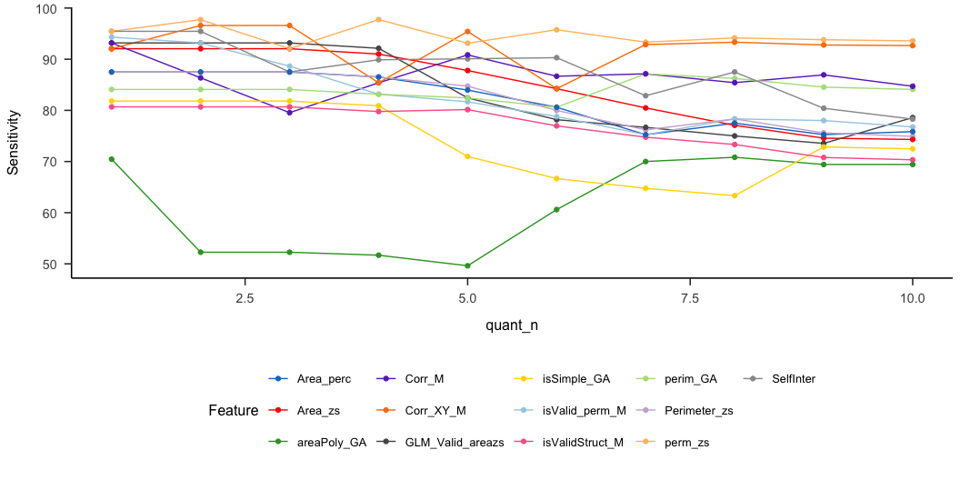
Figure 6: Lineplots of Sensitivity by percentile

Slide 17
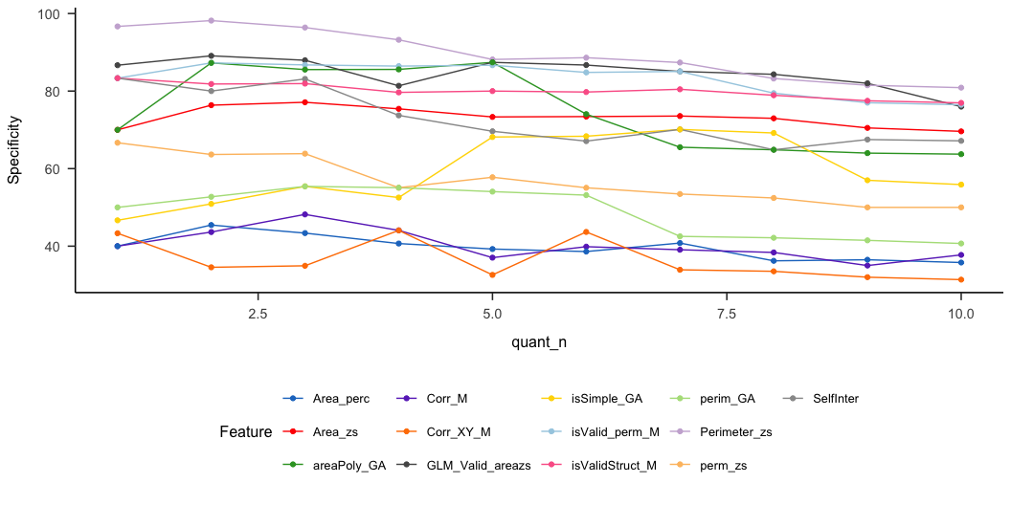
Figure 7: Lineplots of Specificity by percentile

Slide 18
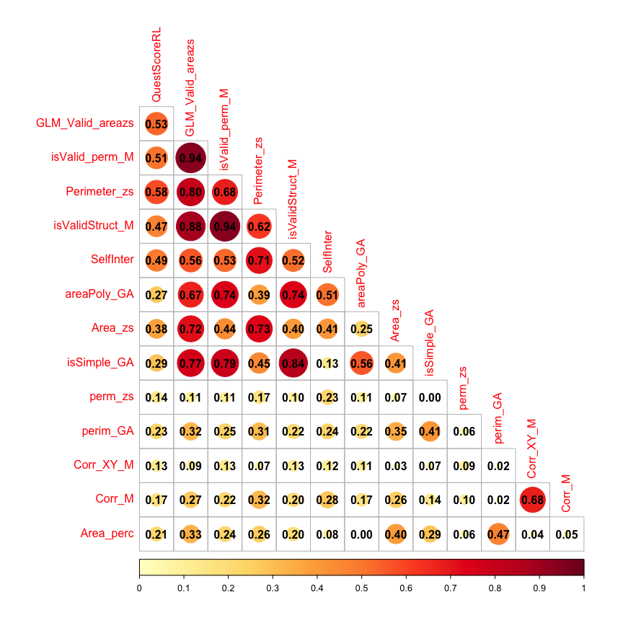
Appendix 2 Correlation with self-report
The best criterion should also best correlate with SSS self-reported questionnaire score.
Works only with Ward’s aggregated data, see Figure 6.
Figure 8: Correlation with self-reported questionnaire

Slide 19
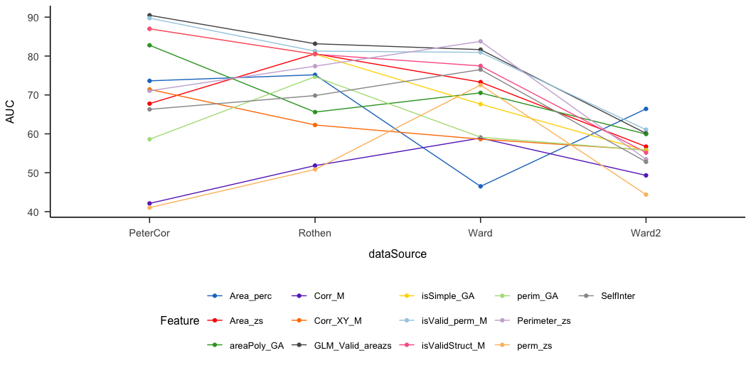
Appendix 3 By dataset
Here we compare the ROC for each specific data sample. Although the different authors have used a similar method, there might be a recruitment bias or other.
Figure 9
Figure 10
Figure 11
Figure 9: Lineplots of AUC by data source

Slide 20
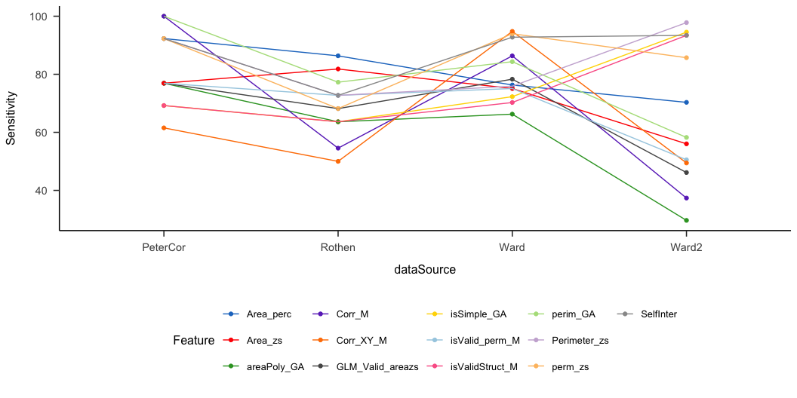
Figure 10: Lineplots of Sensitivity by data source

Slide 21
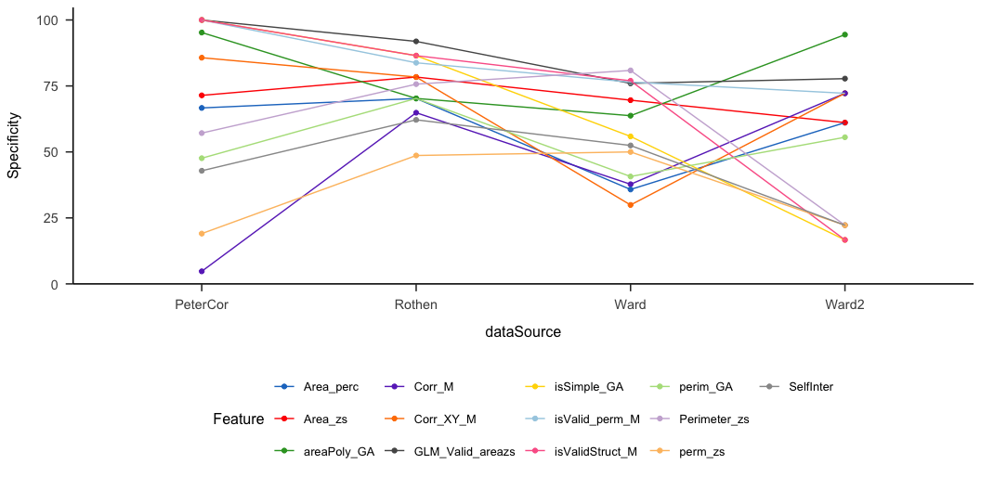
Figure 11: Lineplots of Specificity by data source

Slide 22
 | Feature | AUC | DP | threshold | sensitivity | specificity | ci_low | ci_high | power
3 | Perimeter_zs | 81.92 | 2.44 | 2.02 | 79.79 | 75.37 | 77.03 | 86.82 | 1.00
13 | GLM_Valid_areazs | 81.70 | 2.35 | -0.08 | 80.83 | 72.39 | 76.94 | 86.45 | 1.00
12 | isValid_perm_M | 80.84 | 2.21 | 0.22 | 62.69 | 85.07 | 76.01 | 85.68 | 1.00
5 | SelfInter | 77.64 | 2.11 | 1.17 | 82.90 | 64.18 | 72.24 | 83.04 | 1.00
9 | isValidStruct_M | 75.97 | 1.74 | 0.17 | 70.98 | 70.90 | 70.83 | 81.10 | 1.00
2 | Area_zs | 75.50 | 2.08 | 0.08 | 79.27 | 68.66 | 69.68 | 81.31 | 1.00
6 | areaPoly_GA | 69.41 | 1.36 | 1.68 | 49.22 | 80.60 | 63.70 | 75.13 | 1.00
8 | isSimple_GA | 69.41 | 1.55 | 0.39 | 47.67 | 84.33 | 63.70 | 75.13 | 1.00
4 | perm_zs | 68.36 | 2.40 | -3.09 | 94.82 | 38.81 | 62.18 | 74.53 | 1.00
7 | perim_GA | 63.61 | 1.31 | 9.20 | 76.68 | 53.73 | 57.14 | 70.09 | 0.99
10 | Corr_XY_M | 58.17 | 1.53 | 0.29 | 90.16 | 34.33 | 51.45 | 64.88 | 0.73
11 | Corr_M | 57.14 | 1.21 | 0.09 | 87.56 | 32.84 | 50.46 | 63.83 | 0.62
1 | Area_perc | 55.18 | 1.10 | 0.20 | 77.72 | 47.01 | 48.20 | 62.16 | 0.37
Appendix 4 Reliability

Slide 23
 | Feature | AUC | DP | threshold | sensitivity | specificity | ci_low | ci_high | power
12 | isValid_perm_M | 79.65 | 2.13 | 0.17 | 73.63 | 76.03 | 74.82 | 84.48 | 1.00
13 | GLM_Valid_areazs | 79.02 | 2.14 | 0.11 | 75.27 | 74.66 | 74.13 | 83.91 | 1.00
9 | isValidStruct_M | 78.34 | 1.87 | 0.17 | 72.53 | 71.92 | 73.47 | 83.20 | 1.00
3 | Perimeter_zs | 75.21 | 1.92 | 2.94 | 82.42 | 60.27 | 69.71 | 80.71 | 1.00
6 | areaPoly_GA | 72.53 | 1.48 | 1.32 | 67.03 | 69.18 | 67.07 | 78.00 | 1.00
8 | isSimple_GA | 70.60 | 1.25 | 0.28 | 61.54 | 69.18 | 65.05 | 76.14 | 1.00
5 | SelfInter | 66.21 | 2.25 | 4.83 | 93.96 | 39.04 | 60.14 | 72.29 | 1.00
2 | Area_zs | 66.11 | 1.42 | 0.07 | 71.43 | 63.01 | 59.88 | 72.34 | 1.00
4 | perm_zs | 63.58 | 2.23 | -3.67 | 94.51 | 36.30 | 57.32 | 69.84 | 0.99
10 | Corr_XY_M | 59.83 | 0.87 | 0.05 | 64.29 | 57.53 | 53.51 | 66.16 | 0.88
7 | perim_GA | 57.98 | 1.28 | 10.44 | 82.97 | 43.15 | 51.41 | 64.56 | 0.72
11 | Corr_M | 54.70 | 0.87 | 0.10 | 84.07 | 31.51 | 48.29 | 61.11 | 0.32
1 | Area_perc | 49.00 | 0.55 | 0.18 | 70.88 | 41.78 | 42.39 | 55.62 | 0.05

Slide 24
Appendix 5 Plot all
This exports many pdf’s. It plots each ID and condition z-score x and y coordinates. Since each coordinate is repeated 3 times, these are represented by triangles. The line paths connect average coordinates to visualize forms (stimulus are ordered, i.e. 1 to 9, monday to sunday, january to december). Finally in the top right corner, each dots indicates if the ID would pass / fails depending on the criteria.

