Slide 1
Untitled
RL

Slide 2
From: https://osf.io/p5xsd/files/osfstorage

Slide 3
0. Load and prepare data
0.1 Load data:
The permutation takes to long to allow for re-computing the code each time, so load it:
0.1.1. Ward Data
0.1.1. Rothen Data
0.1.2. Rename variables to match datasets
0.2 Merge data:
0.3 Wrangle dataset
0.4 Filter ID’s
0.4 Standardize/scale coordinates

Slide 4
1. Compute Consistency:
Calculating consistency Each stimulus is represented by three xy coordinates - (x1, y1), (x2, y2), (x3, y3) - from the three repetitions. For each stimulus, the area of the triangle bounded by the coordinates is calculated as follows:
$Area=\left(x1y2+x2y3+x3y1–x1y3–x2y1–x3y2\right)/2$
The mean area is calculated by adding together the area for each stimulus and dividing by 29. This unit is transformed into a percentage area taking into account the different pixel resolution of each participant.
Mean area = $(Summed area / 29) * 100 / Screen area $ Where: $Screenarea=Xpixels*Ypixels$
Note: 29 since 29 stimuli

Slide 5
2. Compute Permuted consistency
Replicate Rothen methods. Might take some time to compute.
Calculating chance levels of consistency To create permuted datasets for each participant: the 87 xy coordinates are randomly shuffled so they are no longer linked to the original data labels (“Monday”, “5”, “April”, etc.). The mean area of the triangles based on the shuffled coordinates is computed (as described above), and the whole process is repeated 1000 times to obtain a subject-specific distribution of chance levels of consistency. A z-score is calculated comparing the observed consistency against the mean and SD of the permuted data:
$Z=\left[\left(observedconsistency\right)–\left(meanconsistencyofpermuteddata\right)\right]/\left(SDofpermuteddata\right)$

Slide 6
3. Compute SD as in Ward
As in Ward:
“Specifically, the standard deviation of the x-coordinates and/or the standard deviation of the y-coordinates (measured across all trials) should exceed a proposed value of 0.075 for a normalized screen with width and height of 1 unit.”
“A participant who produced a horizontal straight-line form would have a very low standard deviation in the y-coordinates but a high standard deviation in x-coordinates, and a participant with a vertical line would have the reverse profile. A participant with a circular spatial form would be high on both. A participant who clicks randomly around the screen would also be high on both x and y standard deviation, but would fail the consistency tests (the triangles would be large).”
[1] 0.2030271
[1] 0.2018569

Slide 7
5. Compute line intersections
An idea I have is to look into the lines and order of the forms. I would exclude when lines crosses. (since we expect forms the lines crossing means no form is formed). Needs refinement.
I think that the number of stimuli per condition should be taken into account (i.e. 9 numbers, 7 days, 12 months). Hence would need to be divided by this number of stimulus.
In each condition the connected x and y generates a segment, hence the number of segment is length(stimuli)-1. Moreover, currently, each stimuli is connected by 3 segment, one for each (of the 3) repetition. So dividing by 3, we have the average number of segment crossings per condition. Next we sum these for each ID Ideally we should compute the number of crossings across the repetitions, in addition to make it more complex it would also be computationally more demanding, and I don’t believe it would lead to a significant difference.
To do: - Maybe the easier would be to have the average number of crossing per segment.
IMPORTANT: data frame needs to be informed of stimulus order to make sense!
4.1 Random walk
There are thee way of dealing with repetitions: - compute separately the line crossing across repetitions - compute the line crossing as if we had a very long line (i.e. 1_1 -> 2_1 -> 3_1 -> 4_1, … 7_3 -> 8_3 -> 9_3) (_x = repetition). - do a random walk across repetitions. (But I don’t know if it makes any sense practically).
4.2. Line intersections
Arbitrary threshold of 0.25.
GA_lineInter is the general average of all repetitions and conditions, of the chances that two segments within each Condition and repetition would cross. That is, for each IDXConditionXrepetition separatedly, we computed the number of segments that crosses in ordered stimuli (note the number of segment is the number of stimuli - 1), divided by the number of segments. This gives, for each IDXConditionXrepetition separately, the chances that two segments intersect. This chance is then averaged for each ID. This also means that conditions with more stimuli might have smaller averages (?). Could also compute the median.

Slide 8
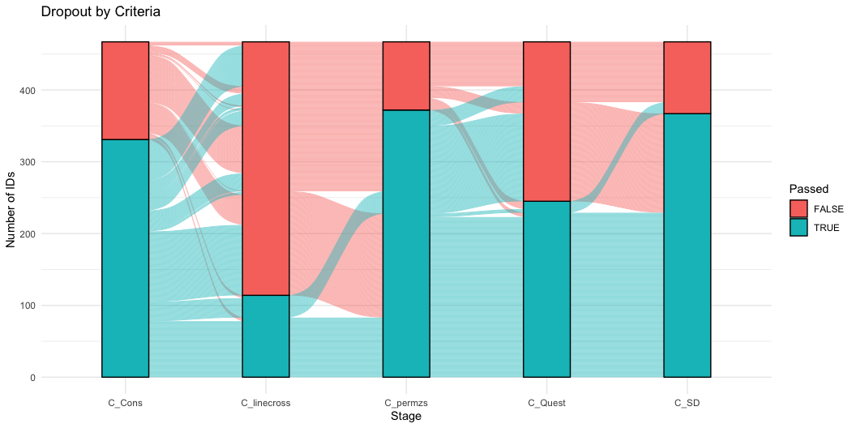
5. Questionnaire Classification based
see ´SynQuest´
[1] NA
With this criteria alone NA % would qualify as 3S
5.2. Consistency
see ´SynCons´
[1] 331
With this criteria alone 70.8779443 % would qualify as 3S
5.3. SD
With this criteria alone 93.3618844 % would qualify as 3S
5.4. Permuted z-score
see ´SynPermzs´
Note this might vary due to the randomisation process involved in the permutation. Some sd are 0, leadiong to NaN in the z score. The two additional lines are to take this into account.
With this criteria alone 94.6466809 % would qualify as 3S
5.4. Summary plot for each criteria:
[1] "1005_SeMi" "101_Elin" "1025_MaJo" "1027_ReEd" "103_PG" "10_AS"
[7] "1107_GeBe" "1178_AlCa" "1188_MiBo" "1198_LiKe" "1230_FeKe" "12_CH"
[13] "13_vz" "146_ChSa" "147_MeWi" "148_KaHe" "150_AnTa" "156_LoGr"
[19] "157_OlJe" "158_JuWa" "160_ToPa" "161_FrCo" "1_LD" "2002_PaKr"
[25] "2006_MeFu" "2008_SaMa" "2009_YaAh" "2010_SoBr" "2011_CoSc" "2012_FiDo"
[31] "2013_ChKi" "2014_DeMl" "2015_RhPo" "2016_PaPu" "2017_MaEl" "2018_KaAr"
[37] "2019_RiDa" "201_PaMi" "2020_FrHa" "2021_GiBo" "2022_ChPo" "2023_ChHu"
[43] "202_NiBl" "204_KaHo" "205_ZiLi" "209_LuSm" "210_ChWa" "214_ChKw"
[49] "214_LuBe" "215_JaWi" "217_PhKe" "219_AlMu" "28301" "28307"
[55] "28521" "28563" "28740" "28746" "28777" "28779"
[61] "28796" "28803" "29043" "29048" "29053" "29058"
[67] "29063" "29104" "29119" "29123" "29128" "29134"
[73] "29147" "29151" "29153" "29154" "29157" "29166"
[79] "29172" "29180" "29189" "29195" "29207" "29213"
[85] "29216" "29255" "29289" "29291" "29303" "29306"
[91] "29320" "29324" "29332" "29346" "29352" "29367"
[97] "29395" "29400" "29403" "29408" "29426" "29434"
[103] "29436" "29457" "29463" "29485" "29489" "29497"
[109] "29514" "29526" "29530" "29535" "29544" "29548"
[115] "29571" "29578" "29599" "29704" "29711" "29775"
[121] "29784" "29818" "29844" "29851" "29863" "29864"
[127] "29995" "30103" "30159" "30259" "30321" "30642"
[133] "30648" "30650" "30653" "30658" "30662" "30679"
[139] "30681" "30686" "30694" "30721" "30756" "30799"
[145] "30838" "30883" "30889" "30892" "30893" "30900"
[151] "30937" "30984" "31065" "31076" "31236" "31403"
[157] "31406" "31795" "31887" "33010" "33160" "33168"
[163] "33344" "33531" "34096" "34433" "34464" "34469"
[169] "34732" "34757" "35430" "35556" "35732" "36062"
[175] "36067" "36096" "36660" "36820" "36828" "36911"
[181] "36918" "37578" "38175" "38176" "38626" "38637"
[187] "38750" "38791" "38815" "38822" "38908" "39188"
[193] "39200" "39208" "39216" "39217" "39236" "39237"
[199] "39254" "39266" "39285" "39381" "39386" "39492"
[205] "39524" "3_GA" "40048" "40867" "410_ChAd" "424_ToWi"
[211] "42698" "43416" "44133" "44140" "44183" "44293"
[217] "44298" "44306" "44307" "44308" "44309" "44341"
[223] "44347" "44351" "44371" "44415" "44427" "44453"
[229] "44489" "44540" "44582" "44588" "44589" "44590"
[235] "44618" "44627" "44666" "44672" "44685" "44695"
[241] "44731" "44733" "44773" "44784" "44787" "44833"
[247] "44857" "44871" "44973" "45041" "45043" "45047"
[253] "45169" "45290" "45292" "45299" "45300" "45363"
[259] "45369" "45376" "45475" "45714" "45720" "45727"
[265] "45728" "45731" "45733" "45734" "45736" "45743"
[271] "45748" "45759" "45760" "45763" "45775" "45776"
[277] "45782" "45791" "45819" "45829" "45878" "45905"
[283] "45920" "45948" "46082" "46110" "46125" "46126"
[289] "46130" "46150" "46214" "46264" "46288" "46293"
[295] "46299" "46308" "46313" "46315" "46320" "46363"
[301] "46378" "46419" "46439" "46473" "46555" "46583"
[307] "46603" "46604" "46613" "46636" "46639" "46693"
[313] "46706" "46730" "46740" "46742" "46746" "46751"
[319] "46802" "46811" "46868" "47191" "47246" "480_BeHe"
[325] "48114" "48243" "48245" "48249" "482_MiSa" "48373"
[331] "48398" "48522" "48587" "48830" "48989" "49011"
[337] "49326" "49369" "49393" "49395" "49399" "49410"
[343] "49701" "49733" "4_JB" "50392" "52064" "52269"
[349] "52783" "52960" "53238" "53252" "53284" "532_DePa"
[355] "53343" "53347" "53351" "53357" "53381" "53417"
[361] "53432" "53461" "53494" "53535" "53725" "53727"
[367] "53730" "53732" "53751" "53759" "538_RoBr" "55397"
[373] "55459" "55515" "55774" "56173" "56211" "593_FrPo"
[379] "59738" "59741" "59742" "59749" "59750" "59752"
[385] "59774" "59778" "59780" "59785" "59791" "59798"
[391] "59803" "59808" "59813" "59820" "59830" "59831"
[397] "59854" "60241" "60242" "60246" "60314" "62624"
[403] "62777" "62784" "62793" "62797" "62807" "62811"
[409] "62812" "62816" "62848" "62868" "62874" "62882"
[415] "62886" "62899" "62934" "62943" "63028" "63127"
[421] "63156" "63158" "63170" "63233" "63309" "63482"
[427] "63695" "63742" "6_gks" "755_FrIn" "792_AnMa" "806_AmSq"
[433] "867_SaSe" "887_MaEi" "896_MaSc" "933_ClDa"
[1] "1005_SeMi" "101_Elin" "1025_MaJo" "1027_ReEd" "103_PG" "10_AS"
[7] "1107_GeBe" "1178_AlCa" "1188_MiBo" "1198_LiKe" "1230_FeKe" "12_CH"
[13] "13_vz" "146_ChSa" "147_MeWi" "148_KaHe" "149_MaRo" "150_AnTa"
[19] "156_LoGr" "157_OlJe" "158_JuWa" "160_ToPa" "161_FrCo" "1_LD"
[25] "2002_PaKr" "2006_MeFu" "2008_SaMa" "2009_YaAh" "2010_SoBr" "2011_CoSc"
[31] "2012_FiDo" "2013_ChKi" "2014_DeMl" "2015_RhPo" "2016_PaPu" "2017_MaEl"
[37] "2018_KaAr" "2019_RiDa" "201_PaMi" "2020_FrHa" "2021_GiBo" "2022_ChPo"
[43] "2023_ChHu" "202_NiBl" "204_KaHo" "205_ZiLi" "209_LuSm" "210_ChWa"
[49] "214_ChKw" "214_LuBe" "215_JaWi" "217_PhKe" "219_AlMu" "28301"
[55] "28307" "28521" "28563" "28740" "28746" "28777"
[61] "28779" "28796" "28803" "29043" "29048" "29053"
[67] "29058" "29063" "29104" "29119" "29123" "29128"
[73] "29134" "29147" "29151" "29153" "29154" "29157"
[79] "29166" "29172" "29180" "29189" "29195" "29207"
[85] "29213" "29216" "29255" "29289" "29291" "29303"
[91] "29306" "29320" "29324" "29332" "29346" "29352"
[97] "29367" "29395" "29400" "29403" "29408" "29426"
[103] "29434" "29436" "29457" "29463" "29485" "29489"
[109] "29497" "29514" "29526" "29530" "29535" "29544"
[115] "29548" "29571" "29578" "29599" "29696" "29704"
[121] "29711" "29775" "29784" "29818" "29844" "29851"
[127] "29863" "29864" "29995" "30103" "30159" "30259"
[133] "30321" "30642" "30648" "30650" "30653" "30658"
[139] "30662" "30679" "30681" "30686" "30694" "30721"
[145] "30725" "30756" "30799" "30838" "30883" "30889"
[151] "30892" "30893" "30900" "30937" "30984" "31065"
[157] "31076" "31236" "31403" "31406" "31561" "31795"
[163] "32074" "32633" "33010" "33160" "33344" "33531"
[169] "34096" "34433" "34464" "34469" "34732" "35430"
[175] "35554" "35992" "36062" "36067" "36196" "36828"
[181] "37055" "37578" "37652" "38175" "38176" "38444"
[187] "38637" "38750" "38813" "38815" "38908" "39188"
[193] "39200" "39208" "39216" "39217" "39236" "39237"
[199] "39254" "39266" "39285" "39381" "39386" "39492"
[205] "39524" "3_GA" "40048" "40867" "410_ChAd" "424_ToWi"
[211] "42698" "43416" "44133" "44140" "44183" "44293"
[217] "44296" "44298" "44306" "44307" "44308" "44309"
[223] "44340" "44341" "44347" "44351" "44371" "44427"
[229] "44489" "44540" "44582" "44588" "44589" "44590"
[235] "44618" "44627" "44666" "44672" "44685" "44695"
[241] "44731" "44733" "44773" "44784" "44787" "44833"
[247] "44857" "44871" "44956" "44973" "45041" "45043"
[253] "45047" "45169" "45280" "45290" "45292" "45299"
[259] "45300" "45369" "45376" "45475" "45714" "45720"
[265] "45727" "45728" "45731" "45733" "45734" "45736"
[271] "45743" "45748" "45759" "45760" "45763" "45775"
[277] "45776" "45782" "45791" "45819" "45829" "45878"
[283] "45905" "45920" "45948" "46110" "46125" "46126"
[289] "46150" "46214" "46264" "46288" "46293" "46297"
[295] "46299" "46308" "46313" "46315" "46320" "46358"
[301] "46378" "46419" "46439" "46473" "46480" "46555"
[307] "46583" "46603" "46604" "46613" "46636" "46639"
[313] "46693" "46706" "46730" "46740" "46742" "46746"
[319] "46751" "46802" "46811" "46868" "47191" "47246"
[325] "480_BeHe" "48114" "48243" "48245" "48249" "482_MiSa"
[331] "48373" "48398" "48522" "48587" "48830" "48989"
[337] "49011" "49369" "49393" "49395" "49399" "49410"
[343] "49547" "49701" "49733" "4_JB" "50392" "52064"
[349] "52269" "52783" "52960" "53238" "53284" "532_DePa"
[355] "53343" "53347" "53351" "53357" "53381" "53417"
[361] "53432" "53461" "53494" "53535" "53725" "53727"
[367] "53730" "53732" "53751" "53759" "538_RoBr" "55397"
[373] "55459" "55515" "55774" "56173" "593_FrPo" "59738"
[379] "59741" "59742" "59749" "59750" "59752" "59774"
[385] "59778" "59780" "59785" "59791" "59798" "59803"
[391] "59808" "59813" "59820" "59830" "59831" "59854"
[397] "60241" "60242" "60246" "60314" "62624" "62777"
[403] "62784" "62793" "62797" "62807" "62811" "62812"
[409] "62816" "62848" "62868" "62874" "62882" "62886"
[415] "62899" "62934" "62943" "63028" "63127" "63156"
[421] "63158" "63170" "63233" "63309" "63482" "63695"
[427] "63742" "6_gks" "755_FrIn" "792_AnMa" "806_AmSq" "867_SaSe"
[433] "887_MaEi" "896_MaSc" "933_ClDa" "34405" "36795" "37643"
[439] "37928" "38181" "39032" "44141"

Slide 9
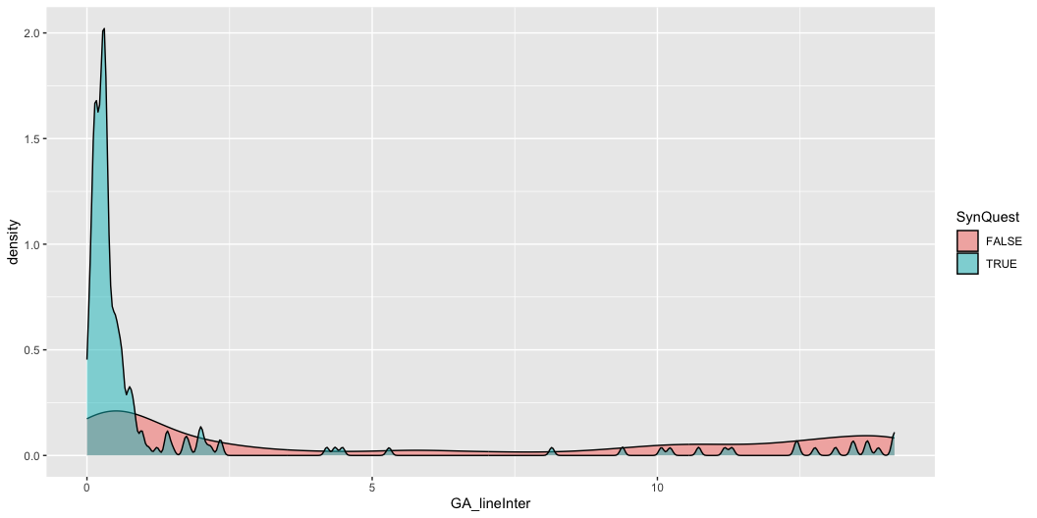
5.5 Plot desities
This plot exites me the most, indicates that those who self report synesthesia seem to have less line crossings than non synesthetes. Also indicates that most do not have line crossings.

Slide 10
# A tibble: 2 × 3
SynQuest `median(Consistency)` `sd(Consistency)`
<lgl> <dbl> <dbl>
1 FALSE 0.0966 0.755
2 TRUE 0.102 0.338
# A tibble: 2 × 3
SynQuest `median(GA_lineInter)` `sd(GA_lineInter)`
<lgl> <dbl> <dbl>
1 FALSE 3.02 5.53
2 TRUE 0.320 3.25

Slide 11
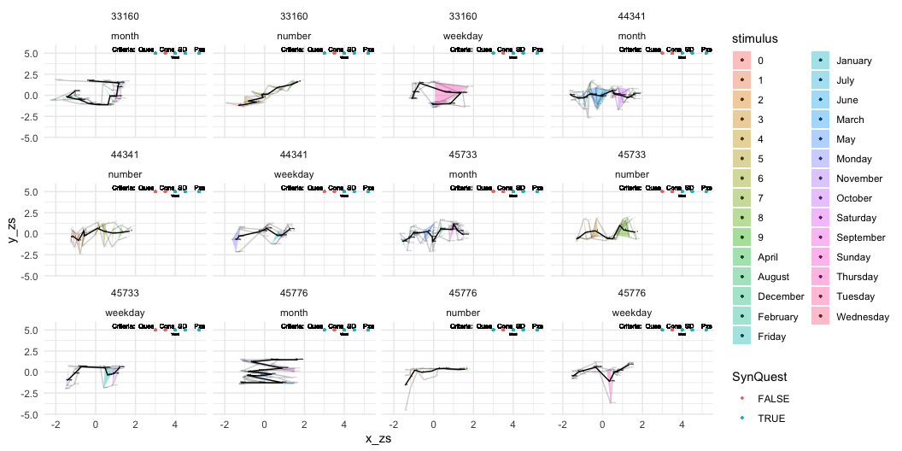
6.Figure Mega plot
This exports many pdf’s. It plots each ID and condition z-score x and y coordinates. Since each coordinate is repeated 3 times, these are represented by triangles. The line paths connect average coordinates to visualize forms (stimulus are ordered, i.e. 1 to 9, monday to sunday, january to december). Finally in the top right corner, each dots indicates if the ID would pass / fails depending on the criteria:
Questionnaire SynQuest
Consistency SynCons
SD SynSD
Permuted z-score SynPermzs
6.1. ID issues:
Maybe could automatize by pulling the inconsistent but with few line crossings.
6.1.1 Inconsitent ID’s that pass line criteria:

Slide 12
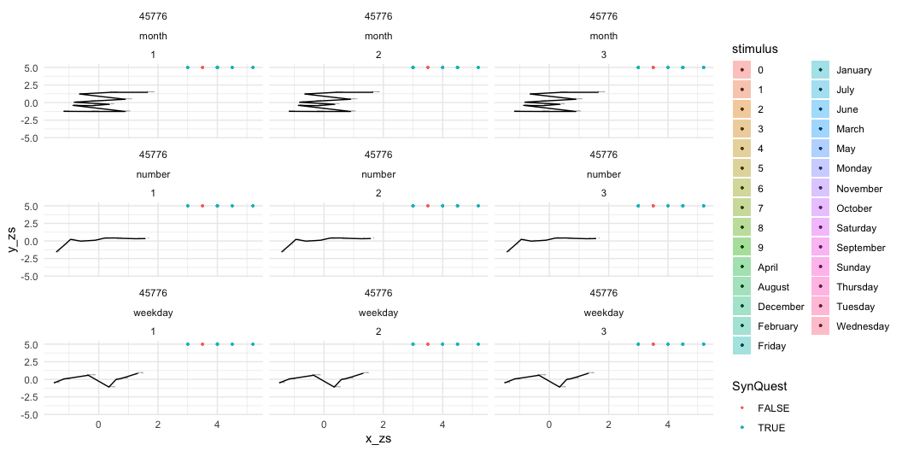
# A tibble: 9 × 5
# Groups: Cond, repetition [9]
Cond repetition triangle_area nLineCross GA_lineInter
<chr> <int> <dbl> <dbl> <dbl>
1 month 1 20 0 0.246
2 month 2 20 0 0.246
3 month 3 20 0 0.246
4 weekday 1 1472. 0 0.246
5 weekday 2 1472. 2 0.246
6 weekday 3 1472. 0 0.246
7 number 1 1385 0 0.246
8 number 2 1385 0 0.246
9 number 3 1385 1 0.246

Slide 13
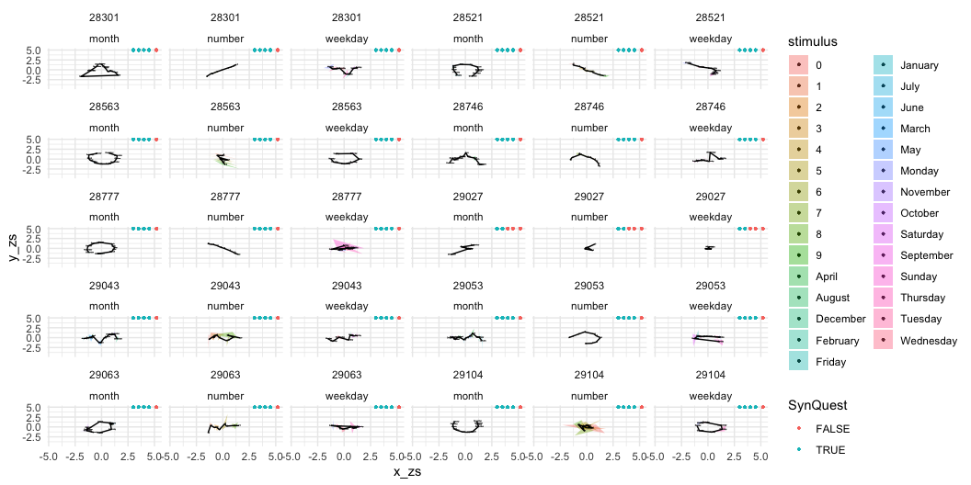
# A tibble: 1 × 3
# Groups: ID [1]
ID Consistency GA_lineInter
<chr> <dbl> <dbl>
1 45776 0.367 0.176
# A tibble: 3 × 3
# Groups: Cond [3]
Cond triangle_area nLineCross
<chr> <dbl> <dbl>
1 month 765 1
2 weekday 0.5 0
3 number 767 0
# A tibble: 3 × 4
Cond Mx My nStim
<chr> <dbl> <dbl> <int>
1 month 1.23e-17 -4.93e-17 36
2 number 1.48e-16 8.33e-17 30
3 weekday 6.34e-17 2.22e-15 21
# A tibble: 3 × 6
Cond Mx My SDx SDy nStim
<chr> <dbl> <dbl> <dbl> <dbl> <int>
1 month 830. 512. 612. 335. 36
2 number 830. 487. 575. 102. 30
3 weekday 1019. 520. 652. 19.2 21
# A tibble: 29 × 7
# Groups: Cond [3]
Cond stimulus Mx My SDx SDy nStim
<chr> <chr> <dbl> <dbl> <dbl> <dbl> <int>
1 month April 300. 379 232. 126. 3
2 month August 662 579. 466. 34.0 3
3 month December 1844. 1001. 10.7 9.02 3
4 month February 698. 87 311. 20.1 3
5 month January 104. 94 79.1 102. 3
6 month July 325. 529. 314. 22.7 3
7 month June 1052. 431. 584. 124. 3
8 month March 1377 88.3 590. 37.1 3
9 month May 700. 364 391. 59.0 3
10 month November 1084. 1000. 157. 20.2 3
# ℹ 19 more rows
# A tibble: 3 × 3
Cond Mwidth Mheight
<chr> <dbl> <dbl>
1 month 1920 1057
2 number 1920 1057
3 weekday 1920 1057
# A tibble: 87 × 38
# Groups: ID, stimulus [29]
stimulus x y width height group ID dataSource trial_index trial_id
<chr> <dbl> <dbl> <dbl> <dbl> <chr> <chr> <chr> <dbl> <dbl>
1 January 56 38 1920 1057 Syn 45776 Ward 76 1426066
2 January 60 32 1920 1057 Syn 45776 Ward 48 1426038
3 January 195 212 1920 1057 Syn 45776 Ward 20 1425987
4 February 353 110 1920 1057 Syn 45776 Ward 4 1425960
5 February 783 73 1920 1057 Syn 45776 Ward 43 1426032
6 February 957 78 1920 1057 Syn 45776 Ward 71 1426061
7 March 696 124 1920 1057 Syn 45776 Ward 5 1425961
8 March 1710 50 1920 1057 Syn 45776 Ward 69 1426059
9 March 1725 91 1920 1057 Syn 45776 Ward 30 1426006
10 April 151 292 1920 1057 Syn 45776 Ward 34 1426014
# ℹ 77 more rows
# ℹ 28 more variables: session_id <dbl>, rt <dbl>, Cond <chr>, Nrep <int>,
# repetition <int>, X_mean <dbl>, Y_mean <dbl>, x_zs <dbl[,1]>,
# y_zs <dbl[,1]>, X_mean_zs <dbl>, Y_mean_zs <dbl>, triangle_area <dbl>,
# Screen_area <dbl>, Consistency <dbl>, xSc <dbl>, ySc <dbl>, SD_IDx <dbl>,
# SD_IDy <dbl>, nSegments <dbl>, nLineCross <dbl>, meanLineCross <dbl>,
# GA_lineInter <dbl>, mean_lineInter <dbl>, SynLine <lgl>, SynQuest <lgl>, …
6.1.1 Not pass SD ID’s that pass line criteria:

Slide 14
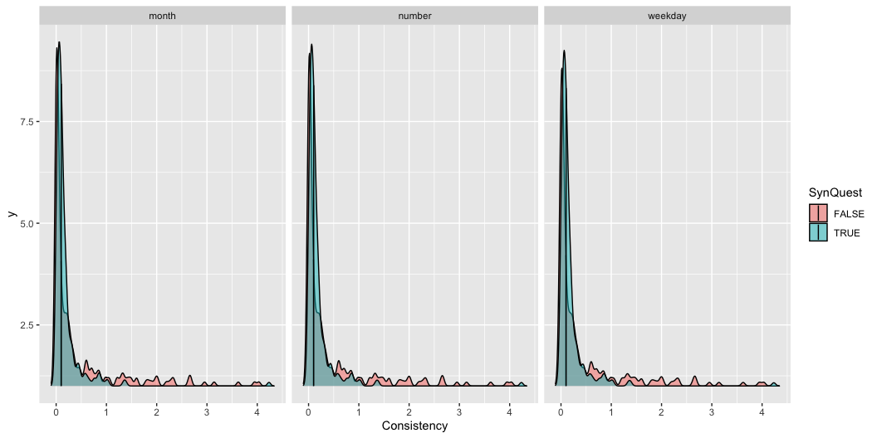
7. Fig Distributions

Slide 15
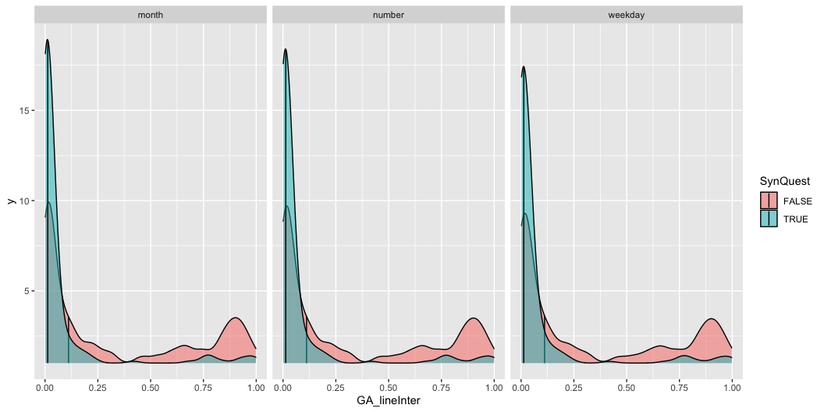

Slide 16
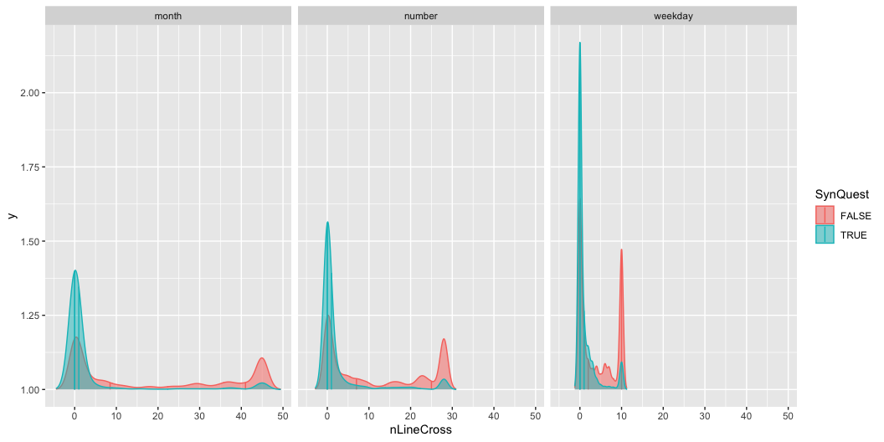
Laboratory or Sandkiste

Slide 17
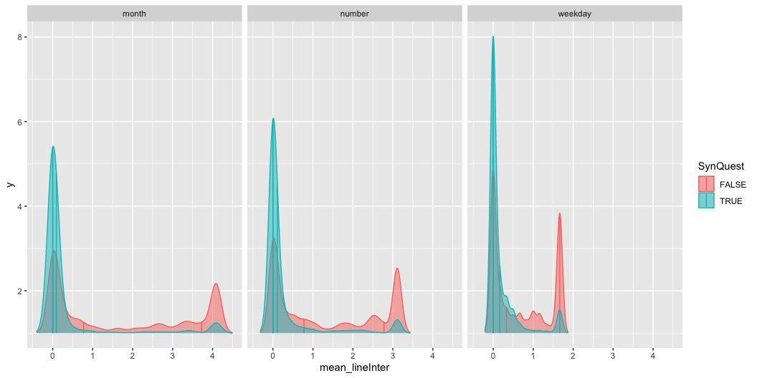

Slide 18
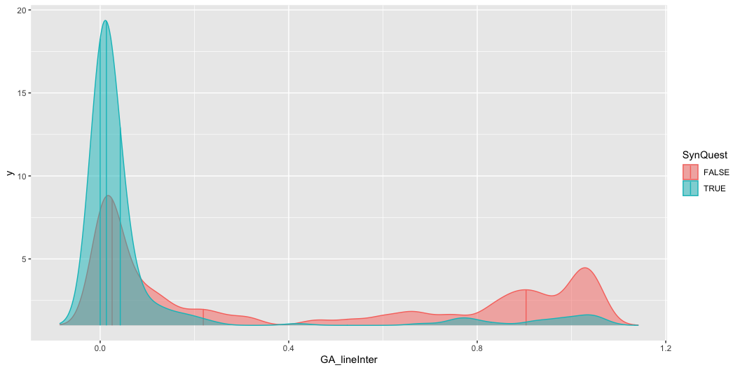

Slide 19
7. Cohen’s k,consistency, Specificity and Accuracy
Cohen's Kappa for 2 Raters (Weights: unweighted)
Subjects = 467
Raters = 2
Kappa = -0.0979
z = -2.12
p-value = 0.0342
Cohen's Kappa for 2 Raters (Weights: unweighted)
Subjects = 467
Raters = 2
Kappa = 0.187
z = 4.35
p-value = 1.34e-05
Light's Kappa for m Raters
Subjects = 467
Raters = 4
Kappa = 0.244
z = 1.06
p-value = 0.288
Fleiss' Kappa for m Raters
Subjects = 467
Raters = 4
Kappa = 0.233
z = 12.3
p-value = 0
Fleiss' Kappa for m Raters (exact value)
Subjects = 467
Raters = 4
Kappa = 0.245
7.1. Consistency
Accuracy: 0.60
Sensitivity: 0.59
Agreement: 0.60
7.2. Line Intersection:
Accuracy: 0.71
Sensitivity: 0.66
Agreement: 0.71
7.2.3. Tried to do it with different questionnaires cutoffs

Slide 20
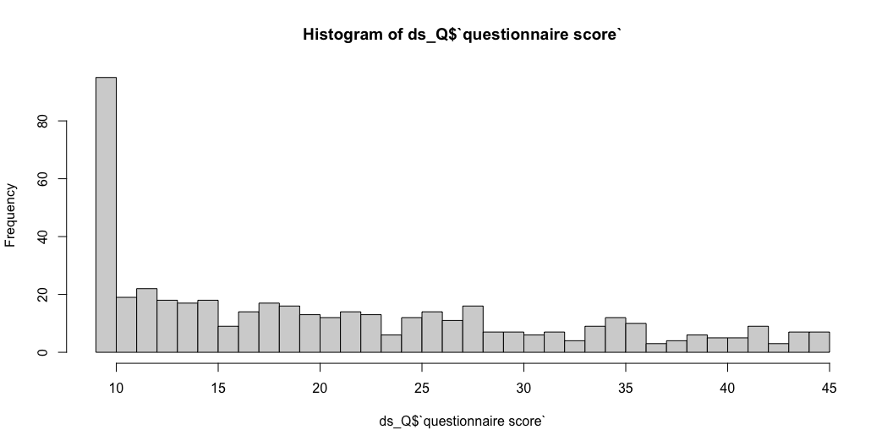
Consistency

Slide 21
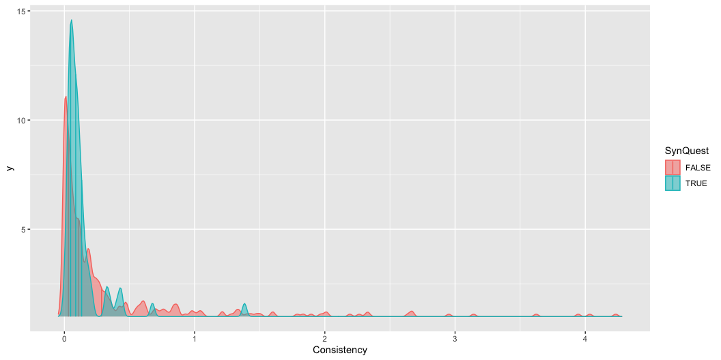

Slide 22
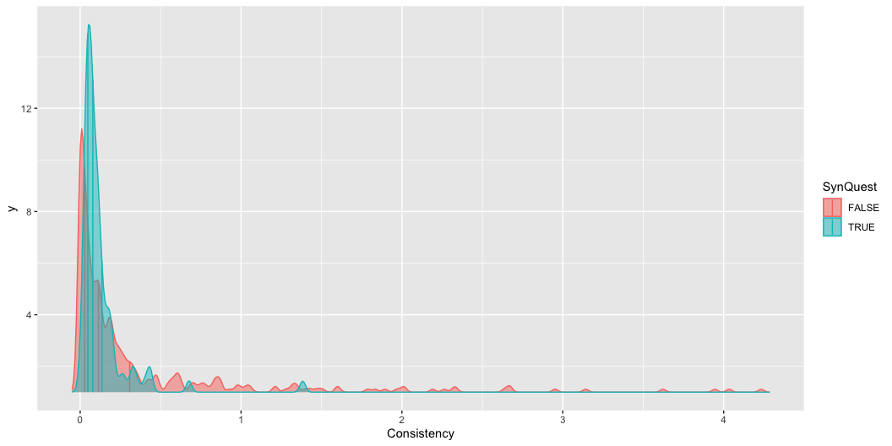
Questionnaire score: 9.00
n ID pass Quest: 142.000000
Accuracy: 0.55
Sensitivity: 0.68
Agreement: 0.55
|SynQuest | Med_Cons| SD_Cons|
|:--------|--------:|-------:|
|FALSE | 0.1086| 0.6301|
|TRUE | 0.0868| 0.1877|
|SynQuest | Med_Line| SD_Line|
|:--------|--------:|-------:|
|FALSE | 0.0469| 0.3997|
|TRUE | 0.0043| 0.0818|

Slide 23
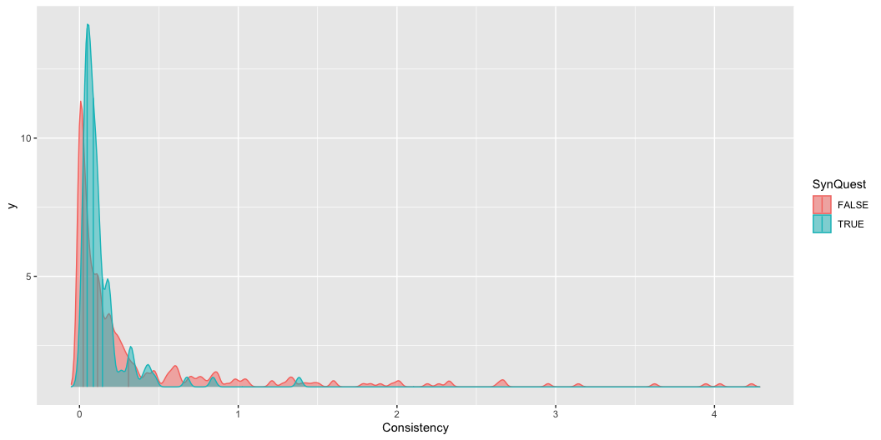
Questionnaire score: 10.00
n ID pass Quest: 165.000000
Accuracy: 0.55
Sensitivity: 0.68
Agreement: 0.55
|SynQuest | Med_Cons| SD_Cons|
|:--------|--------:|-------:|
|FALSE | 0.1135| 0.6463|
|TRUE | 0.0786| 0.1677|
|SynQuest | Med_Line| SD_Line|
|:--------|--------:|-------:|
|FALSE | 0.0592| 0.4050|
|TRUE | 0.0043| 0.0718|

Slide 24
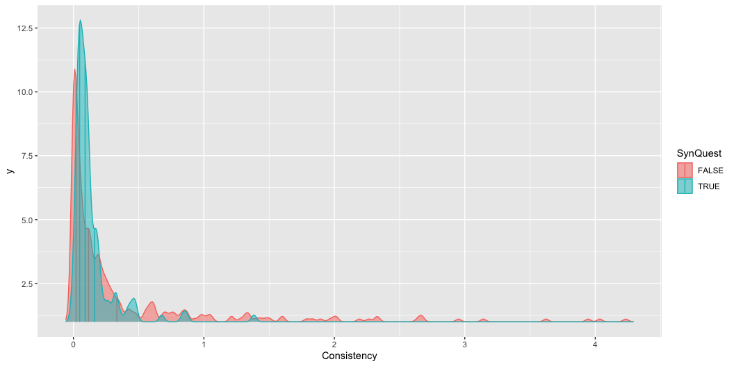
Questionnaire score: 11.00
n ID pass Quest: 184.000000
Accuracy: 0.55
Sensitivity: 0.68
Agreement: 0.55
|SynQuest | Med_Cons| SD_Cons|
|:--------|--------:|-------:|
|FALSE | 0.1138| 0.6606|
|TRUE | 0.0868| 0.1736|
|SynQuest | Med_Line| SD_Line|
|:--------|--------:|-------:|
|FALSE | 0.0683| 0.4092|
|TRUE | 0.0044| 0.0986|

Slide 25
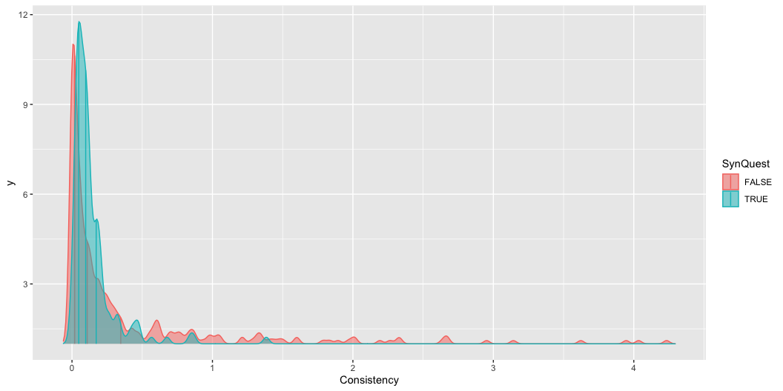
Questionnaire score: 12.00
n ID pass Quest: 206.000000
Accuracy: 0.55
Sensitivity: 0.68
Agreement: 0.55
|SynQuest | Med_Cons| SD_Cons|
|:--------|--------:|-------:|
|FALSE | 0.1157| 0.6783|
|TRUE | 0.0892| 0.1783|
|SynQuest | Med_Line| SD_Line|
|:--------|--------:|-------:|
|FALSE | 0.0759| 0.4122|
|TRUE | 0.0086| 0.1701|

Slide 26
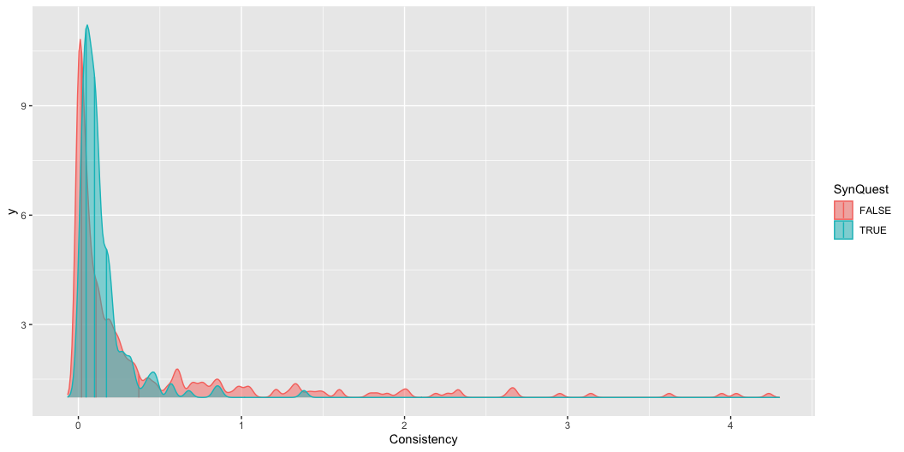
Questionnaire score: 13.00
n ID pass Quest: 224.000000
Accuracy: 0.55
Sensitivity: 0.68
Agreement: 0.55
|SynQuest | Med_Cons| SD_Cons|
|:--------|--------:|-------:|
|FALSE | 0.1086| 0.6952|
|TRUE | 0.0976| 0.1725|
|SynQuest | Med_Line| SD_Line|
|:--------|--------:|-------:|
|FALSE | 0.0939| 0.4154|
|TRUE | 0.0086| 0.1761|

Slide 27

Questionnaire score: 14.00
n ID pass Quest: 241.000000
Accuracy: 0.55
Sensitivity: 0.68
Agreement: 0.55
|SynQuest | Med_Cons| SD_Cons|
|:--------|--------:|-------:|
|FALSE | 0.1083| 0.7115|
|TRUE | 0.0990| 0.1699|
|SynQuest | Med_Line| SD_Line|
|:--------|--------:|-------:|
|FALSE | 0.1133| 0.4179|
|TRUE | 0.0086| 0.1822|

Slide 28
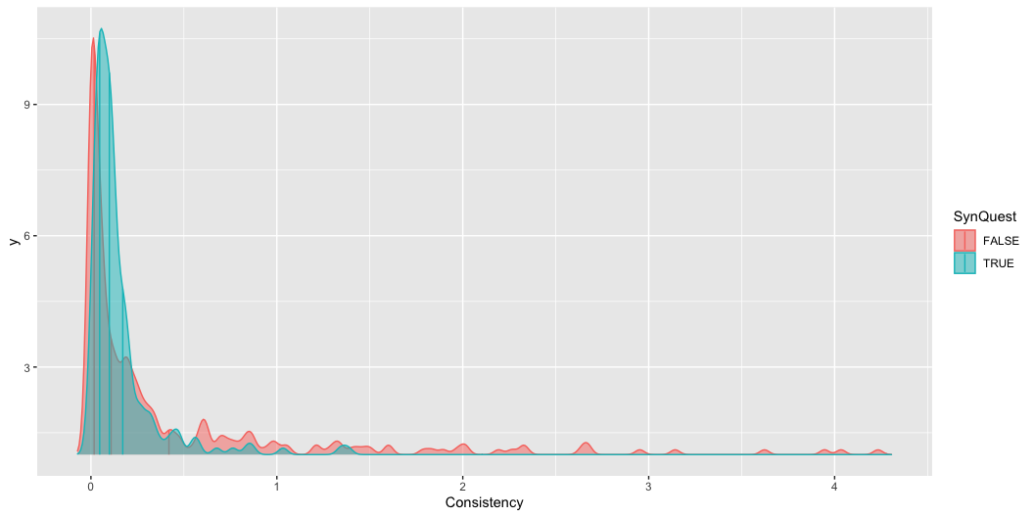
Questionnaire score: 15.00
n ID pass Quest: 259.000000
Accuracy: 0.55
Sensitivity: 0.68
Agreement: 0.55
|SynQuest | Med_Cons| SD_Cons|
|:--------|--------:|-------:|
|FALSE | 0.1072| 0.7271|
|TRUE | 0.0991| 0.2036|
|SynQuest | Med_Line| SD_Line|
|:--------|--------:|-------:|
|FALSE | 0.1282| 0.4212|
|TRUE | 0.0089| 0.1931|

Slide 29
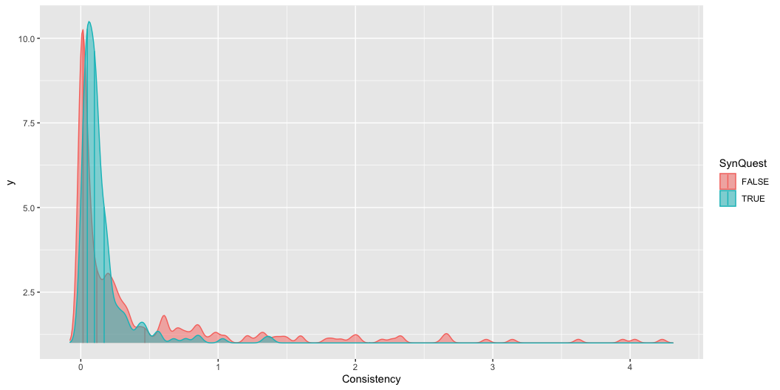
Questionnaire score: 16.00
n ID pass Quest: 268.000000
Accuracy: 0.55
Sensitivity: 0.68
Agreement: 0.55
|SynQuest | Med_Cons| SD_Cons|
|:--------|--------:|-------:|
|FALSE | 0.1086| 0.7368|
|TRUE | 0.0991| 0.1998|
|SynQuest | Med_Line| SD_Line|
|:--------|--------:|-------:|
|FALSE | 0.1356| 0.4224|
|TRUE | 0.0089| 0.2002|

Slide 30

Questionnaire score: 17.00
n ID pass Quest: 282.000000
Accuracy: 0.55
Sensitivity: 0.68
Agreement: 0.55
|SynQuest | Med_Cons| SD_Cons|
|:--------|--------:|-------:|
|FALSE | 0.1169| 0.7530|
|TRUE | 0.0992| 0.1951|
|SynQuest | Med_Line| SD_Line|
|:--------|--------:|-------:|
|FALSE | 0.1526| 0.4234|
|TRUE | 0.0126| 0.2159|

Slide 31
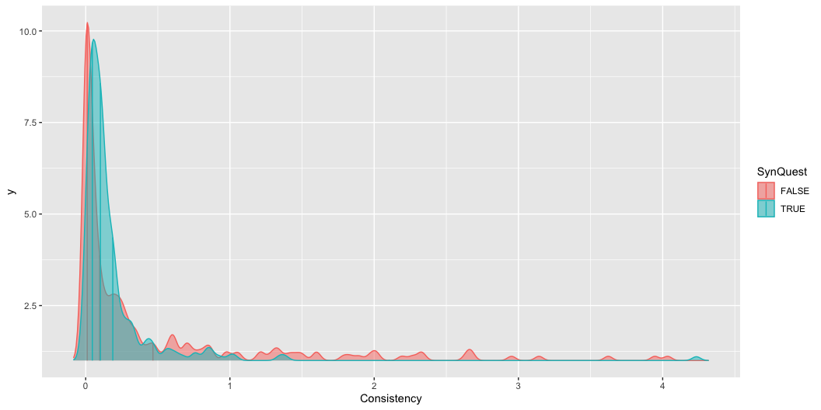
Questionnaire score: 18.00
n ID pass Quest: 299.000000
Accuracy: 0.55
Sensitivity: 0.68
Agreement: 0.55
|SynQuest | Med_Cons| SD_Cons|
|:--------|--------:|-------:|
|FALSE | 0.1068| 0.7731|
|TRUE | 0.1003| 0.2115|
|SynQuest | Med_Line| SD_Line|
|:--------|--------:|-------:|
|FALSE | 0.1847| 0.4227|
|TRUE | 0.0128| 0.2385|

Slide 32
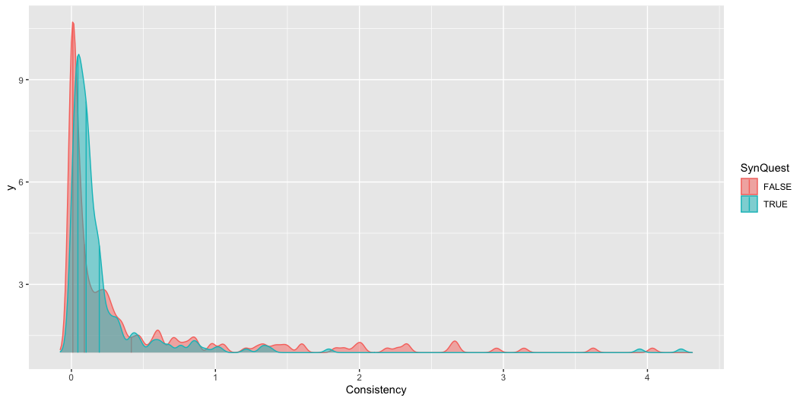
Questionnaire score: 19.00
n ID pass Quest: 315.000000
Accuracy: 0.55
Sensitivity: 0.68
Agreement: 0.55
|SynQuest | Med_Cons| SD_Cons|
|:--------|--------:|-------:|
|FALSE | 0.0966| 0.7547|
|TRUE | 0.1020| 0.3378|
|SynQuest | Med_Line| SD_Line|
|:--------|--------:|-------:|
|FALSE | 0.2188| 0.4248|
|TRUE | 0.0132| 0.2445|

Slide 33

Questionnaire score: 20.00
n ID pass Quest: 328.000000
Accuracy: 0.55
Sensitivity: 0.68
Agreement: 0.55
|SynQuest | Med_Cons| SD_Cons|
|:--------|--------:|-------:|
|FALSE | 0.0894| 0.7245|
|TRUE | 0.1022| 0.4285|
|SynQuest | Med_Line| SD_Line|
|:--------|--------:|-------:|
|FALSE | 0.2533| 0.4262|
|TRUE | 0.0134| 0.2506|

Slide 34

Questionnaire score: 21.00
n ID pass Quest: 340.000000
Accuracy: 0.55
Sensitivity: 0.68
Agreement: 0.55
|SynQuest | Med_Cons| SD_Cons|
|:--------|--------:|-------:|
|FALSE | 0.0832| 0.7423|
|TRUE | 0.1038| 0.4241|
|SynQuest | Med_Line| SD_Line|
|:--------|--------:|-------:|
|FALSE | 0.3218| 0.4268|
|TRUE | 0.0169| 0.2499|

Slide 35
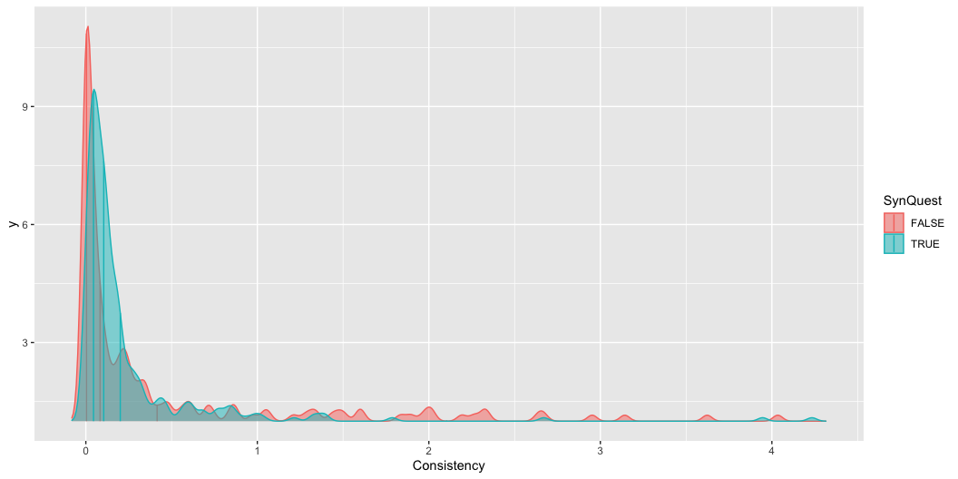
Questionnaire score: 22.00
n ID pass Quest: 354.000000
Accuracy: 0.55
Sensitivity: 0.68
Agreement: 0.55
|SynQuest | Med_Cons| SD_Cons|
|:--------|--------:|-------:|
|FALSE | 0.0859| 0.7467|
|TRUE | 0.1030| 0.4413|
|SynQuest | Med_Line| SD_Line|
|:--------|--------:|-------:|
|FALSE | 0.459| 0.4262|
|TRUE | 0.017| 0.2639|

Slide 36

Questionnaire score: 23.00
n ID pass Quest: 367.000000
Accuracy: 0.55
Sensitivity: 0.68
Agreement: 0.55
|SynQuest | Med_Cons| SD_Cons|
|:--------|--------:|-------:|
|FALSE | 0.0830| 0.7659|
|TRUE | 0.1044| 0.4402|
|SynQuest | Med_Line| SD_Line|
|:--------|--------:|-------:|
|FALSE | 0.5396| 0.4261|
|TRUE | 0.0170| 0.2687|

Slide 37
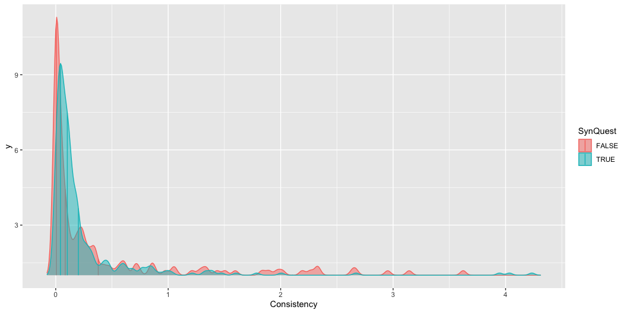
Questionnaire score: 24.00
n ID pass Quest: 373.000000
Accuracy: 0.55
Sensitivity: 0.68
Agreement: 0.55
|SynQuest | Med_Cons| SD_Cons|
|:--------|--------:|-------:|
|FALSE | 0.0864| 0.7667|
|TRUE | 0.1029| 0.4484|
|SynQuest | Med_Line| SD_Line|
|:--------|--------:|-------:|
|FALSE | 0.5396| 0.4252|
|TRUE | 0.0173| 0.2791|

Slide 38

Questionnaire score: 25.00
n ID pass Quest: 385.000000
Accuracy: 0.55
Sensitivity: 0.68
Agreement: 0.55
|SynQuest | Med_Cons| SD_Cons|
|:--------|--------:|-------:|
|FALSE | 0.0846| 0.7246|
|TRUE | 0.1032| 0.5009|
|SynQuest | Med_Line| SD_Line|
|:--------|--------:|-------:|
|FALSE | 0.5396| 0.4282|
|TRUE | 0.0177| 0.2950|

Slide 39
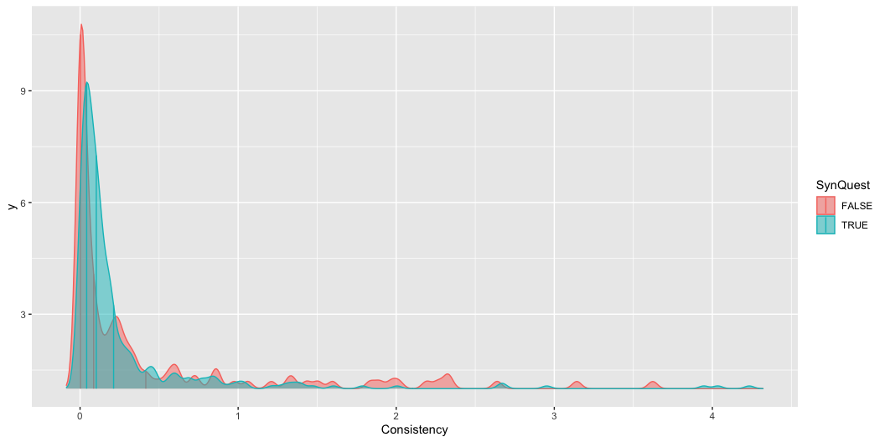
Questionnaire score: 26.00
n ID pass Quest: 399.000000
Accuracy: 0.55
Sensitivity: 0.68
Agreement: 0.55
|SynQuest | Med_Cons| SD_Cons|
|:--------|--------:|-------:|
|FALSE | 0.0864| 0.7173|
|TRUE | 0.1029| 0.5185|
|SynQuest | Med_Line| SD_Line|
|:--------|--------:|-------:|
|FALSE | 0.5906| 0.4303|
|TRUE | 0.0179| 0.3018|

Slide 40

Questionnaire score: 27.00
n ID pass Quest: 410.000000
Accuracy: 0.55
Sensitivity: 0.68
Agreement: 0.55
|SynQuest | Med_Cons| SD_Cons|
|:--------|--------:|-------:|
|FALSE | 0.0859| 0.7149|
|TRUE | 0.1026| 0.5279|
|SynQuest | Med_Line| SD_Line|
|:--------|--------:|-------:|
|FALSE | 0.5975| 0.4310|
|TRUE | 0.0179| 0.3092|

Slide 41

Questionnaire score: 28.00
n ID pass Quest: 426.000000
Accuracy: 0.55
Sensitivity: 0.68
Agreement: 0.55
|SynQuest | Med_Cons| SD_Cons|
|:--------|--------:|-------:|
|FALSE | 0.0676| 0.7407|
|TRUE | 0.1030| 0.5267|
|SynQuest | Med_Line| SD_Line|
|:--------|--------:|-------:|
|FALSE | 0.6843| 0.4276|
|TRUE | 0.0179| 0.3156|

Slide 42

Questionnaire score: 29.00
n ID pass Quest: 433.000000
Accuracy: 0.55
Sensitivity: 0.68
Agreement: 0.55
|SynQuest | Med_Cons| SD_Cons|
|:--------|--------:|-------:|
|FALSE | 0.0752| 0.7598|
|TRUE | 0.1029| 0.5224|
|SynQuest | Med_Line| SD_Line|
|:--------|--------:|-------:|
|FALSE | 0.6853| 0.4226|
|TRUE | 0.0179| 0.3217|

Slide 43
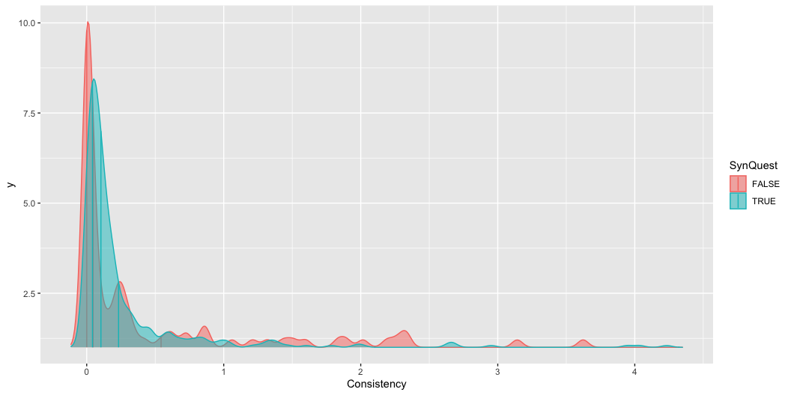
Questionnaire score: 30.00
n ID pass Quest: 440.000000
Accuracy: 0.55
Sensitivity: 0.68
Agreement: 0.55
|SynQuest | Med_Cons| SD_Cons|
|:--------|--------:|-------:|
|FALSE | 0.0625| 0.7451|
|TRUE | 0.1030| 0.5353|
|SynQuest | Med_Line| SD_Line|
|:--------|--------:|-------:|
|FALSE | 0.6863| 0.4211|
|TRUE | 0.0209| 0.3281|

Slide 44
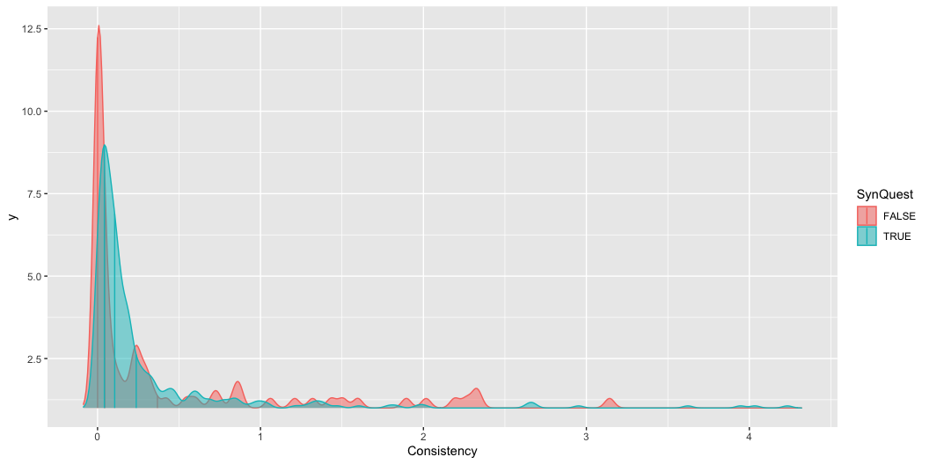
Questionnaire score: 31.00
n ID pass Quest: 446.000000
Accuracy: 0.55
Sensitivity: 0.68
Agreement: 0.55
|SynQuest | Med_Cons| SD_Cons|
|:--------|--------:|-------:|
|FALSE | 0.0466| 0.7660|
|TRUE | 0.1038| 0.5314|
|SynQuest | Med_Line| SD_Line|
|:--------|--------:|-------:|
|FALSE | 0.6863| 0.4211|
|TRUE | 0.0210| 0.3337|

Slide 45
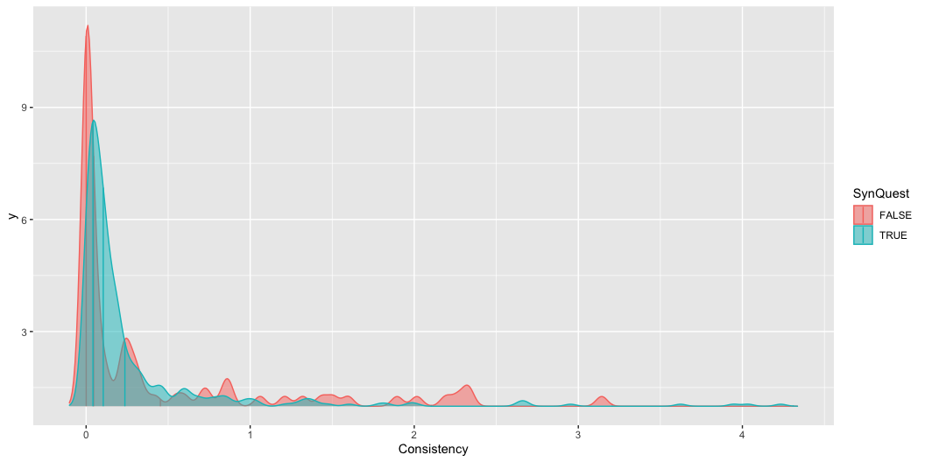
Questionnaire score: 32.00
n ID pass Quest: 453.000000
Accuracy: 0.55
Sensitivity: 0.68
Agreement: 0.55
|SynQuest | Med_Cons| SD_Cons|
|:--------|--------:|-------:|
|FALSE | 0.0453| 0.6961|
|TRUE | 0.1052| 0.5599|
|SynQuest | Med_Line| SD_Line|
|:--------|--------:|-------:|
|FALSE | 0.7209| 0.4220|
|TRUE | 0.0213| 0.3364|

Slide 46
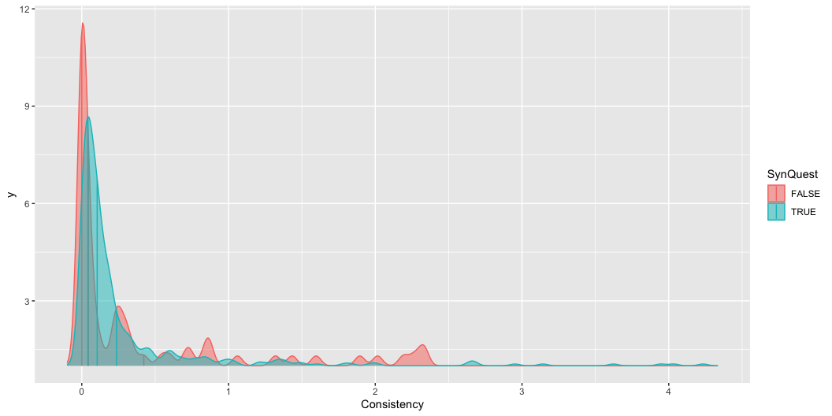
Questionnaire score: 33.00
n ID pass Quest: 457.000000
Accuracy: 0.55
Sensitivity: 0.68
Agreement: 0.55
|SynQuest | Med_Cons| SD_Cons|
|:--------|--------:|-------:|
|FALSE | 0.0459| 0.7088|
|TRUE | 0.1044| 0.5575|
|SynQuest | Med_Line| SD_Line|
|:--------|--------:|-------:|
|FALSE | 0.7209| 0.4243|
|TRUE | 0.0213| 0.3391|

Slide 47

Questionnaire score: 34.00
n ID pass Quest: 466.000000
Accuracy: 0.55
Sensitivity: 0.68
Agreement: 0.55
|SynQuest | Med_Cons| SD_Cons|
|:--------|--------:|-------:|
|FALSE | 0.0453| 0.6512|
|TRUE | 0.1048| 0.5755|
|SynQuest | Med_Line| SD_Line|
|:--------|--------:|-------:|
|FALSE | 0.8048| 0.4184|
|TRUE | 0.0220| 0.3420|

Slide 48

Questionnaire score: 35.00
n ID pass Quest: 478.000000
Accuracy: 0.55
Sensitivity: 0.68
Agreement: 0.55
|SynQuest | Med_Cons| SD_Cons|
|:--------|--------:|-------:|
|FALSE | 0.0529| 0.6949|
|TRUE | 0.1030| 0.5690|
|SynQuest | Med_Line| SD_Line|
|:--------|--------:|-------:|
|FALSE | 0.7342| 0.4102|
|TRUE | 0.0223| 0.3539|

Slide 49

Questionnaire score: 36.00
n ID pass Quest: 488.000000
Accuracy: 0.55
Sensitivity: 0.68
Agreement: 0.55
|SynQuest | Med_Cons| SD_Cons|
|:--------|--------:|-------:|
|FALSE | 0.0529| 0.6975|
|TRUE | 0.1030| 0.5726|
|SynQuest | Med_Line| SD_Line|
|:--------|--------:|-------:|
|FALSE | 0.7342| 0.4015|
|TRUE | 0.0238| 0.3594|

Slide 50

Questionnaire score: 37.00
n ID pass Quest: 491.000000
Accuracy: 0.55
Sensitivity: 0.68
Agreement: 0.55
|SynQuest | Med_Cons| SD_Cons|
|:--------|--------:|-------:|
|FALSE | 0.0497| 0.7152|
|TRUE | 0.1032| 0.5711|
|SynQuest | Med_Line| SD_Line|
|:--------|--------:|-------:|
|FALSE | 0.7695| 0.4019|
|TRUE | 0.0253| 0.3611|

Slide 51
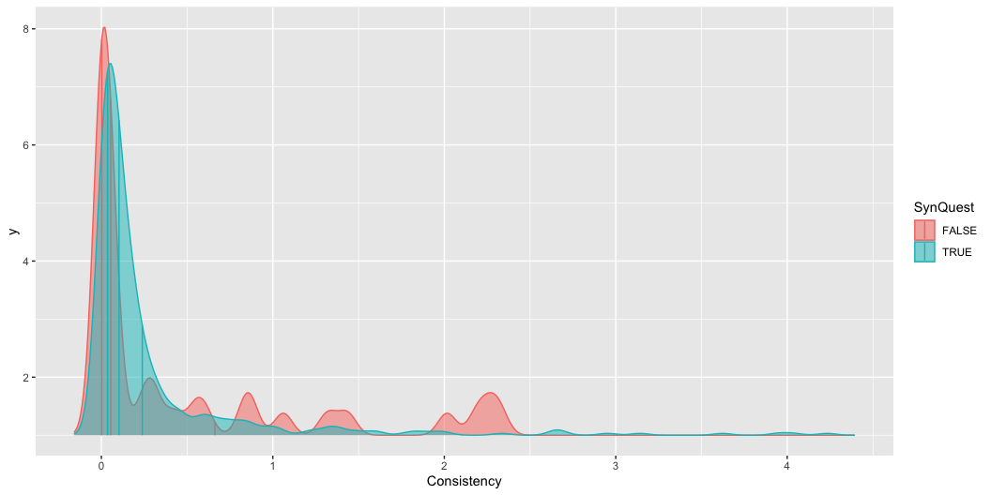
Questionnaire score: 38.00
n ID pass Quest: 495.000000
Accuracy: 0.55
Sensitivity: 0.68
Agreement: 0.55
|SynQuest | Med_Cons| SD_Cons|
|:--------|--------:|-------:|
|FALSE | 0.0497| 0.6812|
|TRUE | 0.1032| 0.5774|
|SynQuest | Med_Line| SD_Line|
|:--------|--------:|-------:|
|FALSE | 0.7695| 0.4018|
|TRUE | 0.0254| 0.3633|

Slide 52
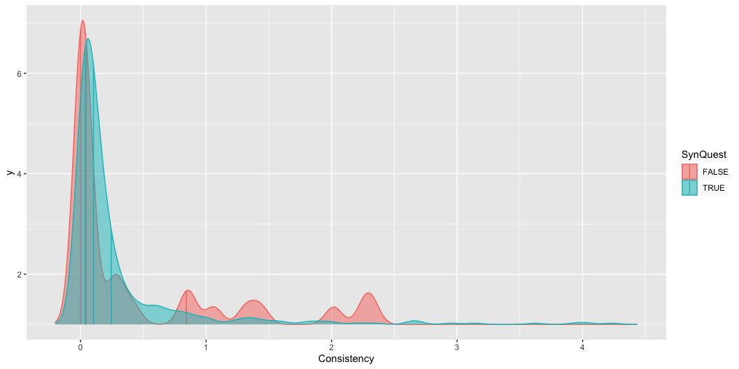
Questionnaire score: 39.00
n ID pass Quest: 501.000000
Accuracy: 0.55
Sensitivity: 0.68
Agreement: 0.55
|SynQuest | Med_Cons| SD_Cons|
|:--------|--------:|-------:|
|FALSE | 0.0545| 0.7206|
|TRUE | 0.1029| 0.5740|
|SynQuest | Med_Line| SD_Line|
|:--------|--------:|-------:|
|FALSE | 0.7695| 0.4034|
|TRUE | 0.0257| 0.3671|

Slide 53
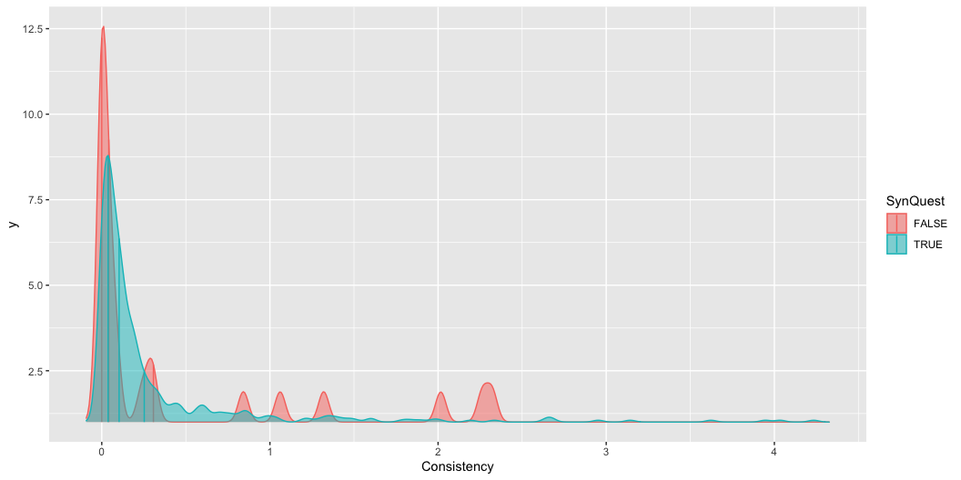
Questionnaire score: 40.00
n ID pass Quest: 506.000000
Accuracy: 0.55
Sensitivity: 0.68
Agreement: 0.55
|SynQuest | Med_Cons| SD_Cons|
|:--------|--------:|-------:|
|FALSE | 0.0466| 0.7022|
|TRUE | 0.1030| 0.5785|
|SynQuest | Med_Line| SD_Line|
|:--------|--------:|-------:|
|FALSE | 0.8048| 0.4012|
|TRUE | 0.0261| 0.3689|

Slide 54
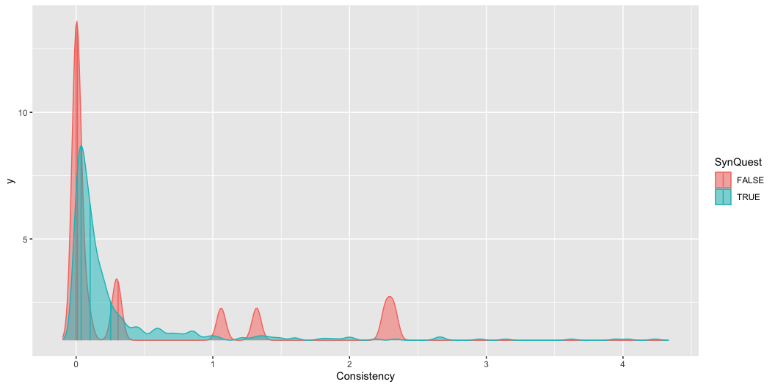
Questionnaire score: 41.00
n ID pass Quest: 511.000000
Accuracy: 0.55
Sensitivity: 0.68
Agreement: 0.55
|SynQuest | Med_Cons| SD_Cons|
|:--------|--------:|-------:|
|FALSE | 0.0417| 0.7274|
|TRUE | 0.1032| 0.5787|
|SynQuest | Med_Line| SD_Line|
|:--------|--------:|-------:|
|FALSE | 0.8649| 0.4099|
|TRUE | 0.0266| 0.3700|

Slide 55
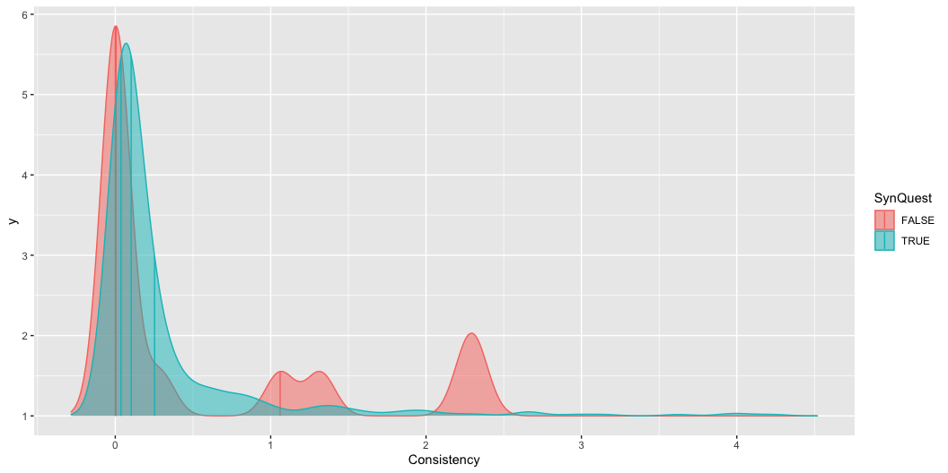
Questionnaire score: 42.00
n ID pass Quest: 520.000000
Accuracy: 0.55
Sensitivity: 0.68
Agreement: 0.55
|SynQuest | Med_Cons| SD_Cons|
|:--------|--------:|-------:|
|FALSE | 0.0098| 0.7709|
|TRUE | 0.1026| 0.5799|
|SynQuest | Med_Line| SD_Line|
|:--------|--------:|-------:|
|FALSE | 0.8769| 0.4152|
|TRUE | 0.0297| 0.3742|

Slide 56
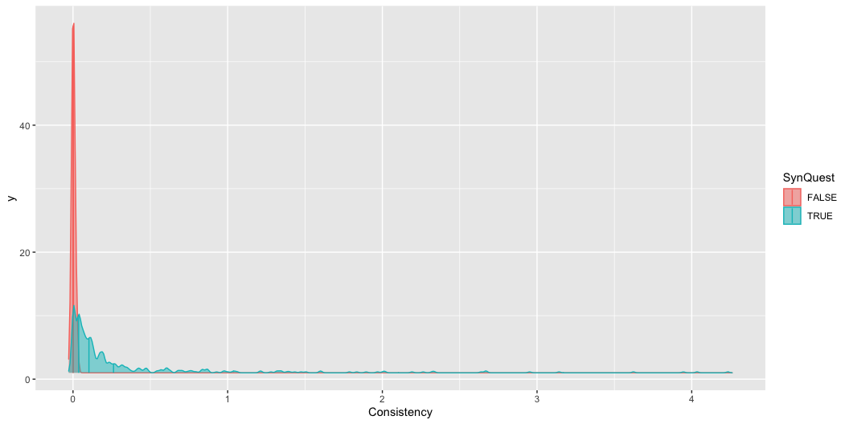
Questionnaire score: 43.00
n ID pass Quest: 523.000000
Accuracy: 0.55
Sensitivity: 0.68
Agreement: 0.55
|SynQuest | Med_Cons| SD_Cons|
|:--------|--------:|-------:|
|FALSE | 0.0049| 0.8318|
|TRUE | 0.1024| 0.5783|
|SynQuest | Med_Line| SD_Line|
|:--------|--------:|-------:|
|FALSE | 0.8814| 0.3825|
|TRUE | 0.0297| 0.3746|

Slide 57
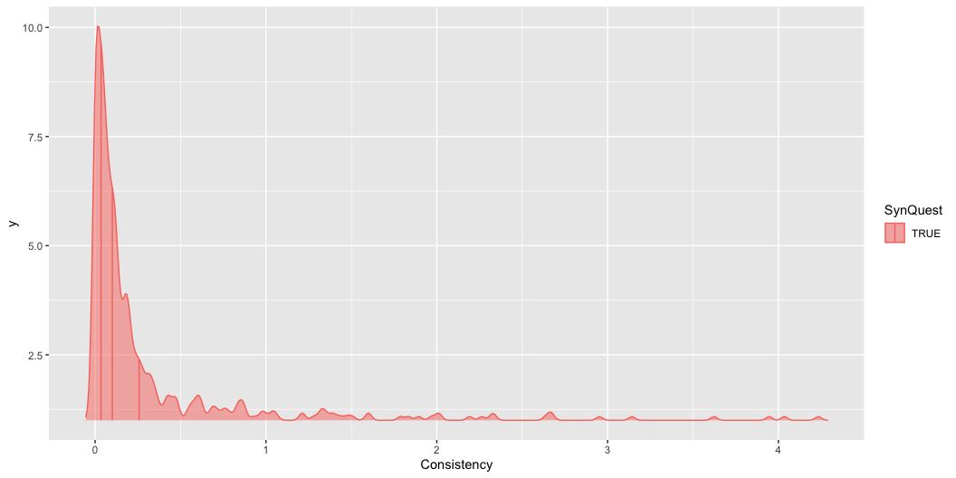
Questionnaire score: 44.00
n ID pass Quest: 530.000000
Accuracy: 0.55
Sensitivity: 0.68
Agreement: 0.55
|SynQuest | Med_Cons| SD_Cons|
|:--------|--------:|-------:|
|FALSE | 0.000| 0.0069|
|TRUE | 0.103| 0.5919|
|SynQuest | Med_Line| SD_Line|
|:--------|--------:|-------:|
|FALSE | 0.9909| 0.0666|
|TRUE | 0.0298| 0.3750|

Slide 58
Questionnaire score: 45.00
n ID pass Quest: 537.000000
Accuracy: 0.55
Sensitivity: 0.68
Agreement: 0.55
|SynQuest | Med_Cons| SD_Cons|
|:--------|--------:|-------:|
|TRUE | 0.1009| 0.5887|
|SynQuest | Med_Line| SD_Line|
|:--------|--------:|-------:|
|TRUE | 0.0309| 0.3823|

Slide 59
Line Intersect

Slide 60
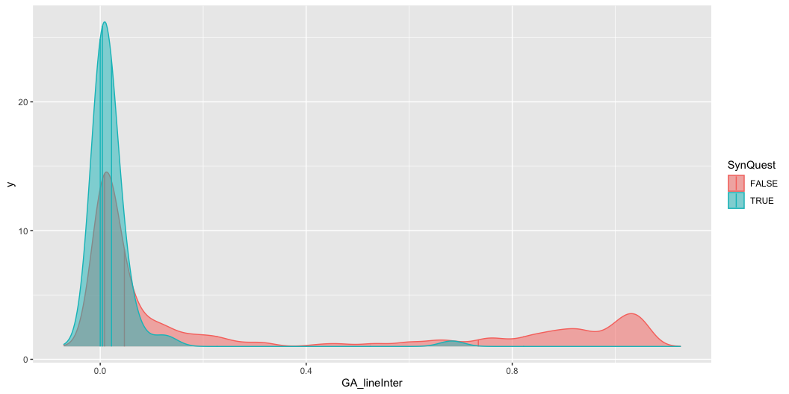

Slide 61

Questionnaire score: 9.00
n ID pass Quest: 142.000000
Accuracy: 0.42
Sensitivity: 0.21
Agreement: 0.42
|SynQuest | Med_Cons| SD_Cons|
|:--------|--------:|-------:|
|FALSE | 0.1086| 0.6301|
|TRUE | 0.0868| 0.1877|
|SynQuest | Med_Line| SD_Line|
|:--------|--------:|-------:|
|FALSE | 0.0469| 0.3997|
|TRUE | 0.0043| 0.0818|

Slide 62

Questionnaire score: 10.00
n ID pass Quest: 165.000000
Accuracy: 0.47
Sensitivity: 0.28
Agreement: 0.47
|SynQuest | Med_Cons| SD_Cons|
|:--------|--------:|-------:|
|FALSE | 0.1135| 0.6463|
|TRUE | 0.0786| 0.1677|
|SynQuest | Med_Line| SD_Line|
|:--------|--------:|-------:|
|FALSE | 0.0592| 0.4050|
|TRUE | 0.0043| 0.0718|

Slide 63
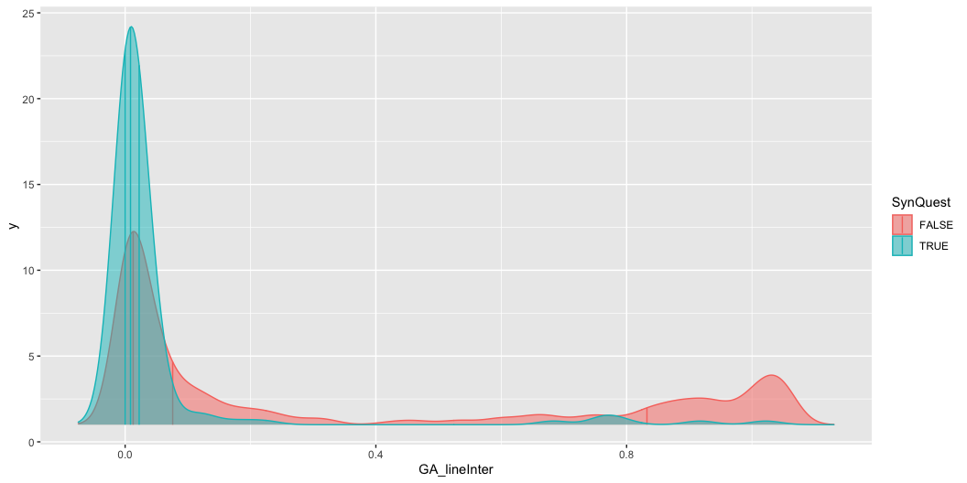
Questionnaire score: 11.00
n ID pass Quest: 184.000000
Accuracy: 0.51
Sensitivity: 0.33
Agreement: 0.51
|SynQuest | Med_Cons| SD_Cons|
|:--------|--------:|-------:|
|FALSE | 0.1138| 0.6606|
|TRUE | 0.0868| 0.1736|
|SynQuest | Med_Line| SD_Line|
|:--------|--------:|-------:|
|FALSE | 0.0683| 0.4092|
|TRUE | 0.0044| 0.0986|

Slide 64
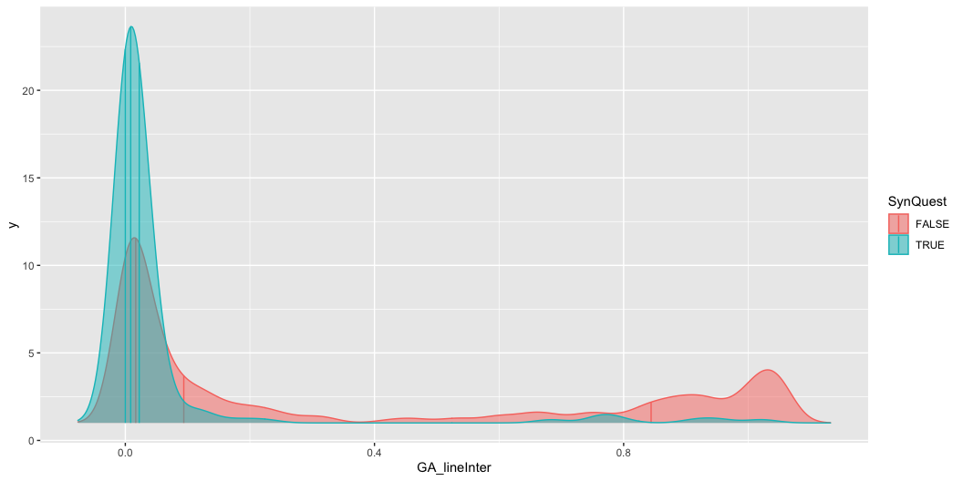
Questionnaire score: 12.00
n ID pass Quest: 206.000000
Accuracy: 0.54
Sensitivity: 0.38
Agreement: 0.54
|SynQuest | Med_Cons| SD_Cons|
|:--------|--------:|-------:|
|FALSE | 0.1157| 0.6783|
|TRUE | 0.0892| 0.1783|
|SynQuest | Med_Line| SD_Line|
|:--------|--------:|-------:|
|FALSE | 0.0759| 0.4122|
|TRUE | 0.0086| 0.1701|

Slide 65
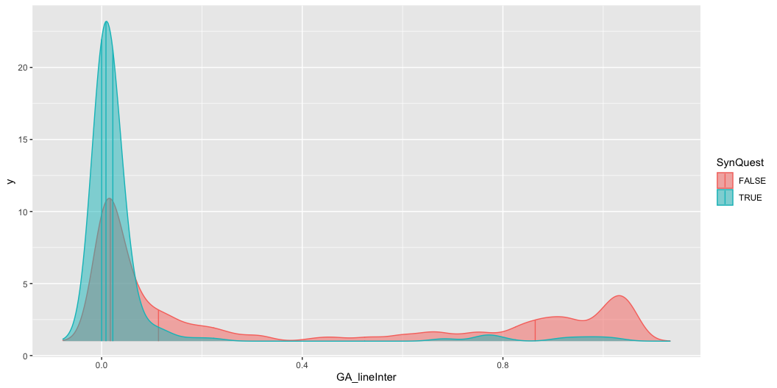
Questionnaire score: 13.00
n ID pass Quest: 224.000000
Accuracy: 0.57
Sensitivity: 0.43
Agreement: 0.57
|SynQuest | Med_Cons| SD_Cons|
|:--------|--------:|-------:|
|FALSE | 0.1086| 0.6952|
|TRUE | 0.0976| 0.1725|
|SynQuest | Med_Line| SD_Line|
|:--------|--------:|-------:|
|FALSE | 0.0939| 0.4154|
|TRUE | 0.0086| 0.1761|

Slide 66
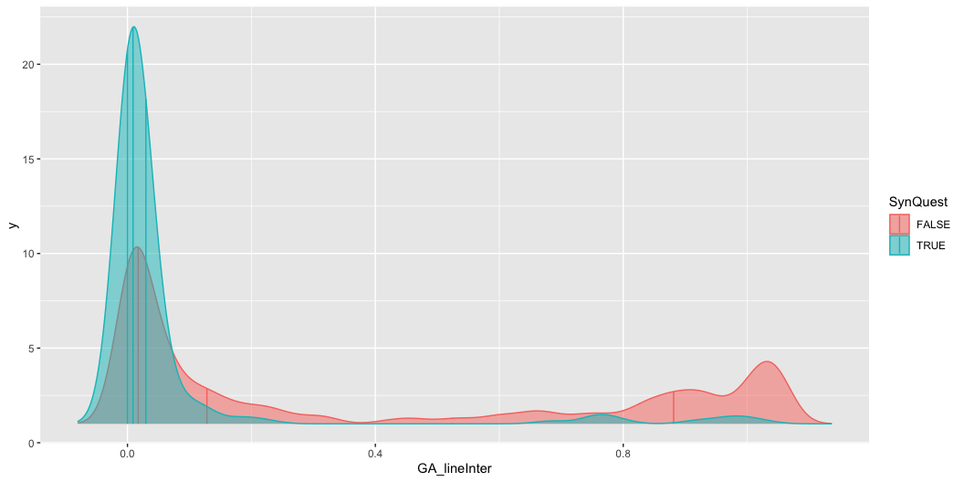
Questionnaire score: 14.00
n ID pass Quest: 241.000000
Accuracy: 0.61
Sensitivity: 0.48
Agreement: 0.61
|SynQuest | Med_Cons| SD_Cons|
|:--------|--------:|-------:|
|FALSE | 0.1083| 0.7115|
|TRUE | 0.0990| 0.1699|
|SynQuest | Med_Line| SD_Line|
|:--------|--------:|-------:|
|FALSE | 0.1133| 0.4179|
|TRUE | 0.0086| 0.1822|

Slide 67

Questionnaire score: 15.00
n ID pass Quest: 259.000000
Accuracy: 0.64
Sensitivity: 0.53
Agreement: 0.64
|SynQuest | Med_Cons| SD_Cons|
|:--------|--------:|-------:|
|FALSE | 0.1072| 0.7271|
|TRUE | 0.0991| 0.2036|
|SynQuest | Med_Line| SD_Line|
|:--------|--------:|-------:|
|FALSE | 0.1282| 0.4212|
|TRUE | 0.0089| 0.1931|

Slide 68

Questionnaire score: 16.00
n ID pass Quest: 268.000000
Accuracy: 0.65
Sensitivity: 0.55
Agreement: 0.65
|SynQuest | Med_Cons| SD_Cons|
|:--------|--------:|-------:|
|FALSE | 0.1086| 0.7368|
|TRUE | 0.0991| 0.1998|
|SynQuest | Med_Line| SD_Line|
|:--------|--------:|-------:|
|FALSE | 0.1356| 0.4224|
|TRUE | 0.0089| 0.2002|

Slide 69

Questionnaire score: 17.00
n ID pass Quest: 282.000000
Accuracy: 0.67
Sensitivity: 0.59
Agreement: 0.67
|SynQuest | Med_Cons| SD_Cons|
|:--------|--------:|-------:|
|FALSE | 0.1169| 0.7530|
|TRUE | 0.0992| 0.1951|
|SynQuest | Med_Line| SD_Line|
|:--------|--------:|-------:|
|FALSE | 0.1526| 0.4234|
|TRUE | 0.0126| 0.2159|

Slide 70
Questionnaire score: 18.00
n ID pass Quest: 299.000000
Accuracy: 0.69
Sensitivity: 0.63
Agreement: 0.69
|SynQuest | Med_Cons| SD_Cons|
|:--------|--------:|-------:|
|FALSE | 0.1068| 0.7731|
|TRUE | 0.1003| 0.2115|
|SynQuest | Med_Line| SD_Line|
|:--------|--------:|-------:|
|FALSE | 0.1847| 0.4227|
|TRUE | 0.0128| 0.2385|

Slide 71

Questionnaire score: 19.00
n ID pass Quest: 315.000000
Accuracy: 0.71
Sensitivity: 0.66
Agreement: 0.71
|SynQuest | Med_Cons| SD_Cons|
|:--------|--------:|-------:|
|FALSE | 0.0966| 0.7547|
|TRUE | 0.1020| 0.3378|
|SynQuest | Med_Line| SD_Line|
|:--------|--------:|-------:|
|FALSE | 0.2188| 0.4248|
|TRUE | 0.0132| 0.2445|

Slide 72
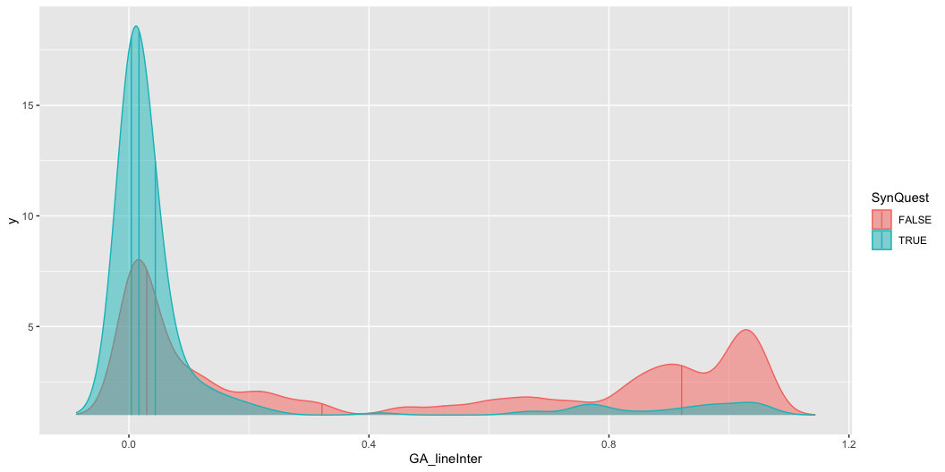
Questionnaire score: 20.00
n ID pass Quest: 328.000000
Accuracy: 0.73
Sensitivity: 0.69
Agreement: 0.73
|SynQuest | Med_Cons| SD_Cons|
|:--------|--------:|-------:|
|FALSE | 0.0894| 0.7245|
|TRUE | 0.1022| 0.4285|
|SynQuest | Med_Line| SD_Line|
|:--------|--------:|-------:|
|FALSE | 0.2533| 0.4262|
|TRUE | 0.0134| 0.2506|

Slide 73
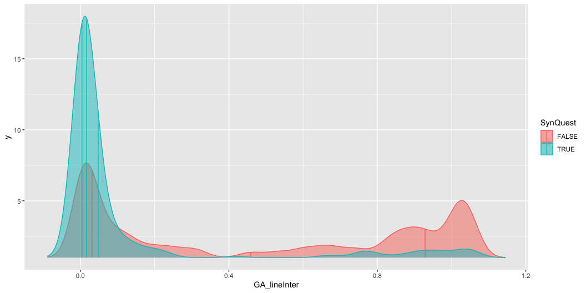
Questionnaire score: 21.00
n ID pass Quest: 340.000000
Accuracy: 0.75
Sensitivity: 0.73
Agreement: 0.75
|SynQuest | Med_Cons| SD_Cons|
|:--------|--------:|-------:|
|FALSE | 0.0832| 0.7423|
|TRUE | 0.1038| 0.4241|
|SynQuest | Med_Line| SD_Line|
|:--------|--------:|-------:|
|FALSE | 0.3218| 0.4268|
|TRUE | 0.0169| 0.2499|

Slide 74

Questionnaire score: 22.00
n ID pass Quest: 354.000000
Accuracy: 0.76
Sensitivity: 0.76
Agreement: 0.76
|SynQuest | Med_Cons| SD_Cons|
|:--------|--------:|-------:|
|FALSE | 0.0859| 0.7467|
|TRUE | 0.1030| 0.4413|
|SynQuest | Med_Line| SD_Line|
|:--------|--------:|-------:|
|FALSE | 0.459| 0.4262|
|TRUE | 0.017| 0.2639|

Slide 75

Questionnaire score: 23.00
n ID pass Quest: 367.000000
Accuracy: 0.78
Sensitivity: 0.78
Agreement: 0.78
|SynQuest | Med_Cons| SD_Cons|
|:--------|--------:|-------:|
|FALSE | 0.0830| 0.7659|
|TRUE | 0.1044| 0.4402|
|SynQuest | Med_Line| SD_Line|
|:--------|--------:|-------:|
|FALSE | 0.5396| 0.4261|
|TRUE | 0.0170| 0.2687|

Slide 76
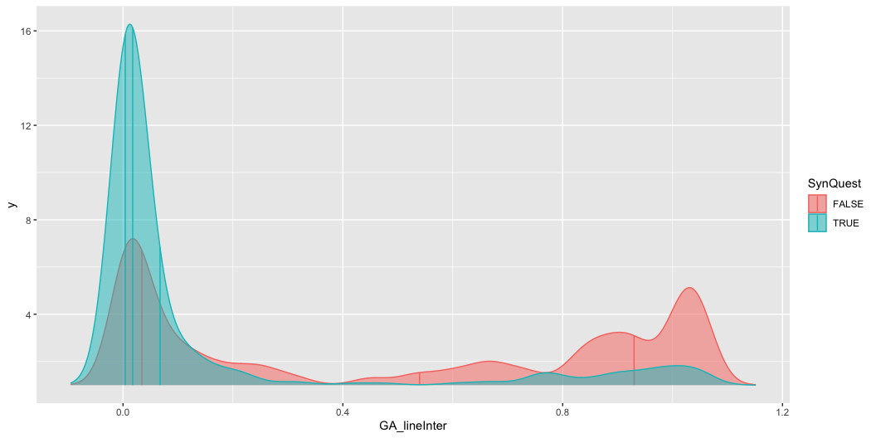
Questionnaire score: 24.00
n ID pass Quest: 373.000000
Accuracy: 0.78
Sensitivity: 0.79
Agreement: 0.78
|SynQuest | Med_Cons| SD_Cons|
|:--------|--------:|-------:|
|FALSE | 0.0864| 0.7667|
|TRUE | 0.1029| 0.4484|
|SynQuest | Med_Line| SD_Line|
|:--------|--------:|-------:|
|FALSE | 0.5396| 0.4252|
|TRUE | 0.0173| 0.2791|

Slide 77
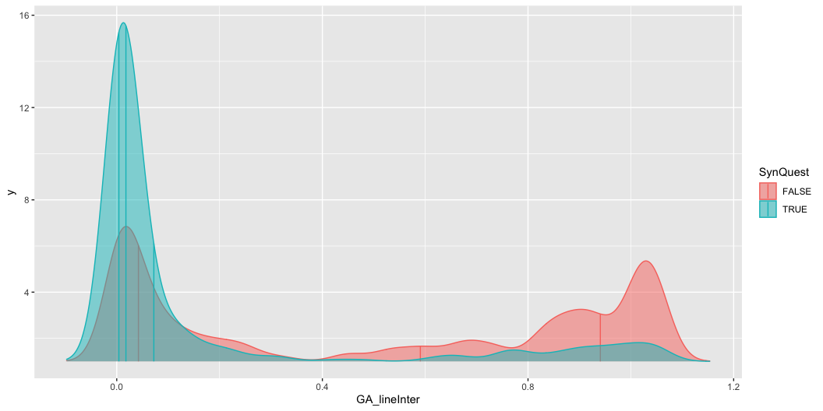
Questionnaire score: 25.00
n ID pass Quest: 385.000000
Accuracy: 0.76
Sensitivity: 0.80
Agreement: 0.76
|SynQuest | Med_Cons| SD_Cons|
|:--------|--------:|-------:|
|FALSE | 0.0846| 0.7246|
|TRUE | 0.1032| 0.5009|
|SynQuest | Med_Line| SD_Line|
|:--------|--------:|-------:|
|FALSE | 0.5396| 0.4282|
|TRUE | 0.0177| 0.2950|

Slide 78
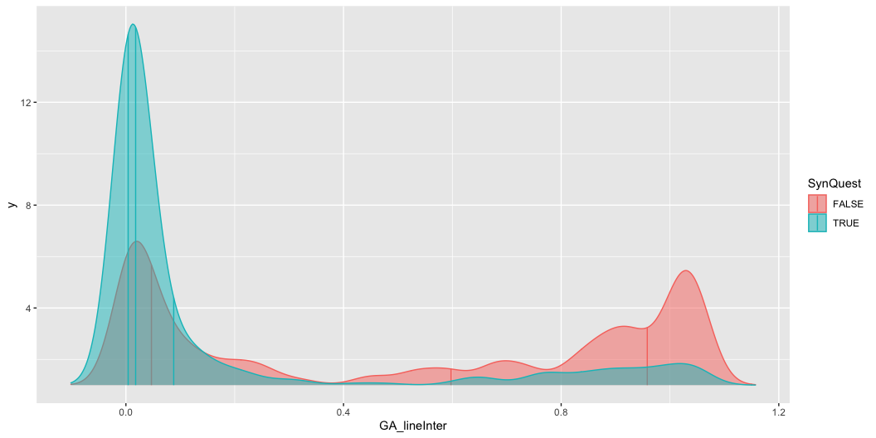
Questionnaire score: 26.00
n ID pass Quest: 399.000000
Accuracy: 0.76
Sensitivity: 0.82
Agreement: 0.76
|SynQuest | Med_Cons| SD_Cons|
|:--------|--------:|-------:|
|FALSE | 0.0864| 0.7173|
|TRUE | 0.1029| 0.5185|
|SynQuest | Med_Line| SD_Line|
|:--------|--------:|-------:|
|FALSE | 0.5906| 0.4303|
|TRUE | 0.0179| 0.3018|

Slide 79
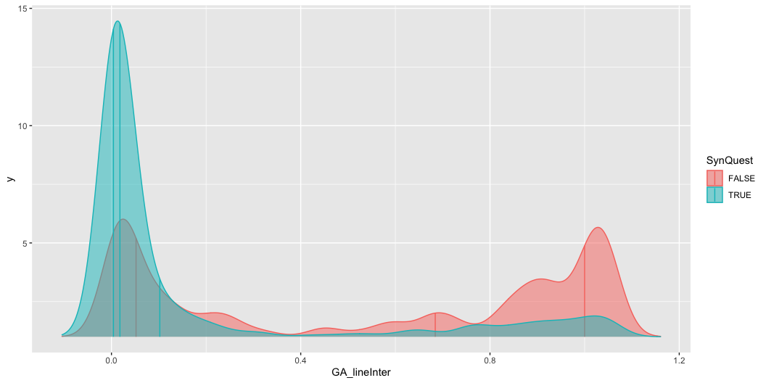
Questionnaire score: 27.00
n ID pass Quest: 410.000000
Accuracy: 0.77
Sensitivity: 0.84
Agreement: 0.77
|SynQuest | Med_Cons| SD_Cons|
|:--------|--------:|-------:|
|FALSE | 0.0859| 0.7149|
|TRUE | 0.1026| 0.5279|
|SynQuest | Med_Line| SD_Line|
|:--------|--------:|-------:|
|FALSE | 0.5975| 0.4310|
|TRUE | 0.0179| 0.3092|

Slide 80
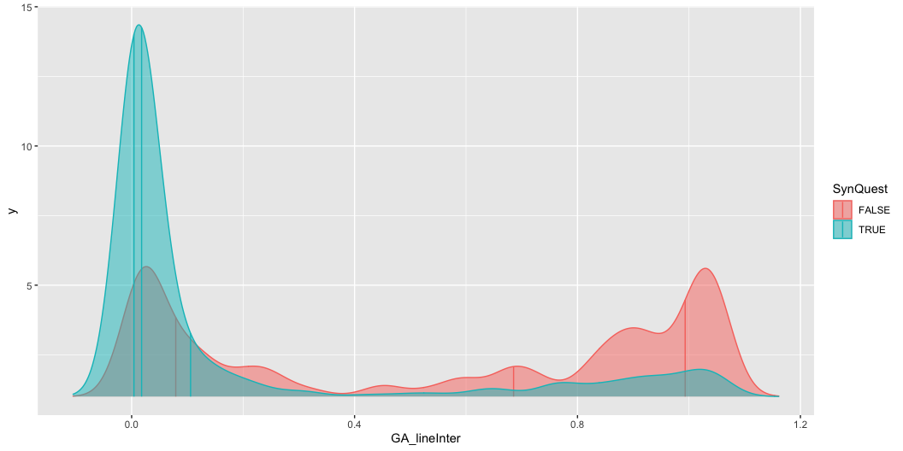
Questionnaire score: 28.00
n ID pass Quest: 426.000000
Accuracy: 0.78
Sensitivity: 0.87
Agreement: 0.78
|SynQuest | Med_Cons| SD_Cons|
|:--------|--------:|-------:|
|FALSE | 0.0676| 0.7407|
|TRUE | 0.1030| 0.5267|
|SynQuest | Med_Line| SD_Line|
|:--------|--------:|-------:|
|FALSE | 0.6843| 0.4276|
|TRUE | 0.0179| 0.3156|

Slide 81

Questionnaire score: 29.00
n ID pass Quest: 433.000000
Accuracy: 0.78
Sensitivity: 0.88
Agreement: 0.78
|SynQuest | Med_Cons| SD_Cons|
|:--------|--------:|-------:|
|FALSE | 0.0752| 0.7598|
|TRUE | 0.1029| 0.5224|
|SynQuest | Med_Line| SD_Line|
|:--------|--------:|-------:|
|FALSE | 0.6853| 0.4226|
|TRUE | 0.0179| 0.3217|

Slide 82
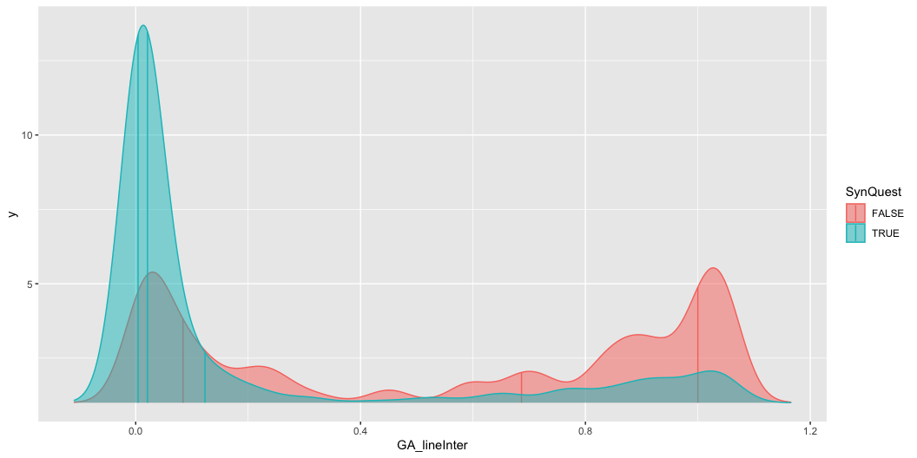
Questionnaire score: 30.00
n ID pass Quest: 440.000000
Accuracy: 0.78
Sensitivity: 0.89
Agreement: 0.78
|SynQuest | Med_Cons| SD_Cons|
|:--------|--------:|-------:|
|FALSE | 0.0625| 0.7451|
|TRUE | 0.1030| 0.5353|
|SynQuest | Med_Line| SD_Line|
|:--------|--------:|-------:|
|FALSE | 0.6863| 0.4211|
|TRUE | 0.0209| 0.3281|

Slide 83
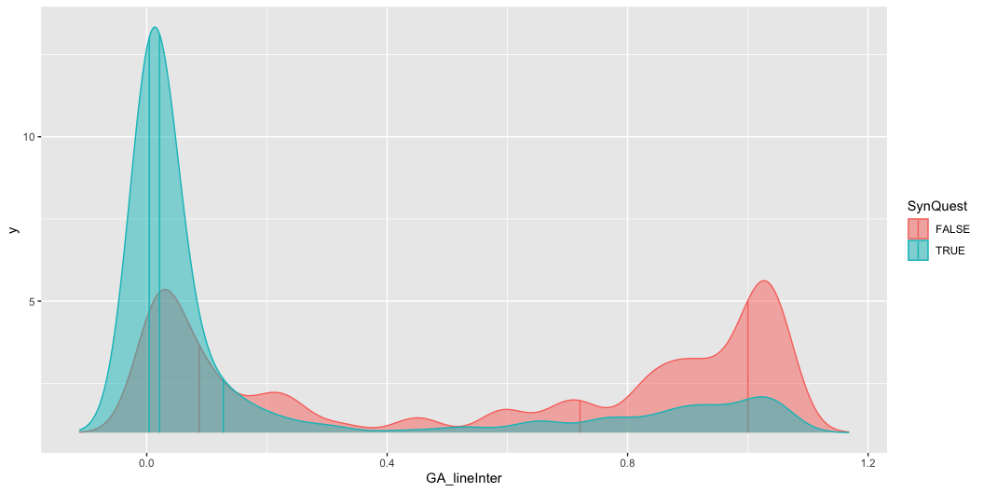
Questionnaire score: 31.00
n ID pass Quest: 446.000000
Accuracy: 0.77
Sensitivity: 0.90
Agreement: 0.77
|SynQuest | Med_Cons| SD_Cons|
|:--------|--------:|-------:|
|FALSE | 0.0466| 0.7660|
|TRUE | 0.1038| 0.5314|
|SynQuest | Med_Line| SD_Line|
|:--------|--------:|-------:|
|FALSE | 0.6863| 0.4211|
|TRUE | 0.0210| 0.3337|

Slide 84

Questionnaire score: 32.00
n ID pass Quest: 453.000000
Accuracy: 0.77
Sensitivity: 0.91
Agreement: 0.77
|SynQuest | Med_Cons| SD_Cons|
|:--------|--------:|-------:|
|FALSE | 0.0453| 0.6961|
|TRUE | 0.1052| 0.5599|
|SynQuest | Med_Line| SD_Line|
|:--------|--------:|-------:|
|FALSE | 0.7209| 0.4220|
|TRUE | 0.0213| 0.3364|

Slide 85
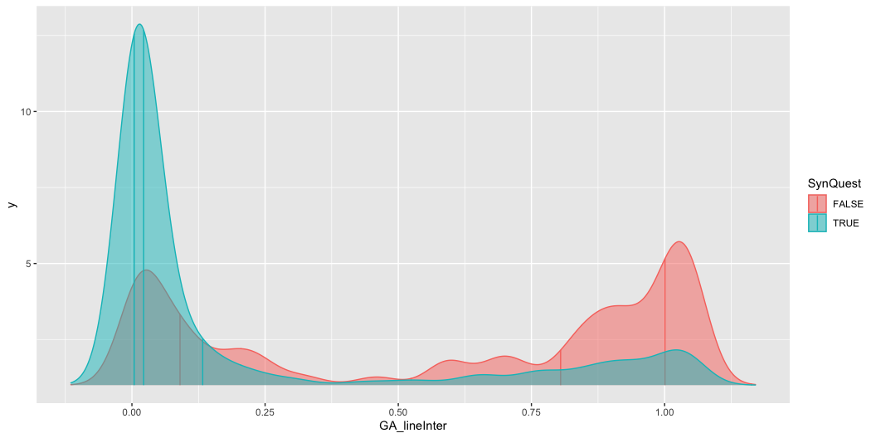
Questionnaire score: 33.00
n ID pass Quest: 457.000000
Accuracy: 0.76
Sensitivity: 0.91
Agreement: 0.76
|SynQuest | Med_Cons| SD_Cons|
|:--------|--------:|-------:|
|FALSE | 0.0459| 0.7088|
|TRUE | 0.1044| 0.5575|
|SynQuest | Med_Line| SD_Line|
|:--------|--------:|-------:|
|FALSE | 0.7209| 0.4243|
|TRUE | 0.0213| 0.3391|

Slide 86

Questionnaire score: 34.00
n ID pass Quest: 466.000000
Accuracy: 0.77
Sensitivity: 0.93
Agreement: 0.77
|SynQuest | Med_Cons| SD_Cons|
|:--------|--------:|-------:|
|FALSE | 0.0453| 0.6512|
|TRUE | 0.1048| 0.5755|
|SynQuest | Med_Line| SD_Line|
|:--------|--------:|-------:|
|FALSE | 0.8048| 0.4184|
|TRUE | 0.0220| 0.3420|

Slide 87

Questionnaire score: 35.00
n ID pass Quest: 478.000000
Accuracy: 0.76
Sensitivity: 0.94
Agreement: 0.76
|SynQuest | Med_Cons| SD_Cons|
|:--------|--------:|-------:|
|FALSE | 0.0529| 0.6949|
|TRUE | 0.1030| 0.5690|
|SynQuest | Med_Line| SD_Line|
|:--------|--------:|-------:|
|FALSE | 0.7342| 0.4102|
|TRUE | 0.0223| 0.3539|

Slide 88

Questionnaire score: 36.00
n ID pass Quest: 488.000000
Accuracy: 0.76
Sensitivity: 0.95
Agreement: 0.76
|SynQuest | Med_Cons| SD_Cons|
|:--------|--------:|-------:|
|FALSE | 0.0529| 0.6975|
|TRUE | 0.1030| 0.5726|
|SynQuest | Med_Line| SD_Line|
|:--------|--------:|-------:|
|FALSE | 0.7342| 0.4015|
|TRUE | 0.0238| 0.3594|

Slide 89

Questionnaire score: 37.00
n ID pass Quest: 491.000000
Accuracy: 0.76
Sensitivity: 0.95
Agreement: 0.76
|SynQuest | Med_Cons| SD_Cons|
|:--------|--------:|-------:|
|FALSE | 0.0497| 0.7152|
|TRUE | 0.1032| 0.5711|
|SynQuest | Med_Line| SD_Line|
|:--------|--------:|-------:|
|FALSE | 0.7695| 0.4019|
|TRUE | 0.0253| 0.3611|

Slide 90

Questionnaire score: 38.00
n ID pass Quest: 495.000000
Accuracy: 0.76
Sensitivity: 0.96
Agreement: 0.76
|SynQuest | Med_Cons| SD_Cons|
|:--------|--------:|-------:|
|FALSE | 0.0497| 0.6812|
|TRUE | 0.1032| 0.5774|
|SynQuest | Med_Line| SD_Line|
|:--------|--------:|-------:|
|FALSE | 0.7695| 0.4018|
|TRUE | 0.0254| 0.3633|

Slide 91

Questionnaire score: 39.00
n ID pass Quest: 501.000000
Accuracy: 0.75
Sensitivity: 0.96
Agreement: 0.75
|SynQuest | Med_Cons| SD_Cons|
|:--------|--------:|-------:|
|FALSE | 0.0545| 0.7206|
|TRUE | 0.1029| 0.5740|
|SynQuest | Med_Line| SD_Line|
|:--------|--------:|-------:|
|FALSE | 0.7695| 0.4034|
|TRUE | 0.0257| 0.3671|

Slide 92

Questionnaire score: 40.00
n ID pass Quest: 506.000000
Accuracy: 0.75
Sensitivity: 0.97
Agreement: 0.75
|SynQuest | Med_Cons| SD_Cons|
|:--------|--------:|-------:|
|FALSE | 0.0466| 0.7022|
|TRUE | 0.1030| 0.5785|
|SynQuest | Med_Line| SD_Line|
|:--------|--------:|-------:|
|FALSE | 0.8048| 0.4012|
|TRUE | 0.0261| 0.3689|

Slide 93

Questionnaire score: 41.00
n ID pass Quest: 511.000000
Accuracy: 0.74
Sensitivity: 0.97
Agreement: 0.74
|SynQuest | Med_Cons| SD_Cons|
|:--------|--------:|-------:|
|FALSE | 0.0417| 0.7274|
|TRUE | 0.1032| 0.5787|
|SynQuest | Med_Line| SD_Line|
|:--------|--------:|-------:|
|FALSE | 0.8649| 0.4099|
|TRUE | 0.0266| 0.3700|

Slide 94

Questionnaire score: 42.00
n ID pass Quest: 520.000000
Accuracy: 0.74
Sensitivity: 0.98
Agreement: 0.74
|SynQuest | Med_Cons| SD_Cons|
|:--------|--------:|-------:|
|FALSE | 0.0098| 0.7709|
|TRUE | 0.1026| 0.5799|
|SynQuest | Med_Line| SD_Line|
|:--------|--------:|-------:|
|FALSE | 0.8769| 0.4152|
|TRUE | 0.0297| 0.3742|

Slide 95

Questionnaire score: 43.00
n ID pass Quest: 523.000000
Accuracy: 0.74
Sensitivity: 0.99
Agreement: 0.74
|SynQuest | Med_Cons| SD_Cons|
|:--------|--------:|-------:|
|FALSE | 0.0049| 0.8318|
|TRUE | 0.1024| 0.5783|
|SynQuest | Med_Line| SD_Line|
|:--------|--------:|-------:|
|FALSE | 0.8814| 0.3825|
|TRUE | 0.0297| 0.3746|

Slide 96

Questionnaire score: 44.00
n ID pass Quest: 530.000000
Accuracy: 0.74
Sensitivity: 1.00
Agreement: 0.74
|SynQuest | Med_Cons| SD_Cons|
|:--------|--------:|-------:|
|FALSE | 0.000| 0.0069|
|TRUE | 0.103| 0.5919|
|SynQuest | Med_Line| SD_Line|
|:--------|--------:|-------:|
|FALSE | 0.9909| 0.0666|
|TRUE | 0.0298| 0.3750|

Slide 97
Questionnaire score: 45.00
n ID pass Quest: 537.000000
Accuracy: 0.73
Sensitivity: 1.00
Agreement: 0.73
|SynQuest | Med_Cons| SD_Cons|
|:--------|--------:|-------:|
|TRUE | 0.1009| 0.5887|
|SynQuest | Med_Line| SD_Line|
|:--------|--------:|-------:|
|TRUE | 0.0309| 0.3823|
R version 4.3.3 (2024-02-29)
Platform: aarch64-apple-darwin20 (64-bit)
Running under: macOS 15.5
Matrix products: default
BLAS: /Library/Frameworks/R.framework/Versions/4.3-arm64/Resources/lib/libRblas.0.dylib
LAPACK: /Library/Frameworks/R.framework/Versions/4.3-arm64/Resources/lib/libRlapack.dylib; LAPACK version 3.11.0
locale:
[1] en_US.UTF-8/en_US.UTF-8/en_US.UTF-8/C/en_US.UTF-8/en_US.UTF-8
time zone: Europe/Zurich
tzcode source: internal
attached base packages:
[1] stats graphics grDevices utils datasets methods base
other attached packages:
[1] irr_0.84.1 lpSolve_5.6.23 ggforce_0.4.2 ggalluvial_0.12.5
[5] ggridges_0.5.6 readxl_1.4.5 ggplot2_3.5.2 dplyr_1.1.4
[9] tidyr_1.3.1 readr_2.1.5
loaded via a namespace (and not attached):
[1] gtable_0.3.6 jsonlite_2.0.0 compiler_4.3.3 Rcpp_1.0.14
[5] tidyselect_1.2.1 textshaping_1.0.1 systemfonts_1.2.3 scales_1.4.0
[9] yaml_2.3.10 fastmap_1.2.0 R6_2.6.1 labeling_0.4.3
[13] generics_0.1.4 knitr_1.50 MASS_7.3-60.0.1 polyclip_1.10-7
[17] tibble_3.3.0 pillar_1.10.2 RColorBrewer_1.1-3 tzdb_0.5.0
[21] rlang_1.1.6 utf8_1.2.6 xfun_0.52 cli_3.6.5
[25] tweenr_2.0.3 withr_3.0.2 magrittr_2.0.3 digest_0.6.37
[29] grid_4.3.3 rstudioapi_0.17.1 hms_1.1.3 lifecycle_1.0.4
[33] vctrs_0.6.5 evaluate_1.0.3 glue_1.8.0 farver_2.1.2
[37] cellranger_1.1.0 ragg_1.4.0 rmarkdown_2.29 purrr_1.0.4
[41] tools_4.3.3 pkgconfig_2.0.3 htmltools_0.5.8.1

