Slide 1
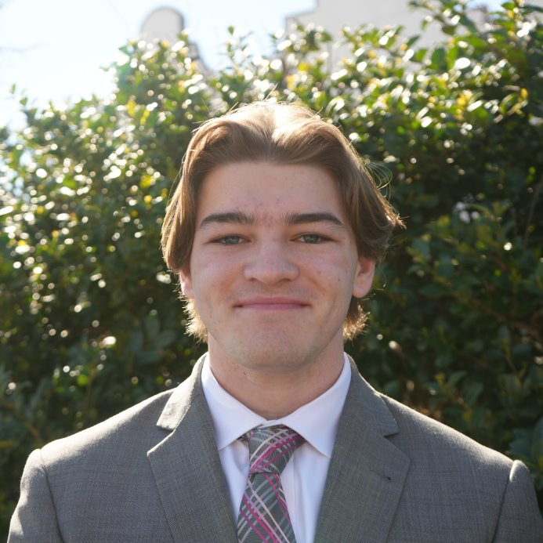
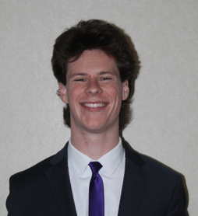
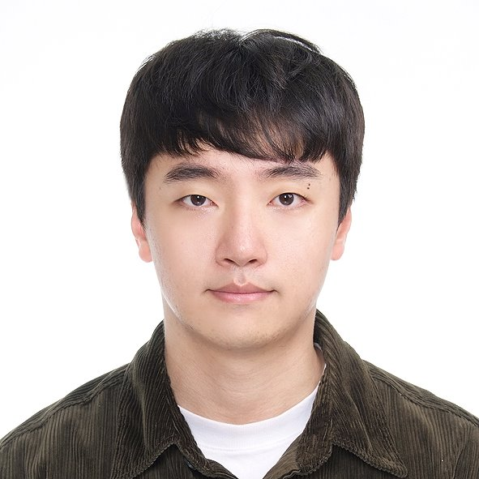
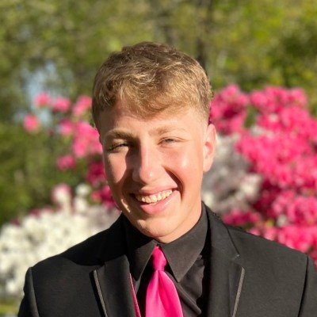
Tutor Nation Sprint 2 Presentation
August Connors
Casey Derringer
Github URL: https://github.com/ahconnors/Tutor_Nation
Project Website: https://remcculley.github.io/tutor-nation-website
Minseok Kim
Ryan McCulley

Slide 2

Project Reminder
Tutoring Service for K-12
Mobile learning app
Personalized practice outside of sessions

Slide 3
Project Backlog Highlights
View and open lesson content on student page
View tutors that students are assigned to on parent page
View list of students as tutor

Slide 4
Sprint 2 Goals
Start setting up backend
Define PostgreSQL database
Connect app views
Align views with consistent design

Slide 5
Sprint 2 Backlog
Setup SpringBoot application to control backend
Write controllers for various views
Define/Create Student, Parent, Tutor tables
Implement reusable components across frontend views
Define common data structures that DB info can be stored in

Slide 6
Accomplishments
Deployed backend to AWS
Defined table specifications for database
Connected various app views
Refactored frontend designs for consistency
Backend controllers (student and tutor)
Feedback
Sponsors are very pleased with flow and look of app
"A+" - TutorNation Sponsors
Cyber Feedback:
Credential Management
Client-side backdoors
Exposed API keys

Slide 7
Remaining Work
Lessons Learned
Finish backend calls
Test app functionality with dummy data
Generate content/activities
Create documentation for use and deployment
Poor division of roles
Component-based division would have been better
Would prevent frontend refactoring

Slide 8




Technologies Used
Swift
Readable code
Easy frontend development (SwiftUI)
Inconvenient to develop on Mac
SpringBoot
Robust, maintainable, easy to collaborate on
IntelliJ IDEA somewhat buggy
AWS
EC2 for backend deployment
RDS for PostgreSQL database
Difficult to configure

Slide 9
Team Contributions
August Connors
Implementing reusable components
Frontend API calls
Casey Derringer
Profile page on student view
Splash screen
Completed student controller
Minseok Kim
Configured backend with docker
Set up AWS RDS database
Deployed code to AWS EC2
Completed Tutor Controller
Ryan McCulley
Defined and Checked Data Tables for All Users
Planned out Backend Calls for All Users
Helped Straighten Backend Pathways

Slide 10
Demo

