Slide 1
DECO6500 · ADVANCED HUMAN-COMPUTER INTERACTION · SEMESTER 2, 2026
Week 7 Lecture
What the Evidence Can Tell You
A first pass at thematic analysis and descriptive statistics — and how to say no more than your data lets you
Week 7 — What the Evidence Can Tell You
DECO6500 | Week 7 Lecture
Notes:
Sixty minutes. About forty of me, twenty of you — more talk than Week 6, deliberately, because this is new content rather than a diagnostic on content you already have. Nobody has their own data yet; everything today is on shared material. On Friday you do it to your own.

Slide 2

Acknowledgement of Country
The University of Queensland (UQ) acknowledges the Traditional Owners and their custodianship of the lands on which we meet.
We pay our respects to their Ancestors and their descendants, who continue cultural and spiritual connections to Country.
We recognise their valuable contributions to Australian and global society.
The Brisbane River pattern from A Guidance Through Time
by Casey Coolwell and Kyra Mancktelow.

Slide 3
Commitment to Diversity and Inclusion
Diverse perspectives, abilities, experiences and backgrounds inspire creativity, encourage innovation and enrich our communities.
Members of our broad community are valued and respected for their individuality.
UQ strives to create a culturally safe, welcoming and inclusive workplace, with strong community connections and partnerships.

Slide 4
WHERE WE ARE
You Are Collecting Evidence. Now Find Out What It Says.
What you will have by Friday
What this hour does
What it is not
Measures, demographics and psychographics from 16–20 participants.
Think-aloud or interview talk from 6 of them — the same 6 who are inside the 16–20.
A deviation log that is already growing.
Gives you two ways of finding out what the evidence shows: thematic analysis for the talk, descriptive statistics for the numbers.
Works on shared material; you apply it to your own on Friday.
Not a tool demonstration — the NVivo and Colab walkthroughs are videos and guides on the course website.
Not themes, not findings, not the report. Today and Friday are the first pass.
Analysis is the discipline of saying no more than the data lets you — and no less.
Forty minutes of me. Twenty minutes of you, in two activities.
Week 7 — What the Evidence Can Tell You
DECO6500 | Week 7 Lecture
Notes:
Name the nested sample and the shape of the week. Analysis is being taught for the first time today, by design — you could not have used it before you had data to imagine it on. Say plainly what a first pass is so Friday is not frightening.

Slide 5
THE CHAIN, ONE MORE TIME
Today Is Link Five. Link Six Is Where It Is Going.
Question
→
Method
→
Instrument
→
Data produced
→
Analysis
→
Claim
Three words for what evidence can do. You wrote them prospectively in Week 5; today you learn what has to be true in the data for each.
Demonstrates
Rare at this scale
Directly observed, in every relevant case, with no plausible other explanation. Mostly 1.1 questions: “all eighteen completed the sign-up unaided.”
Suggests
The normal register
The evidence points this way, and here is why it might not. Almost everything you will write in A2 lives here.
Cannot establish
A finding, not a failure
The evidence is silent, contradictory, or the wrong kind. Saying so honestly is assessed; hiding it is not.
A broken claim is almost always a claim one register too strong. Walk the chain to link five and ask: what does the analysis actually license?
Week 7 — What the Evidence Can Tell You
DECO6500 | Week 7 Lecture
Notes:
Week 6 walked the first four links. Analysis is the step that turns what they collected into something they can say — and the step where teams most often say more than the data allows. Introduce the three-word register here; it is used all the way to submission.

Slide 6
WHAT A FIRST PASS IS
Nobody Finishes on Friday. Everybody Starts.
Read everything once
Put initial codes on the talk
Put the numbers in a table and count
Every transcript, start to finish, before a single code. Familiarisation is where you notice P03 was confused for the whole session, not just at the moment you were watching for.
In NVivo, through the UQ Digital Workspace. Codes, not themes. One transcript coded well, then compared with a second coder, beats six coded alone.
One row per participant in a de-identified CSV; the Colab notebook does the counting. Counts, medians, one plot per measure — and one look at association and difference.
Nobody is expected to finish analysis on Friday. Everybody is expected to have started it — in the tools they will finish it in, on their own data or on the sample.
Both tools have a step-by-step guide on the course website under Resources. The applied class is where you use them with a tutor beside you.
Week 7 — What the Evidence Can Tell You
DECO6500 | Week 7 Lecture
Notes:
Say this plainly because it lowers the stakes. A first pass is three things. The tools matter only in one way: start in the tool you will finish in.

Slide 7
PART 1
Thematic Analysis: Two Types, One Discipline
Finding patterned meaning in talk, and reporting it in a form someone else could check.
Week 7 — What the Evidence Can Tell You
DECO6500 | Week 7 Lecture
Notes:
The harder of the two, and most teams have more of this data than they planned for. Activity A depends on it.

Slide 8
TWO IDEAS CARRY THE WHOLE THING
A Code Is Not a Theme
TODAY
WEEK 8
A code
A theme
A short label on a piece of data that says what is happening there.
“Re-read the instruction three times.”
“Asked the facilitator what the icon meant.”
“Said it felt like being told off.”
Many, small, and close to the data. Fifteen to forty on a first pass of one transcript.
A pattern across codes that says something in answer to the evaluation question.
“Participants could not tell which elements on the screen were actionable.”
Few — three to five for a question at this scale.
Every one supported by extracts a reader can trace back to a participant and a moment.
Familiarisation comes before either. Read the transcript through once, start to finish, before you code anything. Teams skip it because it feels unproductive; it is where the session as a whole becomes visible.
Week 7 — What the Evidence Can Tell You
DECO6500 | Week 7 Lecture
Notes:
Codes are many, small and close to the data. Themes are few and each is supported by traceable extracts. Today is codes. Say it twice.

Slide 9
THE PHASES, COMPRESSED
Six Phases. This Week Is the First Two.
1
2
3
4
5
6
Familiarise
Generate initial codes
Search for themes
Review themes
Define and name
Write up
Weeks 7 and Friday
Week 8
What phases one and two produce
What they do not produce yet
A memo per transcript from familiarisation.
Initial codes on the talk, with definitions.
A second coder’s pass on a sample, and the disagreements resolved into tighter definitions.
Themes. A theme written before the coding is stable is a hunch with a heading.
Findings. The claim-strength check on Friday tells you what the evidence can bear; the finding comes after.
If you find yourself writing a theme on Friday, stop and check whether every code under it has extracts. If it does not, you are in phase three with phase two unfinished.
Week 7 — What the Evidence Can Tell You
DECO6500 | Week 7 Lecture
Notes:
Braun and Clarke’s six phases are the shape of the whole job. Shade the first two and say the shading is the point — nobody is being asked for themes this week.

Slide 10
TWO TYPES
The Type Follows From the Question
In-context use
Inductive
How the intervention fits, or fails to fit, into what people already do. No framework anticipates a particular person’s routine, so codes are built up from the data.
Usability
Deductive · Nielsen or Norman
Whether the interface could be perceived, understood and operated. Code against a framework of known breakdowns — Nielsen’s heuristics by default; Norman’s principles when the question is about discoverability or the user’s model.
Experience
Deductive · PACE+W
What happened to and for the person while using it. Code against the course’s model of the human, so every team reports experience in the same terms.
Inductive: codes come up from the data
Deductive: codes come down from a framework
Strength: sees what no framework named. Risk: codes that are topics rather than events, and a codebook that drifts between coders.
Strength: comparability and a shared language. Risk: force-fitting — reading everything as an instance of the framework and missing what it does not name.
Both types share one discipline — traceable extracts, a second coder, and the facilitator coded as part of the data. That comes after the two of them.
Week 7 — What the Evidence Can Tell You
DECO6500 | Week 7 Lecture
Notes:
Most teams have both kinds of question and will use both. The same transcript can be coded twice, once each way. This slide is the rule they take away.

Slide 11
INDUCTIVE ANALYSIS · THE IN-CONTEXT USE QUESTION
Code What Happened, Not What It Was About
A topic
Not a code
“The menu.” Tells a reader what the passage is about and nothing about what happened in it.
An event
A code
“Could not find the menu.” What the participant did. Someone who reads only the code knows what they would see in the extract.
An event with its reason
A better code
“Assumed the menu would be where it is in the app they already use.” Carries why — and why is what the in-context use question is asking.
Semantic and latent
How many
Where it goes
Most first-pass codes are semantic: what was said or done, on the surface. Some are latent: what lies beneath (“treats the app as something to get through”). Both legitimate; latent codes need more evidence and a second coder.
Fifteen to forty for one thirty-minute transcript. Codes merge and split as more transcripts are coded — that is normal, and it is recorded in the code memo.
In Week 8, codes group into candidate themes about fit, friction and substitution: what the intervention displaced, what it added, what people did instead.
Code the facilitator too. “Facilitator intervened” bounds the claim: a task completed after a hint is not the evidence a task completed unaided is.
Week 7 — What the Evidence Can Tell You
DECO6500 | Week 7 Lecture
Notes:
The test for a code: could someone read the code alone and know what the participant did or said? Fifteen to forty codes per transcript on a first pass is typical. Fewer than ten is topics; more than sixty is every sentence labelled.

Slide 12
DEDUCTIVE ANALYSIS · USABILITY QUESTIONS
A Framework Is a Codebook — and a Lens, Not a Cage
DEFAULT FOR USABILITY
WHEN THE QUESTION IS ABOUT UNDERSTANDING
Nielsen’s ten heuristics
Norman’s seven principles
Visibility of system status
Match between system and the real world
User control and freedom
Consistency and standards
Error prevention
Recognition rather than recall
Flexibility and efficiency of use
Aesthetic and minimalist design
Help users recognise, diagnose and recover from errors
Help and documentation
Discoverability
Feedback
Conceptual model
Affordances
Signifiers
Mappings
Constraints
Better when the question is why an interface was or was not understood — the participant’s model of the system.
Every deductive codebook gets one extra top-level code: “Does not fit the framework.” Passages that matter but land nowhere go there and are read together at the end. If it is empty after three transcripts, you are forcing the data.
Both frameworks are on the course website as codebooks you can set up in NVivo directly, with definitions and an example passage per code.
Week 7 — What the Evidence Can Tell You
DECO6500 | Week 7 Lecture
Notes:
Recommend Nielsen as the default because heuristics map directly onto observed breakdowns in a think-aloud; Norman for questions about discoverability or the participant’s model. Name the framework in the notebook; do not mix them on one question. Then the protective rule.

Slide 13
DEDUCTIVE ANALYSIS · EXPERIENCE QUESTIONS
PACE+W — The Course’s Model of the Human
Dimension | What it covers | What it looks like in the data
Perception | Taking in and de-coding information — seeing, hearing, reading, recognising what something is. Includes the effort of de-coding itself. | Misreadings; re-reading; not noticing an element; asking what something is; slowing at dense text; relying on colour or position rather than words.
Action | What the person does and can do — the motor and procedural side. | Errors and slips; repeated attempts; hesitation before acting; workarounds; abandoning a step; physical difficulty with a control.
Cognition | Attention, memory, understanding, reasoning, deciding. The person’s model of how the system works. | Wrong predictions about the system; forgetting where something was; working out a rule; asking “so does that mean…”; deliberate strategies.
Emotion | The felt response in the moment — frustration, relief, embarrassment, delight, anxiety, boredom. | Tone and exclamations; self-criticism; laughter; sighing; apologising to the facilitator; visible relief on success.
Wellbeing · hedonia | Pleasure, comfort, enjoyment, ease. Whether it was a good experience in the plain sense. | Spontaneous positive remarks; wanting to keep going; “pleasant”, “calm”, “satisfying” — or tiring, tedious, stressful.
Wellbeing · eudaimonia | Meaning, growth, functioning well as a person. Through self-determination theory: autonomy, competence, relatedness. | Autonomy: control, choice, dignity given or taken. Competence: feeling capable, learning, mastery. Relatedness: connection to others, or isolation.
Hedonia is whether it felt good. Eudaimonia is whether it helped the person be more themselves — more in control, more capable, more connected. A system can score well on one and badly on the other.
Week 7 — What the Evidence Can Tell You
DECO6500 | Week 7 Lecture
Notes:
Five dimensions of what is happening to and for the person while they use the system. They overlap, and a single moment often codes to two or three of them; the interplay is where the experience finding usually lies. Perception includes the effort of de-coding itself — for a person living with aphasia, decoding a sentence can be the whole task.

Slide 14
PACE+W IN THE DATA
Six Extracts, Six Dimensions — and Most Carry Two
PERCEPTION
ACTION
“I saw the red thing but I didn’t know it was a button until you said.”
“I pressed it twice because nothing happened the first time — or I thought nothing happened.”
COGNITION
EMOTION
“I figured it saves automatically because there’s no save button — is that right?”
“Oh, thank goodness. I really thought I’d broken it.”
WELLBEING · HEDONIA
WELLBEING · EUDAIMONIA
“That was actually quite nice. I’d do that in the evening with a cup of tea.”
Autonomy: “I like that it lets me decide, it doesn’t just do it.” Competence: “By the third one I didn’t need the instructions.” Relatedness: “My daughter would see this and stop ringing to check.”
Teams with a 2.2 question: check tonight whether your instruments can produce Wellbeing data at all. If not, Friday’s claim-strength check will say “cannot establish” — better to know now.
Week 7 — What the Evidence Can Tell You
DECO6500 | Week 7 Lecture
Notes:
Read two or three aloud and ask the room where else each could be coded. The confusion extract is Perception and Emotion at once; the “saves automatically” extract is Cognition and, arguably, competence. That overlap is a feature.

Slide 15
WHAT BOTH TYPES SHARE
One Discipline: Traceable, Checked, Honest
Traceability
Every code has extracts; every theme names its codes; every extract has a participant ID and a location. NVivo does this for free if you code in it. A theme with no extracts is an opinion.
A second coder
One other member codes a sample — one transcript, or a few pages — and you compare. No kappa. The disagreements, discussed, and the code definitions tightened as a result, both recorded.
The facilitator is in the data
Code where the facilitator prompted or helped. A task completed after a hint is not the evidence a task completed unaided is, and the claim has to reflect it.
Coding is not summarising
A paragraph restating what the participant said in your words is a summary. A code is a claim about what was happening that the extract can be checked against.
The type follows from the question. Most of you have both kinds of question, so most of you will do both — and the same transcript can be coded twice.
Week 7 — What the Evidence Can Tell You
DECO6500 | Week 7 Lecture
Notes:
Four rules. No agreement statistic is needed at this scale — what is needed is the conversation about the disagreements and the tightened definitions, recorded.

Slide 16
ACTIVITY A · CODE IT TWICE
One Page, Two Passes
THE MATERIAL
In your group
One page of a think-aloud and debrief transcript from the study planner for first-year students — the Week 6 clinic system. The in-context use question is printed at the top of the page. Wide margin, two colours of pen.
Groups of three or four.
Pass 1 on your own. Pass 2 together.
Aim for eight to twelve codes on Pass 1 — commit to labels, not a range.
1
Pass 1 · inductive (4 min). Code for the in-context use question. Write codes in the margin: what happened, not what it was about.
2
Pass 2 · PACE+W (4 min). Same page, other colour. Code each passage to one or more dimensions; anything that matters and fits none goes to “does not fit”.
3
Compare (4 min). What did Pass 1 find that PACE+W has no home for? What did PACE+W make you notice? Where did two of you code the same line differently — and who was right?
12 MINUTES · INDIVIDUAL, THEN GROUPS OF THREE OR FOUR
Week 7 — What the Evidence Can Tell You
DECO6500 | Week 7 Lecture
Notes:
PROPOSAL — the extract is not yet written. Pass 1 individually so the disagreements appear; Pass 2 as a group. Hold the in-context use question on screen. Twelve minutes total; if the room is slow, Pass 2 only and show an inductive coder’s margin on the next slide.

Slide 17
ACTIVITY A · THE EXTRACT
Study Planner — Think-Aloud and Debrief, P10
In-context use question (2.1): How does the planner fit into the way first-year students already organise their week?
1 F: So the assignment's due next Friday. Add it and see what the planner does with it.
2 P10: Okay. Add… task, I guess. [taps] Right, so it wants a name and a — where do I put when it's due? There's a date thing somewhere. [pause] Oh. It's that little grey bit under the name. I thought that was just a subtitle.
3 F: Mm-hm.
4 P10: [types] Friday the — hang on, it's given me a calendar. Fine. Friday. [taps] Did that go? I pressed it and nothing… no, it's there now. It just didn't do anything for a second, so I pressed it twice. Hope it hasn't made two.
5 P10: Okay so now it's — oh, it's put blocks in. Tuesday, Wednesday, Thursday evening. I didn't ask it to do that. I mean that's the point, I know, but it's decided I'm working Thursday night and I've got footy Thursday night. Can I move it? [drags] Yeah, okay. That's fine actually. It just felt a bit like being told.
6 F: What would you normally do with a deadline like this?
7 P10: Honestly? Screenshot the ECP and put it in the group chat, and then someone messages the night before going "is this due tomorrow??" That's the system. [laughs] It's not a good system.
8 P10: [scrolls] So it's showing me the whole week now with the blocks in it. That's — yeah. That's actually kind of nice. I can see it. Normally I just know I'm behind, I don't know where I'm behind. [pause] I'd want the footy in here too though, otherwise it's a picture of a week that isn't my week.
9 F: Is there a save button you need to press?
10 P10: Is there? I assumed it just… saves. There's no button. I'll go with it saves. If it doesn't, I'll find out Friday I suppose.
11 F: [after task] How did that feel?
12 P10: Bit stupid at the start, with the date thing — I was looking straight at it. Once it was in, good. Like I'd actually done something about it rather than just knowing about it. The blocks moving it around, I'm not sure. I'd want to be the one saying when, but I probably wouldn't bother if I had to do it all myself. So. [shrugs]
13 F: Would you use it?
14 P10: If my housemate did, yeah, because then she'd stop asking me. If it's just me — it's another app with a login. And I don't know why the uni doesn't just do this in the app it already makes me have.
Week 7 — What the Evidence Can Tell You
DECO6500 | Week 7 Lecture
Notes:
P10: 25–34, confidence 4, no prior planning habit, one error on Task 1 (64 s), SUS 55, one of the six interviewees. Task 1 is: add an assignment deadline and let the planner schedule study blocks. This slide stays up during both passes; the same page is the handout, and the same text is the sample transcript in the Digital Workspace. Seeded moments for you: Perception at 2 and 12; Action at 4; Cognition at 5 and 10; Emotion at 12 and the relief in 4; hedonia at 8; autonomy at 5 and 12, competence at 12, relatedness at 14; the facilitator’s hint at 9; the in-context material at 7, 8 and 14; and the last sentence of 14 fits no framework — it is a systemic question.

Slide 18
ACTIVITY A · WHAT WE SAW
Neither Pass Is Complete. That Is the Point.
PASS 1
PASS 2
INSIDE THE GROUP
What the inductive pass found
What PACE+W made you notice
Where you disagreed
Fit, routine, and reasons — the participant’s week, what they already use, why they would or would not come back.
The things PACE+W has no home for. That is what “does not fit” is for.
Moment-to-moment experience you read past: the sigh, the re-read, the apology.
That most moments carry two dimensions. The interplay is the finding.
Same line, different codes. Neither of you was wrong; the codebook was underspecified.
That conversation, and the tightened definition it produces, is the second-coder step.
A framework is a lens, not a cage. An inductive pass is a torch, not a map. You will use both, on the same data, for different questions — and a code with no definition will be coded differently by every member of your team.
On Friday: set the codebook up in NVivo from the resource page, code one transcript, and have a second person code a few pages before you go further.
Week 7 — What the Evidence Can Tell You
DECO6500 | Week 7 Lecture
Notes:
Take two or three groups. Ask for the link first: which codes had no home in PACE+W (usually fit, routine, reasons), and which PACE+W codes made them notice something skipped (usually Emotion and Perception). Then the disagreement inside a group — the argument for a codebook with definitions and a second coder.

Slide 19
PART 2
Numbers, Association and Difference
What sixteen to twenty people can tell you, what six of them can add, and what neither can prove.
Week 7 — What the Evidence Can Tell You
DECO6500 | Week 7 Lecture
Notes:
The rules are few and most teams have the same shape of data. Row 4 in Week 6 showed the small-n fault without teaching the fix; this part teaches the fix and goes one step further.

Slide 20
THE SHAPE OF YOUR DATA
Eighteen Produced Numbers. Six Also Talked.
ONE TEAM’S SAMPLE
The numbers describe all eighteen
What they did, how long it took, what they scored — and who they are.
The talk explains, from inside the eighteen
18 did the tasks, the questionnaires, and the demographics sheet
Six people’s reasons, confusions and feelings. You can check where those six sit among the eighteen.
6 of those 18 also thought aloud and were interviewed
The numbers say what happened. The talk says why. Everything you learn from the six can be placed against the eighteen — were they the most confident? the fastest? all one age band?
That check is Section 10 of the Colab notebook. It is where your limitations section starts writing itself.
Week 7 — What the Evidence Can Tell You
DECO6500 | Week 7 Lecture
Notes:
Restate Week 6: the quantitative strand sets your total, the qualitative strand sets your subset. The six are inside the eighteen. Whether the six were typical of the whole is answerable on Friday from the demographics sheet alone — the first integration question.

Slide 21
STEP 1 · LOOK AT THE COLUMN
What Kind of Number Is It?
Categories
No order
Task outcome (unaided / assisted / not completed). Age band. Summarise with counts.
Yes / no
Two categories
Completed or not. Interviewed or not. Prior habit or not. Summarise with counts. Also the natural way to split people into two groups.
Ordered
An order, but unequal gaps
A 1–5 rating such as confidence. 2 to 3 is not the same step as 4 to 5, so a mean is meaningless. Summarise with counts at each point, or the middle value (median).
Measured
Equal gaps on a scale
Time in seconds. Error count. SUS 0–100 (a ten-item score, treated as measured by convention). Summarise with the median and range; the mean where it is the convention.
Look at the column, name its kind, then choose the summary. Later, the kind also chooses the tool. Never the other way round.
The Colab notebook guesses the kind from the column. Check that it agrees with you — the wrong kind gives you a number, not an error.
Week 7 — What the Evidence Can Tell You
DECO6500 | Week 7 Lecture
Notes:
Four kinds, and every column in the CSV is one of them. The kind decides how you summarise it, how you plot it, and — later — which tool you may use on it. Do not name the tests here; they come after the two questions. The Likert trap is the one to land: it looks like a number, it is an order, and a mean of it is a mean of labels. SUS is the exception by convention.

Slide 22
STEP 2 · DESCRIBE
Four Rules for Describing Sixteen to Twenty People
Count first, percentage second
“13 of 18 (72%)”
One person is 5½ points. The count with its n is the finding. A percentage may sit beside it, never instead of it. From the six interviewees: counts only.
Median for times
Mean only by convention
One person who got stuck drags the mean. The median is the middle person. SUS and TLX are reported as means because that is the convention — with n stated.
Show every value
A dot per person
A dot plot for each measure. With eighteen people, one outlier can make or unmake a pattern, and the reader has to be able to see it.
Describe before you compare
Then ask the two questions
Counts, medians and plots first. Only then ask whether things go together or groups differ — and whatever you find is still a description of these eighteen people. It can suggest. It cannot prove.
Eighteen people are eighteen people, and six of them talked. Report them as that — and let the six explain what the eighteen show.
Week 7 — What the Evidence Can Tell You
DECO6500 | Week 7 Lecture
Notes:
Rule one is the Row 4 fix from Week 6. Rule four is the bridge to the next slide. Percentages from the six interviewees: never.

Slide 23
STEP 2 · DESCRIBE
The Measures You Are Likely to Have
Task success
n of N
Unaided kept separate from assisted. A task finished after the facilitator helped is “completed with assistance”, not “completed”.
Errors
Counts
Per person per task, against an error definition written down before the counting started.
Time on task
Median and range
Completers only. Say what started and stopped the clock.
SUS
Mean, SD, range, n
Ten items → 0–100 (the notebook does the sum). 68 is a commonly cited midpoint, not a pass mark. With n = 18 it is indicative.
NASA-TLX
Six sub-scales, then the total
Report the sub-scales — the total hides whether the load was mental, time pressure or frustration, and that is the finding.
Non-completions
Never dropped
“Abandoned at 3:10 after two failed attempts” is data. Success as n of N; times for completers only.
The Colab notebook does all of this from one de-identified CSV, one row per person. Only de-identified numbers go into it. Transcripts never do.
Week 7 — What the Evidence Can Tell You
DECO6500 | Week 7 Lecture
Notes:
Quick reference; the resource page repeats it. Non-completions are never dropped — and they go in the deviation log if they were not planned for.

Slide 24
STEP 3 · ASK THE TWO QUESTIONS
Two Questions You Can Ask the Numbers
QUESTION 1
QUESTION 2
Does one thing go with another?
Do two groups differ?
Does a person’s confidence go with their SUS score? Does age go with time on task?
Called association. The picture is a scatterplot: one dot per person, one thing across, the other up.
You are asking whether the dots drift in a direction — not whether one causes the other.
Did people with a prior planning habit finish faster than those without? Did more high-confidence people complete unaided?
Called difference. The picture is two columns of dots side by side, medians marked — or a 2×2 count table for yes/no outcomes.
You are asking whether one group tends to sit higher — not why.
One rule for both: look at the picture before you look at any number. If the picture shows nothing, there is nothing to report — whatever the number says. If one dot is doing all the work, say so.
Every tool on the next slide also gives a p-value: how surprising a pattern this big would be if there were really nothing there. With eighteen people, only a big pattern is surprising. So p = .07 is not a failure, and p = .03 is not proof.
Week 7 — What the Evidence Can Tell You
DECO6500 | Week 7 Lecture
Notes:
This is the conceptual introduction — no test names yet. Two questions, one shared rule: plot first. Introduce the p-value idea here in plain words, because it belongs to both questions. With eighteen people, only a big pattern is surprising; a small one is invisible to any test.

Slide 25
STEP 3 · ONE TOOL PER QUESTION AND KIND OF DATA
The Four Tools the Notebook Uses
Spearman’s ρ (rho)
Q1 · Association
Ordered or measured
Puts both things in rank order and asks: do the ranks move together? Gives a number from −1 to +1 — sign is direction, size is strength. An extreme value cannot drag it. The default.
Pearson’s r
Q1 · Association
Measured only
Asks: is there a straight line through the actual values? Also −1 to +1. One extreme person can make or break it — so use it only when the scatterplot looks like a line.
Mann–Whitney U
Q2 · Difference
Measured or ordered outcome
Ranks everyone from both groups together and asks: does one group tend to sit higher? No assumptions about the shape of the data. Use it for time, errors or SUS between two groups.
Fisher’s exact
Q2 · Difference
Yes / no outcome
For the 2×2 count table — completed or not, in group A and group B. Asks: how unlikely is a split this uneven? Exact at small counts, where chi-square is not.
None of them says why. None of them says cause. None of them says anything about people who were not in the room. That is what the six interviewees are for.
How big is big? For ρ: below 0.3 weak, 0.3–0.5 moderate, above 0.5 strong — as a description of this sample. With n = 18, ρ needs to reach about 0.47 before p < .05.
Week 7 — What the Evidence Can Tell You
DECO6500 | Week 7 Lecture
Notes:
Now the names — and only now. Each tool is a question plus a kind of data. Spearman works on ranks, so an extreme value cannot drag it and it is safe for ordered data; that makes it the default. Pearson wants a straight line through measured values and one extreme point can make or break it — Activity B shows exactly that. Mann–Whitney is Spearman’s cousin for two groups. Fisher’s exact is for the yes/no count table, where chi-square would be wrong at these counts. The notebook picks the right one from the kind of column.

Slide 26
QUESTION 1 · DONE CAREFULLY
Does One Thing Go With Another?
1
Decide before you compute. Write down the two or three pairs your committed questions care about, and why. Run those. Anything else is exploratory and labelled as such.
2
Plot first. One dot per person. Nothing to see means nothing to report. One dot doing the work means say so.
3
Use Spearman unless both things are measured and the plot looks like a line. Then Pearson as well. If the two disagree, an extreme value is why — the plot shows which person.
4
Read the size, then the p. Weak, moderate or strong, as a description of these eighteen. Then how surprising it would be if there were nothing there.
5
Report ρ, n and p together — never p alone. “Statistically significant” only if p < .05 was actually computed. Association is not cause, and eighteen people who were available generalise to nobody in particular.
“We looked for an association between confidence and task success and found none worth reporting (ρ = 0.12, n = 18).” That is a finding, and a useful one for Week 8.
Still out: regression, and any tool you cannot explain in one sentence to a teammate.
Week 7 — What the Evidence Can Tell You
DECO6500 | Week 7 Lecture
Notes:
The discipline for association. Decide in advance — thirty possible pairs and one or two will look interesting by chance. Report ρ, n and p together. A null is a finding.

Slide 27
QUESTION 2 · DONE CAREFULLY
Do Two Groups Differ?
Make the groups real, and make them first. Nine and nine is the most the sample can stand. A group of two or three is not a group. Split a rating where it makes sense (4–5 vs 1–3), before you look at the outcome, and say why.
1
Describe each group, then plot. Median and range (or count) per group. Two columns of dots, medians marked. If the columns overlap almost entirely, that is the finding.
2
Pick the tool from the kind of outcome. A measured or ordered outcome (time, errors, SUS, a rating): Mann–Whitney U. A yes/no outcome (completed or not): Fisher’s exact on the 2×2 table.
3
Report the difference, then the test. “Median 52 s vs 69 s (n = 9 and 8)” is the finding. U and p say whether a gap that size would be surprising in groups this small — and with nine a side, it takes a large one.
4
A null is not “no difference”. “No statistically significant difference” is honest. “The groups performed the same” is a claim the data cannot make. Say the study was too small to detect anything but a large effect.
5
Still out: more than two groups; the same people under two versions (a paired test — ask a tutor); and any test you cannot explain in one sentence.
Week 7 — What the Evidence Can Tell You
DECO6500 | Week 7 Lecture
Notes:
Same discipline, same order. Two groups only. The null message is the one they will get wrong: a test that cannot confirm a difference has not shown there is none.

Slide 28
ACTIVITY B · THE STRONGEST HONEST CLAIM
Eighteen Participants, One Table
ID | Age | Conf. (1–5) | Prior habit | Interviewed | Task 1 | Time (s) | Errors | SUS
P01 | 18–24 | 2 | no |  | unaided | 78 | 0 | 70.0
P02 | 18–24 | 3 | yes |  | unaided | 41 | 0 | 60.0
P03 | 25–34 | 4 | yes | ★ | unaided | 58 | 1 | 57.5
P04 | 18–24 | 3 | no |  | assisted | 55 | 2 | 55.0
P05 | 35+ | 5 | yes | ★ | unaided | 52 | 0 | 97.5
P06 | 18–24 | 2 | no |  | not completed | — | 4 | 62.5
P07 | 25–34 | 4 | no |  | unaided | 88 | 1 | 62.5
P08 | 18–24 | 3 | yes |  | unaided | 44 | 0 | 65.0
P09 | 18–24 | 5 | yes | ★ | unaided | 36 | 0 | 70.0
P10 | 25–34 | 4 | no | ★ | unaided | 64 | 1 | 55.0
P11 | 18–24 | 3 | no |  | unaided | 140 | 1 | 62.5
P12 | 35+ | 2 | no |  | assisted | 49 | 3 | 50.0
P13 | 18–24 | 4 | yes |  | unaided | 66 | 0 | 57.5
P14 | 25–34 | 5 | yes | ★ | unaided | 47 | 0 | 72.5
P15 | 18–24 | 3 | no |  | unaided | 74 | 1 | 57.5
P16 | 18–24 | 4 | yes | ★ | unaided | 63 | 0 | 60.0
P17 | 25–34 | 3 | no |  | unaided | 42 | 2 | 57.5
P18 | 18–24 | 5 | yes |  | unaided | 75 | 0 | 85.0
IN YOUR GROUP
Write two sentences
The strongest claim this data supports.
One claim it cannot support.
Name the n every time.
THE TRAPS
Watch for
A percentage without its count.
A mean time.
Anything that says “because”.
4 MINUTES IN GROUPS · THEN THE PLOTS
Week 7 — What the Evidence Can Tell You
DECO6500 | Week 7 Lecture
Notes:
PROPOSAL. Groups of three or four, four minutes: write two sentences — the strongest claim the data supports, and one claim it cannot support. The data is the study planner sample from the Colab notebook; the six marked ★ are the interviewees, and P10 is the person in the Activity A extract.

Slide 29
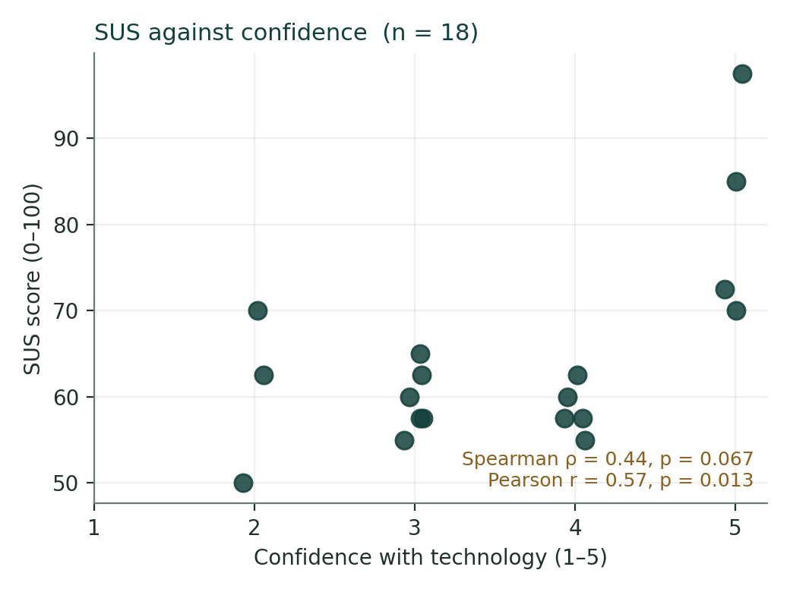
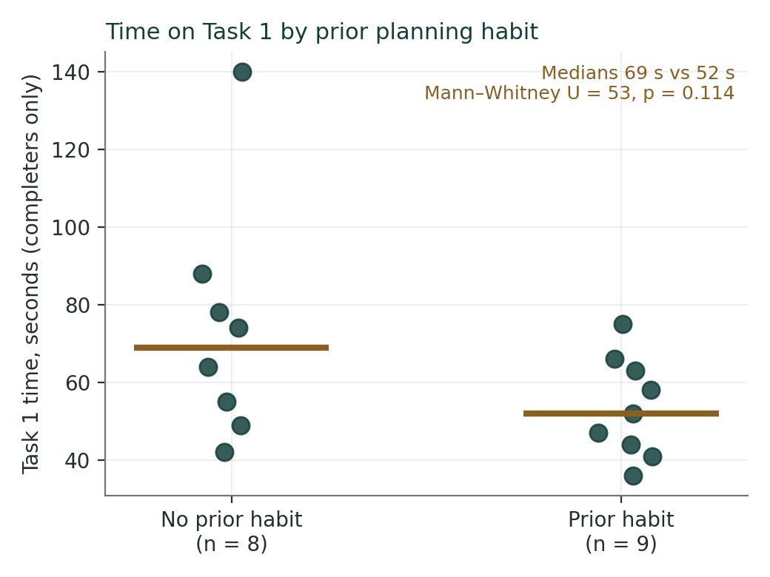
ACTIVITY B · TWO PLOTS FROM THE SAME EIGHTEEN
Now Look Before You Believe the Number
Left: which participant is the correlation? Right: is p = .11 “no difference”? Write the honest sentence for each.
Week 7 — What the Evidence Can Tell You
DECO6500 | Week 7 Lecture
Notes:
Left: Pearson says significant, Spearman does not, and P05 at 97.5 is why — one dot making the line. Right: a 17-second gap in medians that nine-versus-eight cannot confirm — and “performed the same” is wrong. Someone will say each of those; let them, then correct it with the plot.

Slide 30
ACTIVITY B · WHAT WE SAW
The Honest Claim Names Its n and Shows Its Plot
“83% completed”
Fifteen of eighteen (83%) completed unaided; two with assistance; one did not. The count carries the n; the assisted completions are not the same evidence.
“Mean time 63 s”
Median 58 s (range 36–140, n = 17 completers). P11’s 140 seconds drags the mean; the median is the middle person.
“Confidence significantly predicts SUS”
Spearman ρ = 0.44, p = .07, n = 18 — moderate, not significant, and the scatterplot shows P05 at 97.5 making Pearson look strong. Association, not prediction.
“Prior habit made no difference”
Median 52 s vs 69 s (n = 9 and 8), U = 53, p = .11. A visible difference the test cannot confirm at this size — not “no difference”.
And the six interviewees had a median confidence of 4.5 against 3.0 for the rest. Whatever the talk says about ease of use, it is the talk of the confident — which bounds the claim, and goes in the limitations now.
This dataset is the sample inside the Colab notebook. On Friday the notebook reproduces every number on this slide.
Week 7 — What the Evidence Can Tell You
DECO6500 | Week 7 Lecture
Notes:
Four things surface in the room: 83% with the assisted completions folded in; the mean time dragged by P11; “significant” from Pearson with P05 doing the work; and “performed the same” from p=.11. Rewrite one live. Then the interviewee check: the six were the most confident.

Slide 31
TWO RECORDS TO KEEP AS YOU GO
Deviations, and the Claim-Strength Check
AS IT HAPPENS
ON FRIDAY
The deviation log
The claim-strength check
A dated list in the notebook: what changed, why, who decided, and what it does to interpretation.
“P04’s time on Task 2 is not comparable — the prototype crashed and was restarted.”
Written as it happens it is a strength. Reconstructed in Week 8 it is worth nothing.
Beside each committed question: the Week 5 prospective claim, and the claim the evidence now supports.
Three honest outcomes: it holds; it drops a register, and you say why; or “cannot establish”, with the reason.
The third outcome is a finding — and often a systemic question register entry for A3.
Demonstrates
Every relevant case, directly observed, no plausible other explanation. “All eighteen completed the sign-up unaided” demonstrates that people like these eighteen can — not that it is easy, and not that the intended users can if these were not them.
A deviation you logged is evidence of judgement. A deviation you hid is evidence of the opposite, and markers can tell.
Week 7 — What the Evidence Can Tell You
DECO6500 | Week 7 Lecture
Notes:
Something will not go to plan this week. Not writing it down is the problem. The claim-strength check on Friday: the Week 5 prospective claim beside the claim the evidence now supports, with the gap named. Say what “demonstrates” needs so it is used rarely and correctly.

Slide 32
BEFORE FRIDAY
Three Things To Do on Friday, in This Order
1 · Organise and de-identify
2 · Start in the real tools
3 · The two checks, and the review
Everything into the Team SharePoint folder. IDs, not names; one key file kept separately.
Transcription approach decided and started.
The one-row-per-participant CSV built.
NVivo through the UQ Digital Workspace — nothing to install, the same on Mac and Windows — with your codebook set up from the resource page.
The Colab notebook on your de-identified CSV. Sample data first if yours is not ready.
Deviation log current.
Claim-strength check for every committed question with any evidence.
The mid-project team review — every team, at the same time, in the middle of the class.
Do not write themes. Do not write findings. Do not report a percentage without its count, or call a correlation significant without its scatterplot, or say two groups were the same because a test came back null. Do not wait for the last session before coding the first.
Week 8 is where the numbers and the talk meet: what they agree on, where they disagree, where one is silent. Friday is for starting both.
Week 7 — What the Evidence Can Tell You
DECO6500 | Week 7 Lecture
Notes:
Whatever state the team is in. Then what not to do. Week 8 is where the strands meet — only possible if both have been started.

Slide 33
WHERE TO FIND THINGS
Resources for This Week
Quantitative Analysis with Colab
Course website · Resources
The notebook step by step, what to write as you go, and how to report eighteen people honestly.
Getting Set Up with NVivo
Course website · Resources
Four steps into NVivo through the UQ Digital Workspace, and where your project has to live.
Using NVivo for Qualitative Analysis
Course website · Resources
The two videos, NVivo’s parts in the course’s terms, and the order of work.
Analysis frameworks: PACE+W, Nielsen, Norman
Course website · Resources
Codebooks with definitions and example passages, ready to set up in NVivo. Being prepared this week.
Analysing What You Collect
Course website · Resources
Qualitative, quantitative, triangulation, and the claim language.
Research Ethics and Data Handling
Course website · Resources
Where data lives, what may leave the team folder, and the transcription rules.
Ask your tutor in the applied class if anything on this list is unclear.
Week 7 — What the Evidence Can Tell You
DECO6500 | Week 7 Lecture

