Slide 1
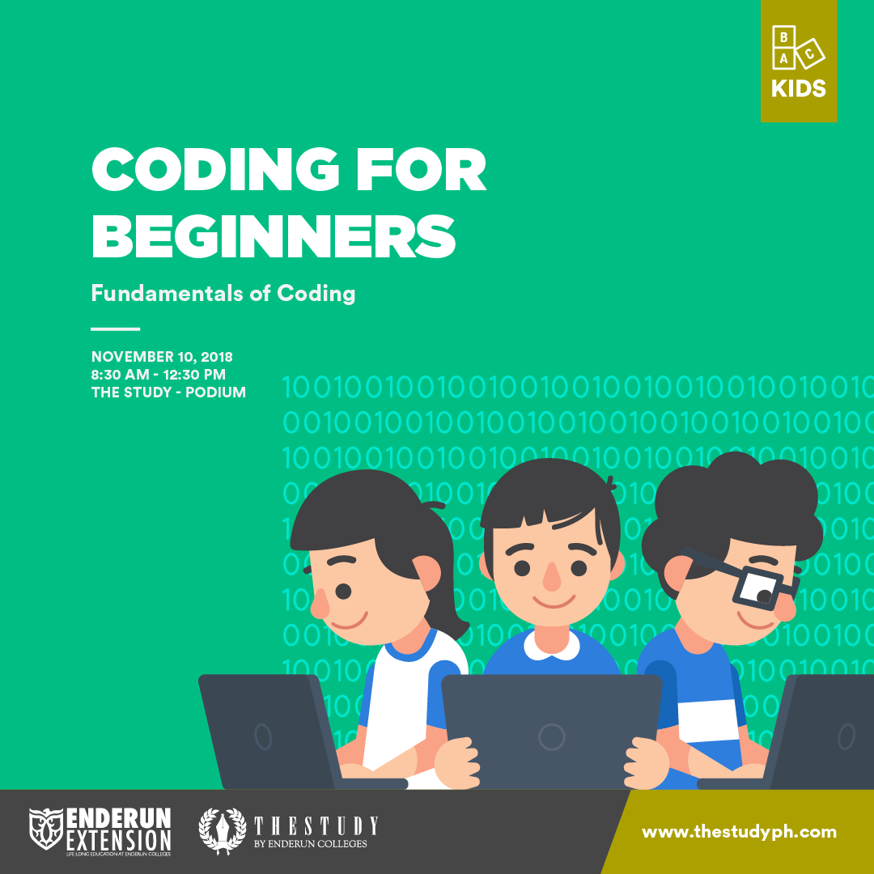
PYTHON FOR BEGINNERS
Python Foundation I
MARCH 14, 2018
7:30 PM – 9:30 PM
UTOWN

Slide 2
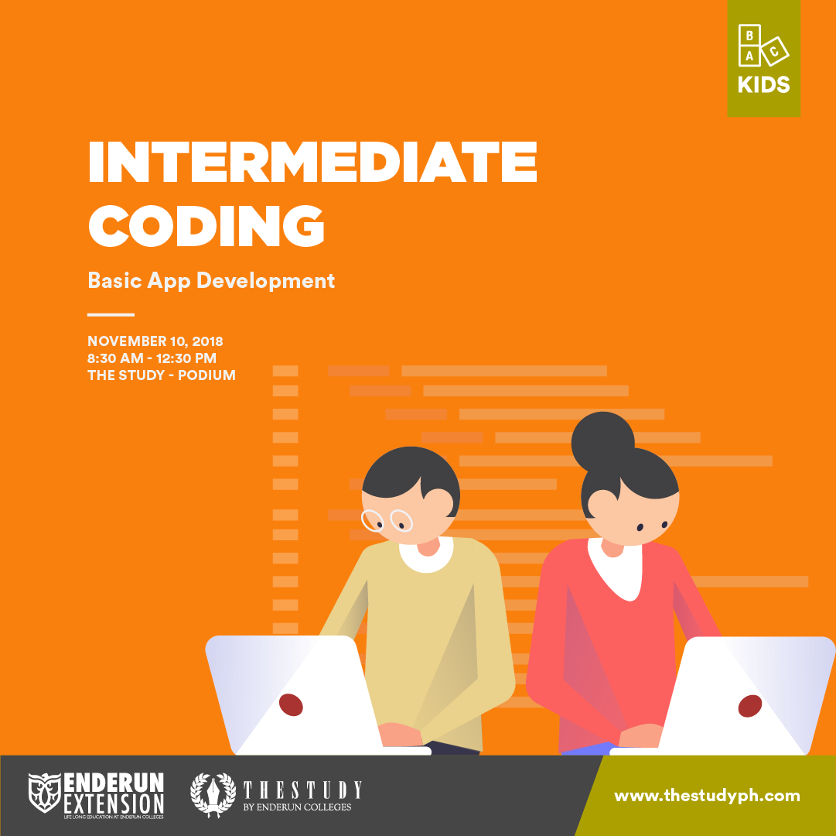
INTERMEDIATE PYTHON PROGRAMMING
Python Foundation II
APRIL 11, 2018
7:30 PM – 9:30 PM
UTOWN

Slide 3

“R” You Ready?:
Introduction to R Programming
MAY 11, 2019
12:30 PM – 5:30 PM
UTOWN

Slide 4
“R” You Ready?:
Introduction to R Part II
MAY 25, 2019
12:30 PM – 5:30 PM
UTOWN

