Slide 1
Welcome to the CHONe Data Management Workshop
Please download the following:
OpenRefine OpenRefine (formerly Google Refine) is a powerful tool for working with messy data: cleaning it; transforming it from one format into another. (Download and extract only, no ‘install’)
R is a language and environment for statistical computing and graphics.
RStudio (the open source ‘free’ version) is an integrated development environment (IDE) for R. It includes a console, syntax-highlighting editor that supports direct code execution, as well as tools for plotting, history, debugging and workspace management.
Github Desktop (the app) is a seamless way to contribute to projects on GitHub (the website)
A Github account Will allow you to host your version controlled project folder (repository) in the cloud for collaboration, sharing (and backup!).

Slide 2

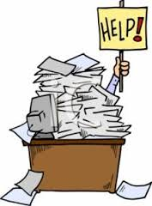
Welcome
Data Management Workshop
May 1st, 2017
Gatineau, Quebec

Slide 3

Workshop Agenda
May 1st (6-9pm)
Introduction to Data Workshop
Metadata
Data organization with spreadsheets
Data cleaning and raw data management
May 2nd (8:30am-5pm)
Shock and awe with R
Data Analysis and Visualization in R
Text analysis
Data Archiving & Version control
Hacky Hour (6-8pm)
Notes:
Four Points by Sheraton Hotel: Renaissance B (4th Floor)

Slide 4
Workshop Agenda
May 1st (6-9pm)
Introduction to Data Workshop
Metadata
Data organization with spreadsheets
Data cleaning and raw data management
May 2nd (8:30am-5pm)
Shock and awe with R
Data Analysis and Visualization in R
Text analysis
Data Archiving & Version control
Hacky Hour (6-8pm)
Coffee Break 10-10:20am
Lunch 12-1pm
Coffee Break 3-3:20am
Notes:
Four Points by Sheraton Hotel: Renaissance B (4th Floor)

Slide 5
Network Deliverables
Journal publications
Technical/policy reports
Books
Theses
Educational documents
Technical/analytical frameworks
New statistical/analytical techniques
Maps (pdf, raster, shapefiles..)
Models
Code (R, Python..)
Spreadsheets
Samples
Specimens
Video, Audio and Photos
Partnership meetings
Posters
Presentations
Public forums
Podcasts, blogs and videos
Participation in workshops and conferences and dicussions
Uptake of research by private enterprise
Contribution to management and policy decisions
Interviews with radio, tv or newspapers

Slide 6

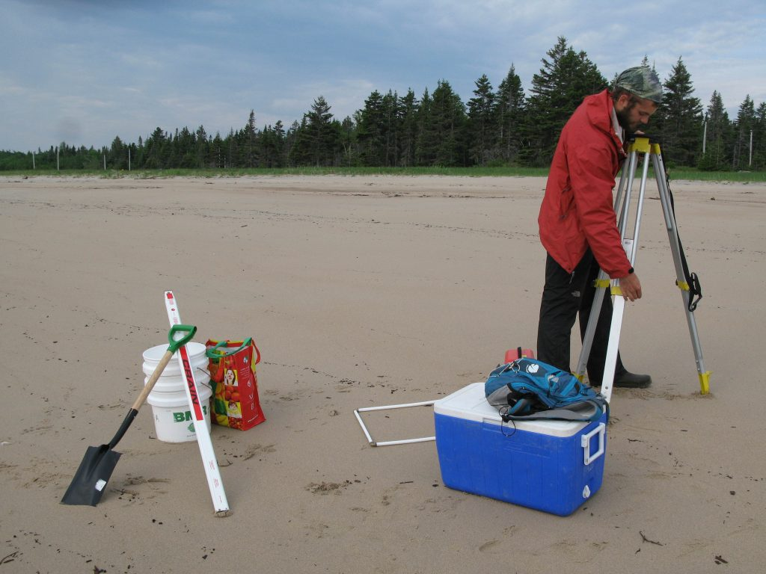
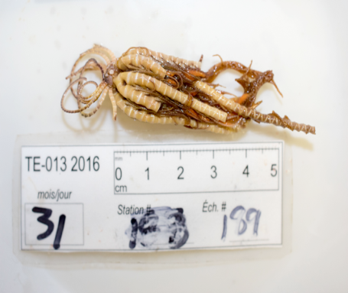
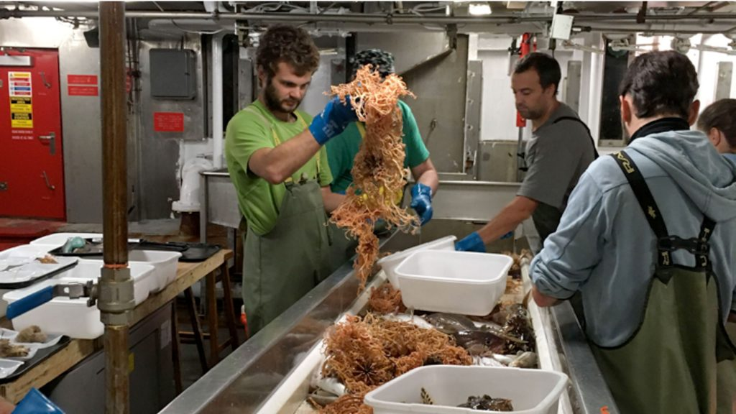

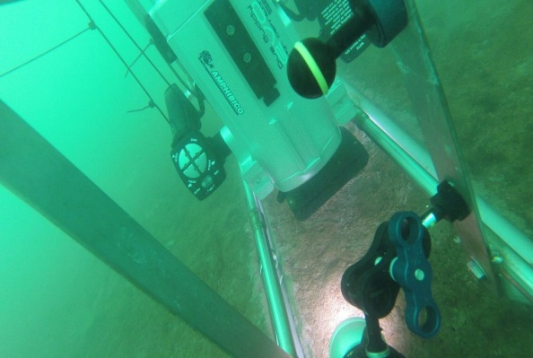
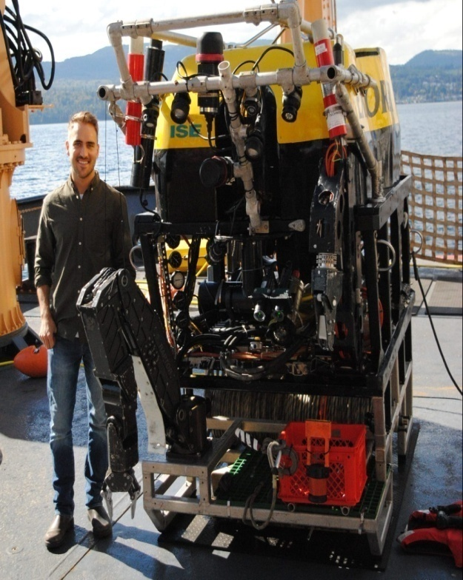
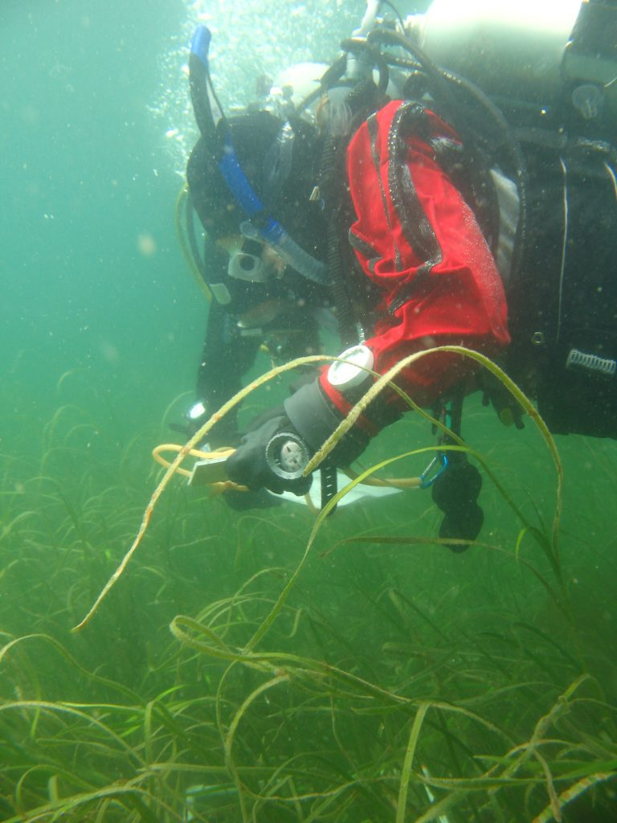
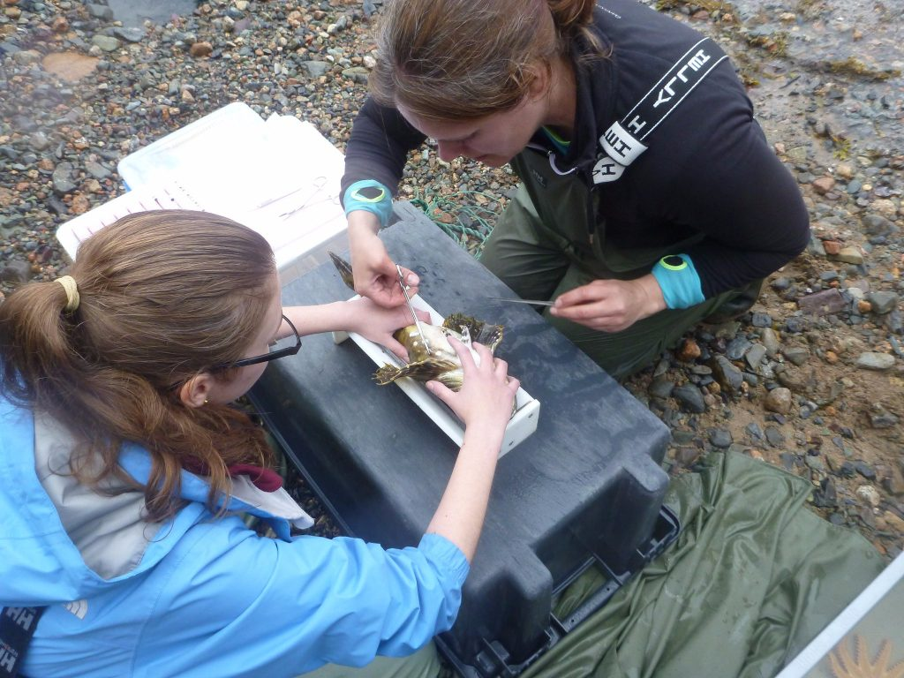
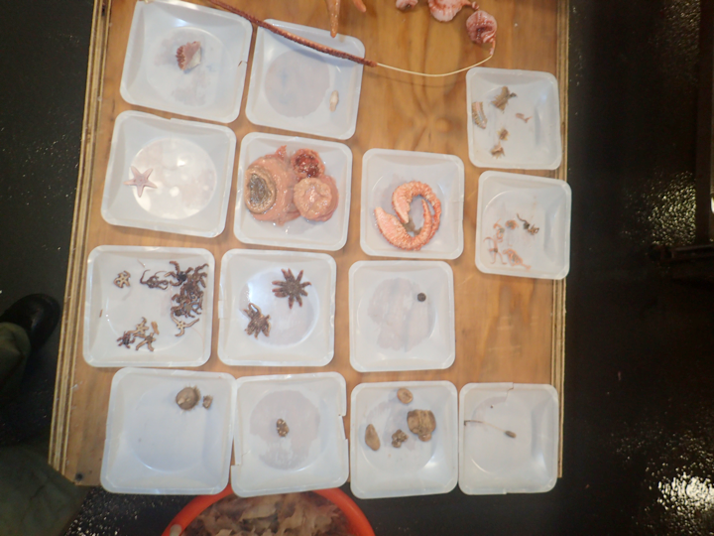
CHONe Data Efforts...

Slide 7
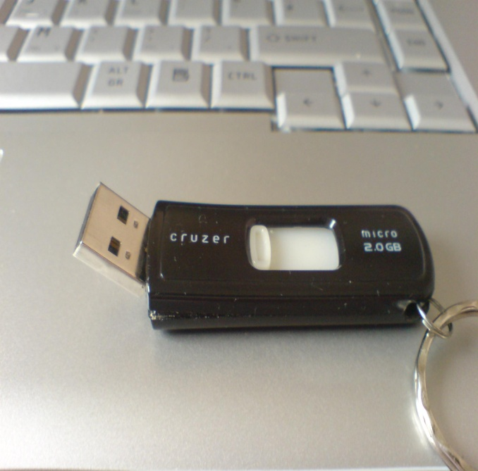
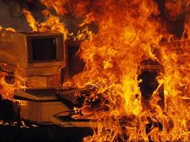
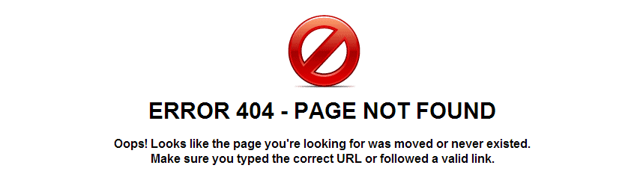
What can go wrong?
Boken media device
Stolen/damaged property
Hardware/software malfunction
Building (i.e. fire, flooding, loose power)

Slide 8
Solution!
Backups:
Used to take periodic snapshots of data in case the current version is destroyed or lost
Backups are copies of files stored for short or near-long-term
Often performed on a somewhat frequent schedule
Archiving:
Used to preserve data for historical reference or potentially during disasters
Archives are usually the final version, stored for long-term, and generally not copied over
Often performed at the end of a project or during major milestones
Data Preservation:
Includes archiving in addition to processes such as data rescue, data reformatting, data conversion, metadata

Slide 9
Solution!
3-2-1 Rule:
Have at least three copies of your data.
Store the copies on two different media.
Keep one backup copy offsite.

Slide 10
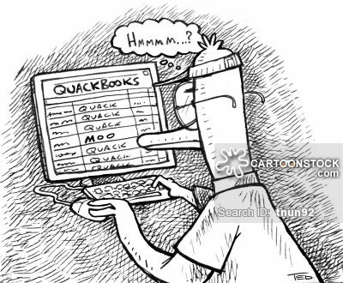

What can go wrong?
Human error
Missing data
Unauthorized changes to data
Sensor malfunction
Equipment not calibrated

Slide 11
Solution!
Quality Assurance and Control: (QA/QC)
Strategies for preventing errors from entering a dataset
Activities to ensure quality of data before collection
Activities that involve monitoring and maintaining the quality of data during the study
Designate who is responsible for QA/QC throughout the project

Slide 12
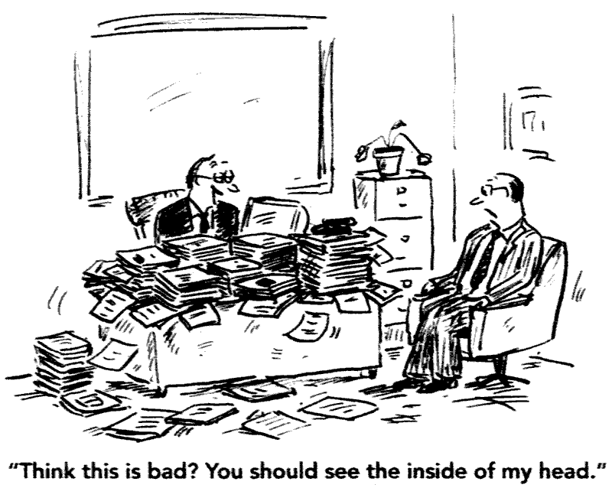
What can go wrong?
Unspecified acronyms
Unknown units of measurement
Methods not described
Inappropriate use of data
Not given credit for data use

Slide 13
Solution!
Metadata:
“Data that provides information about other data”
WHO created the data?
WHAT is the content of the data?
WHEN were the data created?
WHERE is it geographically?
HOW were the data developed?
WHY were the data developed?

Slide 14
Data Management Planning
Data Management Questionnaire: a series of questions outlining how you plan to manage your data.
Structured planning process for each CHONe student and researcher.
Help identify project requirements early on e.g. storage space, software, metadata standards, training workshops…
Get advice from DM before data collection/analysis
Fosters network collaboration and data sharing

Slide 15
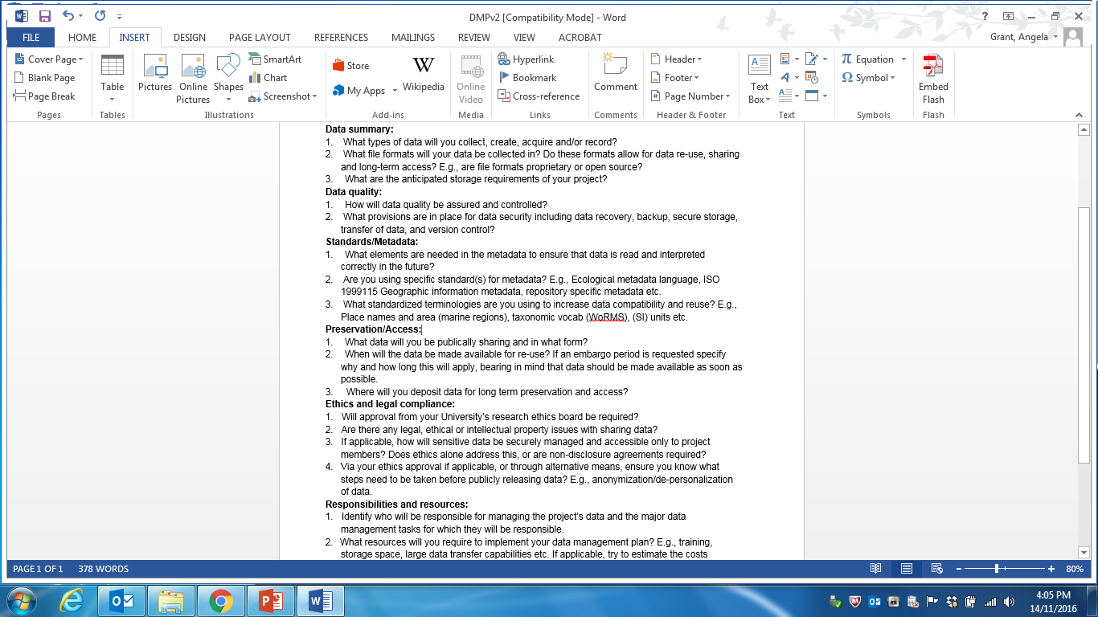
Data Management Planning
CHONe DMQ:
Data Summary
Data Quality
Standards/Metadata
Preservation/Access
Ethics/Legal Compliance
Responsibilities/Resources

Slide 16
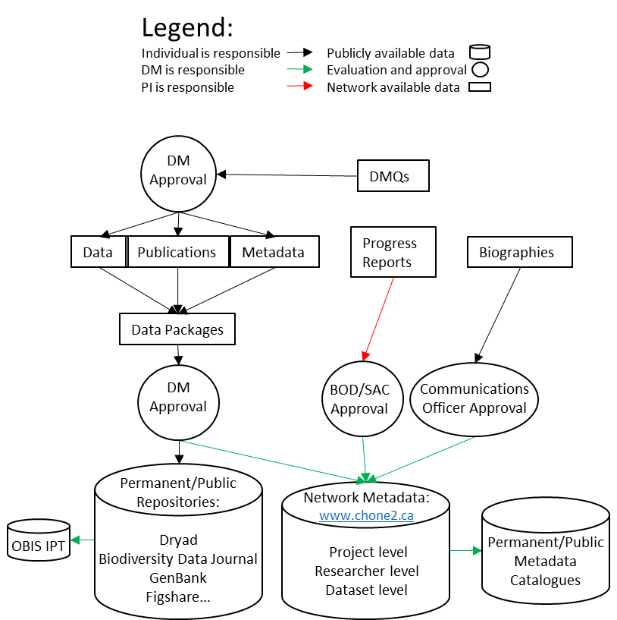
CHONe Data Management Plan

Slide 17
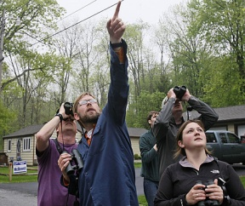
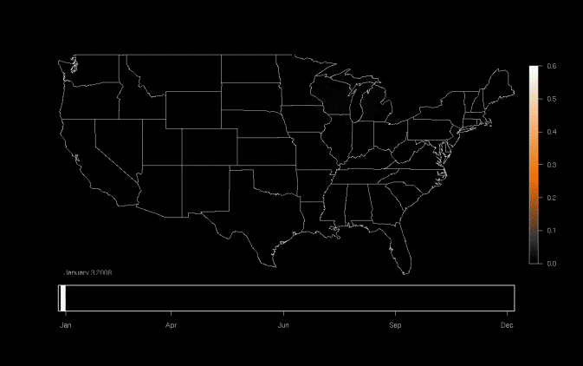
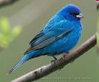
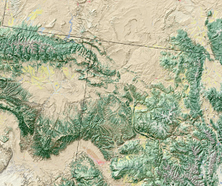
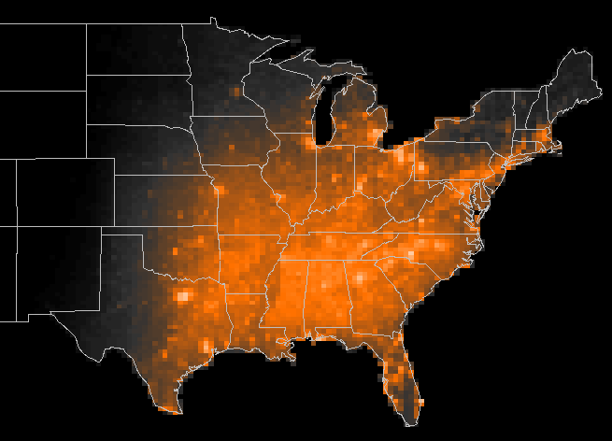


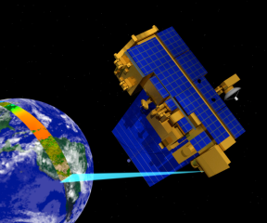
Well-Managed Data Can Result in Re-use, Integration, and New Science
Model results
Bird Observations
Occurrence of Indigo Bunting
Model: Indigo Bunting locations during the year
Land Cover
Jan
Apr
Jun
Sep
Dec
Meteorology
Potential Uses-
Examine patterns of migration
Infer impacts of climate change
Measure patterns of habitat usage
Measure population trends
MODIS – Remote sensing data
Slide courtesy of DataOne
Notes:
By re-using data collected from a variety of sources – eBird database, land cover data, meteorology, and remotely sensed by NASA – this project was able to compile and process the data using supercomputering to determine bird migration routes for particular species.

Slide 18
Why Data Management?
Keep yourself organized
Improved data quality
Avoid data loss
Facilitate data analysis
Reproducibility /accountability of research
Get credit for your data
Promote your research through data sharing
Get hired after graduation
NSERC funding requirements
Notes:
Aside from reproducibility and transparency (though both excellent reasons!), good data management provides many benefits to the researcher.

Slide 19
Why Data Management?
Data as a public good
Data is a valuable asset – it is expensive and time consuming to collect/analyze
Reduce research duplication
Speed up innovation
Facilitate data sharing
Foundation to advance science
Notes:
Data management and sharing help advance science through re-use…

Slide 20
Summary
If data are:
Well-organized
Documented
Preserved
Accessible
Verified as to accuracy and validity
Result is:
High quality data
Easy to share and re-use in science
Citation and credibility to the researcher
Cost-savings to science

Slide 21
Data Management Resources:
Data One: Education Modules
Dalhousie Library: Guide to Research Data Management
UBC Library: Research Data Management
Me (the Data Manager): angela.grant@mun.ca, 1-(709)-864-2298, or on the CHONe Slack page.

