Slide 1
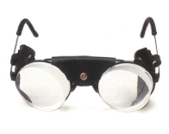
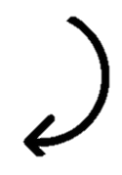
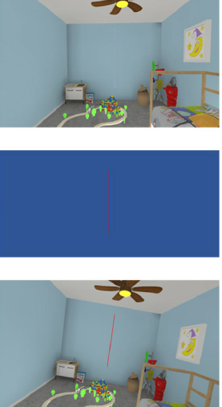
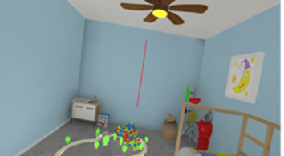
250 pointing toward 2 targets
10 minutes ?
Plain glasses
+/- 10° prisms
Between-S
(left vs right)
10 Subjects in each condition
Prismatic adaptation
Left
Right
8 trials
5/6 minutes ?
VV
VV
Intervention
Control
Perturbation
SA
SA
Fixed order
VTR
Within-S
(control vs perturbation)
10 trials
1-2 minutes
Upright
+/- 18° tilt
Task = music ?
5 minutes ?

