Slide 1
AI CLINIC
AI for Healthcare Compliance and Regulations Across Countries
Interactive Dashboard and Comparative Regulatory Analysis
Remi Uttejitha ALLAM · Baptiste Langlois · Tong Li · Darryl Towa
Supervisor: Dr. Anuradha Kar | aivancity | Academic year 2025-2026

Slide 2
Agenda
1. What is this project about?
2. Problem statement and objectives
3. Methodology pipeline (data → scores → dashboard)
4. Compliance scoring and maturity classes
5. Seven regulatory themes explained
6. Key results - tables and figures
7. Gaps, convergence, and recommendations
8. Future impact - how this work helps improve practice
9. Limitations and thank you
AI Clinic | aivancity | AI Healthcare Compliance Across Countries

Slide 3
What is this project about?
AI Clinic compares how different countries regulate artificial intelligence in healthcare, and turns that comparison into an interactive dashboard and research report.
Literature synthesis
20-country dataset
Interactive dashboard
Research report
Policy and peer-reviewed sources on SaMD, privacy, ethics, and lifecycle governance (2018-2026).
Seven themes scored 1-10, maturity labels, device counts, challenges, and notable developments.
Map, theme analysis, peer comparison, trends, country profiles, and literature browser.
Method, results figures/tables, country profiles, conclusions, and recommendations.
AI Clinic | aivancity | AI Healthcare Compliance Across Countries

Slide 4
Problem: why does this matter?
AI medical software (SaMD) is growing fast in imaging, clinical decision support, genomics, and drug discovery.
Rules are not the same everywhere: privacy laws, approval pathways, validation standards, and liability differ by country.
Public information is fragmented across statutes, agency guidance, ethics documents, and device lists.
Developers, policymakers, clinicians, and researchers need one structured, comparable view.
Our response: a coded comparative framework + live dashboard (decision support, not legal advice).
AI Clinic | aivancity | AI Healthcare Compliance Across Countries

Slide 5
Project objectives
Synthesise literature and regulatory texts on AI healthcare compliance across 20 jurisdictions.
Define seven thematic dimensions and score maturity on a transparent 1-10 scale.
Build a curated, machine-readable dataset with regional metadata and global trends.
Implement an interactive dashboard for exploration, comparison, and literature browsing.
Document methodology, architecture, findings, and recommendations in the research report.
AI Clinic | aivancity | AI Healthcare Compliance Across Countries

Slide 6
Methodology pipeline: data collection → score calculation
1. Scope
20 jurisdictions across seven regions: North America, Europe, Asia, Middle East, Africa, Oceania, South America.
2. Collect
Primary: FDA, EMA, MHRA, NMPA, PMDA, WHO, IMDRF, GDPR/AI Act… Secondary: PubMed, Scopus, IEEE, Scholar, SSRN (2018-2026).
3. Code
Same schema for every country: privacy, AI rule, device framework, approval, validation, ethics, post-market, liability…
4. Score
Assign 1-10 per theme using 4 criteria; assign qualitative maturity label separately.
5. Store
Version-controlled JSON: data/compliance_dataset.json.
6. Derive
Dashboard computes overall mean, gaps (max−min), and use-case readiness.
7. Report
Figures, tables, country profiles, conclusions.
AI Clinic | aivancity | AI Healthcare Compliance Across Countries

Slide 7
Compliance score - what it is and how it is calculated
Each theme score is ordinal 1-10: 1 = little/no documented requirement; 10 = mature, enforceable practice.
Evidence mapped with four criteria: (1) law/guidance exists, (2) AI/SaMD specificity, (3) enforcement/reporting, (4) IMDRF/WHO/GMLP alignment.
Overall score = arithmetic mean of selected theme scores (rounded to 1 decimal).
Formula: Overall = (1/k) × Σ sᵢ where k = number of selected themes.
Important: these are comparative research indicators - not official government ratings.
No machine-learning model invents scores at runtime; scores are curated from documentary evidence.
AI Clinic | aivancity | AI Healthcare Compliance Across Countries

Slide 8
Seven dashboard variables (compliance themes)
Theme
What it measures
Data Privacy
Health-data protection laws, cross-border transfers, DPIAs
Clinical Validation
Evidence standards, clinical evaluation, bias assessment
Approval Process
SaMD pathways, AI-specific guidance, regulatory sandboxes
Transparency
Explainability expectations, documentation, clinician intelligibility
Ethics
National AI ethics frameworks, fairness, human oversight
Post-Market
Adverse-event reporting, lifecycle monitoring, update governance
Liability
Product liability, malpractice interfaces, AI-specific proposals
AI Clinic | aivancity | AI Healthcare Compliance Across Countries

Slide 9
Maturity classes - definitions (not a formula on overall score)
Class
Definition
Examples
n
Early
Limited AI-specific healthcare rules; few approvals
Nigeria, Kenya
2
Emerging
Privacy/ethics exist; SaMD pathway still forming
Saudi Arabia, South Africa
3
Developing
Device framework + emerging AI guidance
India, Brazil
3
Moderate
Working SaMD registration & post-market system
Australia
1
Advanced
Dedicated AI/ML SaMD or high-risk AI law + lifecycle
US, EU, Japan, Singapore…
11
Maturity is assigned from documentary evidence (AI rules, device pathway, approval activity, privacy/ethics enforcement). Device risk class (FDA I-III) describes the product; maturity describes the country.
AI Clinic | aivancity | AI Healthcare Compliance Across Countries

Slide 10
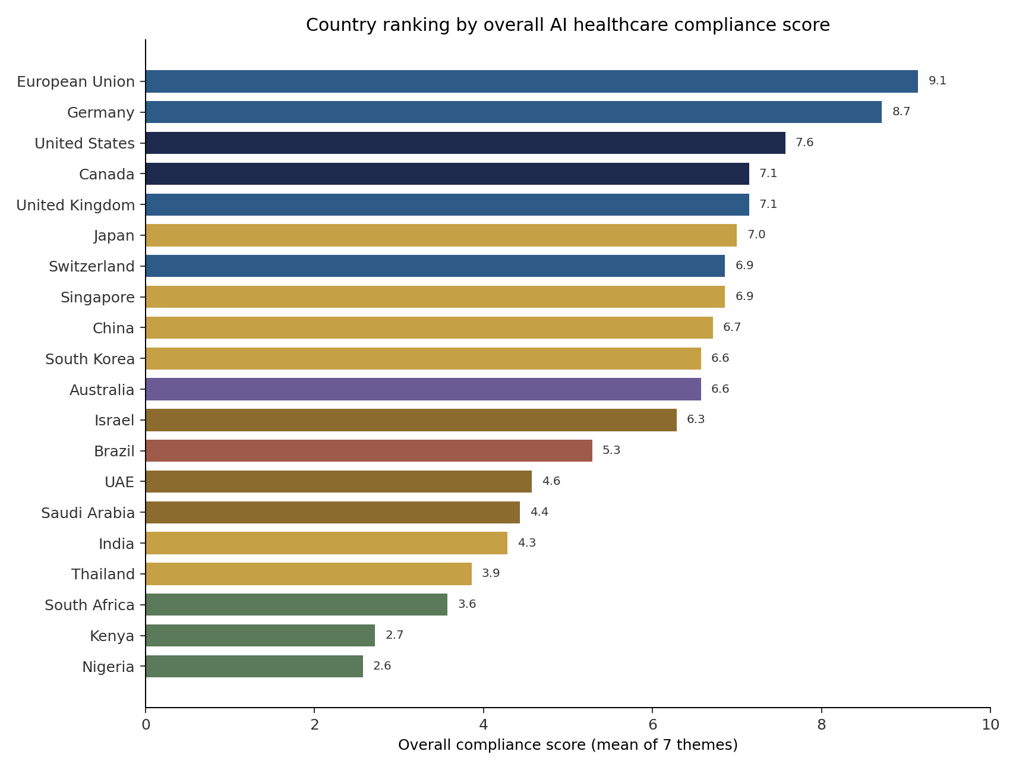
Figure: overall country ranking
Mean of seven theme scores. EU / Germany / United States lead; Kenya and Nigeria trail - capacity gap at a glance.
AI Clinic | aivancity | AI Healthcare Compliance Across Countries

Slide 11
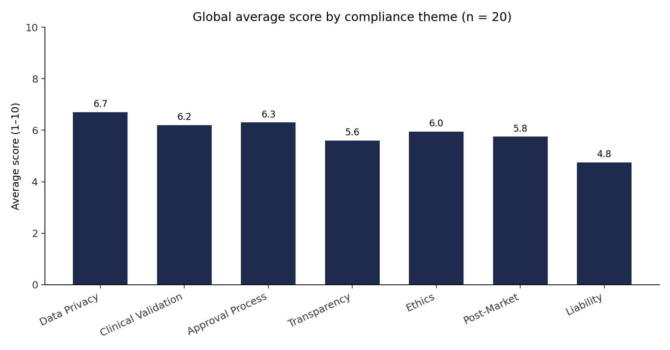
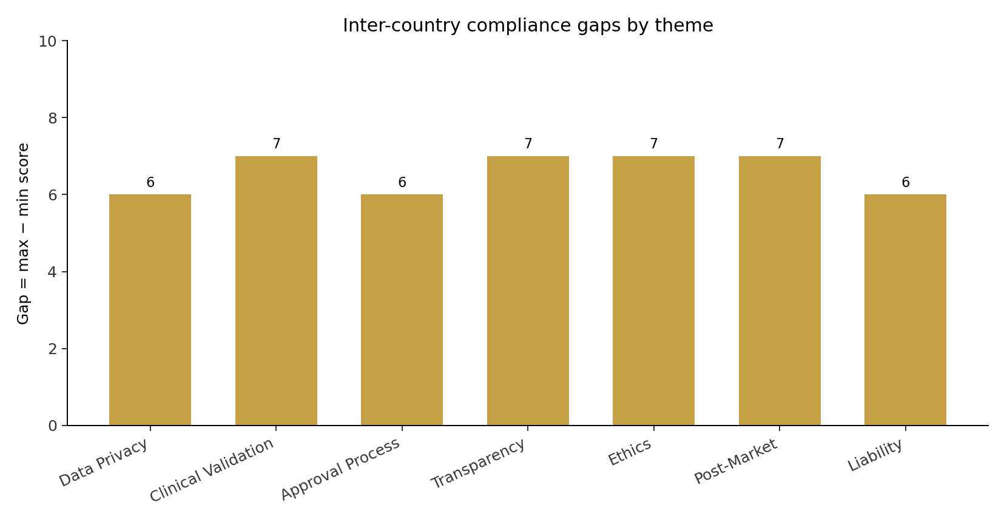
Figures: theme averages and inter-country gaps
Left: worldwide average maturity by theme (approval & privacy lead; post-market & liability lag). Right: Gap = max − min score - large gaps mean strong divergence.
AI Clinic | aivancity | AI Healthcare Compliance Across Countries

Slide 12
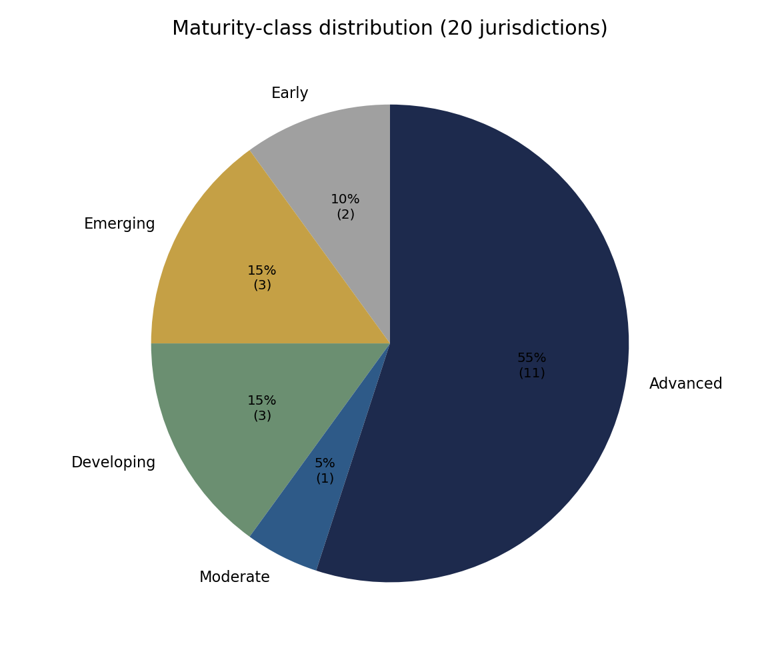
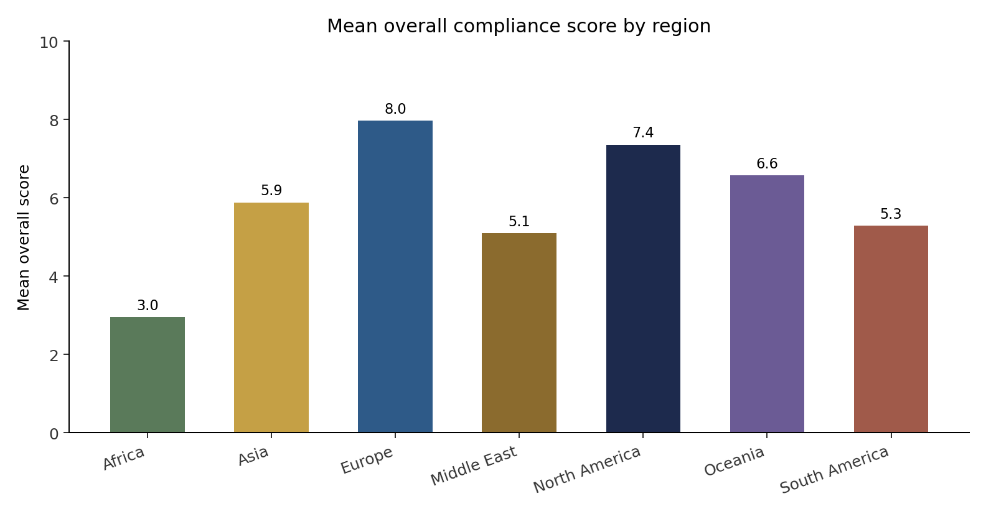
Figures: maturity mix and regional means
Advanced slice is large because the sample includes major regulators. Europe leads regional means; Africa is lowest.
AI Clinic | aivancity | AI Healthcare Compliance Across Countries

Slide 13
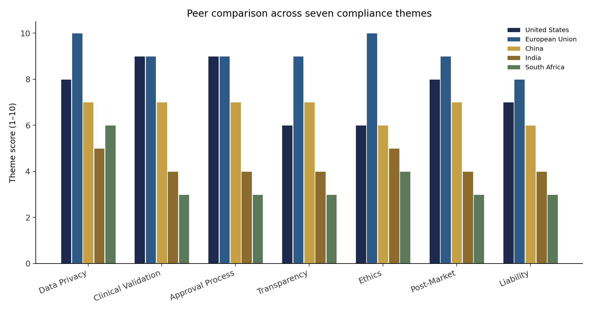
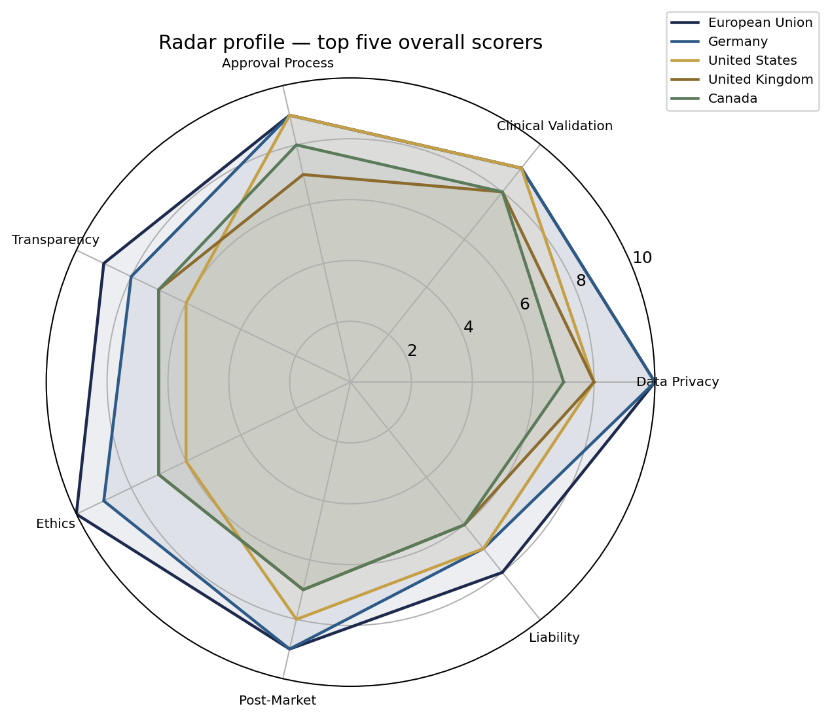
Figures: peer comparison and top-5 radar profiles
US/EU lead most themes; India and South Africa lag on validation, post-market, and liability. Radar shape shows theme strengths differ even among top scorers.
AI Clinic | aivancity | AI Healthcare Compliance Across Countries

Slide 14
Table: country compliance scores (top 12 + bottom 3)
Country
Overall
Priv
Clin
Appr
Trans
Eth
Post
Liab
Maturity
European Union
9.1
10
9
9
9
10
9
8
Advanced
Germany
8.7
10
9
9
8
9
9
7
Advanced
United States
7.6
8
9
9
6
6
8
7
Advanced
United Kingdom
7.1
8
8
7
7
7
7
6
Advanced
Canada
7.1
7
8
8
7
7
7
6
Advanced
Japan
7.0
7
8
8
6
7
8
5
Advanced
Singapore
6.9
7
7
7
8
8
6
5
Advanced
Switzerland
6.9
8
8
8
6
6
7
5
Advanced
China
6.7
7
7
7
7
6
7
6
Advanced
Australia
6.6
7
7
7
6
7
7
5
Moderate
South Korea
6.6
7
7
8
6
6
7
5
Advanced
Israel
6.3
6
8
7
6
6
6
5
Advanced
South Africa
3.6
6
3
3
3
4
3
3
Emerging
Kenya
2.7
5
2
3
2
3
2
2
Early
Nigeria
2.6
4
2
3
2
3
2
2
Early
AI Clinic | aivancity | AI Healthcare Compliance Across Countries

Slide 15
Headline results
Sample: 20 jurisdictions · 7 themes · maturity distribution includes 11 Advanced and 2 Early.
Top overall: European Union (9.1), Germany (8.7), United States (7.6).
Europe leads privacy/ethics/transparency; United States leads clinical validation and approval volume.
Asia is heterogeneous: Japan/Singapore/China Advanced; India/Thailand Developing.
Africa: South Africa Emerging; Kenya & Nigeria Early - privacy statutes alone do not raise overall AI healthcare compliance.
Weakest global pillars: post-market surveillance and liability (lifecycle & accountability).
AI Clinic | aivancity | AI Healthcare Compliance Across Countries

Slide 16
What we mean by gaps and convergence trends
Gaps
Convergence
Gap = max(country score) − min(country score) on one theme.
Large gap = divergence zone.
Useful for multi-country evidence strategy.
Widest gaps often: clinical validation & transparency.
Not identical laws - shared principles & tools.
Risk-based SaMD classification (IMDRF-style).
GDPR-like health-data protection.
GMLP / lifecycle / PCCP thinking.
Shift from voluntary ethics toward binding rules (e.g. EU AI Act).
AI Clinic | aivancity | AI Healthcare Compliance Across Countries

Slide 17
Table: selected global trends
Trend
Adoption
Since
Description (short)
Convergence on Risk-Based Regulation
High
2017
Most jurisdictions adopting risk-based classification of AI medical de…
Comprehensive Data Protection Laws
High
2018
Post-GDPR wave of national data protection laws with health data as se…
AI-Specific Legislation
Medium
2021
Growing trend toward dedicated AI laws (EU AI Act leading, followed by…
International Harmonization Efforts
Medium
2019
IMDRF, GMLP (FDA-Health Canada-MHRA), and WHO guidance driving converg…
Ethical AI Frameworks
High
2018
Proliferation of national AI ethics principles, mostly voluntary, incr…
Regulatory Sandboxes for Health AI
Low
2020
Controlled testing environments for innovative AI devices before full …
Real-World Evidence Acceptance
Medium
2019
Growing regulatory acceptance of real-world data and evidence for AI d…
Adaptive Algorithm Governance
Low
2021
Frameworks for managing continuously learning AI systems (e.g., FDA Pr…
AI Clinic | aivancity | AI Healthcare Compliance Across Countries

Slide 18
Interactive dashboard artefact
Public web app (React + TypeScript + Recharts + maps), hosted on GitHub Pages.
Tabs: Overview · Theme Analysis · Comparison · Trends & Use Cases · Country Detail · Literature.
Filters by region, maturity, and themes recalculate overall scores and gaps instantly.
Live URL: https://remi7025.github.io/AI-Healthcare-Compliance-Dashboard/
Canonical data: data/compliance_dataset.json (same source as this presentation's tables).
AI Clinic | aivancity | AI Healthcare Compliance Across Countries

Slide 19
Future impact - how this work helps improve
For developers: choose first markets by theme strength (e.g. validation-heavy imaging → US/EU).
For policymakers: see where gaps are largest (validation, post-market, liability) and prioritise capacity building.
For researchers & students: reproducible open dataset + dashboard for teaching comparative AI governance.
For hospitals/clinics: link use-case readiness (radiology, genomics…) to local regulatory maturity.
Future upgrades: live regulatory feeds, Delphi expert scoring, more Latin America & African regulators,
and a dedicated evaluation track for foundation-model medical products.
Net effect: faster, safer, more transparent market access decisions and clearer reform priorities.
AI Clinic | aivancity | AI Healthcare Compliance Across Countries

Slide 20
Recommendations (synthesised from WHO, IMDRF, GMLP, EU AI Act, NIST, literature)
1. Expand IMDRF/WHO coordination on AI-specific clinical-evidence methods.
2. Build regulatory capacity in developing countries (technical assistance, mutual-recognition pilots).
3. Operationalise ethics through measurable fairness, monitoring, and documentation standards.
4. Update liability frameworks before harm cases proliferate.
5. Maintain public dashboards and open datasets for transparent comparative research.
6. Treat foundation-model medical products as a dedicated evaluation track.
Note: recommendations are a synthesis of the evidence base - not a new Delphi survey.
AI Clinic | aivancity | AI Healthcare Compliance Across Countries

Slide 21
Limitations
Scores are expert documentary syntheses and will drift as laws change.
Device-approval counts are incomplete where agencies do not publish AI-specific tallies.
Sample over-represents Advanced jurisdictions relative to the true world map.
Oceania and South America regional means rest on single countries (Australia, Brazil).
This is academic decision support - not legal advice for market authorisation.
AI Clinic | aivancity | AI Healthcare Compliance Across Countries

Slide 22
Thank You
Questions & Discussion
Remi Uttejitha ALLAM · Baptiste Langlois · Tong Li · Darryl Towa
Supervisor: Dr. Anuradha Kar | aivancity School for Technology, Business & Society
Dashboard: remi7025.github.io/AI-Healthcare-Compliance-Dashboard

