Slide 1
Library Management Program
Tutor: Mr. Nguyen Ngoc Duy
Students: Truong Vu Binh
Dao Ngoc Quan
Class: C2005L

Slide 2

Agenda
Goals, requirements
Users
System Analysing
Program Demonstration
Final words

Slide 3

Software Objectives
Managing books detail, author listing, categories, publishers, issued books, and returning information at ease
Increase management tasks accuracy and efficiency
Saving time

Slide 4

Requirements
Easy to use and intuitive graphical user interface
Able to save large amount of information about books, borrowers, and issued information
Allows performing information management tasks at ease

Slide 5

Users
For librarian working at libraries for easier management tasks
Administrator can update students information, author listing, publishers, and books categories and manage users sign-in information

Slide 6


Software functions, capabilities
For Librarian:
Manage books information
Update issued books, returned books information
Quản trị viên
Manage books information, author, publisher, category listing
Update issued books, returned books information
Manage user sign-in credentials, students information

Slide 7
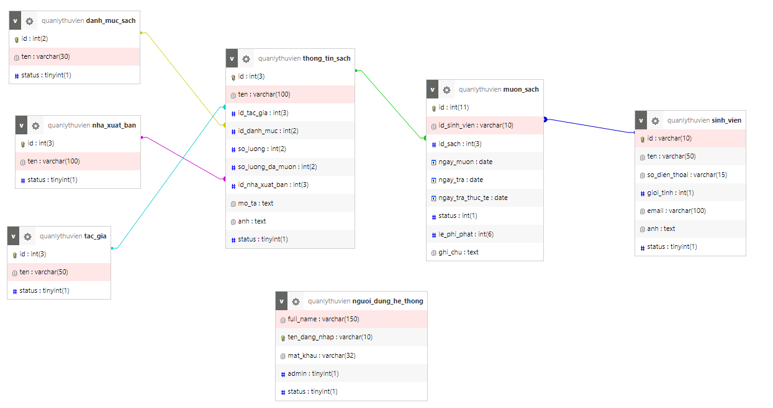
Entity Relationship Diagram

Slide 8
Final Word
The Software has managed to reduce library related task time and complexity, resulting in a more efficient working day.
We’re hoping to get more ideas and suggestions to improve our projects

Slide 9


