Slide 1
So we’re running ZooKeeper. Now What?
Camille Fournier, Rent the Runway
@skamille

Slide 2



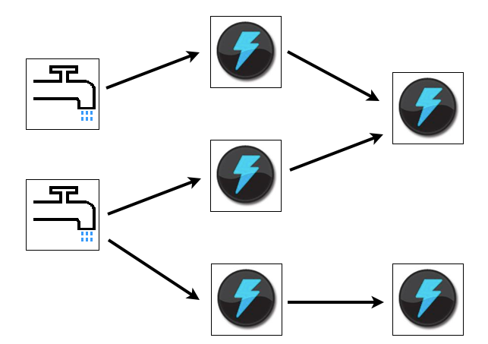
Big Data. Big Systems.

Slide 3
Common Challenges
Outages
Coordination
Operational Complexity
Notes:
Example of outage…
Nodes Goes Down
Network Partitions
Disk Corruption
Coordination: Task Assignment
Operational Complexity:
Finding other cluster members
Dynamic Configuration
Group Membership

Slide 4
Common Deficiency
Consistency guarantees

Slide 5
ZooKeeper in Storm
Storm uses Zookeeper for coordinating the cluster. Zookeeper is not used for message passing, so the load Storm places on Zookeeper is quite low

Slide 6
ZooKeeper
A centralized service for maintaining configuration information, naming, providing distributed synchronization, and providing group services
Distributed, Consistent Data Store
Highly Available
High performance
Strictly ordered access

Slide 7
Highly Available
Tolerates the loss of a minority ((n/2) – 1) of ensemble members and still function

Slide 8
High Performance
All data is stored in memory
Performance measured around 50,000 operations/second
Particularly fast for read performance, built for read-dominant workloads

Slide 9
Strictly Ordered Access
Atomic Writes
In the order you sent them
Changes always seen in the order they occurred
Reliable, no writes acked will be dropped

Slide 10
Basics: Cluster Interactions
leader
follower
follower
cli
cli
cli
cli
cli
cli

Slide 11
Basics: Cluster Interactions
leader
cli
cli
follower
follower
cli
cli
cli
cli

Slide 12
Basics: Cluster Interactions
leader
cli
cli
follower
cli
cli
cli
cli

Slide 13
Data Structure
cli
/a/b/myNode
/a/b
/a/b/d
/a
/a/c
/a/c/e000001

Slide 14
Basics: Data Structure
Nodes can contain data, have children, or both
Ephemeral nodes are associated with the session that created them
They cannot have children, and disappear when that session ends
Sequential nodes have an ever-increasing number attached to them

Slide 15
Watches
client
leader
client
getData “/foo” true
follower
return “mydata”
client
follower

Slide 16
Watches
client
leader
client
follower
client
setData “/foo” “bar”
follower

Slide 17
Watches
client
leader
client
NOTIFICATION
follower
client
follower

Slide 18
Watches
client
leader
client
getData “/foo” true
follower
return “bar”
client
follower

Slide 19
Basics: Watches
Set against data or path changes
Ordered with respect to other events, other watches, and asynchronous replies.
A client will see a watch event for a node it is watching before seeing the new data that corresponds to that node.
The order of watch events corresponds to the order of the updates as seen by the ZooKeeper service
One time notifications; must be reset, changes can be missed between notification and reset of the watch

Slide 20
Basics: Creation API
create
delete
setData

Slide 21
Basics: Get/Watch API
exists
getData
getChildren

Slide 22
Basics: API
multi * new in 3.4
sync
Notes:
If you use the sync call before a read, ZooKeeper provides
ilnearizability for sync+read and write operations (this is true with
certain timing assumption made in ZooKeeper for efficiency).

Slide 23
Common Uses
Service Management
Distributed Locking

Slide 24
Coordination
In Storm, ZooKeeper is the source of communication between Nimbus and Supervisors
Nimbus finds Supervisors via ZooKeeper

Slide 25
Discovery (Naming)
Find servers doing job “Products”
Encode as path in ZooKeeper:
/servers/products
Servers register as ephemeral nodes under this path with details about location, other connection info

Slide 26
Configuration
Read config from nodes
Watch nodes for config changes

Slide 27
Locking
Shared Locks
Barriers and Latches
Leader Election
Two-Phase Commit

Slide 28

And Now, The Scary Part

Slide 29
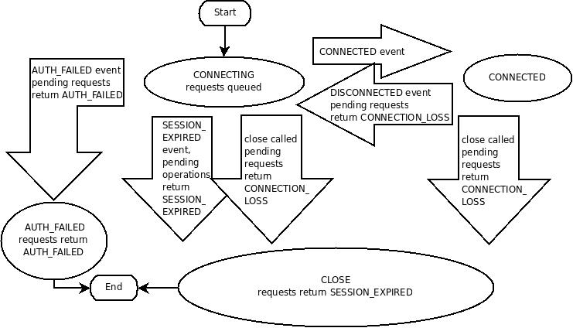
The State Machine

Slide 30
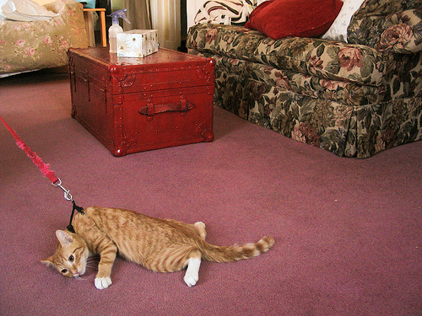
NOPE
NOPE

Slide 31
Recommended Clients
Curator (Java)
Kazoo (Python)
Twitter Commons for Discovery

Slide 32
Be Aware
ZooKeeper Owns Your Availability
(maybe)

Slide 33
Credits and Contact
Thank you to @zaa for the format of the slide on watches
Tweet me! @skamille
Email me! camille@apache.org
Kazoo: http://kazoo.readthedocs.org/en/latest/
Curator: http://curator.incubator.apache.org/
Twitter commons: http://twitter.github.io/commons/

