Slide 1
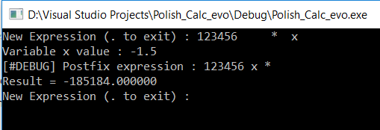
Supported (1):
Spaces
A negative value for the variables
A decimal value for the variables
Multi-digit fixed operands

Slide 2
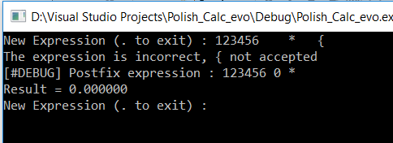
Supported (2):
Variable name is [a-z,A-Z] :
If different the expression can not be computed and an error message appears

Slide 3
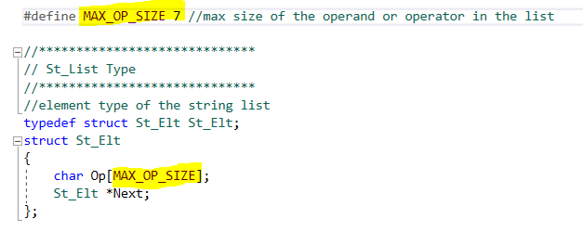
Not Supported / Known limitations :
Unary “-” (minus) operator
Multi letter variable name (only a single letter variable name is accepted)
Multi-digit fixed operands are limited to 6 digits

Slide 4
Remarks (1) :
The ReversePolish function calls 2 sub-routines :
Infix2Polish
Polish2Calc
4 main data structures are used :
A linked list of ”variables” to store the variables and their value
A linked list of “strings”, to store the operators when parsing the pre-fixed expression
A linked list of “strings”, to build the post-fixed expression
A linked list of “floats”, as evaluation stack of the post-fixed expression

Slide 5
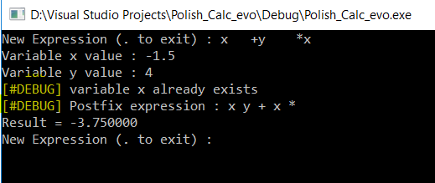
Remarks (2) :
#define DEBUG is left uncommented in “functions.h”

