Slide 1
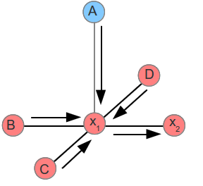
Loopy belief propagation
The belief propagation is a message passing algorithm that computes exact inference on trees. It can be used in graphs with cycles as well, however its convergence is not guaranteed and the result it yieds is not exact. Loopy comes form the cycles in general graphs.
Each node send a message to its neighbors telling them how likely he believes they are in a certain state. Messages are exchanged between nodes until the beliefs are stable (if ever).
The choice of the message passing scheme is arbitrary. Different sequences will generally produce different results.
Message passing from x1 to x2
Messages also tend to explode, so using log or normalizing them at each iteration is necessary, each yielding a different result as well

Slide 2
Mean Fields Algorithm
We approximate the joint distribution with a product distribution to infer the mean parameters mu.
Update : mu

