Slide 1
Docker & ECS in Production
How We Migrated Our Infrastructure from Heroku to AWS
Eric Holmes & Michael Barrett, Remind
Notes:
Thanks for coming! This is going to be a talk about how we migrated our infrastructure from Heroku using an internal platform as a service that we built on top of Amazon EC2 Container Service.

Slide 2
A brief introduction about why we decided to build an internal platform at Remind, and the lessons we learned along the way
An introduction to the open source PaaS we built called Empire, and how we’re leveraging Amazon EC2 Container Service
Demo
Q&A
Notes:
I’m going to start with a little background about why we decided to build a PaaS, our path that led to Empire and how we’re ultimately leveraging Amazon EC2 Container Service as the backend. I’ll give a short demo of setting up an Empire environment and deploying an app to it, and then I’ll open it up for any questions.

Slide 3

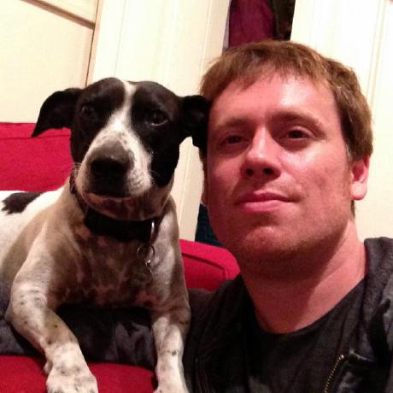
About Us
Eric Holmes & Michael Barrett
Infrastructure Engineers at Remind
We build things for developers
You can find our open source stuff at:
https://github.com/ejholmes
https://github.com/phobologic
Notes:
But first, a little bit about myself. My name is Eric Holmes and I’m an infrastructure engineer at Remind. I like building things for other developers. I work mostly with Go these days but my background is primarily in Ruby. I open source a lot of crazy ideas, and you can find them all on my GitHub.

Slide 4

Remind
A messaging platform for teachers.
Chat/Announcements/Files
Over 30 million users
Used actively in ~50% of U.S. public schools
Over 2 billion messages delivered
~50 employees. ~30 engineers.
Notes:
So, I work for this company called Remind. We build a product for teachers that makes it easier for them to communicate with their students and parents. We have 3 major features, which is real-time Chat, announcements and we support attaching files.
We have about 25 million users right now. During the “back-to-school” period, which is around September, we add about 350,000 new users and send about 5 million messages per day. We do this all with about 60 employees but we’re growing pretty fast.

Slide 5
A Little History

Slide 6
A Little History
Started as a “monorail”
Scaling challenges during BTS
Migrated to an SOA/micro-service architecture
Notes:
Remind started back in 2011 as what could be called a monorail, or a monolithic Ruby on Rails application. When we started, having a monolithic code base was great because it’s a lot easier to refactor across API boundries within a single code base, than refactoring across a socket.
But as we started to grow, having a monolith performing all responsibilities of the application became challenging to scale. About 2 years ago we reached a point where we were either going to have to shard our primary database, or break out the message delivery subsystem into it’s own isolated service.
We opted down the route of breaking out a service and we’ve continued to use this pattern as we come across scaling or maintenance challenges. As of right now, we have about 30 services that are core to the product.

Slide 7
Heroku was great…but
Every app on Heroku is publicly accessible
Databases need to be exposed to internet traffic
Limited visibility and control
Notes:
Up until recently all of Remind was hosted on Heroku. Heroku worked out really well for us in the beginning because it allowed us to focus on building the product rather than the infrastructure to run it. But as we moved to a micro-services architecture, some of Heroku’s constraints started to break down for us.
Every app on Heroku is publicly accessible on the internet, which widened our surface area and opened us up for Denial of Service attacks and security vulnerabilities.
Databases needed to be exposed to internet traffic instead of being able to lock down access to the app that needed access.
We also didn’t have a lot of visibility into the underlying hosts and had no control over the routing layer.

Slide 8
What we want from a PaaS
AWS
Flexibility
Shared patterns for deployment
Easy service operation
Containers/Docker
Notes:
About 9 months ago we took a step back and asked ourselves what we really wanted from a platform.
We wanted something that was going to be easy to run and used AWS services when possible.
We wanted something that was going to be flexible and give us control over what software is installed on the underlying hosts.
We wanted to maintain shared patterns for deployment, so that all of our services could be deployed exactly the same way.
We wanted to maintain the ease of operation that we had grown accustomed to on Heroku.
If we could, we wanted to use Docker or some other form of containerization.

Slide 9
Why Containers?
Fast build + deploy iteration cycles
Isolate dependencies
Better dev/prod parity
Immutable images
Better resource utilization
Notes:
So why containers?
Containers can be built and deployed really fast. Our build + release time is around 1-2 minutes right now for every service.
Containers allow us to isolate dependencies and provide a common abstraction for how to run a program. I think the best way to think about containers is that they’re like statically linked binaries. It helps conceptually to think of Docker more like a linker.
Docker and containers allow for better dev/prod parity. The same image that we build and run in production can be pulled and run on the developers machine.
Immutable infrastructure is talked about a lot and containers get us most of the way there. We can build an image and we know that wherever we run it, the contents are going to be exactly the same. This allows us to easily throw away running containers and replace them with fresh instances.
Containers allow us to utilize our resources better. We can pack 20-30 containers onto a host easily, which keeps our costs down significantly.

Slide 10
Building an Empire
Notes:
We started working on our internal PaaS, which we called Empire, back in January, and while we knew what we wanted there was still a long road ahead.

Slide 11
Design Goals
Easy to operate
Open Source
Support 12 factor stateless apps (12factor.net)
Swappable scheduling back-ends
Stability!
Docker images as a unit of deployment
Notes:
We had some design goals that we wanted to achieve.
We wanted Empire to be incredibly easy to operate with a minimal amount of dependencies.
We wanted to Open Source it so that we could give back to the community that has given us so much.
Like Heroku, we decided to only support 12 factor stateless apps. If you’re not familiar with 12 factor apps, it’s essentially a methodology or a set of best practices for how you should build stateless services. I’ll go into more detail about 12factor and how it relates to Empire, ECS and Docker later in the talk.
We had a lot of choices for what we could use as the scheduling backend when we started out. We weren’t sure what was going to be the best solution, so we wanted to have a pluggable interface for scheduling backends so that we could easily swap out different implementations.
We needed it to be stable! We’re running a large scale production system, and we couldn’t incur any downtime while migrating to a new platform.
We had been experimenting with Docker in development and we decided that we wanted to try to use it in production as well.

Slide 12
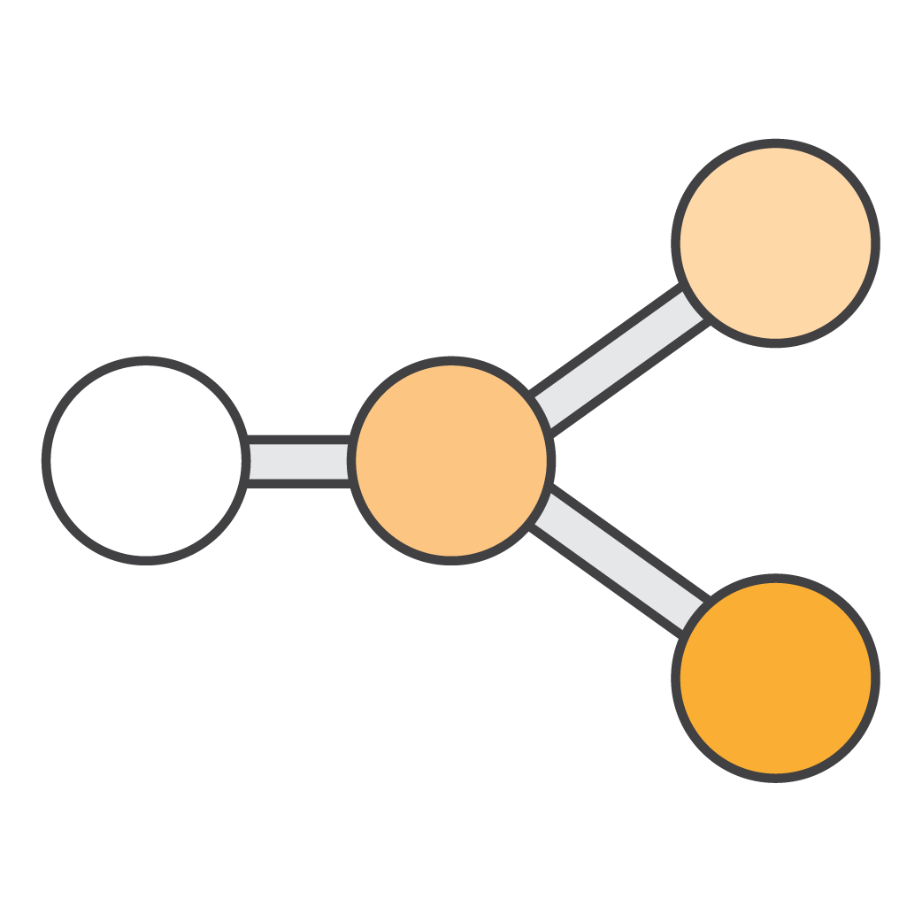
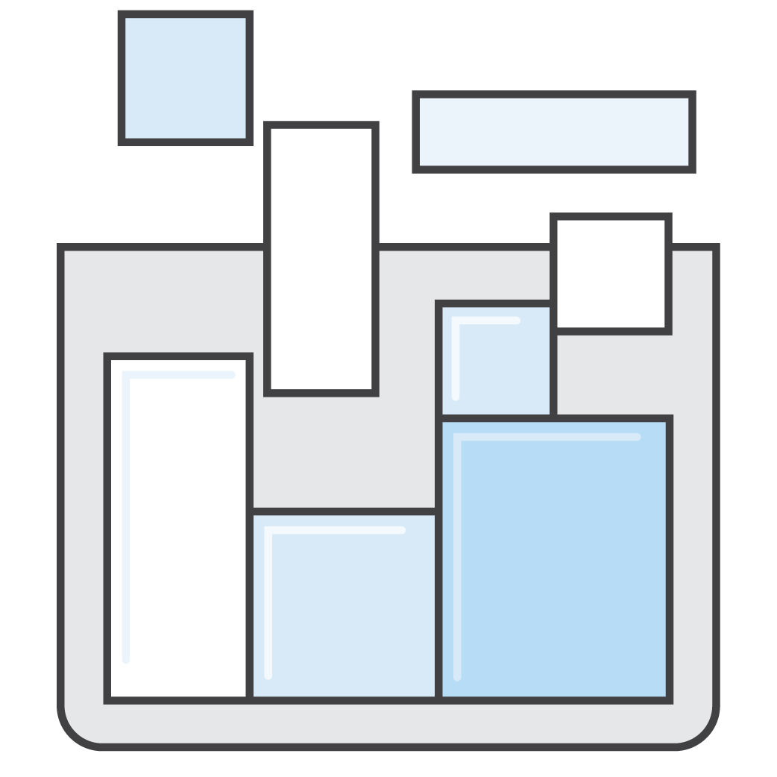
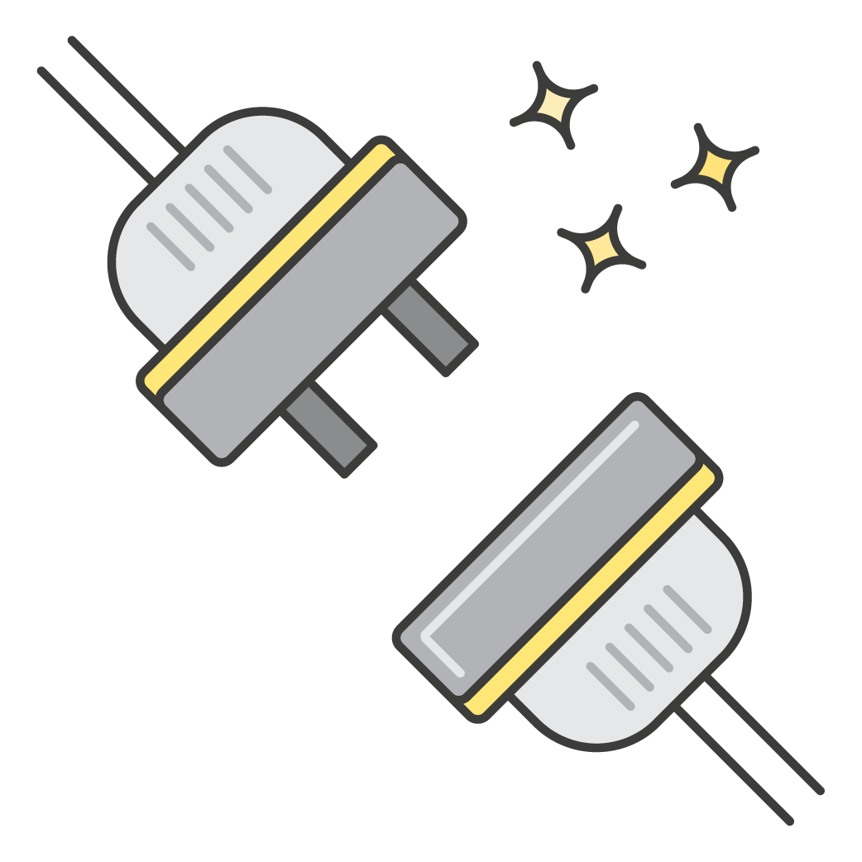
Components of a PaaS
Scheduler
Router
Control Plane
Notes:
As we started to build Empire, we isolated its architecture into 3 main components.
The scheduling component is what the platform would talk to to actually run the applications. This could be something like Mesos, Kubernetes or ECS.
The routing layer is what would handle service discovery and allow applications that expose TCP/HTTP services to communicate with each other.
The control plane is the interface into the platform itself. This could be a GUI or an API for a CLI interface.

Slide 13
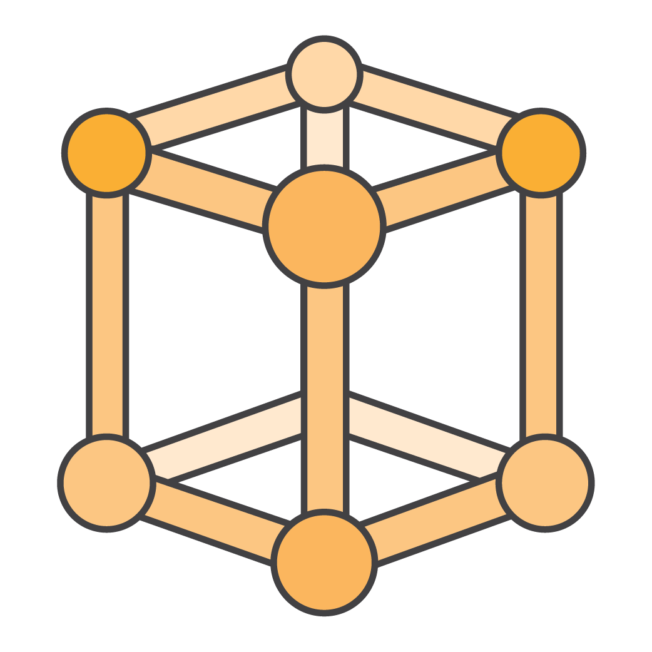
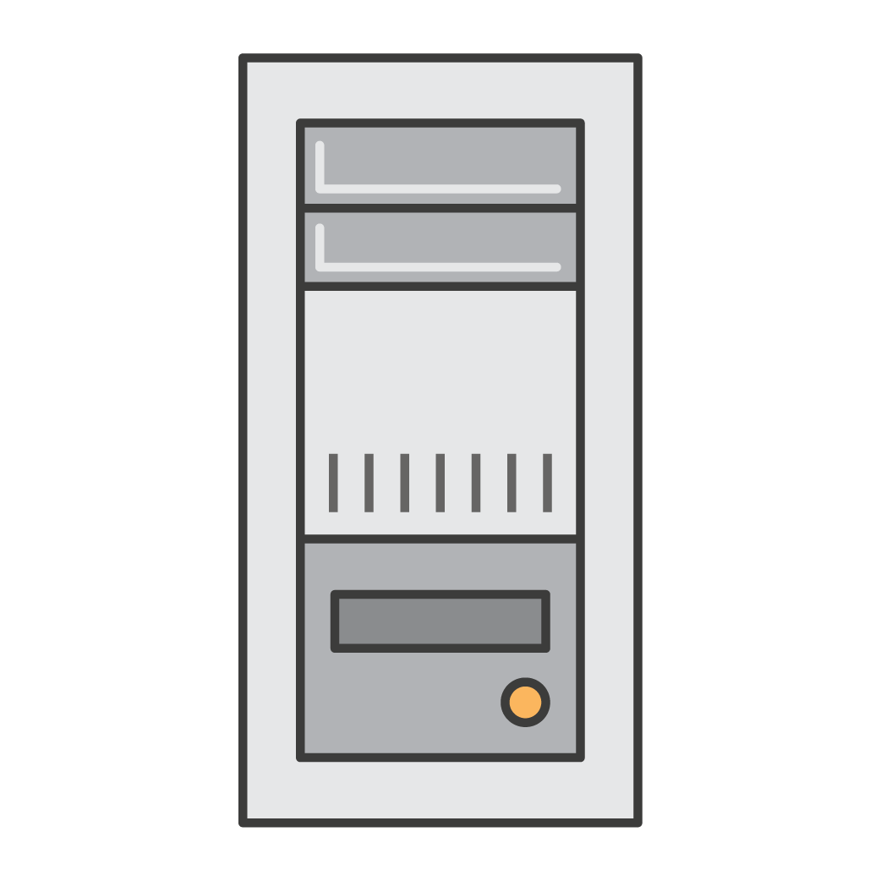
Scheduler :: Cluster Management
Join
Leave
Notes:
The scheduling component generally will have some form of cluster management, allowing machines to register themselves into the cluster and offer up their CPU, Memory and Network resources into the pool of machines.

Slide 14
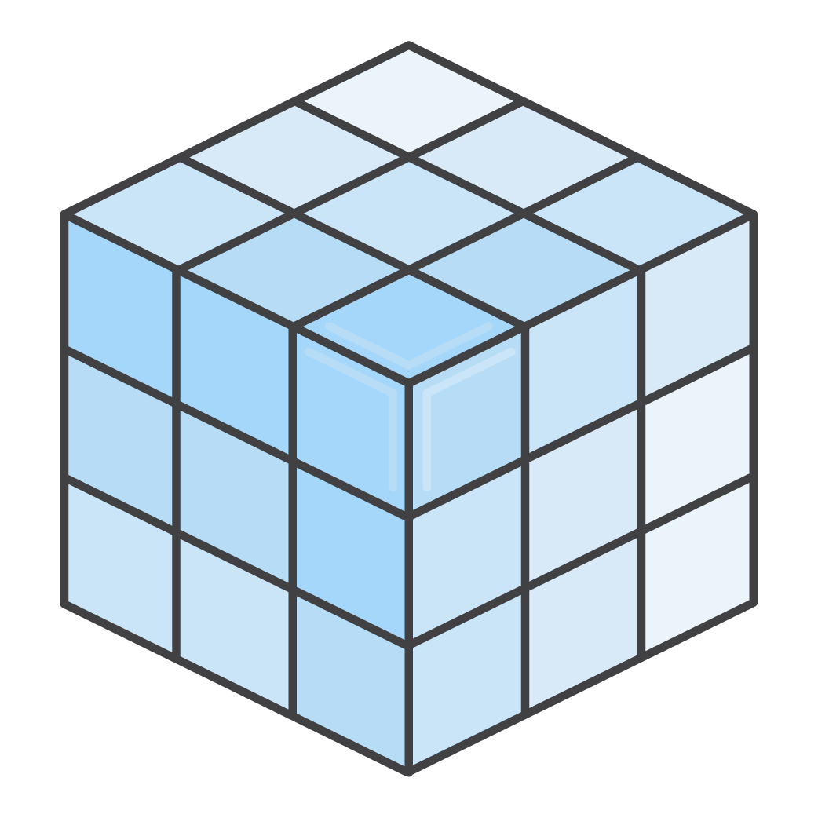

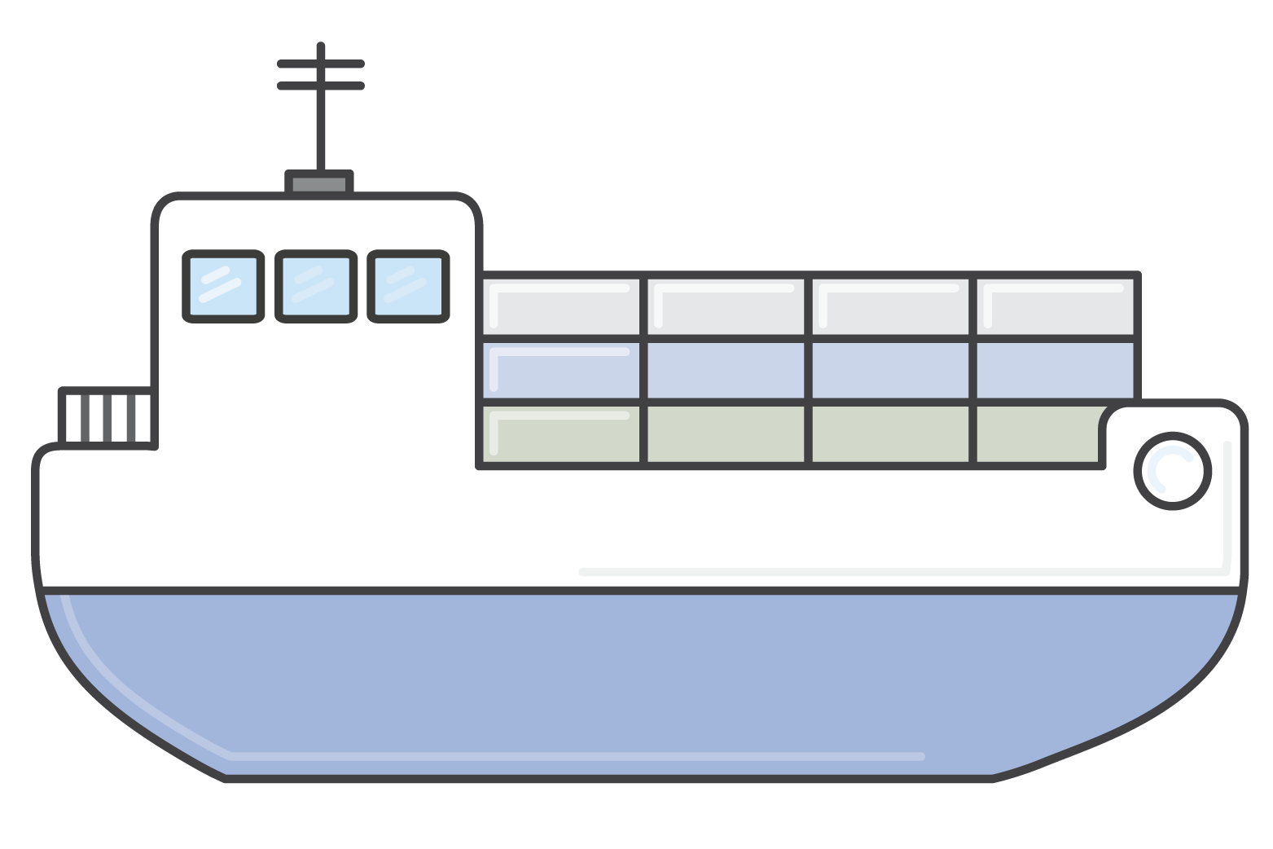
Scheduler :: Task Placement
Find Host
Run Job
Container
CPU/
Memory
Cluster
Notes:
The scheduler will also have some form of task placement, allowing consumers to tell the scheduler what they want to run, and the scheduler will find an appropriate host with enough CPU and Memory to run that job.

Slide 15
Scheduler :: Task Placement
type App []Process
type Scheduler interface {
Run(App)
Remove(App)
Scale(Process)
Tasks(App) []Task
Stop(Task)
}
Notes:
One of the most important interfaces that we extracted early on was the interface between the scheduler and the control plane, which looks like this. Very simply it provides a generic API for running an App, removing an App, scaling individual processes of the app and returning state about the running processes.

Slide 16
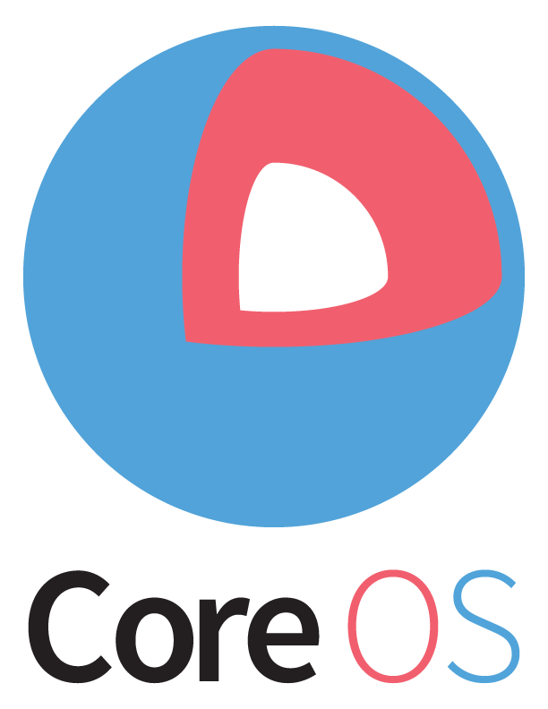

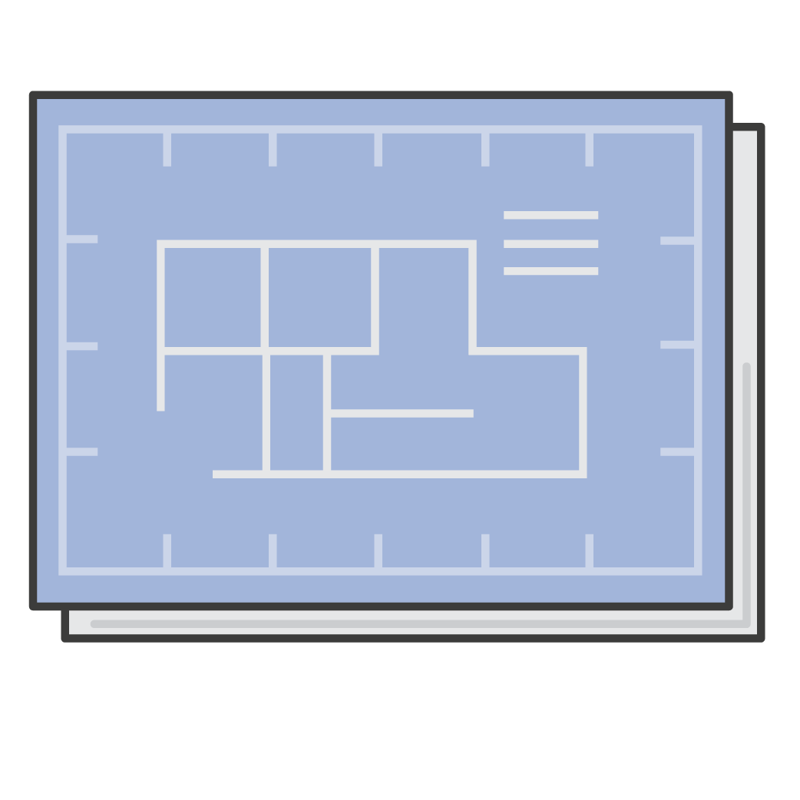
Empire :: V1
Scheduler
Router
Control Plane
Heroku Platform API
Spec + hk CLI
+ Fleet
etcd + registrator + confd
Notes:
About 3 months into the project, we had a V1 that we started testing in a staging environment.
We initially started with CoreOS and Fleet as our scheduling backend, which uses etcd for cluster management.
For the routing layer, we used a combination of nginx, etcd, registrator and confd. Registator would watch for Docker events and would register containers as services within the etcd key value store. Confd would listen for changes to these keys and update an nginx configuration file.
For the control plane, we decided to use the Heroku Platform API as a spec and implement it within Empire. This allowed us to initially use the Heroku CLI against Empire, which was a huge productivity win early on.
This version of Empire worked well initially until we started testing failure modes.
In our experience, etcd was fragile and Fleet had a number of bugs.
We also hadn’t solved the problem of zero downtime deployments in the routing layer.

Slide 17
EC2 Container Service
Managed cluster manager and scheduler
Supports Docker
Built-in service scheduler
Integrates with ELB
Notes:
Around this time, EC2 Container Service was made Generally Available. ECS is a managed AWS service that provides a cluster manager, task scheduler and it supports Docker out of the box.
If I were to describe ECS, I would say it’s the easiest way to run Docker containers on a cluster of machines in production.

Slide 18
EC2 Container Service :: Resources
Clusters
Task Definitions
Tasks
Services
Notes:
ECS exposes a number of resources through the AWS API’s:
Clusters are a logical grouping of EC2 instances. EC2 instances can run a simple agent that will register the instance with a cluster and begin accepting tasks that can be run with Docker.
Task Definitions are like templates, where you can specify the images and environment variables for a task to run.
Tasks represent a running instance of a task definition.
Services provide a way to manage the desired state of a Task Definition and provide a way to scale a service up or down. ECS Services are kind of like auto scaling groups, but at the container level rather than the Host level.

Slide 19
ECS Scheduler Implementation
Scheduler Interface
ECS API
Run(App)
Remove(App)
Scale(Process)
Tasks(App) []Task
Stop(Task)
RegisterTaskDefinition -> CreateService/UpdateService
DeleteService
UpdateService
ListTasks
StopTask
Notes:
If we take a look at the Scheduler interface again, we could essentially map it to these ECS API calls.

Slide 20

Empire :: V2
Scheduler
Router
Control Plane
Heroku Platform API
Spec + emp CLI
ECS
ELB
Notes:
After some initial investigation and prototyping, we built an ECS implementation of the Scheduler interface. This allowed us to offload the scheduler and routing components to AWS managed services, allowing us to focus on just building the control plane. This meant that we wouldn’t have to run, manage and monitor our own clustering software, which is huge for our team since we are still very small.
This is still the architecture that we use today inside Empire.

Slide 21
Empire :: V2
An Open Source self hosted PaaS for running twelve-factor Docker apps backed by AWS services
Notes:
Today, Empire is one of the easiest self hosted platforms for running 12factor Docker apps.

Slide 22
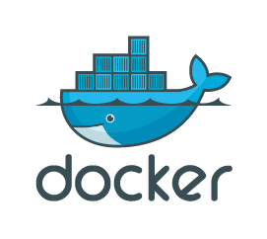


Twelve-Factor
Notes:
Let’s dive into how Empire uses Docker and Amazon ECS to provide a robust and user friendly platform for running twelve-factor applications.

Slide 23
Twelve-Factor Tenants
Codebase
Dependencies
Config
Backing Services
Build, release, run
Processes
Port binding
Concurrency
Disposability
Dev/prod parity
Logs
Admin processes
Notes:
12factor.net describes twelve main tenants that application developers should following when building robust, stateless services.
I’m not going to go into all of these, but we’ll take a look at a few of the most important.

Slide 24
12factor :: Dependencies
“Explicitly declare and isolate dependencies”
FROM ruby
RUN apt-get install imagemagick
RUN bundle install
Notes:
It specifies that you should explicitly declare and isolate your dependencies. Docker makes this incredibly easy to do with Dockerfiles. For example, if you had a ruby app that did some image processing, you could bundle up your gems as well as the dynamic libraries for imagemagick.

Slide 25
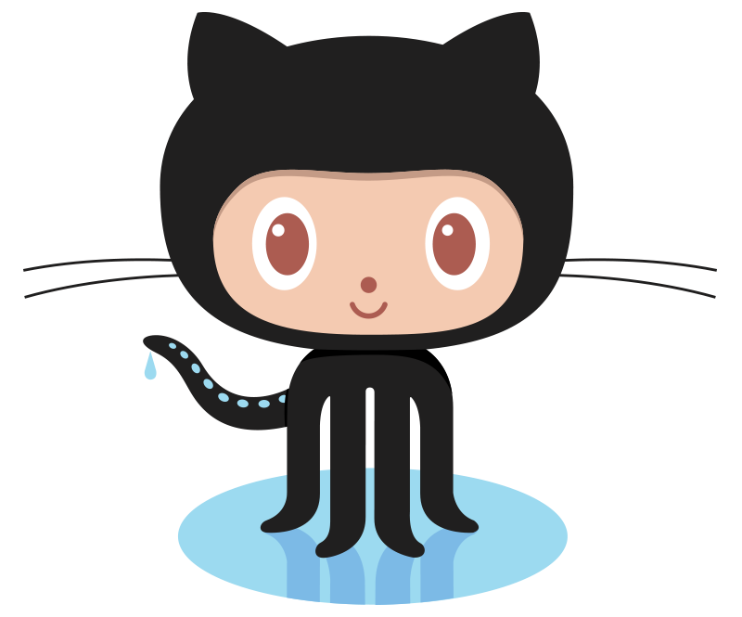
12factor :: Build, release, run
“Strictly separate build and run stages”
Empire
Notes:
Twelve-factor specifies that you should strictly separate build and run stages.

Slide 26
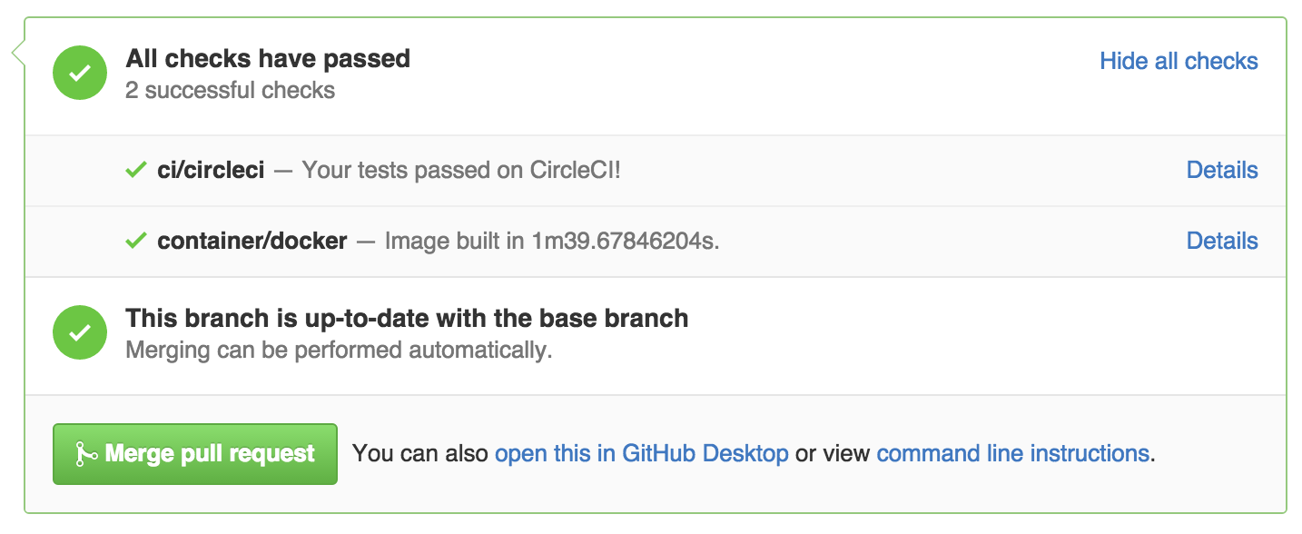
12factor :: Build
$ git push
Notes:
At Remind, whenever a developer pushes to GitHub, we build a Docker image, tag it with the git sha, and push it to the Docker registry.

Slide 27
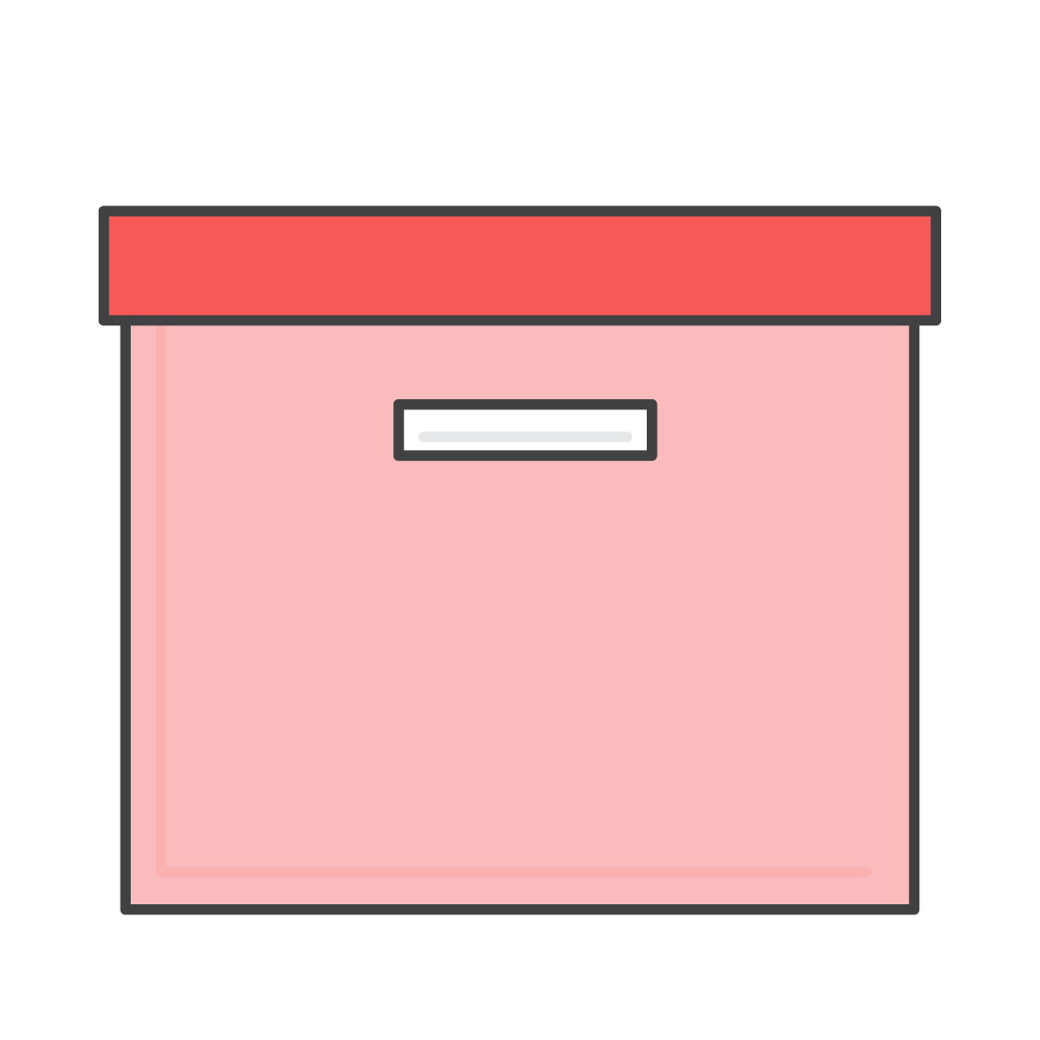
12factor :: Release, Run
ECS
Release
Config
{}
Notes:
When a developer wants to deploy, they simply deploy the Docker image that maps to the git commit that they want to run. This gets combined with the current configuration for the app and turned into a release. The release is then sent to ECS to run.

Slide 28
12factor :: Release, Run
$ cat Procfile
web: ./bin/web
worker: ./bin/worker
$ emp deploy org/api:latest
Status: Created v1 release.
$ aws ecs list-services
arn:aws:ecs:us-east-1:***:service/api--web
arn:aws:ecs:us-east-1:***:service/api--worker
Notes:
Like Heroku, Empire supports the concept of Procfiles, which allow you to define the individual processes that compose an application. For example, it’s not uncommon for an application to have a “web” process that exposes an HTTP API, and a “worker” process that performs some background tasks.
When you deploy a Docker image to Empire, the Procfile is extracted, analyzed and each process defined in the Procfile gets it’s own ECS service that can be scaled independently via the Empire CLI.

Slide 29
Service Discovery
$ aws ecs describe-services --service api--web
"loadBalancers": [{
"containerName": "web”,
"containerPort": 9001,
"loadBalancerName”: "2888...a31d4c”
}]
$ curl http://api
Ok
Notes:
If the Procfile defines a “web” process, then Empire takes advantage of the ELB integration in ECS and attaches an ELB to the associated ECS service. As a form of service discovery, we also create an internal CNAME for the ELB using the app name, making it easy for services to communicate with each other.
By default, all applications that expose a web process are considered internal, meaning that they are only accessible within the VPC. Empire supports making an applications external.

Slide 30
12factor :: Concurrency
“Scale out via the process model”
$ emp scale web=10
$ aws ecs describe-service --service api--web
“desired-count”: 10
Notes:
Twelve-factor also specifies that we should scale out via the process model. Empire supports scaling individual processes defined in the Procfile separately, which tells the associated ECS service to scale up or down.

Slide 31
12factor :: Dev/prod parity
“Keep development, staging, and production as similar as possible”
$ docker run --env-file <(emp env -a api) org/api
Notes:
Twelve-factor specifies that you should keep development, staging and production as similar as possible. Docker makes it easy for us to pull the same Docker image that we’re running in production onto our development machine, and we can run the image with the same environment variables that we use in production with a little unix magic and the empire CLI.

Slide 32
12factor :: Logs
“Treat logs as event streams”
STDOUT
Kinesis
$ emp log
“GET / HTTP/1.1” 200
Notes:
Twelve-factor says that you should treat logs as event streams. In Empire, we send all application logs to Amazon Kinesis streams. Service operators can then use the emp CLI to stream the logs on their terminal for easy debugging.

Slide 33
12factor :: Admin processes
“Run admin/management tasks as one-off processes”
$ emp run rake db:migrate
Migrated
Notes:
And lastly twelve-factor specifies that you should run admin tasks, like database migrations, as one-off tasks. Empire supports this by running the container directly with docker and conecting stdin and stdout of the users shell to the container.

Slide 34
Demo
Notes:
Let’s jump into a demo of how we can setup an Empire environment on AWS and then build and deploy an application.

Slide 35
Pain Points & Lessons Learned
Notes:
Overall, Docker and Amazon ECS has been an amazing combination for us, allowing us to quickly build and scale our 12 factor applications while giving us the flexibility and control that we needed.
But, having been running Docker in production for over 4 months now, we’ve run into issues and learned a few things along the way.

Slide 36
Container Instance Rollout
Update AMI in CloudFormation stack.
Kill 1 host
Wait for new ECS services to start running on new Host
Rinse and repeat
Notes:
Within our ECS cluster, we keep a pool of EC2 hosts that run our base AMI. This AMI includes Docker, the ECS agent, statsd and some logging infrastructure components. One pain point that we discovered is that when we want to update the AMI we’re running, it can take a very long time to roll it out safely across a large ECS cluster.
When we update the AMI, we have to ensure that we don’t tear down too many hosts at once, because it could take some time for the existing ECS tasks to be moved to another container instance.

Slide 37

Logging
Logspout
Notes:
Unfortunately, logging in Docker leaves a lot to be desired. At Remind, we use Sumologic to aggregate all of our logs in a central location. In order to get our logs out of Docker, we run the Sumologic agent and Logspout in all the container instances. Logspout simply connects to the Docker daemon and streams logs for applications to the sumologic agent, which then forwards them to Sumologic.

Slide 38
Logging
SOURCE=<app>.<process>.<version>
SYSLOG_STRUCTURED_DATA=app={{ .Container.Config.Env "SOURCE" }}
Notes:
When you have a large number of containers from different sources like we do, it can be difficult to know where the log line originated from.
Empire will include a SOURCE environment variable in every container, which includes the name of the app, the process type, and the release version.
Logspout also allows us to attach metadata to the logs, so that we can identify the application that the line originated from.

Slide 39

Docker Monolith
=
Bad Times
Notes:
Docker runs as a single daemon on every host. This means that if Docker panics and crashes, all of your containers will go down. Fortunately, ECS shields us from a lot of instability within Docker.

Slide 40
Docker Performance
Early versions of Docker had abysmal push/pull performance
Use Docker >= 1.8.1
Make your Dockerfile’s use the layer cache efficiently
https://github.com/remind101/conveyor
Notes:
When we first started using Docker, we built our images within CircleCI. Because we were using an earlier version of Docker, and not maximizing the layer cache, our Docker images were being built in about 6-7 minutes on average. We eventually built our own build pipeline, called Conveyor, based on Docker 1.8.1, optimized our Dockerfiles to use cached layers as much as possible and now our build times are almost always under 2 minutes.

Slide 41
This space moves fast!
Containers have been around, but Docker made them accessible
New tools coming out ever day
AWS’s offerings have been incredibly stable and feature rich
Notes:
And lastly, this space moves really fast! It has been incredibly fun keeping up to speed with the pace of innovation that has been happening with containers, and we’ve been consistently impressed with the stability and feature set of AWS’s offerings in this space.

Slide 44
Deck Guidelines
Fonts, sizes, colors, and layouts are all pre-built in this template.
Color palette
Please do not use gradients, shadows, or outlines on shape elements. Limit color use for chart graphics to grayscale plus one accent color.

Slide 45
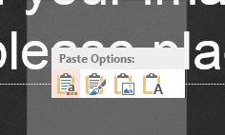
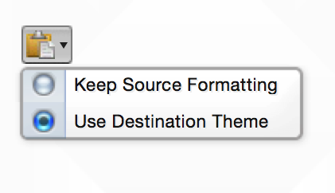
Copy & Paste Content
When pasting content from another presentation please paste using “Destination Theme.”
Windows
Mac
Note: This works when copying entire slides from other presentations as long as the source presentation is also 16:9

Slide 46
Copy & Paste Code
When pasting content Code into a Code template please use the
“Keep Text Only Function” for Windows and “Destination Theme” for Macs. If any additional coloring needs to be done to your code type please do it after pasting it into your slide.
Windows
Mac

Slide 47
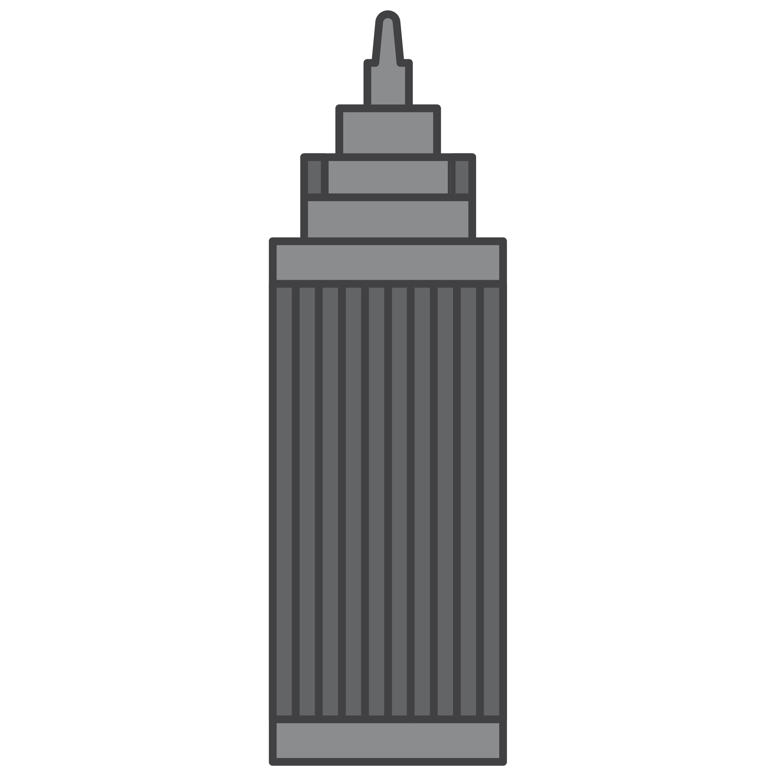
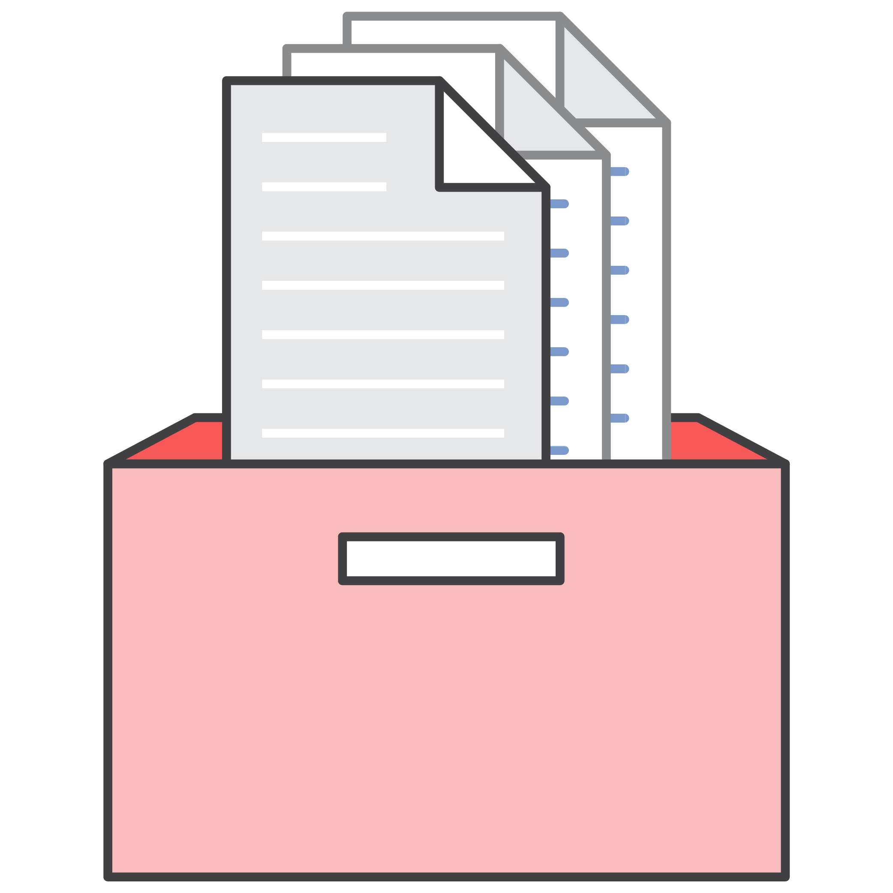


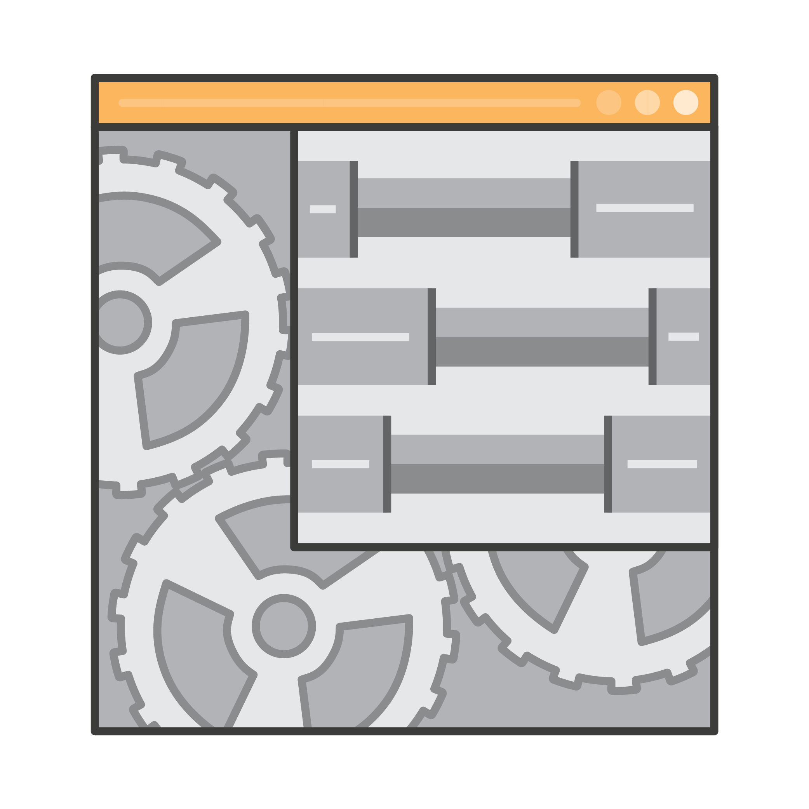


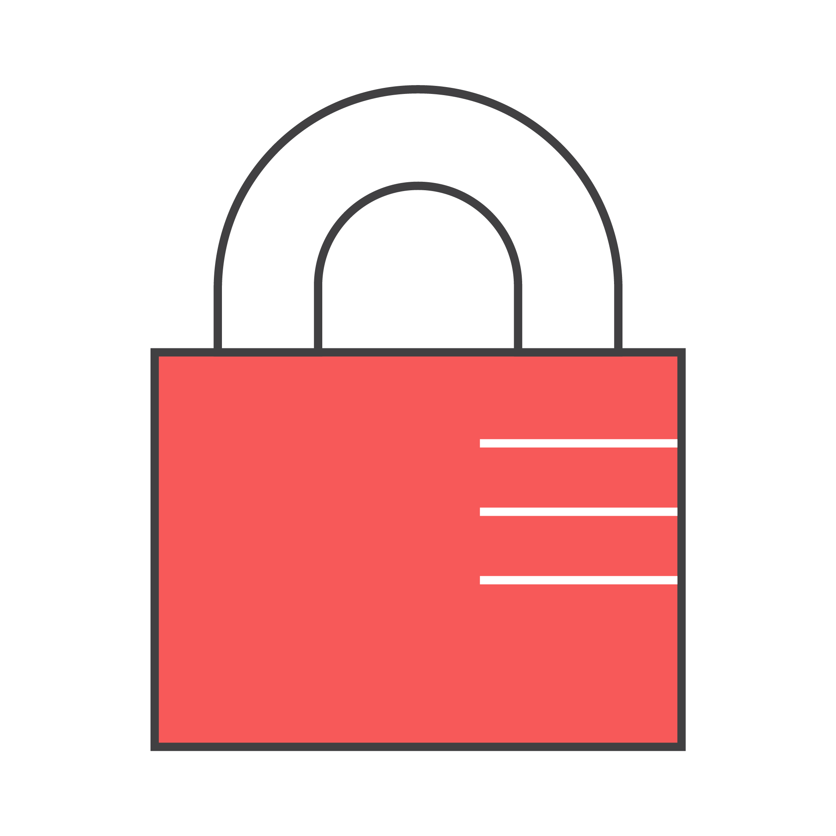

Assets Usage
Multiple assets can be combined to create one graphic
Deck_Box-Files.png
Deck_Arrows1.png
Deck_Buildings-MediumBusiness.png
Deck_Buildings-Enterprise.png
Deck_Buildings-SmallBusiness.png
Deck_Laptop-Dark-Code.png
Deck_Certification-Badge.png
Deck_App2.png
Deck_Lock.png

Slide 48
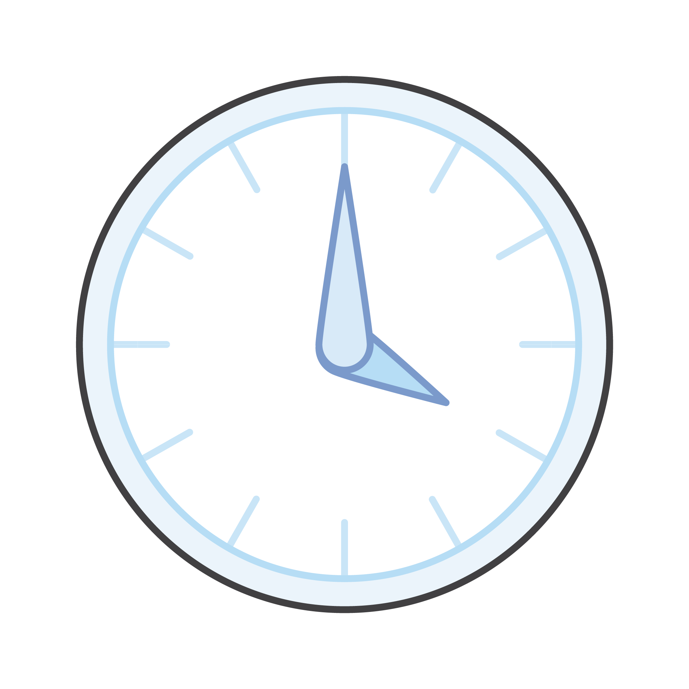
Resizing Assets
Always hold down shift key and drag from corners when scaling assets
with Shift
without Shift

Slide 49
Presentation Title

Slide 51
Title Only

Slide 52
Title + Content

Slide 54
Section Title

Slide 55
Two Content

Slide 56
Comparison

Slide 57
Three Content

Slide 58
Four Content - Graphics

Slide 59
Six Content - Graphics

