Slide 1

7 Seconds to Freedom
Abdulrehman Ismaeel
dpu196@usask.ca
Gavin Caras
gsc565@usask.ca
Leo Liu
wni817@usask.ca
Andrew Kipsang
ank699@usask.ca

Slide 2
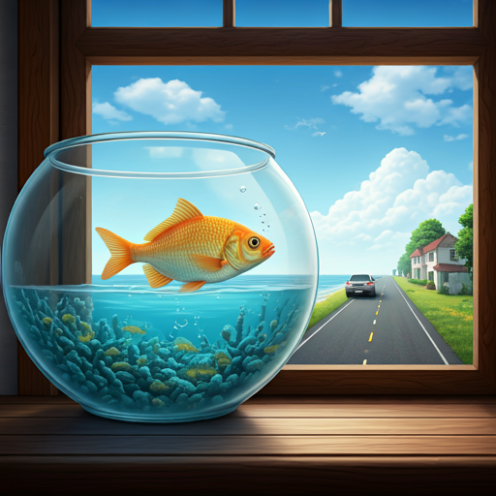
Our Vision
Swim to freedom under a time limit!
Avoid breaking your fishbowl along the way.
Complete levels without resetting or dying.
- It’s like Level Devil but HARDER and more INTENSE!!!

Slide 3
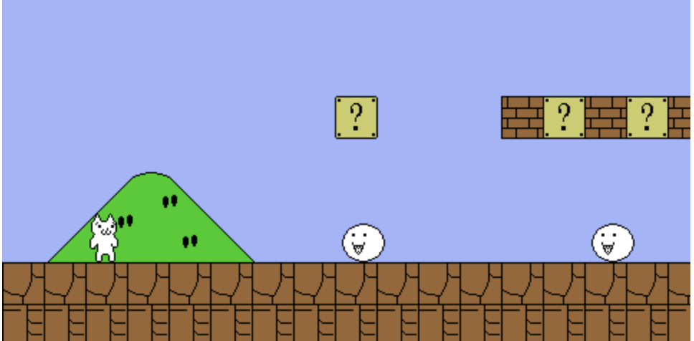
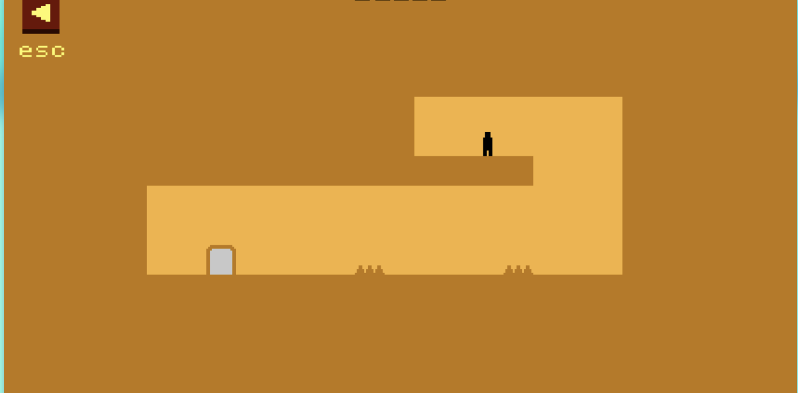
Inspiration
Level Devil
Cat Mario

Slide 4

Gameplay Walkthrough
The player controls a fish in a bowl, swimming through levels under a time limit.
Levels become progressively more difficult with unknown/random obstacles and paths.
Replayability
https://youtu.be/h2GnO01df_k

Slide 5

Game Features
Increasing difficulty with each level.
Different themes in various levels (e.g., living room, backyard, city escape).
Random or unknown obstacles and paths for dynamic gameplay.

Slide 6
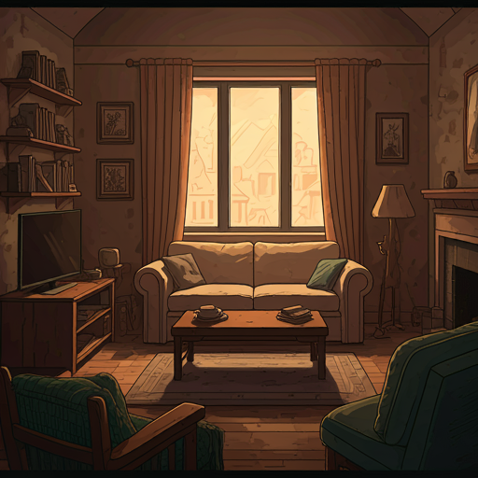
Art
2D Cozy Cartoon Style:
The game will feature a cozy, soft cartoon aesthetic that is friendly and visually appealing.
Warm Filter:
A consistent warm filter will be applied to all levels to give the game a comfortable, welcoming feel.
Multiple Themes & Colors:
Each level will have a unique theme, and the colour palette will vary based on the theme to create a distinct

Slide 7
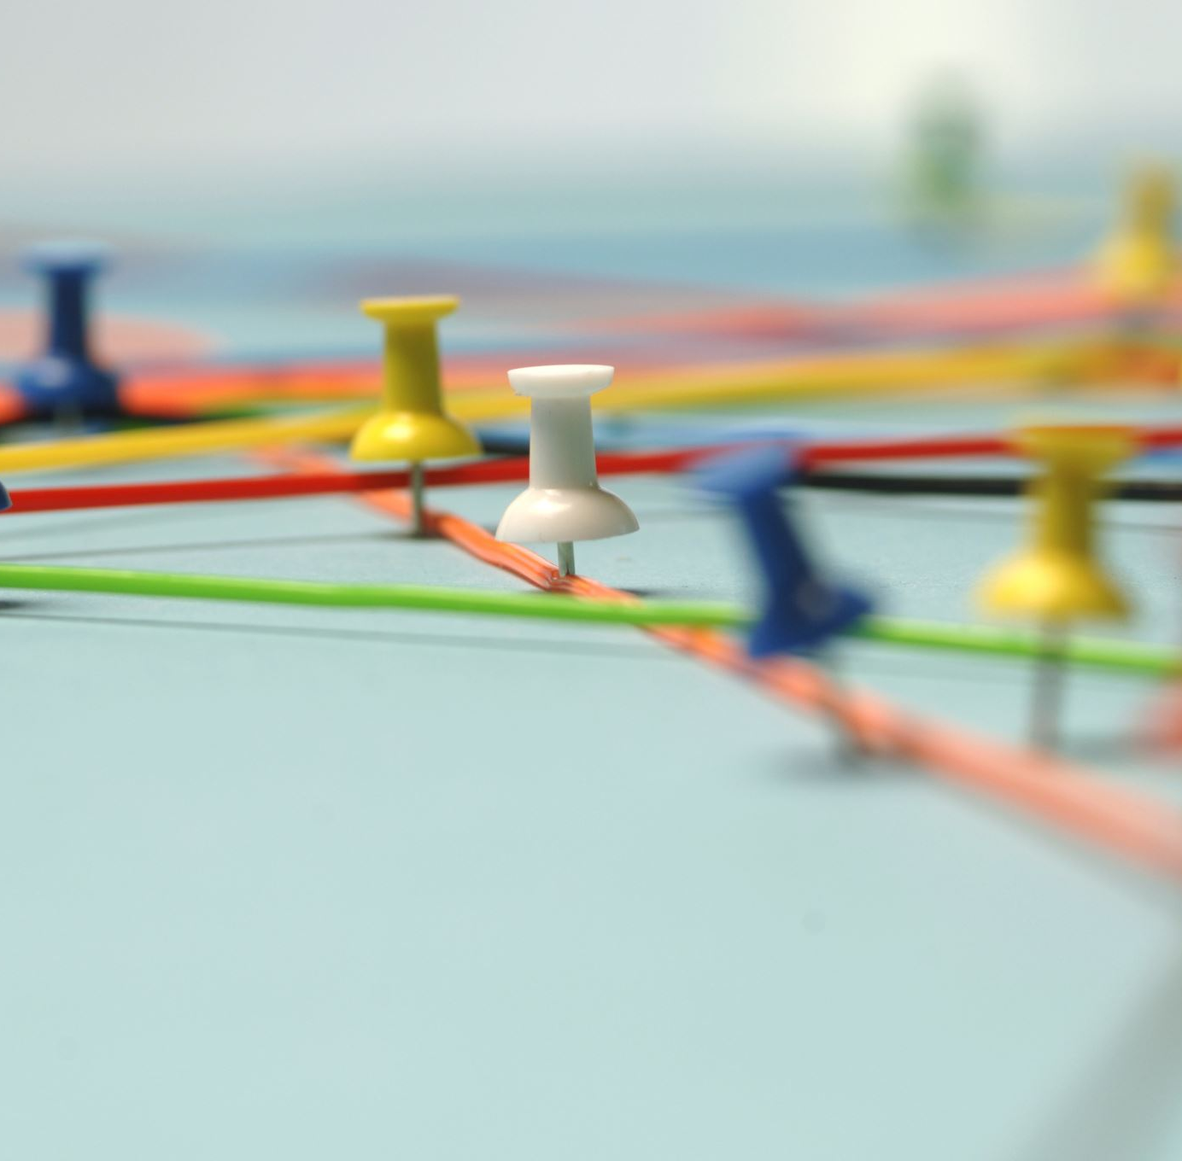
Our Challenges
Combining levels smoothly into a cohesive game.
Lots of detailed animations for movement and effects.
Creating small design details to enrich immersion.
Ensuring consistency in animations and plot integration (escaping to the ocean).

Slide 8
Thank you!
Game Name: 7 Seconds to Freedom
Our members:
Abdulrehman Ismaeel – dpu196@usask.ca
Gavin Caras – gsc565@usask.ca
Leo Liu – wni817@usask.ca
Andrew Kipsang – ank699@usask.ca

