Slide 1
Shallow water / rigid body simulation
Physically-based Simulation course project 2013
Remo Dietlicher
Moritz Geilinger
Hartmut Keil

Slide 2
Project idea
Shallow water simulation
Interaction water / rigid body
Real time rendering
User can move the rigid body
User can influence the water (rain, tsunami,..)

Slide 3
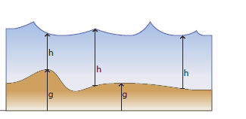
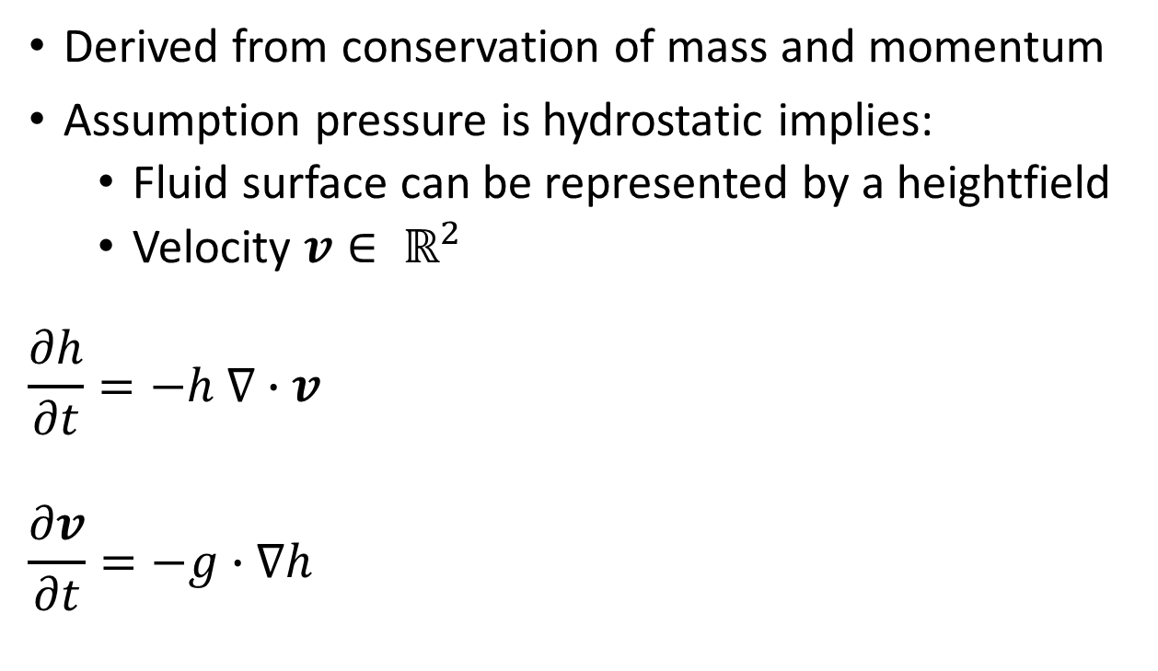
Shallow Water Equations (SWE)
Derived from conservation of mass and momentum
Assumption pressure is hydrostatic implies:
Fluid surface can be represented by a heightfield
Velocity $v∈ ℝ^{2}$
$$\frac{∂h}{∂t}=−h ∇∙v$$
$$\frac{∂v}{∂t}=−g∙∇h$$

Slide 4
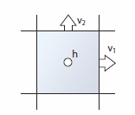

SWE Solver
Explicite time integration
Compute Semi-Lagrangian avection of $h_{i,j}$ and $v_{i,j}$ on staggered grid
update velocities $v_{i,j}$ and $h_{i,j}$

Slide 5
Rigid Body / Water interaction
Assumption: Rigid body is much larger then a grid cell
Compute water displaced by the box, distribute on neighbor cells
Compute buoyancy forces

Slide 6
Overview solution
CPU
GPU
Grid size 50 x 250
Timestep:realtime
get elapsed system time
while(sim_time < elapsed){ advance_timestep(…) }
~ 60 frames/second
advance timestep
compute normals
copy buffers
render
…
vertex shader
fragment shader
…

Slide 7
Challenges / extensions
Interaction Rigid Body / Water
…
Several Rigid Bodies including collisions
More ‘water like’ shader

