Slide 1

NativeScript UI 📈 📆 📊

Slide 2
TJ VanToll 🚀
@tjvantoll

Slide 3


Slide 4
Agenda
Introduce {N} UI
Demo 🎉
Raucous applause 👏🏻

Slide 5
What is {N} UI?
A NativeScript plugin
7 UI components
Supports Angular and non-Angular usage.
Used to have free and paid tiers—now all free!

Slide 6
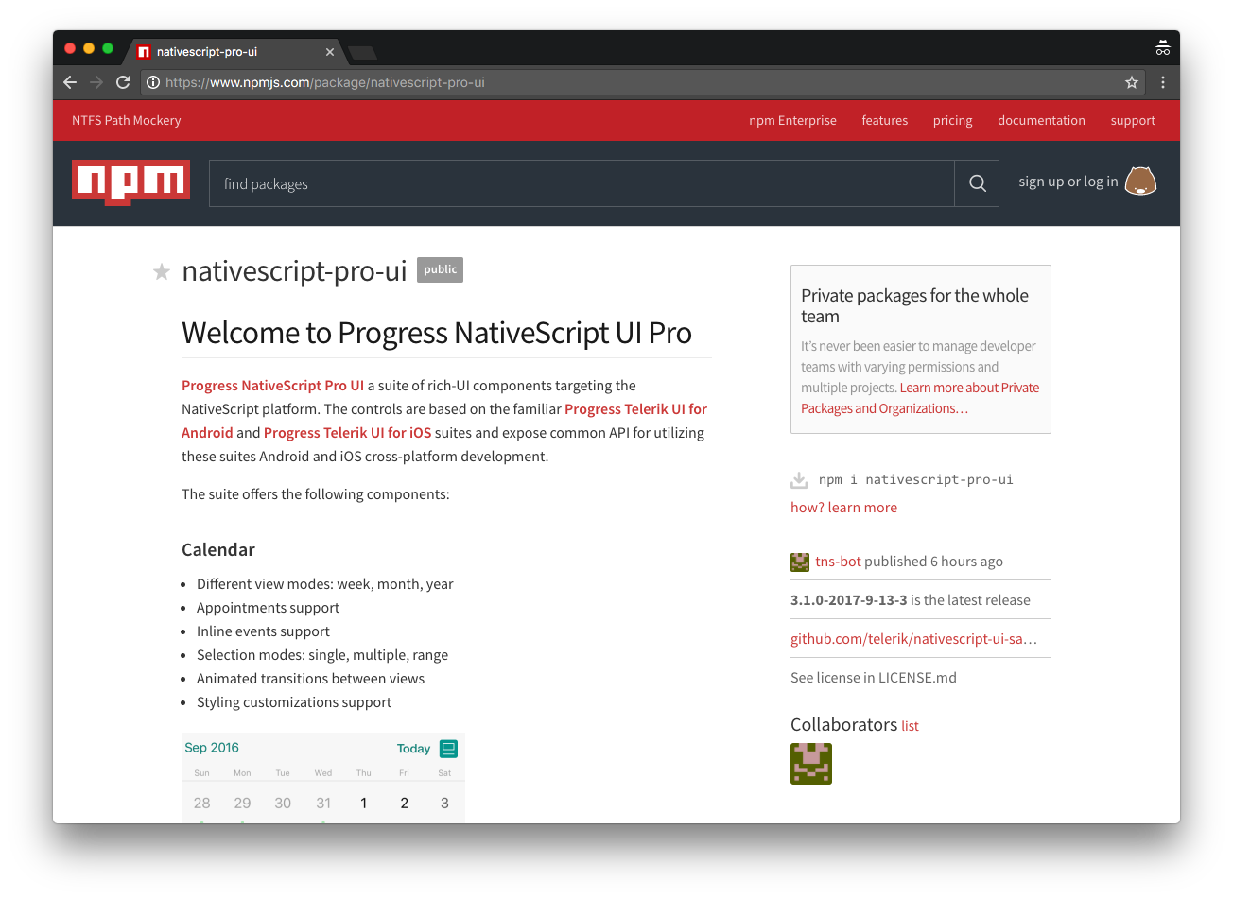

Slide 7
Agenda
Introduce {N} UI
Demo 🎉
Raucous applause 👏🏻

Slide 8
Controls
SideDrawer 🗄️
ListView 📔
DataForm 📝
AutoComplete ✏️
Calendar 📆
Chart 📈
Gauges 🔵

Slide 9
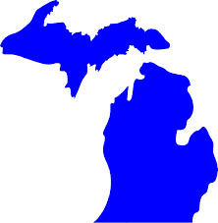

Slide 10
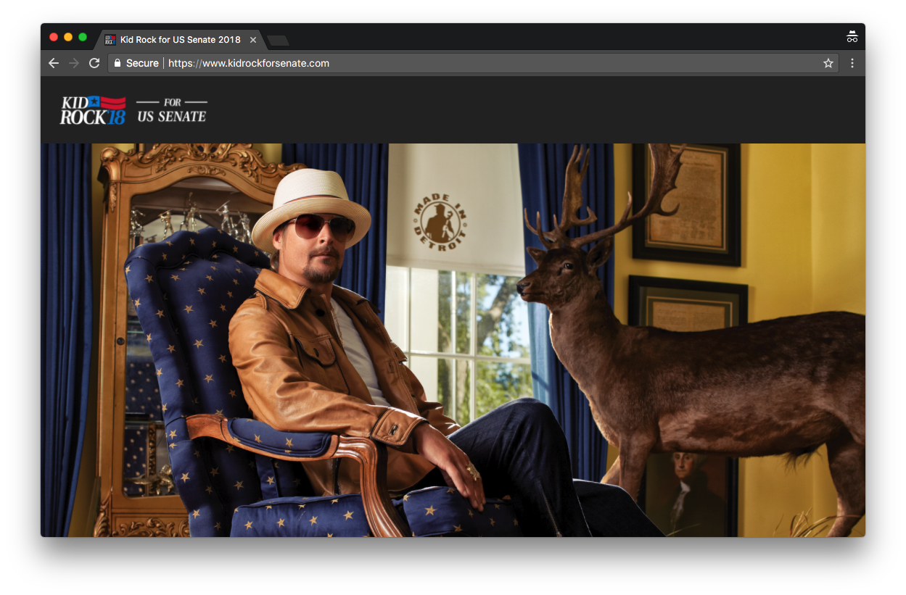

Slide 11
Notes:
And I know this because I’m from the great state of Michigan, where we know a thing or two about hockey.

Slide 12
Michigan Fact #1
Michigan has the most ___ of any state in the US.
Freshwater coastline
Public golf courses
Non-motorized trails

Slide 13
Michigan Fact #2
One US president is from Michigan.

Slide 14
Michigan Fact #3
Detroit has the largest municipal bankruptcy in US history. The city is an estimated $20 billion in debt.

Slide 15
Michigan Fact #4
74% of the US’s tart cherries come from Michigan.

Slide 16
Michigan Fact #5
Mackinac Island has banned the use of cars since 1898.

Slide 17
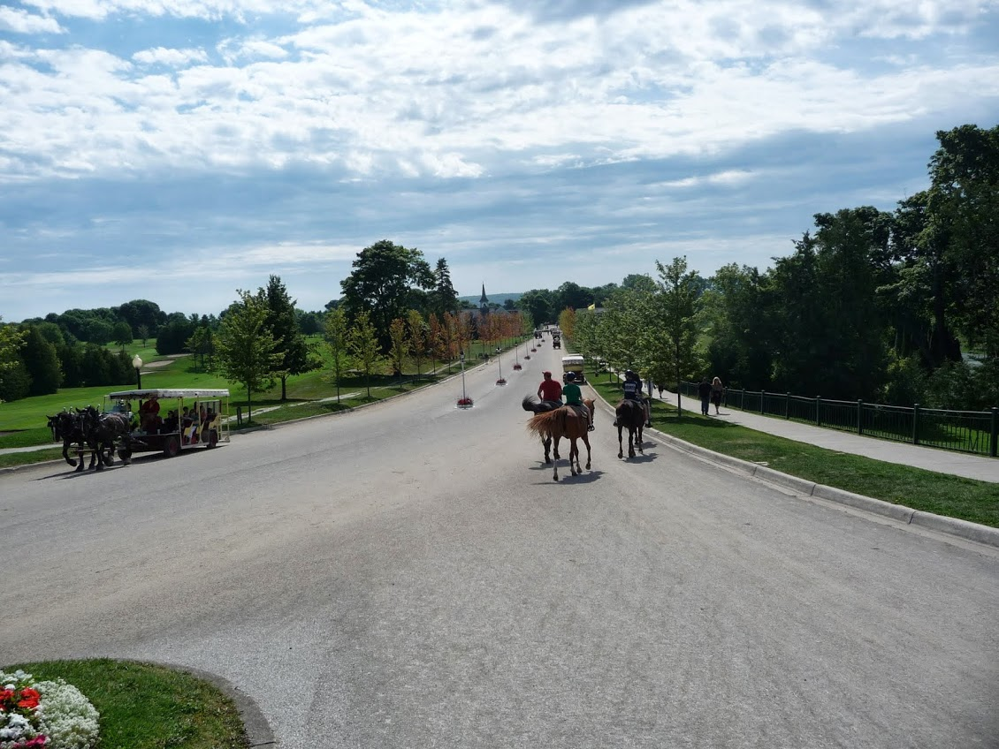

Slide 18
Michigan Fact #6
Michigan was the only state to lose population in the 2010 census.

Slide 19
Michigan Fact #7
Sleeping Bear Dunes was voted the “Most Beautiful Place in America” by an Good Morning America 2011.

Slide 20
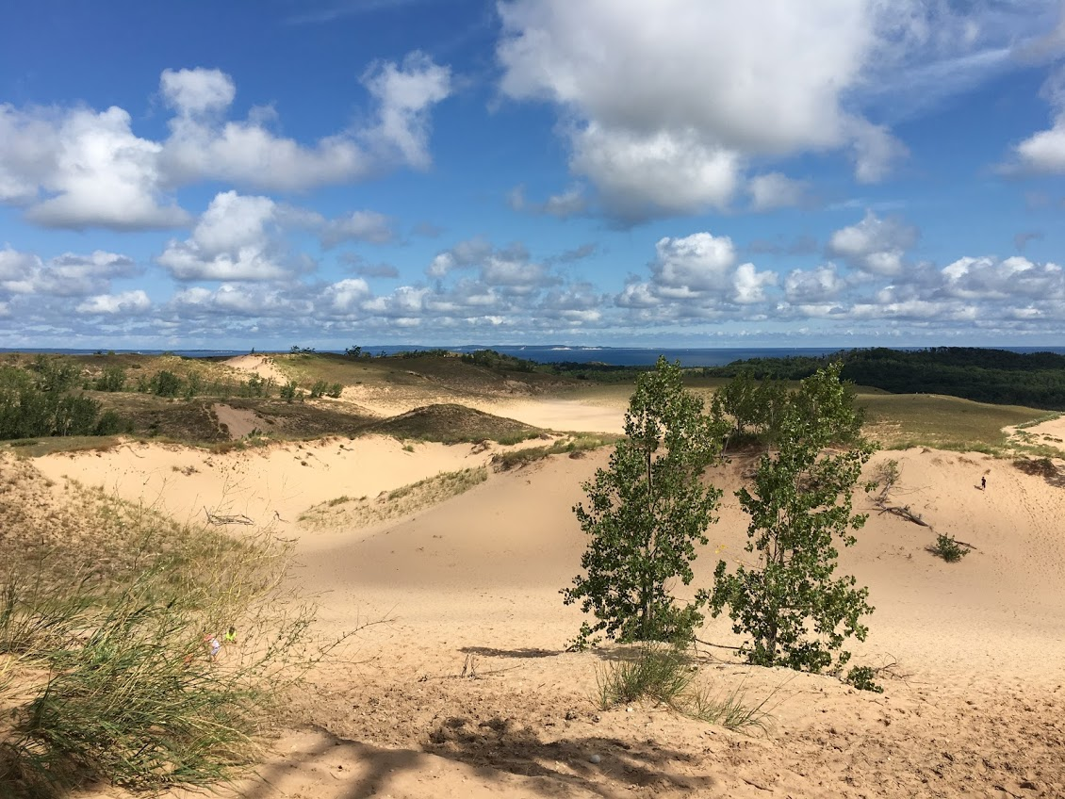

Slide 21
NativeScript UI
Docs
http://docs.telerik.com/devtools/nativescript-ui/introduction
Samples
https://github.com/telerik/nativescript-ui-samples
https://github.com/telerik/nativescript-ui-samples-angular

Slide 22
Thanks! 😊
@tjvantoll

