Slide 1

Performance

Slide 2
Lets dive into Performance issues.
Everything in JavaScript defaults to being on the same thread. Too much work on main thread
Android nested layouts
Functions and objects defined in loops
Statements like debugger, eval, with.
How to access Native Engine information
Object class modifications.

Slide 3
Threading
In NativeScript by default everything runs on the main thread. This design has both pro’s and cons
Pros: Easy access to anything dealing with GUI
Bad: Jank when doing lengthy work
Potential Solutions: Worker thread

Slide 4
Nested Layouts
Primarily a Android issue; but does impact iOS.
GridLayout is the King of simplifying layouts. You can eliminate virtually all stack layouts with one GridLayout.

Slide 5
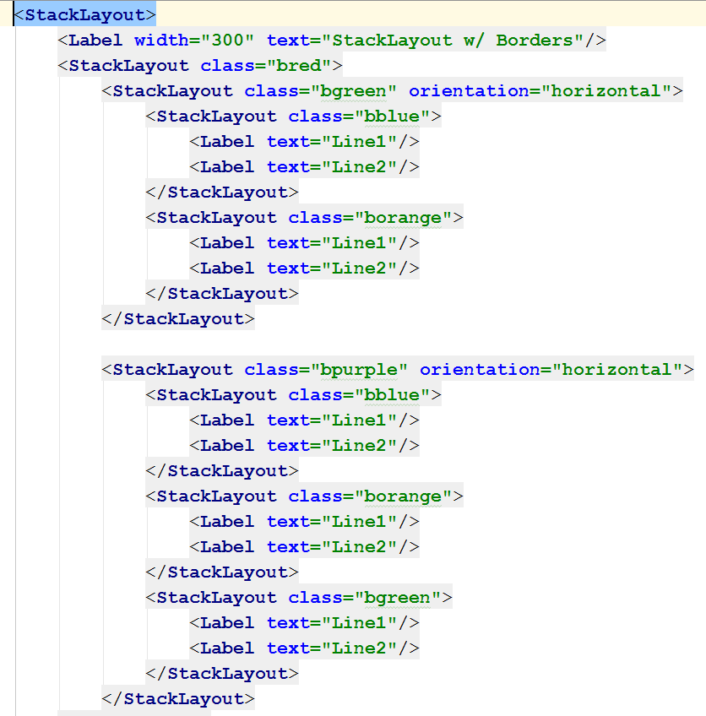
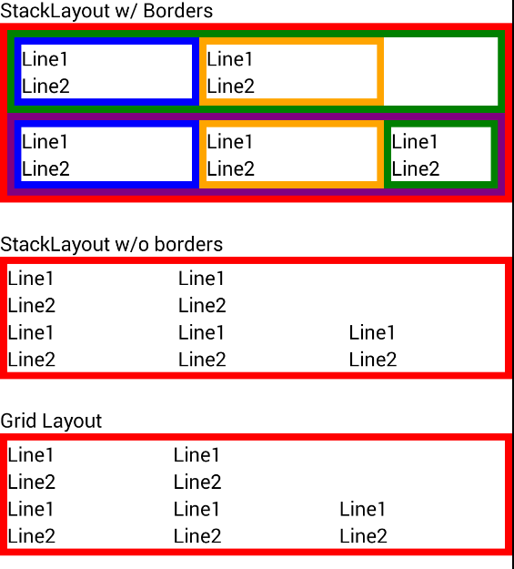

Slide 6
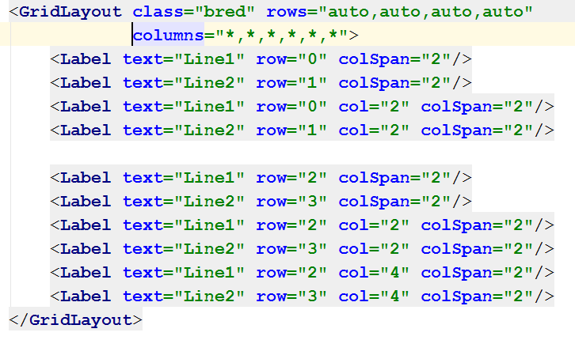

Slide 7
Loops
Beware of function and memory allocations inside of loops.
You see this as a standard pattern.
function loopFunction () { var val = 0; for (var i=0;i<100000;i++) { doSomething( () => { val++; } ); } }

Slide 8
Loops
Proper way
function loops() { var val = 0, fun = function() { val++; }; for (var i=0;i<100000;i++) { doSomething(fun); } }

Slide 9
Data Processing
Anything that does any amount of work; if possible move to your worker thread.
Gathering and saving data from/to your database is a prime example.

Slide 10
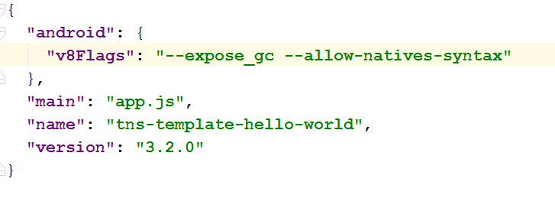
Enabling Optimization Testing
npm i v8-natives --save
Edit your app/package.json
Add --allow-native-syntax to v8Flags

Slide 11
V8 Natives
Docs: https://github.com/NathanaelA/v8-Natives
Gives you access to low level engine information. Things like: getHeapUsage(), deoptimizeNow, optimizeFunctionOnNextCall, getOptimizationStatus
v8.helpers.testOptimization(func[, funcNames]) - Allows you to test a set of functions to see if v8 will be able to optimize it.

Slide 12
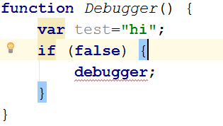
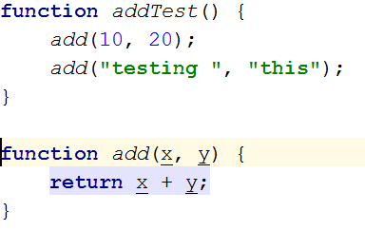
Example code that can’t be optimized
debugger; statement.
Polymorphic functions

Slide 13
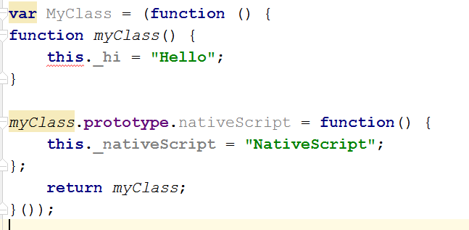
Beware of Object changes!

Slide 14

Questions

Slide 15





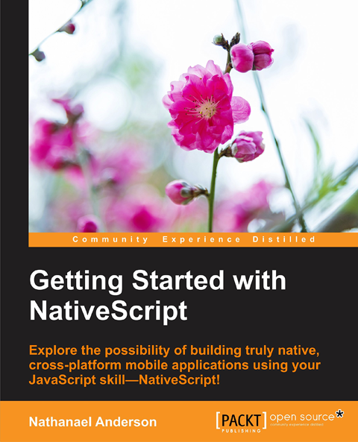
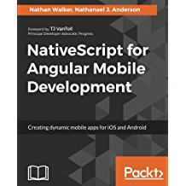
A little about me
Developer of the NativeScript.rocks sites:
> 20 years doing programming and DevOps
> 20 Languages and many OS’s
> 30 NativeScript Plugins
Wrote books on NativeScript
Owner of Master.Technology
Senior partner in nStudio, LLC.
Blog: http://fluentReports.com/blog
Twitter: @CongoCart
Email: Nathan@Master.Technology
Email: NAnderson@nstudio.io

