Slide 1
Cross-Channel Data Integration with Digital Experience Cloud
Connect data from every channel to provide key marketing insights
Radoslav Georgiev, Tim Ahlenius & Seth Cleaver

Slide 2
Session Agenda
Digital Experience Cloud Objectives
The New CMS Requirements
CRM Integration in the Digital Experience Cloud
Available SDKs
Using the JavaScript SDK
Question Time

Slide 3
Session Agenda
Session feedback:
http://bit.ly/next-cleaver
Twitter
  @sethcleaver
  @georgievrado

Slide 4
Digital Experience Cloud Objectives
Seth Cleaver

Slide 5




Slide 6
Channels

APP

SOCIAL
MEDIA

CRM / LOYALTY
SYSTEMS
DIGITAL
EXPERIENCE
CLOUD

MARKETING
AUTOMATION

WEBSITES

Slide 7
Objectives
Customer Journey Analysis


DIGITAL
EXPERIENCE
CLOUD

Customer Journey Optimization


Results Measurement

Slide 8
The New CMS Requirements
Tim Ahlenius

Slide 9
“The Sitefinity Digital Experience Cloud provides marketers with a digital command center that takes the guesswork out of their job.”

Slide 10
Personalization Is In All Channels
WEB
MOBILE
ECOMMERCE
SOCIAL MEDIA
EMAIL
PRINT

Slide 11
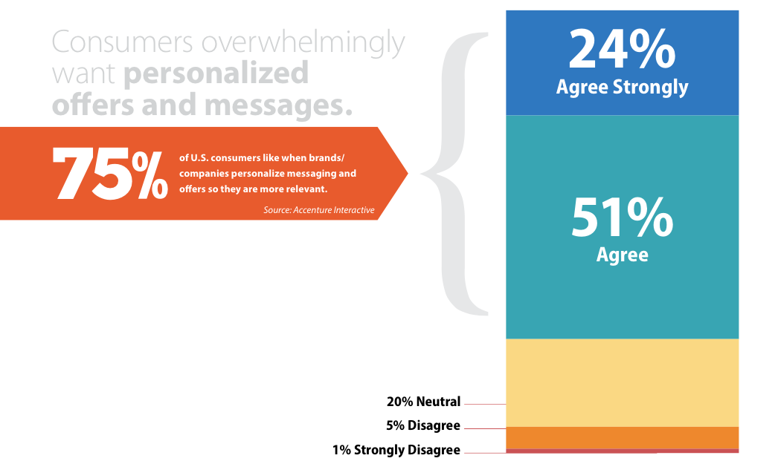

Slide 12
Business Challenges for Digital Marketers
Create a unique personalized digital experience
Big data cannot mean big effort (think scattered systems)
Measuring multi-channel (online & offline) experience
Technology has to continually learn and recommend options

Slide 13

Benefits of Personalization

Slide 14
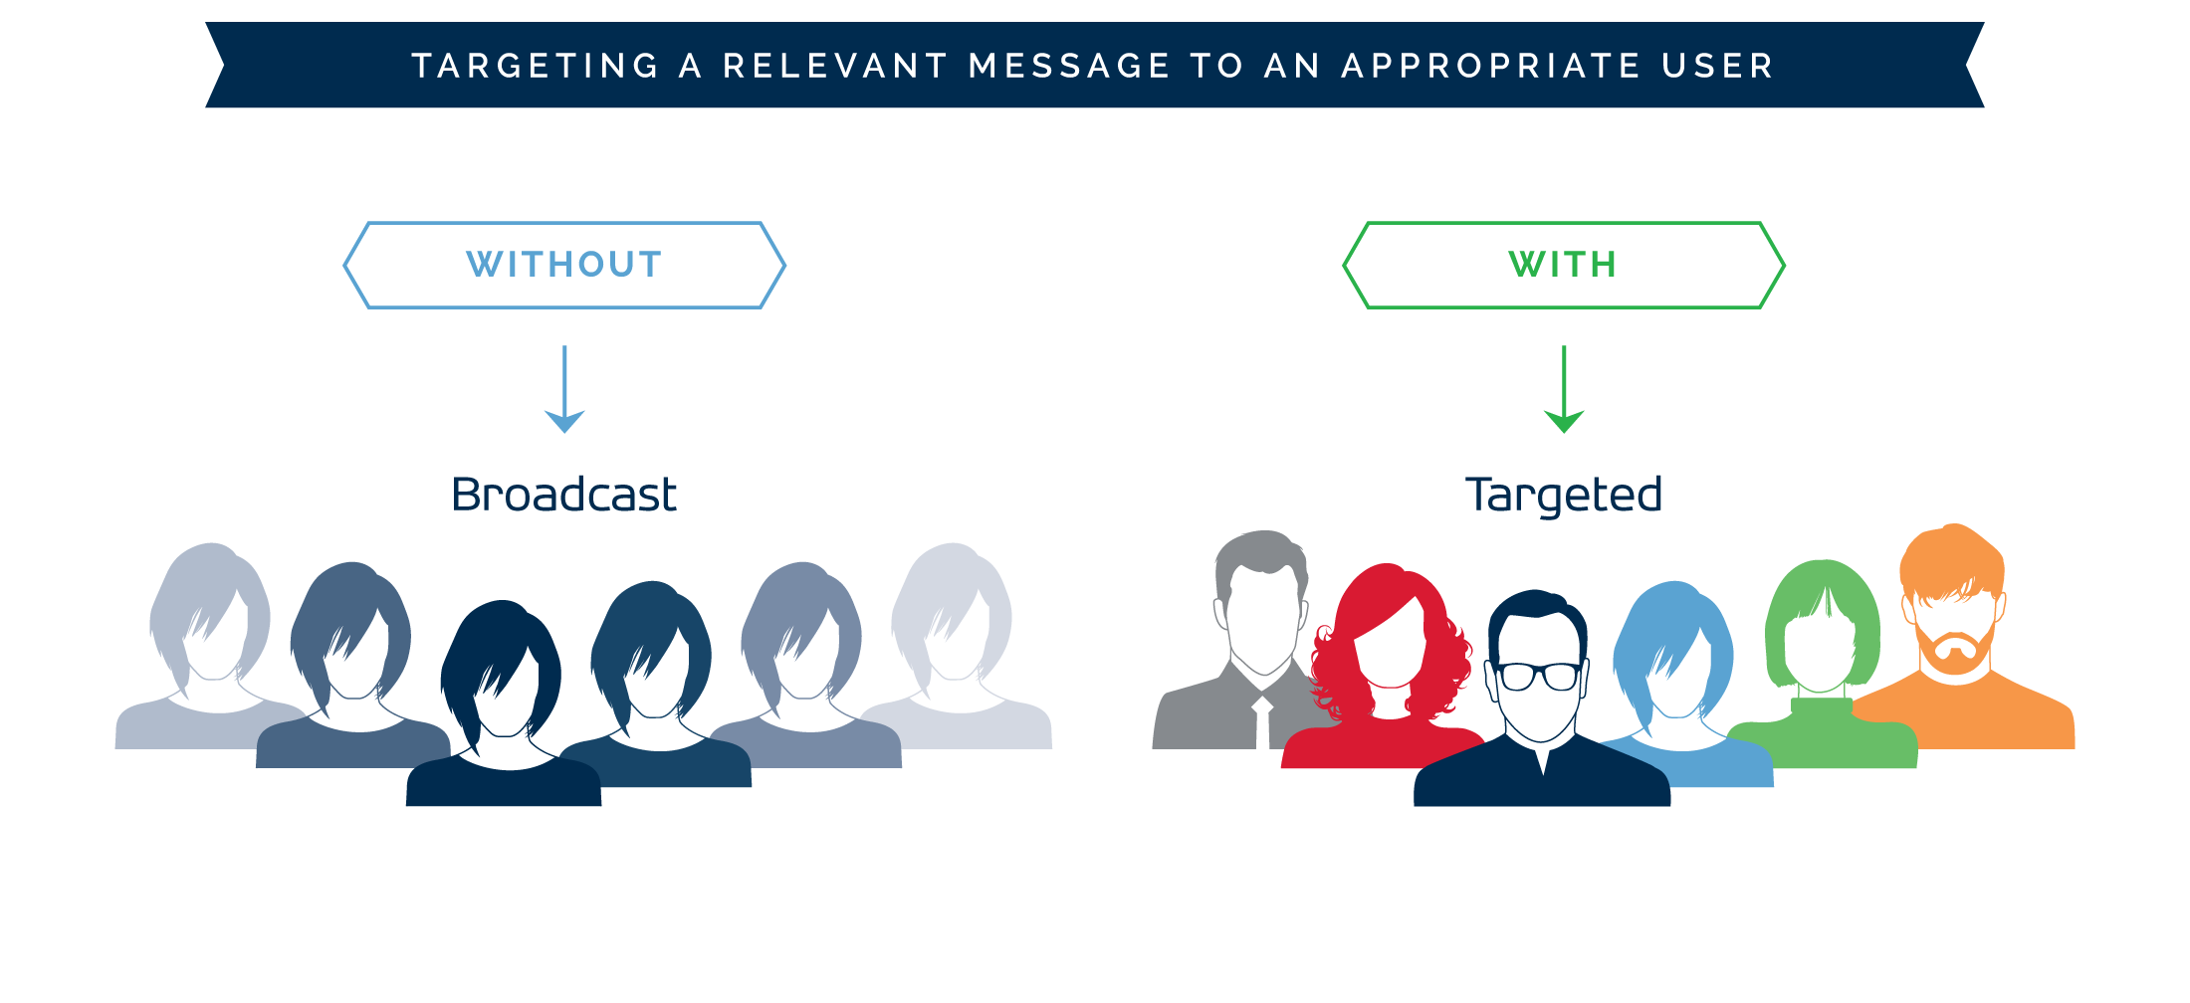
Personalization

Slide 15
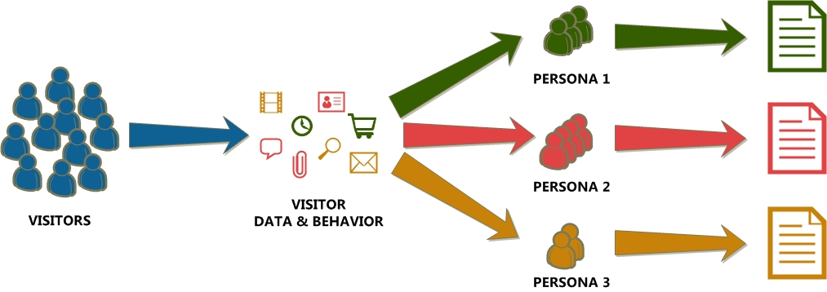
The Road to Personalization

Slide 16
Personalization – Bridging the Gap
Every action on a website can be tracked
It’s all 0’s and 1’s, unless it provides insight
Make the most of each opportunity with Big Data
Automate the delivery of the “Best Next Experience”

Slide 17

What are the top 3 recommendations for clients?
Personalization
Marketing Automation
Predictive Analytics

Slide 18
What’s the process to introduce the Digital Experience Cloud?
Starts with a Strategic Mindset
Develop an Analytical Foundation
Workshops & Stakeholder Interviews
DEC Implementation Roadmap
Deployment
Rinse and Repeat

Slide 19
Examples of the Sitefinity Digital Experience Cloud
The Publisher
    Focused on segmentation and personalized content to drive unique experiences for schools, library and individuals
    Increased optimizations for subscription sign-ups and initial leads
    More effective targeting of their vast amount of reference material
The Association
    Target content to both their members and general public
    Understand content consumption per segment
    Understand next best

Slide 20
CRM Integration
Radoslav Georgiev

Slide 21
APIs & SDKs
Seth Cleaver

Slide 22
Digital Experience Cloud Integration Points
SDK Documentation:
http://docs.sitefinity.com/dec/track-data---deep-dive
REST API – Interacts directly with the DEC
C# SDK
  Server side integration
  Retrieve analyzed data
JavaScript SDK
  Client side integration
  HTML5 instrumentation

Slide 23
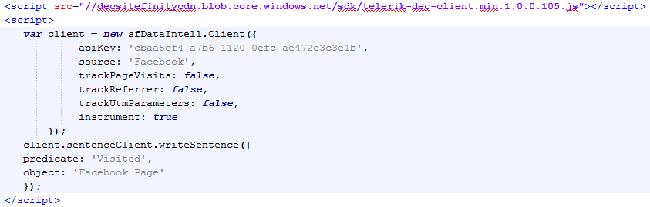
JavaScript SDK

Slide 24
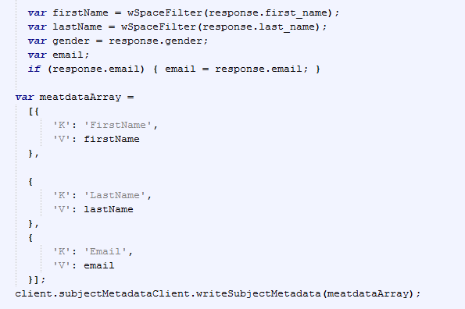
JavaScript SDK
Tracking Subject
Metadata

Slide 25
Question Time
Radoslav Georgiev, Tim Ahlenius & Seth Cleaver

Slide 26
Thanks for Attending
Session feedback:
http://bit.ly/next-cleaver
Twitter
  @sethcleaver
  @georgievrado

