Slide 1
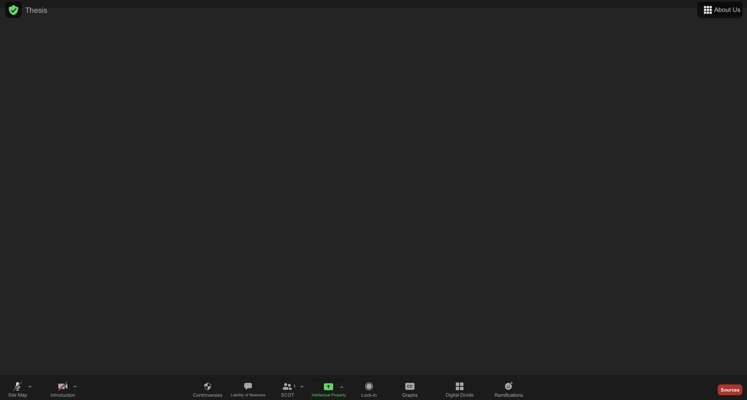
How remote working technologies overcame the liability of newness
About us!
Our thesis
Relevant social groups in remote working technologies
The digital divide in videoconferencing technologies
Infrastructure: how remote working technologies “locked-in”
Controversies around remote working technologies
Features shaped by various social groups
Impact of videoconferencing technologies
This sitemap
Our introduction
Bibliography

