Slide 1
VXLAN in Flannel
杨谕黔(boscoyoung@gmail.com)
https://github.com/yangyuqian

Slide 2
I am…
杨谕黔/Yuqian Yang
Senior Software Engineer and Container Evangelist @FreeWheel
Email: boscoyoung@gmail.com
Github: https://github.com/yangyuqian

Slide 3
outline
VXLAN
Brief introduction to vxlan support in Linux Kernel
Create an Overlay Network with native vxlan support in the Kernel
vxlan backend in flannel
Brief introduction to implementation of vxlan backend in Flannel

Slide 4
Benefits
Extend IP address ranges in a multi-tenant platform by a 24bit VNI
Virtualized L2 communication upon existing L3 network(UDP)

Slide 5
VXLAN
Virtual eXtensible Local Area Network (VXLAN) is a protocol to overlay a virtualized L2 network over an existing IP network with little setup.
Thanks to patches from Stephen Hemminger, Linux can act as VTEPs till v3.7.0
Stephen Hemminger also created tools, known as iproute2 and bridge, for Linux

Slide 6
Objective of Vxlan

Slide 7
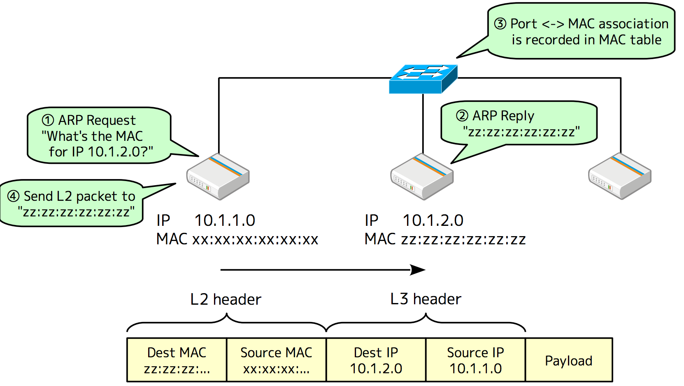
Basic mechanism

Slide 8
VTEP
Packet encapsulation is not enough for L2 over L3. VXLAN switches need to implement the following features:
ARP resolution: need to reply to ARP request from local servers without broadcasting the ARP packet.
Destination search : need to find the destination location corresponding to the destination MAC
The VXLAN endpoint providing these features is referred as "VTEP"

Slide 9
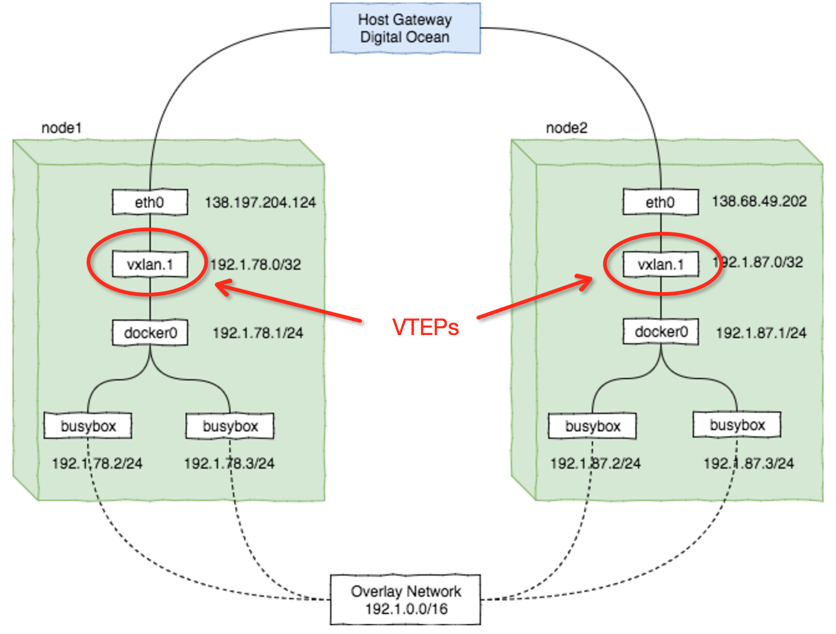
Example: Manually Create an Overlay Network

Slide 10
Example: Manually Create an Overlay Network
Install and setup Docker Daemon, and set IP ranges with --bip
Create VTEPs, including virtual vxlan devices and routes with iproute2 and bridge
Create ARP entries across all hosts with iproute2
For Chinese Audiences, pls refer to https://github.com/yangyuqian/k8s-the-hard-way/blob/master/network/vxlan-flannel-cn.md for more details

Slide 11
Flannel
Flannel is a virtual network that gives a subnet to each host for use with container runtimes.
Platforms like Kubernetes assume that each container (pod) has a unique, routable ip inside the cluster. The advantage of this model is that it reduces the complexity of doing port mapping.

Slide 12
VXLAN backend

Slide 13
VXLAN backend
Flannel daemon listens on L3 MISSes, then update the ARP cache according to registered subnets
Performance test refers to a post of mine

Slide 14
Q&A
Thank You!

